Slide 1
Date: 05-03-2026
MAGDI: Structured Distillation of Multi-Agent Interaction Graphs Improves Reasoning in Smaller Language Models
Justin Chih-Yao Chen, Swarnadeep Saha, Elias Stengel-Eskin, Mohit Bansal
ICML 2024
Presented By:
Mukthish B
Notes:
Justin – PhD
Swarnadeep – ex-Phd, META FAIR
Elias – ex-Postdoc, Asst. Prof UT Austin
Mohit – Prof. UNC Chapel Hill

Slide 2
Introduction
Multi-agent interactions: A collaborative setting where multiple Large Language Model (LLM) agents engage in a structured, multi-round discussion to solve a task.
Pros:
major improvements on diverse reasoning tasks
Cons:
long generation time
requires multiple models
requires multiple rounds
EXPENSIVE!
The multi-agent approaches also fail to provide a final, joint model for efficient inference and require all interacting LLMs at test time.
Notes:
3.2: Built on top of proprietary models, computationally and monetarily expensive
We use proprietary models because they can act as general conversational agents, handle long handle long contexts, and follow instructions

Slide 3
Aim
To reduce cost by teaching reasoning to smaller language models via structured distillation of the interactions between multiple stronger teacher models.
Distillation: A compression technique where a smaller, more efficient model (“student”) is trained to replicate the behavior, reasoning, and performance of a much larger, more complex model (“teacher”).

Slide 4
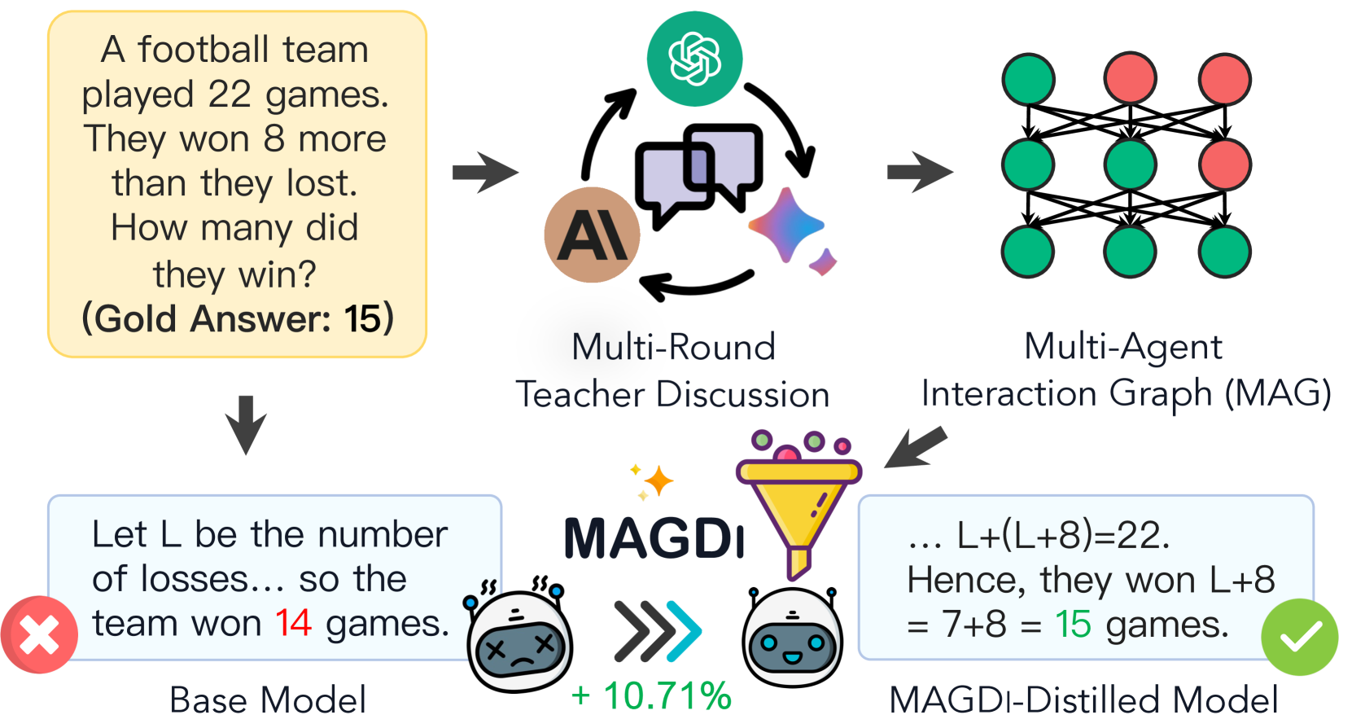
MAGDI
MAGDI: Multi-Agent Interaction Graphs Distillation
Teach a single, highly efficient student model to reason like a multi-agent setup by structured distillation of their reasoning.

Slide 5
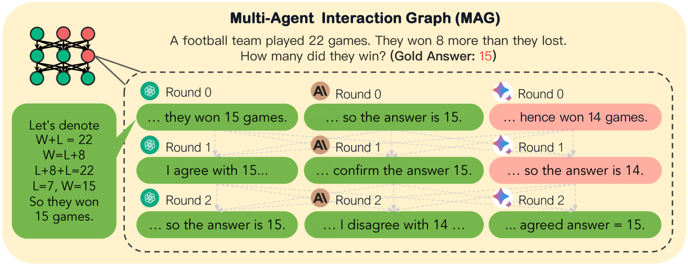
Multi-Agent Interaction Graph (MAG)
A MAG is a directed a directed acyclic graph that captures the iterative process of how agents refine their reasoning through discussion.
MAG consists of:
Nodes (V): represents Chain-of-Thought (CoT) reasoning for a given problem.
Node Labels: Every node is annotated with a binary label indicating the correctness of the answer
Edges (E): denote conditional dependencies between the agents’ interaction.
Notes:
Chain-of-Thought: The output is generated step-by-step.

Slide 6
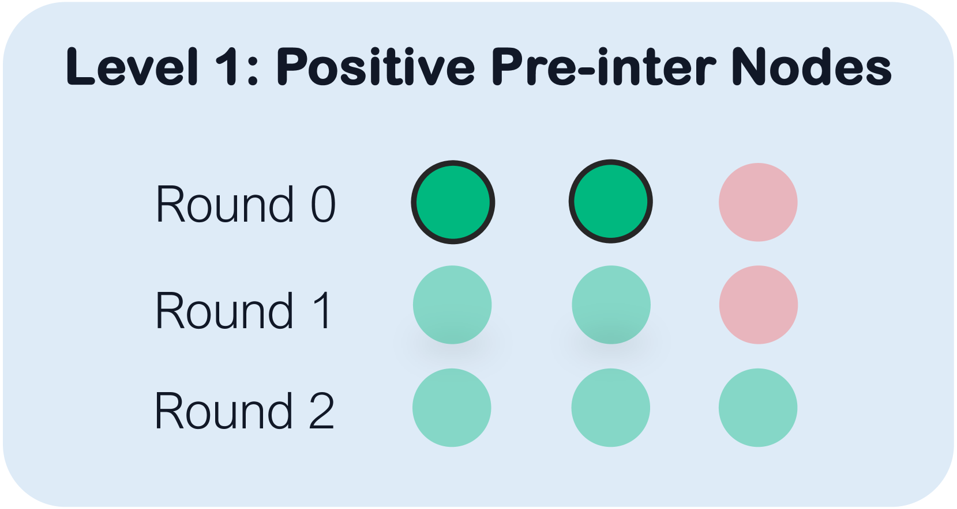
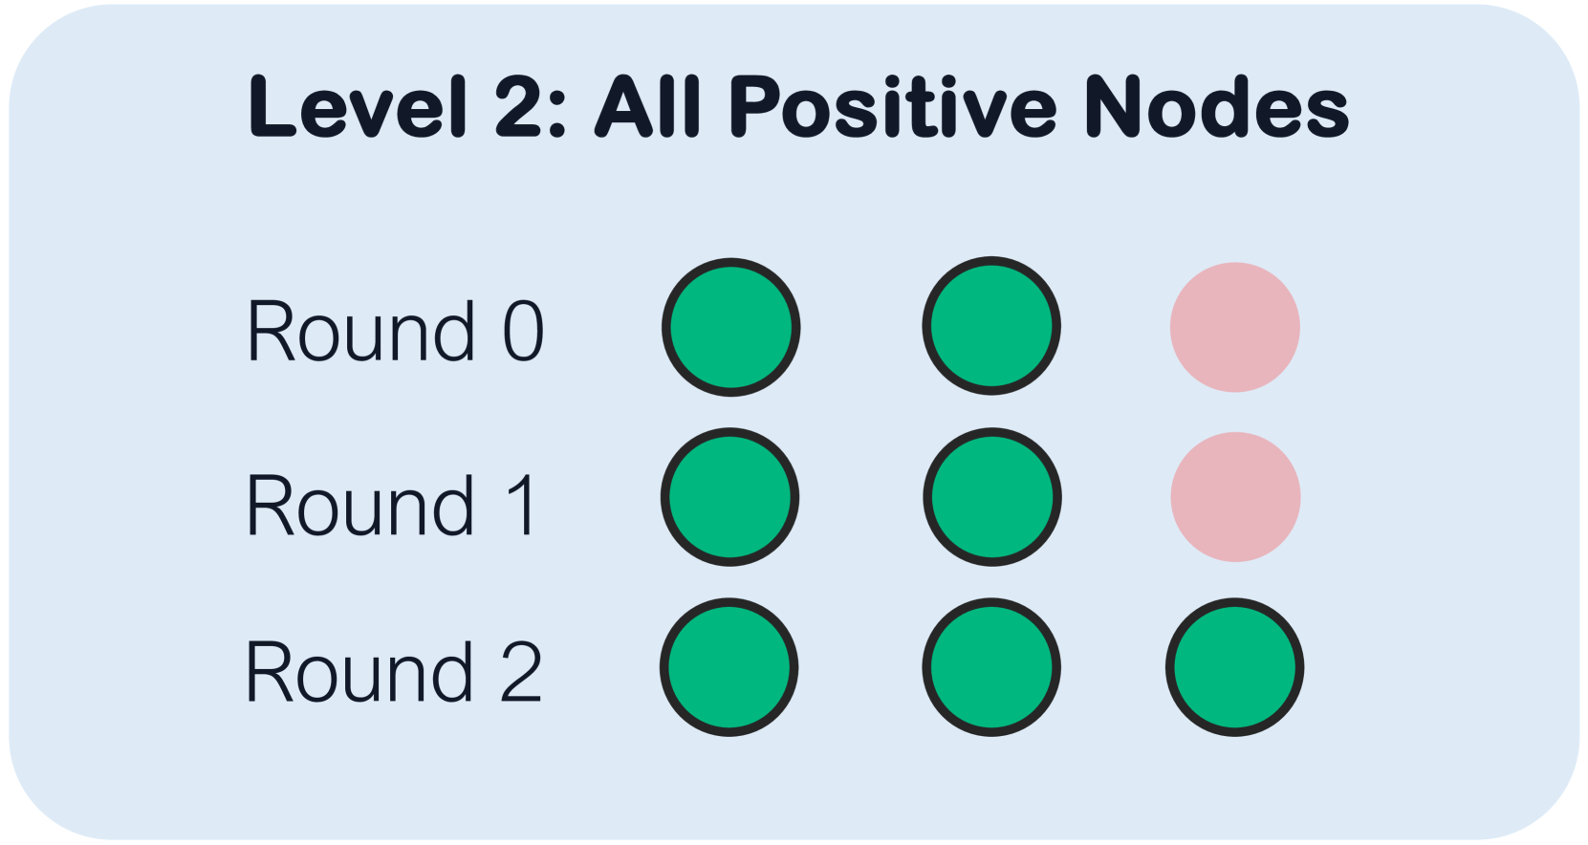
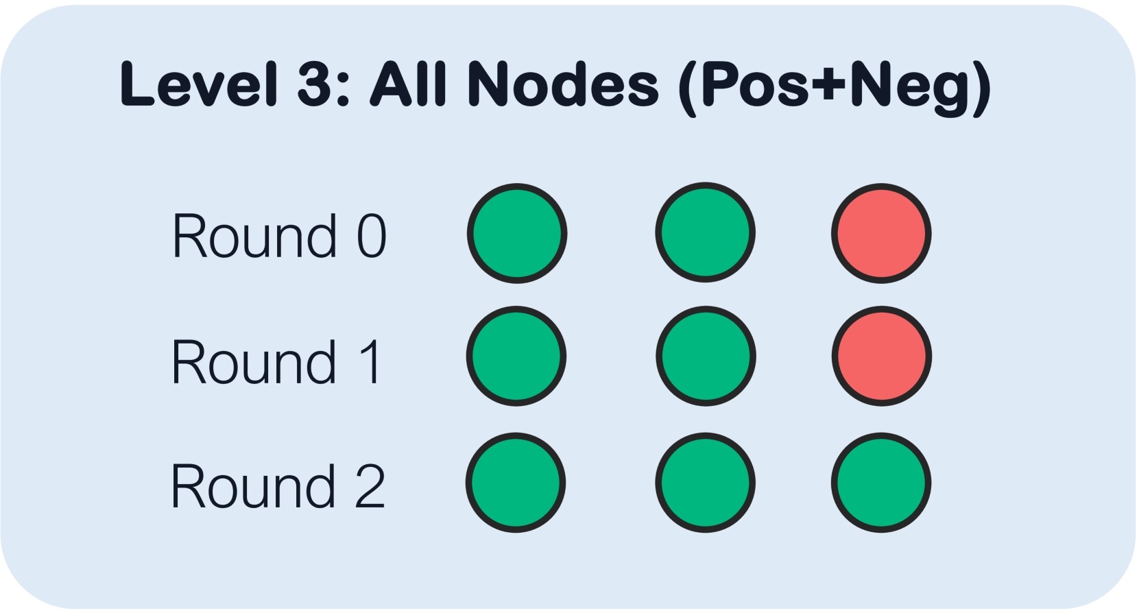
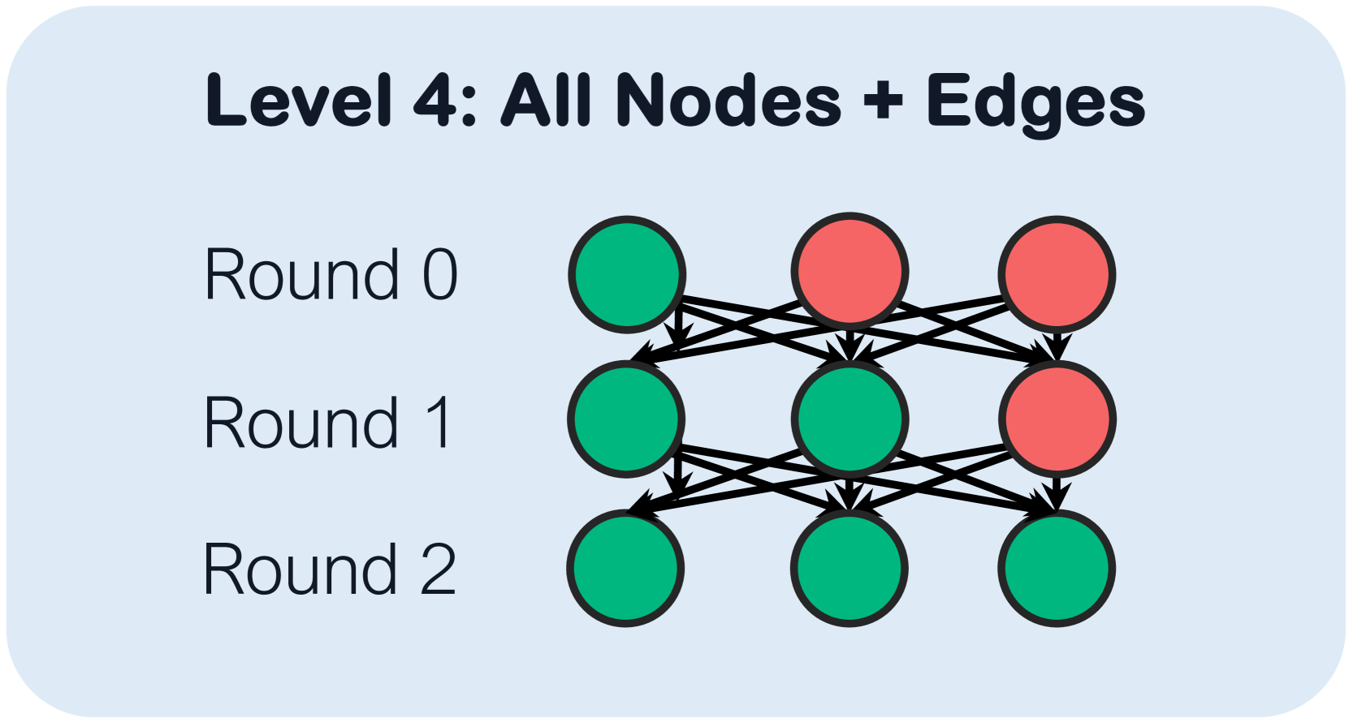
4 Levels of MAG:
Given a reasoning problem, MAGs capture rich knowledge that enables model reasoning.
This knowledge is captured through the following 4 level:
Level 1: Learning from multiple teachers.
Level 2: Learning from teacher interactions.
Level 3: Learning from negative reasoning.
Level 4: Learning from structure.
NOTE: We limit the number of rounds to 3
Notes:
1. student learns from the correct reasoning of multiple teachers.
2. student learns from both pre- and post-interaction data between multiple teachers.
3. student additionally distills from negative or incorrect reasoning from the teacher models.
4. student learns from the output and graph-structure of teacher LLM interactions.

Slide 7
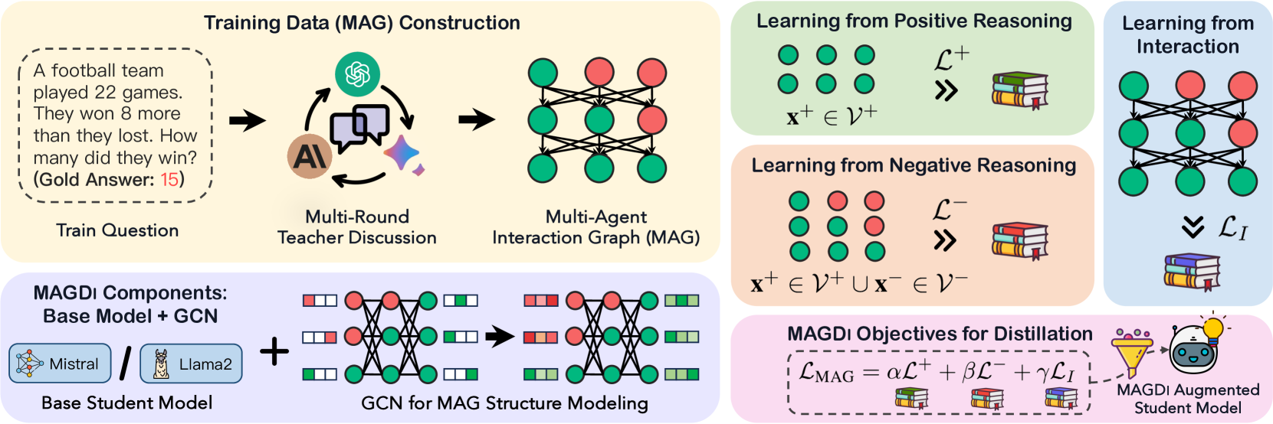
Three-Part Objective
Notes:
Positive reasoning: next-token prediction objective (cross entropy)
Negative reasoning: contrastive loss
Interaction: pass graph through gcn to obtain a representation. Apply softmax to then use cross entropy.

Slide 8
Experimental Setup
Student Model: Mistral-7B-Instruct, LLaMA-2-7B-Chat, LLaMA-2-13B-Chat.
Teacher Models:
Claude2
Bard
GPT4
Discussion Type:
ReCONCILE: Each subsequent round of interaction on all agent outputs from the previous round.
Datasets:
In Domain: StrategyQA, CommonsenseQA, ARC-c, GSM8K, MATH
Out of Domain: BoolQ, SVAMP

Slide 9
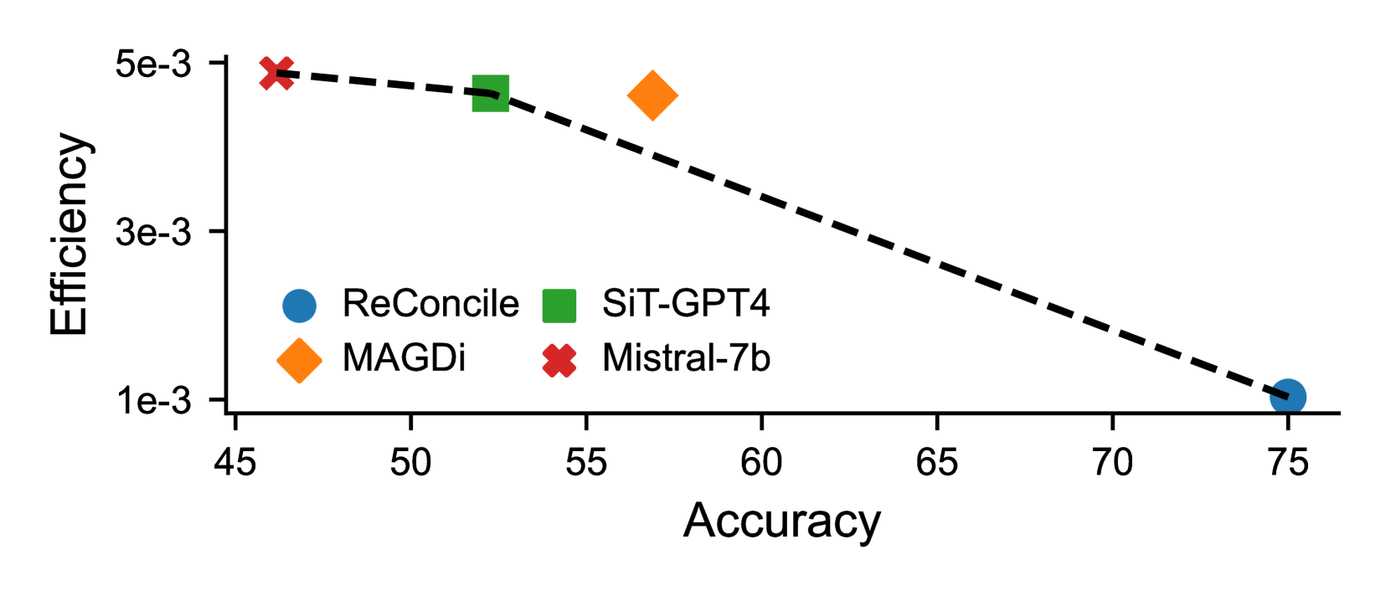
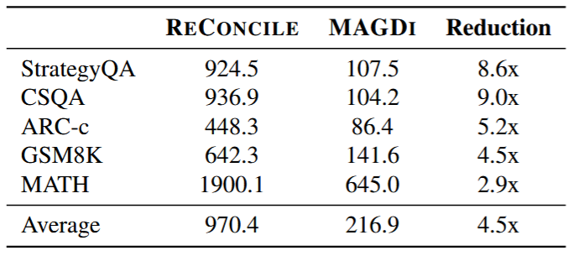
Results
MAGDI performed:
10.71% better than the base student model (Mistral-7B)
4.61% better than model distilled using single teacher (SiT-GPT4).
MAGDI on average generated 4.5x less tokens than ReCONCILE.

Slide 10
Thank You

