Slide 1

ANALYSIS REPORT
Airbnb Is An Online Marketplace That Connects People Who Want To Rent Out Their Property With People Who Are Looking For Accommodations, Typically For Short Stays. Airbnb Offers Hosts A Relatively Easy Way To Earn Some Income From Their Property. Guests Often Find That Airbnb Rentals Are Cheaper And Homier Than Hotels.

Slide 2
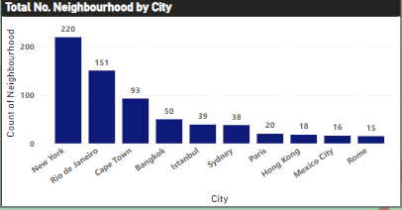
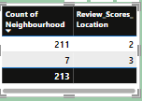
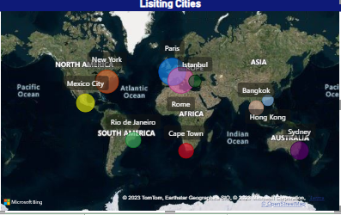
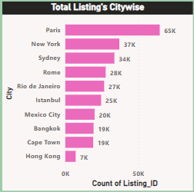
Locations and Low Scores
Total 10 Cities ,660 neighborhood's .
New York has highest number of neighborhood's.
213 neighborhood properties with <= 3 rating.
Paris has highest no. of listing properties.

Slide 3
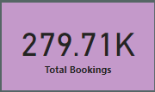
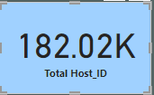
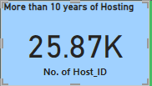
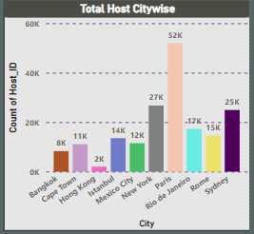
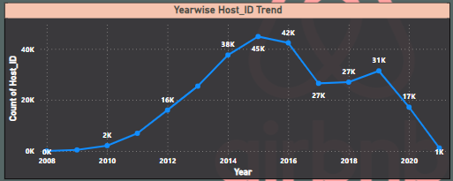
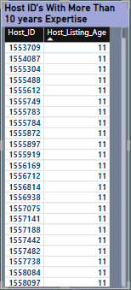
Listings & Hosting's aging
2015 observed highest no. of Host_Id .
Falling trend in Host_Id after 2015.
Paris with highest no. of Host.
Covid-19 affected overall hotel industry with steep downfall in bookings , Hosting and Revenue.

Slide 4
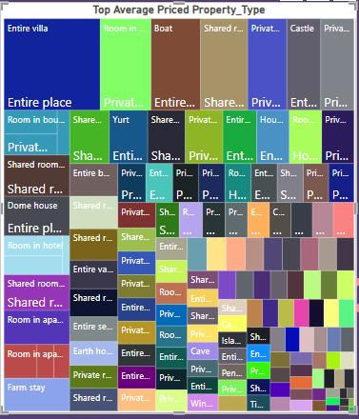
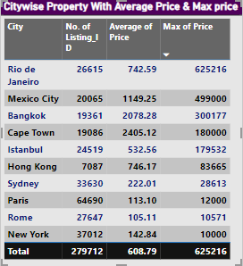
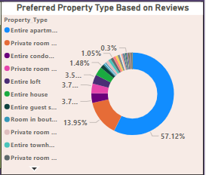
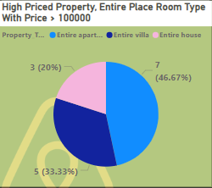
Price Analysis Based on City & Property
Preferred property Entire Apartment and Entire Place for room type .
Cape town has highest average price, Rio de Janeiro has the most high priced property.
7 properties where room rent is more then 100000 for entire place.
Paris Had highest no. of bookings with average price of $113.
Note: High priced property is selected where minimum nights is <=2 and price >100000.

Slide 5
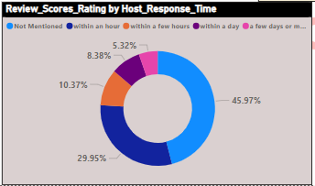
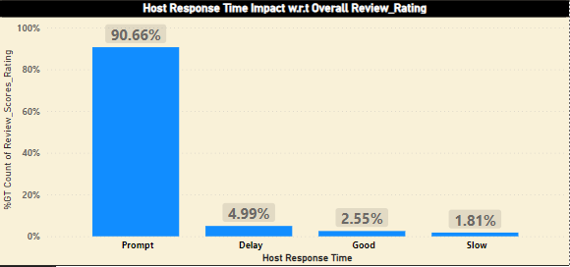
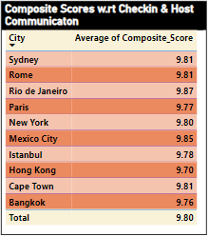
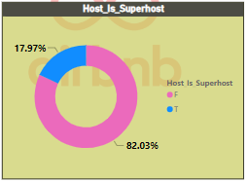
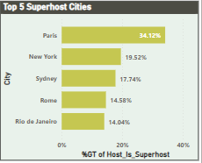
Host Response Time
Note: Composite score has been calculated with 75% of Check-in Score + 25% of Host Communication Scores.

Slide 6
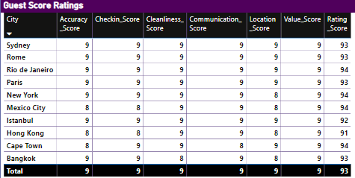
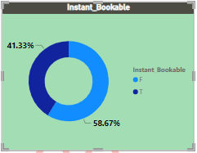
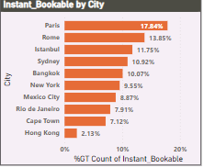
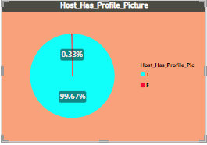
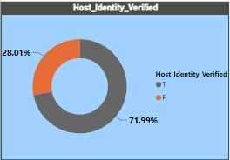
Guest Scores & Other Features

Slide 7
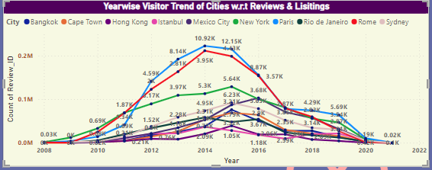
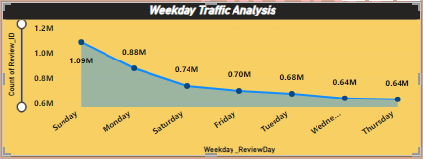
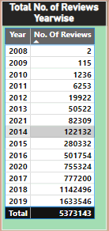
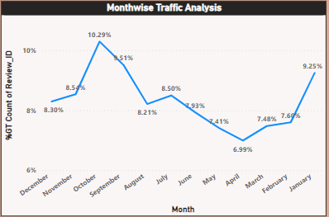
Visitor Trend Over Years
Paris & Rome being most favorite cities for Vacations.
Sept-Dec months are most favorable time for people to spend holidays, least bookings observed in April-May month of year.
Sunday & Monday being most busiest weekdays for booking.

Slide 8
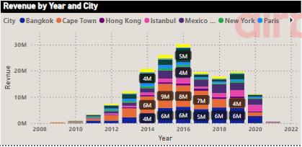

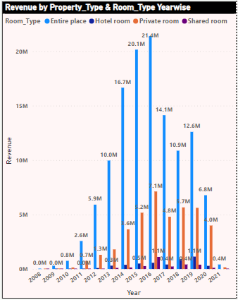
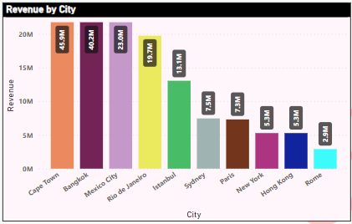
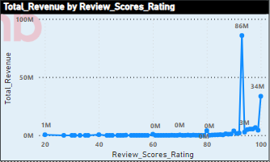
Revenue

Slide 9
THANK YOU
PRESENTER NAME: MUKTI BHUYAN
ABADS BATCH 11

