Slide 1

Analysis Report

Slide 2
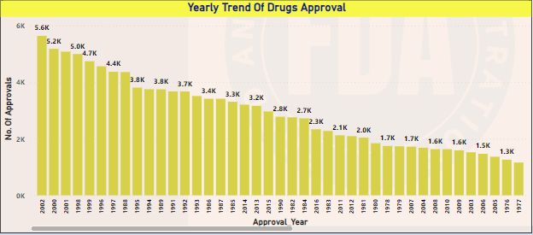

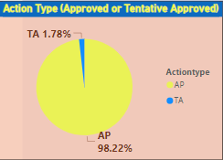
APPROVAL TRENDS
Year 2002 observed highest number of approvals.
98% of drug applications are approved.

Slide 3

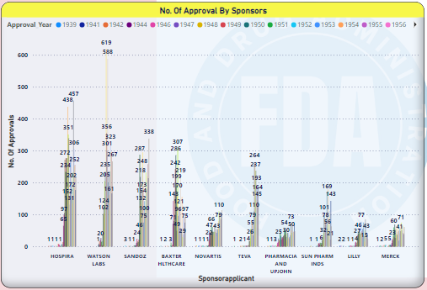
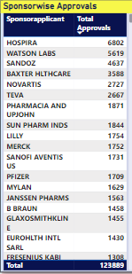
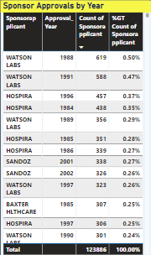
Sponsors approvals
HOSPIRA Drug sponsor has highest no. of approval.
WATSON LABS got highest no of approval in 1988.

Slide 4
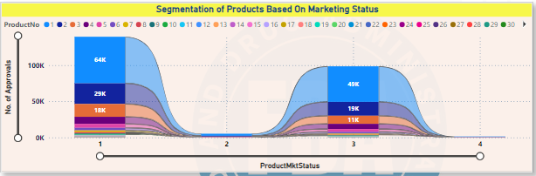
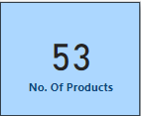
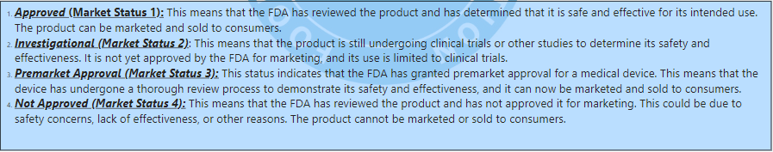
Product segmentation
Product No. 1 is with 64429 Approved Market status.

Slide 5
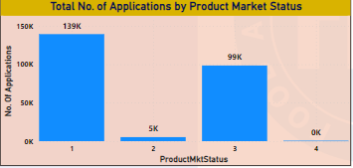
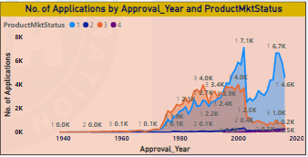
Total applications for each market status
Highest no. of Applications are received under Market Status 1.
2002 observed highest no. of applications.

Slide 6
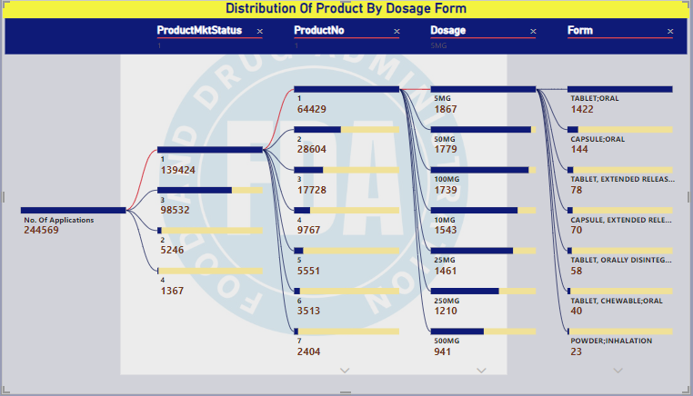
Distribution of product by dosage & form

Slide 7
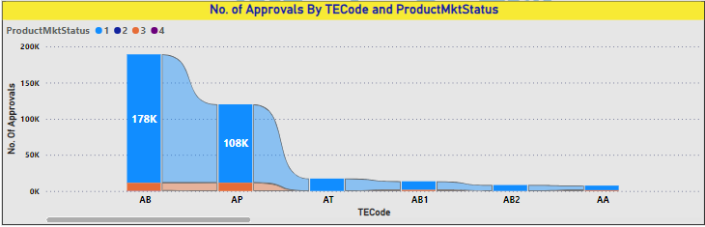

therapeutic segment approvals
TE code AB has highest no of approvals under product market status 1 .

Slide 8
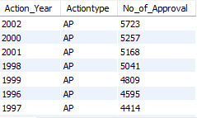

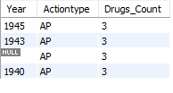
SQL QUERIES
#Task 1 : Identifying Approval Trends
Create view Drug_approval AS
Select A.Applno,Sponsorapplicant,R.Actiontype,ActionDate, InDocTypeSeqNo
From application as A
Join regactiondate as R on A.ApplNo = R.ApplNo;
#Query 1 : Determine the number of drugs approved each year and provide insights into the yearly trends.
Select Extract(Year from ActionDate) as Action_Year,Actiontype,Count(*) as No_of_Approval
FROM Drug_Approval
group by Action_Year having Actiontype = 'AP
'order by Action_Year;
#Query 2 : Identify the top three years that got the highest and lowest approvals, in descending and ascending order, respectively
Select Extract(Year from ActionDate) as Year,actiontype,count(actiontype) as Drugs_Count
FROM Drug_approval
GROUP BY Year having actiontype = 'AP' ORDER BY Drugs_count DESC LIMIT 3;
SELECT Extract(Year from ActionDate) as Year, actiontype, COUNT(actiontype) AS Drugs_Count
FROM Drug_approval
GROUP BY Year HAVING actiontype = 'AP‘
ORDER BY Drugs_count
LIMIT 4;
Output : Query1
Output : Query2

Slide 9
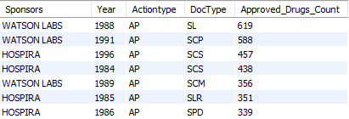
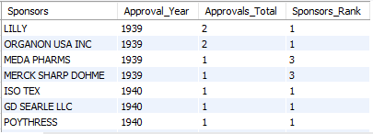
SQL QUERIES
#Task 1 : Identifying Approval Trends
#Query 3: Explore approval trends over the years based on sponsors.
SELECT Sponsorapplicant AS Sponsors, Extract(Year from ActionDate) AS Year,Actiontype, Doctype, COUNT(*) AS Approved_Drugs_CountFROM Drug_approval where Actiontype = 'AP' and doctype != 'TA‘
GROUP BY Sponsors,Year
Order by Sponsors,Year:
#Query 4: Rank sponsors based on the total number of approvals they received each year between 1939 and 1960.
SELECT Sponsors, Approval_Year,Approvals_Total,
RANK() OVER(partition by Approval_Year order by Approvals_Total DESC) AS Sponsors_Rank
FROM
( Select Sponsorapplicant as Sponsors,Extract(Year from ActionDate) as Approval_Year, Count(*) as Approvals_Total
FROM Drug_approval
where Actiontype = 'AP' AND Extract(Year from ActionDate) between 1939 and 1960
Group by Approval_Year,Sponsors ) as Approved_Drugs_Count
Order by Approval_Year,sponsors_rank;
Output : Query3
Output : Query4

Slide 10
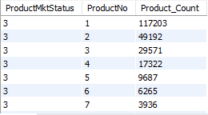
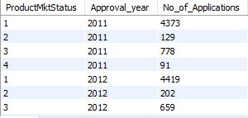
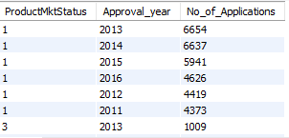
SQL QUERIES
Output : Query1
TASK 2 : Segmentation Analysis Based on Drug Marketing Status
CREATE VIEW Product_Mktstatus AS
Select P.Applno,P.ProductNo,P.ProductMktStatus,ActionDate,A.Actiontype
from Product as P
Join Application as A on P.ApplNo = A.ApplNo
Join regactiondate as R on A.ApplNo = R.ApplNo;
# Query 1: Group products based on Marketing Status . Provide meaningful insights into the segmentation patterns.
Select ProductMktStatus,Productno,count(*) as Product_Count
From Product_MktStatus
Group By Productno;
#Query 2: Calculate the total number of applications for each MarketingStatus year-wise after the year 2010.
Select Productmktstatus,year(actiondate)as Approval_year,Count(applno) as No_of_Applications
from product_mktstatus
WHERE year(actiondate)>2010
GROUP BY productmktstatus,Approval_Year;
Output : Query2

Slide 11
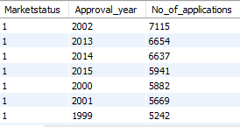
SQL QUERIES
TASK 2 : Segmentation Analysis Based on Drug Marketing Status
#Query 3 : Identify the top MarketingStatus with the maximum number of applications and analyze its trend over time.
Select Marketstatus,Approval_year,No_of_applications,
Rank()over(partition by Approval_year order by No_of_Applications DESC) as Rank_pmktst
From(Select Productmktstatus as Marketstatus,Extract(Year from ActionDate) as Approval_Year,
Count(applno) as No_of_applications FROM Product_mktstatus Group by Marketstatus,Approval_year ) as Product_MktST_Count
group by Marketstatus,Approval_year
order by no_of_Applications DESC ;
Output : Query3

Slide 12
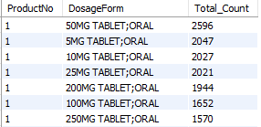
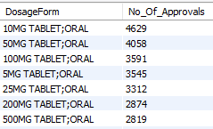
SQL QUERIES
#TASK 3 : Analyzing Products
CREATE VIEW Product_Dosageforms AS Select P.Applno,P.ProductNo,P.ProductMktStatus,concat(dosage,' ',form) as DosageForm,dosage,form,ActionDate,DocType
FROM Product as P
Join Application as A on P.ApplNo = A.ApplNo
Join regactiondate as R on A.ApplNo = R.ApplNo;
#Query 1 : Categorize Products by dosage form and analyze their distribution.
Select Productno,Dosageform,count(*) as Total_Count
from Product_dosageforms
group byProductno, dosageform
order byProductno, dosageform;
#Query 2: Calculate the total number of approvals for each dosage form and identify the most successful forms.
Select Dosageform,Count(*) as No_Of_Approvals
from product_dosageforms
group by Dosageform
order by No_of_Approvals DESC;
Output : Query1
Output : Query2

Slide 13
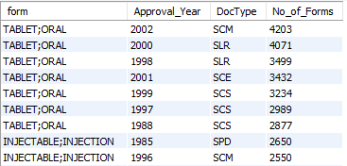
SQL QUERIES
Output : Query3
#TASK 3 : Analyzing Products
#Query 3 : Investigate yearly trends related to successful forms.
Select Form,Extract(Year from ActionDate) as Approval_Year,
DocType,Count(*) as No_of_Forms
From product_dosageforms
Where DocType != 'TA‘
Group by form,Approval_Year
Order by No_of_Forms DESC;

Slide 14
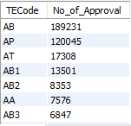
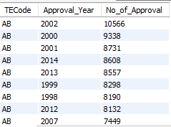
SQL QUERIES
# TASK 4: Exploring Therapeutic Classes and Approval Trends
CREATE VIEW TE_CODE_APPROVAL AS
SELECT P.Applno,PTE.TECode,P.ProductMktStatus,ActionDate
FROM Product as PJoin Product_TECode as PTE on PTE.ApplNo = P.ApplNo
Join Application as A on P.ApplNo = A.ApplNo
Join regactiondate as R on A.ApplNo = R.ApplNo;
# Query 1 : Analyze drug approvals based on therapeutic evaluation code (TE_Code).
Select TEcode,count(*) as No_of_Approval
From TE_CODE_Approval
group by TEcode
Order by No_Of_Approval DESC;
# Query 2 : Determine the therapeutic evaluation code (TE_Code) with the highest number of Approvals in each year
Select TEcode, Extract(Year from ActionDate) as Approval_Year,count(*) as No_of_Approval
From TE_CODE_Approval
group by TEcode,Approval_year
Order by No_Of_Approval DESC;
Output : Query1
Output : Query2

Slide 15
THANK YOU
MUKKTI S BHUYAN
ABADS BATCH 11

