Slide 1

COMP1631 Advanced Spreadsheets – Winter 2024 – Section 06

Slide 2
COMP1631 Advanced Spreadsheets – Winter 2024 – Section 06
Lecture 11 Tuesday, March 26, 2024
Today’s menu a la carte
Apéritifs
Retrieve data with the Query Editor
Create and edit a query
Chart trends and forecast future values
Plat principal
• Add data to the Excel Data Model
• Manage table relations in Power Pivot
• Create PivotTables drawing data from several connected tables
Desserts
• Drill through a hierachy of fields
• Create maps with the map chart type
• Create map presentations with 3D Maps

Slide 3
COMP1631 Advanced Spreadsheets – Winter 2024 – Section 06
Download all the files in lecture 11

Slide 4
COMP1631 Advanced Spreadsheets – Winter 2024 – Section 06
Writing a Data Query
• How to use a Power Query.
• How to retrieve data into an Excel table.
• How to edit a query.
• How to refresh query data.

Slide 5
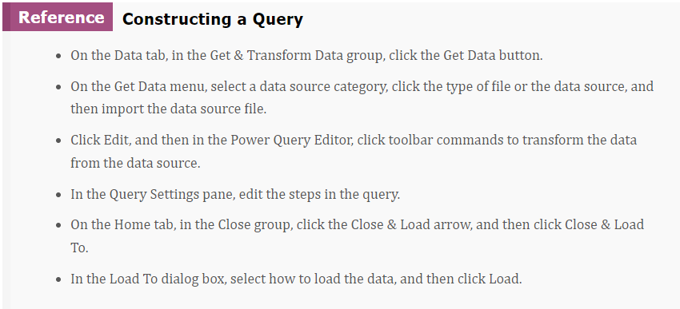
COMP1631 Advanced Spreadsheets – Winter 2024 – Section 06

Slide 6
COMP1631 Advanced Spreadsheets – Winter 2024 – Section 06
Instructions:
Create a query to retrieve data from the Support_EX_10_Sales02.csv file.
Load the data as an Excel table to cell B4 in the Recent Website Sales worksheet.
Format the data in the range C5:C28 as currency with no decimal places.

Slide 7
COMP1631 Advanced Spreadsheets – Winter 2024 – Section 06
Quick Quiz:
• True/False: You can define how Excel updates, or refreshes, the data. (Answer: True)
• What is the BI tool that writes queries for almost any kind of data source, from text files to websites to large data structures? (Answer: Power Query)
• When a text file’s data is separated by commas, it is said to be _______. (Answer: delimited)
• True/False: A text file contains numbers, text, formulas, and special fonts. (Answer: False)

Slide 8
COMP1631 Advanced Spreadsheets – Winter 2024 – Section 06
Quick Quiz:
• True/False: You can define how Excel updates, or refreshes, the data. (Answer: True)
• What is the BI tool that writes queries for almost any kind of data source, from text files to websites to large data structures? (Answer: Power Query)
• When a text file’s data is separated by commas, it is said to be _______. (Answer: delimited)
• True/False: A text file contains numbers, text, formulas, and special fonts. (Answer: False)

Slide 9
COMP1631 Advanced Spreadsheets – Winter 2024 – Section 06
Transforming Data with Queries
• How to transform data using the Query Editor.
• How to add a new column.
• How to group values in a query.

Slide 10
COMP1631 Advanced Spreadsheets – Winter 2024 – Section 06
Instructions:
Create a query to retrieve data from the Support_EX_10_Sales01.csv file.
Edit the data and use Power Query to remove the first four rows of the text file and use the titles in the fifth row as column headers.
Load the three columns of data into an Excel table in cell B4 of the Website History worksheet.

Slide 11
COMP1631 Advanced Spreadsheets – Winter 2024 – Section 06
Quick Quiz:
• True/False: In a query, you can group the data by the values within one of the columns. (Answer: True)
• True/False: You can subtract columns to a query to display other data. (Answer: False, you can add columns)

Slide 12
COMP1631 Advanced Spreadsheets – Winter 2024 – Section 06
Quick Quiz:
• True/False: In a query, you can group the data by the values within one of the columns. (Answer: True)
• True/False: You can subtract columns to a query to display other data. (Answer: False, you can add columns)

Slide 13
COMP1631 Advanced Spreadsheets – Winter 2024 – Section 06
Charting Trends and Creating a Forecast Sheet
How do you add a trendline?
Create a scatter chart of the data.
Select the chart, click the Chart Elements button, click the arrow next to the Trendline check box, and then select the type of trendline.
How do you edit a trendline?
Double-click the trendline in the scatter chart to open the Format Trendline pane.
In the Format Trendline pane, select the option button for the type of trendline to fit to the data.
Project future values along the same trend by entering the number of future values in the Forward box.
Display the equation of the trendline by clicking the Display Equation on chart check box. Display the R2 value by clicking the Display R-squared value on chart check box.

Slide 14
COMP1631 Advanced Spreadsheets – Winter 2024 – Section 06
Charting Trends and Creating a Forecast Sheet
How to set forecast sheet options.
In the Create Forecast Worksheet dialog box, expand Options.
To add a seasonal trend to the forecasts, in the Seasonality group, click the Set Manually option, and then enter the number of periods in one season.
To set the confidence interval for the forecasted values, enter a value in the Confidence Interval input box.
To set the extent of the forecast, enter the ending date in the Forecast End box.

Slide 15
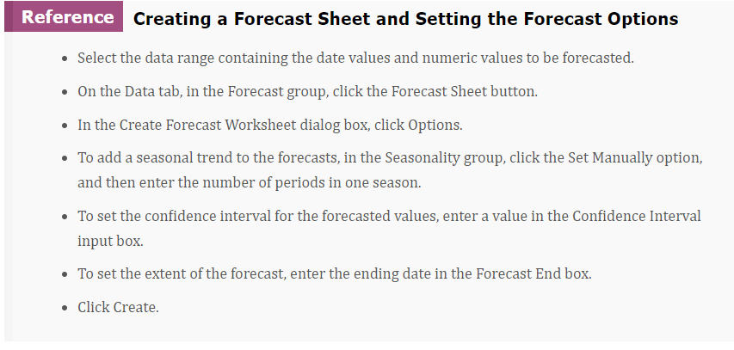
COMP1631 Advanced Spreadsheets – Winter 2024 – Section 06

Slide 16
COMP1631 Advanced Spreadsheets – Winter 2024 – Section 06
Instructions:
Create a scatter chart of the Website Revenue column vs. the Website Year column.
Move the chart to the Summary Report worksheet in the range B4:H16.
Add a polynomial trendline of order 2 to the chart.
Using the data in the range B4:C28 of the Recent Website Sales worksheet, create a Forecast sheet, forecasting website revenue through 12/31/2022.
Assume a seasonality in the data of 12 periods (or months). Name the Forecast sheet as Forecasts.
Move the forecast chart to the Summary Report worksheet in the range B18:H29. Remove the chart legend and add the chart title Two-Year Forecast.

Slide 17
COMP1631 Advanced Spreadsheets – Winter 2024 – Section 06
Quick Quiz:
• ______________ data follows a pattern during the calendar year. (Answer: Seasonal)
• What provides a measure of the uncertainty of the forecast by indicating within what range the forecasted values will lie? (Answer: Confidence bounds)
• True/False: You need at least two complete years of data to project a seasonal trend for the next year. (Answer: True)

Slide 18
COMP1631 Advanced Spreadsheets – Winter 2024 – Section 06
Quick Quiz:
• ______________ data follows a pattern during the calendar year. (Answer: Seasonal)
• What provides a measure of the uncertainty of the forecast by indicating within what range the forecasted values will lie? (Answer: Confidence bounds)
• True/False: You need at least two complete years of data to project a seasonal trend for the next year. (Answer: True)

Slide 19
COMP1631 Advanced Spreadsheets – Winter 2024 – Section 06
Let’s go for a break!
Return in 15 minutes (or at time specified by your instructor).

Slide 20
COMP1631 Advanced Spreadsheets – Winter 2024 – Section 06
Introducing Databases
Databases in which tables can be joined through the use of common fields are known as relational databases.
In a database table, column <-> field, row <-> record.
Show how to query an Access database.

Slide 21
COMP1631 Advanced Spreadsheets – Winter 2024 – Section 06
Exploring the Data Model
• How to work with a data model.
• How to design a database.

Slide 22
COMP1631 Advanced Spreadsheets – Winter 2024 – Section 06
Exploring the Data Model:
Data are placed into the Data Model using the same Power Query application used for retrieving data from CSV files and other data sources.
Once placed in the Data Model, Excel establishes a connection between the Data Model contents and the workbook.
Essentially, it’s like having a connection to an external data source even though the Data Model is saved within the workbook file.

Slide 23
COMP1631 Advanced Spreadsheets – Winter 2024 – Section 06
Instructions:
Create a query that retrieves the Customers, Customer Orders, Items, Item Sales, and Stores tables from the Support_EX_10_Sales03.accdb Access database.
Create a connection to the database file and add the tables in the Excel Data Model.
Do not load any tables in an Excel table, PivotTable, or PivotChart.

Slide 24
COMP1631 Advanced Spreadsheets – Winter 2024 – Section 06
Designing a Database
Keep in mind the following guidelines:
Split data into multiple tables. Keep each table focused on a specific topical area. Link the tables through one or more common fields.
Avoid redundant data. Key pieces of information, such as a customer’s address or phone number, should be entered in only one place in your database.
Use understandable field names. Avoid using acronyms or abbreviations that may unclear or confusing.
Maintain consistency in data entry. Include validation rules to ensure that rules such as abbreviate titles (for example, Mr. instead of Mister) are always followed.
Test the database on a small subset of data before entering all the data. The more errors you weed out early, the easier it will be to manage your database.

Slide 25
COMP1631 Advanced Spreadsheets – Winter 2024 – Section 06
Quick Quiz:
• True/False: The data model is a database built into Excel that provides many of the same tools found in database programs such as Access. (Answer: true)
• True/False: The Data Model contents are immediately available to PivotTables, PivotCharts, and other Excel tools. (Answer: true)

Slide 26
COMP1631 Advanced Spreadsheets – Winter 2024 – Section 06
Quick Quiz:
• True/False: The data model is a database built into Excel that provides many of the same tools found in database programs such as Access. (Answer: true)
• True/False: The Data Model contents are immediately available to PivotTables, PivotCharts, and other Excel tools. (Answer: true)

Slide 27
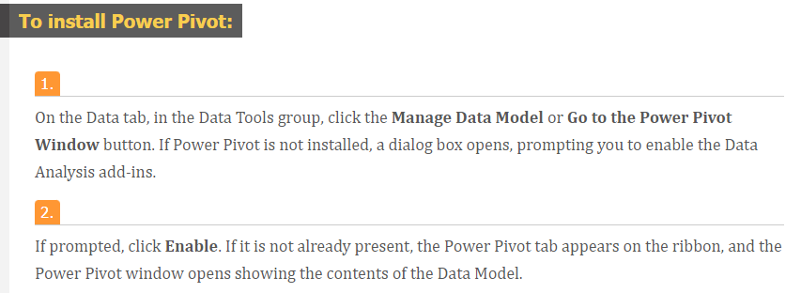
COMP1631 Advanced Spreadsheets – Winter 2024 – Section 06
Transforming Data with Power Pivot
Power Pivot is a BI tool built into Excel used for managing data from multiple sources in a single data structure.
With Power Pivot you can define table relationships, reorganize and regroup your data, and create new columns from calculations on existing fields.
Because Power Pivot is an add-in, you must install it before using it.

Slide 28
COMP1631 Advanced Spreadsheets – Winter 2024 – Section 06
Quick Quiz:
• Power Pivot is a ___ tool for combining multiple data sources within a single data structure. (Answer: BI)
• True/False: You can have Excel install the Power Pivot add-in by attempting to view the contents of the Data Model. (Answer: true)
• What view lists the fields within each table? (Answer: diagram)
• True/False: You can determine how a filter will affect other tables in the Data Model by following the arrows. (Answer: true)

Slide 29
COMP1631 Advanced Spreadsheets – Winter 2024 – Section 06
Quick Quiz:
• Power Pivot is a ___ tool for combining multiple data sources within a single data structure. (Answer: BI)
• True/False: You can have Excel install the Power Pivot add-in by attempting to view the contents of the Data Model. (Answer: true)
• What view lists the fields within each table? (Answer: diagram)
• True/False: You can determine how a filter will affect other tables in the Data Model by following the arrows. (Answer: true)

Slide 30
COMP1631 Advanced Spreadsheets – Winter 2024 – Section 06
Exploring the Data Model in Diagram View
• How to explore the data model in Diagram view.
• How to manage table relationships.

Slide 31
COMP1631 Advanced Spreadsheets – Winter 2024 – Section 06
Instructions:
Go to Power Pivot and create the following table relations between the five database tables:
• Connect the Customer Orders and Customers tables through the Cust ID field.
• Connect the Customer Orders and Stores tables through Store ID field
• Connect the Customer Orders and Item Sales tables through the Order ID field.
• Connect the Item Sales and Items tables through the Item ID field.
Add a hierarchy to the Items table named Item Tree and add the Class, Subclass, and Group fields to it in that order. Close Power Pivot and return to the workbook.

Slide 32
COMP1631 Advanced Spreadsheets – Winter 2024 – Section 06
Creating a Pivot Table from the Data Model
• How to tabulate across fields from multiple tables.
• How to apply slicers and timelines from the Data Model.

Slide 33
COMP1631 Advanced Spreadsheets – Winter 2024 – Section 06
Instructions:
In the Items Pivot worksheet, in cell B4, insert a PivotTable from the Data Model.
Rename the table as Items Pivot.
Add the Item Tree hierarchy from the Items table to the Rows area box, add the Type field from the Stores table to Column area box, and add the Revenue field from the Item Sales table to the Values area box (displaying the revenue sum).

Slide 34
COMP1631 Advanced Spreadsheets – Winter 2024 – Section 06
Exercise:
In the State Revenue worksheet, add a PivotTable from the Data Model to cell B4.
Name the PivotTable as State Revenue.
Place the State field from the Customers table in the Rows area and the Revenue field from the Item Sales table in the Values area.
In the PivotTable Options dialog box, on the Display tab, click the check boxes to show items with no data on the rows and columns.
Copy the data in the range B5:C55. Use Paste Link to paste references to the data values in the range E5:F55. Format the values in the range F5:F55 as currency. Enter State in cell E4 and enter Revenue in cell F4.

Slide 35
COMP1631 Advanced Spreadsheets – Winter 2024 – Section 06
Instructions:
In the Summary Report worksheet, create a timeline using the Date field from the Customer Orders table.
Place the timeline across the range J4:X10. Create connections between the timeline and the Items Pivot and State Revenue PivotTables.
Use the timeline to filter the PivotTables to show data only from July 2021 through December 2021.

Slide 36
COMP1631 Advanced Spreadsheets – Winter 2024 – Section 06
Quick Quiz:
• True/False: Any of the tables in the Data Model can be analyzed in a PivotTable or PivotChart. (Answer: true)
• True/False: Slicers and timelines can be applied across a single table at a time. (Answer: false)
• For a PivotTable to use multiple tables, the tables must be added to the ________. (Answer: Data Model)

Slide 37
COMP1631 Advanced Spreadsheets – Winter 2024 – Section 06
Quick Quiz:
• True/False: Any of the tables in the Data Model can be analyzed in a PivotTable or PivotChart. (Answer: true)
• True/False: Slicers and timelines can be applied across a single table at a time. (Answer: false)
• For a PivotTable to use multiple tables, the tables must be added to the ________. (Answer: Data Model)

Slide 38
COMP1631 Advanced Spreadsheets – Winter 2024 – Section 06
Let’s go for a break!
Return in 15 minutes (or at time specified by your instructor).

Slide 39
COMP1631 Advanced Spreadsheets – Winter 2024 – Section 06
Working with Outlines and Hierarchies
• How to outline a PivotTable by nested fields.
• How to drill down a field hierarchy.
• How to view data with the Quick Explore Tool.

Slide 40
COMP1631 Advanced Spreadsheets – Winter 2024 – Section 06
Instructions:
Create a clustered bar PivotChart from the Items Pivot PivotTable.
Move the chart to the Summary Report worksheet in the range J11:P29.
Remove the field buttons, primary horizontal axis, and gridlines from the chart.
Move the chart legend to the bottom of the chart area. Add data labels to the chart.
Use the Quick Explore tool to drill down the bar chart categories through the Electrics class and the Coffee Makers subclass down to the group level, displaying total revenue of three coffee maker types.

Slide 41
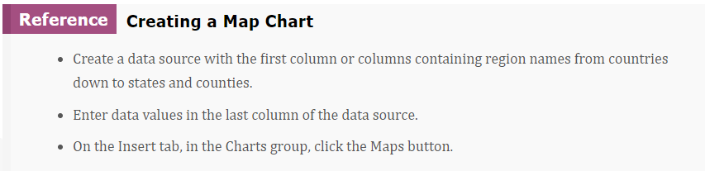
COMP1631 Advanced Spreadsheets – Winter 2024 – Section 06

Slide 42
COMP1631 Advanced Spreadsheets – Winter 2024 – Section 06
Formatting a map chart
• How to format a map chart.
• How to visualize data with 3D maps.
• How to choose a map style.
• How to create new scenes.
• How to set scene options.
• How to play a tour.

Slide 43
COMP1631 Advanced Spreadsheets – Winter 2024 – Section 06
Instructions:
Create a Map chart of the data in the range E4:F55.
Move the map to the Summary Report worksheet in the range R11:X29.
Remove the chart title, add data labels to the chart, and then move the legend to the bottom of the chart area.

Slide 44
COMP1631 Advanced Spreadsheets – Winter 2024 – Section 06
Instructions:
Insert a 3D Map. In scene 1, place the Postal Code field from the Customers table in the Location area, the Revenue field from the Items Sales table in the Height area, and the Store Name field from the Stores table in the Category area.
Add map labels to the map.
Change the view of the globe to a location above Minnesota, looking down and to the east.
Create a second scene of this data positioned above Cuba looking northwest.
Change the durations of Scene 1 and Scene 2 to 1 second and play the tour verifying that your viewpoint moves across the United States from northwest of Chicago around to south of Florida.

Slide 45
COMP1631 Advanced Spreadsheets – Winter 2024 – Section 06
Quick Quiz:
• In __________ maps, regions are filled with a color gradient based on the numeric value associated with each region. (Answer: value)
• In __________ maps, regions belonging to the same category share the same color. (Answer: category)
• True/False: 3D Maps is an Excel tool for creating map presentations. (Answer: true)
• True/False: The 3D map window is organized into two sections. (Answer: false, four)
• True/False: There are five ways of plotting data on a 3D map. (Answer: true)
• What are some of the things the Ideas tool looks for? (Answer: ranks, trends, outliers, majority categories)

Slide 46
COMP1631 Advanced Spreadsheets – Winter 2024 – Section 06
Quick Quiz:
• In __________ maps, regions are filled with a color gradient based on the numeric value associated with each region. (Answer: value)
• In __________ maps, regions belonging to the same category share the same color. (Answer: category)
• True/False: 3D Maps is an Excel tool for creating map presentations. (Answer: true)
• True/False: The 3D map window is organized into two sections. (Answer: false, four)
• True/False: There are five ways of plotting data on a 3D map. (Answer: true)
• What are some of the things the Ideas tool looks for? (Answer: ranks, trends, outliers, majority categories)

Slide 47

COMP1631 Advanced Spreadsheets – Winter 2024 – Section 06
End of Module 10
•Next lecture: SAM Module 10
•Don’t forget to complete the textbook project and SAM Exam
•Final Exam after Module 12.
•Email me makash@conestogac.on.ca if you have any further questions.

