Slide 1

COMP1631 Advanced Spreadsheets – Winter 2024 – Section 06

Slide 2
COMP1631 Advanced Spreadsheets – Winter 2024 – Section 06
Lecture 1 Tuesday, January 9, 2024
Today’s menu a la carte
Apéritifs
Plat principal
Desserts

Slide 3
COMP1631 Advanced Spreadsheets – Winter 2024 – Section 06
Welcome to COMP1631 Advanced Spreadsheets!
This course is designed to build on introductory spreadsheets concepts. You will participate in hands-on training activities like creating advanced formulas, analyzing and summarizing data, automating tasks and using queries to import data into Excel. A variety of analysis tools will also be explored.
We are going to cover Modules 5,6,7,8,10 and 12 in this course.

Slide 4
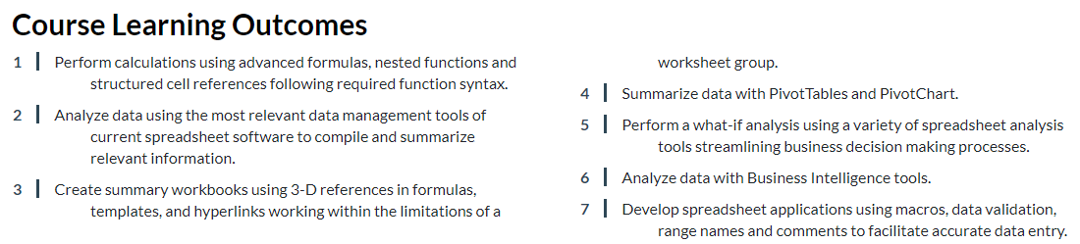
COMP1631 Advanced Spreadsheets – Winter 2024 – Section 06

Slide 5
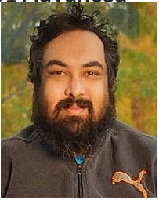

COMP1631 Advanced Spreadsheets – Winter 2024 – Section 06
About the Instructor:
Hello, my name is Mukto Akash.
Completed BSc and MMath from University of Waterloo.
Taught at the University of Waterloo from 2011 to 2020
Since 2021, working and teaching at Conestoga College.

Slide 6
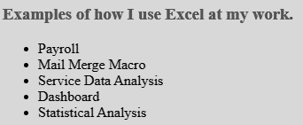
COMP1631 Advanced Spreadsheets – Winter 2024 – Section 06

Slide 7

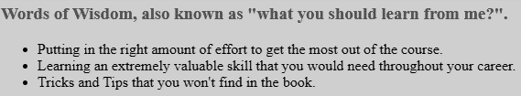
COMP1631 Advanced Spreadsheets – Winter 2024 – Section 06

Slide 8
COMP1631 Advanced Spreadsheets – Winter 2024 – Section 06
To be successful, you are required to go over all the contents posted in the course shell, read etext, review PowerPoint slides, and complete a variety of hands-on practices and assessments on a weekly basis.
Required Textbook
eText │New Perspectives on Microsoft Office 365 & Excel 2019 Comprehensive (2019).
You require Windows 10, Microsoft Office 2019, one of Google Chrome(preferred), Microsoft Edge, and Mozilla Firefox.
Students at Conestoga are expected to be familiar with their rights and responsibilities as learners and as members of this academic community.
Please carefully read all the Course Information content on eConestoga.

Slide 9
COMP1631 Advanced Spreadsheets – Winter 2024 – Section 06
Highlights from the Instructional Plan
This is a PC-based course, but it is possible to complete this course if you have a MAC. To maximize your marks, it is advised that you use a PC because not all components are available in the MAC environment.
Sharing of files is NOT permitted in this course and will be considered an academic offence.
If you complete a computer assignment in Sam/Mindtap and give your completed or starting file to another student, the incident will be documented as an academic offence for both students.
It is the student’s responsibility to complete all work on the due dates.
If an extension is required, the student must make the request in advance of the due date. Approval of the request is at the discretion of the faculty member.
Please read the entire Instructional Plan on eConestoga

Slide 10
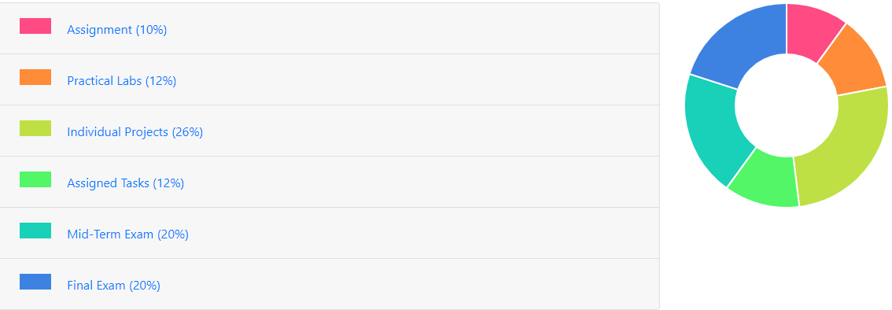
COMP1631 Advanced Spreadsheets – Winter 2024 – Section 06
Evaluation Summary

Slide 11
COMP1631 Advanced Spreadsheets – Winter 2024 – Section 06
In this course, there are:
6 Practical Labs (at 2%) – Textbook Projects
6 Assigned Tasks (at 2%) – Module Exams
7 Individual projects (at 4.3%) – SAM Projects
1 Assignment (10%) (complete in a week)
Midterm (20%) – content from Modules 5, 6, 7
Final (20%) – content from Modules 7, 8, 10, and 12.
Find more details on Weekly Schedule and Evaluations Summary

Slide 12
COMP1631 Advanced Spreadsheets – Winter 2024 – Section 06
Each module would take us roughly two weeks to cover. The following scheme tells us how the content coverage will be broken down over the two weeks.
Before first week: read the textbook chapter and complete the module training on Mindtap.
First week in class
First half of the class – I will answer questions about the training. We will also go over some interactive practice exercise on the content.
Second half of the class – we will attempt the textbook project. This is individual work, so please don’t seek help from classmates, but I will assist you with the work as needed.
After the first lecture, you will complete the textbook project. You will also complete the Module exam on Mindtap. Both of these are due 11:59pm on Monday of the second week.
Second week in class you will be completing the Sam Project for the Module on Mindtap.
Please the Weekly Schedule and Evaluations Summary for more details, and make sure to double check due dates on Mindtap.

Slide 13
COMP1631 Advanced Spreadsheets – Winter 2024 – Section 06
Example of the scheme for Module 5:
Date | In Class | At Home (after class) | Due
Week 0 (Jan 9 – 15) | - | Module 5 Training | -
First Week (Jan 9) | Module 5 Instructor-led interactive exercises | Module 5 Textbook Project (2%) | 11:59pm on Jan 22
 | Module 5 Textbook Project | Module 5 Exam (2%)
Second Week (Jan 23) | Sam Project (4.3%) | Module 6 Training | Sam Project due in class

Slide 14
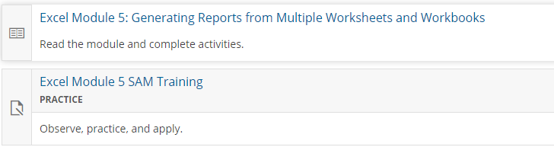
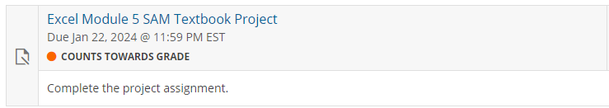
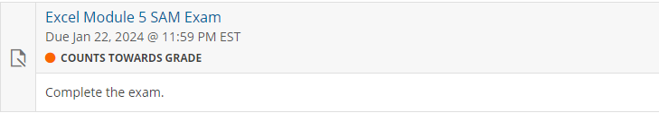
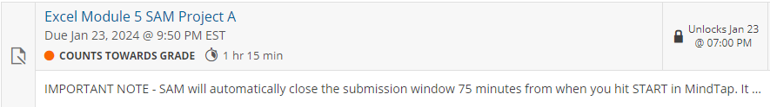
COMP1631 Advanced Spreadsheets – Winter 2024 – Section 06
Example of the Scheme for Module 5:
Before Jan 16:
Due at 11:59pm on Jan 22:
In class on Jan 23:
Let’s explore these briefly on Cengage/MindTap.

Slide 15
COMP1631 Advanced Spreadsheets – Winter 2024 – Section 06
LATE POLICY AND PENALTIES
It is the student’s responsibility to complete all work on the due dates. If graded MindTap activities are not completed by the due date, students will receive a zero on the activity.
If an extension is required, the student must make the request at least 24 hours in advance of the due date. Approval of the request is at the discretion of the faculty member.
Late assignments will receive a deduction of 10% if submitted late on the due date, and 20% per day after the due date up to three days, at which time the assignment will no longer be accepted, and a zero mark will be given for the assignment unless the student has followed the advance notice policy as mentioned in the program handbook.
Please Note: This late policy does not apply to MindTap/SAM Projects, Midterm and the Final Exam– all SAM Projects must be completed in class on MindTap on the scheduled date. You may not complete SAM Projects, the Midterm and the Final Exam at home. If there is an extenuating circumstance that causes you to miss the class for any of these assessments, then the instructor, at their discretion, may arrange an alternate date and time to complete the assessment at the testing center.

Slide 16
COMP1631 Advanced Spreadsheets – Winter 2024 – Section 06
Finally, let’s lay down some ground rules for the classroom:
We treat each other with respect.
Come to class on-time (on-time means at least 5 minutes before class starts at 7pm).
Maintain positive learning environment. OK to be funny and make jokes, but not at the expense of others.
Help each other and ask lots of questions, but do not disrupt the class with private and irrelevant conversations. Good etiquette is to raise your hand to ask questions.
If you need to leave the classroom during the lecture, do so quietly. You do not need my permission, but please don’t bother others.
Avoid using cellphones in class (please set them to silent or vibrate only). Do not distract others by watching videos or doing irrelevant work on your computer/laptop.
Return from break on-time. If you arrive late, please get to your seat quietly without bothering your peers.

Slide 17
COMP1631 Advanced Spreadsheets – Winter 2024 – Section 06
Let’s go for a break!
Return in 15 minutes (or at time specified by your instructor).

Slide 18
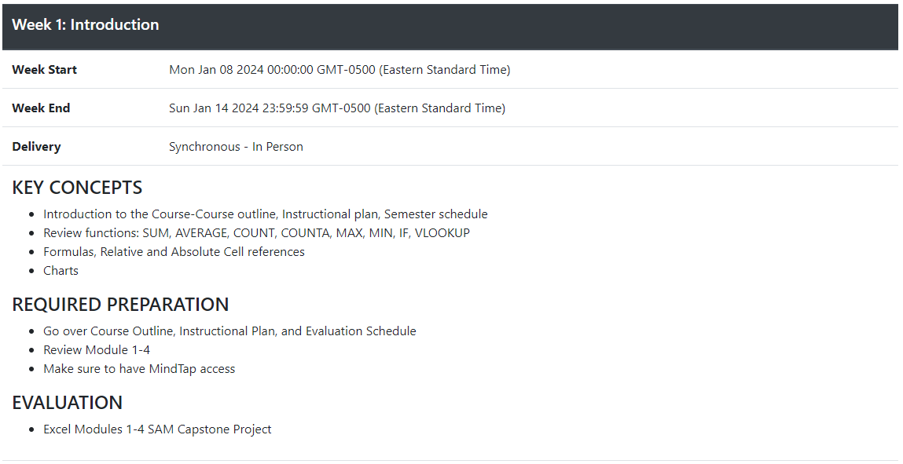
COMP1631 Advanced Spreadsheets – Winter 2024 – Section 06

Slide 19
COMP1631 Advanced Spreadsheets – Winter 2024 – Section 06
Module 1
Open and close a workbook
Navigate through a workbook and worksheet
Select cells and ranges
Plan and create a workbook
Insert, rename, and move worksheets
Enter text, dates, and numbers
Undo and redo actions
Resize columns and rows
Enter formulas and the SUM and COUNT functions
Copy and paste formulas
Move or copy cells and ranges
Insert and delete rows, columns, and ranges
Create patterned text with Flash Fill
Add cell borders and change font size
Change worksheet views
Prepare a workbook for printing
Module 2
Change fonts, font style, and font color
Add fill colors and a background image
Create formulas to calculate sales data
Format numbers as currency and percentages
Format dates and times
Align, indent, and rotate cell contents
Merge a group of cells
Use the AVERAGE function
Apply cell styles
Copy and paste formats with the Format Painter
Find and replace text and formatting
Change workbook themes
Highlight cells with conditional formats
Format a worksheet for printing
Module 3
Translate an equation into a function
Do calculations with dates and times
Extend data and formulas with AutoFill
Use the Function Library
Calculate statistics
Using the Quick Analysis toolbar
Use absolute and relative cell references
Use a logical function
Retrieve data with lookup tables
Do what-if analysis with Goal Seek
Module 4
Create a pie chart
Format chart elements
Create a line chart
Work with chart legends
Create a combination chart
Create a scatter chart
Edit a chart data source
Create a data callout
Insert shapes and icons into a worksheet
Create and edit a data bar
Create and edit a group of sparklines

Slide 20
COMP1631 Advanced Spreadsheets – Winter 2024 – Section 06
We are going to work through a Capstone Project for modules 1 – 4.
Similar to a SAM Project, but over multiple modules.
Need to know the content of the module(s) to be able to work on the project.
Two files: Instructions, and a starter file. Starter file will have your name on it, instructions may differ from student to student, so don’t share files.
Multiple submissions allowed, with instant feedback/report on where you lost marks. The instruction file also shows what the end result should look like.
Notice that submission file has a slightly different name than the Start File. Follow instructions closely.
Let’s start the Capstone Project!

Slide 21
COMP1631 Advanced Spreadsheets – Winter 2024 – Section 06
Module 5
Copy worksheets between workbooks
View a workbook in multiple windows
Organize worksheets in a worksheet group
Write a 3-D reference
Write an external reference
Manage the security features of linked documents
Create a hyperlink to a document source
Link to an email address
Create and apply a named range
Work with name scope
Create a workbook template

Slide 22
COMP1631 Advanced Spreadsheets – Winter 2024 – Section 06

