Slide 1

COMP1631 Advanced Spreadsheets – Winter 2024 – Section 06

Slide 2
COMP1631 Advanced Spreadsheets – Winter 2024 – Section 06
Lecture 11 Tuesday, April 02, 2024
Today:
Academic Integrity – again!
Attendance
Note about next class: Module 12 SAM Project
Module 10 SAM Project

Slide 3
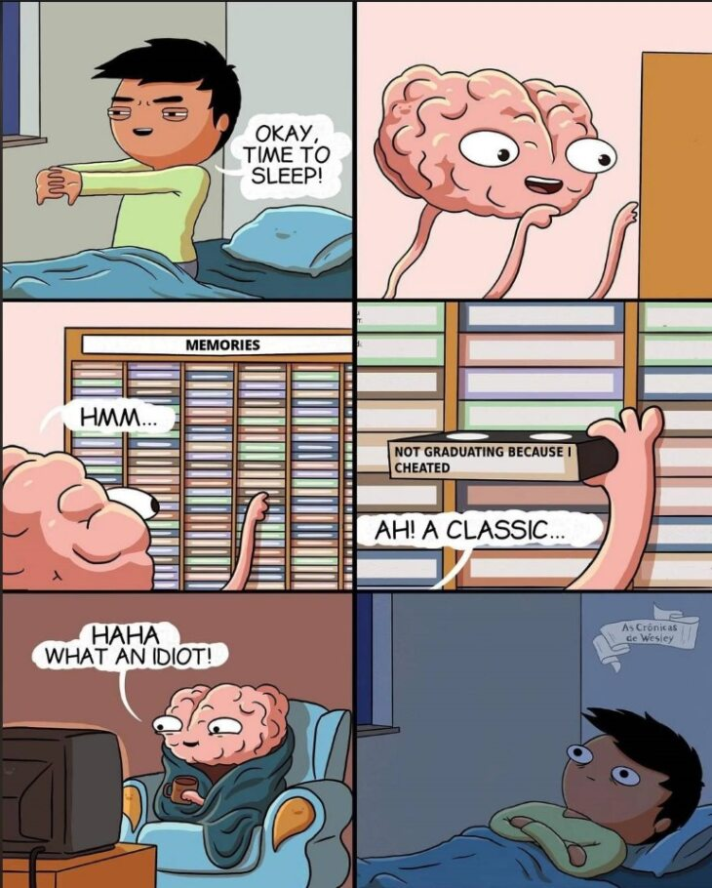
COMP1631 Advanced Spreadsheets – Winter 2024 – Section 06

Slide 4
COMP1631 Advanced Spreadsheets – Winter 2024 – Section 06
What does academic honesty mean to you?
No phones
No talking to each other
No Googling

Slide 5
COMP1631 Advanced Spreadsheets – Winter 2024 – Section 06
Module 10 SAM Project
Password is: module10W24
75 minutes time-limit (as usual)
Individual work - - do not discuss with each other
Once done leave quietly. If you are waiting for your friend to complete, wait for them outside.
Don’t forget about the Student Success Week and Midterm in the coming weeks.

