Slide 1
New Perspectives on Microsoft Excel 2019

Slide 2
Generating Reports from Multiple Worksheets and Workbooks
Module 5

Slide 3
Objectives, Part 1
Copy worksheets between workbooks
View a workbook in multiple windows
Organize worksheets in a worksheet group
Write a 3-D reference
Write an external reference

Slide 4
Objectives, Part 2
Manage the security features of linked documents
Create a hyperlink to a document source
Link to an email address
Create and apply a named range
Work with name scope
Create a workbook template

Slide 5
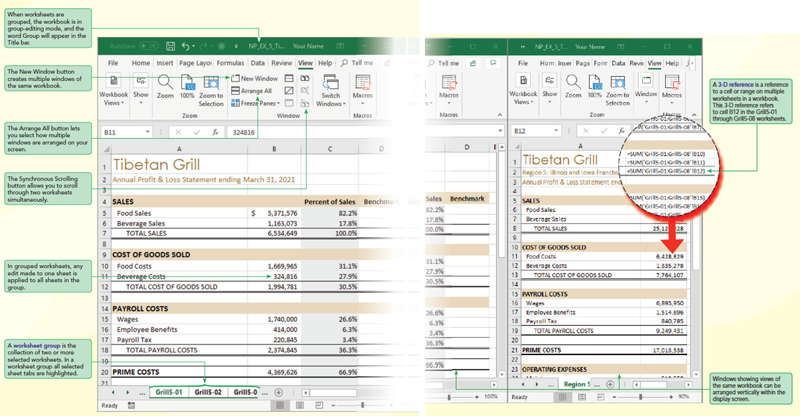
Visual Overview: Worksheet Groups and 3-D References

Slide 6
Working with Multiple Worksheets, Part 1
Copying Worksheets
Use an existing worksheet as a starting point for creating another one
Duplicates all values, formulas, and formats into new worksheet, leaving original worksheet intact
Edit, reformat, and enter new content as needed

Slide 7
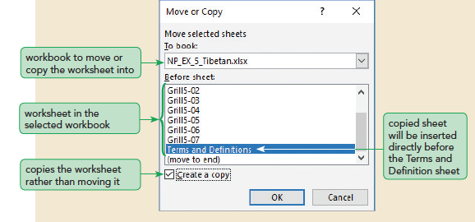
Working with Multiple Worksheets, Part 2

Slide 8
Viewing a Workbook in Multiple Windows, Part 1
Arranging Multiple Workbooks
Can display all the open workbooks on your screen at the same time
Can easily click among the open workbooks to create links as well as quickly compare the contents of worksheets in different workbooks
Layout options:
Tiled
Horizontal
Vertical
Cascade
Using Synchronized Scrolling Between Windows

Slide 9
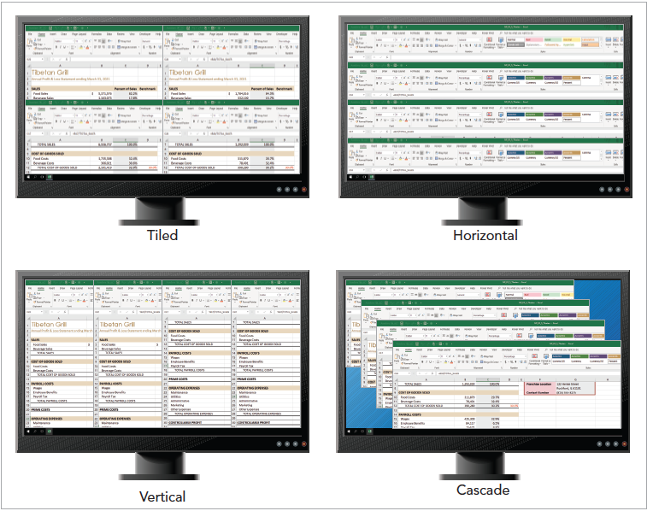
Viewing a Workbook in Multiple Windows, Part 2

Slide 10
Working with Worksheet Groups, Part 1
You can edit several worksheets simultaneously by grouping the worksheets. In a worksheet group, any changes made to one worksheet are automatically applied to all sheets in the group
Same page layout settings apply to all worksheets in the group at the same time
All worksheets in the group can be printed at once

Slide 11
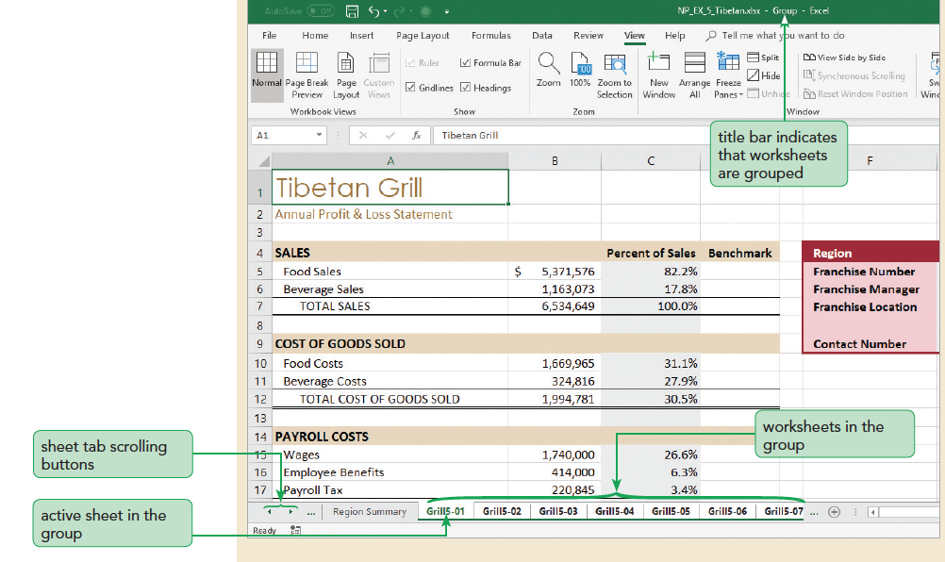
Working with Worksheet Groups, Part 2

Slide 12
Writing 3-D References, Part 1
Referencing Cells in Other Worksheets
Applying 3-D References to Formulas and Functions
3-D cell references can be used within any Excel formula and function
You can create flexible 3-D references by using wildcards

Slide 13
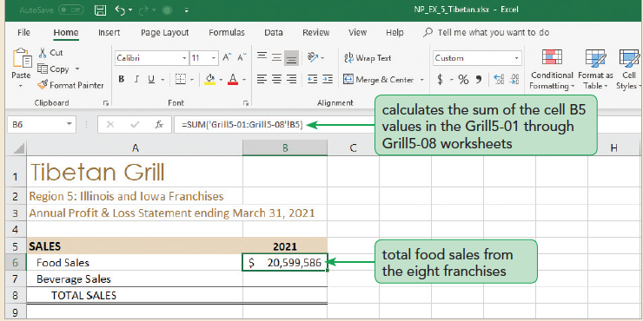
Writing 3-D References, Part 2

Slide 14
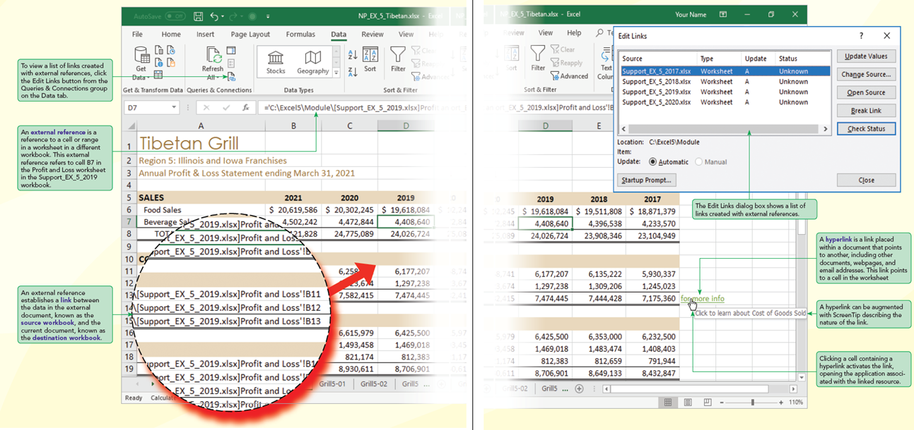
Visual Overview: External References and Links

Slide 15
Linking to External Workbooks, Part 1
When creating formulas in a workbook, reference data in other workbooks by creating a link between the workbooks
Unlike with worksheets, there’s no such thing as a workbook group. You can specify only one workbook at a time
To speed up the process of entering an external reference as well as to avoid a mistake, you can begin entering the formula and then use your mouse to select the cell or cell range from an already opened workbook

Slide 16
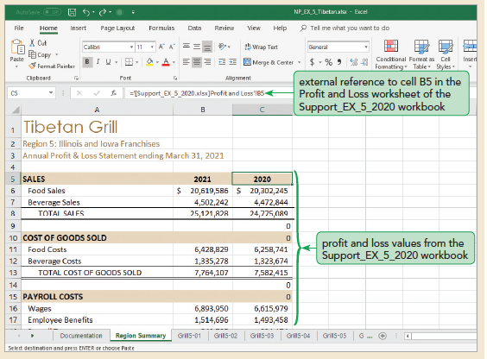
Linking to External Workbooks, Part 2

Slide 17
Linking to External Workbooks, Part 3
If both the destination and source workbooks are currently open, any changes you make to data in the source workbook will also be reflected in the destination workbook
You can view and edit the Excel security settings by clicking the File on the menu bar, clicking Options in Backstage view, and then clicking Trust Center in the Excel Options dialog box

Slide 18
Linking to External Workbooks, Part 4
A list of all links in your workbook is available in the Edit Links dialog box. For each link, the Edit Links dialog box shows the following information:
Source
Type
Update
Status

Slide 19
Linking to External Workbooks, Part 5
Managing Workbook Links
You cannot undo the break link action. To restore the link, you must reenter the external reference formulas
Deciding when to Link Workbooks
Is a large workbook too difficult to use?
Can separate workbooks share a common design and structure?
Can information from different workbooks be summarized?
Can source workbooks continually be updated?
Will the source workbooks be available to the destination workbook?

Slide 20
Creating Hyperlinks, Part 1
A hyperlink is a text string or graphic image connected to a wide variety of resources, including:
Websites
Files on your computer, such as Word documents, PowerPoint presentations, text files, and PDF documents
Cells and cell ranges within the current workbook
Email addresses
New documents created specifically as the source of the hyperlink

Slide 21
Creating Hyperlinks, Part 2
Linking to a Location Within a Workbook
Linking to an Email Address
Clicking a linked email address automatically opens the user’s email program to a new message with your email address and a preset subject line already inserted.

Slide 22
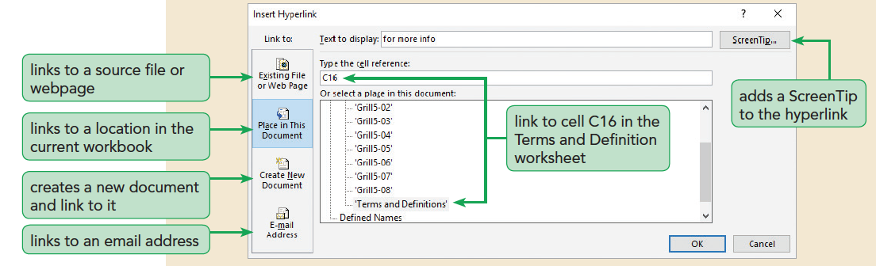
Creating Hyperlinks, Part 3

Slide 23
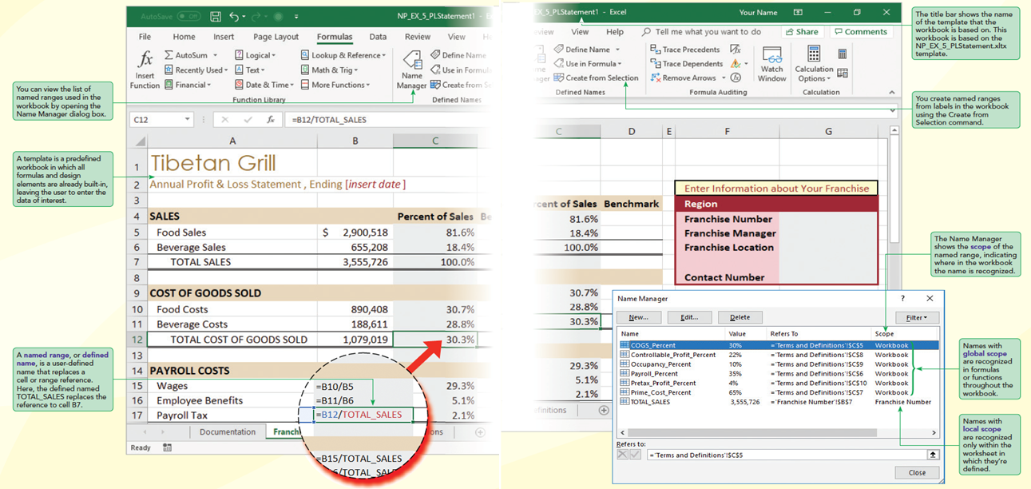
Visual Overview: Named Ranges and Templates

Slide 24
Simplifying Formulas with Named Ranges, Part 1
A named range can refer to any cell or cell range within the workbook, so you can replace a reference such as Sheet1!B7:B43 with the more descriptive name SalesData2021.
Defining a Named Range
The simplest way to define a named range is to select a range and enter the name in the Name box
By default, Excel treats named ranges as absolute cell references

Slide 25
Simplifying Formulas with Named Ranges, Part 2
Using Named Ranges in Formulas
A named range can be used in place of a cell reference in any Excel formula or function. So, the 3-D reference in the formula =SUM('Sales Data'!E4:E20) can be replaced with =SUM(salesFigures)
Determining the Scope of Named Ranges
Local scope is used to avoid name conflicts that would occur when the same name is duplicated across multiple worksheets

Slide 26
Simplifying Formulas with Named Ranges, Part 3
Using Defined Names in Existing Formulas
Once you have defined a named range, you can have Excel replace all cell references in formulas and functions with the equivalent name

Slide 27
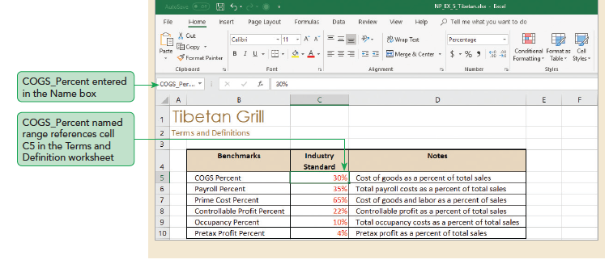
Simplifying Formulas with Named Ranges, Part 4

Slide 28
Exploring Workbook Templates, Part 1
Setting Up a Workbook Template
Any workbook can be turned into a template by just deleting all of the current data, leaving only the formulas and design elements. The data is left blank for end users to fill in at a later date when they start creating their own documents.
Creating a Workbook Based on a Template
Ways to create a workbook based on a template

Slide 29
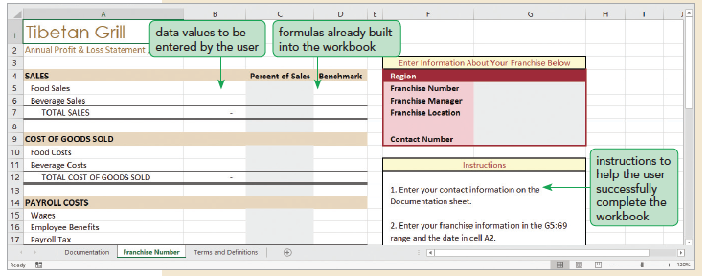
Exploring Workbook Templates, Part 2

