Slide 1

COMP1631 Advanced Spreadsheets – Winter 2024 – Section 06

Slide 2
COMP1631 Advanced Spreadsheets – Winter 2024 – Section 06
Lecture 6 Tuesday, February 13, 2024
Today:
Module 7: Summarizing Data with Pivot Tables
Observe
Apply

Slide 3
Objectives, Part 1
Lookups
Do approximate match lookups
Logical Functions
Work with logical functions
Calculate
Calculate statistics with summary IF functions
Pivot Table
Create a PivotTable
Layout
Change a PivotTable layout

Slide 4
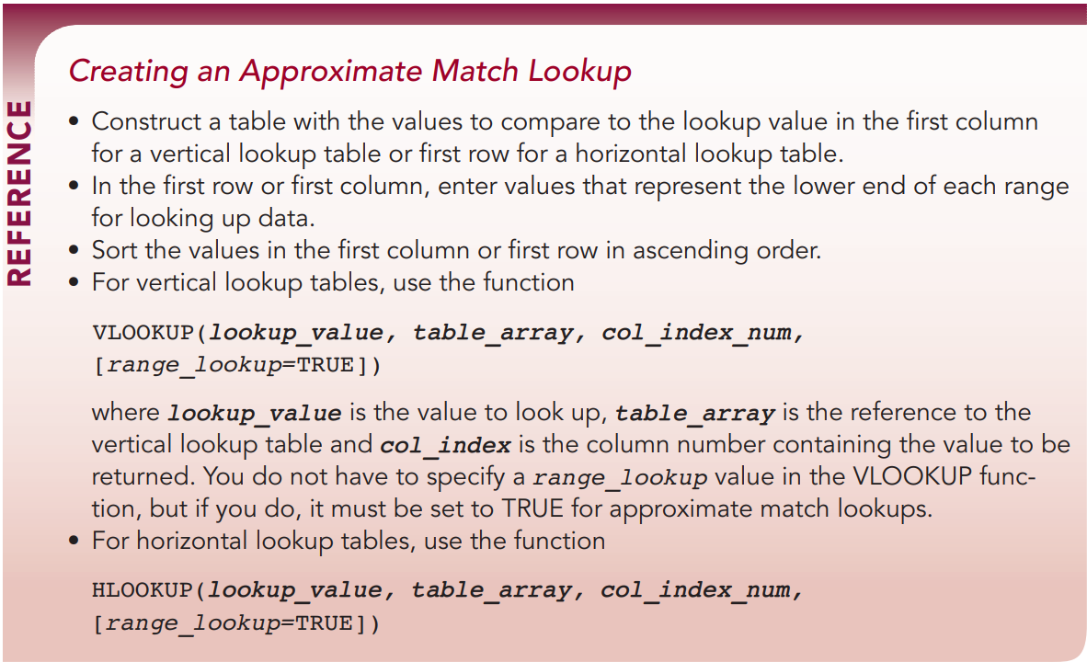
Using Lookup Functions
Creating Approximate Match Lookups
An approximate match lookup is a lookup in which the lookup value is compared to ranges of values rather than a single, specific value.
Approximate match lookups can reference a vertical or horizontal lookup table.

Slide 5
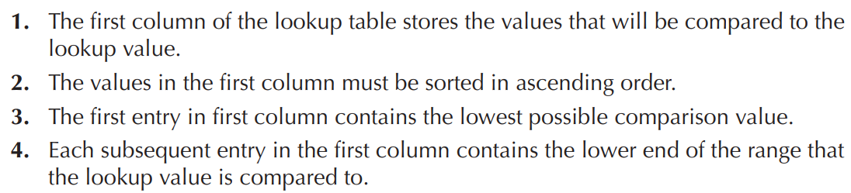
Using Lookup Functions
Creating Approximate Match Lookups
An approximate match lookup occurs when the lookup value is found within a range of numbers in the first column (or row) of the lookup table

Slide 6
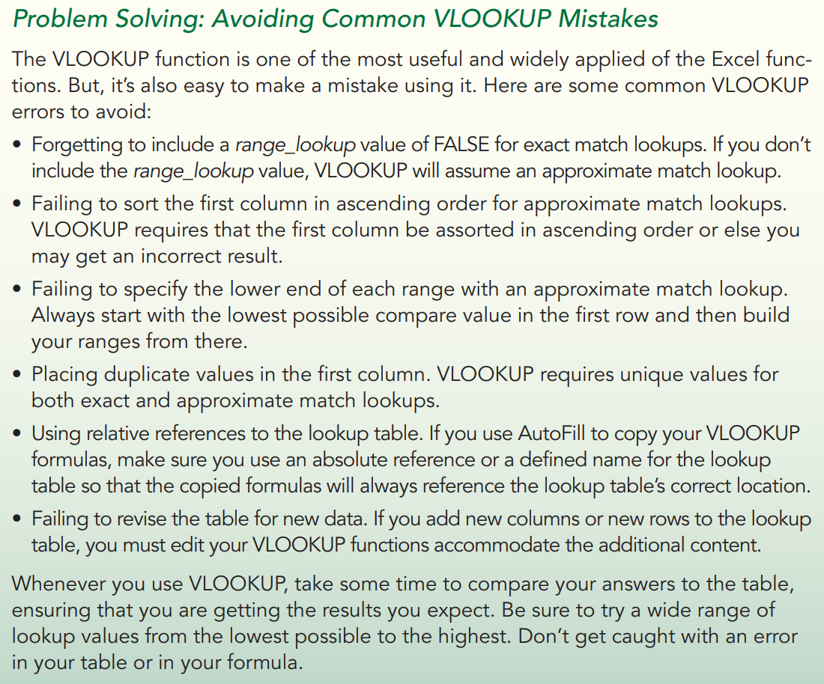

Slide 7
Using Lookup Functions
Demonstration:
Claire continues to analyze social media metrics and needs to evaluate what factors might result in a successful Facebook post.
Claire has compiled a list of Facebook posts that advertise company specials and business news.
Claire wants to know whether user engagement is higher when the posts include photos and coupon offers. She also wants to determine whether certain days of the week are better than others to engage the user. Finally, Claire is mindful that users might ignore long posts and wants to examine whether word count has an impact on user engagement.
Open the Module_7_observe.xlsx workbook

Slide 8
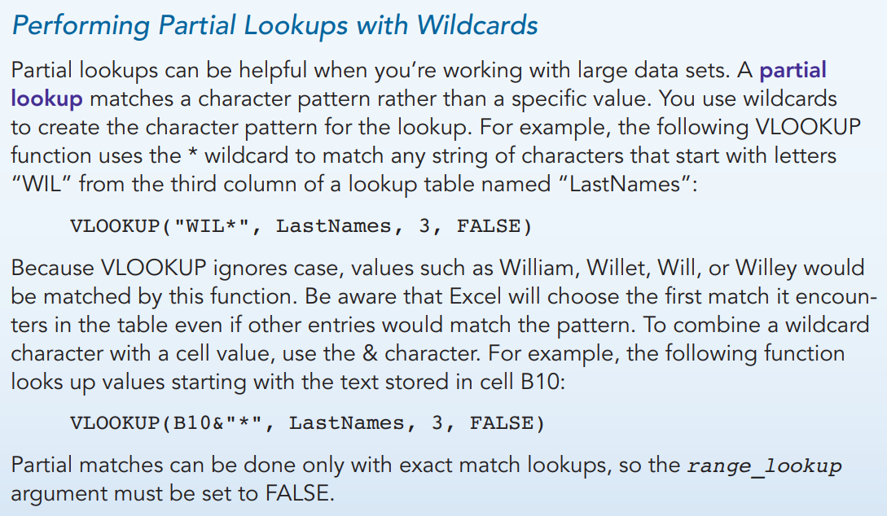
Using Lookup Functions

Slide 9
Using Lookup Functions
Retrieving Data with Index Match Lookups
The VLOOKUP function finds data based on values in the first column.
The HLOOKUP function finds data based on values in the first row.
The MATCH function returns the position of a value found within a row or column.
The syntax of the MATCH function is
MATCH(lookup_value, lookup_array, [match_type=1])
The INDEX function returns the value from a data range at the intersection of a specific row and column, and has the syntax:
INDEX(array, row_num, col_num)
By nesting MATCH functions within the INDEX function, you can retrieve data from a table by searching through the entries in the table’s first column and row, locating matching values.

Slide 10
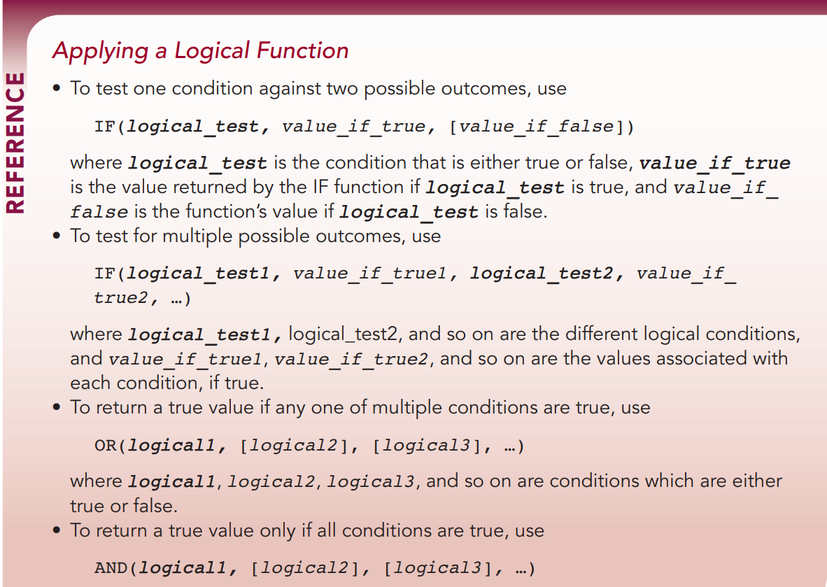
Exploring Logical Functions

Slide 11
Exploring Logical Functions
Demonstration
In the Excel file, complete instructions 1-3 from the Media Posts worksheet

Slide 12
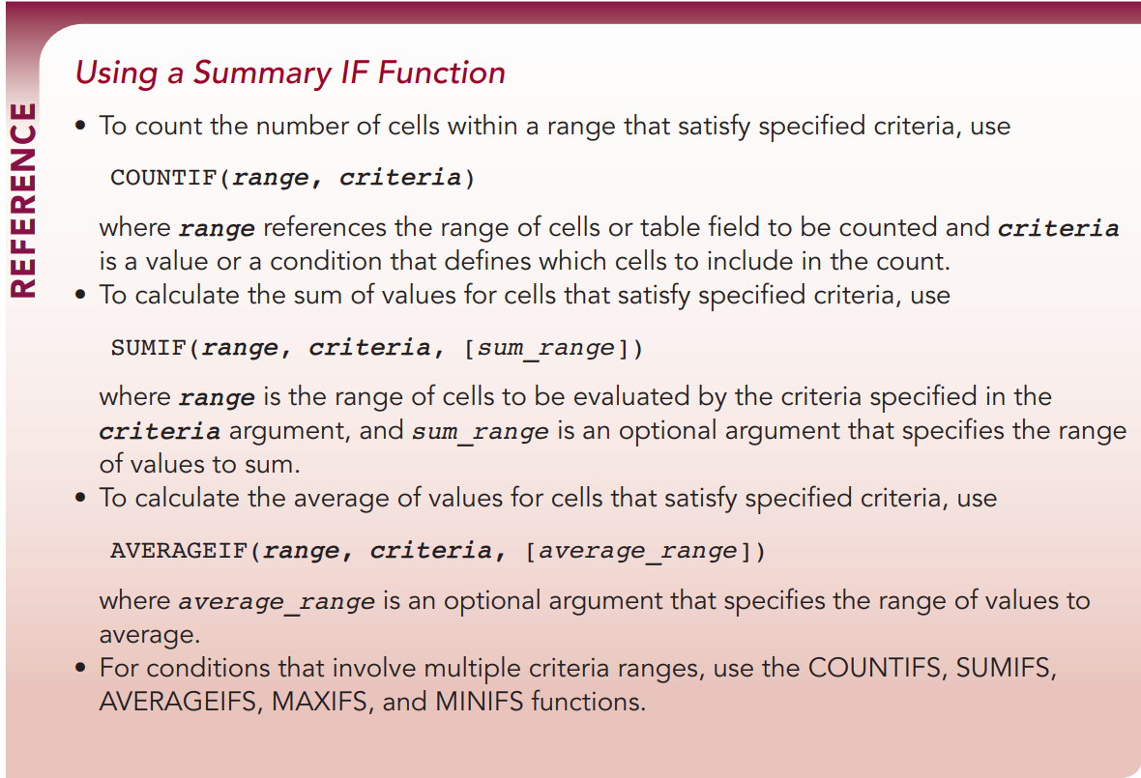
Applying Summary IF Functions

Slide 13
Applying Summary IF Functions
Demonstration
In the Excel file, complete instructions 1-8 from the Report worksheet

Slide 14
Creating PivotTables
Every PivotTable includes the following four primary areas:
Rows area—displays category values from one or more fields arranged in separate rows
Columns area—displays categories from one or more fields arranged in separate columns
Values area—displays summary statistics for one or more fields at each intersection of each row and column category
Filters area—contains a filter button that limits the PivotTable to only those values matching specified criteria

Slide 15
Creating PivotTables
Inserting a PivotTable
To create a PivotTable, click in a data range or an Excel table, and then click the PivotTable button in the Tables group on the Insert tab. Excel reserves a space 3 columns wide by 18 rows tall for the initial PivotTable report.
If the worksheet does not have enough empty space, you’ll be prompted to overwrite the cell content

Slide 16
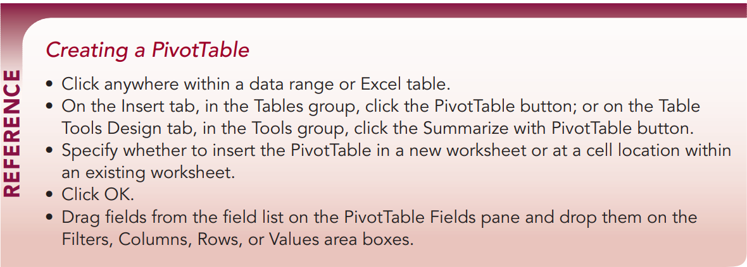
Creating PivotTables

Slide 17
Creating PivotTables
Modifying the PivotTable Layout
PivotTables are excellent for data exploration because you can quickly change the PivotTable layout to view your data from many different angles.
To change the content of the PivotTable, drag fields out of any of the four area boxes to remove them from the table and drop new fields into the area boxes to add them.
PivotTables are not limited to a single field in the Rows or Columns area. You can place additional fields in each area, nesting one field within another.

Slide 18
Creating PivotTables
Demonstration
Complete instructions 9 – 15 in the Reports worksheet

Slide 19
Formatting a PivotTable
You can format PivotTables to make them more visually appealing and the results easier to read. You should format a PivotTable after you have decided on its structure, layout, and content.
Changing Labels and Number Formats
Choosing a PivotTable Summary Function
By default, Excel uses the COUNT function to summarize non-numeric data and the SUM function for numeric data. However, sometimes you’ll want to use different statistics in your analysis.

Slide 20
Formatting a PivotTable
Demonstration
Complete instructions 15 – 20 in the Reports worksheet

Slide 21
COMP1631 Advanced Spreadsheets – Winter 2024 – Section 06
Let’s go for a break!
Return in 15 minutes (or at time specified by your instructor).

Slide 22
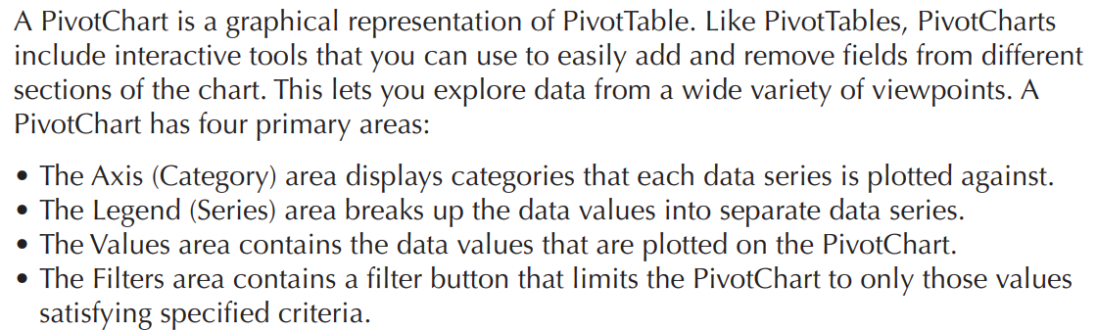
Introducing PivotCharts

Slide 23
Introducing PivotCharts
Creating a PivotChart
A PivotChart is created either from an existing PivotTable or created at the same time as its PivotTable.
The layout of a PivotTable and PivotChart always mirror one another.
Any changes you make to the structure and layout of a PivotTable affect the PivotChart, and vice versa.
Not every Excel chart type can be created as a PivotChart.

Slide 24
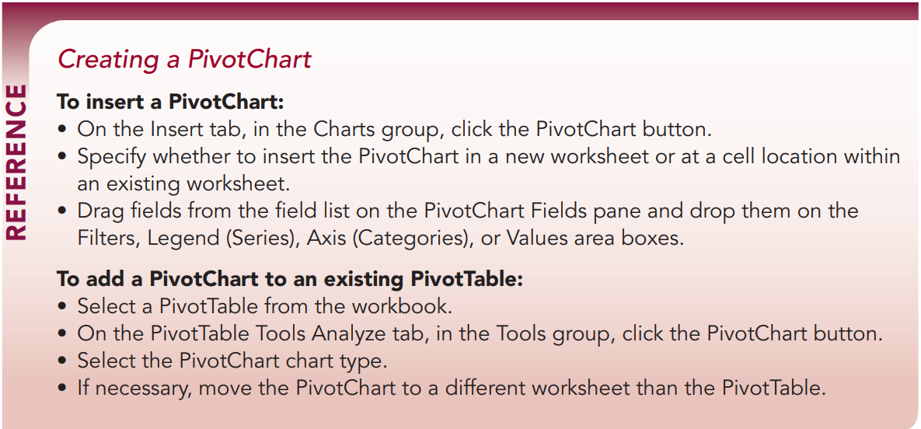
Introducing PivotCharts

Slide 25
Introducing PivotCharts
Demonstration:
Complete instructions 1-10 in the Engagement Types worksheet
And instructions 1-9 in the Engagement History worksheet

Slide 26
Using Slicers and PivotTables
Another way of filtering PivotTable and PivotCharts is with a slicer. By clicking a slicer button, you can limit the PivotTable and PivotChart to a select group of records.
Applying a Slicer to Multiple PivotTables
The same slicer can be applied to multiple PivotTables. They do not need to be in the same worksheet but only the same workbook.
A slicer is not applied directly to a PivotChart, only the PivotTable that PivotChart is based on.
A timeline slicer filters a PivotTable to include only those records from a specified date interval

Slide 27
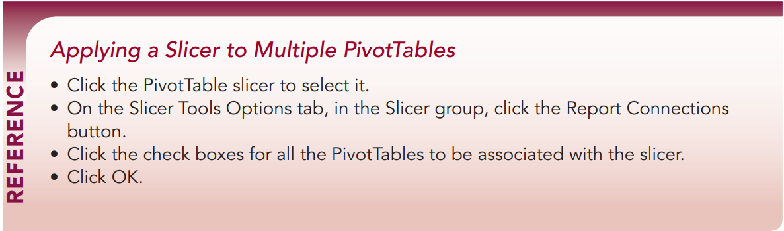
Using Slicers and PivotTables

Slide 28
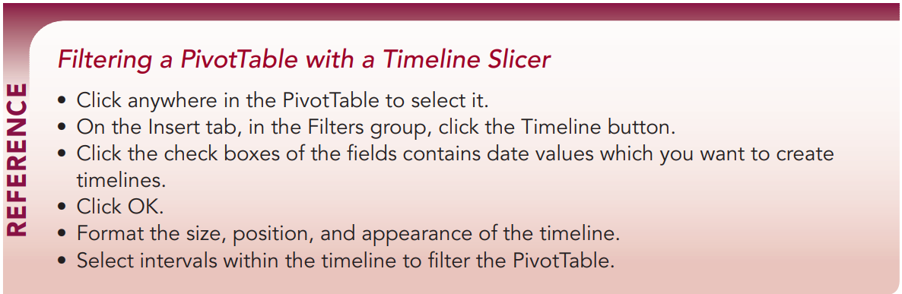
Using Slicers and PivotTables

Slide 29
Using Slicers and PivotTables
Demonstration
Complete instructions 1-10 in the Dashboard worksheet

Slide 30
Drilling Down a PivotTable, Part 1
A PivotTable summarizes data, but sometimes you will want to examine the data records themselves.
You can do this by drilling down the PivotTable to display the records responsible for the PivotTable calculations.
To drill down a PivotTable, double-click any cell within the table. Excel then opens a new sheet displaying the records used to calculate that PivotTable value.

Slide 31
Drilling Down a PivotTable
Demonstration:
Complete instructions 11-14 in the Drilled Data worksheet

Slide 32
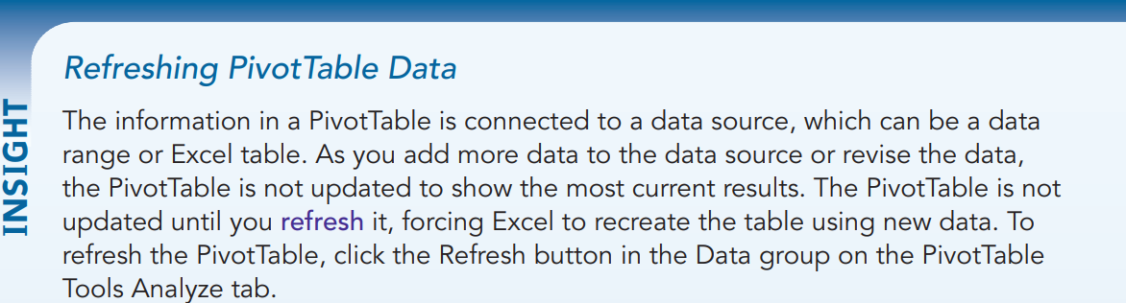
Drilling Down a PivotTable

Slide 33
COMP1631 Advanced Spreadsheets – Winter 2024 – Section 06
Let’s go for a break!
Return in 15 minutes (or at time specified by your instructor).

