Slide 1
B
PART
Linear Algebra. Vector Calculus
Part B p<number>

Slide 2
9
CHAPTER
Vector Differential Calculus.
Grad, Div, Curl
Chapter 9 p<number>

Slide 3
9.1 Vectors in 2-Space and
3-Space
Section 9.1 p<number>

Slide 4
9.1 Vectors in 2-Space and 3-Space
In engineering, physics, mathematics, and other areas we encounter two kinds of quantities. They are scalars and vectors.
A scalar is a quantity that is determined by its magnitude. It takes on a numerical value, i.e., a number. Examples of scalars are time, temperature, length, distance, speed, density, energy, and voltage.
In contrast, a vector is a quantity that has both magnitude and direction. We can say that a vector is an arrow or a directed line segment. For example, a velocity vector has length or magnitude, which is speed, and direction, which indicates the direction of motion.
Section 9.1 p<number>

Slide 5
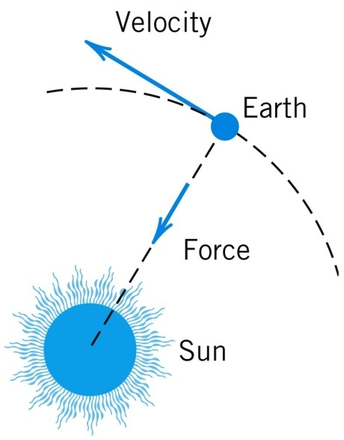

9.1 Vectors in 2-Space and 3-Space
Typical examples of vectors are displacement, velocity, and force, see Fig. 164 as an illustration.
Fig. 164. Force and velocity
More formally, we have the following. We denote vectors by lowercase boldface letters a, b, v, etc. In handwriting you may use arrows, for instance,
Section 9.1 p<number>

Slide 6
9.1 Vectors in 2-Space and 3-Space
A vector (arrow) has a tail, called its initial point, and a tip, called its terminal point. This is motivated in the translation (displacement without rotation) of the triangle in Fig. 165, where the initial point P of the vector a is the original position of a point, and the terminal point Q is the terminal position of that point, its position after the translation. The length of the arrow equals the distance between P and Q. This is called the length (or magnitude) of the vector a and is denoted by |a|. Another name for length is norm (or Euclidean norm).
A vector of length 1 is called a unit vector.
Section 9.1 p<number>

Slide 7
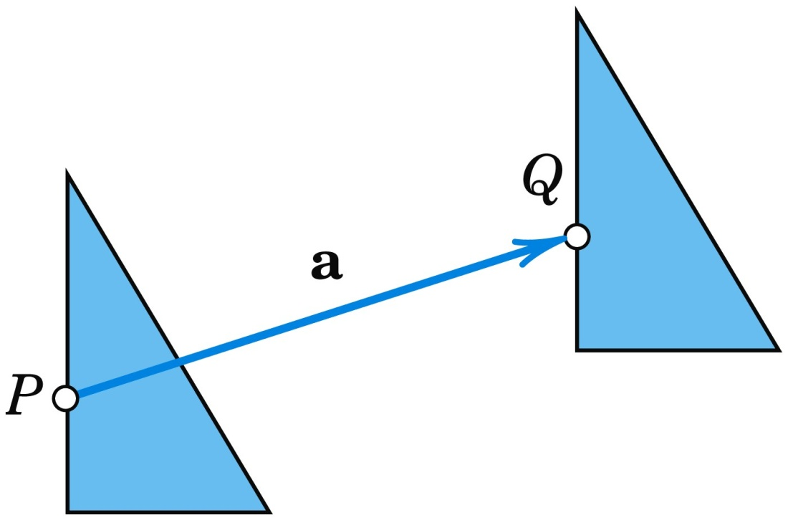
9.1 Vectors in 2-Space and 3-Space
Fig. 165. Translation
Section 9.1 p<number>

Slide 8
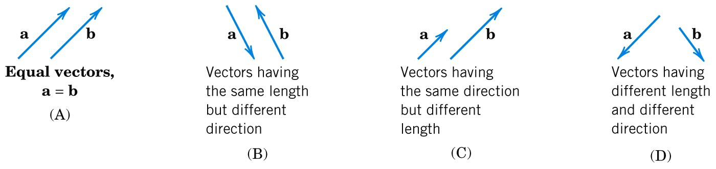
9.1 Vectors in 2-Space and 3-Space
Definition
Equality of Vectors
Two vectors a and b are equal, written a = b, if they have the same length and the same direction [as explained in Fig. 166; in particular, note (B)]. Hence a vector can be arbitrarily translated; that is, its initial point can be chosen arbitrarily.
Fig. 166. (A) Equal vectors. (B)–(D) Different vectors
Section 9.1 p<number>

Slide 9
9.1 Vectors in 2-Space and 3-Space
Components of a Vector
We choose an xyz Cartesian coordinate system in space (Fig. 167), that is, a usual rectangular coordinate system with the same scale of measurement on the three mutually
perpendicular coordinate axes. Let a be a given vector with initial point P: (x₁, y₁, z₁) and terminal point Q: (x₂, y₂, z₂). Then the three coordinate differences
(1) a₁ = x₂ − x₁, a₂ = y₂ − y₁, a₃ = z₂ − z₁
are called the components of the vector a with respect to that coordinate system, and we write simply a = [a₁, a₂, a₃]. See Fig. 168.
Section 9.1 p<number>

Slide 10
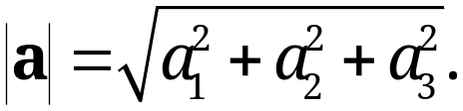
9.1 Vectors in 2-Space and 3-Space
Components of a Vector (continued)
The length |a| of a can now readily be expressed in terms of components because from (1) and the Pythagorean theorem we have
(2)
A Cartesian coordinate system being given, the position vector r of a point A: (x, y, z) is the vector with the origin
(0, 0, 0) as the initial point and A as the terminal point (see
Fig. 169). Thus in components, r = [x, y, z]. This can be seen directly from (1) with x₁ = y₁ = z₁ = 0.
(See next slide for Figures 167, 168 and 169.)
Section 9.1 p<number>

Slide 11
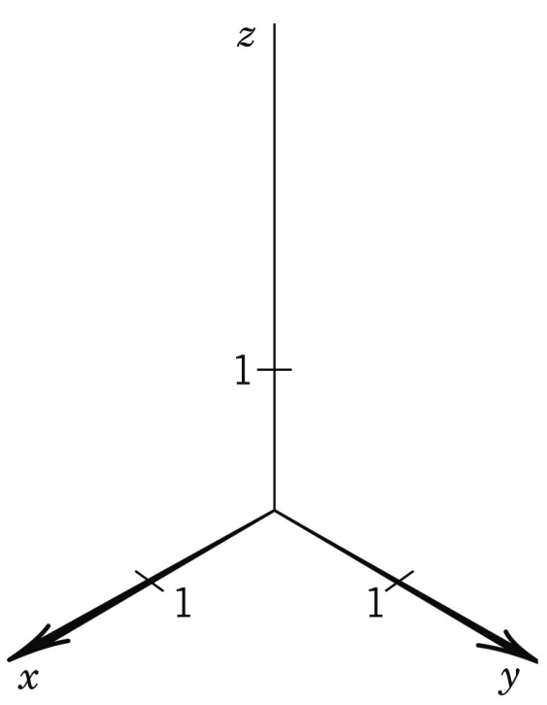
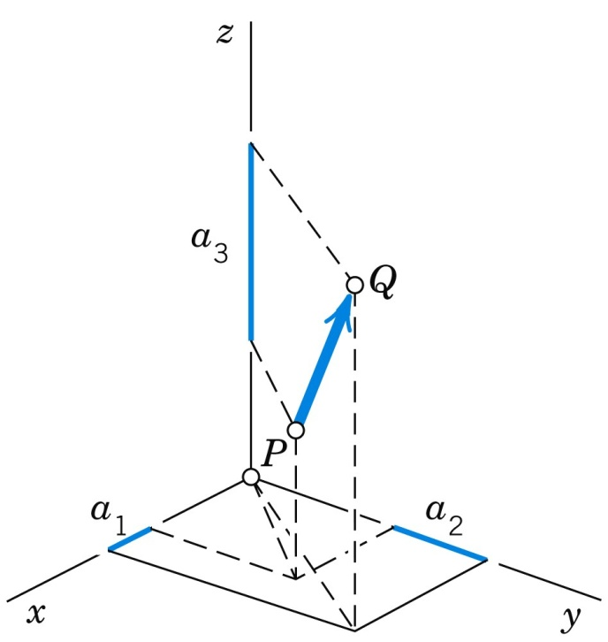
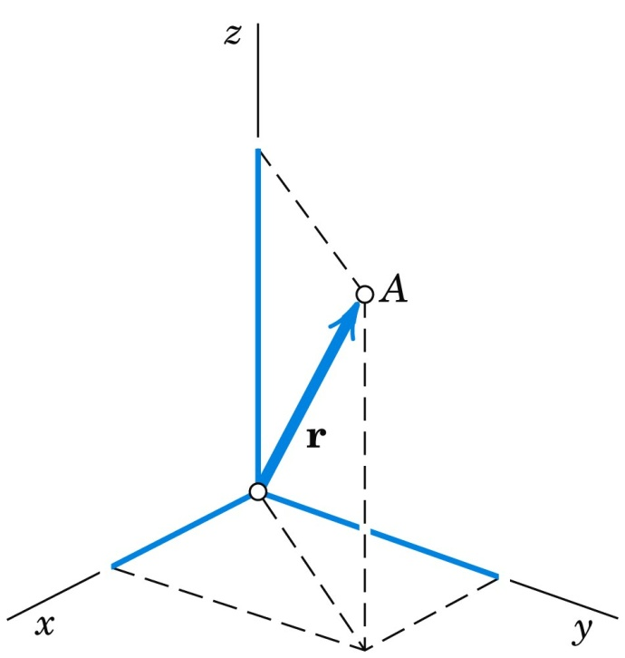
9.1 Vectors in 2-Space and 3-Space
Components of a Vector (continued)
Fig. 167. Cartesian Fig. 168. Components Fig. 169. Position vector r
coordinate system of a vector of a point A: (x, y, z)
Section 9.1 p<number>

Slide 12
9.1 Vectors in 2-Space and 3-Space
Theorem 1
Vectors as Ordered Triples of Real Numbers
A fixed Cartesian coordinate system being given, each vector is uniquely determined by its ordered triple of corresponding components. Conversely, to each ordered triple of real numbers (a₁, a₂, a₃) there corresponds precisely one vector a = [a₁, a₂, a₃], with (0, 0, 0) corresponding to the zero vector 0, which has length 0 and no direction.
Hence a vector equation a = b is equivalent to the three equations a₁ = b₁, a₂ = b₂, a₃ = b₃ for the components.
Section 9.1 p<number>

Slide 13
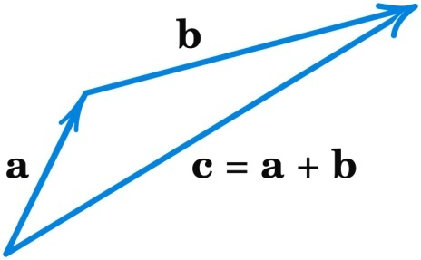
9.1 Vectors in 2-Space and 3-Space
Vector Addition, Scalar Multiplication
Definition
Addition of Vectors
The sum a + b of two vectors a = [a₁, a₂, a₃] and b = [b₁, b₂, b₃] is obtained by adding the corresponding components,
(3) a + b = [a₁ + b₁, a₂ + b₂, a₃ + b₃].
Geometrically, place the vectors as in Fig. 170 (the initial point of b at the terminal point of a); then a + b is the vector drawn from the initial point of a to the terminal point of b.
Fig. 170. Vector
addition
Section 9.1 p<number>

Slide 14
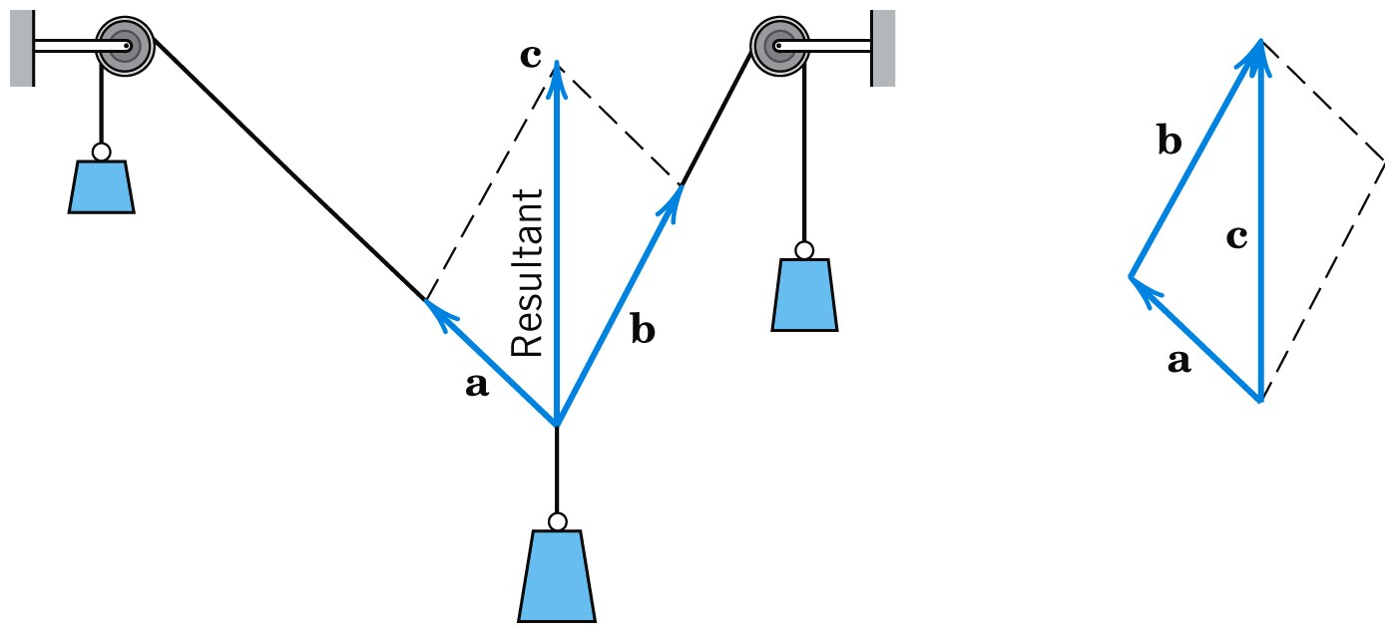
9.1 Vectors in 2-Space and 3-Space
For forces, this addition is the parallelogram law by which we obtain the resultant of two forces in mechanics. See Fig. 171.
Fig. 171. Resultant of two forces (parallelogram law)
Section 9.1 p<number>

Slide 15
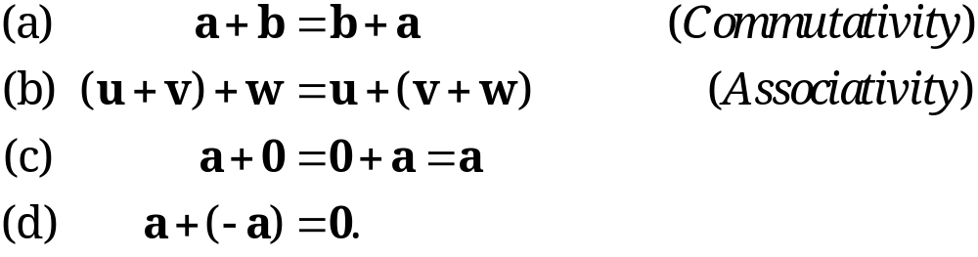
9.1 Vectors in 2-Space and 3-Space
Figure 172 (next slide) shows (for the plane) that the “algebraic” way and the “geometric way” of vector addition give the same vector.
Basic Properties of Vector Addition. Familiar laws for real numbers give immediately
(4)
Properties (a) and (b) are verified geometrically in Figs. 173 and 174 (next slide) . Furthermore, −a denotes the vector having the length |a| and the direction opposite to that of a.
Section 9.1 p<number>

Slide 16
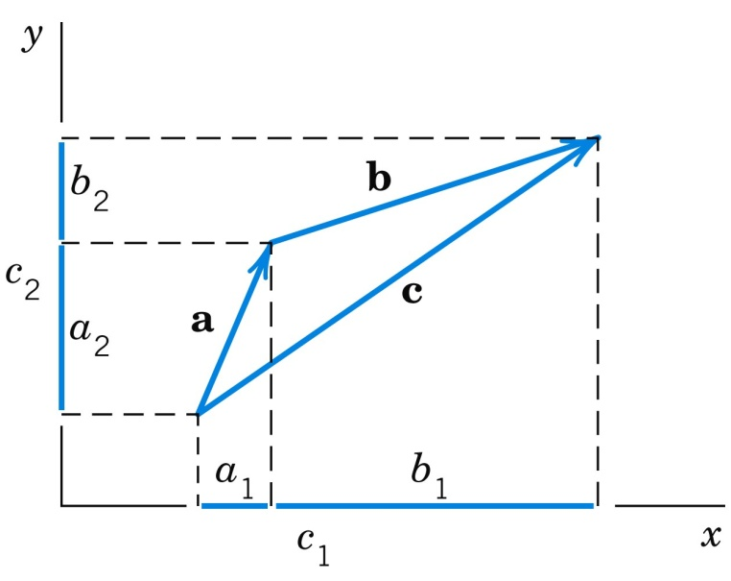
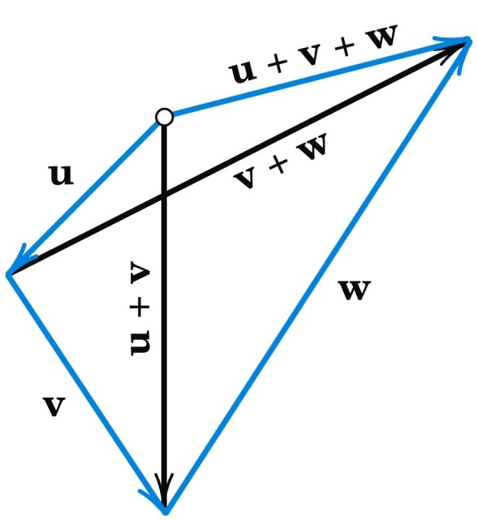
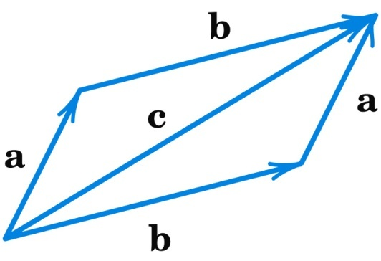
9.1 Vectors in 2-Space and 3-Space
Fig. 172. Vector addition Fig. 173. Cummutativity Fig. 174. Associativity
of vector addition of vector addition
Section 9.1 p<number>

Slide 17
9.1 Vectors in 2-Space and 3-Space
In (4b) we may simply write u + v + w, and similarly for sums of more than three vectors. Instead of a + a we also write 2a, and so on. This (and the notation −a used just before) motivates defining the second algebraic operation for vectors as follows.
Section 9.1 p<number>

Slide 18
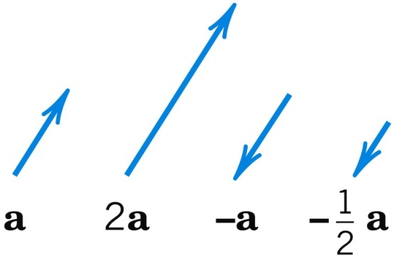
9.1 Vectors in 2-Space and 3-Space
Definition
Scalar Multiplication (Multiplication by a Number)
The product ca of any vector a = [a₁, a₂, a₃] and any scalar c (real number c) is the vector obtained by multiplying each component of a by c,
(5) ca = [ca₁, ca₂, ca₃]
Geometrically, if a ≠ 0, then ca with c > 0 has the direction of a and with c < 0 the direction opposite to a. In any case, the length of ca is |ca| = |c||a| and ca = 0 if
a = 0 or c = 0 (or both). (See Fig. 175.)
Fig. 175. Scalar multiplication [multiplication of vectors by scalars (numbers)]
Section 9.1 p<number>

Slide 19
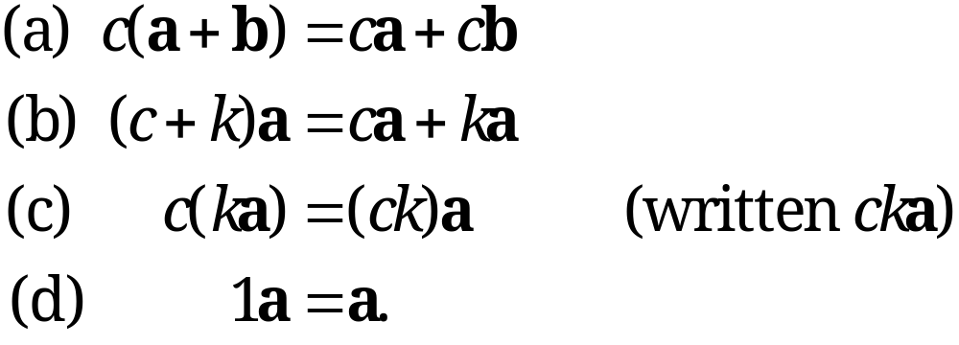
9.1 Vectors in 2-Space and 3-Space
Basic Properties of Scalar Multiplication. From the definitions we obtain directly
(6)
Section 9.1 p<number>

Slide 20
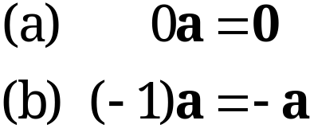
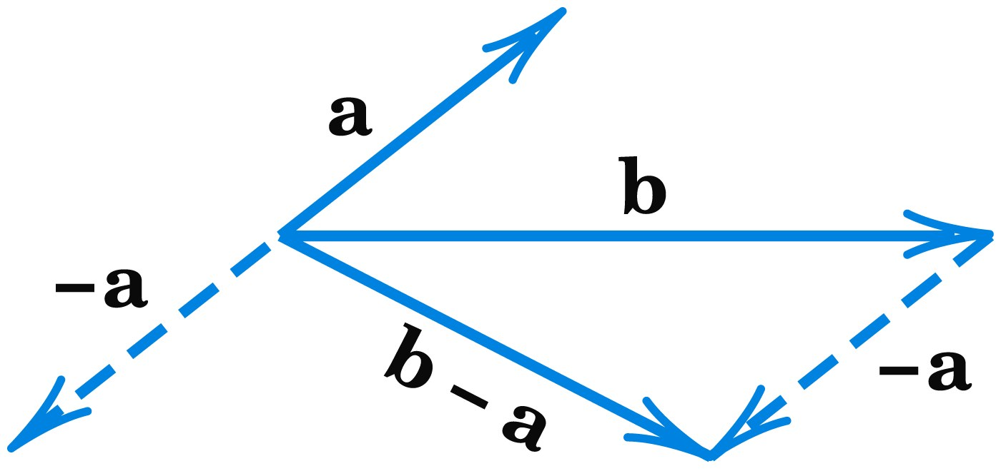
9.1 Vectors in 2-Space and 3-Space
You may prove that (4) and (6) imply for any vector a
(7)
Instead of b + (−a) we simply write b − a (Fig. 176).
Fig. 176. Difference of vectors
Section 9.1 p<number>

Slide 21
9.1 Vectors in 2-Space and 3-Space
Unit Vectors i, j, k. Besides a = [a₁, a₂, a₃] another popular way of writing vectors is
(8) a = a₁i + a₂j + a₃k.
In this representation, i, j, k are the unit vectors in the positive directions of the axes of a Cartesian coordinate system (Fig. 177). Hence, in components,
(9) i = [1, 0, 0], j = [0, 1, 0], k = [0, 0, 1]
and the right side of (8) is a sum of three vectors parallel to the three axes.
Section 9.1 p<number>

Slide 22
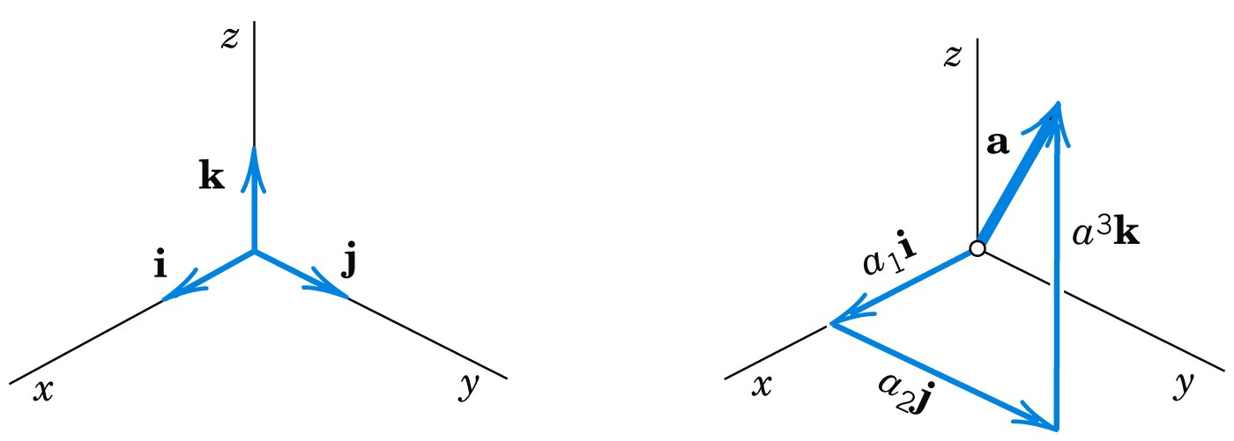
9.1 Vectors in 2-Space and 3-Space
Fig. 177. The unit vectors i, j, k and the representation (8)
All the vectors a = [a₁, a₂, a₃] = a₁i + a₂j + a₃k (with real numbers as components) form the real vector space R³ with the two algebraic operations of vector addition and scalar multiplication as just defined. R³ has dimension 3. The triple of vectors i, j, k is called a standard basis of R³. Given a Cartesian coordinate system, the representation (8) of a given vector is unique.
Section 9.1 p<number>

Slide 23
9.2 Inner Product (Dot Product)
Section 9.2 p<number>

Slide 24
9.2 Inner Product (Dot Product)
Orthogonality
The inner product or dot product can be motivated by calculating work done by a constant force, determining components of forces, or other applications. It involves the length of vectors and the angle between them. The inner product is a kind of multiplication of two vectors, defined in such a way that the outcome is a scalar. Indeed, another term for inner product is scalar product, a term we shall not use here. The definition of the inner product is as follows.
Section 9.2 p<number>

Slide 25
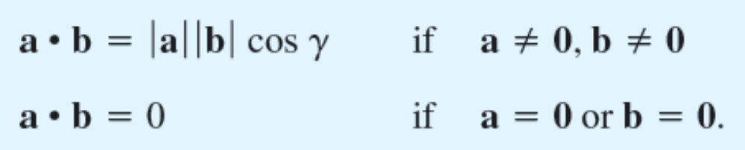
9.2 Inner Product (Dot Product)
Definition
Inner Product (Dot Product) of Vectors
The inner product or dot product a • b (read “a dot b”) of two vectors a and b is the product of their lengths times the cosine of their angle (see Fig. 178),
(1)
The angle γ, 0 ≤ γ ≤ π, between a and b is measured when the initial points of the vectors coincide, as in Fig. 178. In components, a = [a₁, a₂, a₃], b = [b₁, b₂, b₃], and
(2) a • b = a₁b₁ + a₂b₂ + a₃b₃.
Section 9.2 p<number>

Slide 26
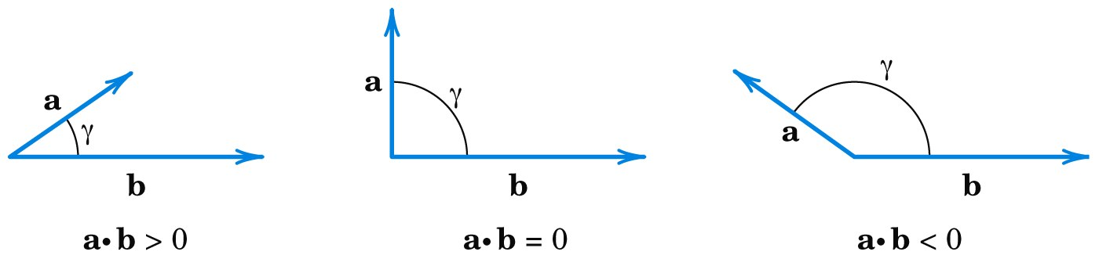
9.2 Inner Product (Dot Product)
The second line in (1) is needed because γ is undefined when a = 0 or b = 0.
Fig. 178. Angle between vectors and value of inner product
Section 9.2 p<number>

Slide 27
9.2 Inner Product (Dot Product)
Orthogonality.
Since the cosine in (1) may be positive, 0, or negative, so may be the inner product (Fig. 178, previous slide). The case that the inner product is zero is of particular practical interest and suggests the following concept.
A vector a is called orthogonal to a vector b if a • b = 0. Then b is also orthogonal to a, and we call a and b orthogonal vectors. Clearly, this happens for nonzero vectors if and only if cos γ = 0; thus γ = π/2 (90°). This proves the important following theorem.
Section 9.2 p<number>

Slide 28
9.2 Inner Product (Dot Product)
Theorem 1
Orthogonality Criterion
The inner product of two nonzero vectors is 0 if and only if these vectors are perpendicular.
Section 9.2 p<number>

Slide 29
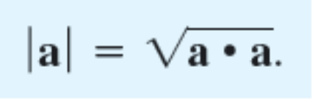
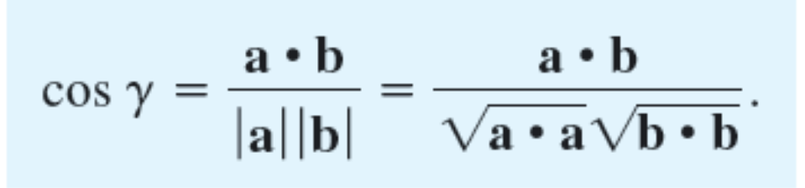
9.2 Inner Product (Dot Product)
Length and Angle.
Equation (1) with b = a gives a • b = |a|². Hence
(3)
From (3) and (1) we obtain for the angle between two nonzero vectors
(4)
Section 9.2 p<number>

Slide 30
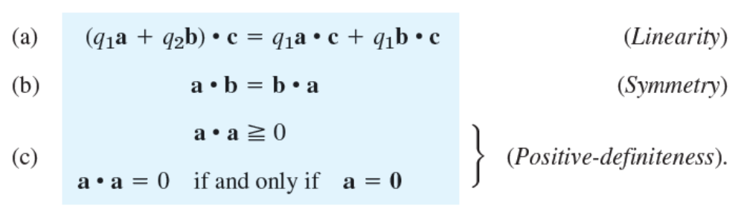
9.2 Inner Product (Dot Product)
From the definition we see that the inner product has the following properties. For any vectors a, b, c and scalars
q₁, q₂,
(5)
Section 9.2 p<number>

Slide 31
9.2 Inner Product (Dot Product)
Hence dot multiplication is commutative as shown by (5b). Furthermore, it is distributive with respect to vector addition. This follows from (5a) with q₁ = 1 and q₂ = 1:
(5a*) (a + b) • c = a • c + b • c (Distributivity).
Furthermore, from (1) and |cos γ| ≤ 1 we see that
(6) |a • b| ≤ |a||b| (Cauchy–Schwarz inequality).
Section 9.2 p<number>

Slide 32
9.2 Inner Product (Dot Product)
Using this and (3), you may prove (see Prob. 16)
(7) |a + b| ≤ |a| + |b| (Triangle inequality).
Geometrically, (7) with < says that one side of a triangle must be shorter than the other two sides together; this motivates the name of (7).
A simple direct calculation with inner products shows that
(8) |a + b|² + |a − b|² = 2(|a|² + |b|²) (Parallelogram equality).
Section 9.2 p<number>

Slide 33
9.2 Inner Product (Dot Product)
Applications of Inner Products
EXAMPLE 2
Work Done by a Force Expressed as an Inner Product
This is a major application. It concerns a body on which a constant force p acts. (For a variable force, see Sec. 10.1.) Let the body be given a displacement d. Then the work done by p in the displacement is defined as
(9) W = |p||d| cos α = p • d,
that is, magnitude |p|of the force times length |d| of the displacement times the cosine of the angle α between p and d (Fig. 179).
Section 9.2 p<number>

Slide 34
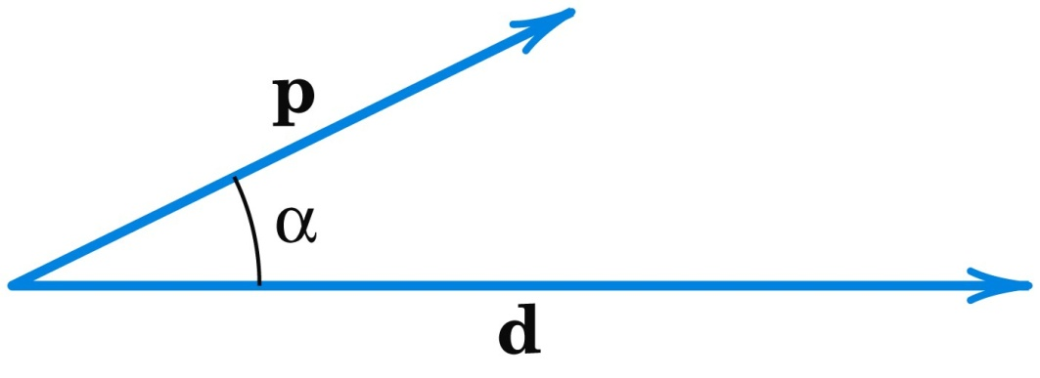
9.2 Inner Product (Dot Product)
EXAMPLE 2 (continued)
Work Done by a Force Expressed as an Inner Product
(continued) If α < 90°, as in Fig. 179, then W > 0. If p and d are orthogonal, then the work is zero (why?). If α > 90°, then W < 0, which means that in the displacement one has to do work against the force. For example, think of swimming across a river at some angle α against the current.
Fig. 179. Work done by a force
Section 9.2 p<number>

Slide 35
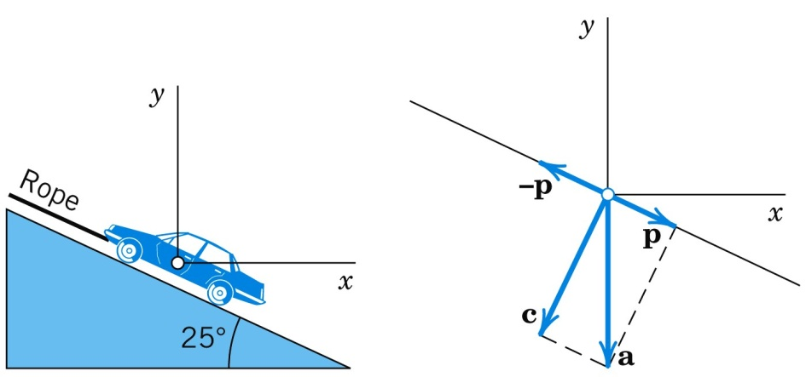
9.2 Inner Product (Dot Product)
EXAMPLE 3
Component of a Force in a Given Direction
What force in the rope in Fig. 180 will hold a car of 5000 lb in equilibrium if the ramp makes an angle of 25° with the horizontal?
Fig. 180. Example 3
Solution. Introducing coordinates as shown, the weight is a = [0, −5000] because this force points downward, in the negative y-direction.
Section 9.2 p<number>

Slide 36
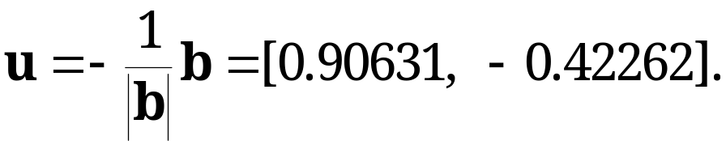
9.2 Inner Product (Dot Product)
EXAMPLE 3 (continued)
Component of a Force in a Given Direction
Solution. (continued 1)
We have to represent a as a sum (resultant) of two forces, a = c + p, where c is the force the car exerts on the ramp, which is of no interest to us, and p is parallel to the rope. A vector in the direction of the rope is (see Fig. 180)
b = [−1, tan 25°] = [−1, 0.46631], thus |b| = 1.10338,
The direction of the unit vector u is opposite to the direction of the rope so that
Section 9.2 p<number>

Slide 37
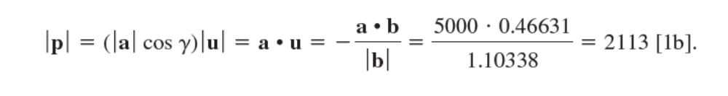
9.2 Inner Product (Dot Product)
EXAMPLE 3 (continued)
Component of a Force in a Given Direction
Solution. (continued 2)
Since |u| = 1 and cos γ > 0, we see that we can write our result as
We can also note that γ = 90° − 25° = 65° is the angle between a and p so that
Answer: About 2100 lb.
Section 9.2 p<number>

Slide 38
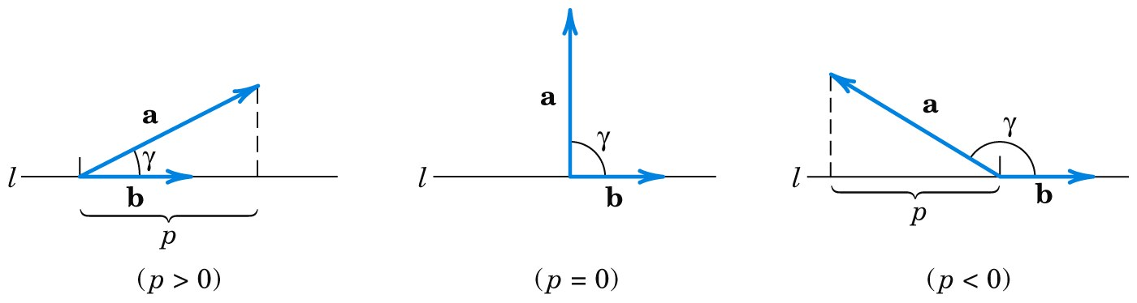
9.2 Inner Product (Dot Product)
Example 3 is typical of applications that deal with the component or projection of a vector a in the direction of a vector b(≠ 0). If we denote by p the length of the orthogonal projection of a on a straight line l parallel to b as shown in Fig. 181, then
(10) p = |a|cos γ.
Here p is taken with the plus sign if pb has the direction of b and with the minus sign if pb has the direction opposite to b.
Fig. 181. Component of a vector a in the direction of a vector b
Section 9.2 p<number>

Slide 39
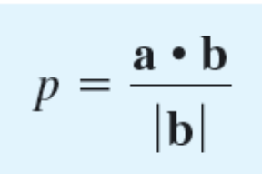
9.2 Inner Product (Dot Product)
Multiplying (10) by |b|/|b| = 1, we have a • b in the numerator and thus
(11) (b ≠ 0).
If b is a unit vector, as it is often used for fixing a direction, then (11) simply gives
(12) p = a • b (|b| = 1).
Section 9.2 p<number>

Slide 40
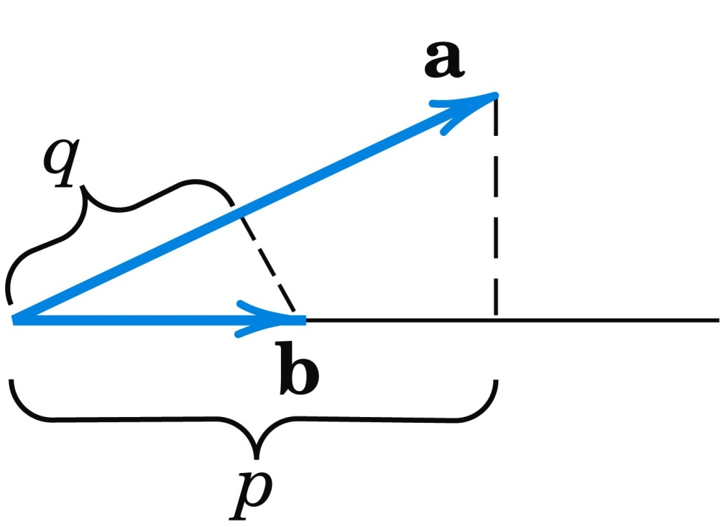
9.2 Inner Product (Dot Product)
Figure 182 shows the projection p of a in the direction of b (as in Fig. 181) and the projection q = |b|cos γ of b in the direction of a.
Fig. 182. Projections p of a on b and q of b on a
Section 9.2 p<number>

Slide 41
9.2 Inner Product (Dot Product)
EXAMPLE 4 Orthonormal Basis
By definition, an orthonormal basis for 3-space is a basis
{a, b, c} consisting of orthogonal unit vectors. It has the great advantage that the determination of the coefficients in representations v = l₁a + l₂b + l₃c of a given vector v is very simple. We claim that l₁ = a • v, l₂ = b • v, l₃ = c • v. Indeed, this follows simply by taking the inner products of the representation with a, b, c, respectively, and using the orthonormality of the basis,
a • v = l₁a • a + l₂a • b + l₃a • c = l₁, etc.
For example, the unit vectors i, j, k in (8), Sec. 9.1, associated with a Cartesian coordinate system form an orthonormal basis, called the standard basis with respect to the given coordinate system.
Section 9.2 p<number>

Slide 42
9.3 Vector Product
(Cross Product)
Section 9.3 p<number>

Slide 43
9.3 Vector Product (Cross Product)
Definition
Vector Product (Cross Product, Outer Product)
of Vectors
The vector product or cross product a × b (read “a cross b”) of two vectors a and b is the vector v denoted by
v = a × b
I. If a = 0 or b = 0, then we define v = a × b = 0.
II. If both vectors are nonzero vectors, then vector v has the length
(1) |v| = |a × b| = |a||b|sin γ,
where γ is the angle between a and b as in Sec. 9.2.
Section 9.3 p<number>

Slide 44
9.3 Vector Product (Cross Product)
Definition (continued)
Vector Product (Cross Product, Outer Product)
of Vectors (continued 1)
Furthermore, by design, a and b form the sides of a parallelogram on a plane in space. The parallelogram is shaded in blue in Fig. 185. The area of this blue parallelogram is precisely given by Eq. (1), so that the length |v| of the vector v is equal to the area of that parallelogram.
III. If a and b lie in the same straight line, i.e., a and b have the same or opposite directions, then γ is 0° or 180° so that sin γ = 0. In that case |v| = 0 so that v = a × b = 0.
Section 9.3 p<number>

Slide 45
9.3 Vector Product (Cross Product)
Definition (continued)
Vector Product (Cross Product, Outer Product)
of Vectors (continued 2)
IV. If cases I and III do not occur, then v is a nonzero vector. The direction of v = a × b is perpendicular to both a and b such that a, b, v—precisely in this order (!)—form a right-handed triple as shown in Figs. 185–187 and explained below.
Another term for vector product is outer product.
Section 9.3 p<number>

Slide 46
9.3 Vector Product (Cross Product)
Remark. Note that I and III completely characterize the exceptional case when the cross product is equal to the zero vector, and II and IV the regular case where the cross product is perpendicular to two vectors.
Just as we did with the dot product, we would also like to express the cross product in components. Let a = [a₁, a₂, a₃] and b = [b₁, b₂, b₃]. Then v = [v₁, v₂, v₃] = a × b has the components
(2) v₁ = a₂b₃ − a₃b₂, v₂ = a₃b₁ − a₁b₃, v₃ = a₁b₂ − a₂b₁.
Here the Cartesian coordinate system is right-handed, as explained below (see also Fig. 188). (For a left-handed system, each component of v must be multiplied by −1. Derivation of (2) in App. 4.)
Section 9.3 p<number>

Slide 47
9.3 Vector Product (Cross Product)
Right-Handed Triple.
A triple of vectors a, b, v is right-handed if the vectors in the given order assume the same sort of orientation as the thumb, index finger, and middle finger of the right hand when these are held as in Fig. 186. We may also say that if a is rotated into the direction of b through the angle γ(< π), then v advances in the same direction as a right-handed screw would if turned in the same way (Fig. 187).
Section 9.3 p<number>

Slide 48
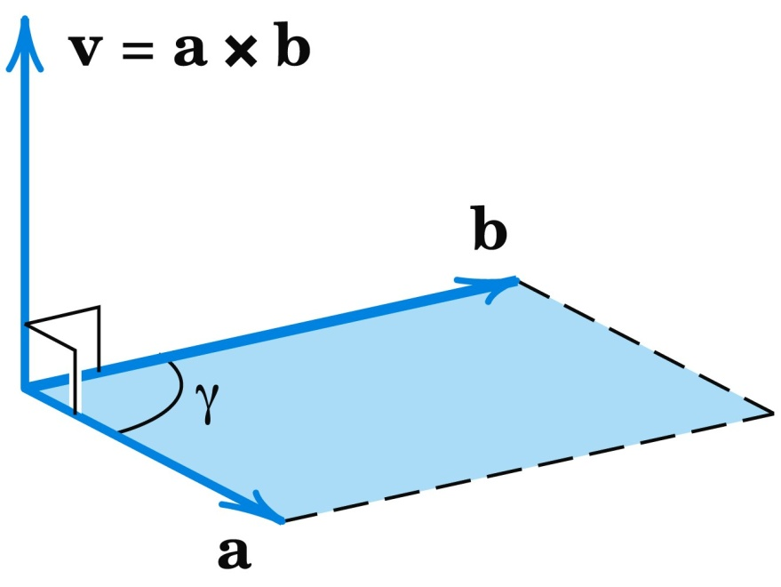
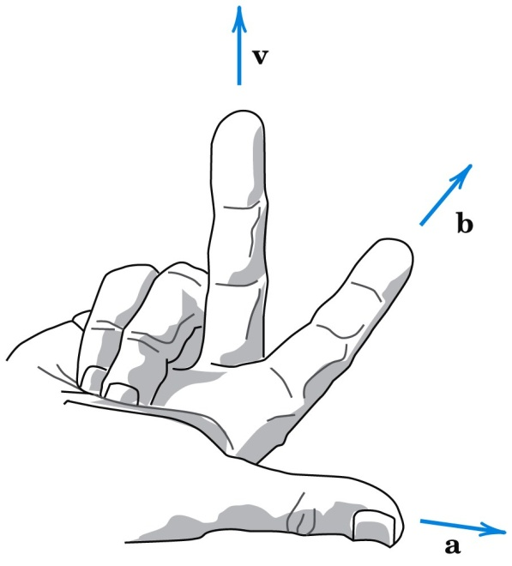
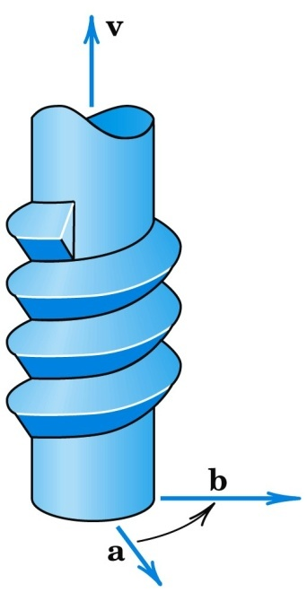
9.3 Vector Product (Cross Product)
Right-Handed Triple. (continued)
Fig. 185. Vector product Fig. 186. Right-handed Fig. 187. Right-handed
triple of vectors a, b, v screw
Section 9.3 p<number>

Slide 49
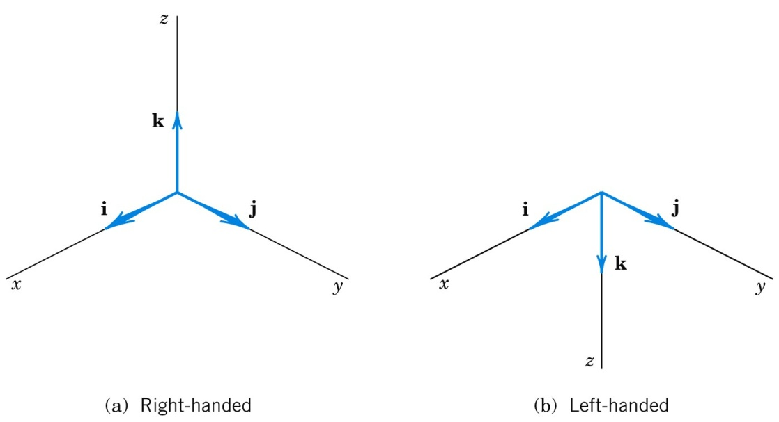
9.3 Vector Product (Cross Product)
Right-Handed Cartesian Coordinate System.
The system is called right-handed if the corresponding unit vectors i, j, k in the positive directions of the axes (see Sec. 9.1) form a right-handed triple as in Fig. 188a. The system is called left-handed if the sense of k is reversed, as in Fig. 188b. In applications, we prefer right-handed systems.
Fig. 188. The two types of Cartesian coordinate systems
Section 9.3 p<number>

Slide 50
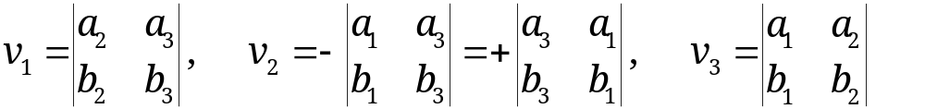
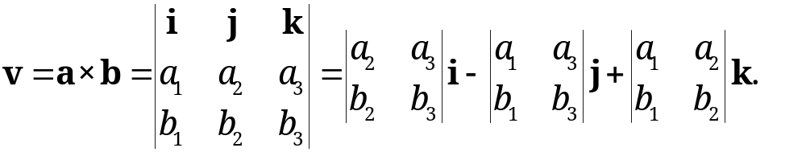
9.3 Vector Product (Cross Product)
How to Memorize (2).
If you know second- and third-order determinants, you see that (2) can be written
(2*)
and v = [v₁, v₂, v₃] = v₁i + v₂ j + v₃k is the expansion of the following symbolic determinant by its first row. (We call the determinant “symbolic” because the first row consists of vectors rather than of numbers.)
(2**)
For a left-handed system the determinant has a minus sign in front.
Section 9.3 p<number>

Slide 51
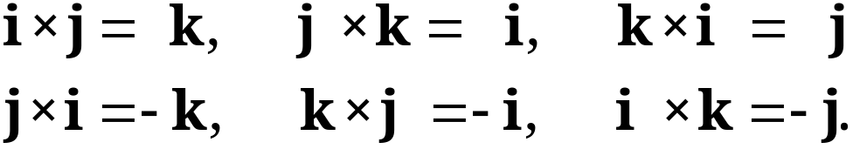
9.3 Vector Product (Cross Product)
EXAMPLE 2
Vector Products of the Standard Basis Vectors
(3)
Section 9.3 p<number>

Slide 52
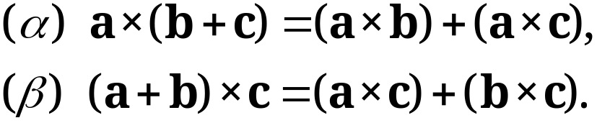
9.3 Vector Product (Cross Product)
Theorem 1
General Properties of Vector Products
(a) For every scalar l,
(4) (la) × b = l(a × b) = a × (lb).
(b) Cross multiplication is distributive with respect to vector addition; that is,
(5)
(c) Cross multiplication is not commutative but anticommutative; that is,
(6) b × a = −(a × b) (Fig. 189).
Section 9.3 p<number>

Slide 53
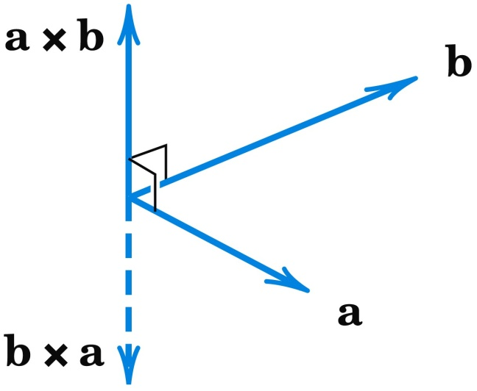
9.3 Vector Product (Cross Product)
Theorem 1 (continued)
General Properties of Vector Products (continued)
(d) Cross multiplication is not associative; that is, in general,
(7) a × (b × c) ≠ (a × b) × c
so that the parentheses cannot be omitted.
Fig. 189. Anticommutativity of cross multiplication
Section 9.3 p<number>

Slide 54
9.3 Vector Product (Cross Product)
EXAMPLE 3 Moment of a Force
In mechanics the moment m of a force p about a point Q is defined as the product m = |p|d, where d is the (perpendicular) distance between Q and the line of action L of p (Fig. 190). If r is the vector from Q to any point A on L, then d = |r| sin γ, as shown in Fig. 190, and
m = |r||p| sin γ.
Since γ is the angle between r and p, we see from (1) that m = |r × p|.
Section 9.3 p<number>

Slide 55
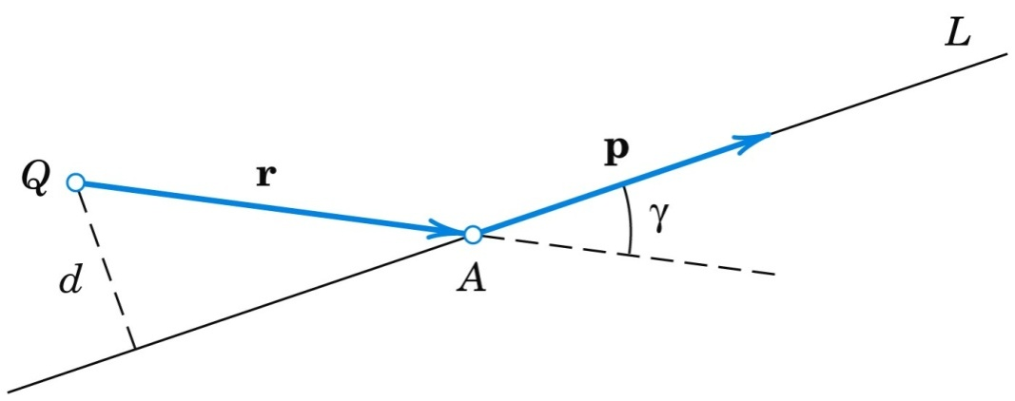
9.3 Vector Product (Cross Product)
EXAMPLE 3 (continued) Moment of a Force
The vector
(8) m = r × p
is called the moment vector or vector moment of p about Q. Its magnitude is m. If m ≠ 0, its direction is that of the axis of the rotation about Q that p has the tendency to produce. This axis is perpendicular to both r and p.
Fig. 190. Moment of a force p
Section 9.3 p<number>

Slide 56
9.3 Vector Product (Cross Product)
EXAMPLE 5 Velocity of a Rotating Body
A rotation of a rigid body B in space can be simply and uniquely described by a vector w as follows. The direction of w is that of the axis of rotation and such that the rotation appears clockwise if one looks from the initial point of w to its terminal point. The length of w is equal to the angular speed ω(>0) of the rotation, that is, the linear (or tangential) speed of a point of B divided by its distance from the axis of rotation.
Let P be any point of B and d its distance from the axis. Then P has the speed ωd. Let r be the position vector of P referred to a coordinate system with origin 0 on the axis of rotation.
Section 9.3 p<number>

Slide 57
9.3 Vector Product (Cross Product)
EXAMPLE 5 (continued)
Velocity of a Rotating Body
(continued 1)
Then d = |r| sin γ, where γ is the angle between w and r. Therefore,
ωd = |w||r| sin γ = |w × r|.
From this and the definition of vector product we see that the velocity vector v of P can be represented in the form (Fig. 192)
(9) v = w × r.
This simple formula is useful for determining v at any point of B.
Section 9.3 p<number>

Slide 58
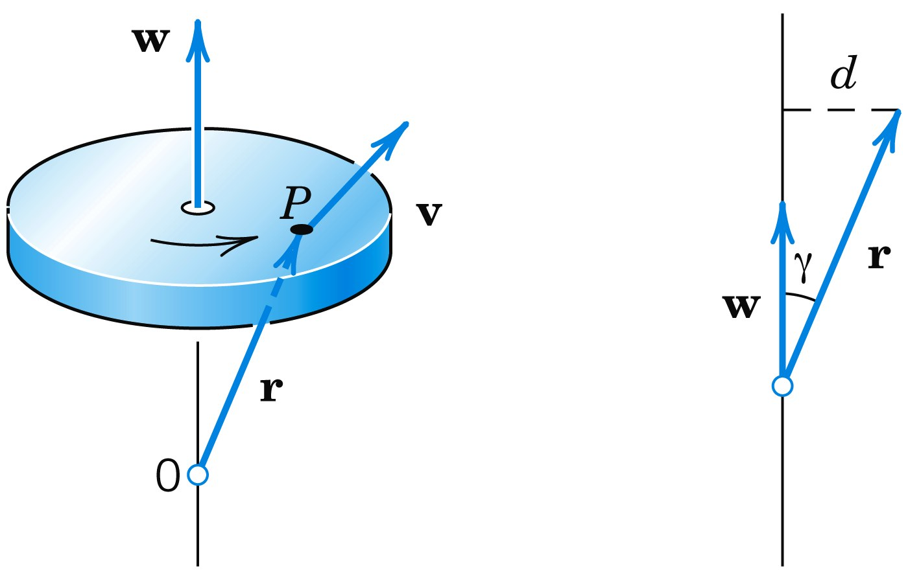
9.3 Vector Product (Cross Product)
EXAMPLE 5 (continued)
Velocity of a Rotating Body
(continued 2)
Fig. 192. Rotation of a rigid body
Section 9.3 p<number>

Slide 59
9.3 Vector Product (Cross Product)
Scalar Triple Product
Certain products of vectors, having three or more factors, occur in applications. The most important of these products is the scalar triple product or mixed product of three vectors a, b, c.
(10*) (a b c) = a • (b × c).
The scalar triple product is indeed a scalar since (10*) involves a dot product, which in turn is a scalar. We want to express the scalar triple product in components and as a third order determinant. To this end, let a = [a₁, a₂, a₃],
b = [b₁, b₂, b₃], and c = [c₁, c₂, c₃].
Section 9.3 p<number>

Slide 60
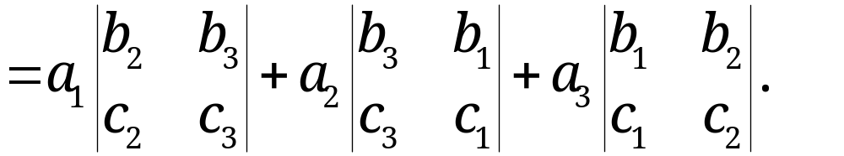
9.3 Vector Product (Cross Product)
Scalar Triple Product (continued 1)
Also set (b × c) = v = [v₁, v₂, v₃]. Then from the dot product in components [formula (2) in Sec. 9.2] and from (2*) with b and c instead of a and b we first obtain
a • (b × c) = a • v = a₁v₁ + a₂v₂ + a₃v₃
Section 9.3 p<number>

Slide 61
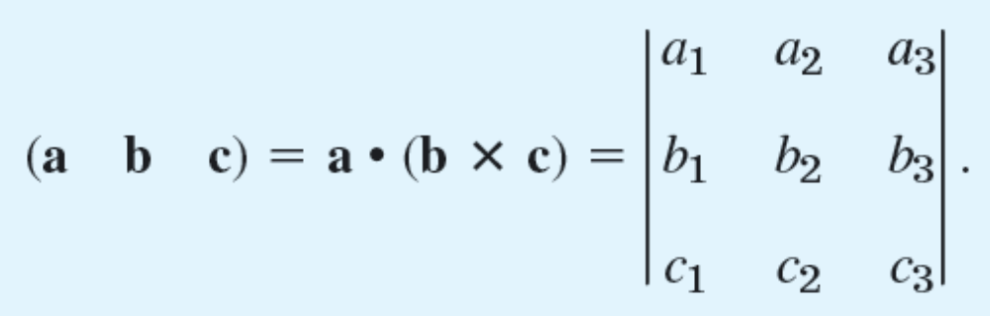
9.3 Vector Product (Cross Product)
Scalar Triple Product (continued 2)
The sum on the right is the expansion of a third-order determinant by its first row. Thus we obtain the desired formula for the scalar triple product, that is,
(10)
The most important properties of the scalar triple product are as follows.
Section 9.3 p<number>

Slide 62
9.3 Vector Product (Cross Product)
Theorem 2
Properties and Applications of Scalar Triple Products
(a) In (10) the dot and cross can be interchanged:
(11) (a b c) = a • (b × c) = (a × b) • c.
(b) Geometric interpretation. The absolute value |(a b c)| of (10) is the volume of the parallelepiped (oblique box) with a, b, c as edge vectors (Fig. 193).
(c) Linear independence. Three vectors in R³ are linearly independent if and only if their scalar triple product is not zero.
Section 9.3 p<number>

Slide 63
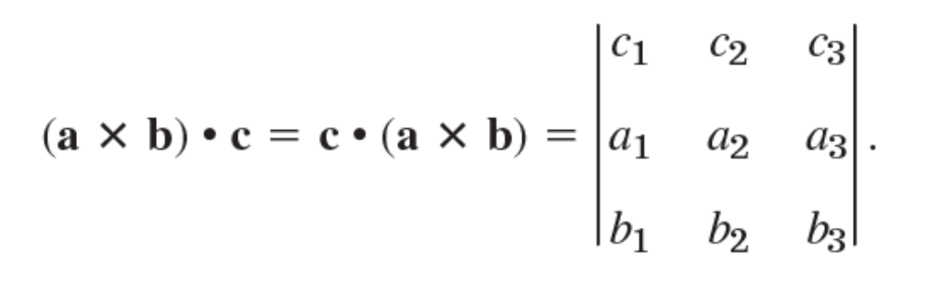
9.3 Vector Product (Cross Product)
PROOF
(a) Dot multiplication is commutative, so that by (10)
From this we obtain the determinant in (10) by interchanging Rows 1 and 2 and in the result Rows 2 and 3. But this does not change the value of the determinant because each interchange produces a factor −1, and (−1)(−1) = 1. This proves (11).
Section 9.3 p<number>

Slide 64
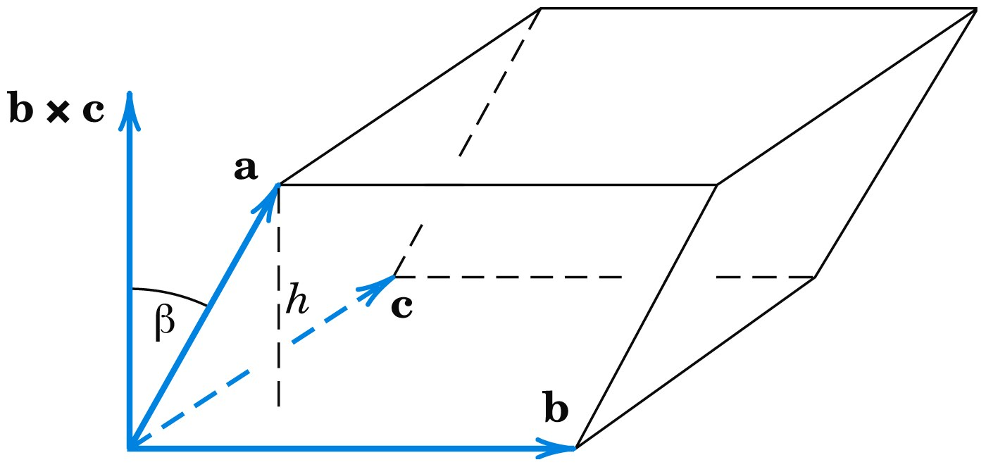
9.3 Vector Product (Cross Product)
(b) The volume of that box equals the height h = |a||cos γ|
(Fig. 193) times the area of the base, which is the area |b × c| of the parallelogram with sides b and c. Hence the volume is
|a||b × c||cos γ| = |a • (b × c)| (Fig. 193)
as given by the absolute value of (11).
Fig. 193. Geometric interpretation of a scalar triple product
Section 9.3 p<number>

Slide 65
9.3 Vector Product (Cross Product)
(c) Three nonzero vectors, whose initial points coincide, are linearly independent if and only if the vectors do not lie in the same plane nor lie on the same straight line.
This happens if and only if the triple product in (b) is not zero, so that the independence criterion follows. (The case of one of the vectors being the zero vector is trivial.)
Section 9.3 p<number>

Slide 66
9.4 Vector and Scalar Functions and Their Fields.
Vector Calculus: Derivatives
Section 9.4 p<number>

Slide 67
9.4 Vector and Scalar Functions and Their Fields.
Vector Calculus: Derivatives
Our discussion of vector calculus begins with identifying the two types of functions on which it operates. Let P be any point in a domain of definition. Typical domains in applications are three-dimensional, or a surface or a curve in space. Then we define a vector function v, whose values are vectors, that is,
v = v(P) = [v₁(P), v₂(P), v₃(P)]
that depends on points P in space. We say that a vector function defines a vector field in a domain of definition. Typical domains were just mentioned.
Section 9.4 p<number>

Slide 68
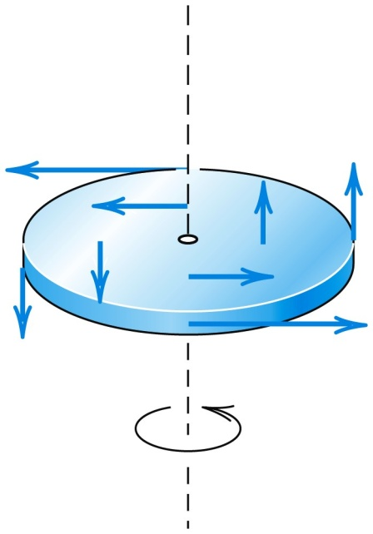
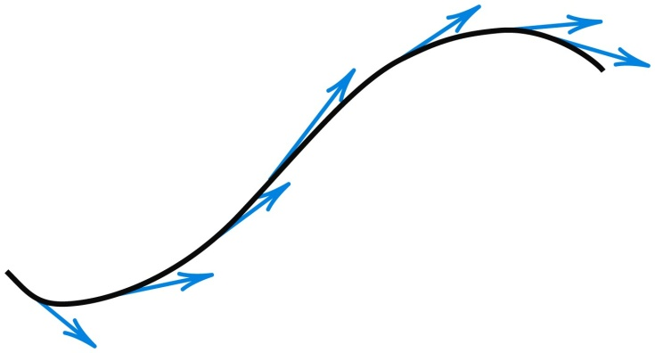
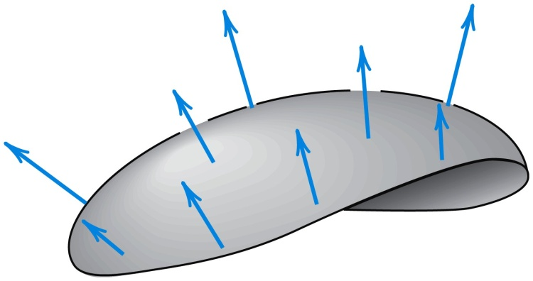
9.4 Vector and Scalar Functions and Their Fields.
Vector Calculus: Derivatives
Examples of vector fields are the field of tangent vectors of a curve (shown in Fig. 195), normal vectors of a surface (Fig. 196), and velocity field of a rotating body (Fig. 197). Note that vector functions may also depend on time t or on some other parameters.
Fig. 195. Field of tangent Fig. 196. Field of normal Fig. 197. Velocity field
vectors of a curve vectors of a surface of a rotating body
Section 9.4 p<number>

Slide 69
9.4 Vector and Scalar Functions and Their Fields.
Vector Calculus: Derivatives
Similarly, we define a scalar function f, whose values are scalars, that is,
f = f(P)
that depends on P. We say that a scalar function defines a scalar field in that three-dimensional domain or surface or curve in space. Two representative examples of scalar fields are the temperature field of a body and the pressure field of the air in Earth’s atmosphere. Note that scalar functions may also depend on some parameter such as time t.
Section 9.4 p<number>

Slide 70
9.4 Vector and Scalar Functions and Their Fields.
Vector Calculus: Derivatives
EXAMPLE 1
Scalar Function (Euclidean Distance in Space)
The distance f(P) of any point P from a fixed point P₀ in space is a scalar function whose domain of definition is the whole space. f(P) defines a scalar field in space. If we introduce a Cartesian coordinate system and P₀ has the coordinates x₀, y₀, z₀, then f is given by the well-known formula
where x, y, z are the coordinates of P.
Section 9.4 p<number>

Slide 71
9.4 Vector and Scalar Functions and Their Fields.
Vector Calculus: Derivatives
EXAMPLE 1 (continued)
Scalar Function (Euclidean Distance in Space)
If we replace the given Cartesian coordinate system with another such system by translating and rotating the given system, then the values of the coordinates of P and P₀ will in general change, but f(P) will have the same value as before. Hence f(P) is a scalar function. The direction cosines of the straight line through P and P₀ are not scalars because their values depend on the choice of the coordinate system.
Section 9.4 p<number>

Slide 72
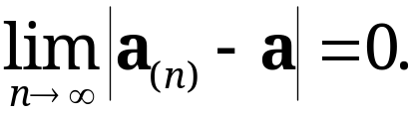
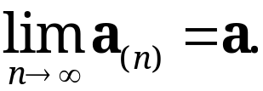
9.4 Vector and Scalar Functions and Their Fields.
Vector Calculus: Derivatives
Vector Calculus
Convergence.
An infinite sequence of vectors a_{(n)}, n = 1, 2, … , is said to converge if there is a vector a such that
(4)
a is called the limit vector of that sequence, and we write
(5)
Section 9.4 p<number>

Slide 73

9.4 Vector and Scalar Functions and Their Fields.
Vector Calculus: Derivatives
Vector Calculus
Convergence. (continued 1)
If the vectors are given in Cartesian coordinates, then this sequence of vectors converges to a if and only if the three sequences of components of the vectors converge to the
corresponding components of a.
Similarly, a vector function v(t) of a real variable t is said to have the limit l as t approaches t₀, if v(t) is defined in some neighborhood of t₀ (possibly except at t₀) and
(6)
Section 9.4 p<number>

Slide 74

9.4 Vector and Scalar Functions and Their Fields.
Vector Calculus: Derivatives
Vector Calculus
Convergence. (continued 2)
Then we write
(7)
Here, a neighborhood of t₀ is an interval (segment) on the
t-axis containing t₀ as an interior point (not as an endpoint).
Section 9.4 p<number>

Slide 75

9.4 Vector and Scalar Functions and Their Fields.
Vector Calculus: Derivatives
Continuity. A vector function v(t) is said to be continuous at t = t₀ if it is defined in some neighborhood of t₀ (including at t₀ itself!) and
(8)
If we introduce a Cartesian coordinate system, we may write
Then v(t) is continuous at t₀ if and only if its three components are continuous at t₀.
Section 9.4 p<number>

Slide 76


9.4 Vector and Scalar Functions and Their Fields.
Vector Calculus: Derivatives
Definition
Derivative of a Vector Function
A vector function v(t) is said to be differentiable at a point t if the following limit exists:
(9)
This vector v’(t) is called the derivative of v(t). See Fig. 199.
Fig. 199. Derivative of a vector function
Section 9.4 p<number>

Slide 77

9.4 Vector and Scalar Functions and Their Fields.
Vector Calculus: Derivatives
In components with respect to a given Cartesian coordinate system,
(10)
Hence the derivative v’(t) is obtained by differentiating each component separately.
For instance, if v = [t, t², 0], then v’ = [1, 2t, 0].
Section 9.4 p<number>

Slide 78

9.4 Vector and Scalar Functions and Their Fields.
Vector Calculus: Derivatives
Equation (10) follows from (9) and conversely because (9) is a “vector form” of the usual formula of calculus by which the derivative of a function of a single variable is defined. [The curve in Fig. 199 is the locus of the terminal points representing v(t) for values of the independent variable in some interval containing t and t + Δt in (9)]. It follows that the familiar differentiation rules continue to hold for differentiating vector functions, for instance
(c constant),
Section 9.4 p<number>

Slide 79


9.4 Vector and Scalar Functions and Their Fields.
Vector Calculus: Derivatives
Section 9.4 p<number>

Slide 80



9.4 Vector and Scalar Functions and Their Fields.
Vector Calculus: Derivatives
Partial Derivatives of a Vector Function
Suppose that the components of a vector function
are differentiable functions of n variables t₁, … , t_{n}. Then the partial derivative of v with respect to t_{m} is denoted by ∂v/∂t_{m} and is defined as the vector function
Similarly, second partial derivatives are and so on.
Section 9.4 p<number>

Slide 81
9.5 Curves. Arc Length. Curvature. Torsion
Section 9.5 p<number>

Slide 82
9.5 Curves. Arc Length. Curvature. Torsion
The application of vector calculus to geometry is a field known as differential geometry.
Bodies that move in space form paths that may be represented by curves C. This and other applications show the need for parametric representations of C with parameter t, which may denote time or something else (see Fig. 200).
Section 9.5 p<number>

Slide 83

9.5 Curves. Arc Length. Curvature. Torsion
A typical parametric representation is given by
(1) r(t) = [x(t), y(t), z(t)] = x(t)i + y(t)j + z(t)k.
Fig. 200. Parametric representation of a curve
Here t is the parameter and x, y, z are Cartesian
coordinates, that is, the usual rectangular coordinates as shown in Sec. 9.1.
Section 9.5 p<number>

Slide 84


9.5 Curves. Arc Length. Curvature. Torsion
To each value t = t₀, there corresponds a point of C with position vector r(t₀) whose coordinates are x(t₀), y(t₀), z(t₀). This is illustrated in Figs. 201 and 202.
Fig. 201. Circle in Example 1 Fig. 202. Ellipse in Example 2
Section 9.5 p<number>

Slide 85
9.5 Curves. Arc Length. Curvature. Torsion
The use of parametric representations has key advantages over other representations that involve projections into the xy-plane and xz-plane or involve a pair of equations with y or with z as independent variable. The projections look like this:
(2) y = f(x), z = g(x).
The advantages of using (1) instead of (2) are that, in (1), the coordinates x, y, z all play an equal role, that is, all three coordinates are dependent variables. Moreover, the parametric representation (1) induces an orientation on C. This means that as we increase t, we travel along the curve C in a certain direction. The sense of increasing t is called the positive sense on C. The sense of decreasing t is then called the negative sense on C, given by (1).
Section 9.5 p<number>

Slide 86

9.5 Curves. Arc Length. Curvature. Torsion
EXAMPLE 3 Straight Line
A straight line L through a point A with position vector a in the direction of a constant vector b (see Fig. 203)
can be represented parametrically in the form
(4) r(t) = a + tb = [a₁ + tb₁, a₂ + tb₂, a₃ + tb₃].
Fig. 203. Parametric representation of a straight line
Section 9.5 p<number>

Slide 87

9.5 Curves. Arc Length. Curvature. Torsion
A plane curve is a curve that lies in a plane in space. A curve that is not plane is called a twisted curve.
A simple curve is a curve without multiple points, that is, without points at which the curve intersects or touches itself. Circle and helix are simple curves. Figure 206 shows curves that are not simple.
An arc of a curve is the portion between any two points of the curve. For simplicity, we say “curve” for curves as well as for arcs.
Fig. 206. Curves with multiple points
Section 9.5 p<number>

Slide 88

9.5 Curves. Arc Length. Curvature. Torsion
Tangent to a Curve
The next idea is the approximation of a curve by straight lines, leading to tangents and to a definition of length. Tangents are straight lines touching a curve. The tangent to a simple curve C at a point P of C is the limiting position of a straight line L through P and a point Q of C as Q approaches P along C. See Fig. 207.
Let us formalize this concept. If C is given by r(t), and P and Q correspond to t and t + Δt, then a vector in the direction of L is
(6)
Section 9.5 p<number>

Slide 89


9.5 Curves. Arc Length. Curvature. Torsion
Tangent to a Curve (continued)
In the limit this vector becomes the derivative
(7)
provided r(t) is differentiable, as we shall assume from now on. If r′(t) ≠ 0 we call r′(t) a tangent vector of C at P because it has the direction of the tangent. The corresponding unit vector is the unit tangent vector (see Fig. 207)
(8)
Note that both r′ and u point in the direction of increasing t. Hence their sense depends on the orientation of C. It is reversed if we reverse the orientation.
Section 9.5 p<number>

Slide 90


9.5 Curves. Arc Length. Curvature. Torsion
Tangent to a Curve (continued)
It is now easy to see that the tangent to C at P is given by
(9) q(w) = r + wr' (Fig. 208).
This is the sum of the position vector r of P and a multiple of the tangent vector r′ of C at P. Both vectors depend on P. The variable w is the parameter in (9).
Fig. 207. Tangent to a curve Fig. 208. Formula (9) for the tangent to a curve
Section 9.5 p<number>

Slide 91

9.5 Curves. Arc Length. Curvature. Torsion
Length of a Curve
If r(t) has a continuous derivative r′, it can be shown that the sequence l₁, l₂, … has a limit, which is independent of the particular choice of the representation of C and of the choice of subdivisions. This limit is given by the integral
(10)
l is called the length of C, and C is called rectifiable.
Section 9.5 p<number>

Slide 92


9.5 Curves. Arc Length. Curvature. Torsion
Arc Length s of a Curve
The length (10) of a curve C is a constant, a positive number. But if we replace the fixed b in (10) with a variable t, the integral becomes a function of t, denoted by s(t) and called the arc length function or simply the arc length of C. Thus
(11)
Here the variable of integration is denoted by
because t is now used in the upper limit.
Section 9.5 p<number>

Slide 93
9.5 Curves. Arc Length. Curvature. Torsion
Arc Length s of a Curve
Linear Element ds.
It is customary to write
(13*) dr = [dx, dy, dz] = dx i + dy j + dz k
and
(13) ds² = dr • dr = dx² + dy² + dz².
ds is called the linear element of C.
Section 9.5 p<number>

Slide 94
9.5 Curves. Arc Length. Curvature. Torsion
Arc Length s of a Curve (continued)
Arc Length as Parameter.
The use of s in (1) instead of an arbitrary t simplifies various formulas. For the unit tangent vector (8) we simply obtain
(14) u(s) = r′(s).
Indeed, |r′(s)| = (ds/ds) = 1 in (12) shows that r′(s) is a unit vector.
Section 9.5 p<number>

Slide 95

9.5 Curves. Arc Length. Curvature. Torsion
Curves in Mechanics. Velocity. Acceleration
Curves play a basic role in mechanics, where they may serve as paths of moving bodies. Then such a curve C should be represented by a parametric representation r(t) with time t as parameter. The tangent vector (7) of C is then called the velocity vector v because, being tangent, it points in the instantaneous direction of motion and its length gives the speed
see (12). The second derivative of r(t) is called the acceleration vector and is denoted by a. Its length |a| is called the acceleration of the motion. Thus
(16) v(t) = r′(t), a(t) = v′(t) = r"(t).
Section 9.5 p<number>

Slide 96
9.5 Curves. Arc Length. Curvature. Torsion
Tangential and Normal Acceleration.
Whereas the velocity vector is always tangent to the path of motion, the acceleration vector will generally have another direction. We can split the acceleration vector into two directional components, that is,
(17) a = a_{tan} + a_{norm},
where the tangential acceleration vector a_{tan} is tangent to the path (or, sometimes, 0) and the normal acceleration vector a_{norm} is normal (perpendicular) to the path (or, sometimes, 0).
Section 9.5 p<number>

Slide 97

9.5 Curves. Arc Length. Curvature. Torsion
Now the length |a_{tan}| is the absolute value of the projection of a in the direction of v, given by (11) in Sec. 9.2 with b = v; that is, |a_{tan}| = |a · v|/ |v|. Hence a_{tan} is this expression times the unit vector (1/|v|)v in the direction of v, that is,
(18*)
Section 9.5 p<number>

Slide 98
9.5 Curves. Arc Length. Curvature. Torsion
EXAMPLE 7 Centripetal Acceleration. Centrifugal Force
The vector function
r(t) = [R cos ωt, R sin ωt] = R cos ωt i + R sin ωt j (Fig. 210)
(with fixed i and j) represents a circle C of radius R with center at the origin of the xy-plane and describes the motion of a small body B counterclockwise around the circle. Differentiation gives the velocity vector
v = r′ = [−Rω sin ωt, Rω cos ωt] = −Rω sin ωt i + Rω cos ωt j (Fig. 210)
v is tangent to C.
Section 9.5 p<number>

Slide 99

9.5 Curves. Arc Length. Curvature. Torsion
EXAMPLE 7 (continued)
Centripetal Acceleration. Centrifugal Force
Its magnitude, the speed, is
Hence it is constant. The speed divided by the distance R from the center is called the angular speed. It equals ω, so that it is constant, too. Differentiating the velocity vector, we obtain the acceleration vector
(19) a = v′ = [−Rω² cos ωt, −Rω² sin ωt]
= −Rω² cos ωt i − Rω² sin ωt j.
Section 9.5 p<number>

Slide 100

9.5 Curves. Arc Length. Curvature. Torsion
EXAMPLE 7 (continued)
Centripetal Acceleration. Centrifugal Force
Fig. 210. Centripetal acceleration a
Section 9.5 p<number>

Slide 101
9.5 Curves. Arc Length. Curvature. Torsion
EXAMPLE 7 (continued)
Centripetal Acceleration. Centrifugal Force
This shows that a = −ω²r (Fig. 210), so that there is an acceleration toward the center, called the centripetal acceleration of the motion. It occurs because the velocity vector is changing direction at a constant rate. Its magnitude is constant, |a| = ω²|r| = ω²R. Multiplying a by the mass m of B, we get the centripetal force ma. The opposite vector −ma is called the centrifugal force. At each instant these two forces are in equilibrium.
We see that in this motion the acceleration vector is normal (perpendicular) to C; hence there is no tangential acceleration.
Section 9.5 p<number>

Slide 102

9.5 Curves. Arc Length. Curvature. Torsion
EXAMPLE 8
Superposition of Rotations. Coriolis Acceleration
A projectile is moving with constant speed along a meridian of the rotating Earth in Fig. 211. Find its acceleration.
Fig. 211. Example 8. Superposition of two rotations
Section 9.5 p<number>

Slide 103
9.5 Curves. Arc Length. Curvature. Torsion
EXAMPLE 8 (continued)
Superposition of Rotations. Coriolis Acceleration
Solution. Let x, y, z be a fixed Cartesian coordinate system in space, with unit vectors i, j, k in the directions of the axes. Let the Earth, together with a unit vector b, be rotating about the z-axis with angular speed ω > 0 (see Example 7). Since b is rotating together with the Earth, it is of the form
b(t) = cos ωt i + sin ωt j.
Let the projectile be moving on the meridian whose plane is spanned by b and k (Fig. 211) with constant angular
speed ω > 0. Then its position vector in terms of b and k is
r(t) = R cos γt b(t) + R sin γt k (R = Radius of the Earth).
Section 9.5 p<number>

Slide 104

9.5 Curves. Arc Length. Curvature. Torsion
EXAMPLE 8 (continued)
Superposition of Rotations. Coriolis Acceleration
Solution. (continued 1)
We have finished setting up the model. Next, we apply vector calculus to obtain the desired acceleration of the projectile. Our result will be unexpected—and highly relevant for air and space travel. The first and second derivatives of b with respect to t are
(20)
Section 9.5 p<number>

Slide 105

9.5 Curves. Arc Length. Curvature. Torsion
EXAMPLE 8 (continued)
Superposition of Rotations. Coriolis Acceleration
Solution. (continued 2)
The first and second derivatives of r(t) with respect to t are
(21)
By analogy with Example 7 and because of b" = −ω²b in (20) we conclude that the first term in a (involving ω in b"!) is the centripetal acceleration due to the rotation of the Earth.
Section 9.5 p<number>

Slide 106
9.5 Curves. Arc Length. Curvature. Torsion
EXAMPLE 8 (continued)
Superposition of Rotations. Coriolis Acceleration
Solution. (continued 3)
Similarly, the third term in the last line (involving γ!) is the centripetal acceleration due to the motion of the projectile on the meridian M of the rotating Earth.
The second, unexpected term −2γR sin γt b′ in a is called the Coriolis acceleration (Fig. 211) and is due to the interaction of the two rotations.
Section 9.5 p<number>

Slide 107
9.5 Curves. Arc Length. Curvature. Torsion
EXAMPLE 8 (continued)
Superposition of Rotations. Coriolis Acceleration
Solution. (continued 4)
On the Northern Hemisphere, sin γt > 0 (for t > 0; also γ > 0 by assumption), so that a_{cor} has the direction of −b′, that is, opposite to the rotation of the Earth. |a_{cor}| is maximum at the North Pole and zero at the equator. The projectile B of mass m₀ experiences a force −m₀a_{cor} opposite to m₀a_{cor} , which tends to let B deviate from M to the right (and in the Southern Hemisphere, where sin γt < 0, to the left). This deviation has been observed for missiles, rockets, shells, and atmospheric airflow.
Section 9.5 p<number>

Slide 108
9.6 Calculus Review:
Functions of Several Variables.
Optional
Section 9.6 p<number>

Slide 109
9.6 Calculus Review: Functions of Several Variables. Optional
Chain Rules
Theorem 1
Chain Rule
Let w = f(x, y, z) be continuous and have continuous first partial derivatives in a domain D in xyz-space. Let x = x(u, v), y = y(u, v),
z = z(u, v) be functions that are continuous and have first partial derivatives in a domain B in the uv-plane, where B is such that for every point (u, v) in B, the corresponding point [x(u, v), y(u, v), z(u, v)] lies in D. See Fig. 213.
Section 9.6 p<number>

Slide 110

9.6 Calculus Review: Functions of Several Variables. Optional
Chain Rules
Theorem 1 (continued)
Chain Rule (continued 1)
Fig. 213. Notations in Theorem 1
Section 9.6 p<number>

Slide 111

9.6 Calculus Review: Functions of Several Variables. Optional
Chain Rules
Theorem 1 (continued)
Chain Rule (continued 2)
Then the function
w = f(x(u, v), y(u, v), z(u, v))
is defined in B, has first partial derivatives with respect to u and v in B, and
(1)
Section 9.6 p<number>

Slide 112
9.6 Calculus Review: Functions of Several Variables. Optional
In this theorem, a domain D is an open connected point set in xyz-space, where “connected” means that any two points of D can be joined by a broken line of finitely many linear segments all of whose points belong to D. “Open” means that every point P of D has a neighborhood (a little ball with center P) all of whose points belong to D. For example, the interior of a cube or of an ellipsoid (the solid without the boundary surface) is a domain.
In calculus, x, y, z are often called the intermediate variables, in contrast with the independent variables u, v and the dependent variable w.
Section 9.6 p<number>

Slide 113

9.6 Calculus Review: Functions of Several Variables. Optional
Special Cases of Practical Interest
If w = f(x, y) and x = x(u, v), y = y(u, v) as before, then (1) becomes
(2)
Section 9.6 p<number>

Slide 114



9.6 Calculus Review: Functions of Several Variables. Optional
Special Cases of Practical Interest (continued 1)
If w = f(x, y, z) and x = x(t), y = y(t), z = z(t), then (1) gives
(3)
If w = f(x, y) and x = x(t), y = y(t), then (3) reduces to
(4)
Finally, the simplest case w = f(x), x = x(t) gives
(5)
Section 9.6 p<number>

Slide 115

9.6 Calculus Review: Functions of Several Variables. Optional
Mean Value Theorems
Theorem 2
Mean Value Theorem
Let f (x, y, z) be continuous and have continuous first partial derivatives in a domain D in xyz-space. Let P₀: (x₀, y₀, z₀) and
P: (x₀ + h, y₀ + k, z₀ + l ) be points in D such that the straight line segment P₀P joining these points lies entirely in D. Then
(7)
the partial derivatives being evaluated at a suitable point of that segment.
Section 9.6 p<number>

Slide 116
9.7 Gradient of a Scalar Field.
Directional Derivative
Section 9.7 p<number>

Slide 117


9.7 Gradient of a Scalar Field. Directional Derivative
Definition 1
Gradient
The setting is that we are given a scalar function f(x, y, z) that is defined and differentiable in a domain in 3-space with Cartesian coordinates x, y, z. We denote the gradient of that function by grad f or
Then the gradient of f(x, y, z) is defined as the vector function
(1)
Section 9.7 p<number>

Slide 118


9.7 Gradient of a Scalar Field. Directional Derivative
(1*)
Section 9.7 p<number>

Slide 119

9.7 Gradient of a Scalar Field. Directional Derivative
Directional Derivative
Definition 2
Directional Derivative
The directional derivative D_{b}f or df/ds of a function f(x, y, z) at a point P in the direction of a vector b is defined by (see Fig. 215)
(2)
Here Q is a variable point on the straight line L in the direction of b, and |s| is the distance between P and Q. Also, s > 0 if Q lies in the direction of b (as in Fig. 215), s < 0 if Q lies in the direction of −b, and s = 0 if Q = P.
Section 9.7 p<number>

Slide 120

9.7 Gradient of a Scalar Field. Directional Derivative
Fig. 215. Directional derivative
The line L is given by
(3) r(s) = x(s) i + y(s) j + z(s) k = p₀ + sb (|b| = 1)
where p₀ is the position vector of P.
Section 9.7 p<number>

Slide 121

9.7 Gradient of a Scalar Field. Directional Derivative
Hence, assuming that f has continuous partial derivatives and applying the chain rule [formula (3) in the previous section], we obtain
(4)
where primes denote derivatives with respect to s (which are taken at s = 0). But here, differentiating (3) gives
r′ = x′ i + y′ j + z′ k = b.
Section 9.7 p<number>

Slide 122


9.7 Gradient of a Scalar Field. Directional Derivative
Hence (4) is simply the inner product of grad f and b [see (2), Sec. 9.2]; that is,
(5)
ATTENTION! If the direction is given by a vector a of any length (≠ 0), then
(5*)
Section 9.7 p<number>

Slide 123
9.7 Gradient of a Scalar Field. Directional Derivative
Gradient Is a Vector. Maximum Increase
Theorem 1
Use of Gradient: Direction of Maximum Increase
Let f(P) = f(x, y, z) be a scalar function having continuous first partial derivatives in some domain B in space. Then grad f exists in B and is a vector, that is, its length and direction are independent of the particular choice of Cartesian coordinates. If grad f(P) ≠ 0 at some point P, it has the direction of maximum increase of f at P.
Section 9.7 p<number>

Slide 124

9.7 Gradient of a Scalar Field. Directional Derivative
Gradient as Surface Normal Vector
Theorem 2
Gradient as Surface Normal Vector
Let be a differentiable scalar function in space. Let f(x, y, z) = c = const represent a surface S. Then if the gradient of f at a point P of S is not the zero vector, it is a normal vector of S at P.
Fig. 216. Gradient as surface normal vector
Section 9.7 p<number>

Slide 125

9.7 Gradient of a Scalar Field. Directional Derivative
EXAMPLE 2 Gradient as Surface Normal Vector. Cone
Find a unit normal vector n of the cone of revolution
z² = 4(x² + y²) at the point P: (1, 0, 2).
Solution.
The cone is the level surface f = 0 of f(x, y, z) = 4(x² + y²) − z². Thus (Fig. 217)
grad f = [8x, 8y, −2z], grad f(P) = [8, 0, 4]
n points downward since it has a negative z-component. The other unit normal vector of the cone at P is −n.
Section 9.7 p<number>

Slide 126

9.7 Gradient of a Scalar Field. Directional Derivative
EXAMPLE 2 Gradient as Surface Normal Vector. Cone
Solution. (continued)
Fig. 217. Cone and unit normal vector n
Section 9.7 p<number>

Slide 127
9.7 Gradient of a Scalar Field. Directional Derivative
Vector Fields That Are Gradients of Scalar Fields (“Potentials”)
At the beginning of this section we mentioned that some vector fields have the advantage that they can be obtained from scalar fields, which can be worked with more easily. Such a vector field is given by a vector function v(P), which is obtained as the gradient of a scalar function, say, v(P) = grad f(P). The function is called a potential function or a potential of v(P). Such a v(P) and the corresponding vector field are called conservative because in such a vector field, energy is conserved; that is, no energy is lost (or gained) in displacing a body (or a charge in the case of an electrical field) from a point P to another point in the field and back to P. We show this in Sec. 10.2.
Section 9.7 p<number>

Slide 128
9.7 Gradient of a Scalar Field. Directional Derivative
Vector Fields That Are Gradients of Scalar Fields (“Potentials”)
(continued)
Conservative fields play a central role in physics and engineering. A basic application concerns the gravitational force (see Example 3 in Sec. 9.4) and we show that it has a potential which satisfies Laplace’s equation, the most important partial differential equation in physics and its applications.
Section 9.7 p<number>

Slide 129

9.7 Gradient of a Scalar Field. Directional Derivative
Theorem 3
Gravitational Field. Laplace’s Equation
The force of attraction
(8)
between two particles at points P₀: (x₀, y₀, z₀) and P: (x, y, z)
(as given by Newton’s law of gravitation) has the potential
f(x, y, z) = c/r, where r (> 0) is the distance between P₀ and P.
Section 9.7 p<number>

Slide 130


9.7 Gradient of a Scalar Field. Directional Derivative
Theorem 3 (continued)
Gravitational Field. Laplace’s Equation
Thus p = grad f = grad (c/r). This potential f is a solution of Laplace’s equation
(9)
[ (read nabla squared f ) is called the Laplacian of f.]
Section 9.7 p<number>

Slide 131
9.8 Divergence of a Vector Field
Section 9.8 p<number>

Slide 132

9.8 Divergence of a Vector Field
To begin, let v(x, y, z) be a differentiable vector function, where x, y, z are Cartesian coordinates, and let v₁, v₂, v₃ be the components of v. Then the function
(1)
is called the divergence of v or the divergence of the vector field defined by v. For example, if
v = [3xz, 2xy, −yz²] = 3xzi + 2xy j − yz²k,
then div v = 3z + 2x − 2yz.
Section 9.8 p<number>

Slide 133


9.8 Divergence of a Vector Field
Another common notation for the divergence is
with the understanding that the “product” (∂/∂x )v₁ in the dot product means the partial derivative ∂v₁/∂x, etc. This is a convenient notation, but nothing more. Note that
means the scalar div v, whereas
defined in Sec. 9.7.
Section 9.8 p<number>

Slide 134

9.8 Divergence of a Vector Field
Theorem 1
Invariance of the Divergence
The divergence div v is a scalar function, that is, its values depend only on the points in space (and, of course, on v) but not on the choice of the coordinates in (1), so that with respect to other Cartesian coordinates x*, y*, z* and corresponding components
v₁*, v₂*, v₃* of v,
(2)
Section 9.8 p<number>

Slide 135



9.8 Divergence of a Vector Field
Let f (x, y, z) be a twice differentiable scalar function. Then
its gradient exists,
and we can differentiate once more, the first component with respect to x, the second with respect to y, the third with respect to z, and then form the divergence,
Hence we have the basic result that the divergence of the gradient is the Laplacian (Sec. 9.7),
(3)
Section 9.8 p<number>

Slide 136
9.8 Divergence of a Vector Field
EXAMPLE 2 Flow of a Compressible Fluid.
Physical Meaning of the Divergence
We consider the motion of a fluid in a region R having no sources or sinks in R, that is, no points at which fluid is produced or disappears. The concept of fluid state is meant to cover also gases and vapors. Fluids in the restricted sense, or liquids, such as water or oil, have very small compressibility, which can be neglected in many problems. In contrast, gases and vapors have high compressibility. Their density ρ (= mass per unit volume) depends on the coordinates x, y, z in space and may also depend on time t. We assume that our fluid is compressible. We consider the flow through a rectangular box B of small edges Δx, Δy, Δz parallel to the coordinate axes as shown in Fig. 218.
Section 9.8 p<number>

Slide 137
9.8 Divergence of a Vector Field
EXAMPLE 2 (continued) Flow of a Compressible Fluid. Physical Meaning of the Divergence
(continued 1)
(Here Δ is a standard notation for small quantities and, of course, has nothing to do with the notation for the Laplacian in (11) of Sec. 9.7.)
The box B has the volume ΔV = Δx + Δy + Δz.
Let v = [v₁, v₂, v₃] = v₁i + v₂j + v₃k be the velocity vector of the motion. We set
(4) u = ρv = [u₁, u₂, u₃] = u₁i + u₂j + u₃k
and assume that u and v are continuously differentiable vector functions of x, y, z, and t, that is, they have first
partial derivatives which are continuous.
Section 9.8 p<number>

Slide 138
9.8 Divergence of a Vector Field
EXAMPLE 2 (continued) Flow of a Compressible Fluid. Physical Meaning of the Divergence
(continued 2) Let us calculate the change in the mass included in B by considering the flux across the boundary, that is, the total loss of mass leaving B per unit time. Consider the flow through the left of the three faces of B that are visible in Fig. 218, whose area is ΔxΔz. Since the vectors v₁i and v₃k are parallel to that face, the components v₁ and v₂ of v contribute nothing to this flow. Hence the mass of fluid entering through that face during a short time interval Δt is given approximately by
(ρv₂)_{y} Δx Δz Δt = (u₂)_{y} Δx Δz Δt,
where the subscript y indicates that this expression refers to the left face.
Section 9.8 p<number>

Slide 139

9.8 Divergence of a Vector Field
EXAMPLE 2 (continued) Flow of a Compressible Fluid. Physical Meaning of the Divergence
(continued 3)
The mass of fluid leaving the box B through the opposite face during the same time interval is approximately
(u₂)_{y + Δy} Δx Δz Δt, where the subscript y + Δy indicates that this expression refers to the right face (which is not visible in Fig. 218). The difference
is the approximate loss of mass. Two similar expressions are obtained by considering the other two pairs of parallel faces of B.
Section 9.8 p<number>

Slide 140


9.8 Divergence of a Vector Field
EXAMPLE 2 (continued) Flow of a Compressible Fluid. Physical Meaning of the Divergence
(continued 4)
If we add these three expressions, we find that the total loss of mass in B during the time interval Δt is approximately
where
Δu₁ = (u₁)_{x + Δx} − (u₁)_{x} and Δu₃ = (u₃)_{z + Δz} − (u₃)_{z}.
This loss of mass in B is caused by the time rate of change of the density and is thus equal to
Section 9.8 p<number>

Slide 141

9.8 Divergence of a Vector Field
EXAMPLE 2 (continued) Flow of a Compressible Fluid. Physical Meaning of the Divergence
(continued 5)
Fig. 218. Physical interpretation of the divergence
Section 9.8 p<number>

Slide 142


9.8 Divergence of a Vector Field
EXAMPLE 2 (continued) Flow of a Compressible Fluid. Physical Meaning of the Divergence
(continued 6)
If we equate both expressions, divide the resulting equation by ΔV Δt, and let Δx, Δy, Δz, and Δt approach zero, then we obtain
or
(5)
This important relation is called the condition for the conservation of mass or the continuity equation of a compressible fluid flow.
Section 9.8 p<number>

Slide 143
9.8 Divergence of a Vector Field
EXAMPLE 2 (continued) Flow of a Compressible Fluid. Physical Meaning of the Divergence
(continued 7)
If the flow is steady, that is, independent of time, then
∂ρ/∂t = 0 and the continuity equation is
(6) div (ρv) = 0.
If the density is constant, so that the fluid is incompressible, then equation (6) becomes
(7) div v = 0.
This relation is known as the condition of incompressibility. It expresses the fact that the balance of outflow and inflow for a given volume element is zero at any time. Clearly, the assumption that the flow has no sources or sinks in R is essential to our argument. v is also referred to as solenoidal.
Section 9.8 p<number>

Slide 144
9.8 Divergence of a Vector Field
EXAMPLE 2 (continued) Flow of a Compressible Fluid. Physical Meaning of the Divergence
(continued 8)
From this discussion you should conclude and remember that, roughly speaking, the divergence measures outflow minus inflow.
Comment. The divergence theorem of Gauss, an integral theorem involving the divergence, follows in the next chapter (Sec. 10.7).
Section 9.8 p<number>

Slide 145
9.9 Curl of a Vector Field
Section 9.9 p<number>

Slide 146

9.9 Curl of a Vector Field
Let v(x, y, z) = [v₁, v₂, v₃] = v₁i + v₂ j + v₃k be a differentiable vector function of the Cartesian coordinates x, y, z. Then the curl of the vector function v or of the vector field given by v is defined by the “symbolic” determinant
(1)
This is the formula when x, y, z are right-handed. If they are left-handed, the determinant has a minus sign in front.
Section 9.9 p<number>

Slide 147
9.9 Curl of a Vector Field
Instead of curl v one also uses the notation rot v. This is suggested by “rotation,” an application explored in Example 2. Note that curl v is a vector, as shown in Theorem 3.
EXAMPLE 2
Rotation of a Rigid Body. Relation to the Curl
We have seen in Example 5, Sec. 9.3, that a rotation of a rigid body B about a fixed axis in space can be described by a vector w of magnitude ω in the direction of the axis of rotation, where ω(>0) is the angular speed of the rotation, and w is directed so that the rotation appears clockwise if we look in the direction of w.
Section 9.9 p<number>

Slide 148
9.9 Curl of a Vector Field
EXAMPLE 2 (continued 1)
Rotation of a Rigid Body. Relation to the Curl
According to (9), Sec. 9.3, the velocity field of the rotation can be represented in the form
v = w × r
where r is the position vector of a moving point with respect to a Cartesian coordinate system having the origin on the axis of rotation. Let us choose right-handed Cartesian coordinates such that the axis of rotation is the z-axis. Then (see Example 2 in Sec. 9.4)
w = [0, 0, ω] = ωk, v = w × r = [−ωy, ωx, 0] = −ωyi + ωxj.
Section 9.9 p<number>

Slide 149

9.9 Curl of a Vector Field
EXAMPLE 2 (continued 2)
Rotation of a Rigid Body. Relation to the Curl
Hence
This proves the following theorem.
Section 9.9 p<number>

Slide 150
9.9 Curl of a Vector Field
Theorem 1
Rotating Body and Curl
The curl of the velocity field of a rotating rigid body has the direction of the axis of the rotation, and its magnitude equals twice the angular speed of the rotation.
Section 9.9 p<number>

Slide 151
9.9 Curl of a Vector Field
Theorem 2
Grad, Div, Curl
Gradient fields are irrotational. That is, if a continuously differentiable vector function is the gradient of a scalar function f, then its curl is the zero vector,
(2) curl (grad f ) = 0.
Furthermore, the divergence of the curl of a twice continuously differentiable vector function v is zero,
(3) div (curl v) = 0.
Section 9.9 p<number>

Slide 152
9.9 Curl of a Vector Field
Theorem 3
Invariance of the Curl
curl v is a vector. It has a length and a direction that are independent of the particular choice of a Cartesian coordinate system in space.
Section 9.9 p<number>

Slide 153
SUMMARY OF CHAPTER 9
Vector Differential Calculus.
Grad, Div, Curl
Section 9.Summary p<number>

Slide 154

SUMMARY OF CHAPTER 9
Vector Differential Calculus. Grad, Div, Curl
All vectors of the form a = [a₁, a₂, a₃] = a₁i + a₂j + a₃k constitute the real vector space R³ with componentwise vector addition
(1) [a₁, a₂, a₃] + [b₁, b₂, b₃] = [a₁ + b₁, a₂ + b₂, a₃ + b₃]
and componentwise scalar multiplication (c a scalar, a real number)
(2) c[a₁, a₂, a₃] = [ca₁, ca₂, ca₃] (Sec. 9.1).
For instance, the resultant of forces a and b is the sum a + b.
The inner product or dot product of two vectors is defined by
(3) (Sec. 9.2)
where γ is the angle between a and b.
Section 9.Summary p<number>

Slide 155

SUMMARY OF CHAPTER 9
Vector Differential Calculus. Grad, Div, Curl
(continued 1)
This gives for the norm or length |a| of a
(4)
as well as a formula for γ. If a • b = 0, we call a and b orthogonal. The dot product is suggested by the work
W = p • d done by a force p in a displacement d.
The vector product or cross product v = a × b is a vector of length
(5) |a × b| = |a||b|sin γ (Sec. 9.3)
and perpendicular to both a and b such that a, b, v form a right-handed triple.
Section 9.Summary p<number>

Slide 156

SUMMARY OF CHAPTER 9
Vector Differential Calculus. Grad, Div, Curl
(continued 2)
In terms of components with respect to right-handed coordinates,
(6) (Sec. 9.3).
The vector product is suggested, for instance, by moments of forces or by rotations.
CAUTION!
This multiplication is anticommutative, a × b = −b × a, and is not associative.
Section 9.Summary p<number>

Slide 157
SUMMARY OF CHAPTER 9
Vector Differential Calculus. Grad, Div, Curl
(continued 3)
An (oblique) box with edges a, b, c has volume equal to the absolute value of the scalar triple product
(7) (a b c) = a • (b × c) = (a × b) • c.
Sections 9.4–9.9 extend differential calculus to vector functions
and to vector functions of more than one variable (see below). The derivative of v(t) is
(8)
Section 9.Summary p<number>

Slide 158


SUMMARY OF CHAPTER 9
Vector Differential Calculus. Grad, Div, Curl
(continued 4)
Differentiation rules are as in calculus. They imply (Sec. 9.4)
Curves C in space represented by the position vector r(t) have r′(t) as a tangent vector (the velocity in mechanics when t is time), r′ (s) (s arc length, Sec. 9.5) as the unit tangent vector, and |r″ (s)| = κ as the curvature (the acceleration in mechanics).
Vector functions v(x, y, z) = [v₁(x, y, z), v₂(x, y, z), v₃(x, y, z)] represent vector fields in space.
Section 9.Summary p<number>

Slide 159




SUMMARY OF CHAPTER 9
Vector Differential Calculus. Grad, Div, Curl
(continued 5)
Partial derivatives with respect to the Cartesian coordinates x, y, z are obtained componentwise, for instance,
(Sec. 9.6).
The gradient of a scalar function is
(9) (Sec. 9.7).
The directional derivative of f in the direction of a vector a is
(10) (Sec. 9.7).
Section 9.Summary p<number>

Slide 160


SUMMARY OF CHAPTER 9
Vector Differential Calculus. Grad, Div, Curl
(continued 6)
The divergence of a vector function v is
(11) (Sec. 9.8).
The curl of v is
(12) (Sec. 9.9)
or minus the determinant if the coordinates are left-handed.
Section 9.Summary p<number>

Slide 161



SUMMARY OF CHAPTER 9
Vector Differential Calculus. Grad, Div, Curl
(continued 7)
Some basic formulas for grad, div, curl are (Secs. 9.7–9.9)
(13)
(14)
(15)
Section 9.Summary p<number>

Slide 162



SUMMARY OF CHAPTER 9
Vector Differential Calculus. Grad, Div, Curl
(continued 8)
(16)
(17)
Section 9.Summary p<number>

