Slide 1

COMP1631 Advanced Spreadsheets – Winter 2024 – Section 06

Slide 2
COMP1631 Advanced Spreadsheets – Winter 2024 – Section 06
Lecture 3 Tuesday, January 23, 2024
Today’s menu a la carte
Apéritifs
How was Module 5 learning?
Plat principal
Module 5 SAM Project
Desserts
Looking forward to Module 6

Slide 3
COMP1631 Advanced Spreadsheets – Winter 2024 – Section 06
A bit of a disappointing start:

Slide 4
COMP1631 Advanced Spreadsheets – Winter 2024 – Section 06
What can be done to help improve the situation?
Show how to cover the module concepts in class …
Give time during class to complete Textbook project and SAM Exam …
Send out more reminder emails …
Get more serious about doing the homework …
Other suggestions?
www.slido.com -> use event ID: 3194540

Slide 5
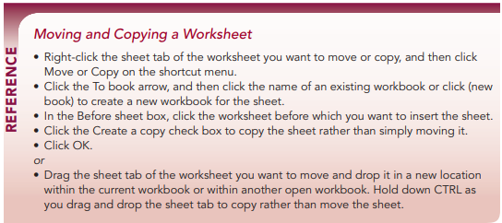
COMP1631 Advanced Spreadsheets – Winter 2024 – Section 06

Slide 6
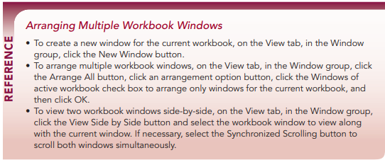
COMP1631 Advanced Spreadsheets – Winter 2024 – Section 06

Slide 7
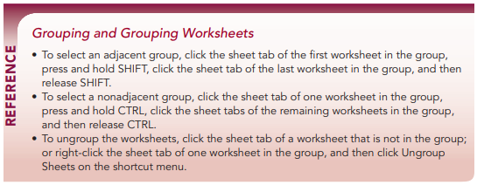
COMP1631 Advanced Spreadsheets – Winter 2024 – Section 06

Slide 8
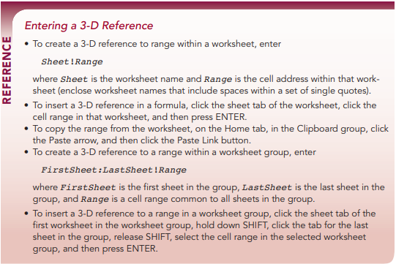
COMP1631 Advanced Spreadsheets – Winter 2024 – Section 06

Slide 9
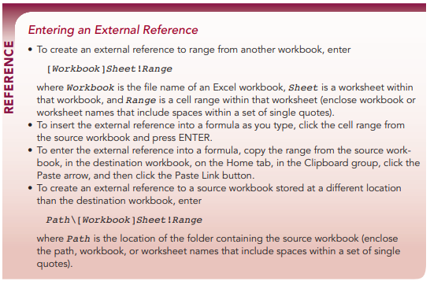
COMP1631 Advanced Spreadsheets – Winter 2024 – Section 06

Slide 10
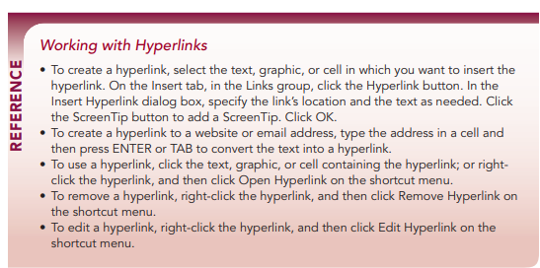
COMP1631 Advanced Spreadsheets – Winter 2024 – Section 06

Slide 11
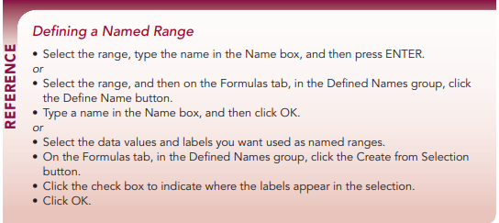
COMP1631 Advanced Spreadsheets – Winter 2024 – Section 06

Slide 12
COMP1631 Advanced Spreadsheets – Winter 2024 – Section 06
Time to start Module 5 SAM Project.
You have 75 minutes once you start
Read instructions carefully
Use your attempts wisely to correct mistakes from previous attempts
Feel free to use these slides as references
This is individual work, do not talk to anyone other than the instructor while people are working on the project
Once you are done with all your attempts, please leave quietly
Remember to review Module 6 for next week.

