Slide 1
New Perspectives on Microsoft Excel 2019

Slide 2
Performing Calculations with Formulas and Functions
Module 3

Slide 3
Objectives, Part 1
Translate an equation into a function
Do calculations with dates and times
Extend data and formulas with AutoFill
Use the Function Library
Calculate statistics

Slide 4
Objectives, Part 2
Using the Quick Analysis toolbar
Use absolute and relative cell references
Use a logical function
Retrieve data with lookup tables
Do what-if analysis with Goal Seek

Slide 5
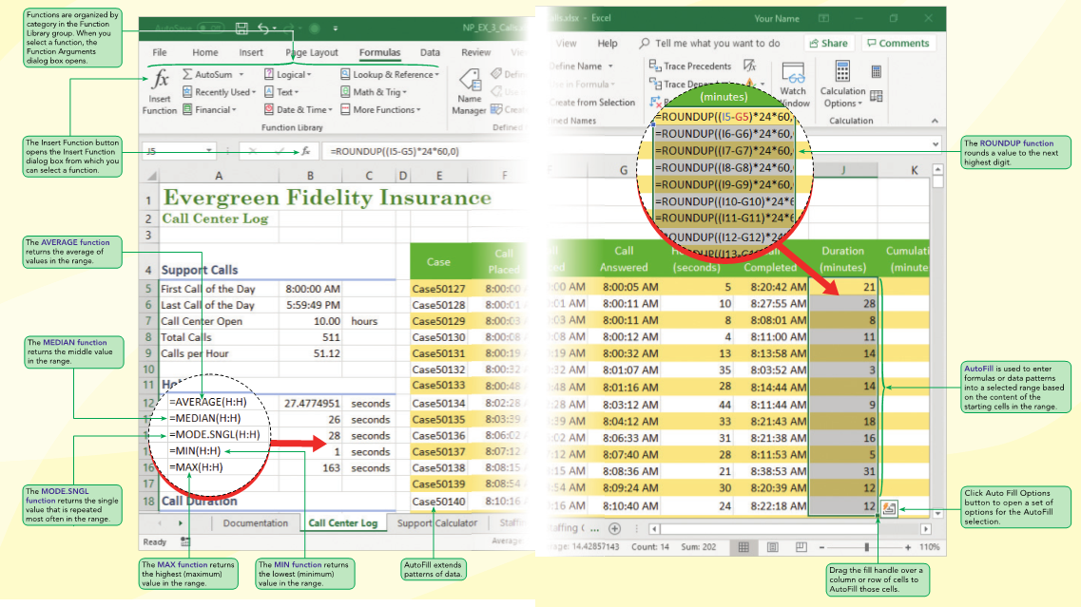
Visual Overview: Formulas and Functions

Slide 6
Designing a Workbook for Calculations
A workbook with many calculations can be challenging for the author to write and for others to use
To help everyone, it is important to list the formulas used in the workbook and to explain the assumptions behind those formulas
The workbook documentation should also include the definitions of key terms to make it clear what is being calculated and why
Some equations use constants , which are terms in an equation whose values don’t change

Slide 7
Calculating with Dates and Times
Excel stores dates and times as the number of days since January 0, 1900. Full days are a whole number and partial days are a fraction such as 0.5 for a half day or 12 hours
Storing dates and times as numbers makes it easier to calculate time and date intervals

Slide 8
AutoFilling Formulas and Data Patterns
One way to efficiently enter long columns or rows of formulas and data values is with AutoFill
AutoFill extends a formula or a pattern of data values into a selected range and is often faster than copying and pasting, which requires two distinct actions on the part of the user

Slide 9
Exploring Auto Fill Options
By default, AutoFill extends both the formulas and the formatting of the initial cell or cells
However, you might want to extend only the formulas or only the formatting

Slide 10
Filling a Series
Use AutoFill to create a series of numbers, dates, or text based on a pattern
To extend a series of data values based on a pattern, enter enough values to establish the pattern, select those cells containing the pattern, and then drag the fill handle extending the pattern into a larger range.
Use the Series dialog box for more complex AutoFill patterns

Slide 11
Applying Excel Functions, Part 1
Rounding Data Values
ROUNDDOWN
ROUNDUP
Calculating Minimums and Maximums
The MIN and MAX functions return the smallest and largest values from a specified set of numbers:
MIN(number1, [number2], …)
MAX(number1, [number2], …)

Slide 12
Applying Excel Functions, Part 2
Measures of Central Tendency
Mean
Median
Mode
Nesting Functions
The Role of Blanks and Zeros

Slide 13
Date and Time Functions, Part 1
Many workbooks include the current date
Use the TODAY function to display the current date in a worksheet
The TODAY function has the following syntax:
=TODAY()
The date displayed by the TODAY function is updated automatically whenever you reopen the workbook or enter a new calculation

Slide 14
Date and Time Functions, Part 2: Figure 3-18 Date and time functions
Function | Description
DATE(year, month, day) | Creates a date value for the date represented by the year, month and day arguments
DAY(serial_number) | Extracts the day of the month from a date value stored as serial_number
MONTH(serial_number ) | Extracts the month number from a date value stored as serial_number, where 1=January, 2=February, and so on
YEAR(serial_number ) | Extracts the 4-digit year value from a date value stored as serial_number
NETWORKDAYS(state_date, end_date, [holidays]) | Calculates the number of whole working days between state_date and end_date; to exclude holidays, add the optional holidays argument containing a list of holiday dates to skip
WEEKDAY(serial_number, [return_type]) | Calculates the weekday from a date value stored as serial_number, where 1=Sunday, 2=Monday, and so forth; to choose a different numbering scheme, set return_type to 1 (1=Sunday, 2=Monday, …), 2 (1=Monday, 2=Tuesday, …), or 3 (0=Monday, 1=Tuesday, …)
WORKDAY(start_date, days, [holidays]) | Returns the workday after days workdays have passed since the start_date; to exclude holidays, add the optional holidays argument containing a list of holiday dates to skip
NOW( ) | Returns the current date and time
TODAY( ) | Returns the current date

Slide 15
Interpreting Error Values, Part 1
An error value indicates that some part of a formula was entered incorrectly
Error values by themselves might not be particularly descriptive or helpful. To help you locate the error, an error indicator appears in the upper-left corner of the cell with the error value

Slide 16
Interpreting Error Values, Part 2: Figure 3-19 Common error values
Error Value | Description
#DIV/0! | The formula or function contains a number divided by 0.
#NAME? | Excel doesn’t recognize text in the formula or function, such as when the function name is misspelled.
#N/A | A value is not available to a function or formula, which can occur when a workbook is initially set up prior to entering actual data values.
#NULL! | A formula or function requires two cell ranges to intersect, but they don’t.
#NUM! | Invalid numbers are used in a formula or function, such as text entered in a function that requires a number.
#REF! | A cell reference used in a formula or function is no longer valid, which can occur when the cell used by the function was deleted from the worksheet.
#VALUE! | The wrong type of argument is used in a function or formula. This can occur when you reference a text value for an argument that should be strictly numeric.

Slide 17
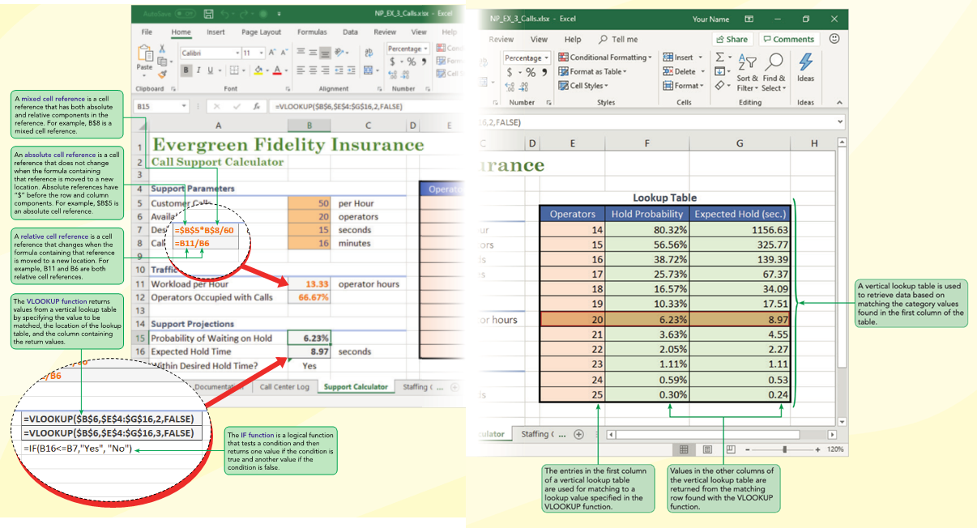
Visual Overview: Lookup Tables and Logical Functions

Slide 18
Calculating Running Totals with the Quick Analysis Tool
The Quick Analysis tool appears whenever you select a range of cells, providing easy access to the most common tools for data analysis, chart creation, and data formatting
It is an excellent tool for doing useful calculations and entering Excel functions

Slide 19
Exploring Cell References, Part 1
Relative cell references
Excel interprets a relative cell reference relative to the position of the cell containing the formula. For example, if cell A1 contains the formula =B1+B2, Excel interprets that formula as “Add the value of the cell one column to the right (B1) to the value of the cell one column to the right and one row down (B2)”
Absolute cell references
An absolute cell reference remains fixed even when a formula or function is copied to a new location. Absolute references include $ (a dollar sign) before each column and row designation. For example, B8 is a relative reference to cell B8, while $B$8 is an absolute reference to that cell

Slide 20
Exploring Cell References, Part 2
Mixed cell references
A mixed cell reference contains both relative and absolute components. For example, a mixed cell reference for cell A2 can be either $A2 where the column is the absolute component and the row is the relative component, or it can be entered as A$2 with a relative column component and a fixed row component

Slide 21
Entering an Absolute Cell Reference
You can easily cycle between relative, absolute, and mixed cell references in formulas by selecting the cell reference in the formula and pressing F4 while in Edit mode

Slide 22
Working with the IF Logical Function
Returns one value if a condition is true and returns a different value if that condition is false
value_if_true is the value returned by the function if the condition is true, and value_if_false is an optional argument containing the value if the condition is false
The = symbol in IF function is a comparison operator, which is an operator expressing the relationship between two values

Slide 23
Formatting Input, Calculated, and Output Values
Formatting cells based on their purpose helps others correctly use and interpret your worksheet
The Cell Styles gallery includes cell styles to format cells containing input, calculation, and output values

Slide 24
Looking Up Data, Part 1
Lookup functions find values in tables of data and insert them in another location in the worksheet such as cells or in formulas
An exact match lookup is when the lookup value must match one of the compare values in the first column of the lookup table
An approximate match lookup occurs when the lookup value falls within a range of numbers in the first column of the lookup table

Slide 25
Looking Up Data, Part 2
To retrieve a return value from a vertical lookup table, you use the VLOOKUP function:
VLOOKUP(lookup_value,table_array,col_index_num,[range_lookup=TRUE])
The lookup table contains the following columns:
Operators
Hold probability
Expected hold (sec)
Failure rate

Slide 26
Performing What-If Analyses with Formulas and Functions, Part 1
A what-if analysis lets you explore the impact that changing input values has on calculated values and output values
One way to perform a what-if analysis is by changing one or more of the input values to see how they affect the calculated results

Slide 27
Performing What-If Analyses with Formulas and Functions, Part 2
The trial-and-error method requires some guesswork as you estimate which values to change and by how much
To perform a what-if analysis by trial and error:
Change the value of a worksheet cell (the input cell)
Observe its impact on one or more calculated cells (the result cells)
Repeat until the desired results are achieved

Slide 28
Using Goal Seek
Goal Seek automates the trial-and-error process by specifying a value for a calculated item
To perform a what-if analysis using Goal Seek:
On the Data tab, in the Forecast group, click the What-If Analysis button, and then click Goal Seek
Select the result cell in the Set cell box, and then specify its value (goal) in the To value box
In the By changing cell box, specify the input cell
Click OK. The value of the input cell changes to set the value of the result cell

