Slide 1

COMP1631 Advanced Spreadsheets – Winter 2024 – Section 06

Slide 2
COMP1631 Advanced Spreadsheets – Winter 2024 – Section 06
Lecture 5 Tuesday, February 6, 2024
Today:
Some big changes to the lecture style … coming up!
Preview and practice before the SAM Project
SAM Project in class

Slide 3
COMP1631 Advanced Spreadsheets – Winter 2024 – Section 06
The plan that we had
For a given module:
You read the module, complete Textbook activities, and SAM Training before first lecture
Lecture reviews Module content and I answer student questions – assuming you have done the work above
After lecture you will complete SAM Textbook Project and SAM Exam before next Monday
Go through SAM Project in class

Slide 4

COMP1631 Advanced Spreadsheets – Winter 2024 – Section 06
The Reality
Only 3 out of 21 submissions
Only one person did both training
Clearly this is not working!

Slide 5

COMP1631 Advanced Spreadsheets – Winter 2024 – Section 06
From Now On
Still want you to read Module and complete SAM Training before first lecture on module
I will not assume that you have done the SAM Training
My lecture will focus on showing how the module concepts are done in Excel
Will expect you to take part in the demonstration
Some of the current structure will need to be compromised to fit this in

Slide 6
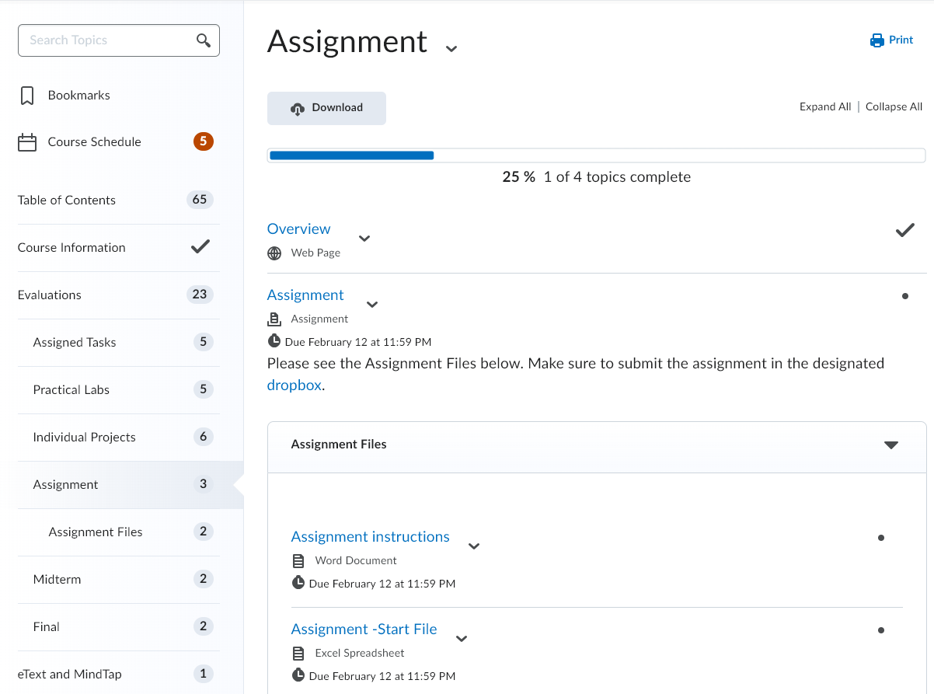
COMP1631 Advanced Spreadsheets – Winter 2024 – Section 06
Looking forward
Complete and submit your assignment
Make sure to start early
Submit as many times as you like
No immediate feedback
Worth 10% of your final grade
Due 11:59pm on Feb 13 (Tuesday) 2024

Slide 7
COMP1631 Advanced Spreadsheets – Winter 2024 – Section 06
Today
Brief practice with a SAM Project
Download the Excel File from today’s lecture
Fill in your name and save as version 2 (see instructions in the file)
Work with me on the project, let me know if you want me to repeat the steps

Slide 8
COMP1631 Advanced Spreadsheets – Winter 2024 – Section 06
Let’s go for a break!
Return in 15 minutes (or at time specified by your instructor).

Slide 9
COMP1631 Advanced Spreadsheets – Winter 2024 – Section 06
Now
Time to work on your own SAM project. The password is:
W24Mod06SAM
Remember that this is an individual assessment, so please do not ask your neighbor for help
Make sure your PC is working as it should. Change your workstation if needed.
You will have 75 minutes to submit. No extra time would be given.
Use any resource from Cengage or Lecture notes.
Once you are done, leave quietly. Don’t forget about the assignment.

Slide 10
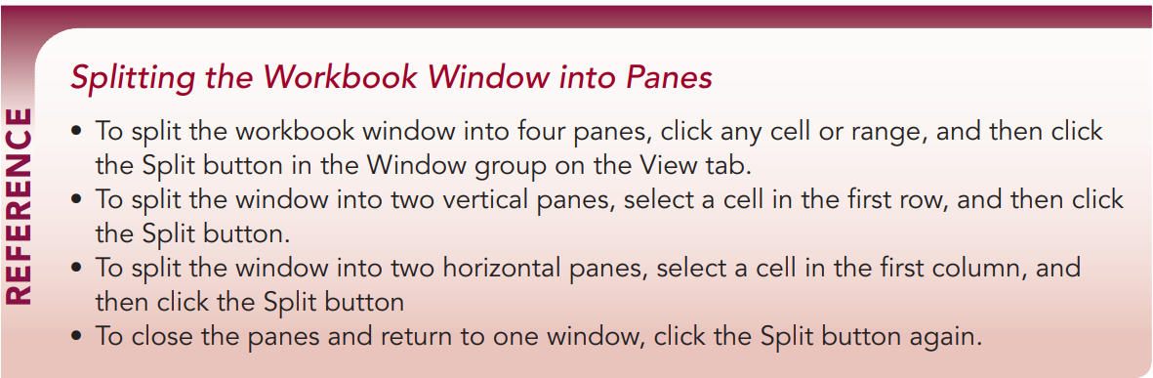
COMP1631 Advanced Spreadsheets – Winter 2024 – Section 06

Slide 11
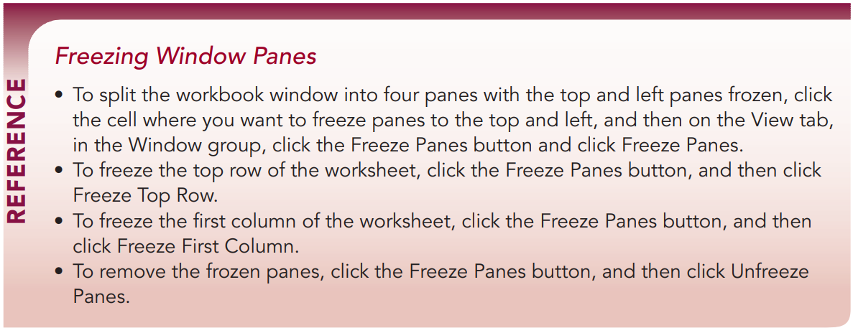
COMP1631 Advanced Spreadsheets – Winter 2024 – Section 06

Slide 12
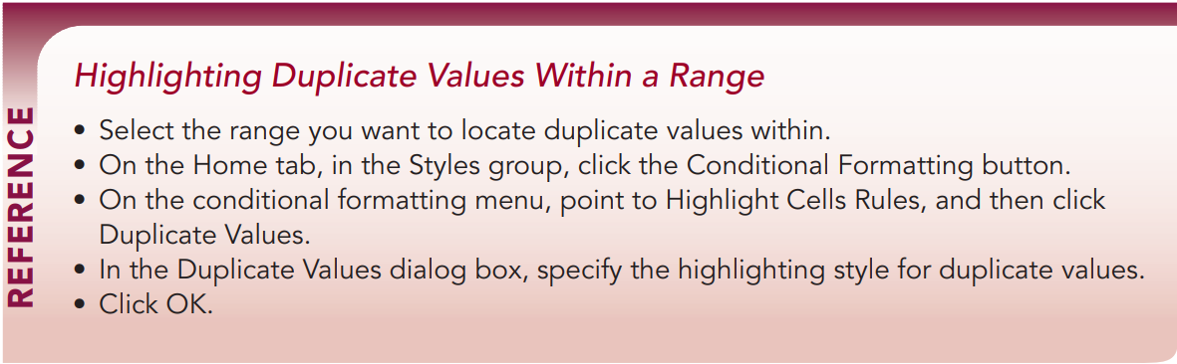
COMP1631 Advanced Spreadsheets – Winter 2024 – Section 06

Slide 13
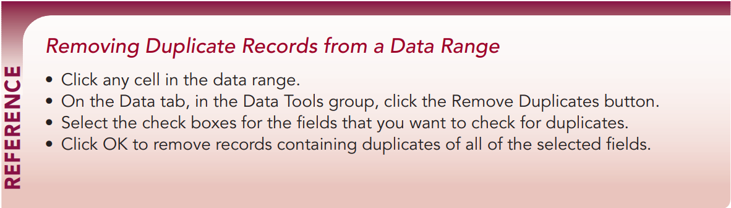
COMP1631 Advanced Spreadsheets – Winter 2024 – Section 06

Slide 14
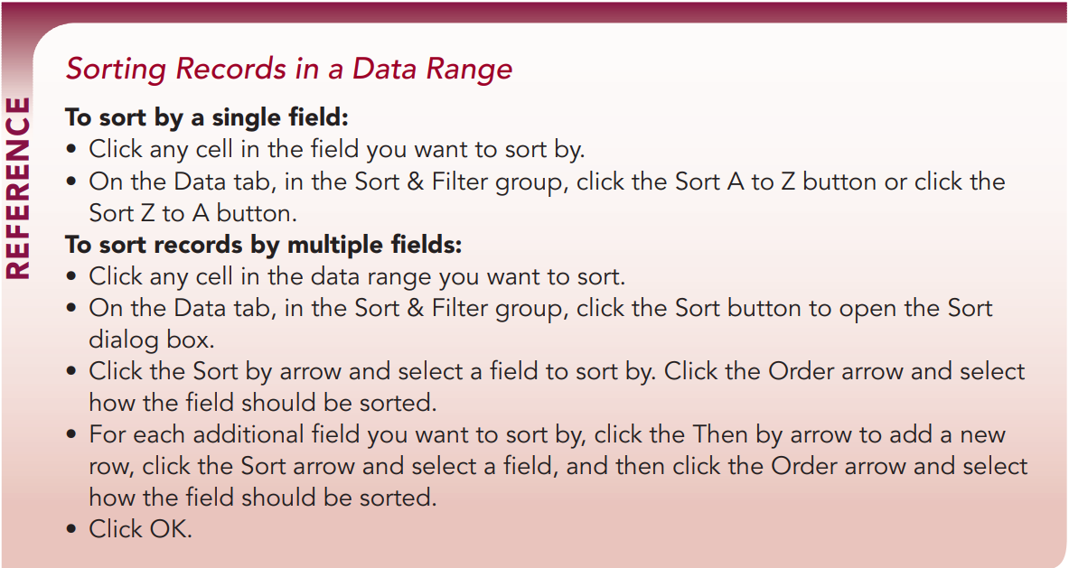
COMP1631 Advanced Spreadsheets – Winter 2024 – Section 06

Slide 15
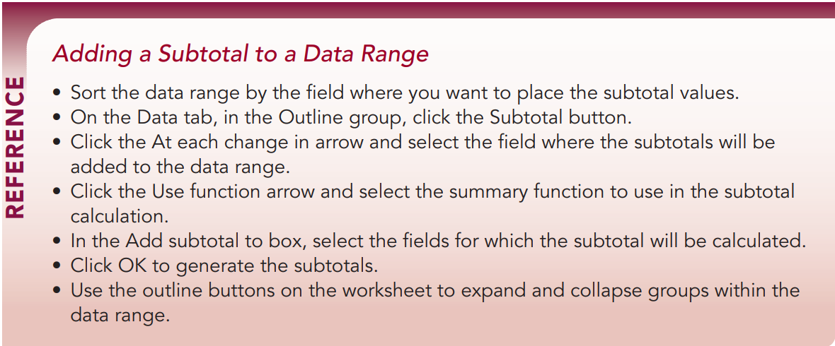
COMP1631 Advanced Spreadsheets – Winter 2024 – Section 06

Slide 16
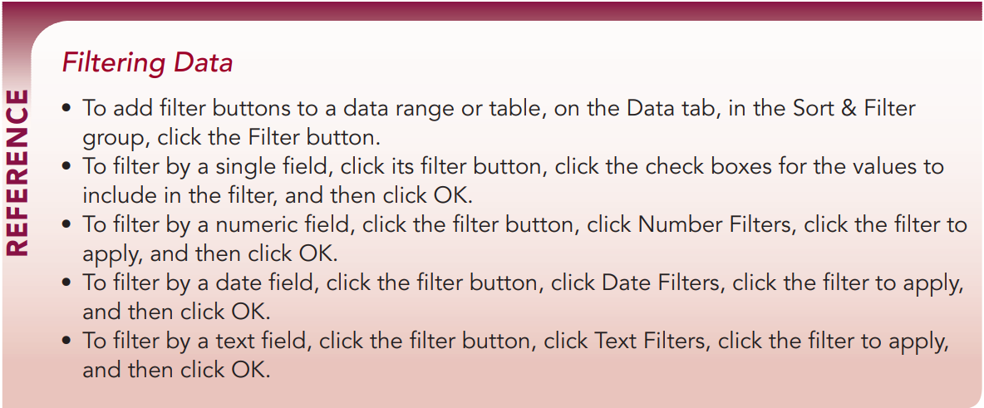
COMP1631 Advanced Spreadsheets – Winter 2024 – Section 06

Slide 17
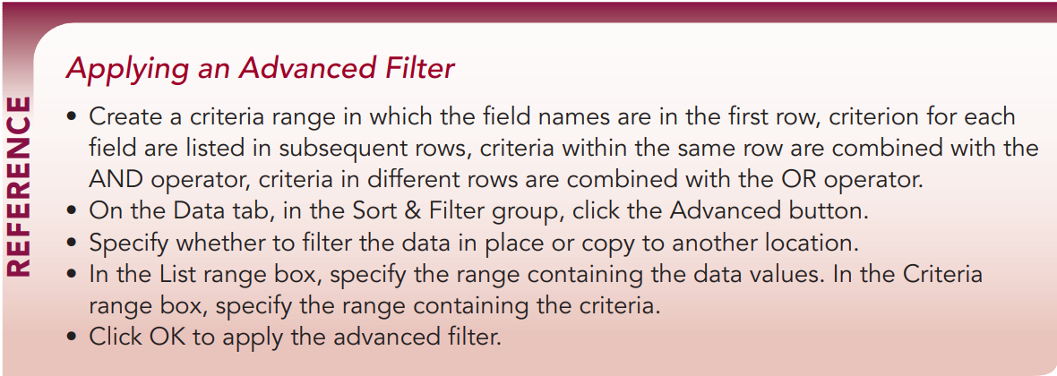
COMP1631 Advanced Spreadsheets – Winter 2024 – Section 06

Slide 18
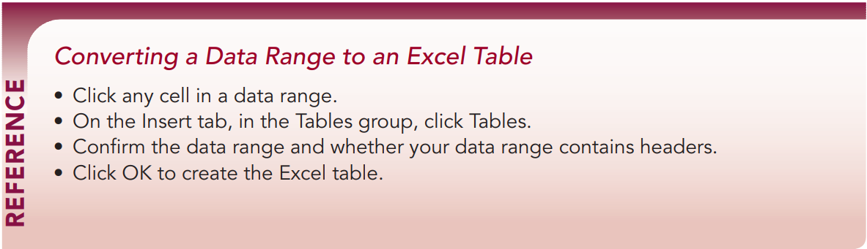
COMP1631 Advanced Spreadsheets – Winter 2024 – Section 06

Slide 19
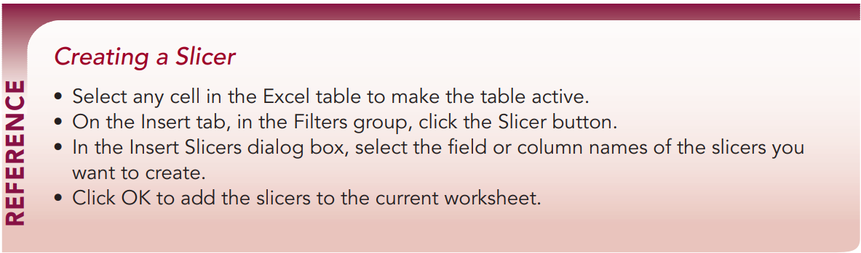
COMP1631 Advanced Spreadsheets – Winter 2024 – Section 06

Slide 20
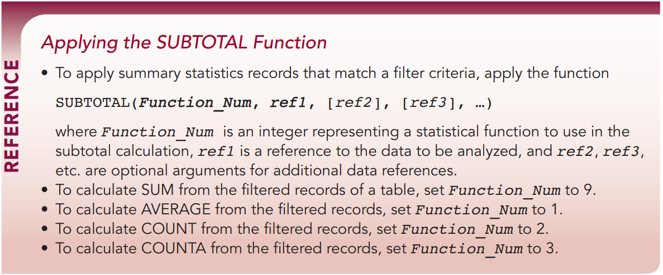
COMP1631 Advanced Spreadsheets – Winter 2024 – Section 06

