Slide 1

COMP1631 Advanced Spreadsheets – Winter 2024 – Section 06

Slide 2
COMP1631 Advanced Spreadsheets – Winter 2024 – Section 06
Lecture 10 Tuesday, March 19, 2024
Today:
Academic Integrity
Attendance
SAM Project

Slide 3
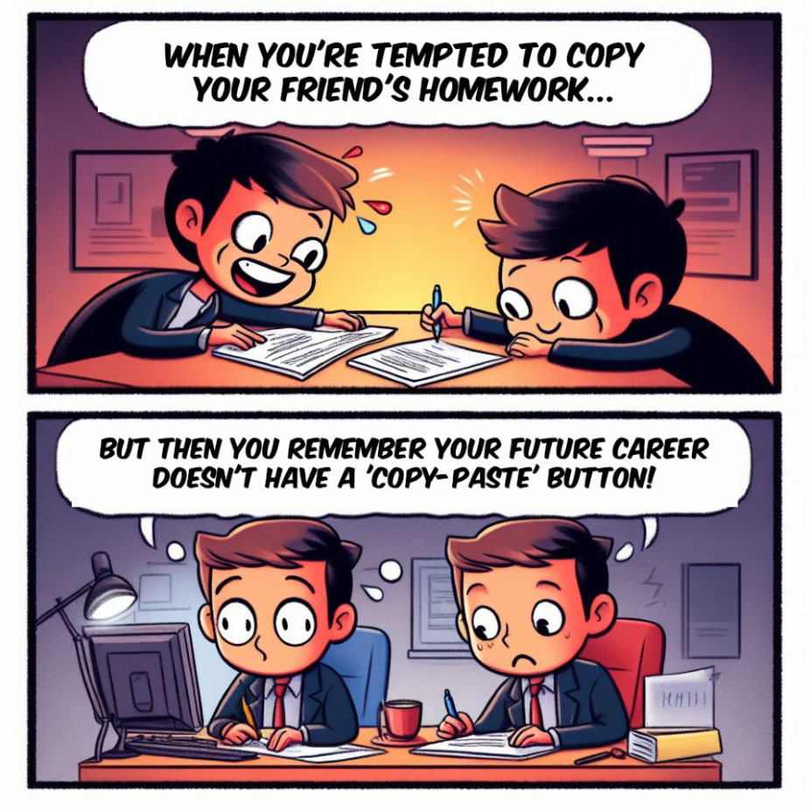
COMP1631 Advanced Spreadsheets – Winter 2024 – Section 06

Slide 4
COMP1631 Advanced Spreadsheets – Winter 2024 – Section 06
A few words on Attendance
Grades are not good enough to justify missing classes
You may get emails about your attendance and course grades in the near future

Slide 5
COMP1631 Advanced Spreadsheets – Winter 2024 – Section 06
Let’s go for a break!
Return in 15 minutes (or at time specified by your instructor).

