Slide 1

COMP1631 Advanced Spreadsheets – Winter 2024 – Section 06

Slide 2
COMP1631 Advanced Spreadsheets – Winter 2024 – Section 06
Lecture 4 Tuesday, January 30, 2024
Today:
Module 6 objectives
Module 6 Case Problem 1 (demo)
Module 6 Notes
Excel Module 6 SAM Textbook Project

Slide 3
COMP1631 Advanced Spreadsheets – Winter 2024 – Section 06
Module 6: Managing Data with Data Tools
Objectives
Split a workbook window into panes
Highlight and remove duplicate values in a data range
Sort a data range by one or more fields
Add subtotals to a data range
Find and select workbook cells
Filter data based on one or more fields
Create an advanced filter
Convert a data range to an Excel table
Work with table styles and table elements
Create and apply a slicer
Calculate summary statistics with the SUBTOTAL function
Design and create an interactive dashboard

Slide 4
COMP1631 Advanced Spreadsheets – Winter 2024 – Section 06
Module 6: Managing Data with Data Tools
Objectives
Split a workbook window into panes
Highlight and remove duplicate values in a data range
Sort a data range by one or more fields
Add subtotals to a data range
Find and select workbook cells
Filter data based on one or more fields
Create an advanced filter
Convert a data range to an Excel table
Work with table styles and table elements
Create and apply a slicer
Calculate summary statistics with the SUBTOTAL function
Design and create an interactive dashboard

Slide 5
COMP1631 Advanced Spreadsheets – Winter 2024 – Section 06
Module 6: Managing Data with Data Tools
Objectives
Split a workbook window into panes
Highlight and remove duplicate values in a data range
Sort a data range by one or more fields
Add subtotals to a data range
Find and select workbook cells
Filter data based on one or more fields
Create an advanced filter
Convert a data range to an Excel table
Work with table styles and table elements
Create and apply a slicer
Calculate summary statistics with the SUBTOTAL function
Design and create an interactive dashboard

Slide 6
COMP1631 Advanced Spreadsheets – Winter 2024 – Section 06
Module 6: Managing Data with Data Tools
Objectives
Split a workbook window into panes
Highlight and remove duplicate values in a data range
Sort a data range by one or more fields
Add subtotals to a data range
Find and select workbook cells
Filter data based on one or more fields
Create an advanced filter
Convert a data range to an Excel table
Work with table styles and table elements
Create and apply a slicer
Calculate summary statistics with the SUBTOTAL function
Design and create an interactive dashboard

Slide 7
COMP1631 Advanced Spreadsheets – Winter 2024 – Section 06
6.1 Data Ranges, Workbook Panes, and Subtotals
Handling Data in Excel
Excel is a popular application for storing data and includes tools for managing and exploring that data.
In a data range, each column stores information known as a field describing a characteristic of a person, place, or thing and each row stores a record containing a group of related field values.
The first row of a data range, known as the header row , typically contains the field names.

Slide 8
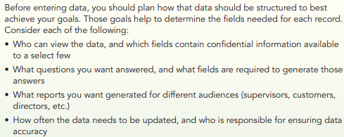
COMP1631 Advanced Spreadsheets – Winter 2024 – Section 06

Slide 9
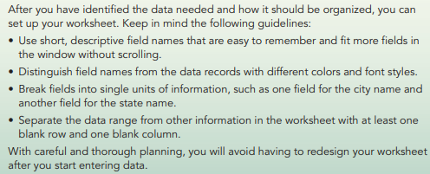
COMP1631 Advanced Spreadsheets – Winter 2024 – Section 06

Slide 10
COMP1631 Advanced Spreadsheets – Winter 2024 – Section 06
With any data range, it’s excellent practice to provide a data definition table, which lists
the fields included with each record,
the type of data stored in each field (such as numbers, text, or dates),
a short description of each field.

Slide 11
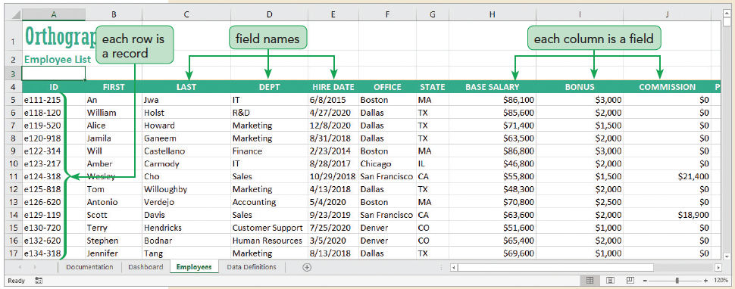
COMP1631 Advanced Spreadsheets – Winter 2024 – Section 06

Slide 12
COMP1631 Advanced Spreadsheets – Winter 2024 – Section 06
Quick Quiz 1
Group Response:
The first row of a data range is known as the ___________ row.
What is a data definition table?
Class Discussion:
What are the guidelines discussed in this module to keep in mind when you set up your worksheet?

Slide 13
COMP1631 Advanced Spreadsheets – Winter 2024 – Section 06
Group Response:
The first row of a data range is known as the ___________ row. (Answer: header)
What is a data definition table? (Answer: A data definition table lists the fields included with each record, the type of data stored in each field, and a short description of each field.)
Class Discussion: What are the guidelines discussed in this module to keep in mind when you set up your worksheet?
(Answer: Use short, descriptive field names that are easy to remember and fit more fields in the window without scrolling. Distinguish field names from the data records with different colors and font styles. Break fields into single units of information, such as one field for the city name and another field for the state name. Separate the data range from other information in the worksheet with at least one blank row and one blank column.)

Slide 14
COMP1631 Advanced Spreadsheets – Winter 2024 – Section 06
Using Panes to View Data
Dividing the Workbook Window into Panes
Excel can split the workbook window in up to four sections called panes with each pane offering a separate view into the worksheet
Freezing Panes
When you freeze a pane, its contents are always visible though you cannot scroll within it. You can freeze the panes located to the top and left of a selected cell, allowing scrolling within the lower-right pane

Slide 15
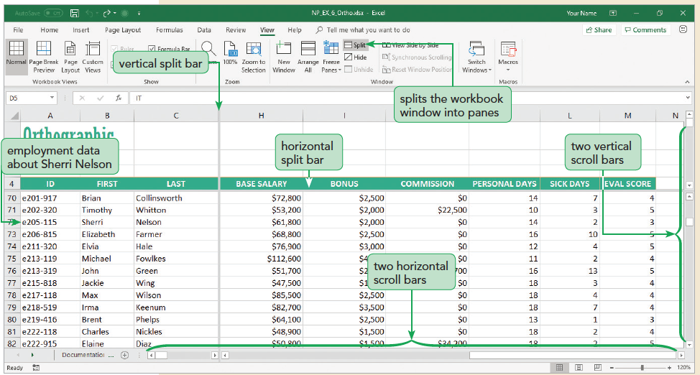
COMP1631 Advanced Spreadsheets – Winter 2024 – Section 06

Slide 16
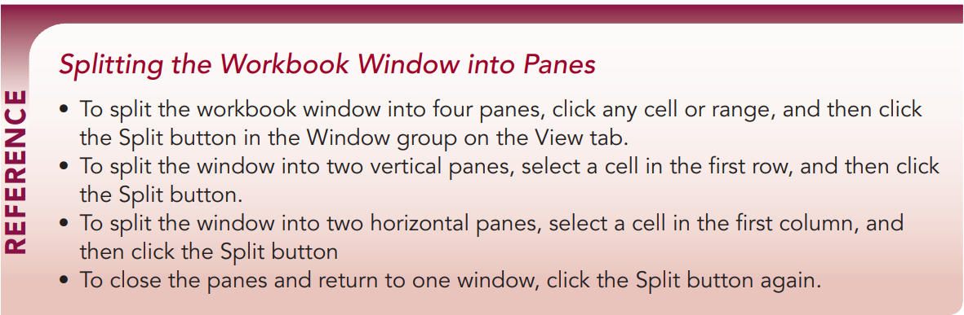
COMP1631 Advanced Spreadsheets – Winter 2024 – Section 06

Slide 17
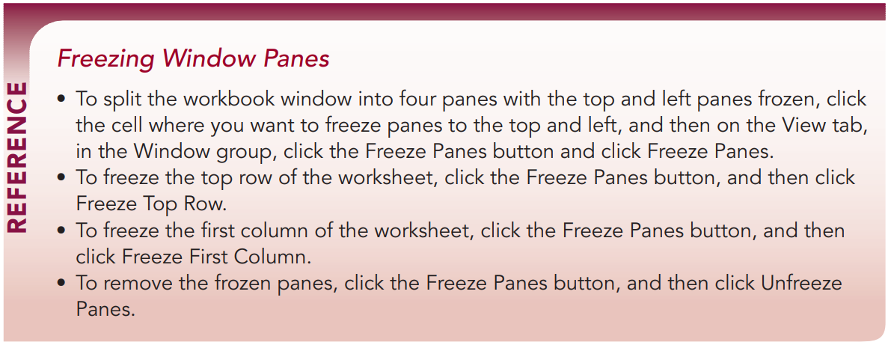
COMP1631 Advanced Spreadsheets – Winter 2024 – Section 06

Slide 18
COMP1631 Advanced Spreadsheets – Winter 2024 – Section 06
Quick Quiz 2
True/False: Excel can split the workbook window into three sections, called panes
To split the workbook window, click any cell or range in the worksheet and then on the _____ tab, click the Split button.
True/False: You can split the window into vertical panes.
When you ______ a pane, its contents are always visible though you cannot scroll within it.

Slide 19
COMP1631 Advanced Spreadsheets – Winter 2024 – Section 06
True/False: Excel can split the workbook window into three sections, called panes. (Answer: False, four sections)
To split the workbook window, click any cell or range in the worksheet and then on the _____ tab, click the Split button. (Answer: View)
True/False: You can split the window into vertical panes. (Answer: True)
When you ______ a pane, its contents are always visible though you cannot scroll within it. (Answer: freeze)

Slide 20
COMP1631 Advanced Spreadsheets – Winter 2024 – Section 06
Locating Duplicate Records
When a worksheet has a lot of data, data entry errors are almost sure to occur.
One common error is creating a duplicate record in which the same record appears multiple times in the worksheet.

Slide 21
COMP1631 Advanced Spreadsheets – Winter 2024 – Section 06
Highlighting Duplicate Values
You can use conditional formatting to locate a duplicate record by highlighting duplicate values within a selected range
Removing Duplicate Records
Click any cell in the data range.
On the Data tab, in the Data Tools group, click the Remove Duplicates button.
Select the check boxes for the fields that you want to check for duplicates.
Click OK to remove records containing duplicates of all of the selected fields.

Slide 22
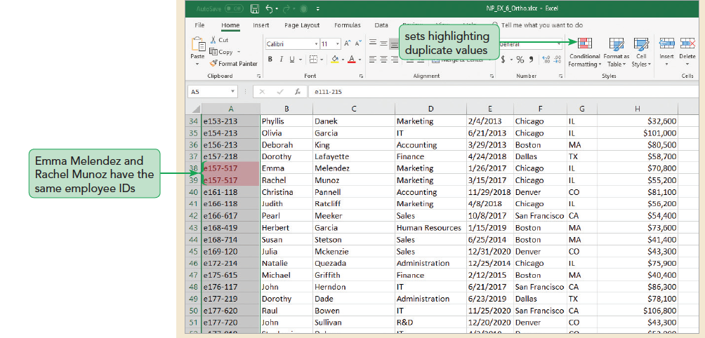
COMP1631 Advanced Spreadsheets – Winter 2024 – Section 06

Slide 23
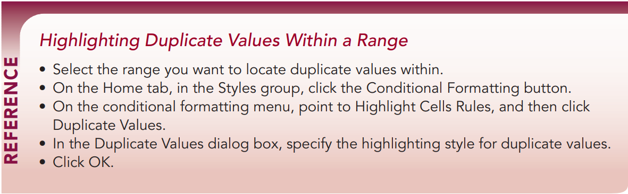
COMP1631 Advanced Spreadsheets – Winter 2024 – Section 06

Slide 24
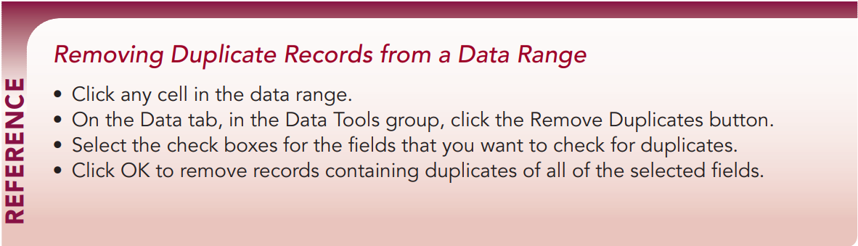
COMP1631 Advanced Spreadsheets – Winter 2024 – Section 06

Slide 25
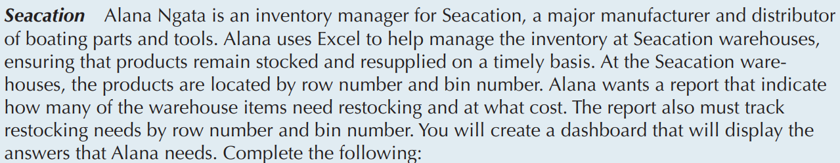
COMP1631 Advanced Spreadsheets – Winter 2024 – Section 06
In class Demo:

Slide 26
COMP1631 Advanced Spreadsheets – Winter 2024 – Section 06
In class Demo:

Slide 27
COMP1631 Advanced Spreadsheets – Winter 2024 – Section 06
Quick Quiz 3
You can use ___________ formatting to locate a duplicate record by highlighting duplicate values with a selected range.
Which tool would you use to locate and delete records that are duplicated across multiple fields?

Slide 28
COMP1631 Advanced Spreadsheets – Winter 2024 – Section 06
You can use ___________ formatting to locate a duplicate record by highlighting duplicate values with a selected range. (Answer: conditional)
Which tool would you use to locate and delete records that are duplicated across multiple fields? (Answer: Remove Duplicates)

Slide 29
COMP1631 Advanced Spreadsheets – Winter 2024 – Section 06
Sorting Records in a Data Range
Sorting by a Single Field
The records in an Excel table initially appear in the order they were entered; you can view the same records in a different order
Ascending order arranges text alphabetically from A to Z, numbers from smallest to largest, and dates from oldest to newest
Descending order arranges text in reverse alphabetical order from Z to A, numbers from largest to smallest, and dates from newest to oldest
Use the Sort A to Z button or the Sort Z to A button to sort data quickly with one sort field

Slide 30
COMP1631 Advanced Spreadsheets – Winter 2024 – Section 06
Sorting by Multiple Fields
The first sort field is called the primary sort field
The second sort is called the secondary sort field
Up to 64 sort fields possible
Sorting with a Custom List
A custom list indicates sequence to order data
Two predefined custom sort lists
Day-of-the-week custom list
Month-of-the-year custom lists
Can create a custom list to sort records in a sequence you define

Slide 31
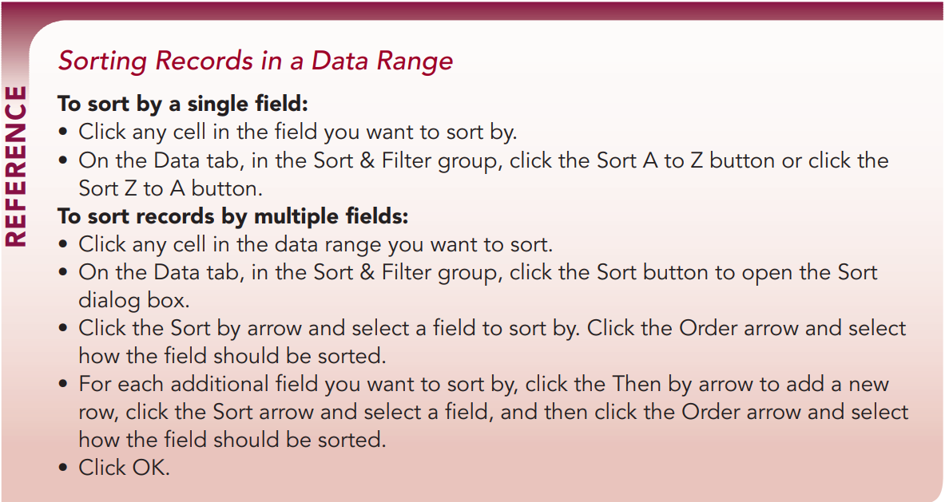
COMP1631 Advanced Spreadsheets – Winter 2024 – Section 06

Slide 32
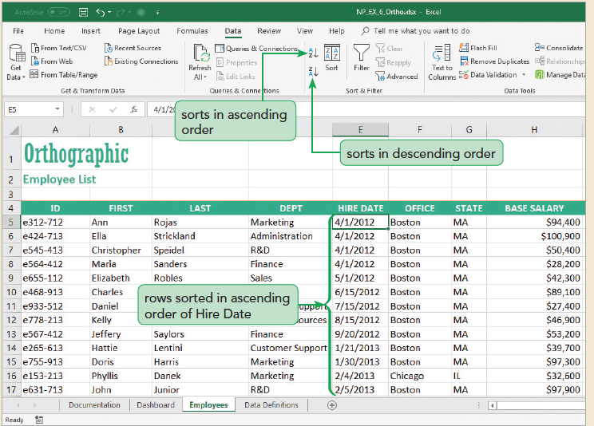
COMP1631 Advanced Spreadsheets – Winter 2024 – Section 06

Slide 33
COMP1631 Advanced Spreadsheets – Winter 2024 – Section 06
Demo NP_EX_6_Seacation:

Slide 34
COMP1631 Advanced Spreadsheets – Winter 2024 – Section 06
Quick Quiz 4
Group Work
True/False: By default, records appear in ascending order.
Sorting records from Z to A is _____________ order.
A _______________ arranges field values in the order you specify.
Class Discussion: What is the difference between primary sort field and secondary sort field?

Slide 35
COMP1631 Advanced Spreadsheets – Winter 2024 – Section 06
True/False: By default, records appear in ascending order. (Answer: False)
Sorting records from Z to A is _____________ order. (Answer: descending)
A _______________ arranges field values in the order you specify. (Answer: custom list)
Class Discussion: What is the difference between primary sort field and secondary sort field?
(Answer: A primary sort field initially sorts the data and the secondary sort field sorts data within the primary sort field.)

Slide 36
COMP1631 Advanced Spreadsheets – Winter 2024 – Section 06
Calculating Subtotals
Creating a Subtotal Row
Some analysis requires calculations on sections of a data range. To do this, you can add subtotals , which are summary functions that are applied to a part of a data range
Using the Subtotal Outline View
The outline tool lets you control the level of detail displayed in the worksheet.

Slide 37
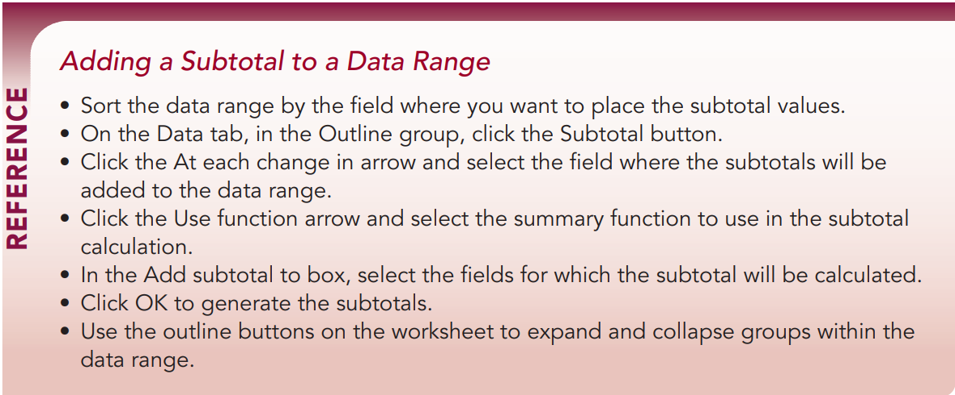
COMP1631 Advanced Spreadsheets – Winter 2024 – Section 06

Slide 38
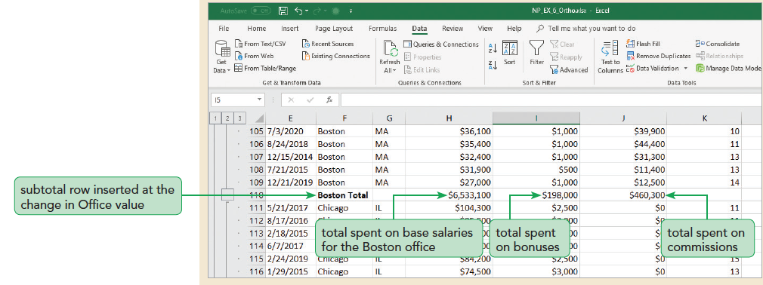
COMP1631 Advanced Spreadsheets – Winter 2024 – Section 06

Slide 39
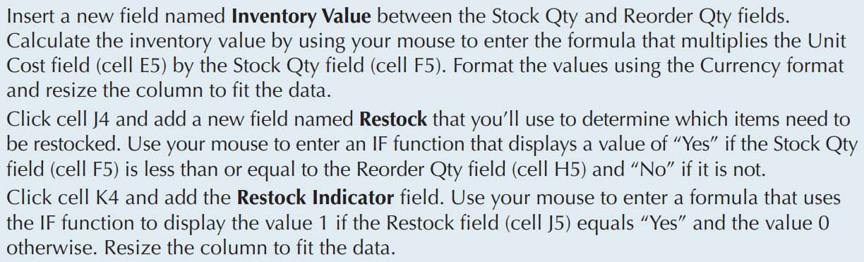
COMP1631 Advanced Spreadsheets – Winter 2024 – Section 06
Demo NP_EX_6_Seacation:

Slide 40
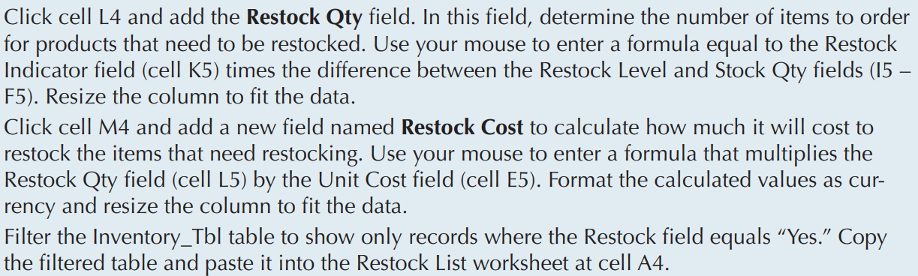
COMP1631 Advanced Spreadsheets – Winter 2024 – Section 06
Demo NP_EX_6_Seacation:

Slide 41
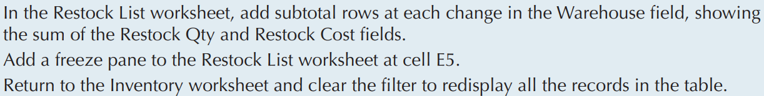
COMP1631 Advanced Spreadsheets – Winter 2024 – Section 06
Demo NP_EX_6_Seacation:

Slide 42
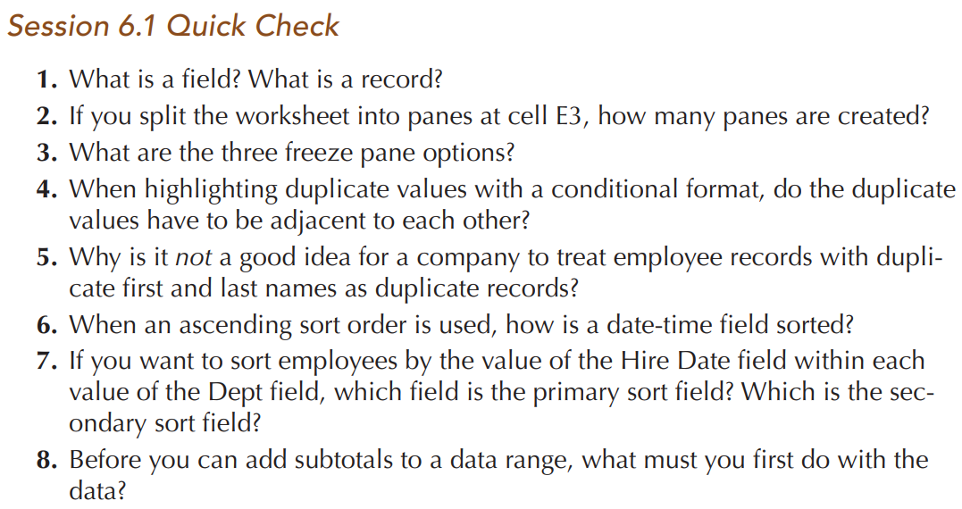
COMP1631 Advanced Spreadsheets – Winter 2024 – Section 06
Individual Work: https://forms.office.com/r/2W4TCcqKda

Slide 43
COMP1631 Advanced Spreadsheets – Winter 2024 – Section 06
Let’s go for a break ~ 10 minutes!
Return in 15 minutes (or at time specified by your instructor).

Slide 44
COMP1631 Advanced Spreadsheets – Winter 2024 – Section 06

