Slide 1

International Conference on Advanced Computing & Communication Technologies (ICACCTech 2023)
Hosted by : Swami Vivekanand Institute of Engineering and Technology , Banur , Punjab , India
IOT BASED SMART CONTROL SYSTEM FOR MONITORING AGRICULTURE
PAPER ID : 262
Presented by : MUSKAN

Slide 2

1. MUSKAN Computer Science and Engineering Department Chandigarh University, Mohali
AUTHORS
2. GARGI GHOSH Computer Science and Engineering Department Chandigarh University, Mohali
3. RUCHI Electronics and Communication Engineering Department Chandigarh University, Mohali
4. VIKAS WASSON Computer Science and Engineering Department Chandigarh University, Mohali

Slide 3

Introduction
Hardware Components
Software Used
OUTLINES
Proposed System
Features
Implementation
Result and Discussion
Conclusion

Slide 4

INTRODUCTION
Farming is a complex yet important process that has been on the course in townlets since mortal civilization. There are numerous aspects that growers need to take into consideration while farming. Cultivating factors involve soil, irrigational installations, temperature, rainfall, water level, etc.
To produce successful crop growth, an agronomist needs to be well set and be conscious of the accurate or absolute values for the various factors, rainfall conditions, or climate changes because the overall affair of the crop is largely dependent upon these factors.
The main goal of this research study is to develop an automated experimental strategy using the Internet of Things to intelligently operate systems for monitoring agriculture.

Slide 5

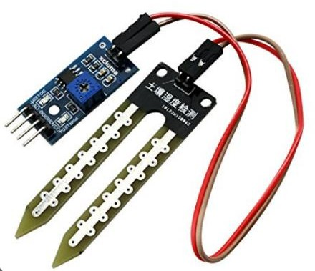
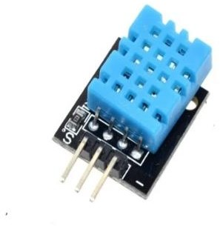
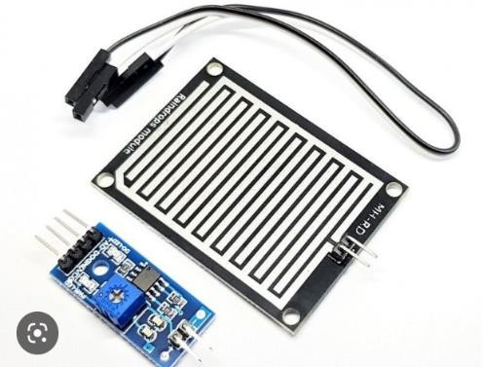
HARDWARE COMPONENTS
SOIL SENSOR
DHT11 SENSOR
RAIN SENSOR
It is used to measure the amount of water in the soil horizon as well as to keep track of the water content of the soil.
The DHT11 is a simple, incredibly affordable digital temperature as well as humidity sensor
A rain sensor or rain switch is a detecting device that is activated by rainfall

Slide 6
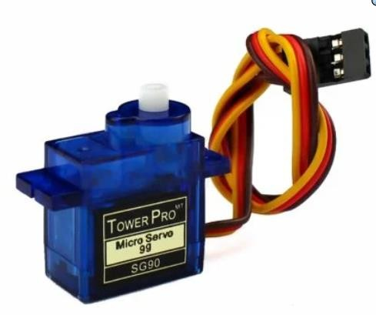
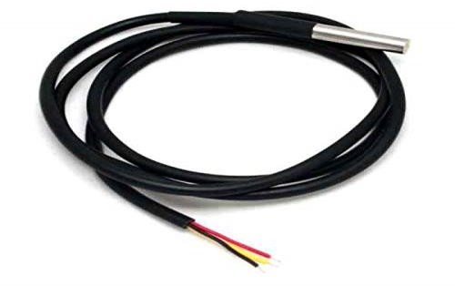
HARDWARE COMPONENTS
DS18B20 WATERPROOF TEMPERATURE SENSOR
180˚ ROTATION SERVO MOTOR
The servo motor, such as the 180-degree servo may rotate to a certain angle in response to the signal.
It is used for rotating roof for automation
The DS18B20 digital thermometer, provides temperature measurements in the 9-bit to 12-bit Celsius range

Slide 7


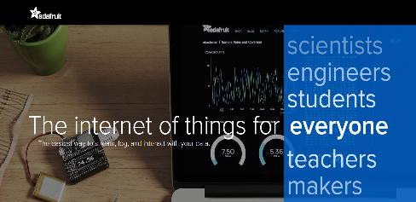
SOFTWARE USED
OPEN WEATHER API
ADAFRUIT IO
It provides real-time and forecast weather data for any location, enabling you to build weather apps and websites , Optimize agriculture and so on.
Think of Adafruit IO as your online hub for connecting, storing, and interacting with data from your electronics projects. It's like a cloud playground for tinkerers and makers!

Slide 8

PROPOSED SYSTEM
IoT-based Smart agriculture monitoring system is to devise a model that can accurately harbinger the weather forecast, soil temperature, moisture, and water level, also with additional attributes such as automatic roof shading.
This model is designed to predict every aspect required for a perfect agricultural environment in real-time or for forthcoming periods, facilitating users to recede costs and save time.
As a result of the interaction between weather and agriculture, precise weather forecasting is required for agriculturalists to make knowledgeable determinations that will not result in losses. The model has significant implications for weather forecasting and monitoring agriculture factors such as water level, soil temperature, and moisture.
Therefore, the successful development of an IoT-based Smart agricultural model can have far-reaching benefits for society, the economy, and the environment.

Slide 9

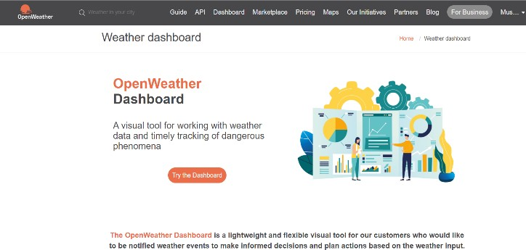
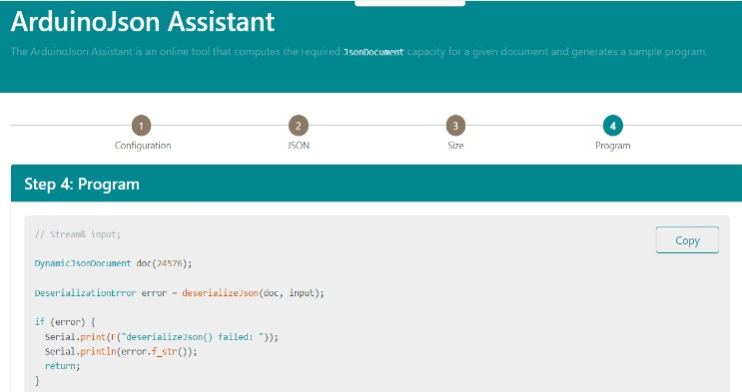
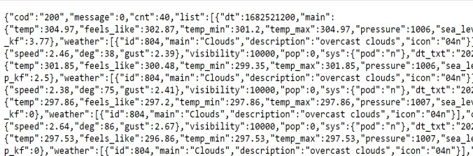
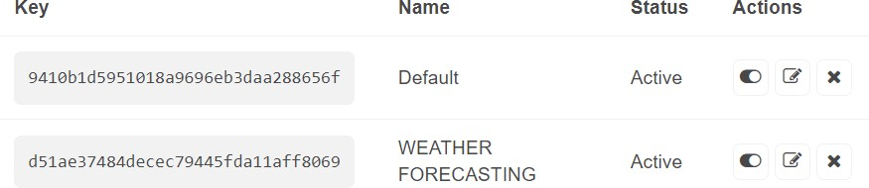
FEATURES
WEATHER FORECASTING USING OPEN WEATHER API
The prediction of atmospheric conditions based on location and time is known as weather soothsaying.
It is essential to accurately predict the amount of precipitation in order to provide growers the information they need to make decisions that are unlikely to result in losses.
Accurate rainfall forecasting is necessary for growers to come up with selections that will not result in losses.
Open weather API screen
API Key created
Collection of weather data of
Chandigarh City using created key
Use of ArduinoJson Assistant to get the program code to implement the collected weather data

Slide 10
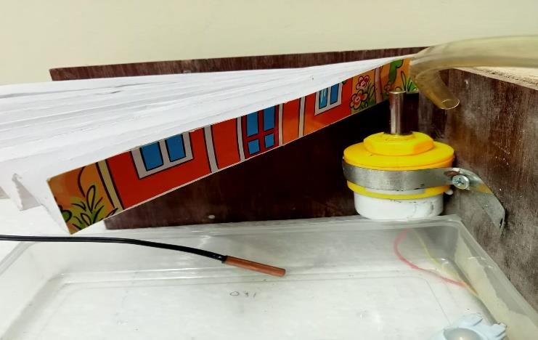
FEATURES
AUTOMATIC ROOF SHADING
When excessive rain falls on the harvested crops, which have been allowed to dry out, they decay and are destroyed, forcing the growers to solve a conundrum.
Some crops need to dry before being offered for sale at the agriculture request yard, a space that the majority of growers don't have and takes a long time to do.
In order to protect growers from extreme loss when they encounter loss, this piece of equipment has been constructed.
Automatic Roof Using Servo Motor

Slide 11
FEATURES
SMART IRRIGATION AND WATER CONSERVATION SYSTEM
Irrigation is the process of applying water to land instinctively to increase agriculture product and farming.
In dry locations and during periods of below-average precipitation, it aids in the growth of agricultural crops, the maintenance of geography, soil, and connections, and the revegetation of disturbed soils.
MONITORING AGRICULTURAL FACTORS
The goal of this design is to support producers in obtaining real-time data (temperature, moisture, soil humidity, and soil temperature) for efficient terrain evaluation, allowing them to improve both yield and quality of the product.

Slide 12

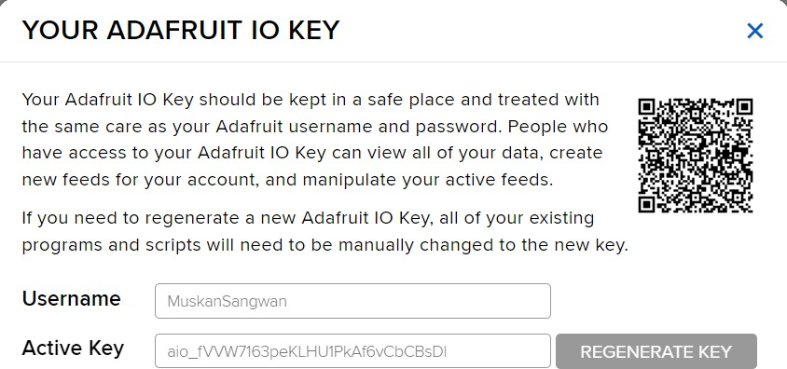
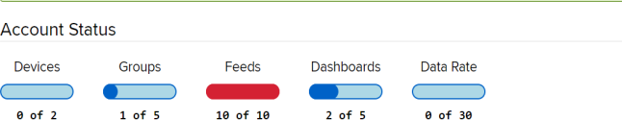
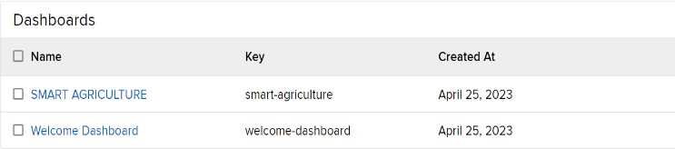
IMPLEMENTATION
IMPLEMENTATION ON ADAFRUIT IO
Adafruit IO is an Internet of Things(IoT) cloud platform that allow users to connect their devices to the internet and collect, store, and visualize data from those devices. It is a low-code/no-code platform. Meaning that users can create and manage Iot projects without having to write a lot of code.
Key generated
Account status on service
Creation of dashboard

Slide 13
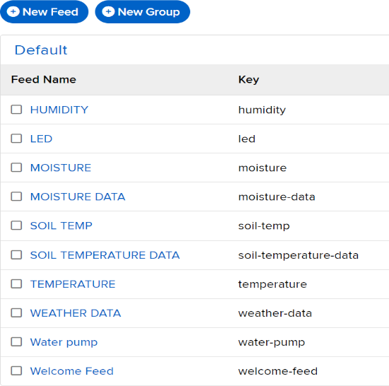
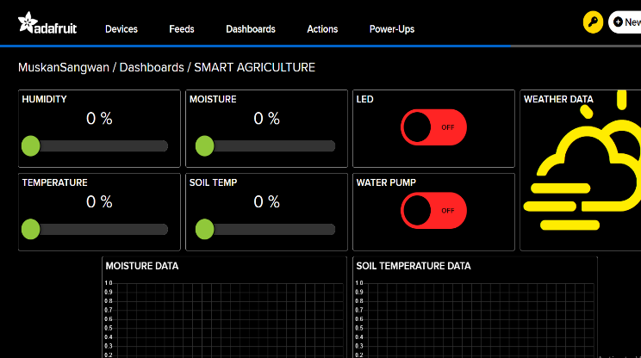
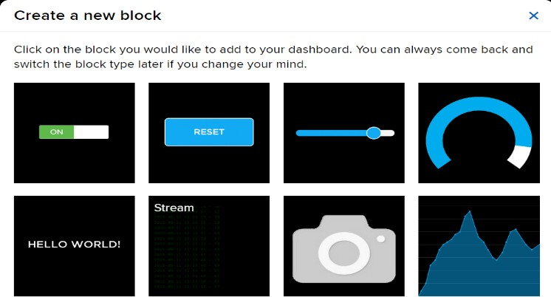
IMPLEMENTATION
IMPLEMENTATION ON ADAFRUIT IO
Output screen on Adafruit IO for monitoring factors and weather
Creation of feeds
Creation of blocks

Slide 14
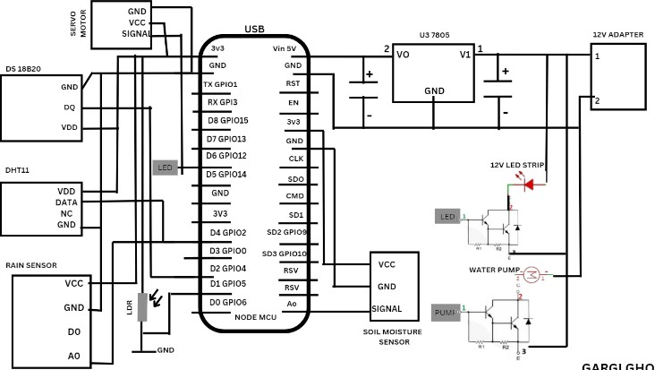
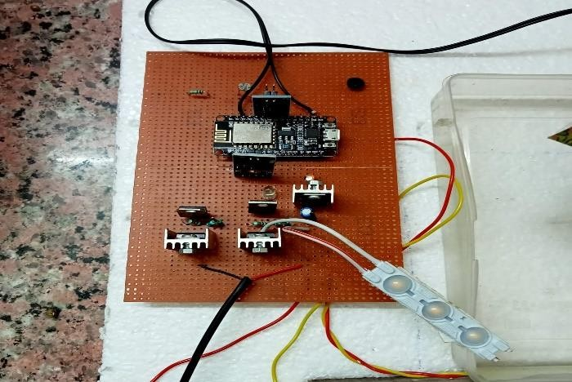
IMPLEMENTATION
HARDWARE CONNECTIONS
All the hardware connections are done as shown in the circuit diagram for smart irrigation, monitoring factors and automatic roof shading and all these connections on PCB board are below :
Circuit diagram for hardware connections
Hardware connections on PCB

Slide 15

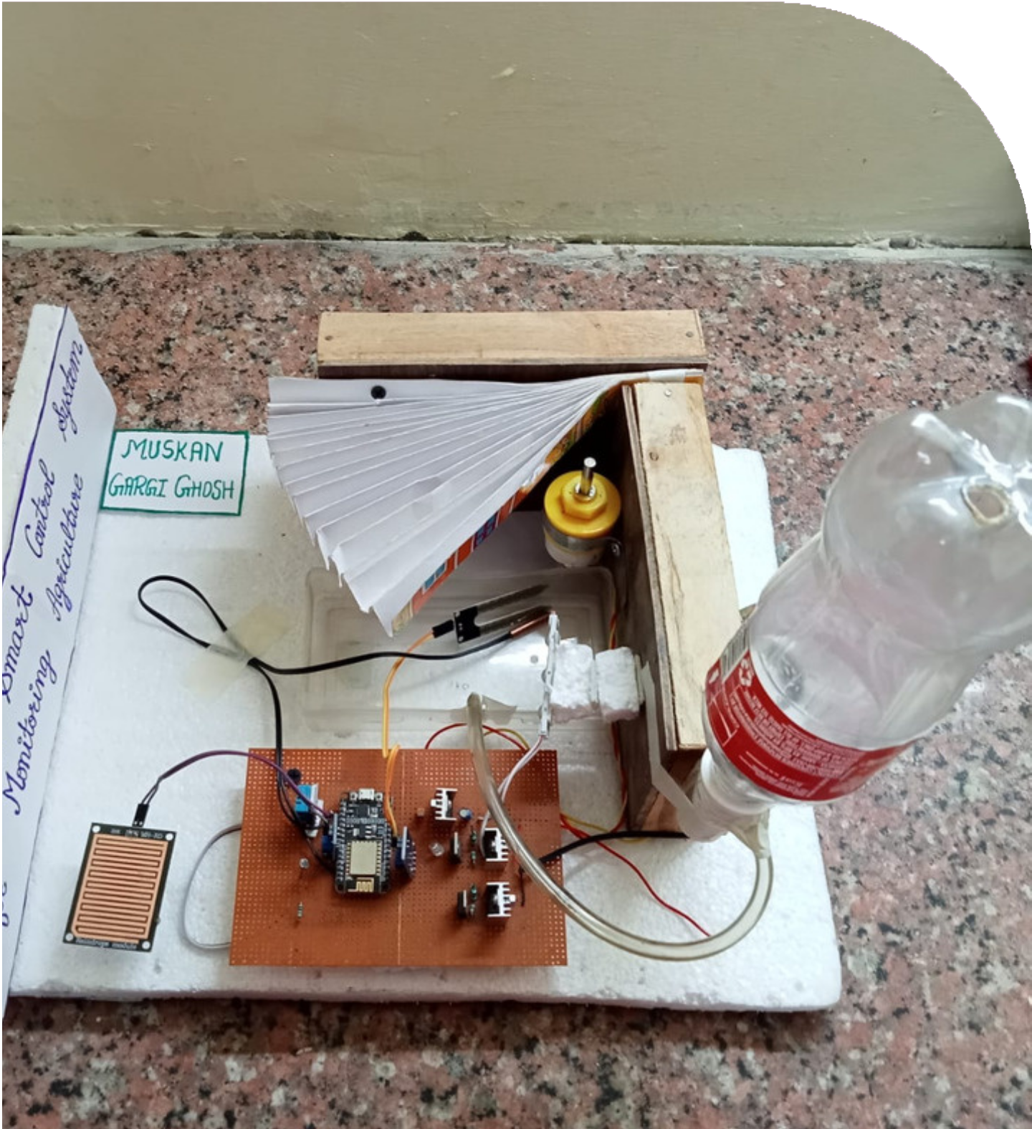
RESULT AND DISCUSSION
The effective layout of an IoT-based smart control system reduces the time and resources required when monitoring agricultural manually. This system makes use of a technology called the Internet of Things. This device measures soil pressure, temperature, and humidity in addition to automating rood shading. The numerous measurements made for weather forecasting and agriculture are shown on the screen .
Additionally, it regulates the irrigation system and makes weather forecasts. Under ideal conditions, this approach works well, but when those criteria fail to meet requirements, as when there is not enough lighting or lightning, additional improvement may be accomplished.
Proposed system

Slide 16
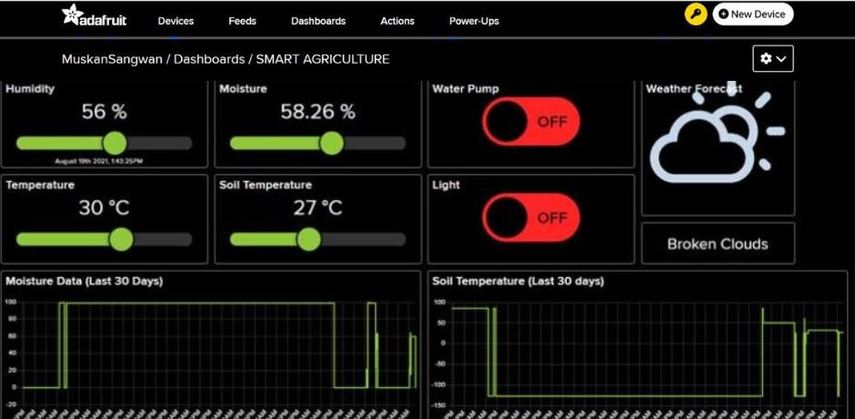
RESULT AND DISCUSSION
As already stated, It is an Iot-based project i.e., combination of hardware and Software. In this project various sensors are used with ESP8266 and servo motor and other components on PCB board and using Adafruit IO online Services, their data is being shown on Software along with live weather data.
In short, this invention helps in getting live weather data, have automatic roof shading to save crops, smart irrigation system to save crops and getting absolute values for various agriculture affecting factors.
Output of Proposed system on Adafruit IO

Slide 17

CONCLUSION
The Objective of this project is to offer assistance to farmers in getting live data (temp, humidity, soil moisture, soil temperature) for efficient-environment monitoring. It will enable them to increase their overall yield and quality of production.
It is an Iot-based project and is a combination of various projects in one go only for farmers.
The proposed system is intended to offer a new element to the agricultural backdrop for farming in order to help farmers produce better-quality and higher-yielding crops. The data used to construct the proposed system makes it clear that there are number of steps that must be performed to create a completely IoT-based smart control system for monitoring agriculture that was successfully created and deployed.
This approach will reduce the farmers' demand for labour as well as save them money and time. Although this policy would have an impact on the economy, it would ultimately be a significant step in the direction of a more sustainable and healthy national economy

Slide 18

REFERENCES
Ritika Srivastava, Vandana Sharma; A Research Paper on Smart Agriculture Using IoT; International Research Journal of Engineering and Technology (IRJET); e-ISSN: 2395-0056; p-ISSN: 2395-0072
Abhimanyu Pandit; IoT Based Smart Irrigation System Using Soil Moisture Sensor and ESP8266 NODEMCU; International Journal of Computer Science and Information Technology Research ISSN 2348-120X; ISSN 2348-1196
Andizo Elion Privat Dany, Prof. Xiong Shuming; Agriculture Monitoring System Using Smart and Innovative Farming: A Real- Time Study; International Journal of Scientific & Technology Research Volume 8, Issue 12, December 2019; ISSN 2277-8616
Dr. M.Murugesan; Smart Agriculture Monitoring System; Turkish Journal of Computer and Mathematics Education; Vol.10 No.03 (2019), 1001-1005
A.Narayana Moorthy; Doubling Farm Income in India: Strategies and Options; Indian Journal of Agriculture Marketing; VOLUME 33.NO.03.

Slide 19
REFERENCES
Joji Mitto K S, Dr. Preeti Savant ; A Research paper on Auto Controlling Irrigation System Using Arduino UNO ; International Journal for Research in Applied Science & Engineering Technology (IJRASET) ; ISSN: 2321-9653; IC Value: 45.98; SJ Impact Factor:7.538 Volume 10 Issue IV Apr 2022
Puja Sharma and Shiva Prakash; Real Time Weather Monitoring System Using Iot; ITM Web of Conferences 40, 01006 (2021) ICACC-2021; Department of Information Technology and Computer Application
Adithya Vadapalli, Swapna Peravali ; Smart Agriculture System using IoT Technology ; International Journal of Advance Research in Science and Engineering ; ISSN 2319-8354 ; Vol.No.9, Issue No.9 September,2020
Okafor, Johnpaul (2018); Design and Implementation of a Rain Sensor as a Protective System. 10.13140/RG.2.2.34760.47366/1.

Slide 20
THANK YOU EVERYONE
HAVE A GOOD DAY

