Slide 1


A Presentation On Summer Project Report On Library Management System
Name : Mukesh Mandal ( 8167/17 )
TU Reg no : 7-2-939-75-2017
Under the Supervision of
Er. Dhiraj Kumar Jha

Slide 2
Objectives
To make the existing system computerized.
To make working procedure faster in library.
To improve the searching of the books.

Slide 3
Methodology
Secondary source of data collection (internet)
Use increment method for requirement collection

Slide 4
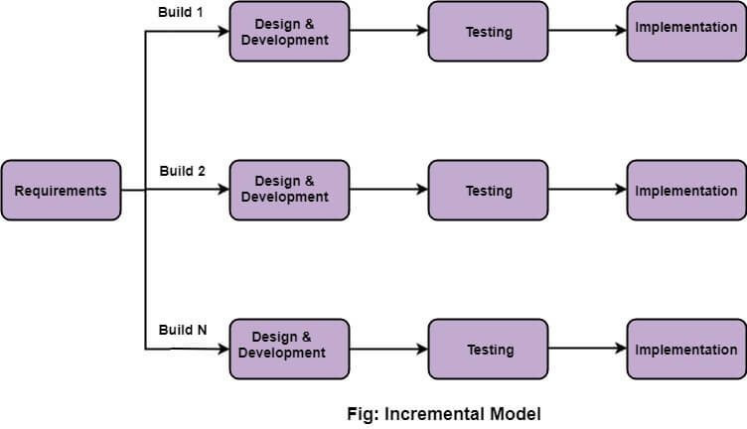
Software Process Model
Whole requirement -> various builds
Multiple development cycle -> “multi-waterfall” cycle.
Cycles -> smaller, more easy managed modules.
Each module -> phases (req, design, imp and testing)

Slide 5
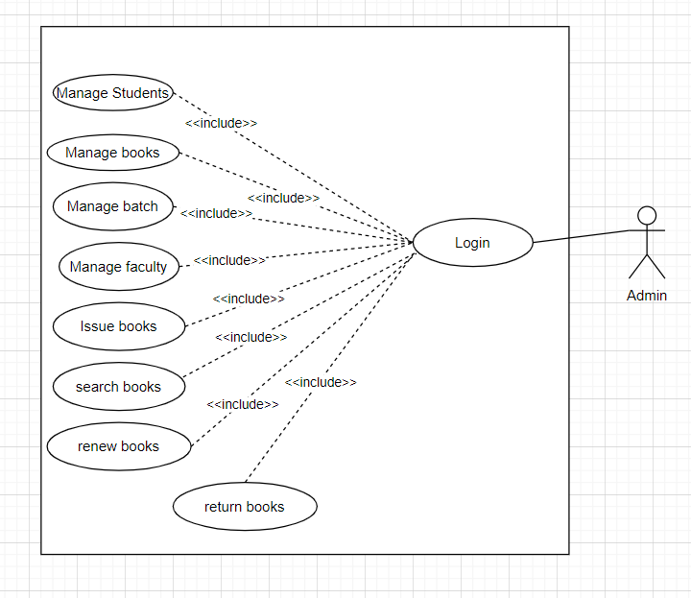
Use Case Diagram

Slide 6
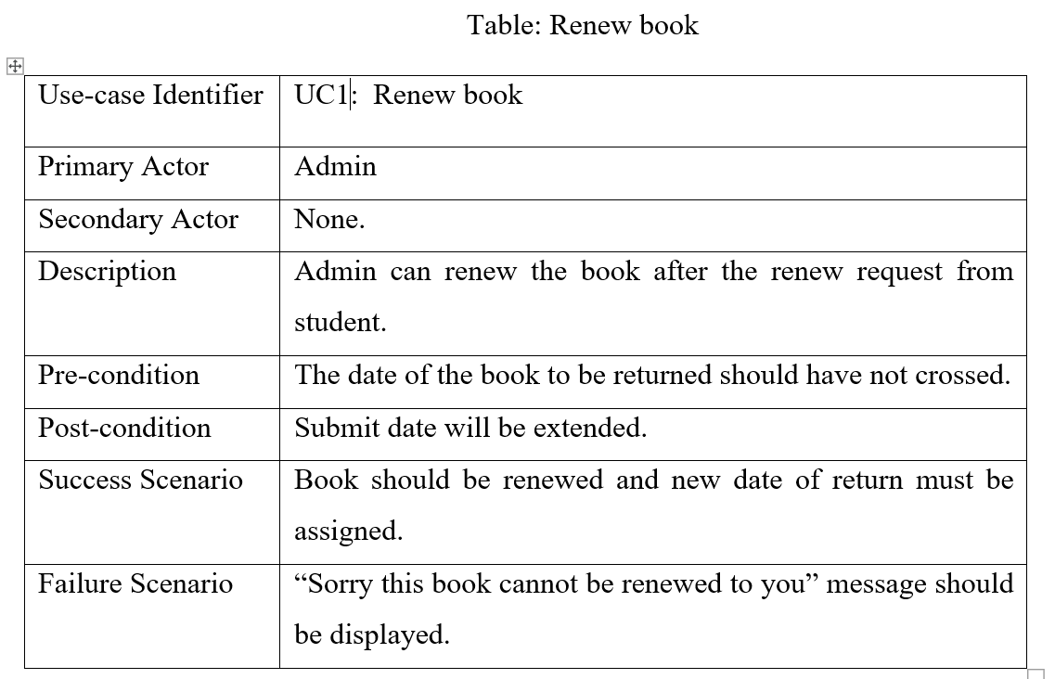

Slide 7
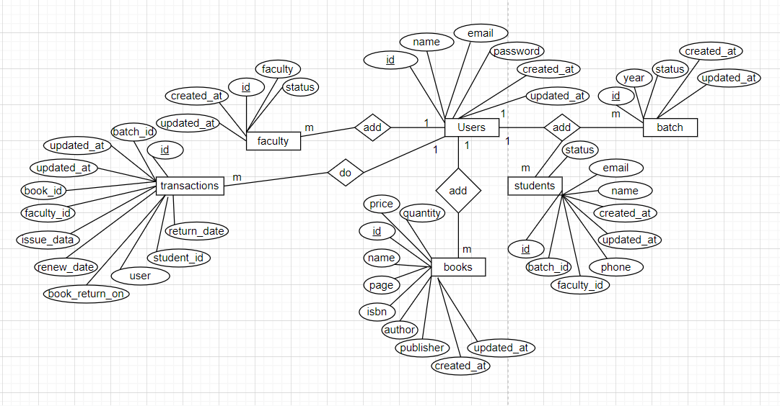
DATABASE DESIGN (ER Diagram)
Figure : ER – Diagram

Slide 8
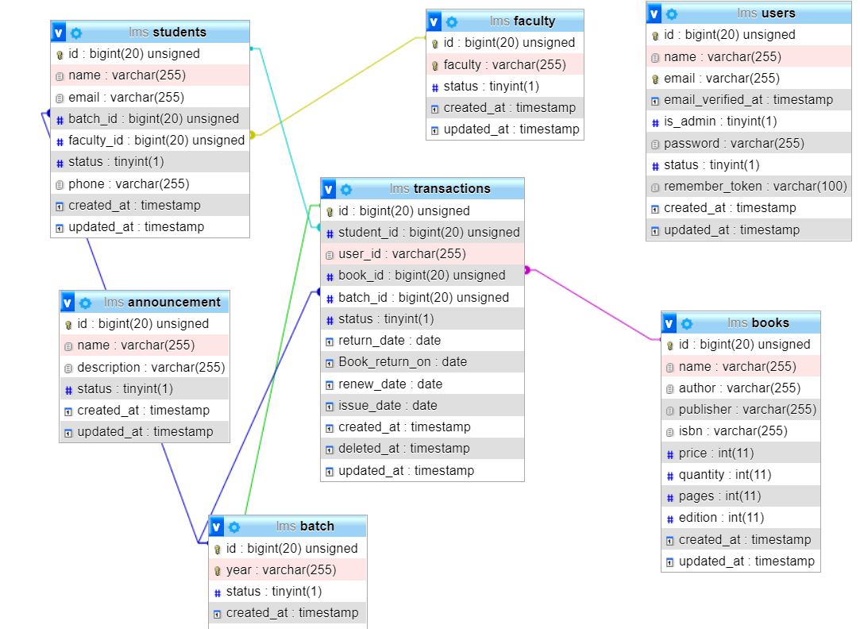
DATABASE DESIGN (Relational diagram)

Slide 9
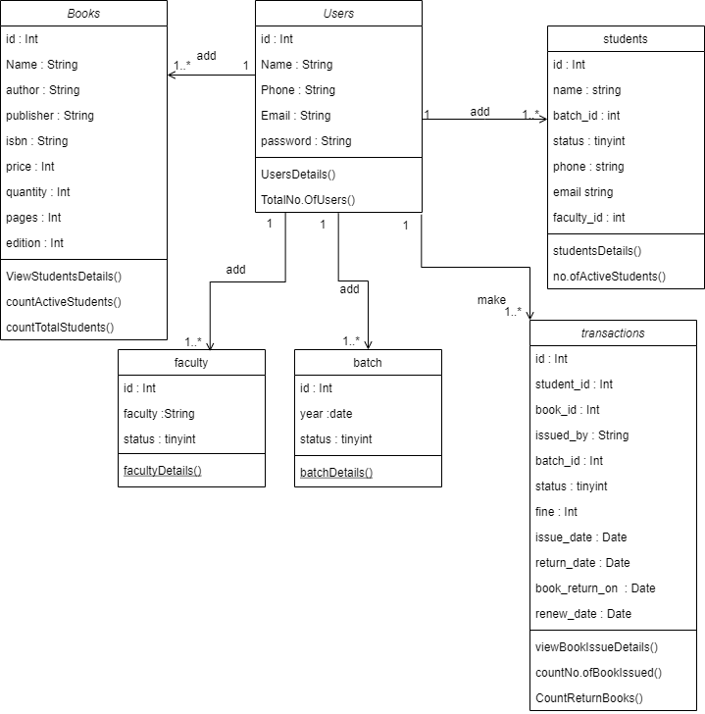
Class Diagram

Slide 10
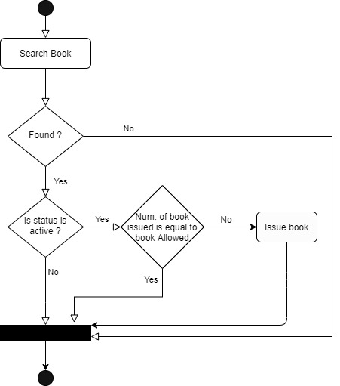
Activity Diagram

Slide 11
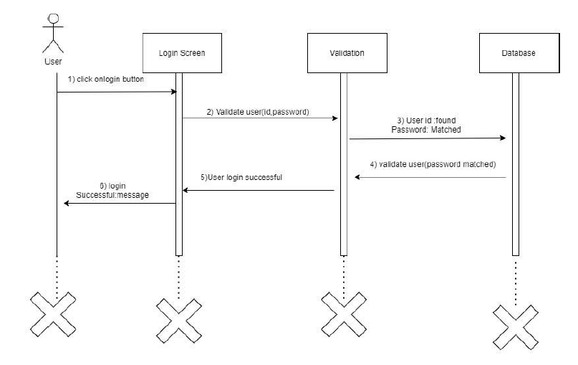
Sequence Diagram

Slide 12
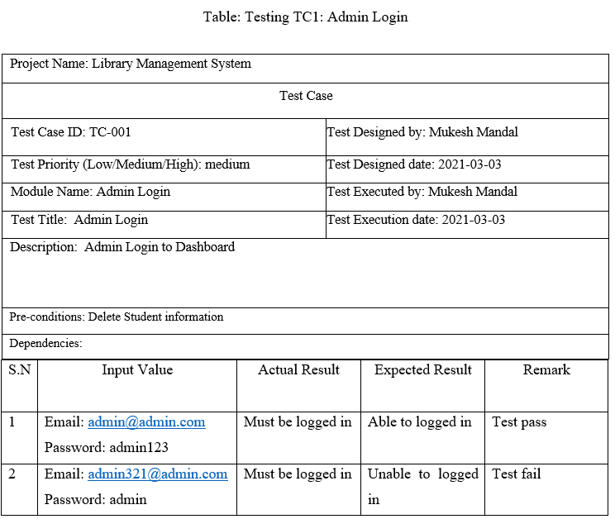
Test Cases

Slide 13
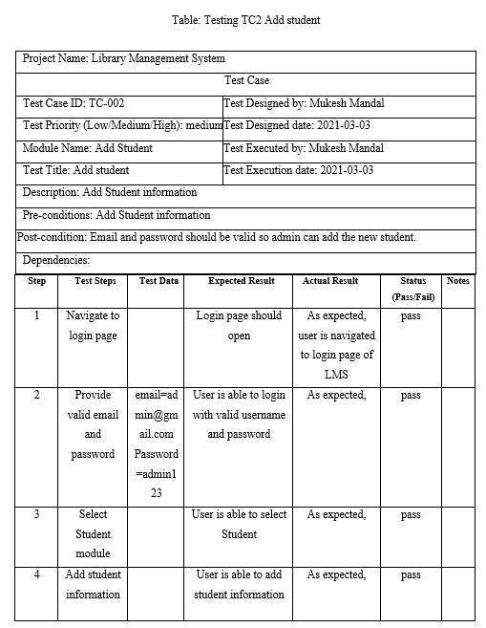

Slide 14
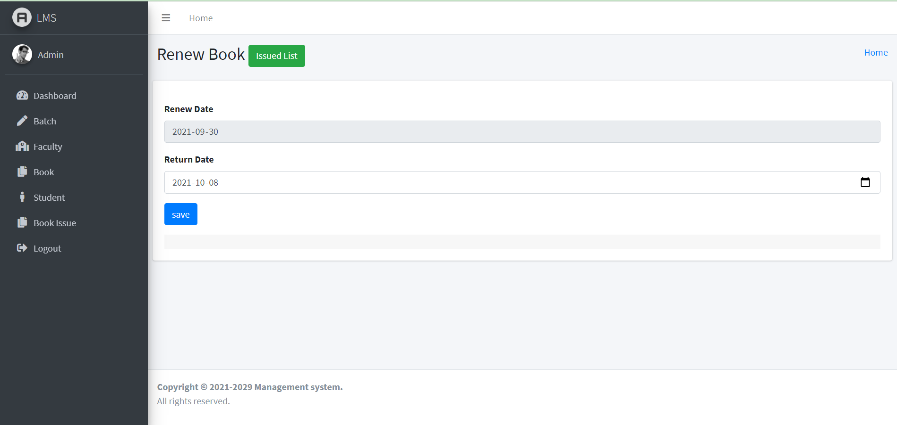
Test Cases – Usability Test

Slide 15
REFERENCES
js.foundation, J. (2019). jQuery.ajax() | jQuery API Documentation. Retrieved from https://api.jquery.com/jquery.ajax/
js.foundation, J. (2019). .clone() | jQuery API Documentation. Retrieved from https://api.jquery.com/clone/
Principles Of MVC for PHP Developers. (2019). Retrieved from https://www.htmlgoodies.com/beyond/php/article.php/3912211/Principles-Of-MVC-for-PHP- Developers.htm
Koreng, I. (2019). Training Material. Retrieved 13 June 2019, from https://about.draw.io/features/training-material/
Fetch data From DatabaseTabele to dropdown menu (2018, May 21). Retrieved from stackoverflow: https://stackoverflow.com/questions/34575/fetch-data-from-databasetable-to-dropdown-menu
PHPTutorial. (2018, May). Retrieved from javatpoint: https://www.w3schools.com/php/php_arrays_multi.asp
Sommerville, I. (2011). Software Engineering ninth edition. Pearson Education .
JavaScriptTutorial. (2018, May). Retrieved from javatpoint: https://www.javatpoint.com/javascript-tutorial
MySql Tutorial. (2018, June). Retrieved from https://www.tutorialspoint.com: https://www.tutorialspoint.com/mysql/index.htm

Slide 16
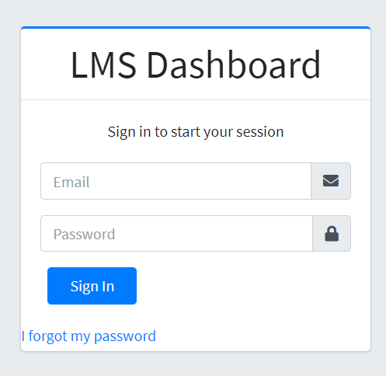
SCREENSHOTS
Figure :Login page

Slide 17
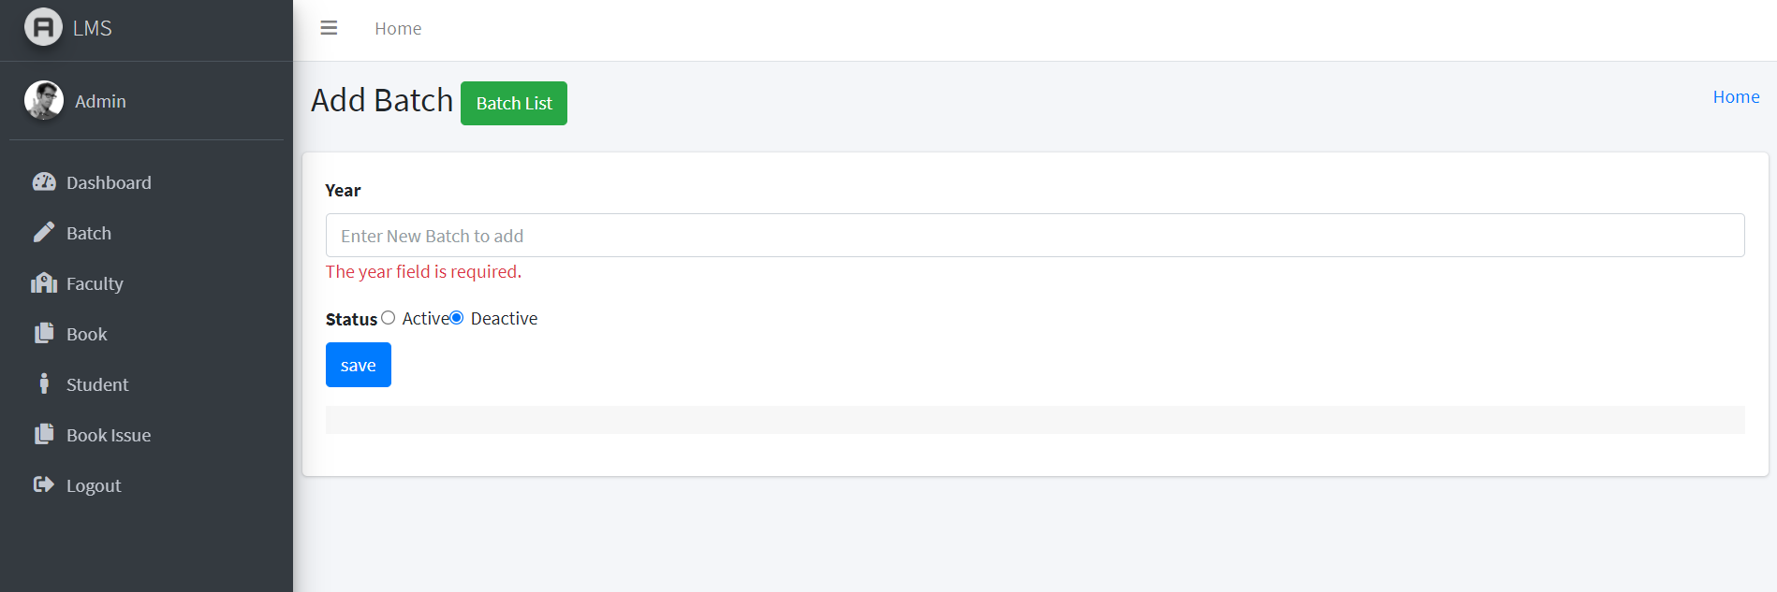
Figure : Create batch for batch table

Slide 18
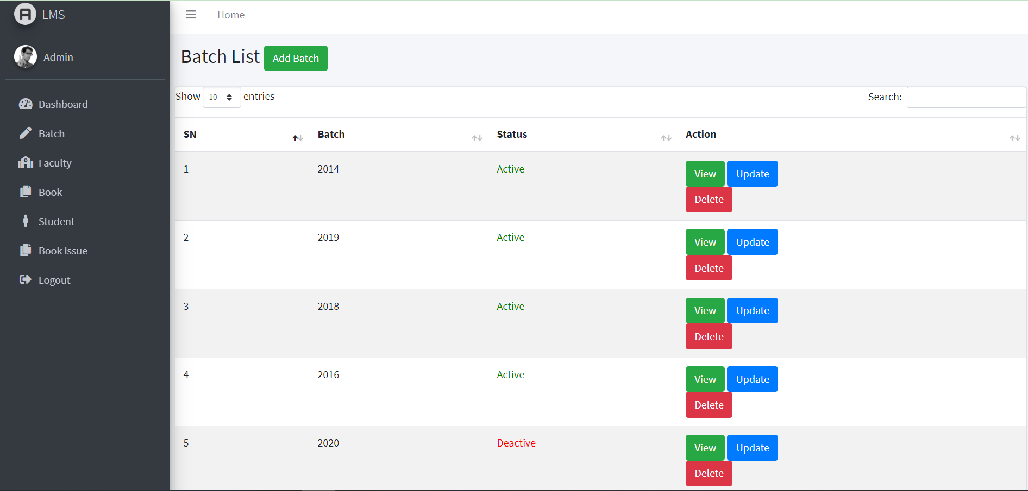
Figure : List of data

Slide 19
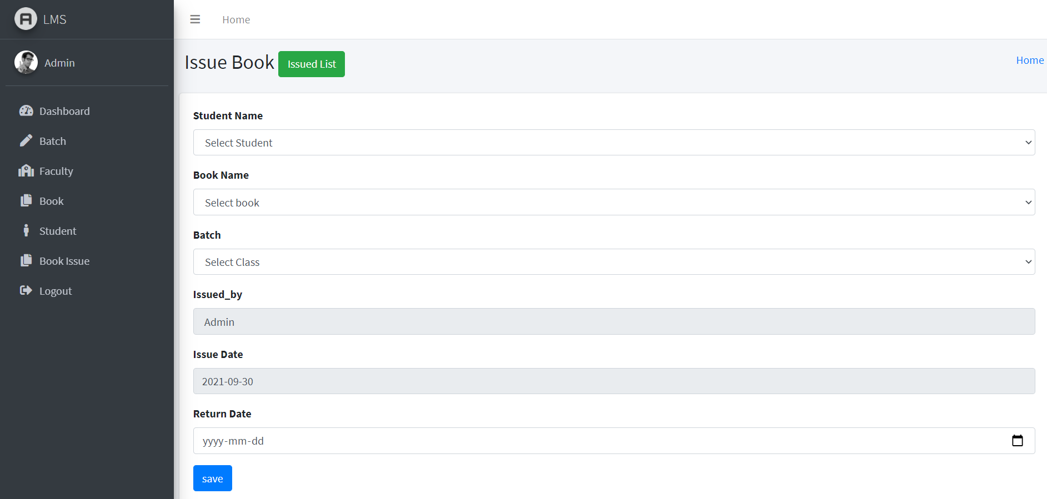
Figure : Issue book

Slide 20
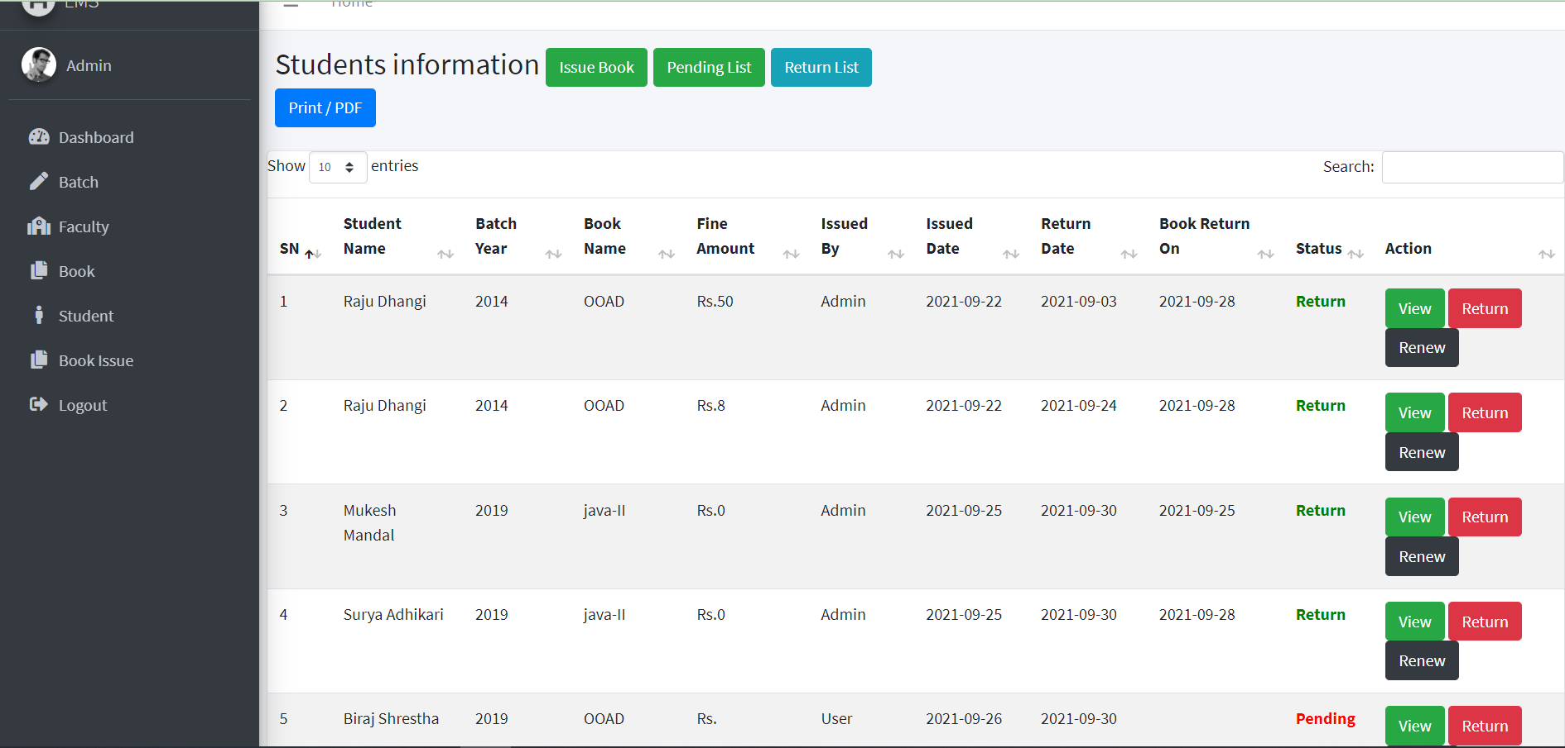
Figure : List of book issued

Slide 21
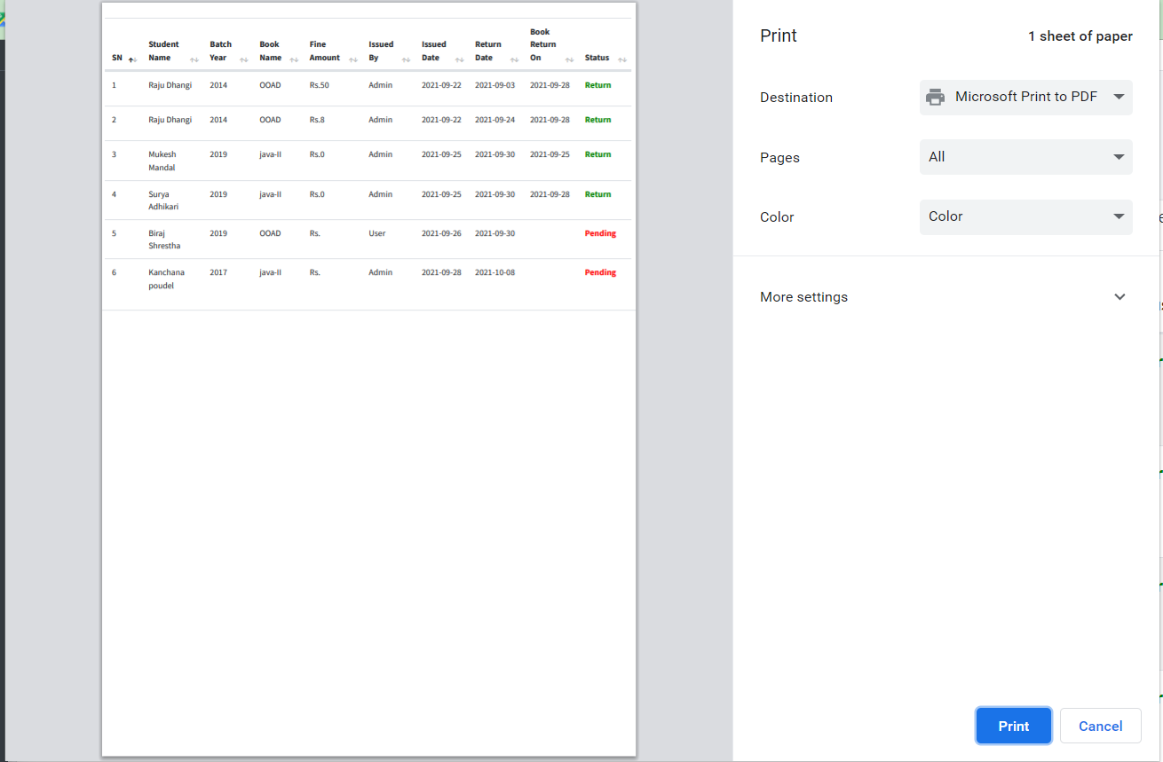
Figure : Book Issued Print

