Slide 1

COMPANIES BANKRUPTCY DATA
GROUP 3 MUKUL AGRAWAL

Slide 2
Introduction
Bankruptcy prediction is of critical importance for businesses, investors, and stakeholders as it allows them to make informed decisions and mitigate potential risks. Understanding the impact of bankruptcies on the economy highlights the need for effective predictive models that can identify vulnerable companies and help prevent financial crises.
1. Bankruptcy prediction enables businesses to:
Assess financial stability
Improve strategic planning
Optimize resource allocation
2. For investors and stakeholders, bankruptcy prediction facilitates:
Risk assessment and management
Identification of investment opportunities
Portfolio diversification

Slide 3
Data Description
1. Dataset Source: Emerging Markets Information Service (EMIS)
Comprehensive database on emerging markets worldwide
2. Timeframe:
Bankrupt companies: 2000-2012
3. Attributes and Variables:
64 financial attributes (X1 to X64)
Examples: net profit / total assets, net profit/sales, total assets, working capital, sales/inventory
4. Dataset Structure:
Instances representing financial statements of companies
Class label indicating bankruptcy status (bankrupted or not bankrupted) within the forecasting period

Slide 4
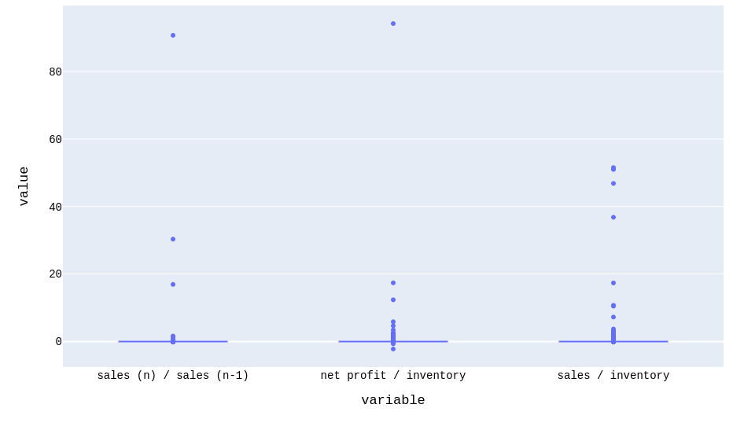
Data Preprocessing
Following steps were taken during Data Preprocessing:
Deal with null values
For this project we have divided our approach to deal with null values into 2 ways:
If in a column the null value percentage is below 3, we have deleted those rows. After this step, we removed almost 7% of the data.
If column has more than 3% null values, then fill with median instead of mean because these columns contain outliers

Slide 5
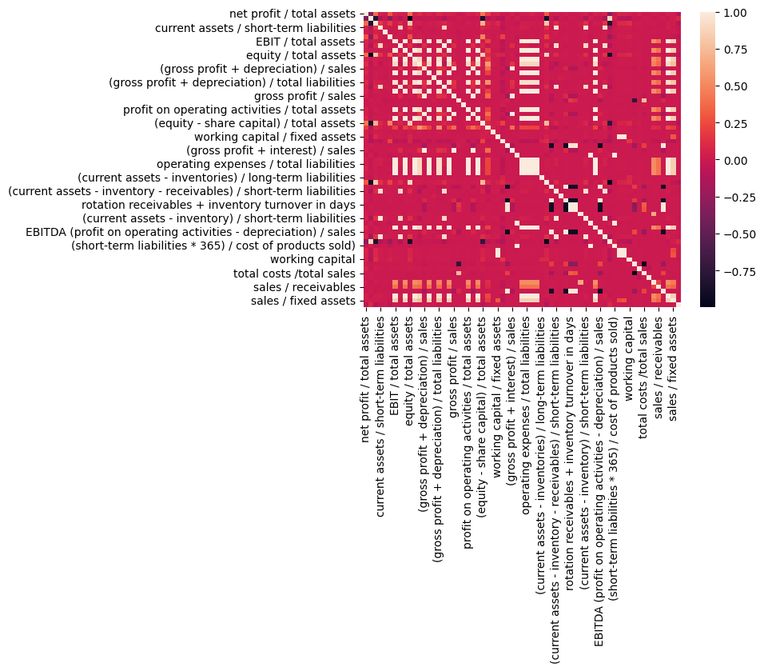

Data Preprocessing
Following steps were taken during Data Preprocessing:
Deal with correlated variables: There are 39 columns that can be dropped to remove collinearity from the dataset. The heat plot after dealing with collinearity looks like the below plot. The number of columns in the dataset is 25.

Slide 6
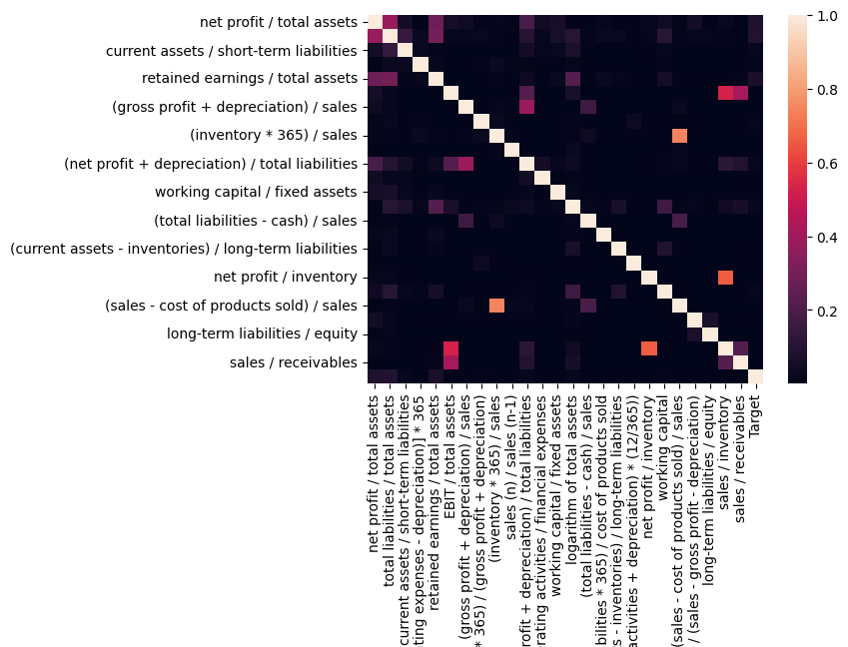
Data Preprocessing
Following steps were taken during Data Preprocessing:
Deal with correlated variables: There are 39 columns that can be dropped to remove collinearity from the dataset. The heat plot after dealing with collinearity looks like the below plot. The number of columns in the dataset is 25.

Slide 7

Data Preprocessing
Following steps were taken during Data Preprocessing:
Deal with unscaled data
Standardization is a scaling method where the values are centered around the mean with a unit standard deviation. This means that the mean of the attribute becomes zero, and the resultant distribution has a unit standard deviation.
Here’s the formula for standardization:

Slide 8
Data Preprocessing
Following steps were taken during Data Preprocessing:
Deal with Imbalanced data
To deal with imbalanced data we are using SMOTE (Synthetic Minority Over-sampling Technique). This works by randomly selecting the value of a column from its nearest k neighbors.
The steps followed by SMOTE are:
Select all minority class observations.
For each minority class observation, find k neighbors
To create a new observation, go through all the observations one by one and select a random value from its neighbors for each column.
Repeat this process the number of times the majority class is to the minority class
In our dataset, the companies that filed for bankruptcy are 379 compared to 9071 companies that did not.
After using SMOTE on training data, the companies that filed for bankruptcy are 6600 while companies that did not are 6340 in number.

Slide 9
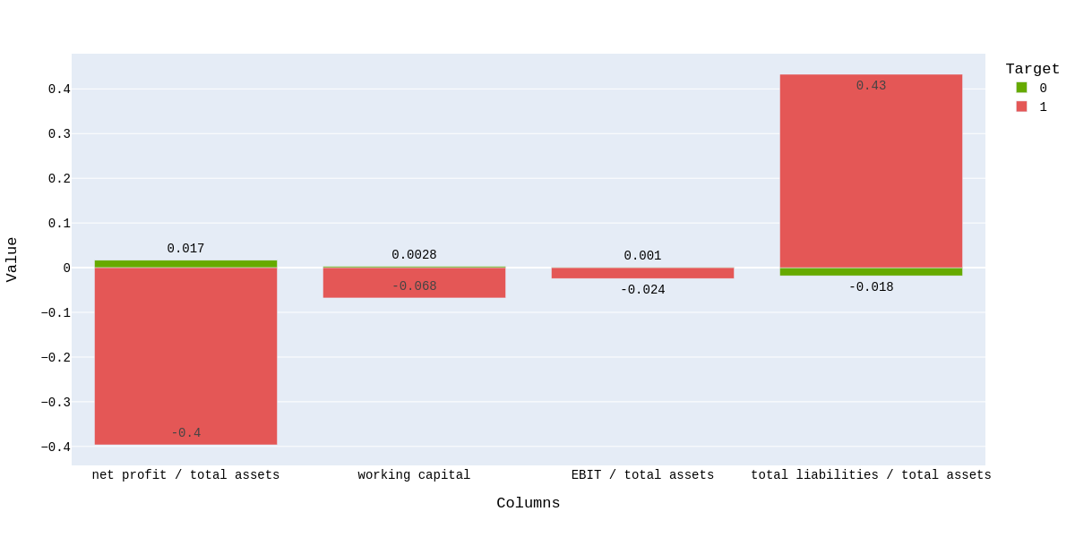
Exploratory Data Analysis
Bar plot for the mean value of different features (0: No Bankruptcy, 1: Bankruptcy)

Slide 10
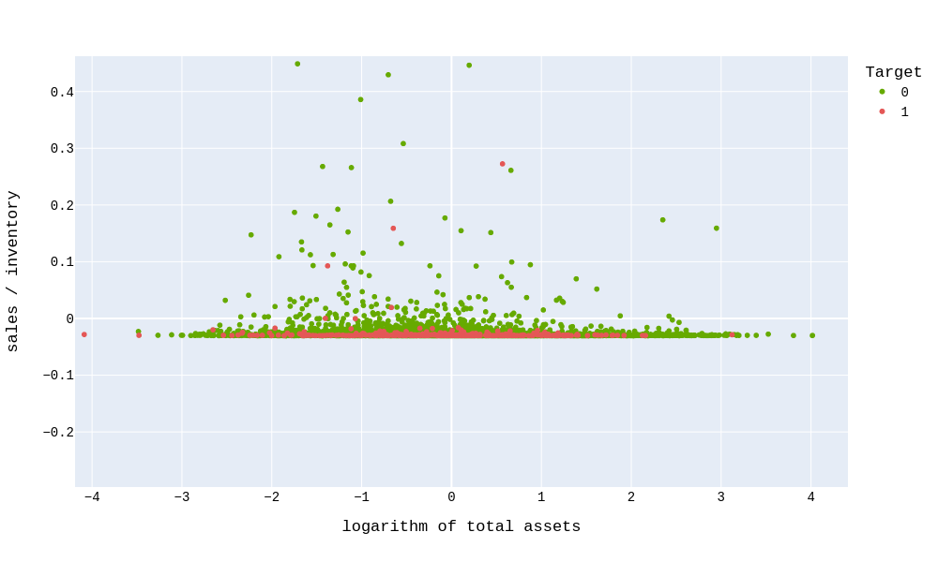
Exploratory Data Analysis
Scatter plot between Sales/inventory and total assets

Slide 11
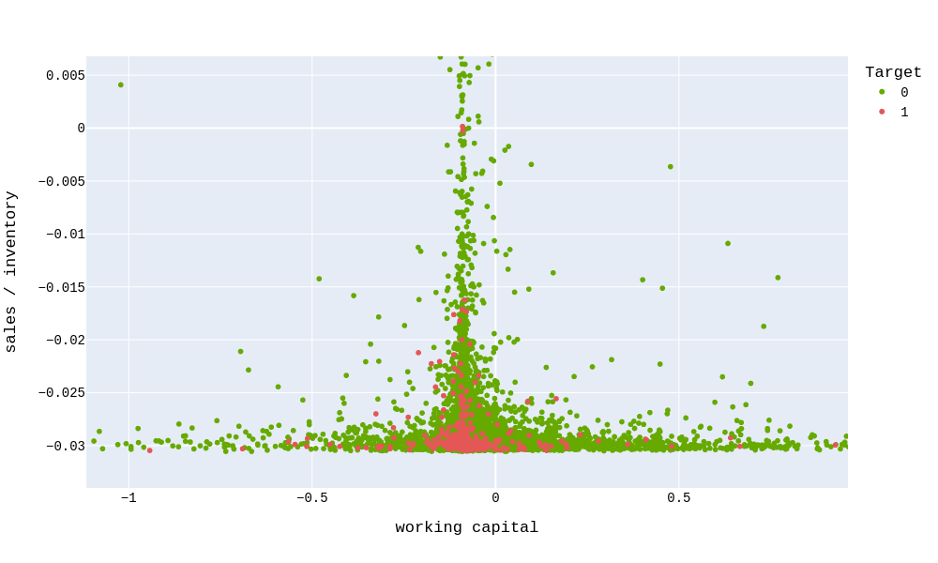
Exploratory Data Analysis
Scatter plot between Sales/inventory and working capital

Slide 12
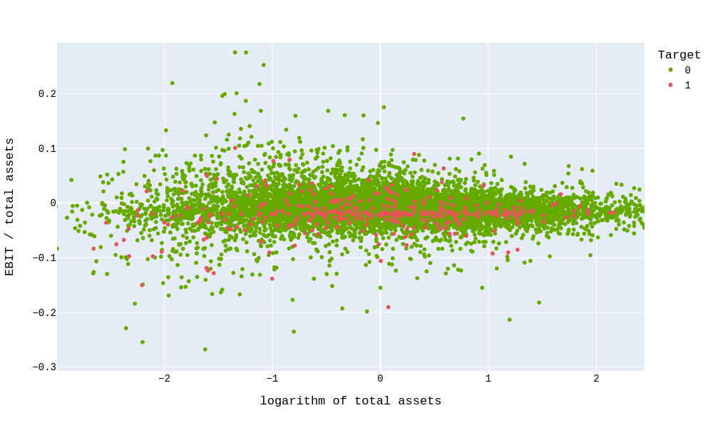
Exploratory Data Analysis
Scatter plot between Sales/inventory and working capital

Slide 13
Machine Learning Models Implementation
For our project, we have used the following models:
Logistic Regression
Gradient Descent
Stochastic Gradient Descent
Ridge Regression
Lasso Regression
Naive Bayes
Support Vector Machine
The metrics taken for evaluation purpose are:
Accuracy
F1 Score
Area Under Curve Receiver Operating Characteristic (AUC ROC)

Slide 14
Results
 | Logistic Regression |  | Gradient Descent |  | Stochastic Gradient Descent |  | Ridge Regression |  | Lasso Regression
 | train | test | train | test | train | test | train | test | train | test
Accuracy | 45.07 | 52.98 | 54.9 | 32.9 | 54.9 | 41.0 | 48.4 | 52.38 | 55.06 | 44.73
Precision | 0.46 | 0.52 | 0.54 | 0.03 | 0.55 | 0.04 | 0.49 | 0.04 | 0.55 | 0.03
Recall | 0.39 | 0.04 | 0.76 | 0.63 | 0.67 | 0.58 | 0.46 | 0.49 | 0.63 | 0.52
F1_Score | 0.42 | 0.07 | 0.63 | 0.06 | 0.6 | 0.07 | 0.47 | 0.07 | 0.59 | 0.06
AUC | 0.53 | 0.62 | 0.54 | 0.46 | 0.54 | 0.47 | 0.48 | 0.53 | 0.55 | 0.45

Slide 15
Results
 | Naive Bayes |  | SVM
 | train | test | train | test
Accuracy | 53.23 | 9.62 | 51.0 | 3.66
Precision | 0.52 | 0.90 | 0.51 | 0.03
Recall | 0.97 | 0.035 | 1.0 | 1.0
F1_Score | 0.68 | 0.06 | 0.67 | 0.07
AUC | 0.98 | 0.91 | 1.0 | 1.0

Slide 16
Conclusion & Future Scope
Both Naive Bayes and SVM models showed good results. Recall is a metric that measures the percentage of actual positive cases correctly identified by the model. This implies that the models are correctly identifying most of the companies that may go bankrupt in the future.
Following are some of the steps which we would like to use to improve our results:
Apply Neural Network
Hyperparameter Tuning
Feature Selection
Use Validation data

