Slide 1
Final Year Project Management System using MERN Stack
Mukul Yadav
Manipal University , Jaipur
Major Project

Slide 2
Introduction & Problem Statement
What is a Project Management System?
Why Digital Tracking Matters
A digital platform that streamlines project tracking, collaboration, and progress monitoring for academic or professional projects.
Manual project handling creates bottlenecks, lost documents, and communication gaps between students and faculty.
Manual Project Handling Issues
Lack of Centralized System
Communication Barriers
Information scattered across emails, documents, and physical files without unified access
Difficulty in real-time updates and feedback between students and teachers
Paper-based systems lead to lost documents, version conflicts, and tracking difficulties

Slide 3



Motivation & Objectives
Automation in Academic Projects
Transparency & Tracking
Reduce Errors
Eliminate manual paperwork and streamline project submission, review, and approval processes
Real-time visibility into project status, milestones, and feedback for all stakeholders
Minimize human errors through structured workflows and automated notifications
Project Objectives
01
02
Centralized System
Role-Based Access
Single platform for all project-related activities and documentation
Secure dashboards for Admin, Teacher, and Student users
03
04
Real-Time Updates
Secure Authentication
Instant notifications and progress tracking across all levels
JWT-based authorization ensuring data protection and privacy

Slide 4




Technologies Used
MongoDB
Express.js
NoSQL database for flexible, scalable data storage
Backend framework for handling API routes and middleware
React.js
Node.js
Frontend library for building responsive user interfaces
Server runtime for executing JavaScript on the backend
Additional Tools
JWT (JSON Web Tokens)
Multer
REST APIs
Secure authentication and session management
File upload middleware for handling project documents
Stateless communication between frontend and backend

Slide 5
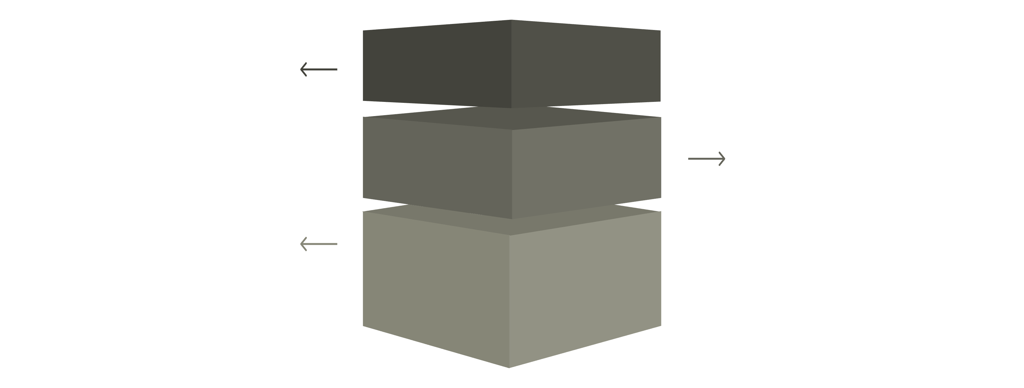
System Architecture
React Frontend
Renders UI, handles interactions, calls APIs.
Express & Node
Processes requests, executes server logic, authenticates.
MongoDB Database
Stores documents, serves queries, persists data.
Frontend Layer
Backend Layer
Database Layer
React.js components render dynamic UI, handle user interactions, and make API calls to backend
Express.js routes process requests, Node.js server executes logic, JWT handles authentication
MongoDB stores user data, projects, files, and relationships in structured collections

Slide 6
Key Features
1
2
User Authentication
Role-Based Access Control
Secure login and registration system with encrypted password storage
Different dashboards and permissions for Admin, Teacher, and Student roles
3
4
Student Dashboard
Teacher Dashboard
Submit projects, track progress, view feedback, and manage documents
Review submissions, provide feedback, approve projects, and monitor student progress
5
6
Admin Panel
File Management
Manage users, approve projects, configure system settings, and view analytics
Upload, store, retrieve, and version control project documents and resources

Slide 7





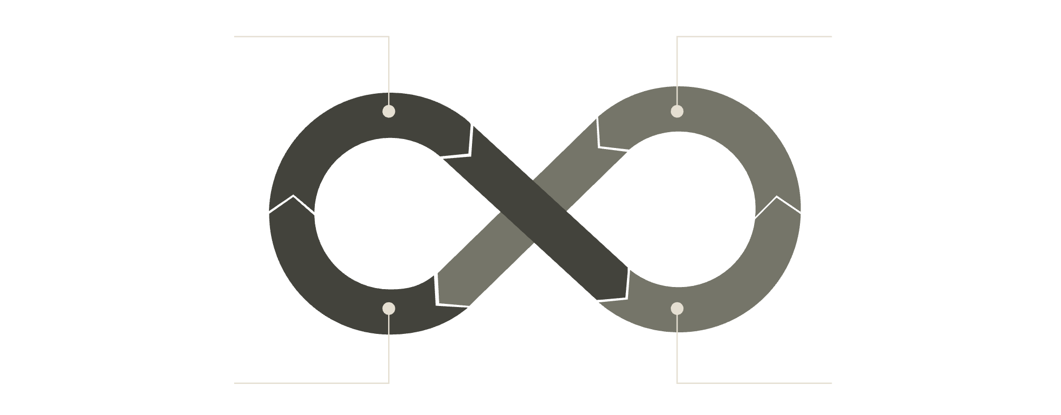
Methodology & Working Flow
Development Methodology
Requirement Analysis
Gather system requirements and user needs
System Design
Database schema and UI/UX planning
Development
Frontend and backend implementation
Testing
Functional and integration testing
Deployment
Production environment setup
System Working Flow
Login
Dashboard
Database
Actions

Slide 8
Advantages, Limitations & Future Scope
Advantages
Limitations
Easy Project Tracking
Requires stable internet connection for all operations
Initial learning curve for new users
Limited offline functionality
Real-time visibility into all project stages and milestones
Improved Communication
Future Enhancements
Streamlined feedback and notifications between stakeholders
AI-based project recommendations and matching
Mobile application for iOS and Android
Integration with college ERP systems
Advanced analytics and reporting dashboards
Centralized System
Single source of truth for all project-related information
Secure Data Management
Encrypted storage and role-based access control

Slide 9
Conclusion & References
This MERN stack-based Project Management System addresses critical challenges in academic project handling by providing a centralized, secure, and transparent platform that improves collaboration between students and faculty.
Key Impact
Technical Achievement
Future Ready
Streamlined project tracking, reduced paperwork, and enhanced communication
Full-stack development with modern web technologies and secure architecture
Scalable design ready for mobile apps and AI enhancements
References
MERN Stack Documentation | MongoDB Official Guides | Express.js API Reference | React Developer Resources | Node.js Documentation | JWT Security Best Practices

