Slide 1


Flask Travel Planner
This presentation outlines the development of a Flask-based travel planner application, showcasing its features, architecture, and deployment process.
by Mukul Sharma
Team Members
Darshan Singh Chauhan
Khushang Patel

Slide 2

Project Directory Structure
Project2 Folder
Templates Folder
Contains the main Flask application files, templates, and requirements.
Holds HTML templates for the application's user interface.
App.py
The core Flask application file, handling CRUD operations and database interactions.

Slide 3
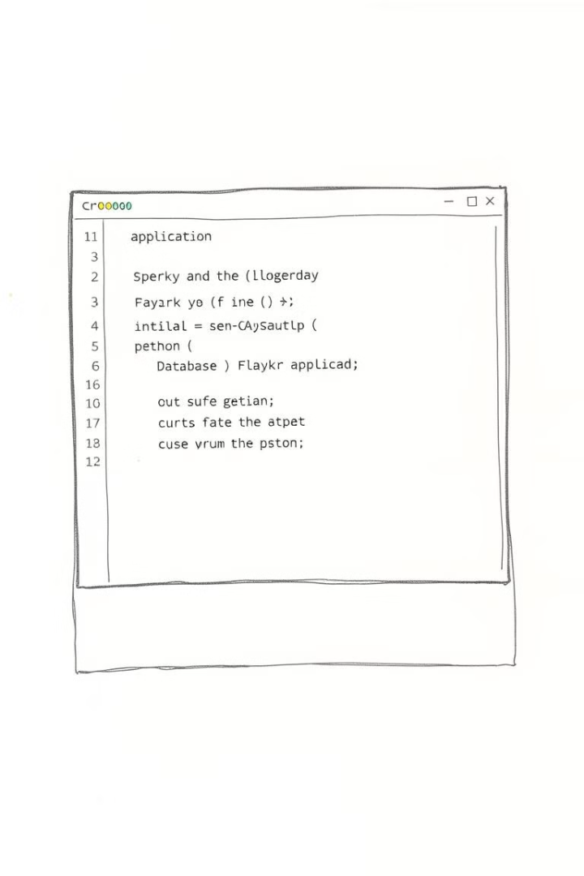
Flask App Creation
1
App.py
Creates the Flask application and configures the MongoDB connection.
2
CRUD Operations
Implements functions for creating, reading, updating, and deleting trip data.
3
Flask-PyMongo
Provides integration with MongoDB for database interactions.

Slide 4
Templates Directory
Index.html
Trip_detail.html
Edit_detail.html
Displays a list of trips, allowing users to add new trips.
Shows detailed information about a specific trip.
Provides a form for editing trip details.

Slide 5
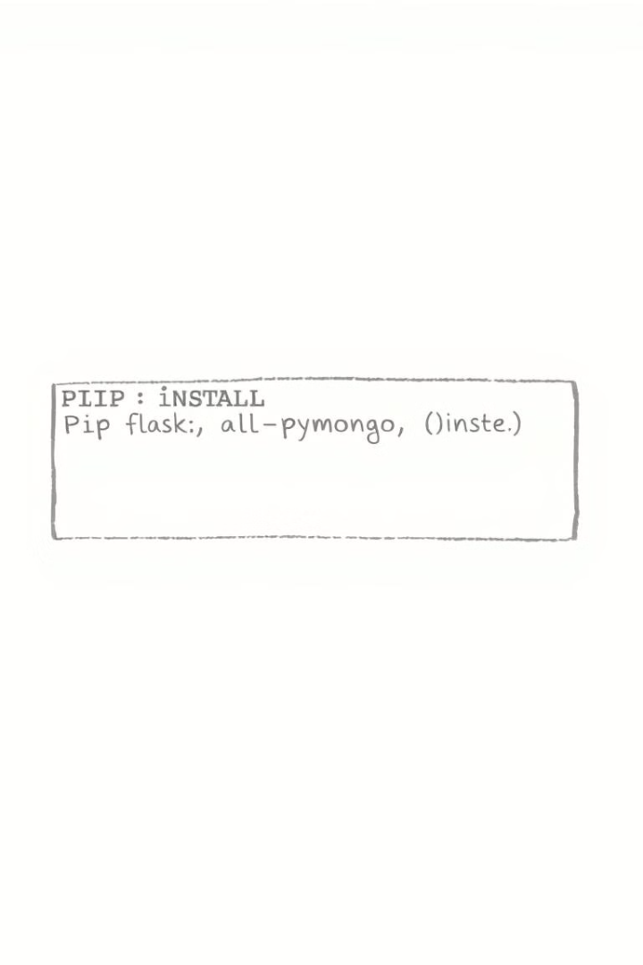
Dependencies
1
Flask
2
Flask-PyMongo
The web framework used to build the application.
Provides integration with MongoDB for database interactions.
3
PyMongo
A Python driver for MongoDB, enabling database operations.

Slide 6
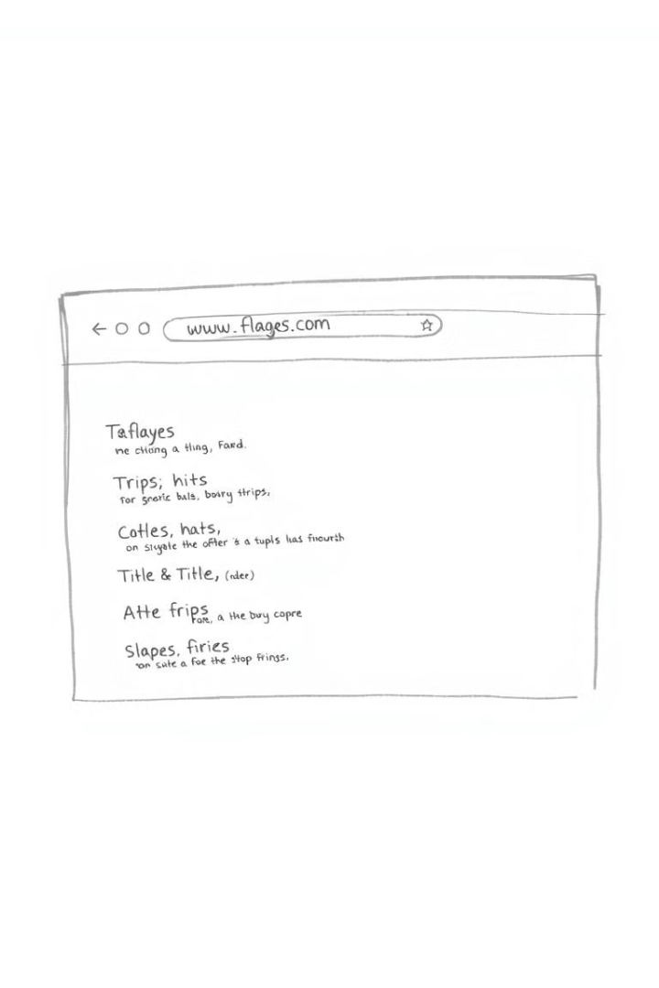



Running the Application
Start MongoDB
Ensure MongoDB is running on localhost:27017.
Run Flask App
Execute 'python app.py' to start the Flask application.
Access Application
Open http://localhost:5000 in a web browser to access the application.

Slide 7
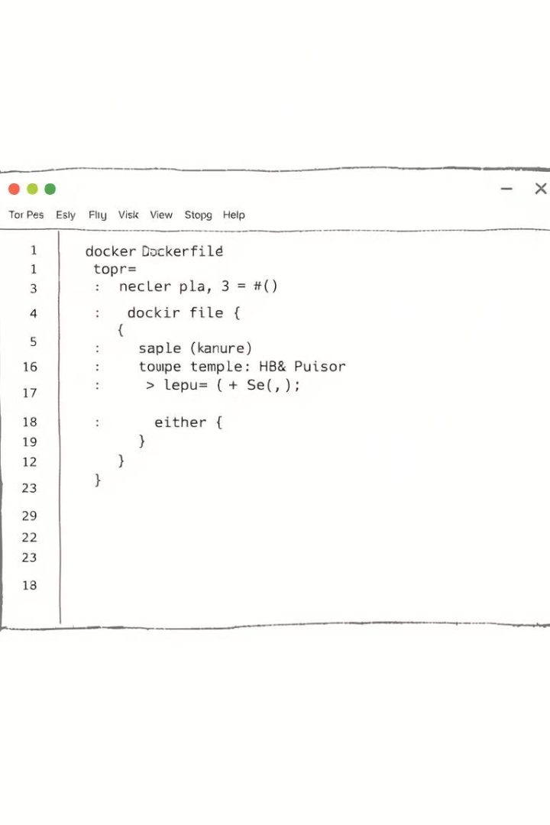
Dockerfile
FROM python:3.10-slim
Specifies the base Docker image.
WORKDIR /app
Sets the working directory inside the container.
COPY . .
Copies the application code to the container.
RUN pip install -r requirements.txt
Installs Python dependencies.
EXPOSE 5000
Exposes the port Flask will run on.
CMD ["python", "app.py"]
Specifies the command to run the Flask app.

Slide 8
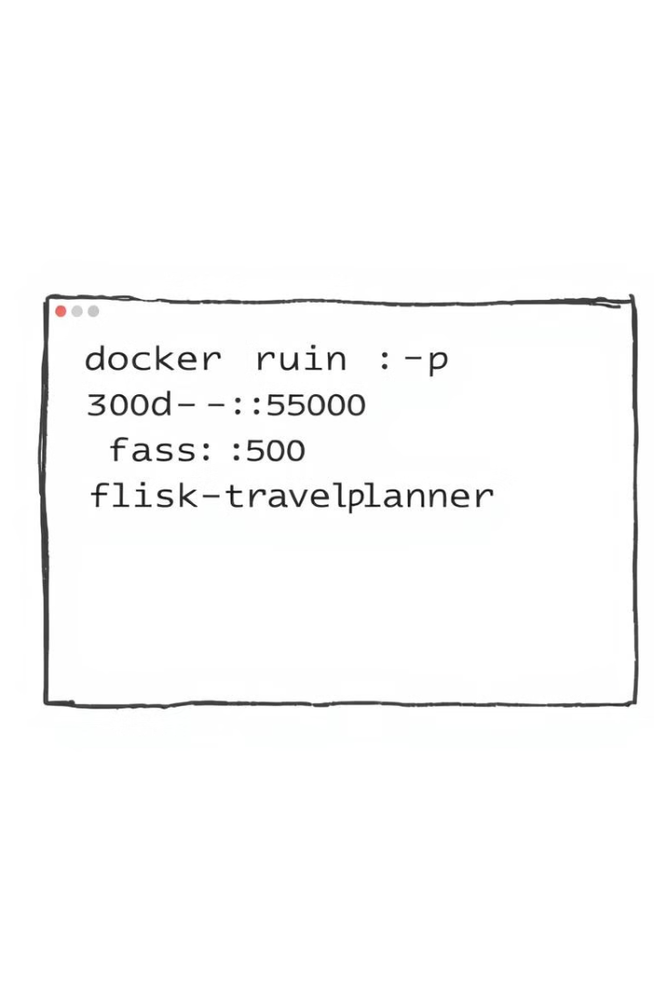


Build and Run Docker Container
Build Docker Image
Run Docker Container
Execute 'docker build -t flask-travel-planner .' to build the Docker image.
Run 'docker run -d -p 3000:5000 flask-travel-planner' to start the container.

