Slide 1
PyCoders Health Reporter
Group Members:
Mukul Bisht (C0857928)
Neelesh Vashist (C0858518)
Rohit Kumar (C0859060)
Saurabh Singh (C0859334)

Slide 2
Introduction
In the current medical era, the Use of artificial intelligence and Machine learning algorithm-based methodologies is increasing to support better decision-making for medical practitioners.
Keeping the broad usage of the Machine learning algorithm and utilizing their learnings from the AIMT course, the PyCoders team (Mukul, Neelesh, Rohit, and Saurabh) has attempted to develop an online tool that focuses on building a machine learning-based health problem diagnostics application.
Objective
We must create a health problem diagnosis application which will assist medical practitioners in making quick decisions in the early stages of diseases based on trained models from predefined data.
Our online tool will use various Machine Learning algorithms like Convolutional Neural Networks (CNN), Artificial Neural Networks (ANN), and Random Forest Classifier to predict health problems a person suffers based on health parameters with the highest accuracy possible.
Currently, we are targeting to predict three diseases, namely, covid-19, breast cancer, and diabetes.

Slide 3
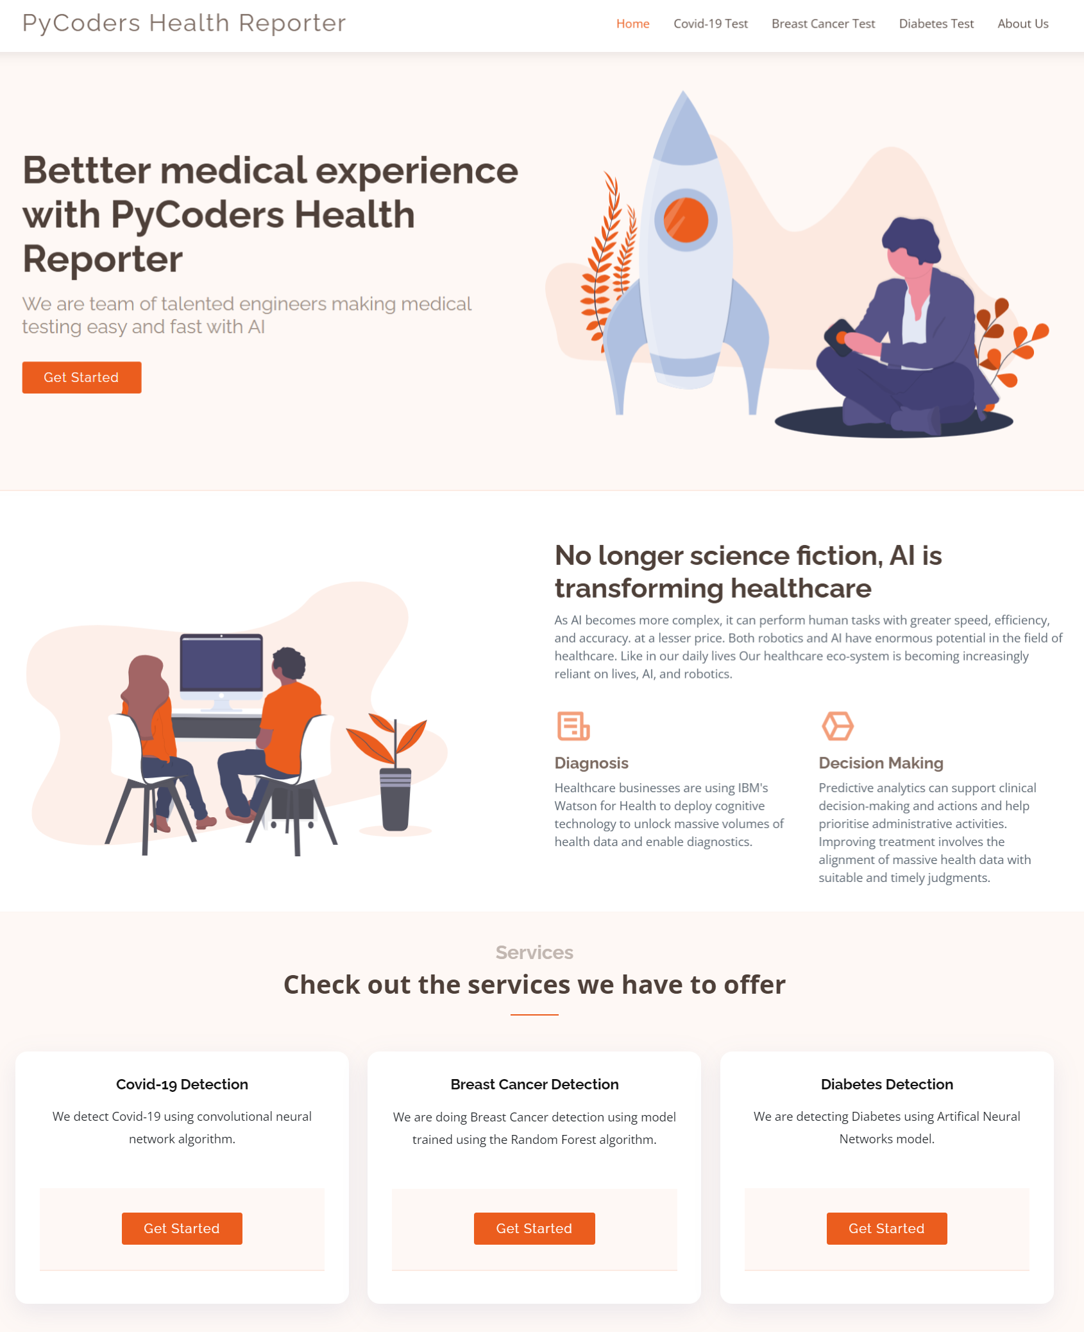
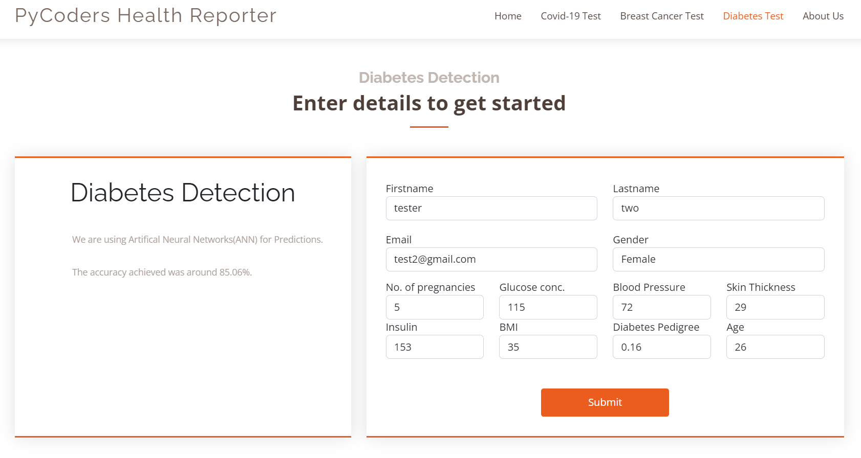
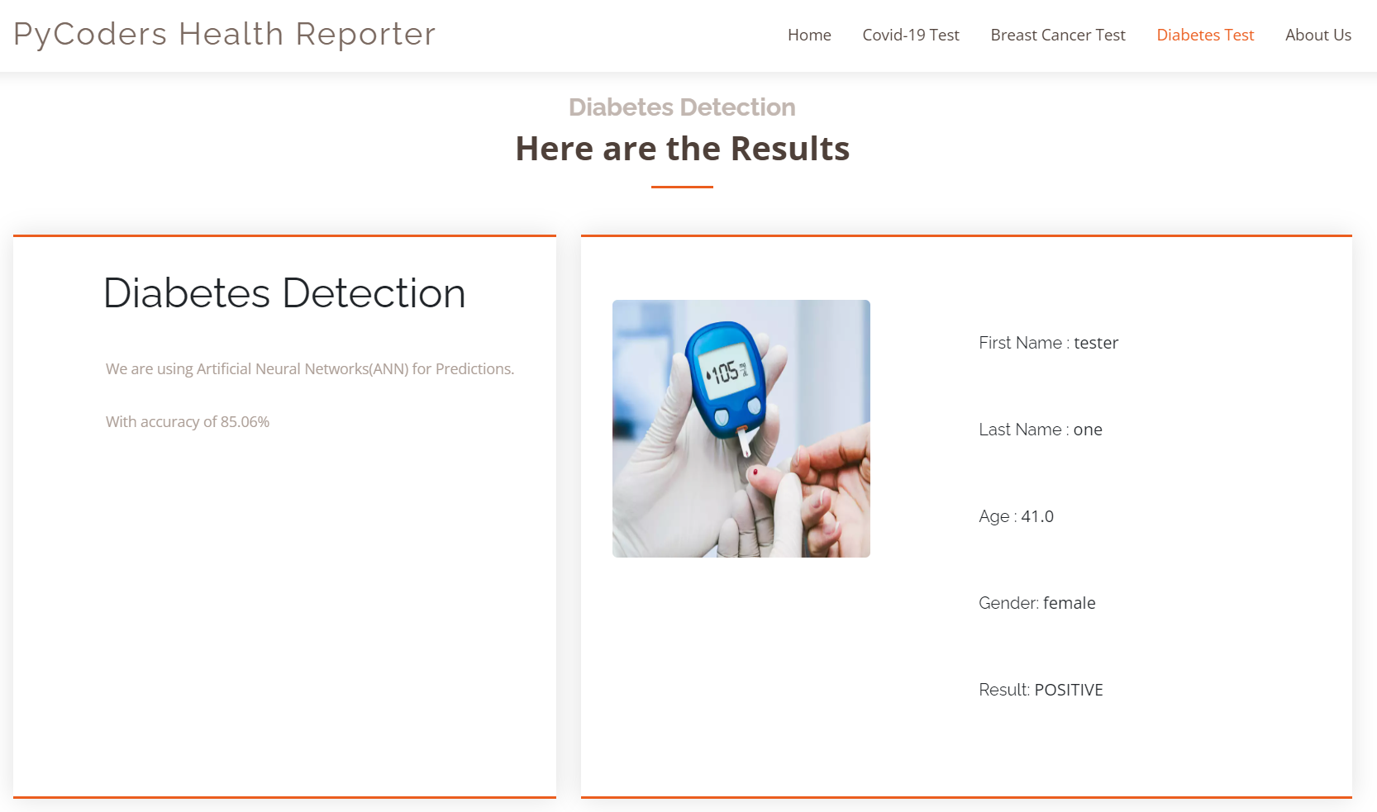
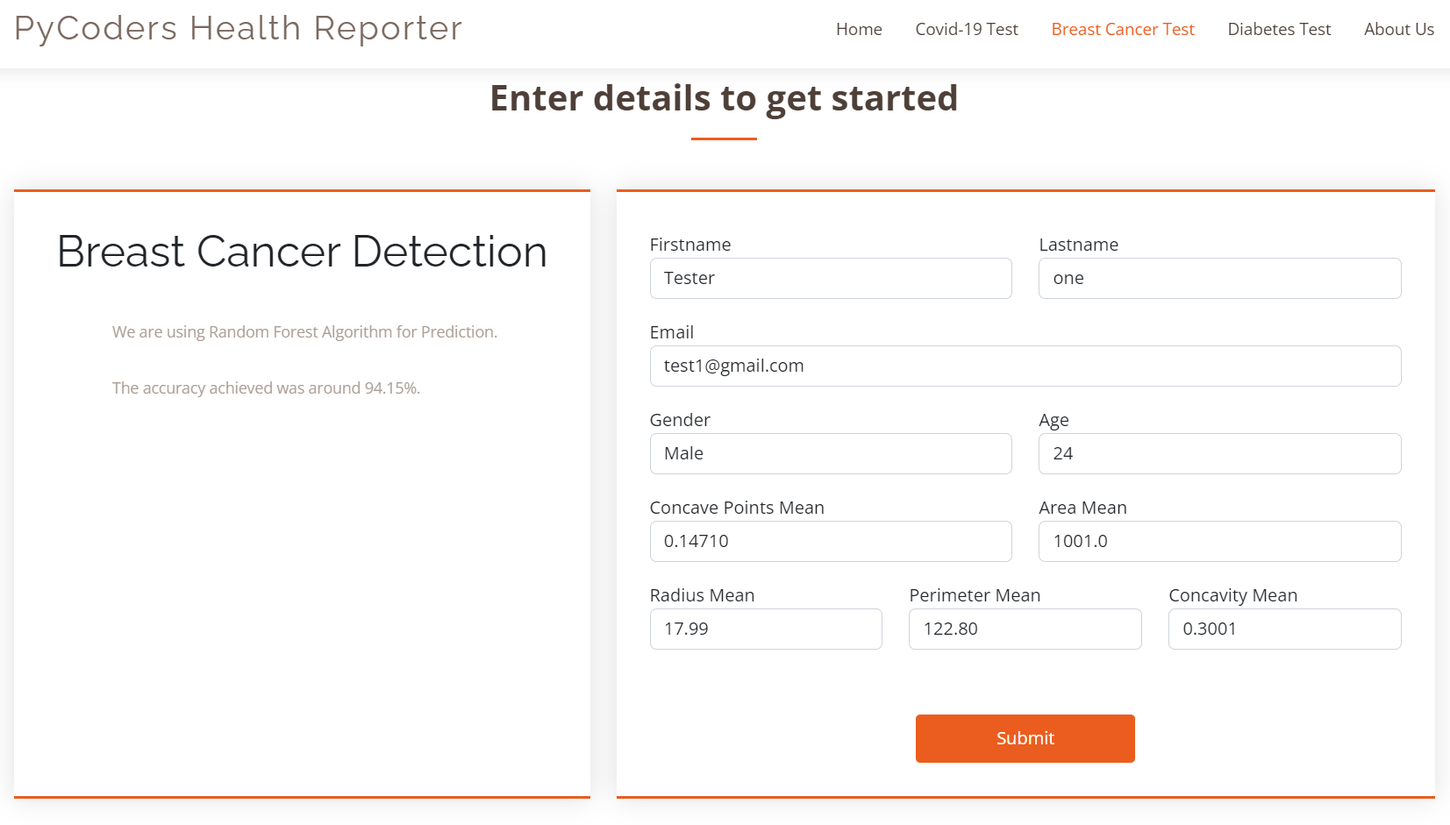
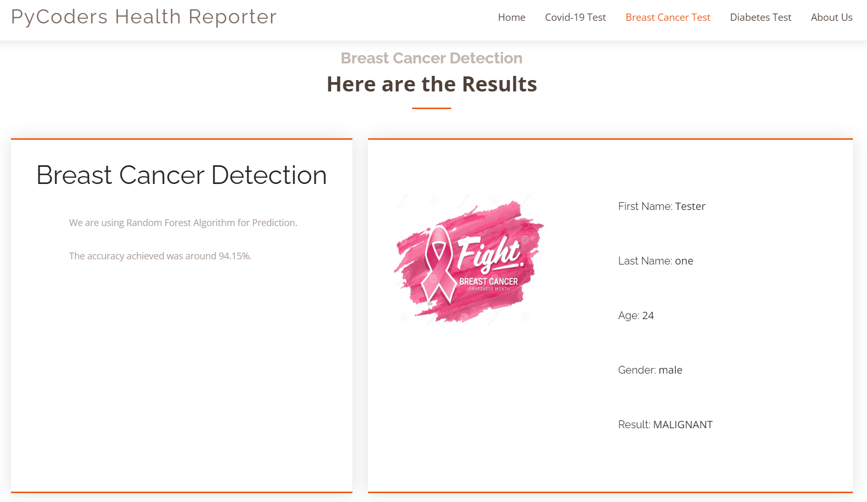
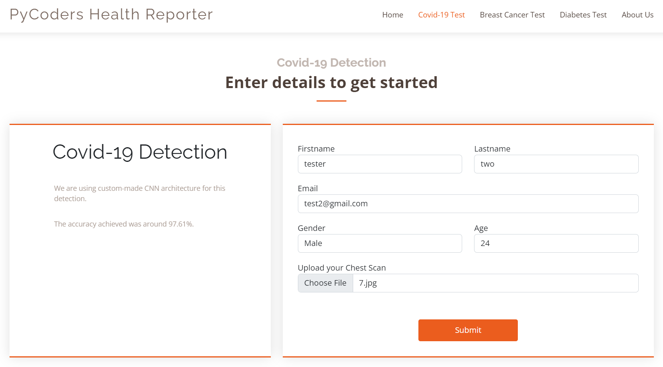
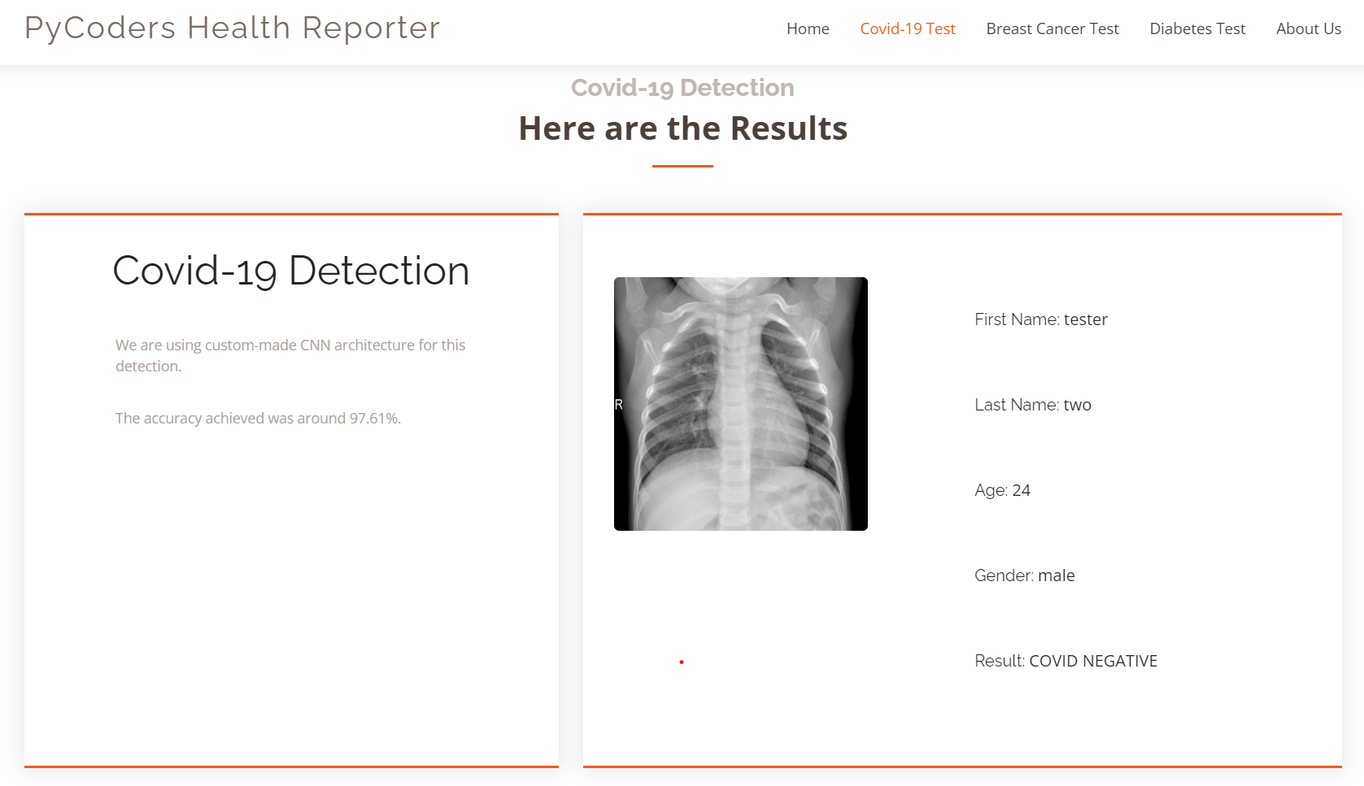
Home screen UI Design
Disease Prediction Screens

Slide 4
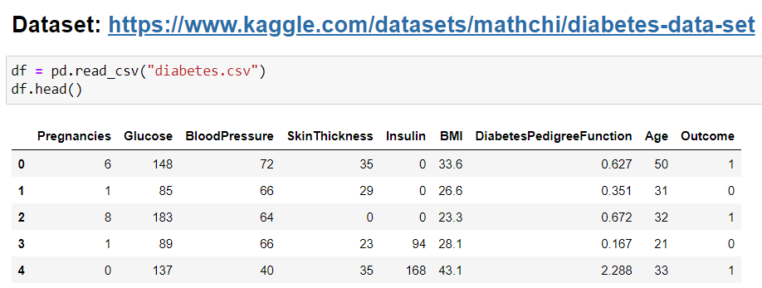
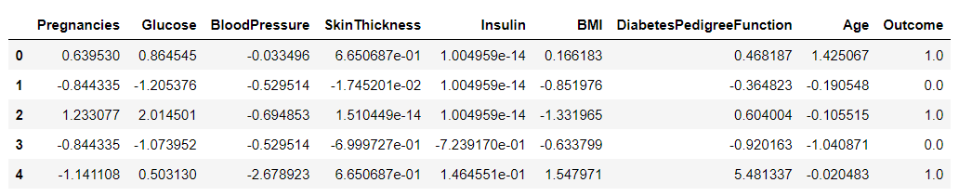
Diabetes Prediction Model
Steps we performed
Screenshots
Data Collection –
We Collected our data from: https://www.kaggle.com/datasets/mathchi/diabetes-data-set
Data Cleaning –
Duplicate Removal & Missing values handled using fillna.
Outlier Analysis.
Data Visualization –
Distribution of Target Variable using count plot.
Correlation between variables using pair plot and heatmap.
Data distribution using the histogram.
Feature Scaling –
Min/Max scalar and standardization.
Data splitting –
train-test split using the sklearn library.
Dataset and its variables.
Dataset after feature scaling.

Slide 5
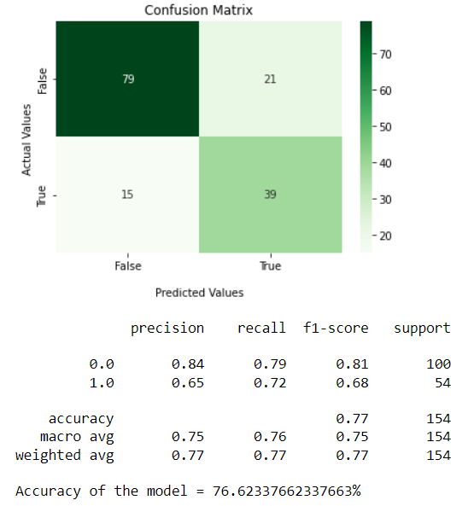
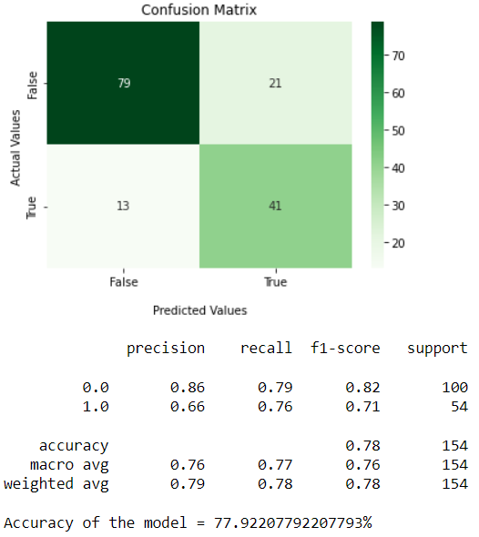
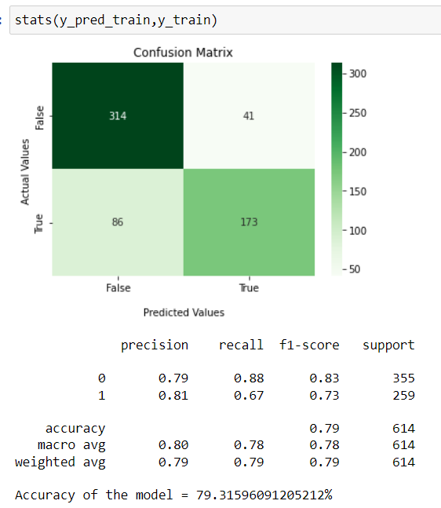
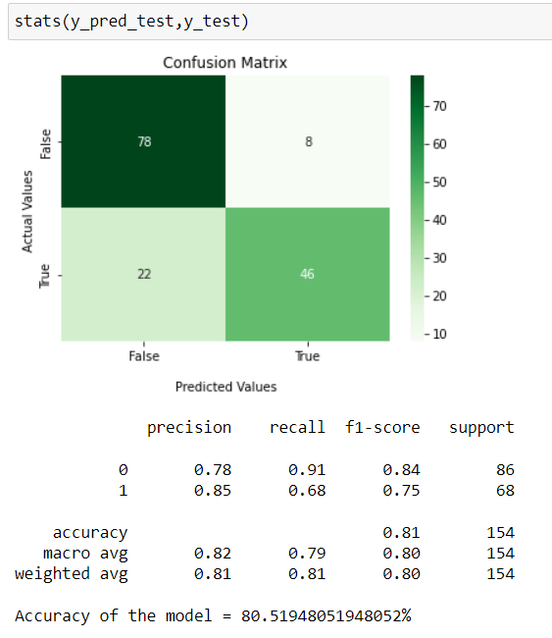
Diabetes Prediction Model (contd.)
Steps we performed
Screenshots
Training With Logistic Regression –
With ‘LBFGS’ solver and achieved 76.62% accuracy, and achieved 77.92% accuracy with scaled parameters.
Training with ANN Model –
We used ANN with Adam optimizer and ReLU and Sigmoid activation function and achieved accuracy of 77%.
Over Sampling dataset –
We noticed that there is imbalance between the outcomes, so to improve predictions we oversample the dataset.
Trying Again with ANN Model –
We Train the model with over sampled data and achieve an training set prediction accuracy of 79.31% and testing set prediction accuracy of 80.51%.
Saving the Final model –
We use inbuilt tensor flow library to save the model to use it for web application.
Accuracies with Logistic Regression Model with un/sampled data.
Accuracies with ANN Model with oversampled data.

Slide 6
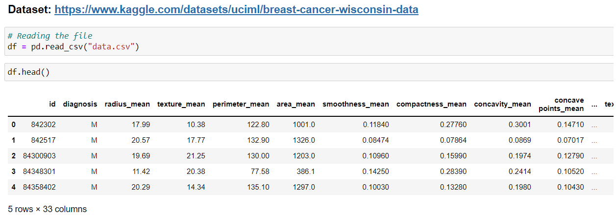
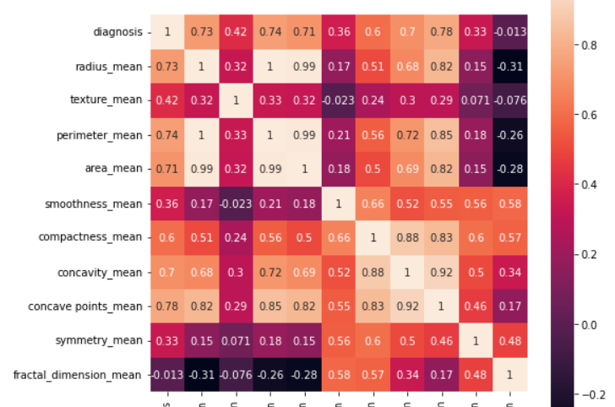
Breast Cancer Prediction Model
Steps we performed
Screenshots
Data Collection –
We Collected our data from: https://www.kaggle.com/datasets/uciml/breast-cancer-wisconsin-data
Data Cleaning –
After looking at the correlation between variables we chose radius_mean, perimeter_mean, area_mean, compactness_mean, concavity_mean, concave points_mean as our main parameters and removed extra columns.
We performed Outlier Detection using IQR and treatment using q10 and q90 quantiles and removed 100% of outliers.
Data Visualization –
Distribution of Target Variable using count plot.
Correlation between variables using pair plot and heatmap.
Box plot for outlier detections and treatment.
Dataset and its variables.
Correlation using Heatmap.

Slide 7
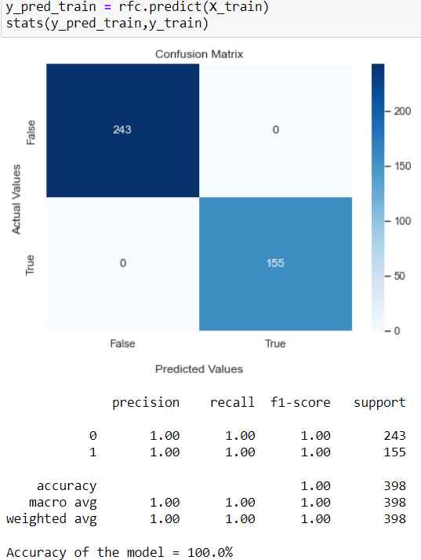
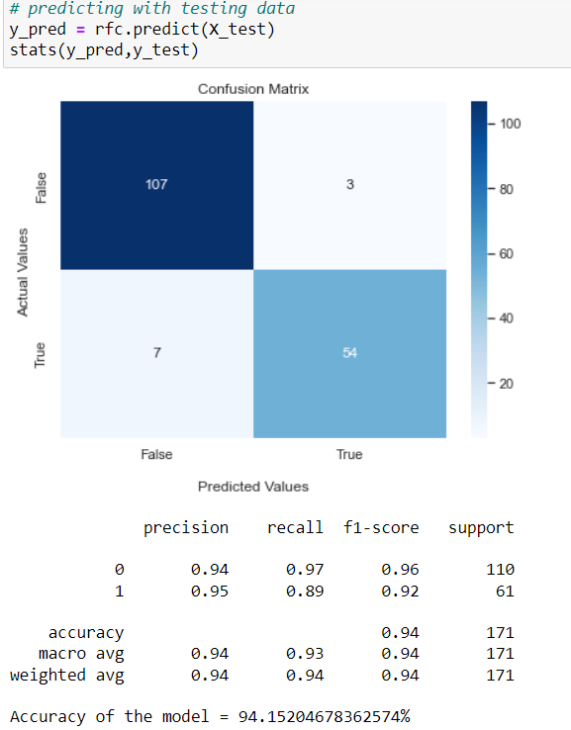
Breast Cancer Prediction Model (contd.)
Steps we performed
Screenshots
Data Splitting –
train-test split using the sklearn library.
Training with Random Forest Classifier–
We used Random Forest Classifier algorithm to create a model using the optimized dataset.
Model predictions using the training dataset give 100% accuracy, but this is because our dataset is a little small.
Our Model with the test dataset produces 94.15% accuracy. With 0.97 recall and 0.96 f1 score.
Saving the Final model –
We use the joblib library to save the model to use it for the web application.
RFC accuracy with training dataset
RFC accuracy with test dataset

Slide 8
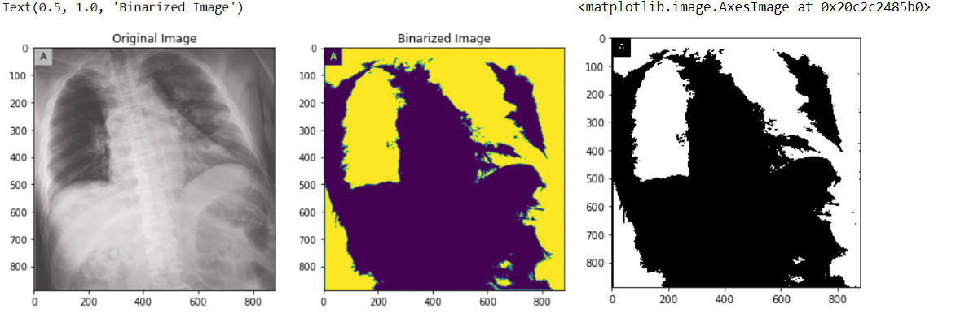
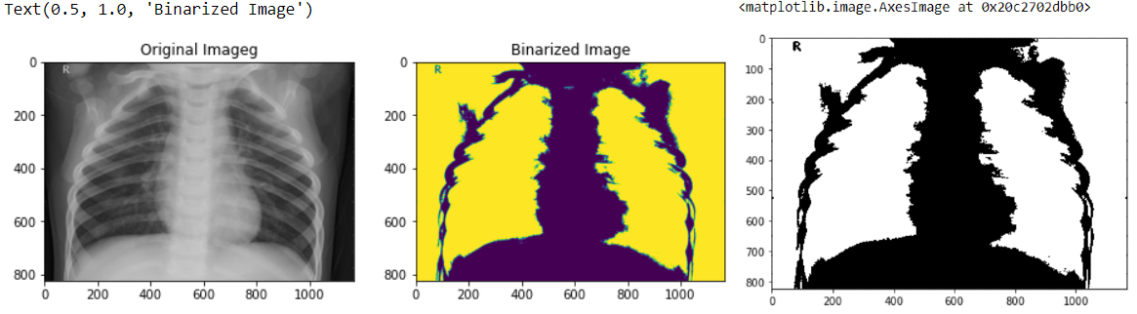
Covid-19 Prediction Model
Steps we performed
Screenshots
Data Collection –
We Generated our dataset from the given two sources:
https://www.kaggle.com/datasets/paultimothymooney/chest-xray-pneumonia
https://github.com/ieee8023/covid-chestxray-dataset
Data Processing –
We use required methods from Skimage library and PIL library.
We created a sliding window element to perform multi erosion on binarized image.
We save the processed images in INPUT folders.
Data Splitting –
Distribution of Target Variable using count plot.
Correlation between variables using pair plot and heatmap.
Box plot for outlier detections and treatment.
Pre processing steps on the Infected Lungs
Pre processing steps on the healthy Lungs

Slide 9
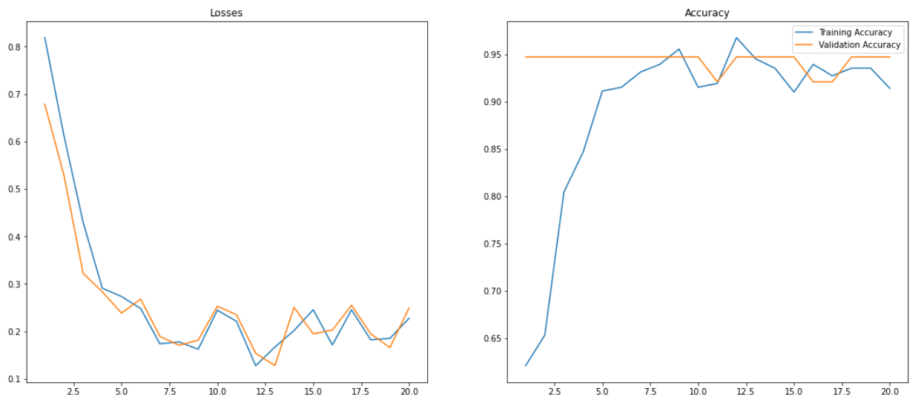
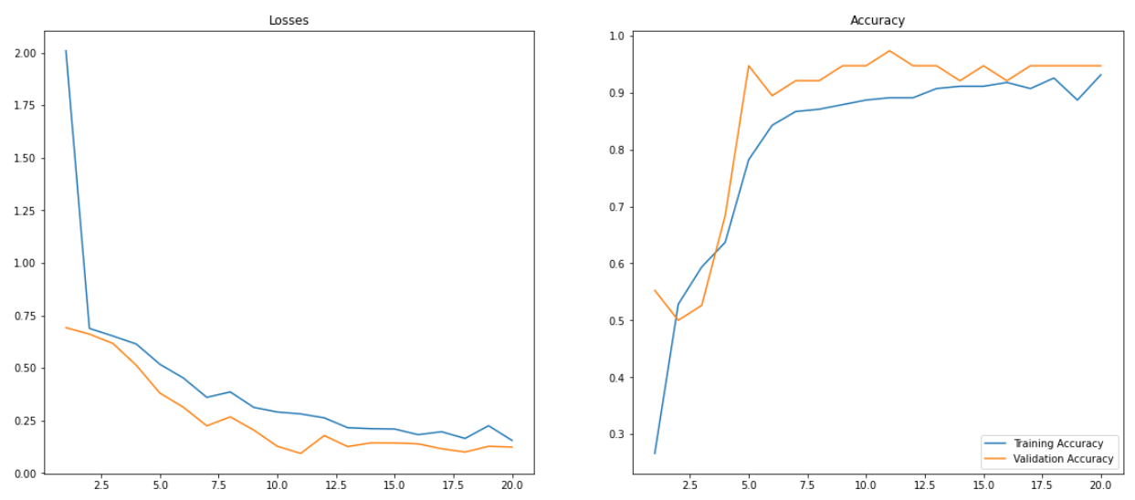
Covid-19 Prediction Model (contd.)
Steps we performed
Screenshots
Training with CNN –
We used the convolutional neural network (CNN) algorithm to create a model sequential model with multiple layers Using the ReLU activation function for the inner layers and the Sigmoid activation function for the Final layer with an ‘Adam’ optimizer.
We use ImageDataGenerator Library to generate, train, test, validation datasets from processed and unprocessed data for our CNN model.
We trained two models and compared their accuracies; we noticed that the processed dataset gives 95.23% accuracy, so we stuck with our first model for predictions with 97.61% accuracy.
Saving the Final model –
We use inbuilt tensor flow library to save the model to use it for web application.
Loss and accuracy with un-processed dataset
Loss and accuracy with processed dataset

Slide 10
Conclusion
In this project we made a web application which offer intuitive UI to users/doctors to predict whether the patient is infected with Covid-19, has Breast Cancer, or has Diabetes.
We used various machine learning techniques like Outlier Detection with IQR, Feature Tuning, Image Processing, Over Sampling, train-test-split, and algorithms like convolutional neural network (CNN), Logistic Regression, Artificial Neural Networks (ANN), and Random Forest Classifier.
We used Flask and web development tools to develop our Front-end UI.
Future Scope
This application can be further worked on to improve and can be used by doctors in future to give faster diagnostics.
This application is flexible and can be extended to add more disease-detection models. The current application includes three modules related to covid 19, diabetes and breast cancer detection.
We can add more functionality to manage customer records related to multiple diseases and can care repository for the patient.

Slide 11
PyCoders Health Reporter
Thank you

