Slide 1


Location Prediction for Tweets
Submitted to – Sanasam Ranbir Singh
Mentored by – LOITONGBAM GYANENDRO SINGH
Date – 21-04-2021
Submitted by - MARD
(MUKUL , ADITYA , RAM AVTAR , DANSINGH)

Slide 2
challenges
Hard to explain to the end users what the model learns.
Hard to model the long-term information
How to deal with informal language in a tweet
RNN-based model for text representation usually suffers from the extremely long training time because every word depends on all the previous words which makes it hard to parallelize and accelerate.
CNN works better in modeling the local information.

Slide 3
EARLIER WORK
Text-representation is important part of the task and some earlier work on it are as following:
Vanilla Recurrent Neural Network (vanilla RNN)
Long Short-term Memory Neural Network (LSTM)
Gated Recurrent Unit Network (GRU)
Convolutional Neural Network (CNN) based models
Sub-word features is used in earlier work giving good results

Slide 4
Motivation why?
Less than 1% of tweets are geographically tagged so people have tried to identify location of users.
This model does not use metadata which was used in earlier methods because we intend to make a model which could be used in other platforms(e.g., online news)
There are a large number of applications benefiting from geographic information:
marketing recommendation systems
event detection systems

Slide 5
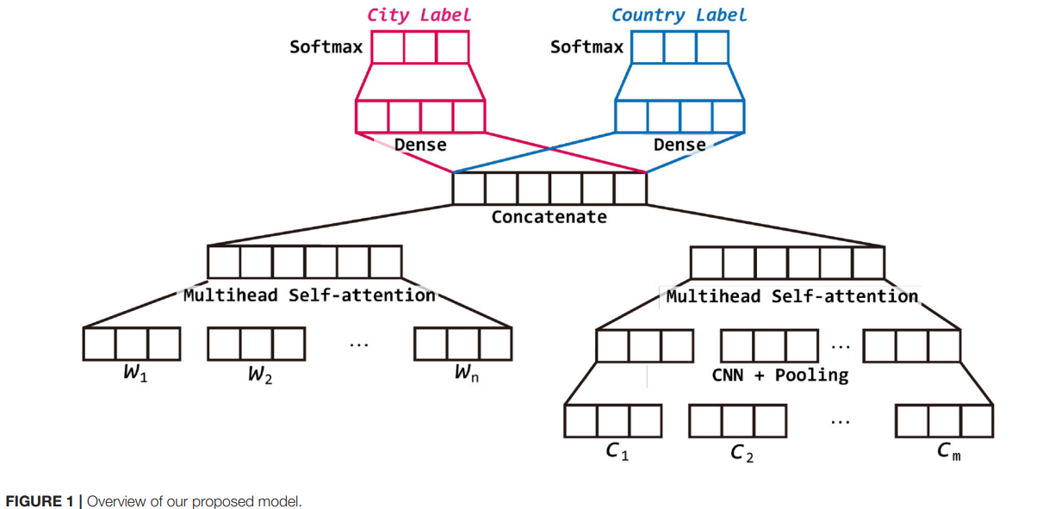
Overview of the MODEL

Slide 6
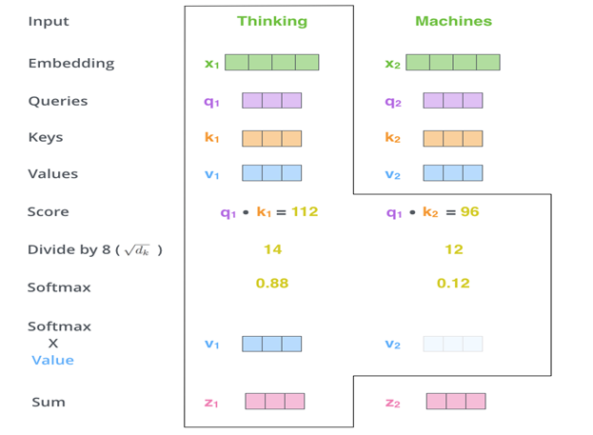
Working of a self attention Layer

Slide 7
Working of Multi Head Attention Model(For Word-level Features)
It is based on auto encoder decoder model which is used for translation.
But in our model we have used only the encoder part.
For Word side the features to the model will be each word.
For the Character side the features to the model will be different subword features that is being captured by different filter size.

Slide 8

result
Work result
 | City Prediction | Country Prediction
Paper Model 1 | 4.0905 | 43.080
Paper Model 2 | 4.003 | 45.691
Paper Model 3 | 4.003 | 46.388
Additional work result
 | City Prediction | Country Prediction
Additional Model 1 | 4.003 | 40.731
Additional Model 2 | 2.872 | 37.771
Additional Model 3 | 3.655 | 45.343
IIT Guwahati
8

Slide 9
Additional work
The base model is the same with modification being of using stack of 3 multiheaded self-attention with dense layers instead of 2. Also, we used CNN and pooling layers in word side representation much like what was done in characters side in the research paper.
The base model is the same with modification being of using Bidirectional LSTM instead of stacks of multiheaded self-attention in both character and word representation.
The base model is the same with modification being of using stack of 3 multiheaded self-attention with dense layers instead of 2.

Slide 10

Limitations
Our model has a limitation of not understanding the semantic meaning of the sentences.

Slide 11

THANKYOU

