Slide 1
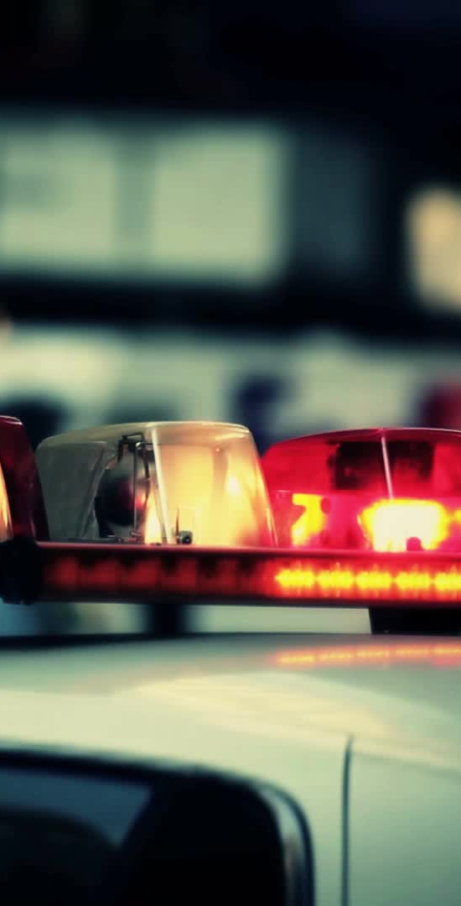
Traffic Vehicle Detection System
An AI-Powered Computer Vision assignment
Presented by: Mukul Potdar – 7th July 2025

Slide 2
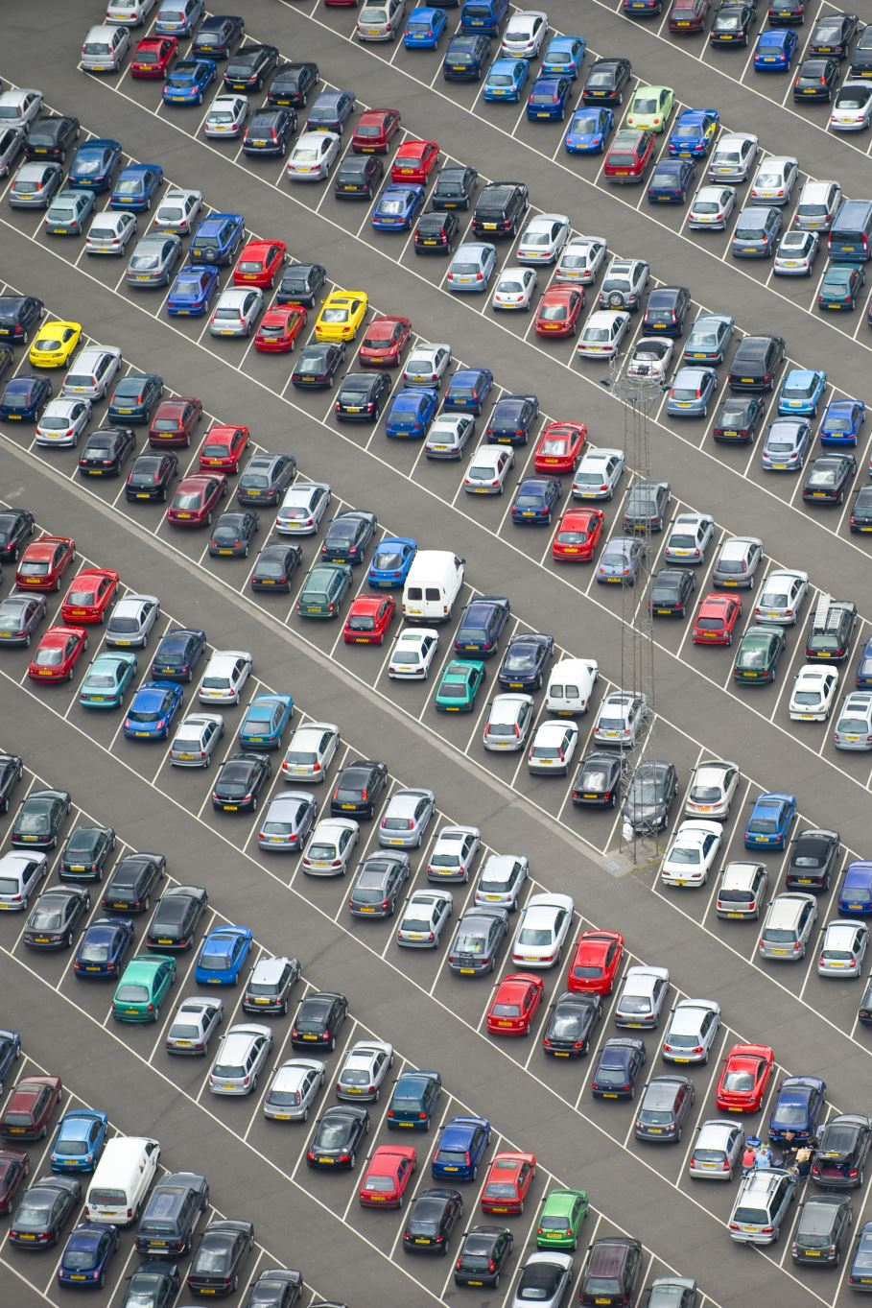
Problem Statement
Automatically detect, classify, and count vehicles in traffic images
Identify cars, motorcycles, and trucks
Provide bounding boxes with confidence scores
Generate summary reports for vehicle counts

Slide 3
Tools & Technology Stack
Language: Python 3.8+
Libraries: OpenCV, NumPy, Matplotlib, Gradio
Model: YOLOv8 (Ultralytics, pre-trained)
Environment: Jupyter Notebook
Data: Real-world traffic images (10 test images)

Slide 4
YOLOv8 Model Overview
Model Used: YOLOv8n (nano) – fast & accurate
Trained on COCO dataset (80 classes)
Filtered classes: Car (2), Motorcycle (3), Truck (7)
Used pre-trained weights – no training required

Slide 5
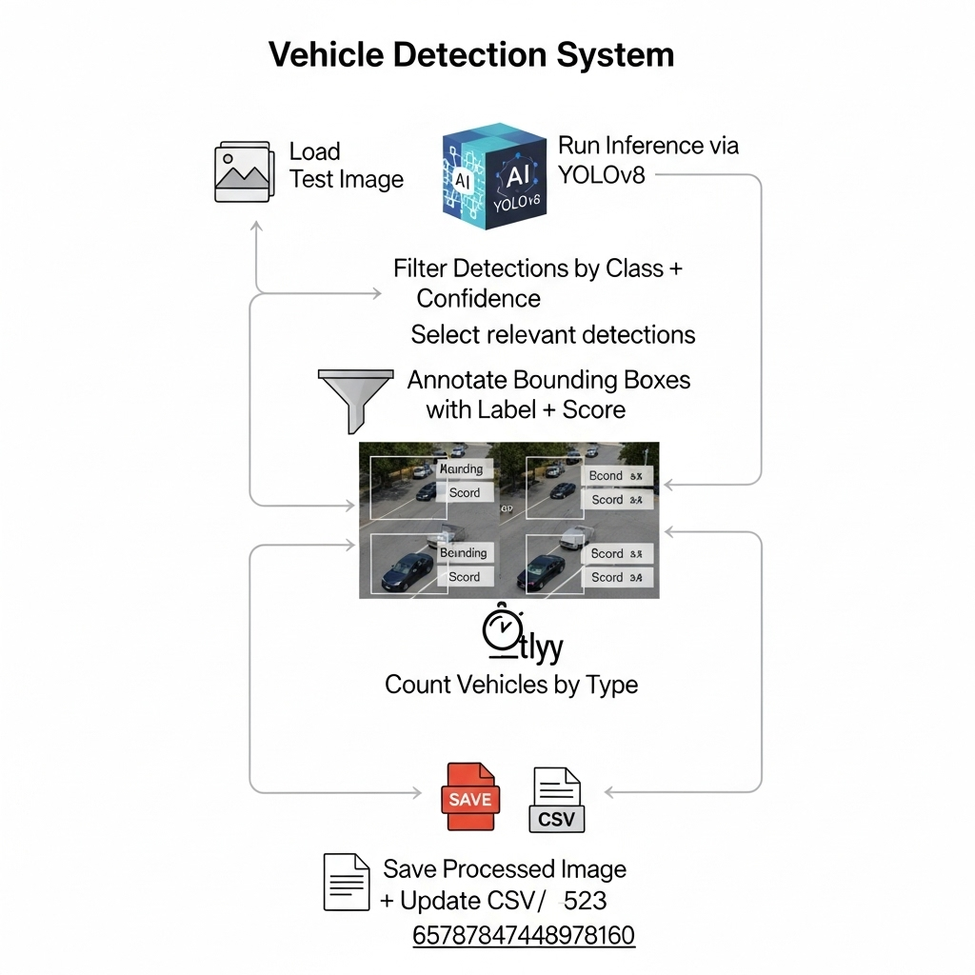

Slide 6
Core Features Implemented
Vehicle detection with bounding boxes
Classification into car, truck, motorcycle
Confidence scoring and annotation
Vehicle counting per image
Output images saved to /output folder

Slide 7

Bonus Features
Gradio Web Interface for image upload
Real-time detection from webcam and video
CSV report generation of vehicle counts
Bar chart visualization of summary stats

Slide 8

Results & Sample Outputs
Processed 10 test images
Average accuracy: 80%+ for visible vehicles
Generated annotated images with labels
Exported summary to CSV format
Displayed result preview in Gradio UI

Slide 9
Challenges & Learnings
Jupyter doesn't support cv2.imshow() (used .py script for video/live demo)
Detected class ID mapping from YOLOv8 COCO labels
File path formatting on Windows
Learned model inference, Gradio UI, OpenCV integration

Slide 10
Conclusion & Live Demo
Modular traffic detection system built using YOLOv8
Accurately identifies and counts multiple vehicle types
Ready for deployment in smart traffic and surveillance applications
Next: Live demo showcasing detection pipeline and outputs

Slide 11
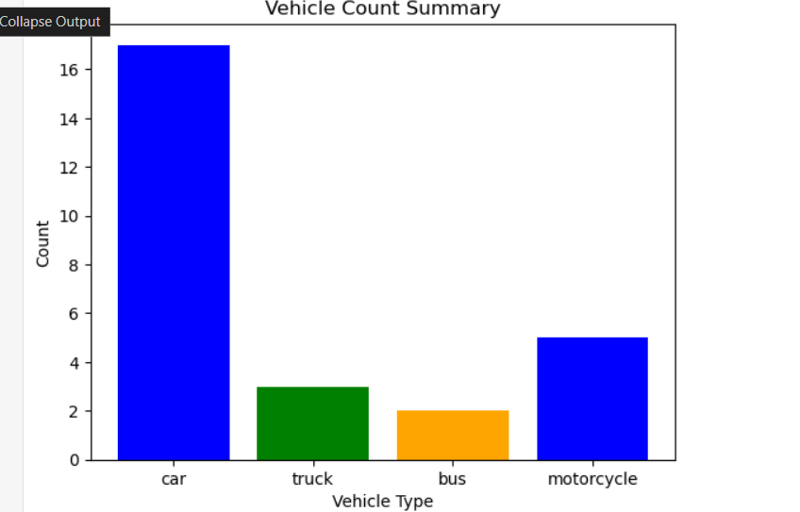
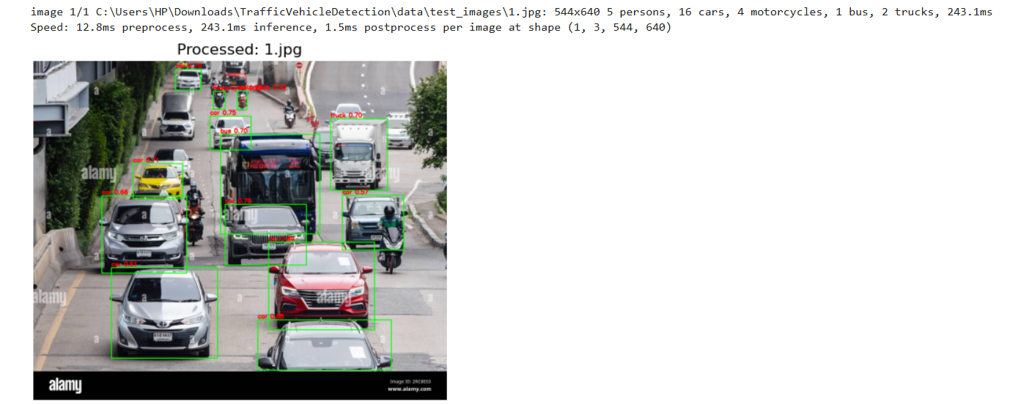
A bar graph showing number vehicles detected
A sample image in the code in jupyter notebook.

Slide 12
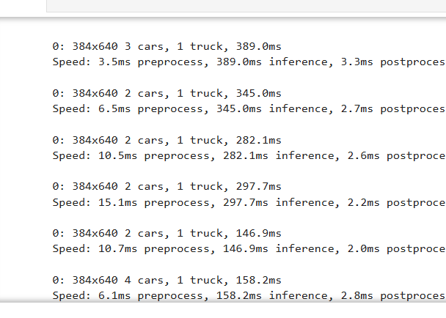
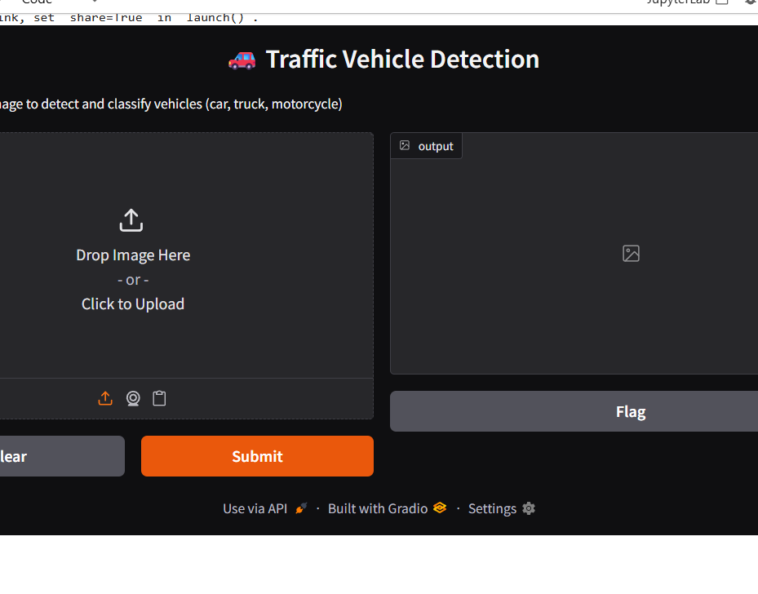
This is a basic UI for the opencv vehicle detection model executed.
This is frame by frame detection of vehicles in a video.

