Slide 1

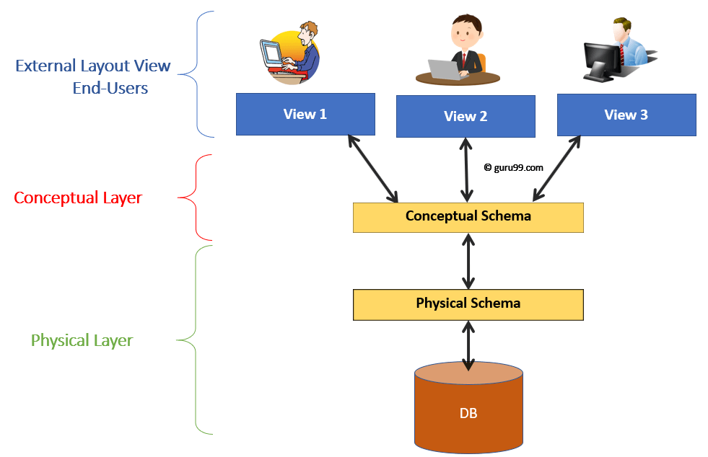
Database Management Systems (BCSC-1003)
Topic: Three-Schema Architecture

Slide 2

Three-Schema Architecture
Physical Level:- This is the lowest level of data abstraction. It describe how data is actually stored in the database. We can get the complex data structure details at this level.
Logical Level:- It is the middle level of 3-level schema architecture. It describes what data is stored in database.
View Level:- It is the highest level of data abstraction. This level describes the user interaction with database system.

Slide 3
Front-End Developers
(PHP, Java)
External Schema (View 1)
External Schema (View 2)
External Schema (View 3)
View Level
Conceptual Schema
Database Designers
(E-R Models)
Logical Level
Physical Schema
Database Administrator (DBA)
Physical Level
(Internal)
Database (Disk)

Slide 4
Stu_ID | Stu_Name | Stu_Address
Faculty_Id | Faculty_Name | Lectures
External Level
Field Name | Data Type
Stu_ID | Int
Stu_Name | Char
Stu_Address | Char
Faculty_ID | Int
Faculty_Name | Char
Lectures | Int
Conceptual Level
Stored_item | Length
Stu_ID | Byte(2)
Stu_Name | Byte(20)
Stu_Address | Byte(30)
Faculty_ID | Byte(2)
Faculty_Name | Byte(20)
Lectures | Byte(2)
Physical Level
(Internal)

Slide 5
Thank You

