Slide 1

Notes:
MUKUL - 0:00 to 0:15
Good morning. We are Team Abrakadabra, and this is PulseTwin: a digital twin for automotive assembly lines that sees what no single station can see alone.

Slide 2
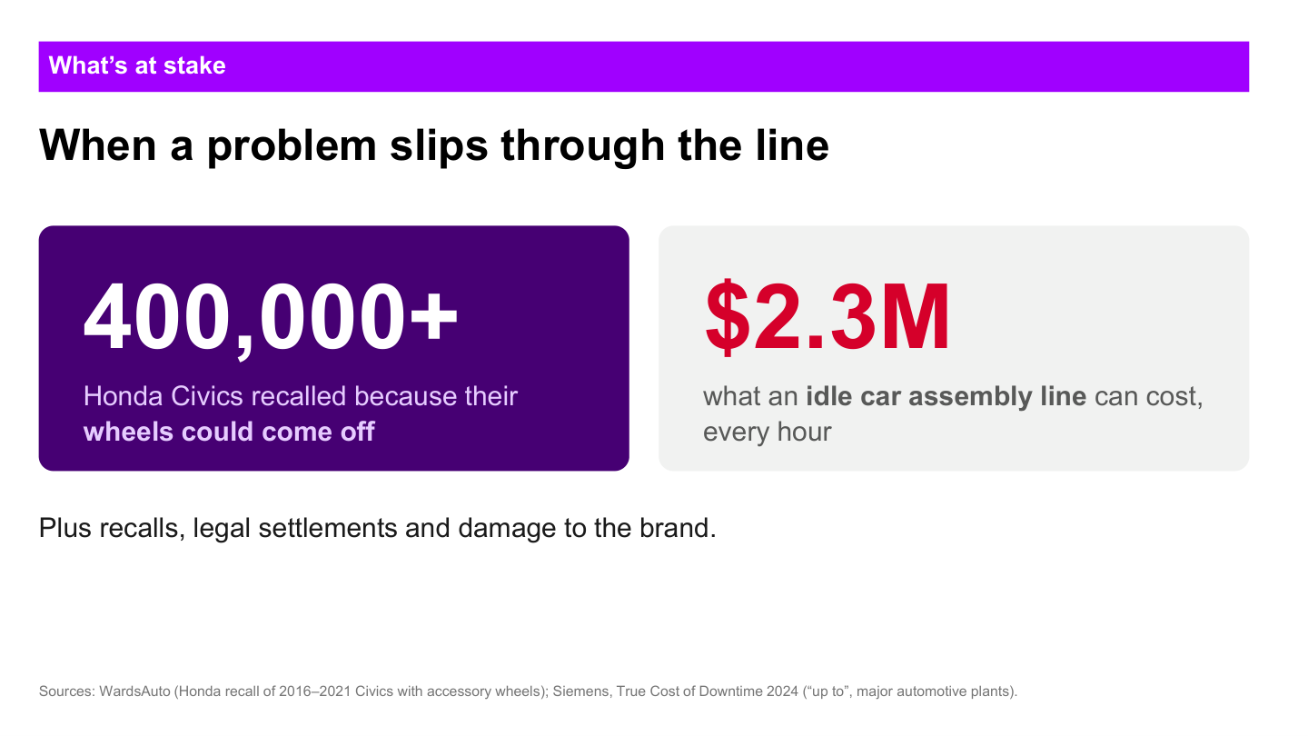
Notes:
MUKUL - 0:15 to 1:05
Automotive failures become expensive when the line discovers them late. The recall example on screen shows the scale of the consequence. A major assembly line can also lose millions during an hour of downtime. For our hypothetical case, imagine a wheel-fastening process beginning to drift. Each individual station still appears acceptable, so production continues. The problem becomes visible only after vehicles have left the line, when a customer reports a loose wheel. By then the response includes containment, reinspection, downtime, recall exposure and loss of trust.
Important: present the accident as a hypothetical scenario. Do not claim it caused the Honda recall referenced on this slide.

Slide 3
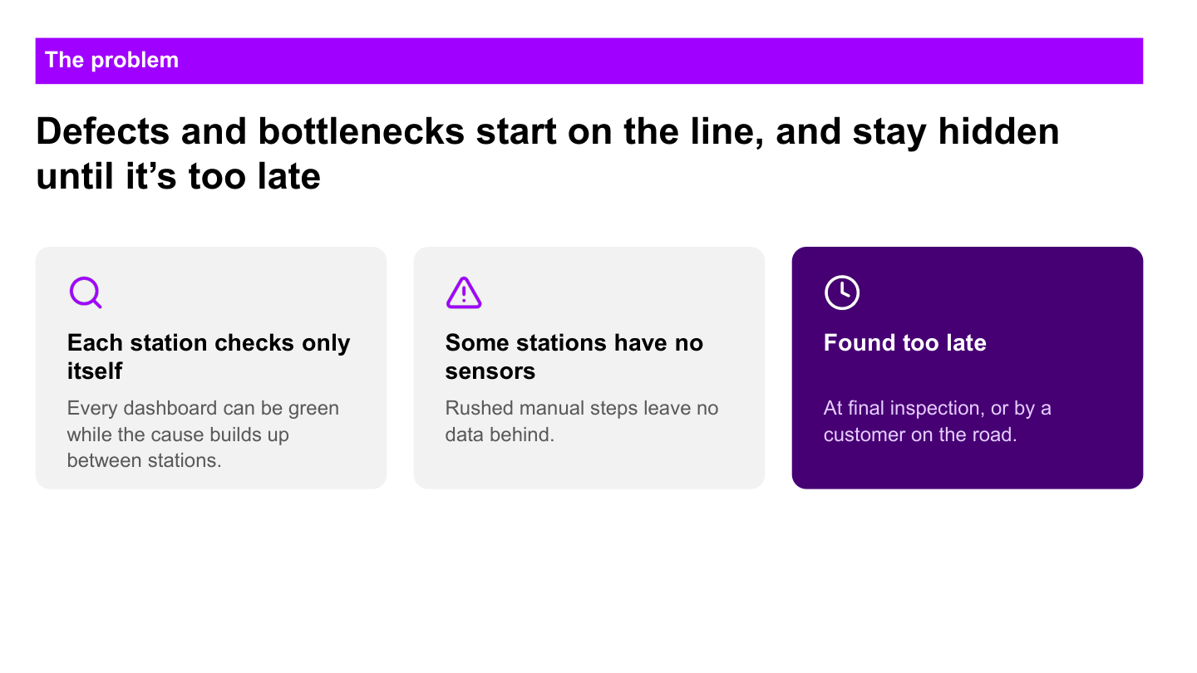
Notes:
MUKUL - 1:05 to 2:10
Why was the problem missed? The first reason is fragmentation. Each station sees its own cycle and its own readings, but nobody sees the complete vehicle journey. The second reason is missing visibility. Manual stations or sensor gaps can hide a rushed check or an abnormal handoff. The third reason is timing. Final inspection may find the issue after many similar vehicles have already passed through the same conditions.
So the problem is not simply that factories have no data. The problem is that the evidence remains separated until it is too late to act.
HANDOFF TO RISHABH:
Rishabh will now continue this same vehicle journey and show how PulseTwin turns those disconnected signals into an early, explainable decision.

Slide 4
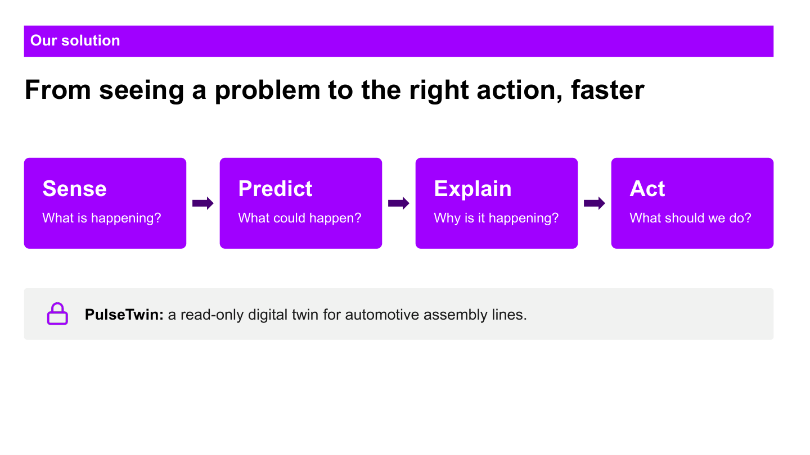
Notes:
RISHABH - 2:10 to 2:40
Let us continue Mukul's hypothetical case. The vehicle is still moving through the plant. A torque pattern has started drifting, one manual check was completed unusually quickly, and flow conditions around the line are changing. None of those signals alone proves a defect. PulseTwin connects them through four steps: Sense what is happening, Predict what could happen, Explain why the system is concerned, and Act before the vehicle leaves the plant.

Slide 5
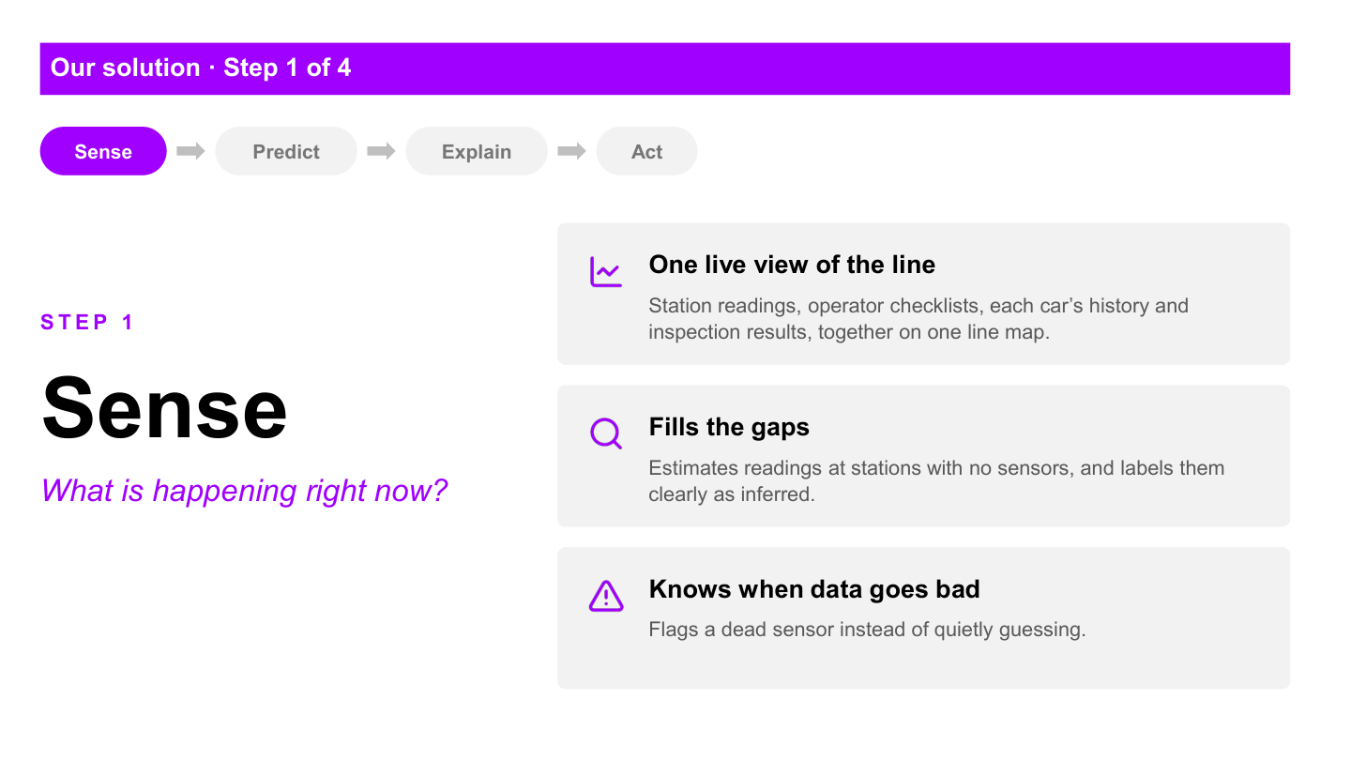
Notes:
RISHABH - 2:40 to 3:15
First, Sense. PulseTwin builds one timeline for the line and for every vehicle. It combines station readings, cycle events, buffer movement, checklists, vehicle genealogy and final inspection results.
Where direct PLC or sensor data exists, we mark it as measured. Where a manual or partially instrumented station has no direct state tag, we reconstruct the state from vehicle movement, buffer occupancy and timing, and label it as inferred. If a sensor goes dark, we flag the dropout instead of presenting an estimate as a measurement.
In our case, this gives us the context that the individual station dashboards were missing.

Slide 6
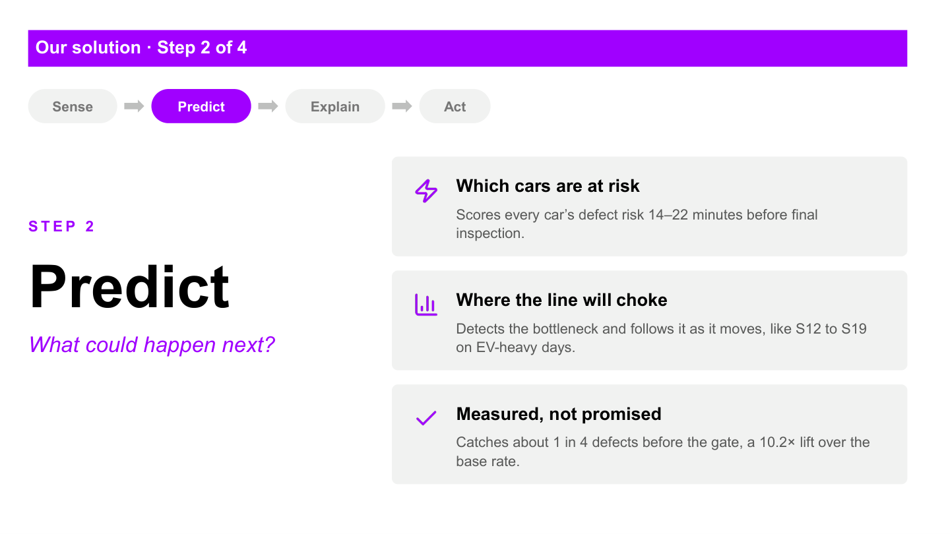
Notes:
RISHABH - 3:15 to 4:00
Second, Predict. At the configured cutoff, before final inspection, the model combines the evidence collected so far and estimates the vehicle's calibrated defect risk. This is a probability, not a guarantee. It gives the supervisor time to inspect or contain the vehicle while it is still inside the plant.
At the same time, PulseTwin watches production flow. It measures how long stations are working, blocked, starved or down, and detects where the active constraint is moving. That matters because a quality problem and a flow problem can reinforce each other. A long buffer dwell or a rushed recovery after blockage can become part of the vehicle's risk pattern.
Our present measured recall is about one in four defects at the configured alert budget, so we show the metric honestly and continue improving it.

Slide 7
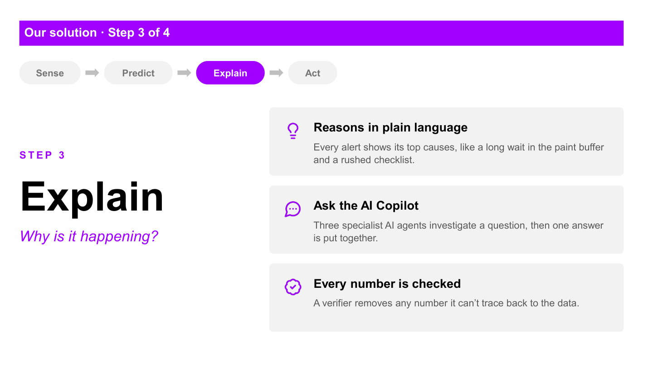
Notes:
RISHABH - 4:00 to 4:45
Third, Explain. A supervisor should never receive only a red score. PulseTwin shows the process factors that pushed the vehicle into the alert group, such as abnormal torque deviation, extended buffer dwell or an unusually short checklist.
For broader incidents, specialist investigation workflows check three perspectives: reliability asks whether sensors or models are trustworthy, production examines the bottleneck and lost throughput, and risk identifies the vehicles that share the same process fingerprint. In AI mode, tool-using agents perform this investigation. If the provider is unavailable, the system uses a clearly labelled deterministic fallback.
Every numerical claim passes through a verifier. If the system cannot trace a number to an actual tool result, it does not present that number as evidence.

Slide 8
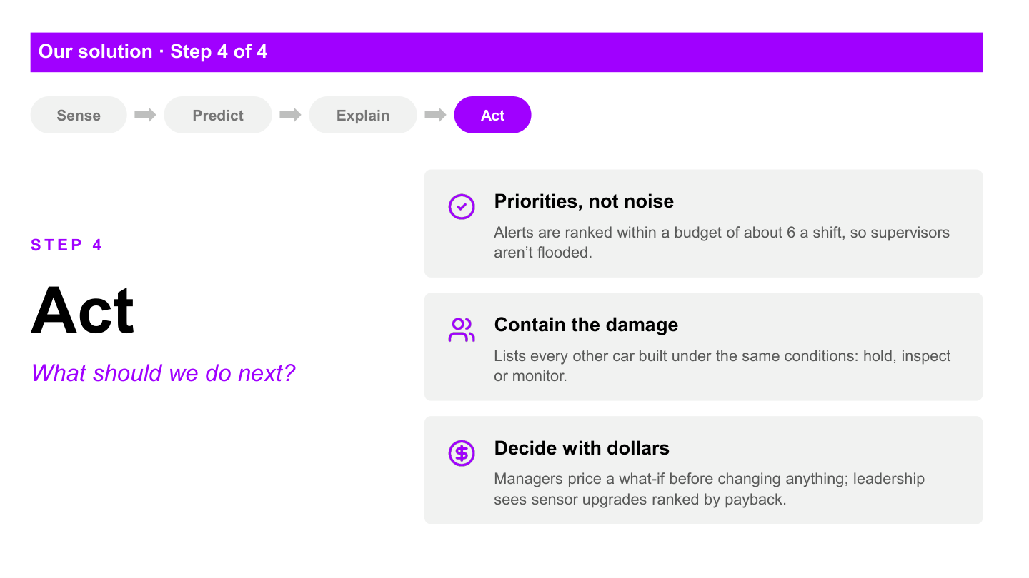
Notes:
RISHABH - 4:45 to 5:30
Fourth, Act. PulseTwin converts the warning into a controlled decision. It finds other in-flight vehicles that share the relevant lot, variant or process conditions and helps the supervisor decide whether to hold, inspect or monitor them.
For production changes, the manager can compare an intervention with the baseline in the digital twin before touching the line. The system can estimate the effect on throughput, work in progress, blockage and starvation. The agent may investigate and propose, but a person approves the action. PulseTwin remains read-only with respect to real equipment.
In our hypothetical wheel case, that means containing the exposed vehicles before shipment, checking the fastening process and testing the production impact of the response.

Slide 9
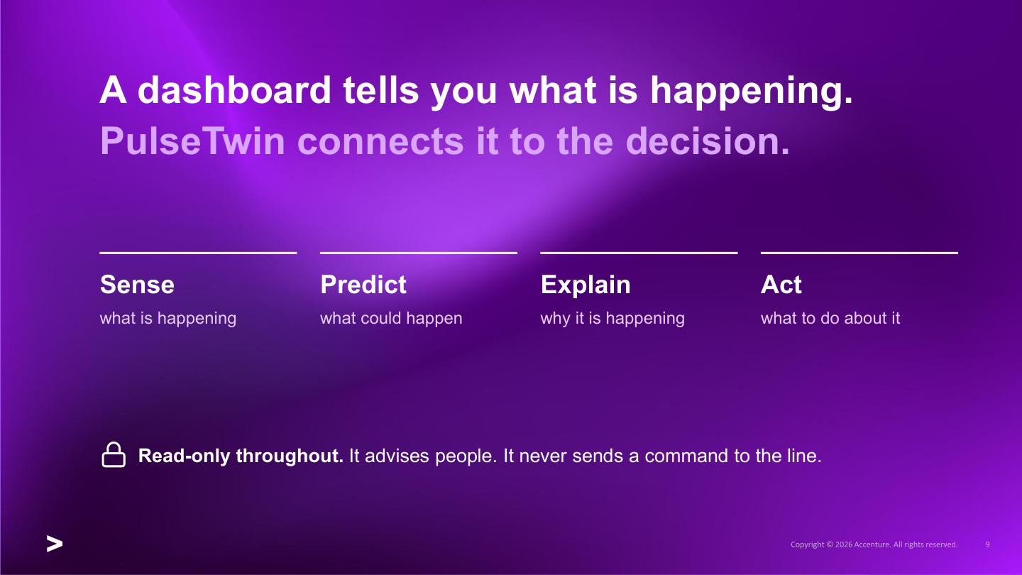
Notes:
RISHABH - 5:30 to 5:50
That is the difference. A normal dashboard tells us what is happening at separate points. PulseTwin connects the vehicle, the line condition and the decision: sense the complete context, predict early, explain the evidence and recommend a controlled action.
HANDOFF TO PRASHANT:
Prashant will now show this flow live, following a vehicle from the line signal to the risk explanation, containment decision and plant-level view.

Slide 10
LIVE DEMO
Now let's see PulseTwin live
Prashant follows one vehicle from line signal to verified decision.
Notes:
PRASHANT - 5:50 to 7:45
LIVE DEMO CHECKLIST
1. Open the Supervisor panel and start or resume Plant A.
2. Point out vehicle movement, station state and the current constraint.
3. Open one at-risk vehicle and show prediction time, calibrated risk and contributing factors.
4. Show containment or related in-flight vehicles.
5. Move to Manager and show the bottleneck and one what-if comparison.
6. Show the agent execution mode honestly: Agent or Deterministic.
7. End on the human approval boundary: the system recommends; a person decides.
Recovery line if the live simulation is slow:
The live stream is still advancing, so I will use this completed vehicle to show the same persisted prediction, explanation and inspection outcome.

Slide 11
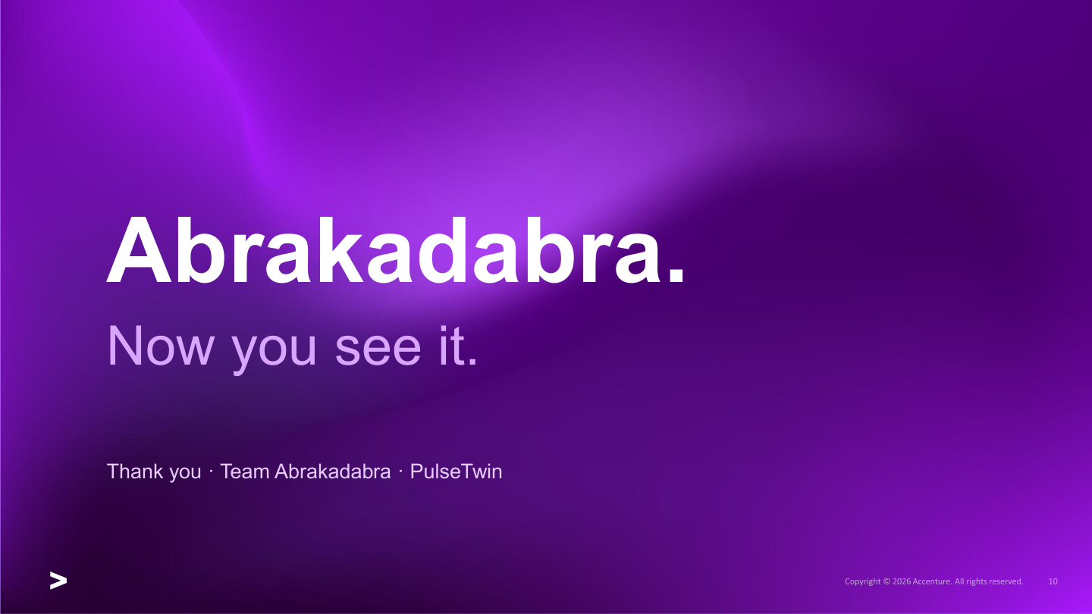
Notes:
CLOSE - 7:45 to 8:00
PulseTwin helps teams find risk earlier, understand why it matters and make a verified decision before the problem leaves the plant. Thank you.

