Slide 1

Notes:
MUKUL - 0:00 to 0:15
Good morning. We are Team Abrakadabra, and this is PulseTwin: a digital twin for automotive assembly lines that sees what no single station can see alone.

Slide 2
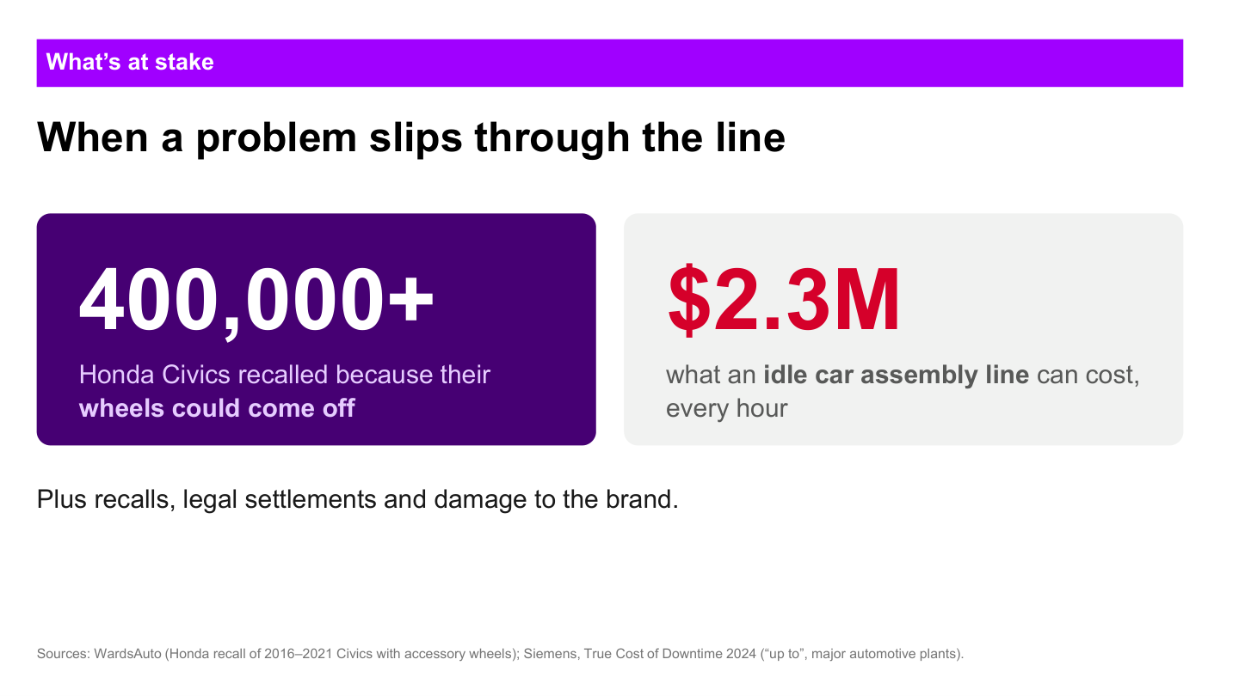
Notes:
MUKUL - 0:15 to 1:05
Automotive failures become expensive when the line discovers them late. The recall example on screen shows the scale of the consequence. A major assembly line can also lose millions during an hour of downtime. For our hypothetical case, imagine a wheel-fastening process beginning to drift. Each individual station still appears acceptable, so production continues. The problem becomes visible only after vehicles have left the line, when a customer reports a loose wheel. By then the response includes containment, reinspection, downtime, recall exposure and loss of trust.
Important: present the accident as a hypothetical scenario. Do not claim it caused the Honda recall referenced on this slide.

Slide 3
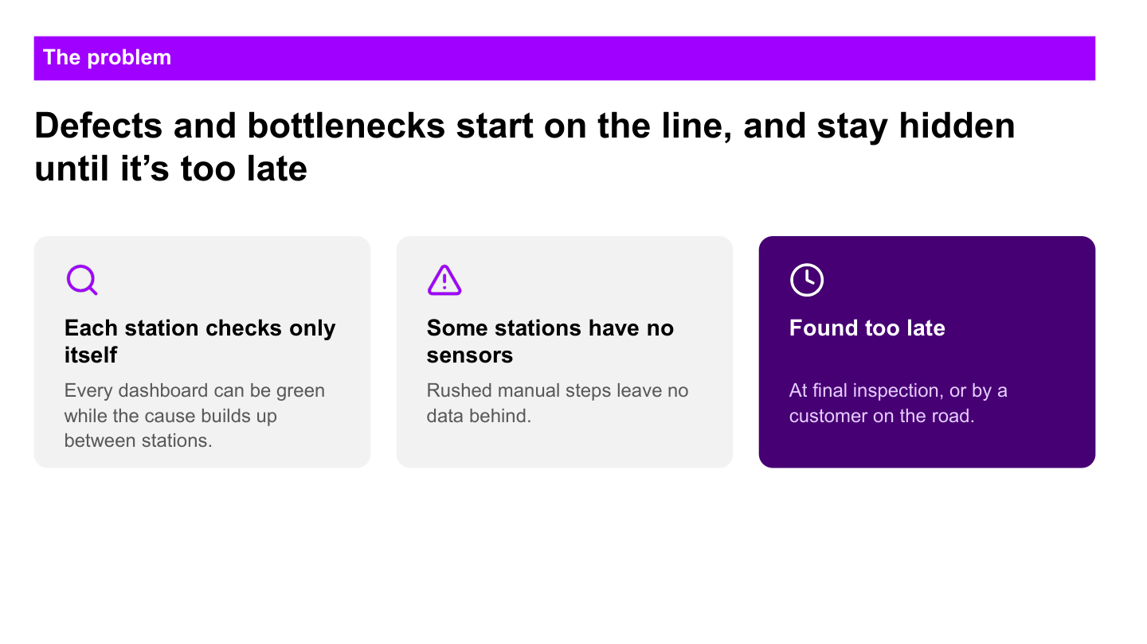
Notes:
MUKUL - 1:05 to 2:10
Why was the problem missed? The first reason is fragmentation. Each station sees its own cycle and its own readings, but nobody sees the complete vehicle journey. The second reason is missing visibility. Manual stations or sensor gaps can hide a rushed check or an abnormal handoff. The third reason is timing. Final inspection may find the issue after many similar vehicles have already passed through the same conditions.
So the problem is not simply that factories have no data. The problem is that the evidence remains separated until it is too late to act.
HANDOFF TO RISHABH:
Rishabh will now continue this same vehicle journey and show how PulseTwin turns those disconnected signals into an early, explainable decision.

Slide 4
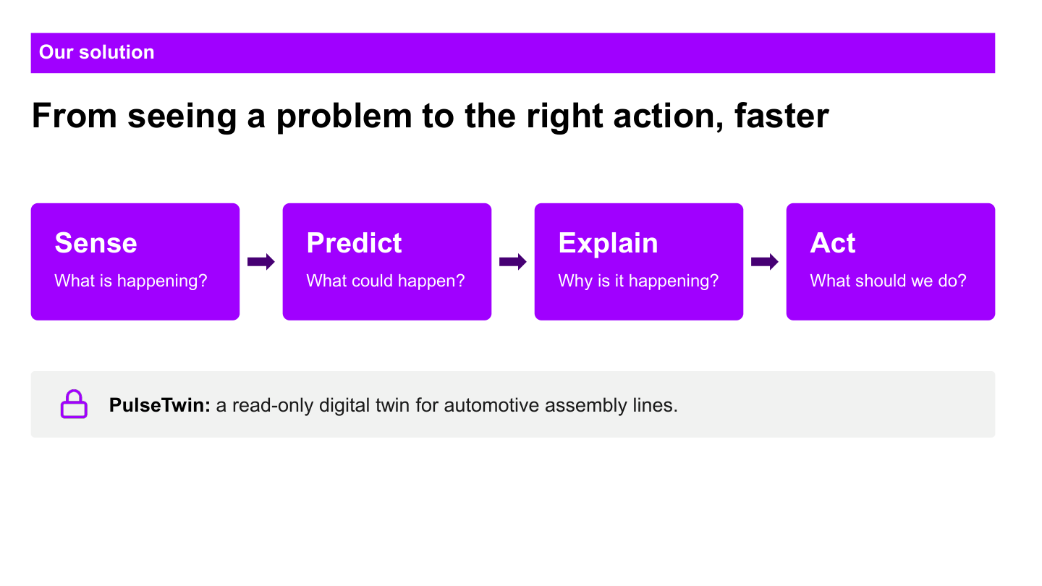
Notes:
RISHABH - 2:10 to 2:40
Let us continue Mukul's hypothetical case. The vehicle is still inside the plant. A torque pattern has started drifting, a manual check was completed unusually quickly, and the line is building a queue. Each event looks small in isolation, but together they form a risk pattern.
PulseTwin connects those signals into one decision journey. It observes the line, predicts risk early, explains the evidence and helps the team respond before the vehicle leaves the plant.

Slide 5
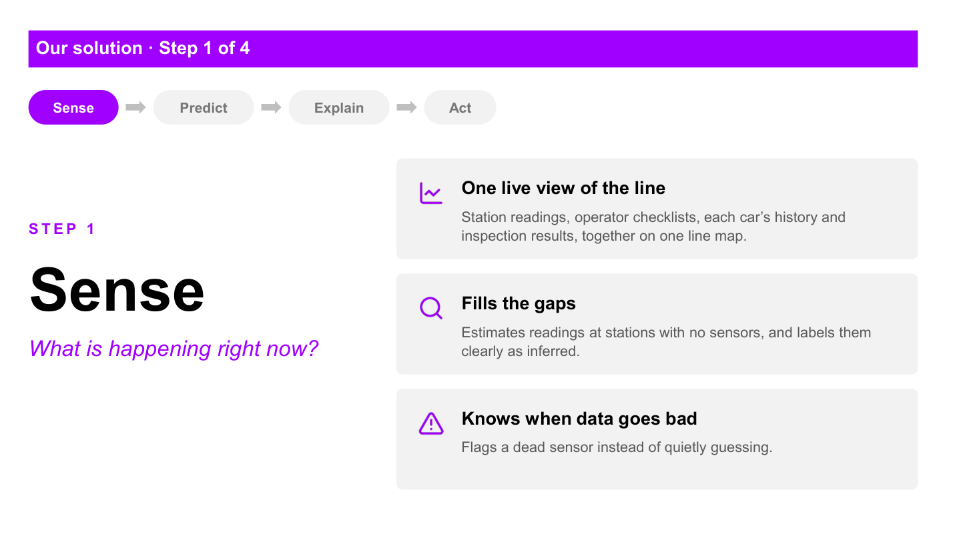
Notes:
RISHABH - 2:40 to 3:05
The Sense layer creates one timeline for every vehicle and station. It joins sensor readings, cycle events, buffer movement, manual checklists and final inspection outcomes.
The Supervisor panel turns this into a live line view. It shows where the vehicle is, which station is blocked or starved, and whether a signal is measured or inferred. If a sensor goes dark, PulseTwin reports the dropout instead of quietly treating a guess as a measurement.

Slide 6
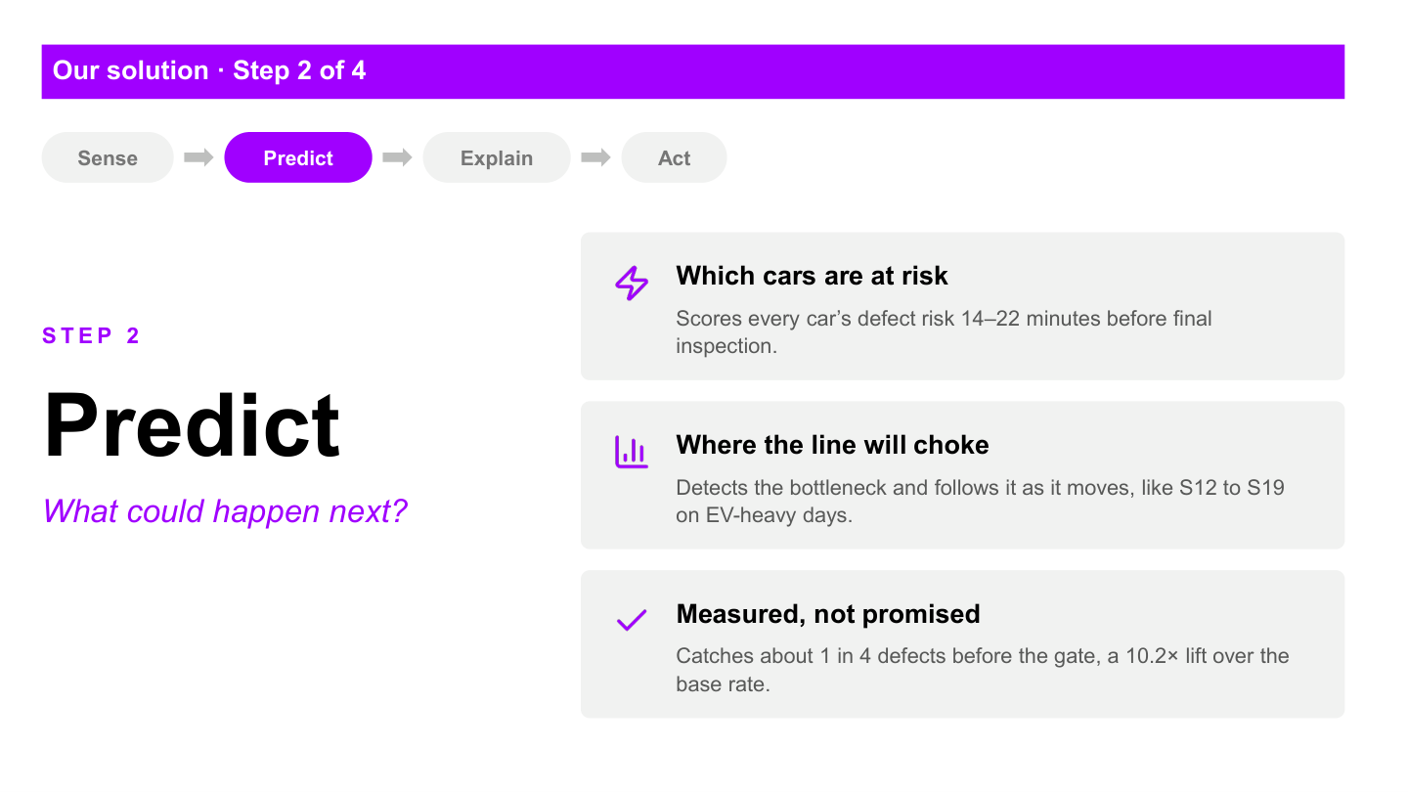
Notes:
RISHABH - 3:05 to 3:35
The Predict layer combines the evidence available before final inspection and produces a calibrated defect-risk estimate. It also detects the current production constraint from working, blocked, starved and down time.
On the Supervisor panel, the team can open an at-risk vehicle, see when the prediction was made and review its contributing factors. On the Manager panel, the same events appear as throughput loss, bottleneck movement and what-if choices. Risk remains a probability, not a statement that the vehicle is definitely defective.

Slide 7
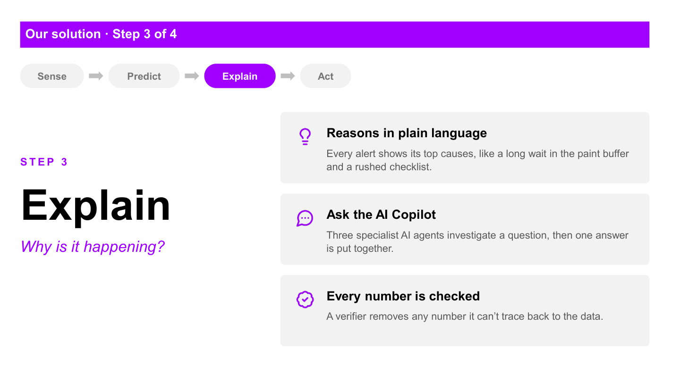
Notes:
RISHABH - 3:35 to 4:40
The part that makes PulseTwin agentic begins after a signal appears. The agent does more than generate a summary. It receives an investigation goal, decides which approved tools it needs, reads live plant APIs and builds an evidence-backed recommendation.
For an incident, three specialists examine different parts of the same situation. The Reliability specialist checks whether a sensor dropout or model issue could explain the alert. The Production specialist examines the constraint, blocked and starved propagation, and the cost in throughput. The Risk specialist identifies the affected vehicle and other in-flight vehicles that share its process fingerprint. A synthesizer then combines their evidence into one finding.
The agent can also test a supported what-if scenario against the digital twin before proposing a response. Every numerical claim is checked by a verifier against the exact tool result. The agent remains read-only: it can investigate and propose, while a person decides.
The UI also shows whether the run used an AI provider or the deterministic fallback, so we do not present a fixed workflow as an AI agent.

Slide 8
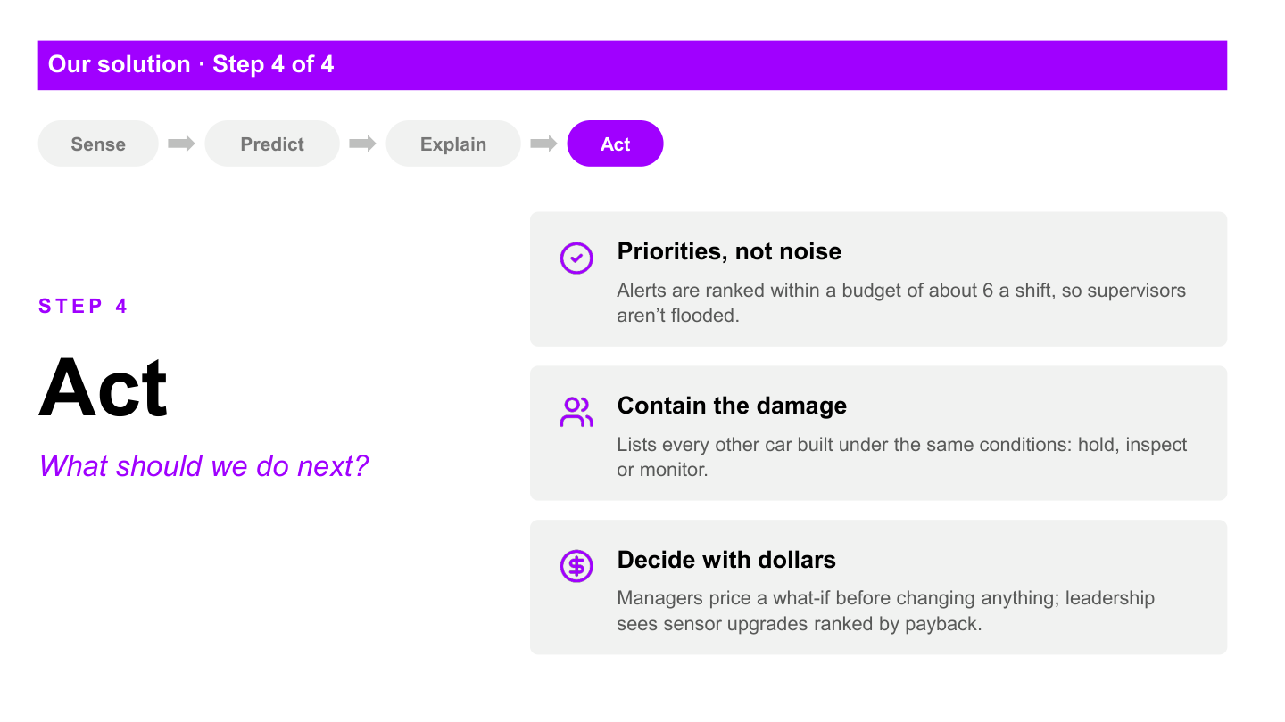
Notes:
RISHABH - 4:40 to 5:30
Each panel supports a different part of that decision.
The Supervisor panel handles the immediate response: vehicle risk, contributing factors, containment and alert actions. The Manager panel explains the constraint, compares stations, runs supported what-if analysis and displays agent proposals. The Leadership panel connects model recall and the alert threshold to business value and sensor investment. The Ops panel monitors model health, drift, sensor coverage, ingestion lag and the audit trail.
In Mukul's hypothetical wheel case, the workflow is clear: detect the pattern, identify exposed vehicles, investigate the cause, test the response in the twin and send a verified proposal to the responsible person. The system supports the decision without sending commands to real equipment.

Slide 9
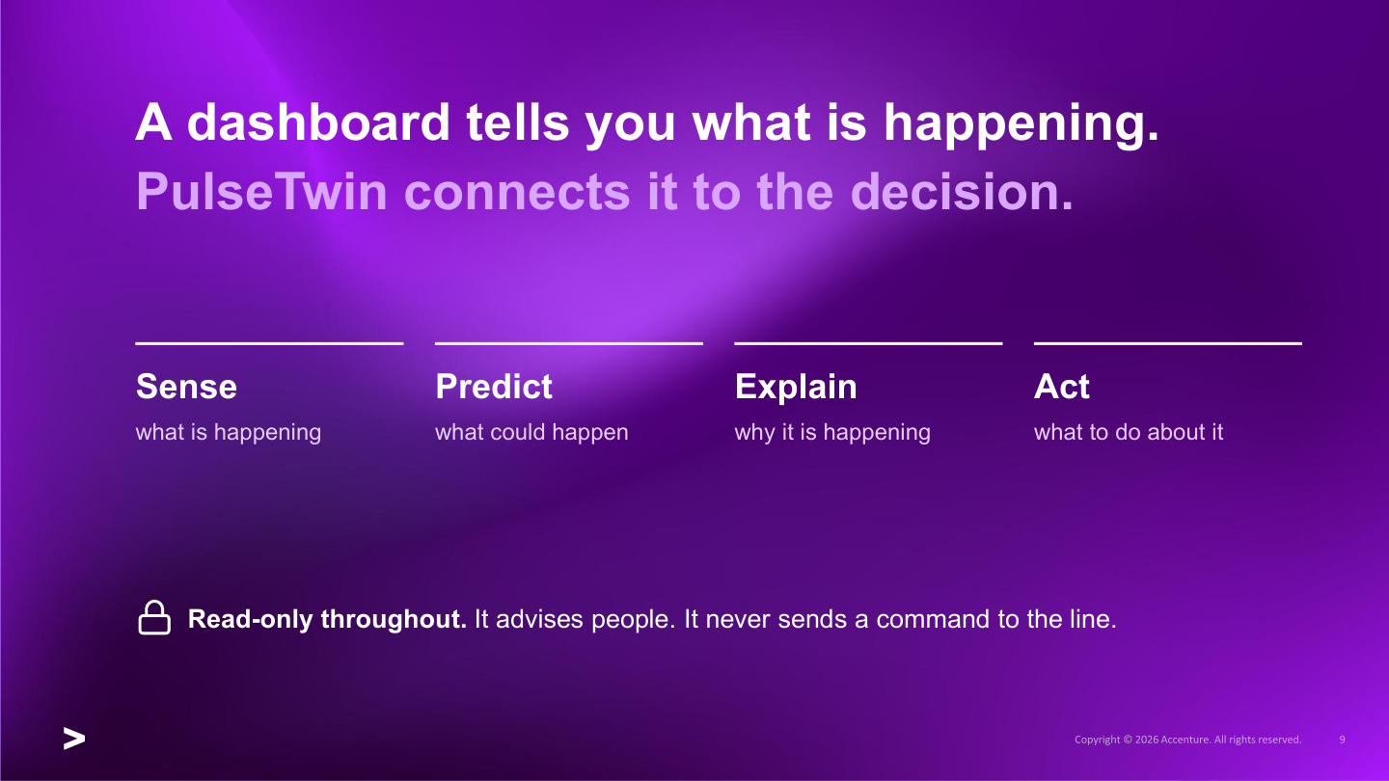
Notes:
RISHABH - 5:30 to 5:50
That is the difference. PulseTwin connects operational data, predictive models, specialist agents and human approval in one traceable workflow. It helps the team move from a weak signal to a verified decision while the vehicle is still inside the plant.
HANDOFF TO PRASHANT:
Prashant will now show this flow live, following a vehicle from the line signal to the risk explanation, containment decision and plant-level view.

Slide 10
LIVE DEMO
Now let's see PulseTwin live
Prashant follows one vehicle from line signal to verified decision.
Notes:
PRASHANT - 5:50 to 7:45
LIVE DEMO CHECKLIST
1. Open the Supervisor panel and start or resume Plant A.
2. Point out vehicle movement, station state and the current constraint.
3. Open one at-risk vehicle and show prediction time, calibrated risk and contributing factors.
4. Show containment or related in-flight vehicles.
5. Move to Manager and show the bottleneck and one what-if comparison.
6. Show the agent execution mode honestly: Agent or Deterministic.
7. End on the human approval boundary: the system recommends; a person decides.
Recovery line if the live simulation is slow:
The live stream is still advancing, so I will use this completed vehicle to show the same persisted prediction, explanation and inspection outcome.

Slide 11
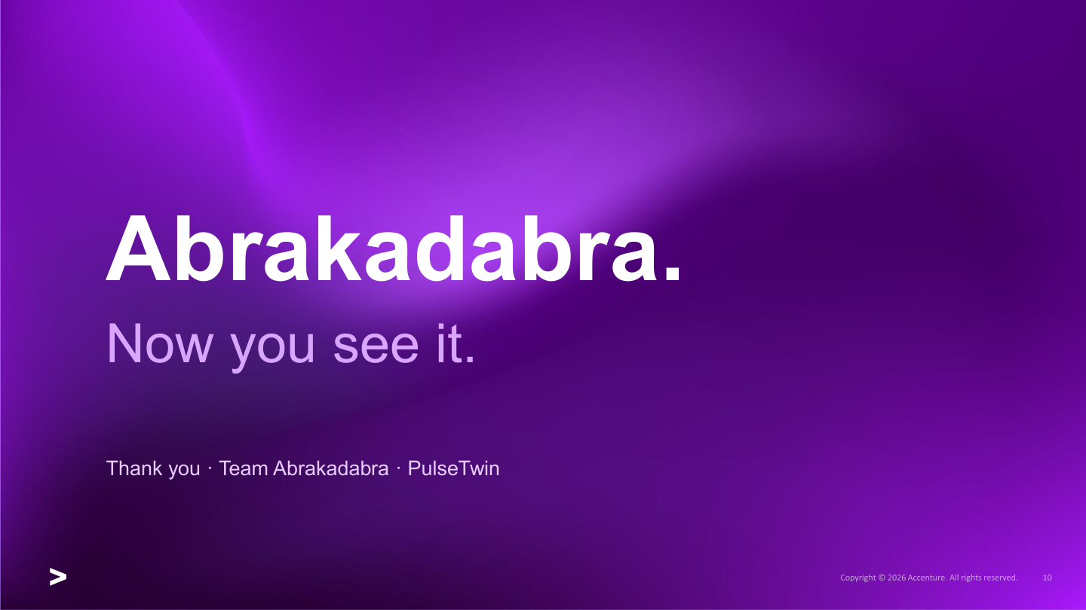
Notes:
CLOSE - 7:45 to 8:00
PulseTwin helps teams find risk earlier, understand why it matters and make a verified decision before the problem leaves the plant. Thank you.

