Slide 1
Flash
Flash is a chatbot, like alice
Differance is
You dont have to type anymore

Slide 2
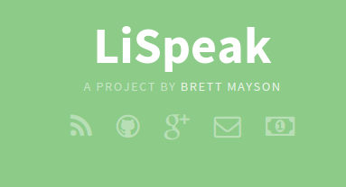
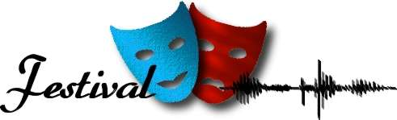
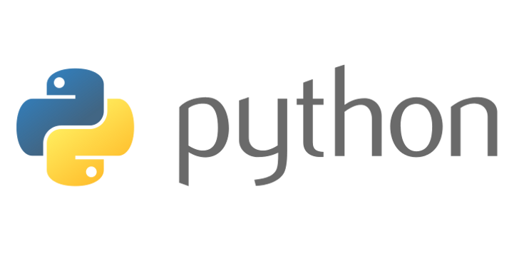
Tools used
Pyaiml
Aiml Files
Festival is optional

Slide 4
Lispeak
Lispeak is a advanced stt, it uses google api for conversion. Python and script for programming, It performs operation according to your command, like opening music player.
I edited Lispeak so that it redirects result text came from google to a file named data.

Slide 5
Festival - tts

Slide 6
Festival
Festival is a tts tool
tts – text to speech

Slide 7
Pyaiml

Slide 8
Pyaiml
Pyaiml is a aiml interpreter written in python.

Slide 9
Lets Start
Download Lispeak from githhub
Extract whereever you wanted to
Then install it by using command, ./lispeak --setup
And run hotkey using “bash hotkey”
Hotkey is trigger for app to start and stop too

Slide 10
Pyaiml
Download Pyaiml
Extract it using “tar xzvf filename.tar.gz”

