Slide 1
HARDWARE ACCELARATOR FOR MOBILENETS
Presented by – Aditya Sharma (112676654)
Mukul Javadekar (112961738)

Slide 2
Introduction
A class of convolutional neural network designed by researches at Google
Improvised CNN architectures for Embedded Applications
In many real world applications such as robotics, self-driving car and augmented reality, the recognition tasks need to be carried out in a timely fashion on a computationally limited platform.

Slide 3
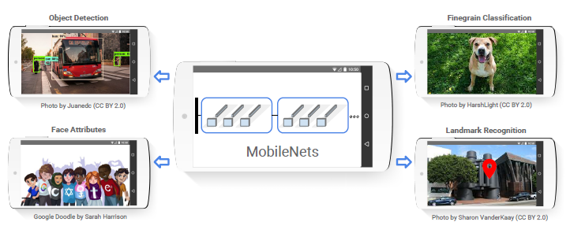
Why MobileNets
Relatively larger magnitude of reduction in number of computations
Consume less power
Energy efficient
Low latency

Slide 4
MobileNets Architecture
The original Mobilenets architecture consists of 28 layers and each layer is followed by Batchnorm and ReLU activation function.
MobileNet is built on which are depthwise separable filters:
1. Depthwise Separable Layer
2. Pointwise Convolution Layer
The basic layer is Standard Convolution Layer.
Based on depthwise separable convolutions which is a form of factorized convolutions which factorize a standard convolution into a depthwise convolution and a 1×1 convolution called a pointwise convolution.
MobileNets use both batchnorm and ReLU nonlinearities for both layers.

Slide 5
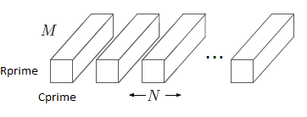
Standard Convolution Layer
It is a standard 2D convolution where we have Inputs(I) convolving with Weights(W) to give the Output(O).
A standard convolutional layer takes as input a Rprime × Cprime × N
It produces output of R × C × M
The standard convolutional layer is parameterized by convolution kernel of K × K × N × M
Computational costs: K*K*N*M*Rprime*Cprime

Slide 6
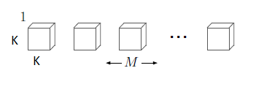
Depthwise Convolution
Depthwise convolution applies a single filter to each input channel.
The basic idea of Depthwise is that the output channels is equal in number to input channels
Kernel Size of K × K × M
Computational cost is K*K*M*Rprime*Cprime

Slide 7
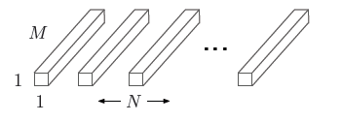
Pointwise Convolution
Pointwise convolution, a simple 11 convolution
Since Depthwise only filters depthwise input channels, pointwise is used that computes a linear combination of the output of depthwise convolution via 1 1 convolution is needed in order to generate the new features.
Convolution costs = N*M*Rprime*Cprime
Depthwise separable convolutions cost: K*K*M*Rprime*Cprime + N*M*Rprime*Cprime

Slide 8
Our Architecture
We have implemented a reduced form of the original architecture with :
Standard convolution (1 layer)
Depthwise convolution (1 Layer)
Pointwise convolution (1 layer)
Each layer followed by batchnorm and ReLU
Finally using Average Pool and Fully Connected Layer
We successfully implemented this in Pytorch
Type/Stride | Filter
Conv/s1 | 3×3×3×32
Conv dw/s1 | 3×3×32×1
Conv/s1 | 1×1×32×512
Avg Pool/s1 | 7×7
FC/s1 | 8192×10

Slide 9
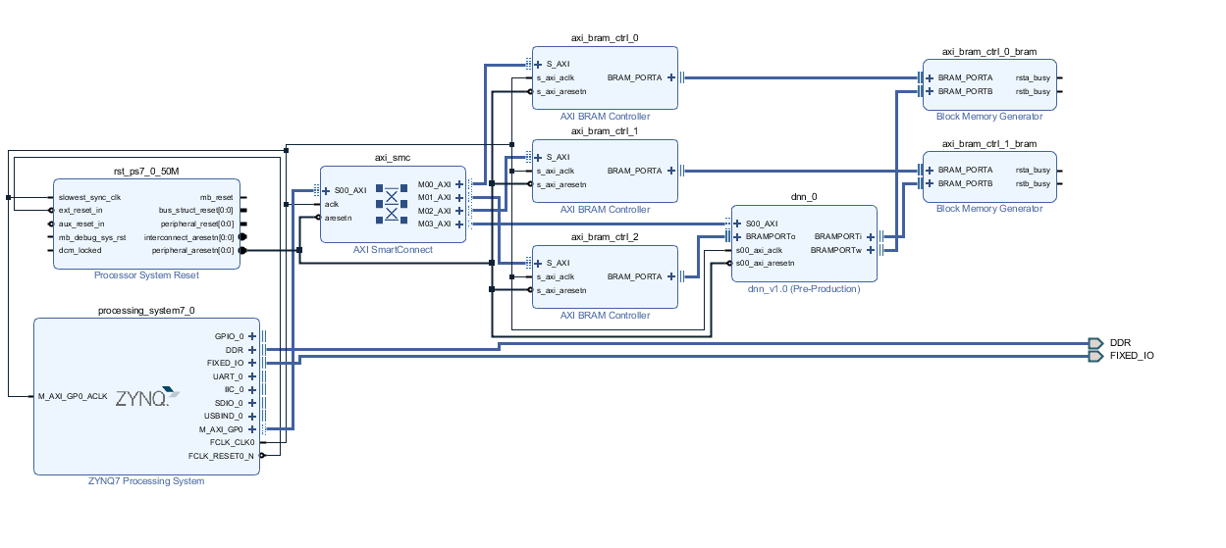
Hardware architecture

Slide 10
CLP-Nano for Convolution of a RxC and KxK feature MAP
BIAS
AXI Interconnect
PL STATUS, PS CONTROL, C VALUE, K VALUE, N VALUE
to/from other components
2:1 mux
N Value &
W Address control signal
AXI BRAM Controller
BRAM I
Floating point MAC
BRAM O
AXI BRAM Controller
BRAM W
AXI BRAM Controller

Slide 11
CLP-Nano - Software
I[N][R’][C’] // N input feature maps
W[M][N][K][K] // M x N x K x K weights
O[M][R][C] // M output feature maps
for(m=0; m<M; m++)
Load Bias, C and K value
for(n=0; n<N; n++) Load N value
copy W[m][n][*][*] to HW weight buffer
copy I[n][*][*] to HW input buffer
tell HW to start and wait for it to finish
O[M][*][*] = [read values from HW output buffer]
Initially N is zero
Set N is 1, Status and control is 0, switch port to read data

Slide 12
CLP-Nano - Hardware
- r_done: When one row of input feature map read
- m_done: When one intermediate value of output matrix done for a weight value
- c_code: When all outputs written to output memory
- k_done: Used to stop address increment and computation, as outputs generated after latency
- counter1: C-1
- counter2: C² -1
- counter3: C² -1
- counter4: C² x K² -1
- row: of weight matrix
- col: of weight matrix
- w_add_g: To add bias or read data
Ibuf[R’][C’] // 1 input feature map Wbuf[K][K] // 1 kernel of weights Obuf[R][C] // 1 output feature map
wait for SW to send start signal
for(i=0; i<K; i++)
for(j=0; j<K; j++)
for(r=0; r<R; r++)
for(c=0; c<C; c++)
Obuf[r][c]+=Wbuf[i][j]*Ibuf[r+i][c+j]
send done signal to hardware

Slide 13
DW convolution in CLP-Nano
Cp
C
K
Rp
R
K
N
N
N
In Depth-wise convolution weights are generated with single dimension and total number of weights generated are equal to number of dimesnions.
Each input and weight feature map are given to CLP-Nano to generate an output feature map

Slide 14
PW convolution in CLP-Nano
32
30
3
3
32
30
3
3
3
3
In Point-wise convolution weights are generated with feature map with single value, rest is similar to normal convolution
Each input and weight feature map are given to CLP-Nano to generate an intermediate output feature map, total N input and weight feature are loaded to CLP-Nano one by one to get an complete output feature map

Slide 15
References:
MobileNets: Efficient Convolutional Neural Networks for Mobile Vision Applications Andrew G. Howard Menglong Zhu Bo Chen Dmitry Kalenichenko Weijun Wang Tobias Weyand Marco Andreetto Hartwig Adam Google Inc.
https://hackernoon.com/creating-insanely-fast-image-classifiers-with-mobilenet-in-tensorflow-f030ce0a2991

