Slide 1
FIFO Implementation Using FPGA Micro-Architecture
Guided by:
Dr. Y.V. Joshi
Dr. S.S. Gajre
Industrial Guide:
Mr. Vaibbhav Taraate
Team members:
Mahesh Baraskar
Mukul Lokhande
Pushpak Ghatode
Tejaswini Khairnar
Ratnamala Patil

Slide 2
SPECIFICATIONS
BURST Size : 1.5K bytes
FIFO Size : 1 K bytes
Input Data Pins: 8
Input Pins: 2 (R/W enable)
Output Data Pins: 8
Write Pointer Pins: 10
Read Pointer Pins: 10
Flag Pins: 5 ( EMPTY, FULL, HALF FULL / EMPTY, ALMOST FULL, ALMOST EMPTY)
Reset: 1
Write Clock (100MHz)
Read Clock (33MHz)

Slide 3
PIN Diagram:
FIFO
(1Kb)
Input [7:0]
Output [7:0]
Write Clock
Read Clock
Write Enable
Read Enable
Reset
Flag [4:0]

Slide 4
Top Level Diagram:
Dual Port SRAM
Write Data
Read Data
Wr_En
Rd_En
Wr_CLK
Rd_CLK
Write Control & Pointer
Read Control & Pointer
Synchronizer & Flag Logic
Reset &
Expansion Logic

Slide 5
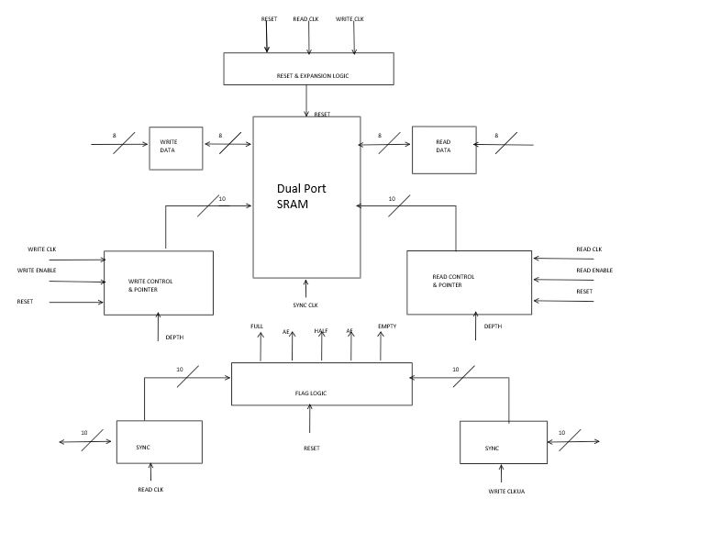
Micro Architecture

Slide 6
Pin Description – Top Level
No. | Name of Pin | No. of Pins | Direction | Description
1. | Write Data | 8 | Input | Input data to SRAM
2. | Read Data | 8 | Output | Output data from SRAM
3. | Write Enable | 1 | Input | Enable write operation
4. | Read Enable | 1 | Input | Enable read operation
5. | Write Clock | 1 | Input | Clock for write operation
6. | Read Clock | 1 | Input | Clock for read operation
7. | Reset | 1 | Input | To reset FIFO memory
8. | Flag Logic | 4 | Output | Show status of FIFO

Slide 7
Flag Logic
Reset
Wr_Ptr
Rd_CLK
Flag Logic
Full
Sync_1
Almost Full
Almost Empty
Sync_2
Empty
Half
Wr_CLK
Rd_Ptr
Depth

Slide 8
Pin Functions – Flag Logic
No. | Name of Pin | No. of Pins | Direction | Function
1. | Write Pointer | 10 | Input | Address input to comparator
2. | Read Pointer | 10 | Input | Address input to comparator
3. | Depth | 10 | Input | Limiting value of memory location
4. | Reset | 1 | Input | To set empty flag
5. | Write Clock | 1 | Input | To synchronize Read pointer
6. | Read Clock | 1 | Input | To synchronize Write pointer
7. | Full | 1 | Output | Show status as FIFO is Full
8. | Empty | 1 | Output | Show status as FIFO is empty
9. | Almost Full | 1 | Output | FIFO is Almost empty
10. | Almost Empty | 1 | Output | FIFO is Almost empty
11. | Half | 1 | Output | Show status as FIFO is half

Slide 9
Synchronizers
Wr_Ptr
Rd_Ptr
Synchronizer
Synchronizer
Rd_Clk
Wr_Clk
Syn_Wr_Ptr
Syn_Rd_Ptr

Slide 10
Pin Functions – Synchronizers
No. | Name of Pin | No. of Pins | Direction | Function
1. | Write Pointer | 10 | Input | Address to be synchronized
2 | Read Pointer | 10 | Input | Address to be synchronized
3 | Write Clock | 1 | Input | Synchronizing clock
4 | Read Clock | 1 | Input | Synchronizing clock
5 | Synchronized Write Pointer | 10 | Output | Synchronized address
6 | Synchronized Read Pointer | 10 | Output | Synchronized address

Slide 11
Dual Port SRAM
DP-SRAM
(1Kb)
Data_Port_1
Data_Port_2
Clock_Port_2
Clock_Port_1
Control_Port_2
Control_Port_1
Address_Port_1 [9:0]
Address_Port_2 [9:0]
Reset

Slide 12
Pin Description – Dual Port SRAM
No. | Name of Pin | No. of Pins | Direction | Function
1 | Data Port x | 8 | Bidirectional | Data to or from the memory
2 | Address Port x | 10 | Input | Specifies memory location for W/R
3 | Clock Port x | 1 | Input | Clock signal for operation
4 | Control Port x | 1 | Input | Specifies operation to be performed W/R
5 | Reset | 1 | Input | Resets the SRAM and memory locations
Here x can be 1 or 2.

Slide 13
Read Control Block
READ CONTROL BLOCK
Depth
READ PTR
EMPTY
READ CLK
READ ENABLE
RESET

Slide 14
Pin Functions – Read Control Block
No. | Name of Pin | No. of Pins | Direction | Function
1. | Read Pointer | 10 | Output | Output address to SRAM
2. | Read Enable | 1 | Input | Enable read operation
3. | Read Clock | 1 | Input | Clock for read operation
4. | Reset | 1 | Input | To reset Read Pointer
5. | Empty | 1 | Input | Show status of FIFO as empty
6. | Depth | 10 | Input | Indicate FIFO size

Slide 15
Write Control Block
WRITE CONTROL BLOCK
Depth
WRITE PTR
FULL
WRITE CLK
WRITE ENABLE
RESET

Slide 16
Pin Functions – Write Control Block
No. | Name of Pin | No. of Pins | Direction | Function
1. | Write Pointer | 10 | Output | Output address to SRAM
2. | Write Enable | 1 | Input | Enable write operation
3. | Write Clock | 1 | Input | Clock for write operation
4. | Reset | 1 | Input | To reset write Pointer
5. | Full | 1 | Input | Show status of FIFO as full
6. | Depth | 10 | Input | Indicate FIFO size

