Slide 1
FIFO
Literature Survey

Slide 2

Why FIFO required?
Exchange of data between two different PCBs working at different frequencies
Otherwise slowest component will determine the speed

Slide 3

What is FIFO?
First In First Out
Ex. Queue at ticket counter

Slide 4
What is FIFO?(Contd.)
Dual Port Memory
Data Output
Data Input
Write Logic
Read Logic

Slide 5
FIFO Implementation
Software
Flexible to requirement change
Hardware
Speed

Slide 6
Types of FIFOs
Shift Register
Fixed number of stored data word.
Exclusively Read/Write FIFO
Variable number of stored data words
Timing restrictions - synchronous
Concurrent Read/Write FIFO
Variable number of stored data words
No timing restriction – asynchronous
Two circuits with different frequencies can be connected together without the need of a synchronizing circuit

Slide 7
Multiple Clock Domain Design
The Clock type, and functions
Moving data across clock domains
Synchronizing interfaces

Slide 8
The Clock and Reset types
Conceptually, a clock consists of two signals
an oscillator
a gating signal
In general, implemented as two wires or digital periodic signal
If ungated, oscillator is running
Whether the reverse is true depends on implementation library—tool doesn’t care

Slide 9
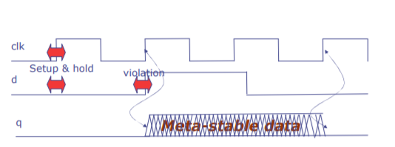
Moving Data Across Clock Domains
Data moved across clock domains appears asynchronous to the receiving (destination) domain
Asynchronous data will cause meta-stability
The only safe way: use a synchronizer

Slide 10
Synchronizers:
Good synchronizer design and use reduces the probability of observing meta-stable data
Synchronizers needed for all crossings
Bit synchronizer
Pulse synchronizer
FIFO synchronizer

Slide 11
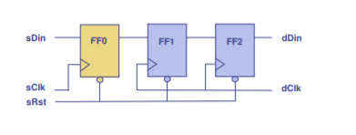
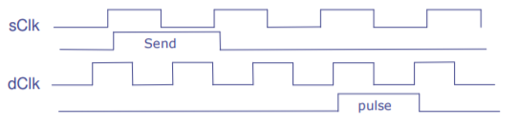
Bit synchronizer
Pulse synchronizer
3. FIFO synchronizer

Slide 12
Synchronizing Interfaces
Hardware approach in clock-domain crossing
Designers instantiate a module having different clocks for different methods, and connect it up explicitly
Alternative linguistic approach
To convert an interface from one clock domain to another
Converts an existing interface to another one of the same type, but on different clock.

Slide 13
Architecture
Write
E
Data
Input
Data
output
D
C
B
A
E
D
C
B
A
Read
Fall-Through
Latch

Slide 14
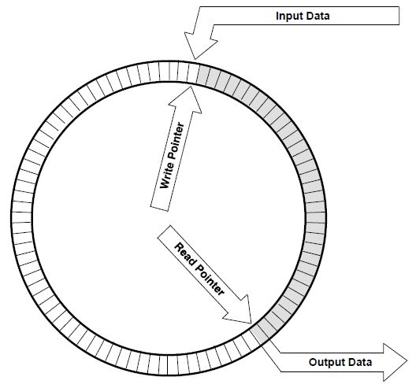
Architecture (Contd.)
Circular FIFO with two pointer

Slide 15
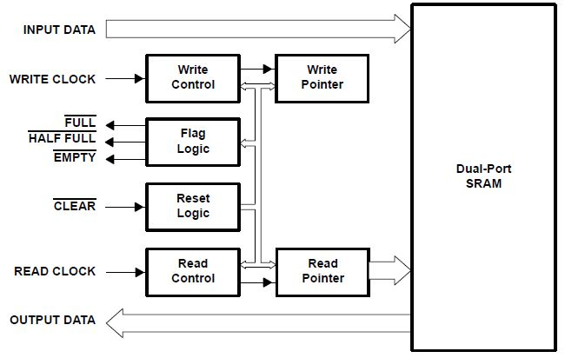
How it functions?
Ref: Document from Texas Instrument

Slide 16
Functionality Of Pins
WRITE CLOCK and FULL(active low)
used to write a data into synchronous FIFO
READ CLOCK and EMPTY(active low)
The control line READ and the EMPTY are used for reading the data
RESET
It is used to perform reset operation. On reset, read and write pointer will initialize to zero (pointer will be pointing to start of the memory)

Slide 17
Functionality Of Pins (Contd.)
INPUT DATA
The input data pin is used to feed an input data to memory. When clock edge is applied read or write operation are perform on the data.
OUTPUT DATA
After performing the operation on given input data the data is available on the output pins of the FIFO.

Slide 18
How it performs read and write?
A FIFO is a First In First Out memory. Data is being shifted in one end and shifted out the other, with the amount of data in the FIFO being allowed to grow up to some maximum limit.
A better way is to use a memory more normally but make it look like a circular buffer by manipulation of the next address to write to and read from.
These addresses live in separate registers, and are often called the read pointer and the write pointer.

Slide 19
Important consideration in design
Overflow:
Occurs when the FIFO is full and writer attempts to insert a new data element
Underflow:
Occurs when the FIFO is empty and reader attempts to retries an element from buffer

Slide 20
Applications
Packet Buffering :
Data written into the FIFO can be stored until the system on the output of the FIFO is ready to accept the data.
Frequency coupling:
FIFO provides frequency coupling, taking data in at one rate and outputting it at another. The input and output data rates of the FIFO being controlled by the discrete Read and Write clock signals.
Bus Matching :
Data transfer may need to take place between separate digital domains with different bus widths. Here the FIFO acts as a bridge between the domains, channeling the data from

Slide 21
Advantages
Data Rate Matching
Buffering and bus matching parallel FIFO structure allow formulation of any word size while serial FIFO structure provide a rapid and simple like other structure.
Interchip communication protocol problem is solved by FIFO.
Only circuitry required is to create fast FIFO, control logic, flag logic

Slide 22
Disadvantages
Noise in signals is caused by switching operation and alteration of memory content
Synchronization circuit is required to synchronize WRITE CLOCK and READ CLOCK

Slide 23
Thank You !
Any Queries ?

