Slide 1
FIFO Implementation Using FPGA
Guided by:
Dr. Y.V. Joshi
Dr. S.S. Gajre
Industrial Guide:
Mr. Vaibbhav Taraate
Team members:
Mahesh Baraskar
Mukul Lokhande
Pushpak Ghatode
Tejaswini Khairnar
Ratnamala Patil

Slide 2

Why FIFO required?
Exchange of data between two different PCBs working at different speed
Otherwise slowest component will determine the speed

Slide 3

What is FIFO?
First In First Out
Ex. Queue at ticket counter
FIFO Implementation
Software
Flexible to change in requirements
Hardware
Speed is High

Slide 4
Types of FIFOs
Shift Register
Fixed number of stored data word.
Exclusively Read/Write FIFO
Variable number of stored data words
Timing restrictions - synchronous
Concurrent Read/Write FIFO
Variable number of stored data words
No timing restriction – asynchronous
Two circuits with different frequencies can be connected together without the need of a synchronizing circuit

Slide 5
Architecture
Write
E
Data
Input
Data
output
D
C
B
A
E
D
C
B
A
Read
Fall-Through
Latch

Slide 6
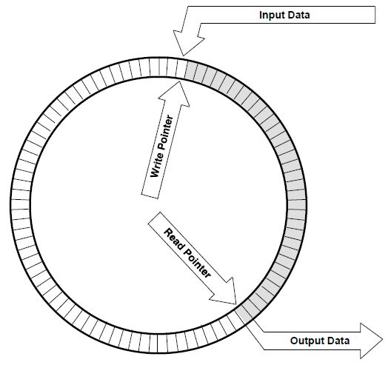
Architecture (Contd.)
Circular FIFO with two pointer

Slide 7
SPECIFICATIONS
BURST Size : 1.5K bytes
FIFO Size : 1 K bytes
Input Data Pins: 8
Input Pins: 2 (R/W enable)
Output Data Pins: 8
Write Pointer Pins: 10
Read Pointer Pins: 10
Flag Pins: 5 ( EMPTY, FULL, HALF FULL / EMPTY, ALMOST FULL, ALMOST EMPTY)
Reset: 1
Write Clock (100MHz)
Read Clock (33MHz)

Slide 8
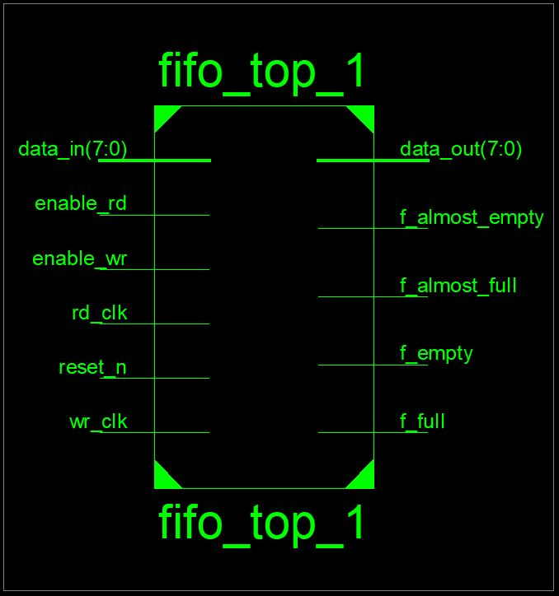
Top Level Diagram:

Slide 9
Top Level Diagram:
Dual Port SRAM
Write Data
Read Data
Write enable
Read enable
Write Control
Read Control
reset
reset
Synchronizer
Write clock
Read clock
Flag Logic

Slide 10
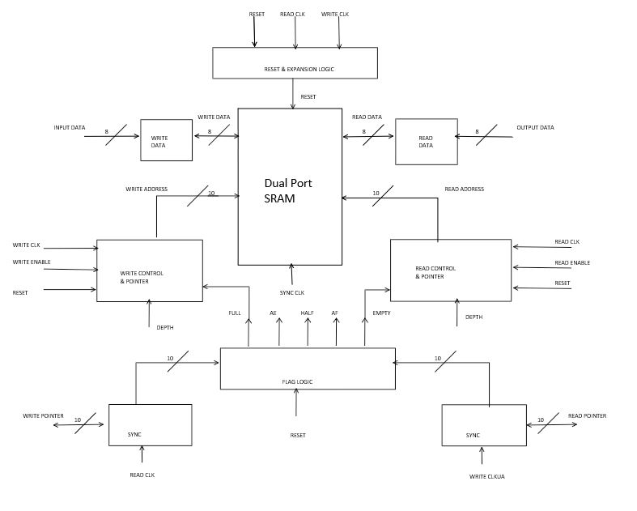
Micro Architecture

Slide 11
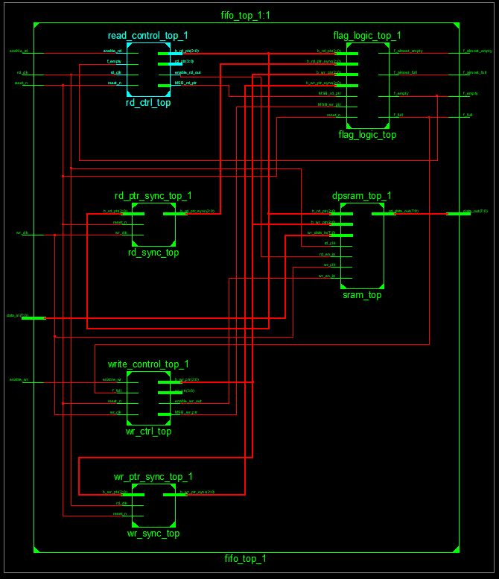
Top Level RTL

Slide 12
Pin Description – Top Level
No. | Name of Pin | No. of Pins | Direction | Description
1. | Write Data | 8 | Input | Input data to SRAM
2. | Read Data | 8 | Output | Output data from SRAM
3. | Write Enable | 1 | Input | Enable write operation
4. | Read Enable | 1 | Input | Enable read operation
5. | Write Clock | 1 | Input | Clock for write operation
6. | Read Clock | 1 | Input | Clock for read operation
7. | Reset | 1 | Input | To reset FIFO memory
8. | Flag Logic | 4 | Output | Show status of FIFO

Slide 13
Important consideration in design
Overflow:
Occurs when the FIFO is full and writer attempts to insert a new data element
Underflow:
Occurs when the FIFO is empty and reader attempts to retrieves data from buffer

Slide 14
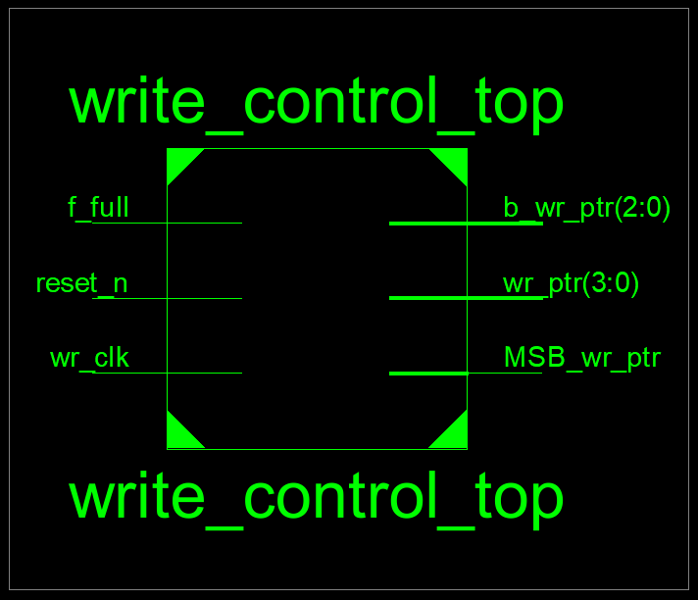
Write Control Block

Slide 15
Pin Functions – Write Control Block
No. | Name of Pin | No. of Pins | Direction | Function
1. | f_full | 1 | Input | Disable signal to write operation
2. | reset_n | 1 | Input | To reset write Pointer
3. | wr_clk | 1 | Input | Clock for write operation
4. | b_wr_ptr | 10 | Output | Output address to SRAM
5. | MSB_wr_ptr | 1 | Output | To generate flag logic

Slide 16
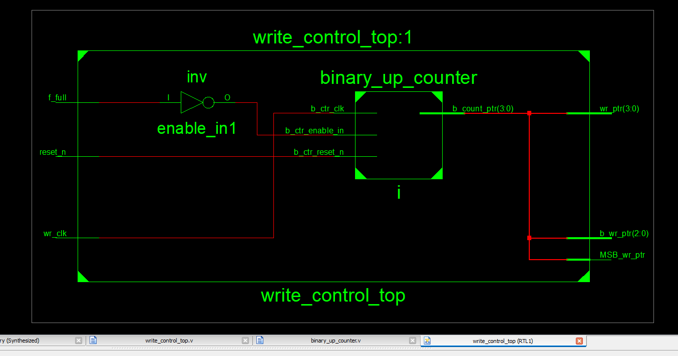
Write Control Block - RTL

Slide 17
Test Cases- Writing data
reset_n = 0, wr_clk= x, f_full=x : O/P wr_ptr = 3’b000;
reset_n = 1, wr_clk= pos , f_full=1 : O/P wr_ptr = Prev_value;
reset_n = 1, wr_clk= pos, f_full=0 : O/P wr_ptr = +1’b1;

Slide 18
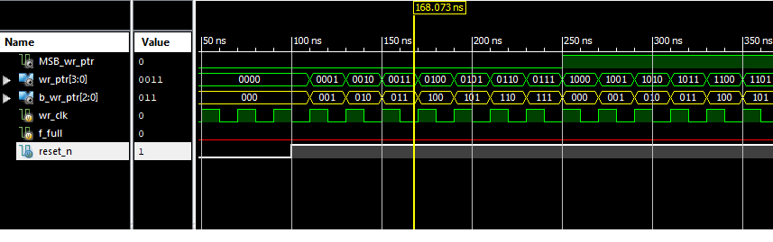
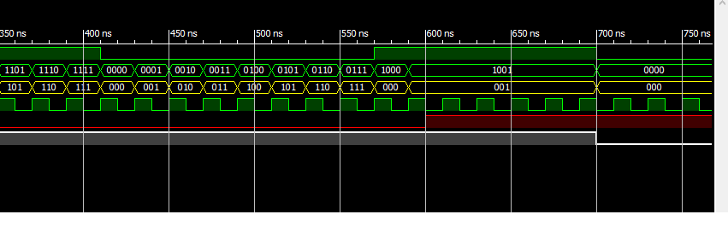
Write Control Block – Simulation Results

Slide 19
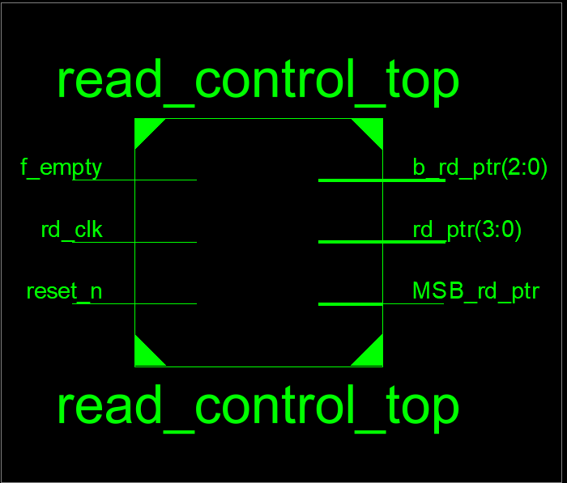
Read Control Block

Slide 20
Pin Functions – Read Control Block
No. | Name of Pin | No. of Pins | Direction | Function
1. | f_empty | 1 | Input | Show status of FIFO as empty
2. | reset_n | 1 | Input | To reset read Pointer
3. | rd_clk | 1 | Input | Clock for read operation
4. | b_rd_ptr | 10 | Output | Output address to SRAM
5. | MSB_rd_ptr | 1 | Output | To generate flag logic

Slide 21
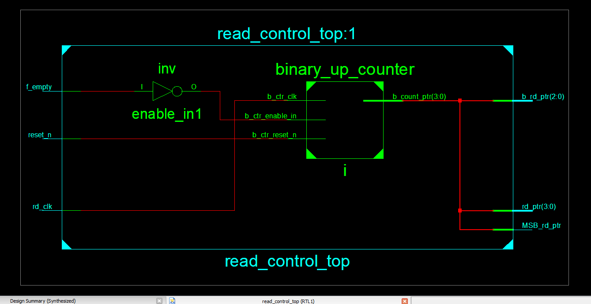
Read Control Block – RTL

Slide 22
Test Cases – Reading data
reset_n = 0, rd_clk= x, f_empty=x : O/P read_ptr = 3’b000;
reset_n = 1, rd_clk= pos , f_empty=1 : O/P read_ptr = Prev_value;
reset_n = 1, rd_clk= pos, f_empty=0 : O/P read_ptr = +1’b1;

Slide 23
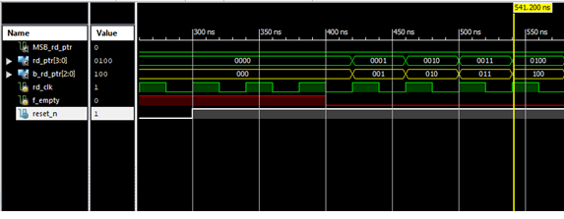
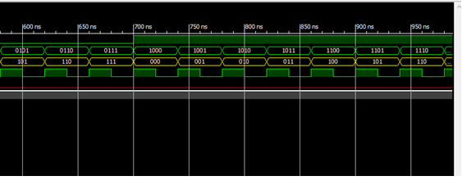
Read Control Block – Simulation Results

Slide 24
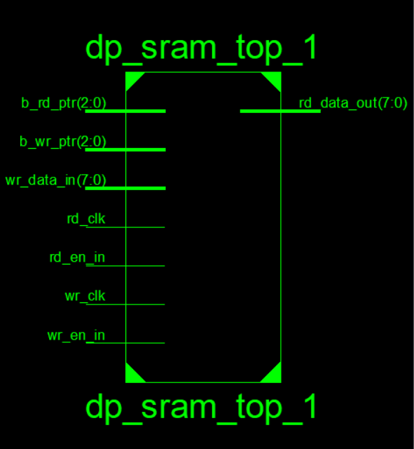
Dual Port SRAM – Top Level Diagram

Slide 25
Pin Description – Dual Port SRAM
No. | Name of Pin | No. of Pins | Direction | Function
1 | b_rd_ptr | 10 | Input | Port specifying the read address
2 | b_wr_ptr | 10 | Input | Port specifying the write address
3 | wr_data_in | 8 | Input | Input data port
4 | rd_clk | 1 | Input | Read clock signal for operation
5 | wr_clk | 1 | Input | Write clock signal for operation
6 | rd_en_in | 1 | Input | Enable pin for the read operation
7 | wr_en_in | 1 | Input | Enable pin for the write operation
8 | rd_data_out | 8 | Output | Output data port

Slide 26
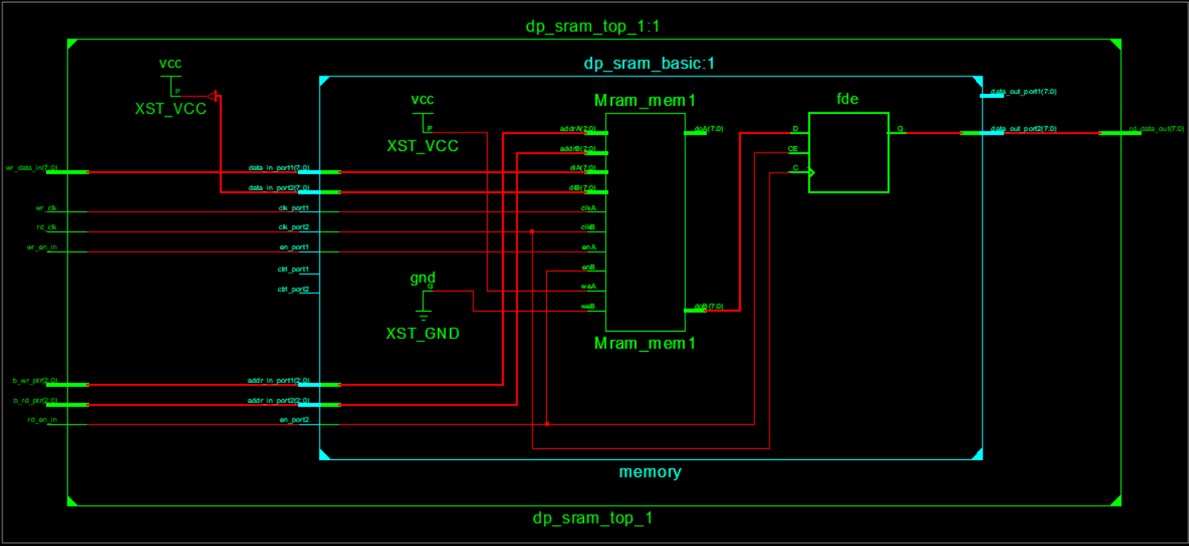
Dual Port SRAM - RTL

Slide 27
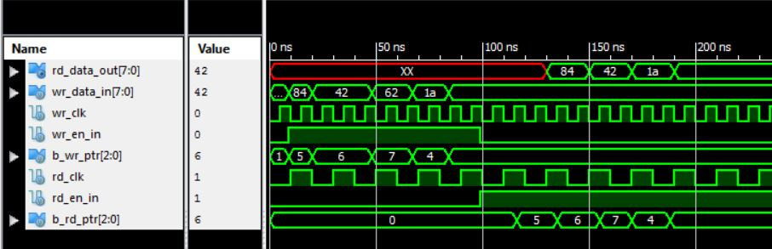
Dual Port SRAM – Simulation Results

Slide 28
Synchronizers
wr_ptr
rd_ptr
Synchronizer
Synchronizer
rd_clk
wr_clk
syn_rd_ptr
syn_wr_ptr

Slide 29
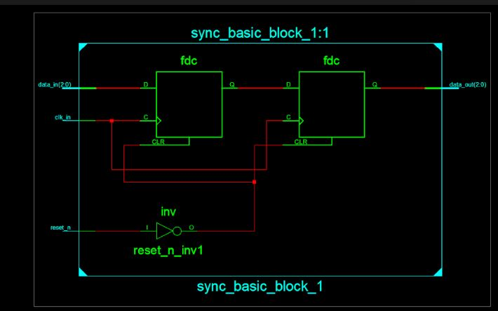
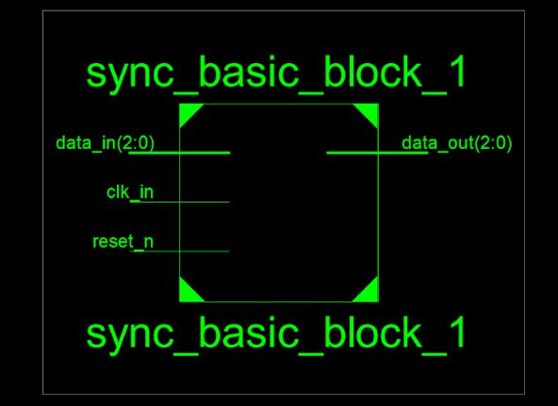
Synchronizer – Top Level and RTL Diagram

Slide 30
Pin Functions – Synchronizers
No. | Name of Pin | No. of Pins | Direction | Function
1. | wr_ptr | 10 | Input | Address to be synchronized
2 | rd_ptr | 10 | Input | Address to be synchronized
3 | wr_clk | 1 | Input | Synchronizing clock
4 | rd_clk | 1 | Input | Synchronizing clock
5 | sync_wr_ptr | 10 | Output | Synchronized address
6 | sync_rd_ptr | 10 | Output | Synchronized address

Slide 31
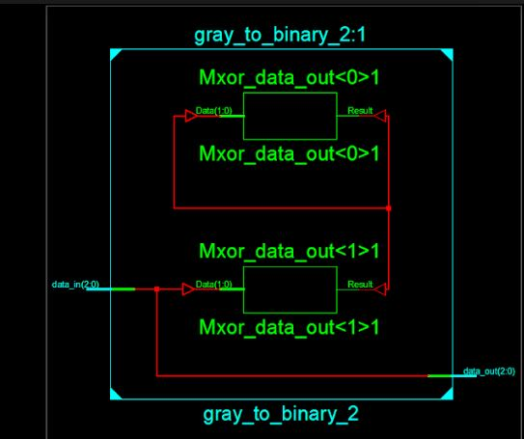
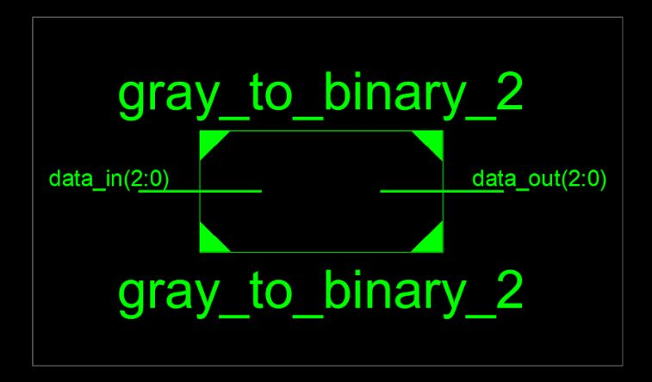
Gray to Binary Converter - RTL

Slide 32
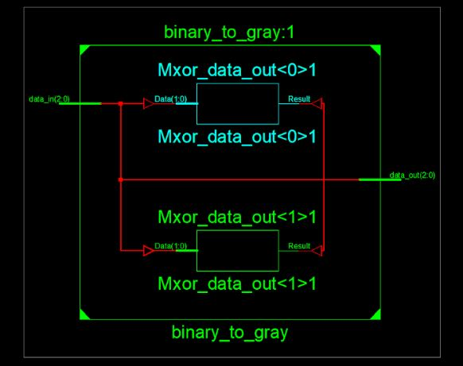
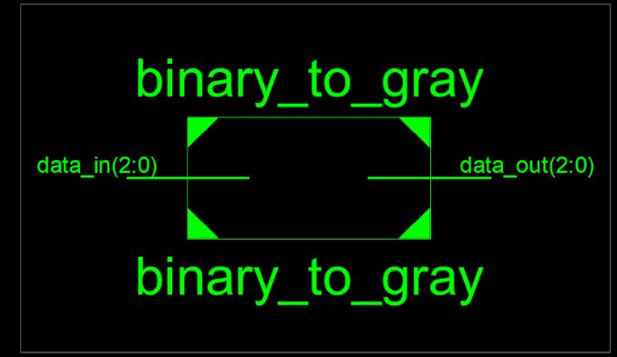
Binary to Gray Converter - RTL

Slide 33
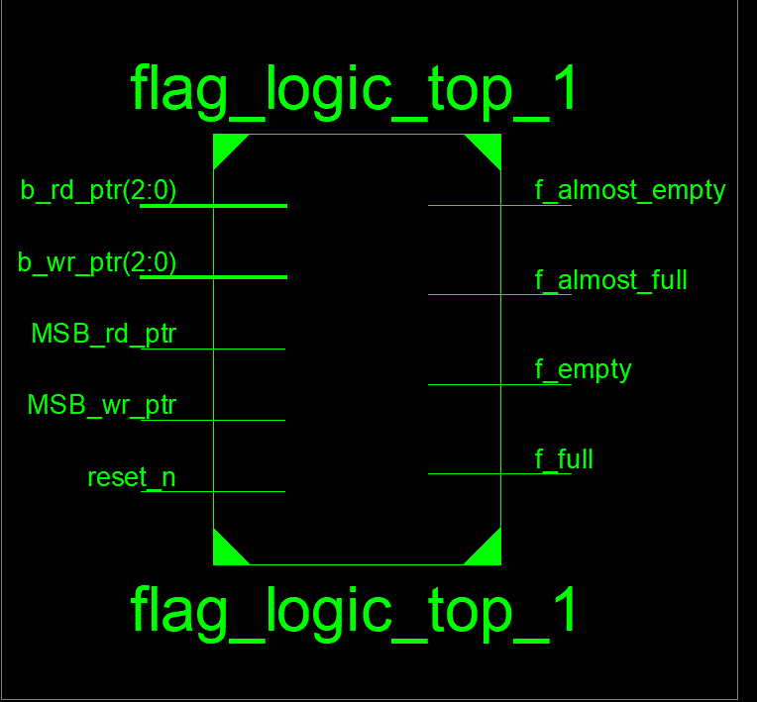
Flag logic block

Slide 34
Pin Functions – Flag Logic
No. | Name of Pin | No. of Pins | Direction | Function
1. | b_wr_ptr | 10 | Input | Address input to comparator
2. | b_rd_ptr | 10 | Input | Address input to comparator
3. | Config_depth | 10 | Input | Limiting value of memory location
4. | Reset_n | 1 | Input | To set empty flag
5. | wr_clk | 1 | Input | To synchronize Read pointer
6. | rd_clk | 1 | Input | To synchronize Write pointer
7. | f_full | 1 | Output | Show status as FIFO is Full
8. | f_empty | 1 | Output | Show status as FIFO is empty
9. | f_almost _full | 1 | Output | FIFO is Almost empty
10. | f_almost_empty | 1 | Output | FIFO is Almost empty

Slide 35
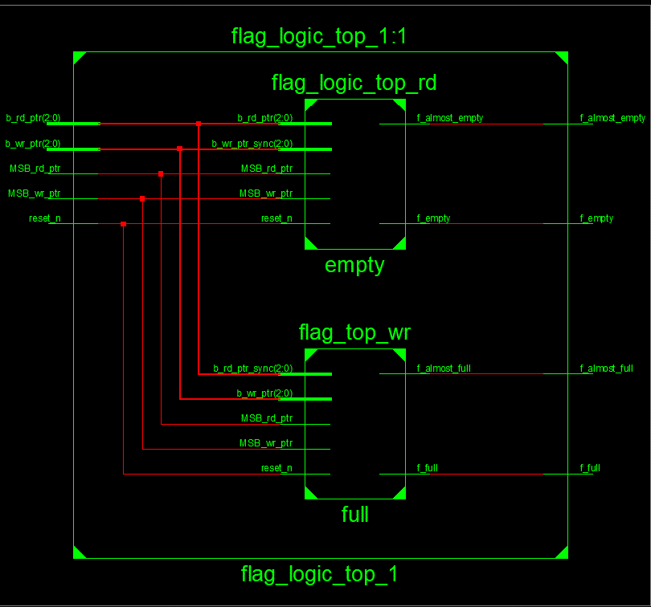
Flag logic block –RTL

Slide 36
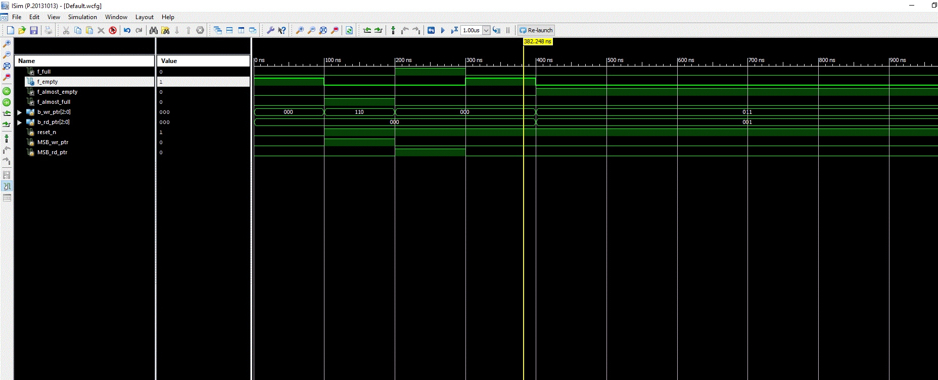
Flag logic block-Simulation

Slide 37
Test Cases- Top Level RTL
reset_n =0 ; wr_en=x , rd_en = x : FIFO reset
reset_n =1 ; wr_en=1 & f_full = 0 , rd_en = 0 : FIFO write operation (b_wr_ptr= +1’b1)
reset_n =1 ; wr_en=0 , rd_en = 1 & f_empty = 0 : FIFO read operation (b_rd_ptr= +1’b1)
reset_n =1 ; wr_en=1 , rd_en = 1 : Async read & write

Slide 38
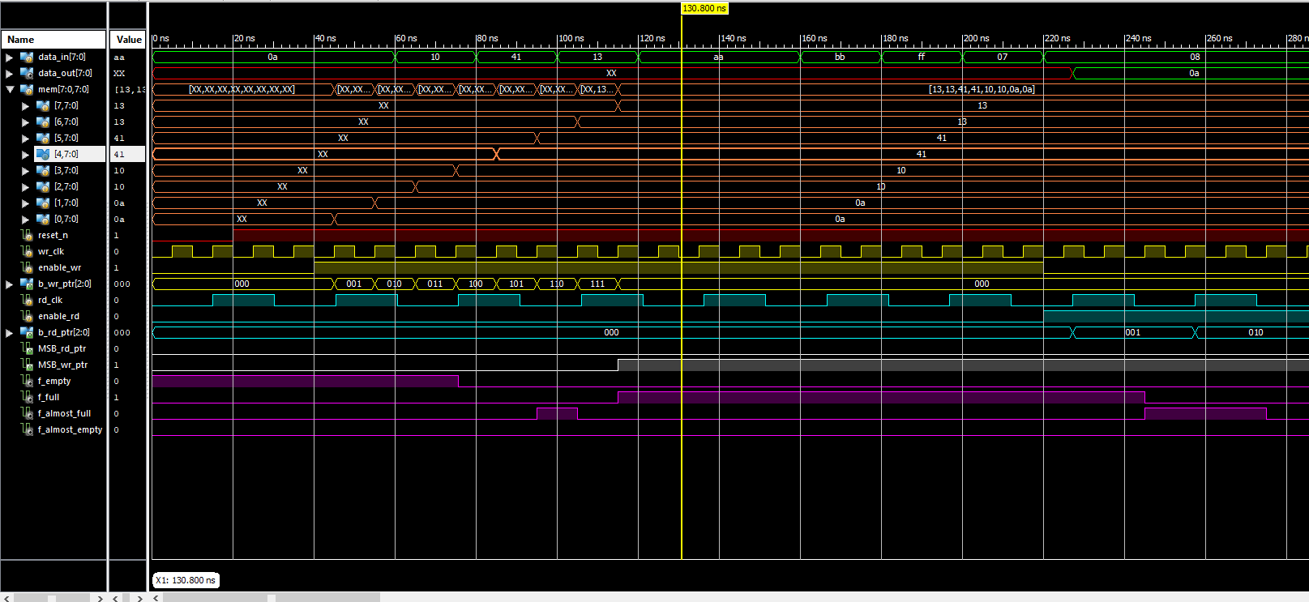
Top Level– Simulation Results

Slide 39
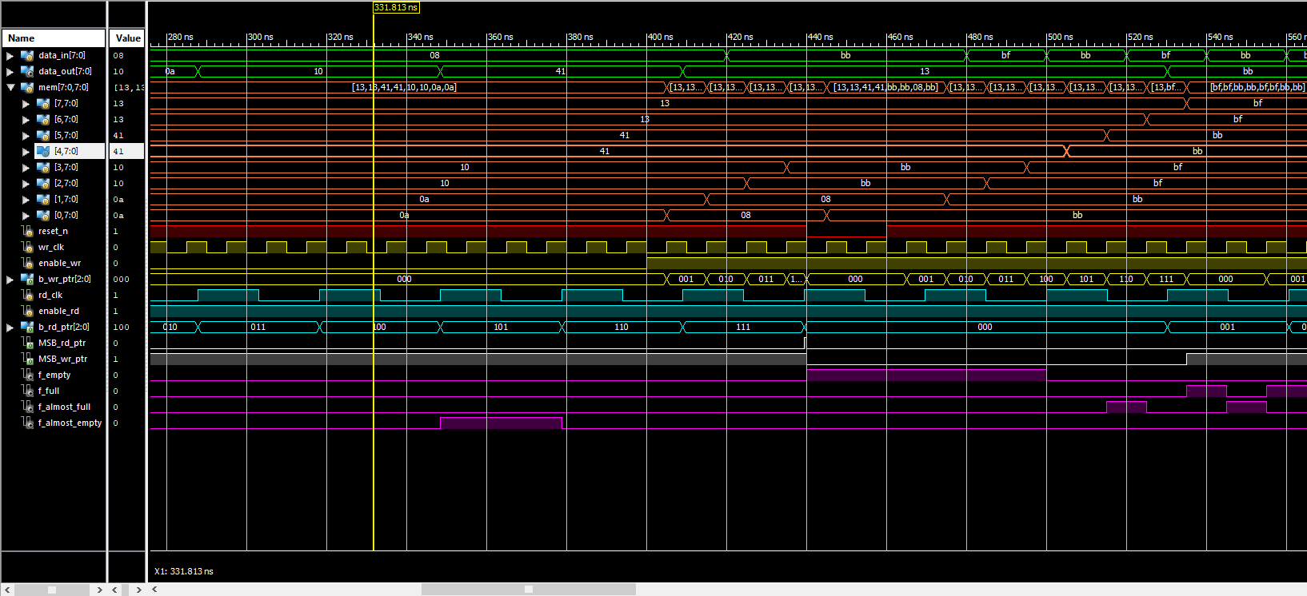
Top Level– Simulation Results

Slide 40
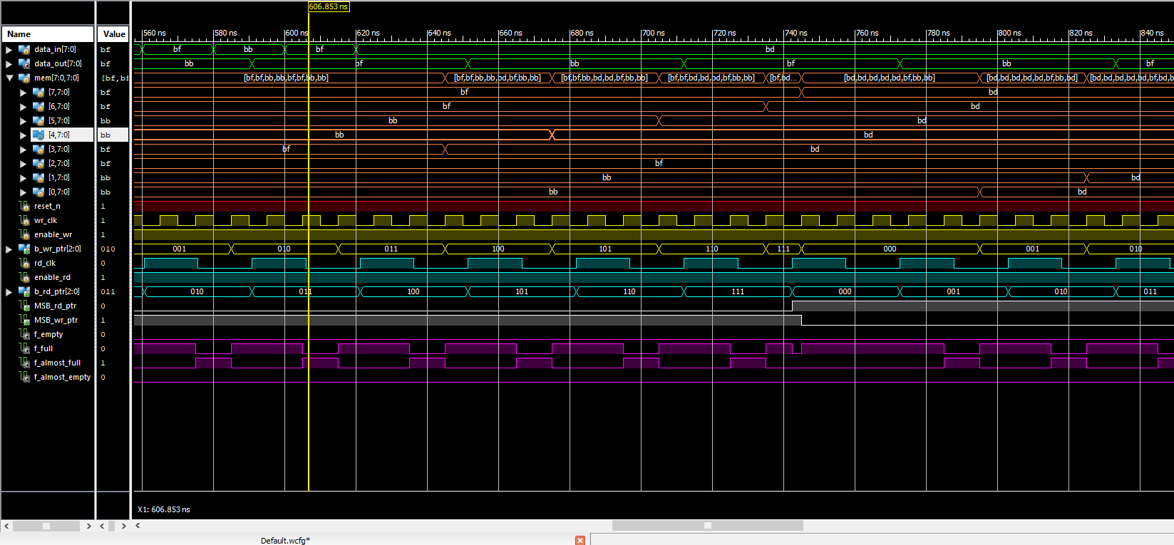
Top Level– Simulation Results

Slide 41
Applications
Packet Buffering :
Data written into the FIFO can be stored until the system on the output of the FIFO is ready to accept the data.
Frequency coupling:
FIFO provides frequency coupling, taking data in at one rate and output the data at another data rate. The input and output data rates of the FIFO being controlled by the discrete Read and Write clock signals.
Bus Matching :
Data transfer may need to take place between separate digital domains with different bus widths. Here the FIFO acts as a bridge between the domains, channeling the data from the input of a particular bus width , to the output with another bus width.

Slide 42
Advantages
Data Rate Matching.
Buffering and bus matching parallel FIFO structure allow formulation of any word size while serial FIFO structure provide a rapid and simple like other structure.
Interchip communication protocol problem is solved by FIFO.

Slide 43
Disadvantages
Noise in signals is caused by switching operation and alteration of memory content.
Synchronization circuit is required to synchronize WRITE CLOCK and READ CLOCK

Slide 44
Thank you…!

