Slide 1

MANAV RACHNA UNIVERSITY DEPARTMENT OF Engineering exploration SECTOR-43, ARAVALI HILLS, SURAJKUND ROAD, FARIDABAD, HARYANA-121001

Slide 2
PROJECT: Pollution band
SUBMITTED TO: SUBMITTED BY:
MR. UMESH DUTTA MUKUL SINGH (32)
PROFESSOR SAURABH CHAHAL (45)
EE DEEPAK RANA(15)
II SEM, SECTION C, CSE GAGAN YADAV(21)

Slide 3
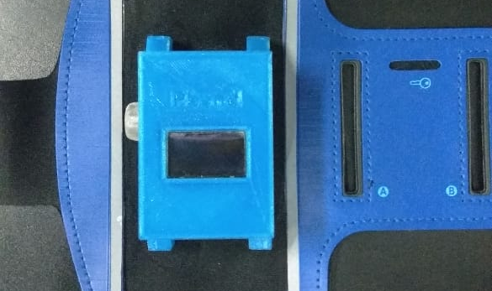
Introduction
We designed an Arduino based arm/wrist band which can measure pollution.
A 128*64 OLED display
Pollution Sensor: MQ-135
Application to interact with band
and server.
Bluetooth device to send and
recieve data from app.

Slide 4
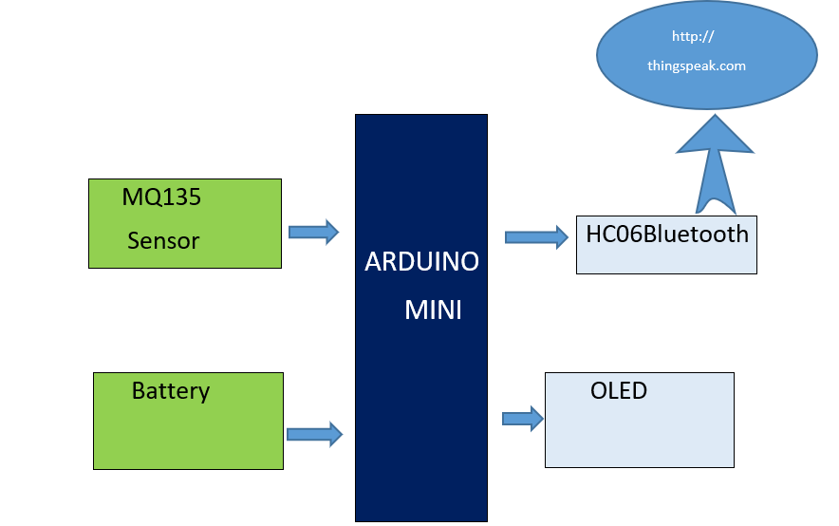
block Diagram

Slide 5
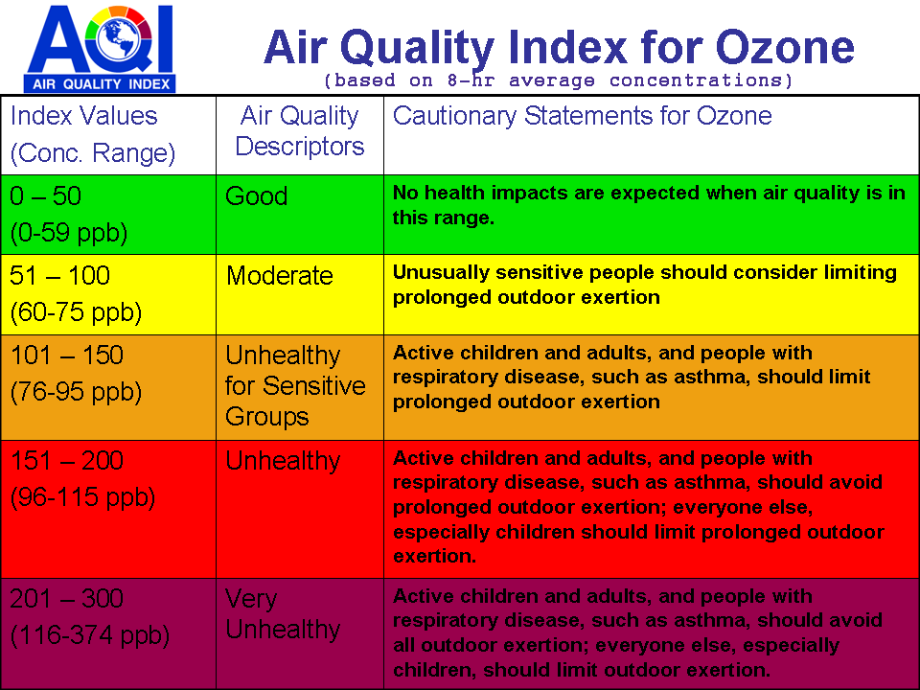
Air quality index

Slide 6
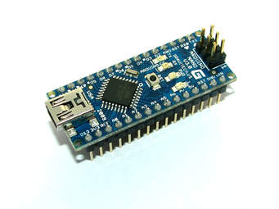
Arduino NANO
Arduino Nano is a microcontroller board based on the ATmega328P.
20 digital input/output pins
Power it with a AC-to-DC adapter or
battery to get started.

Slide 7
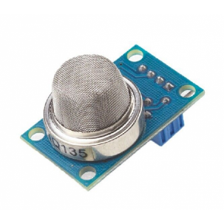
MQ135 Gas Sensor
The sensitive material used in MQ135 gas sensor is SnO2.
The conductivity of this material is lower in clean air.
The sensor conductivity increases with the increasing
concentration of target pollution gas.
It can monitor different kinds of toxic gases such
as sulphide, ammonium as, benzene series steam and CO2.
The detection range is 10-10000ppm.

Slide 8
Working/operation of P-Band
As the device is powered, the Arduino board loads the required libraries, flashes some initial messages on the OLED screen and start sensing data from the MQ-135 sensor. The sensitivity curve of the sensor for different combustible gases is already mentioned above. The sensor can be calibrated so that its analog output voltage is proportional to the concentration of polluting gases in PPM. The analog voltage sensed at the pin A0 of the Arduino is converted to a digital value by using the in-built ADC channel of the Arduino. The Arduino board has 10-bit ADC channels, so the digitized value ranges from 0 to 1023. The digitized value can be assumed proportional to the concentration of gases in PPM. The read value is first displayed on OLED screen and passed to the bluetooth module wrapped in proper string through virtual serial function.

Slide 9
Working (Cont.)
The bluetooth module is configured to connect Application and the application is configured to interact with the Ubidots IOT platform. Ubidots is an IOT analytics platform service that allows to aggregate, visualize and analyze live data streams in the cloud. Ubidots provides instant visualizations of data posted by the IOT devices to Ubidots server. With the ability to execute MATLAB code in . Ubidots one can perform online analysis and processing of the data as it comes in as shown in the figure below.

Slide 10
Thank you
Any Questions…………….

