Slide 1
TECHNOFARM 2.0
Team members:
Mukul Singhal
Pranjal Arora
Jahnvi Gangwar
Tanisha Parkash
HACKTU 2.0

Slide 2
Technofarm 2.0 transforms the existing irrigation system and its process to a more efficient and structured approach
Unlike the conventional method it is able to make use the Data and resources available on the internet to manipulate the functioning of the farm.
By implementing innovative technology such as automated cultivation, it against the effects of weather and enables stable production of safe crops.

Slide 3
TechnoFarm 2.0 is the extension of the conventional model of the current farming system to a modern and more technical model which will be sharing the burden of the fellow farmers in a lot of things and also help the farmer to be in touch with the fast paced technological growth, in addition to this it has the potential to be programmed in order to suggest suitable and most profitable crop to be grown in a particular time of the year to minimise investment and maximise profit based on statistical data of the past years.That being said due to time constraints we have decided to present the extremely basic and primary functioning of the model one of them being a modified approach to water irrigation.
We know that 98% farmers draw groundwater for irrigation which has lead to very unstable and concerning groundwater table depletion all over Indian sub-continent. Needless to say; in the Indian continent majority of the population is affected directly by the depletion of the water table not only this but groundwater depletion is a major concern for a sustainable environment.
As we know that due to sudden increase in reinforced concrete constructions throughout the country; it is approximated that till now the water seepage rate has been cut into half and the most shocking thing is that the projects are still not complete, a survey says that when all the construction is complete we will be left with 20% of the water seepage that we have right now.

Slide 4
Owing to the problem of over-usage of groundwater for irrigation and exponential decrease in the groundwater replenishment we have designed that would minimise useless groundwater consumption without hampering the growth of the crops.
We work on the idea that if the rate of extraction of groundwater is reduced then the net rate of replenishment of groundwater will increase, even though there is an increase in the rate of concrete reinforcement. This model uses a basic controller system without a high initial cost of investment and negligible structural growth (optional).The second basic circuit that we displaying here is to help the farmers’ have a sound sleep during the night when their crops are prone to be attacked by the animals and birds which often cost the farmers his/her livelihood.
Every possible living species that we know of has a defined body temperature, and can be broadly classified into 2 categories:1. Cold-Blooded 2. Warm-Blooded
They give out characteristic temperature emissions in a defined range. Using a combination of LDR and motion sensors (PIR) we can quite efficiently manage to scare (using lights and buzzer system) the birds and animals etc which tend to harm the crop.

Slide 5
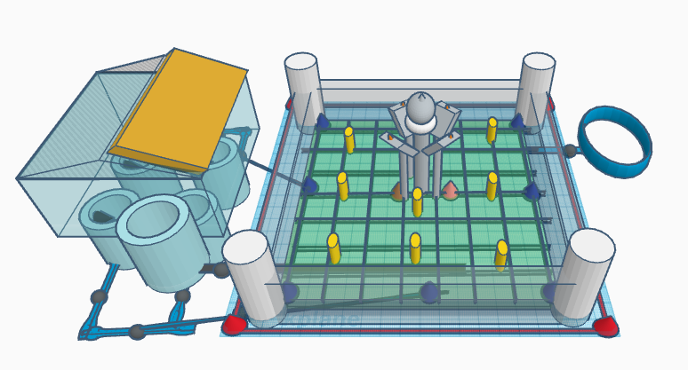
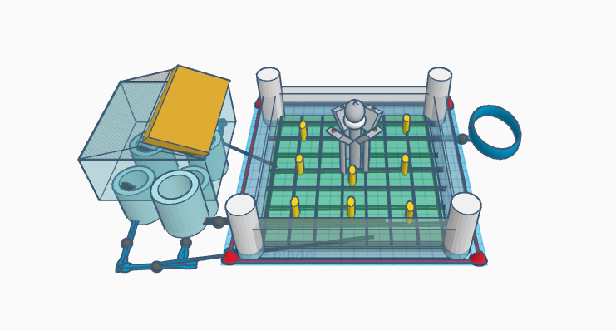

Slide 6
Our project on tinkercad:
https://www.tinkercad.com/things/jAln0UFvPnh-techno-farming/edit?sharecode=iDBJTY8PBnhRKRwy_13Ulao1x-hYR-5zKqz0kyr2LSE

Slide 7
Sensors in the model
RED: Motion Sensors PIR
BLUE: Moisture Sensors
YELLOW: Soil Moisture Sensors
BLACK: Water Level
SQUARE BLACK: NRV (Unidirectional flow of water)
WHITE: Buzzer
ORANGE: LDR Sensor

Slide 8
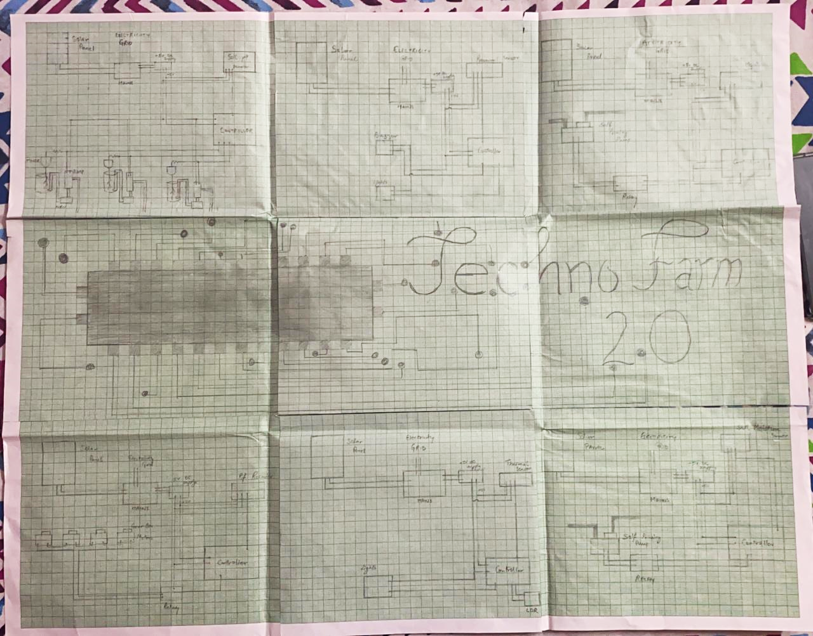
graph

Slide 9

Problems faced by the government in the field of agriculture
Irrigation- water scarcity in field
-water logging in fields
Lack of mechanization
Overuse of resources
Farm hinderances

Slide 10
Our project- Devices used
Input:
Sensors:
Rf Sensor
Soil Moisture
Soil pH
LDR
Motion Sensor PIR
Pressure Sensor
Water level sensor
NRV
Raspberry Pi (CPU-Microcontroller)
Output:
Lights
Buzzers

Slide 11
ADVANTAGES
Conservation of resources
Time optimization
Economic benefits(GDP)
New market (manufacturing)— social equilibrium
Disguised unemployment (major issue)
Boost in tertiary and primary sector
Better form management—good and healthy yield
Safety in farms

Slide 12
FLOWcharts
Moisture detection program

Slide 13
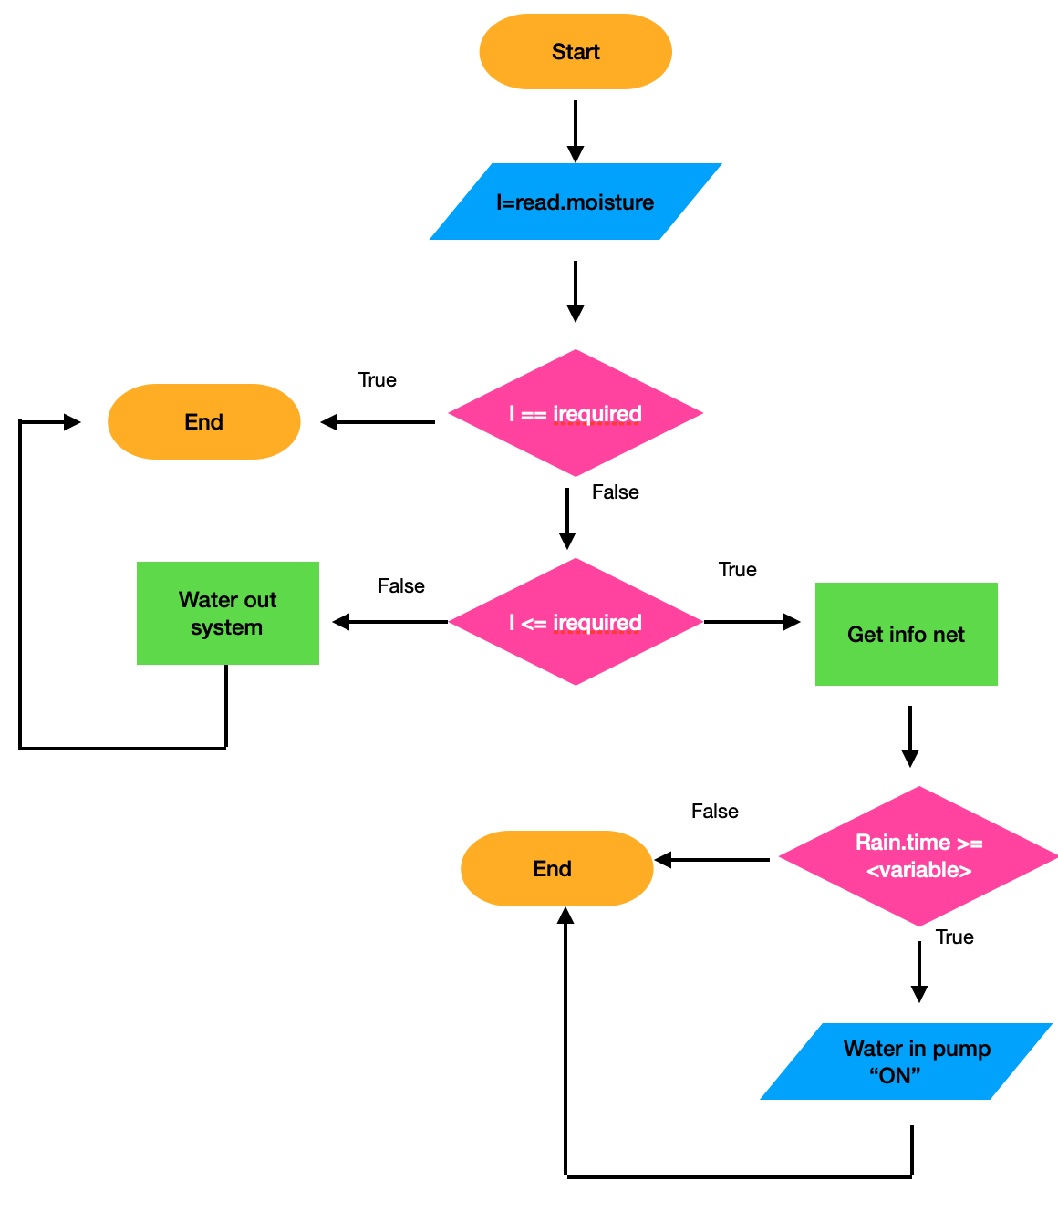

Slide 14
Moisture detection program
Compiler used: DEV C++
#include<iostream>
#include<stdlib.h>
#include<windows.h>
using namespace std;
void loading(char n[])
{
int i=0;
for(;n[i]!='?';++i)
{
cout<<n[i];
Sleep(100);
}
}
int main()
{
int n=0,required=10;
char a[100]={"Accessing the moisture from the sensor with the help of moisture sensor..?"};
loading(a);

Slide 15
cin>>n;
if(n!=required)
{
if(n>required)
{
system("cls");
char a[100]={"Accessing the water out system to remove extra moisture..?"};
loading(a);
}
else
{
system("cls");
char a[100]={"Accessing the weather site for relevant information..?"};
loading(a);
int j=0,k=20; //where 'k' is dependent on the type of crop we have planted (maximum time for which can survive without external water)
cin>>j; //j is rain.time

Slide 16
if(j>k)
{
system("cls");
char a[100]={"Initiating pump for watering the crops..?"};
loading(a);
}
else
{
system("cls");
char a[100]={"The crop can survive without water for the time being and rain would provide the required water..?"};
loading(a);
}
}
}
else
{
system("cls");
char a[100]={"Moisture content is at its best..?"};
loading(a);
}
return 0;
}

Slide 17
Security alarm system

Slide 18
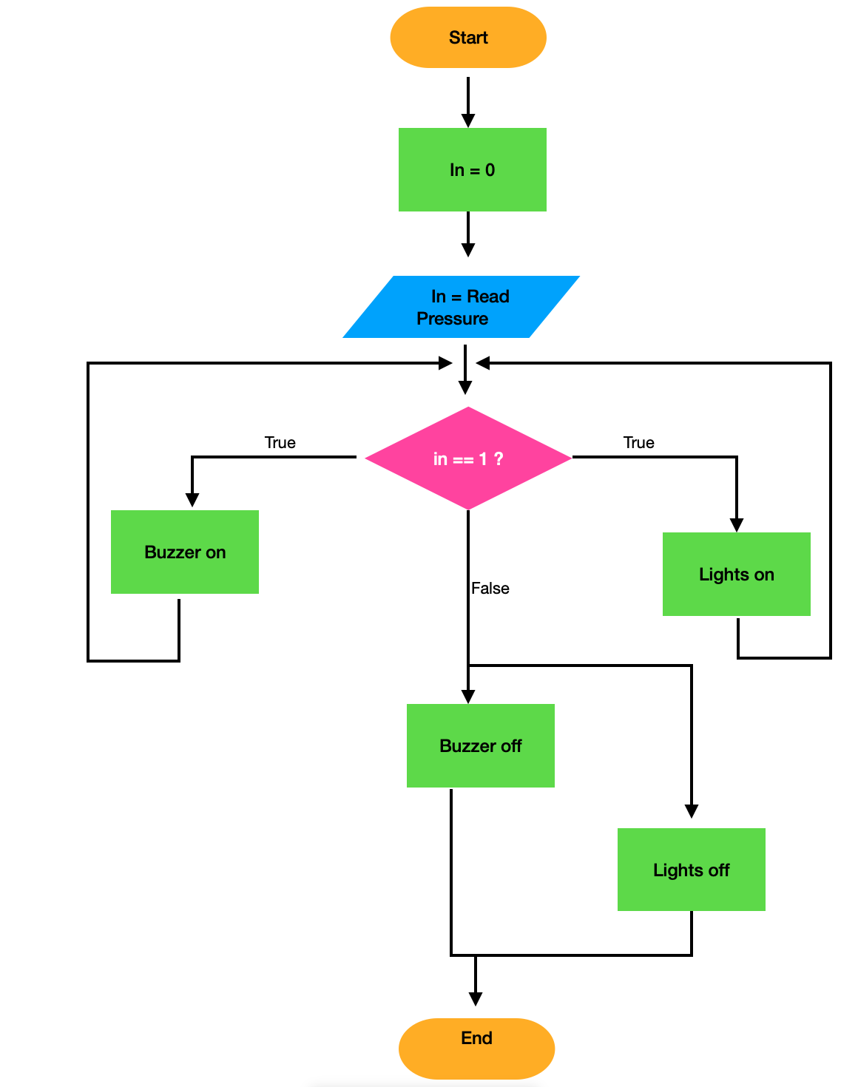

Slide 19
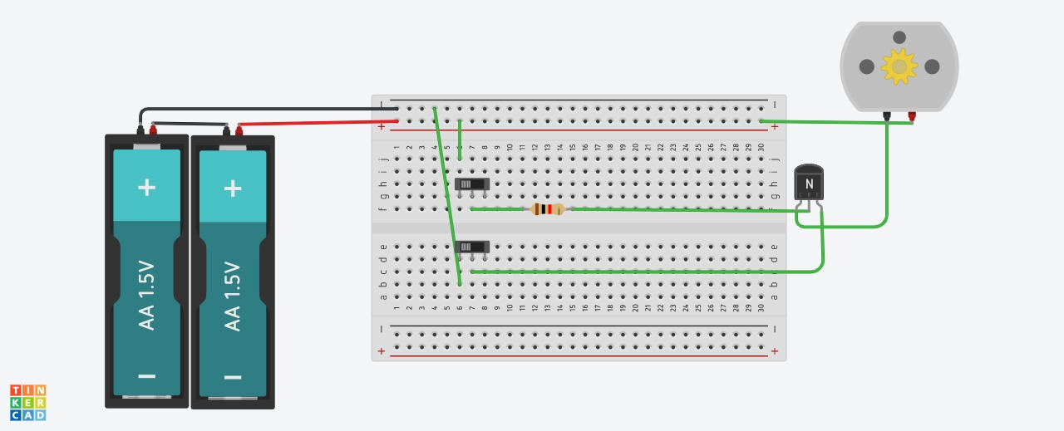
Link for tinkercad program

Slide 20
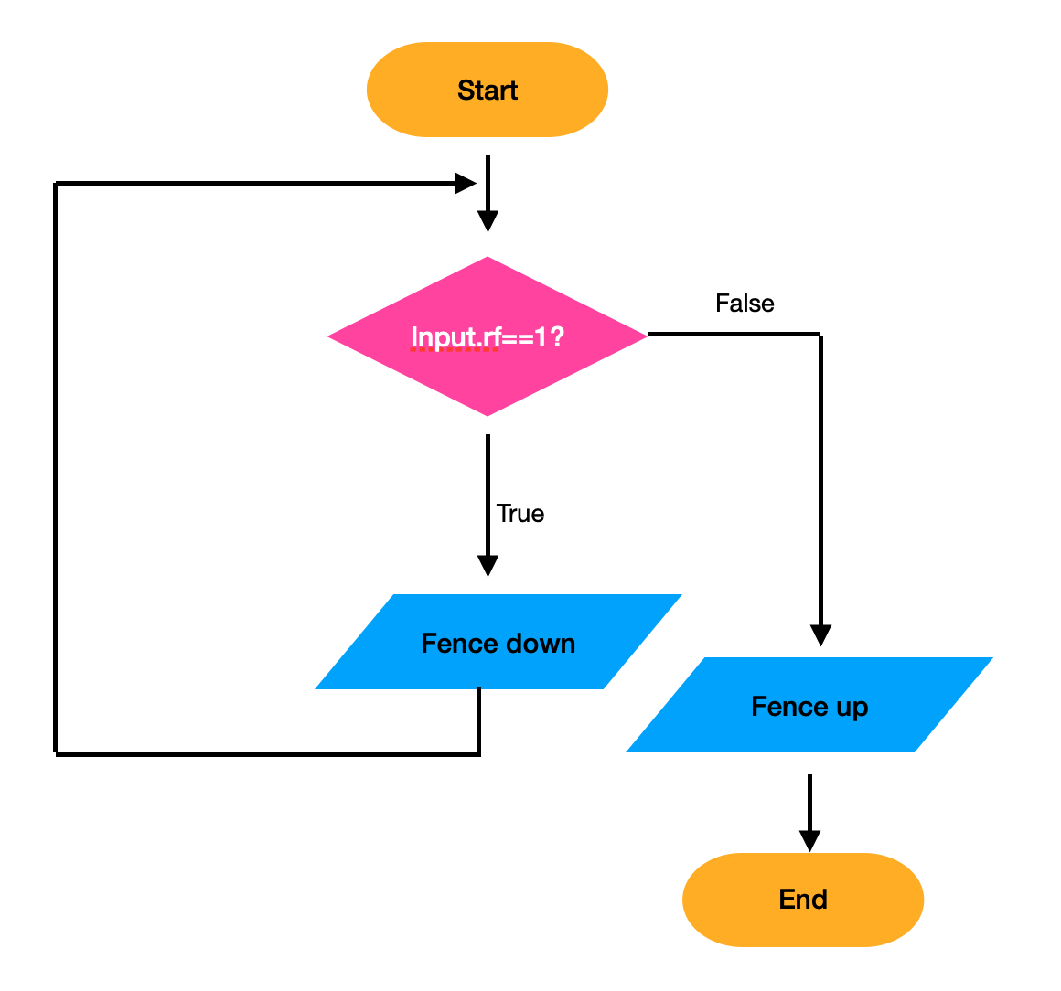
Extension to our project- security aspect
FLOWchart:

Slide 21
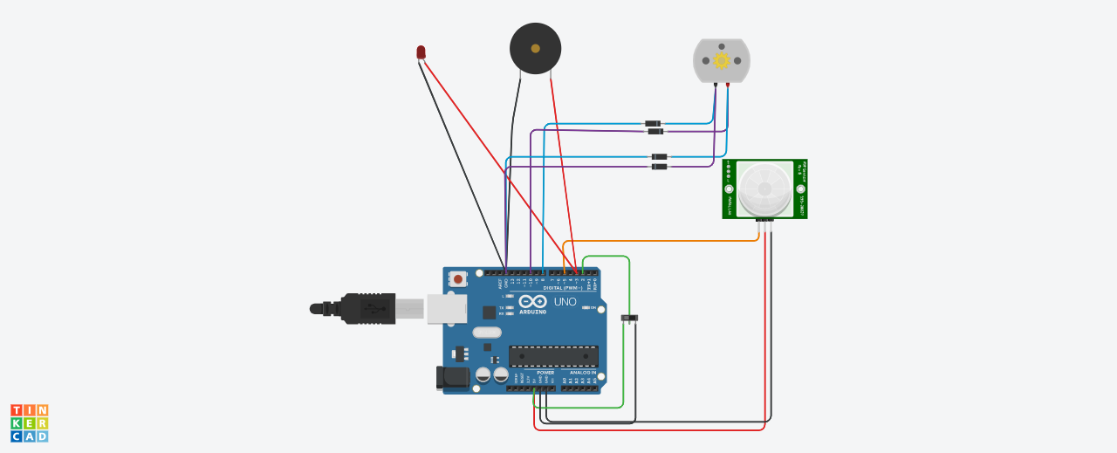
Alarm system (using “AND” GATE):

Slide 22
THANK YOU

