Slide 1

Product Catalogue Tagging Generating tags for each product Id

Slide 2
Product Catalogue Tagging: Introduction
Query
Search System
All possible Tokens/Tags/Entities
Product Catalogue with Tags
Relevant Search Result
Aim is to increase the discoverability for a relevant query with all possible tags

Slide 3
Product Catalogue Tagging: Why Tagging?
Why do we need to tag products ?
Let’s go through some of query results on Ajio/ Jiomart.

Slide 4
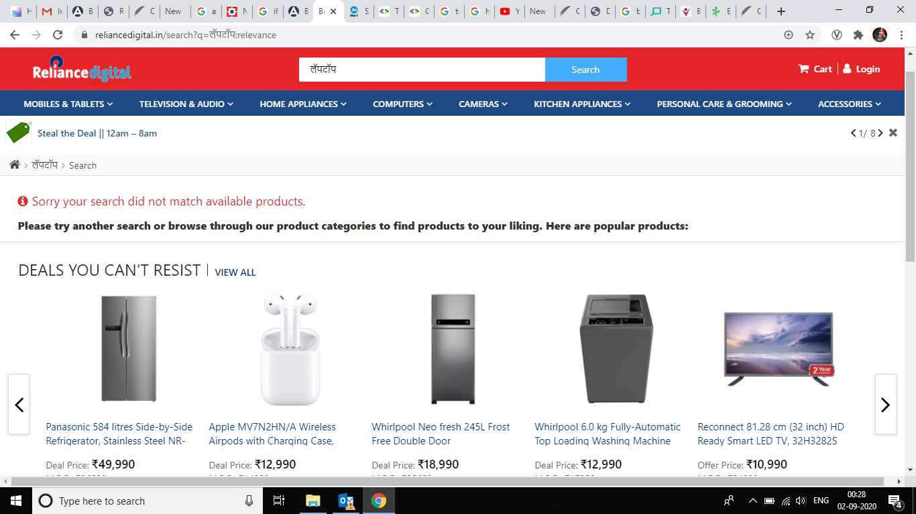
Product Catalogue Tagging: Why Tagging?

Slide 5
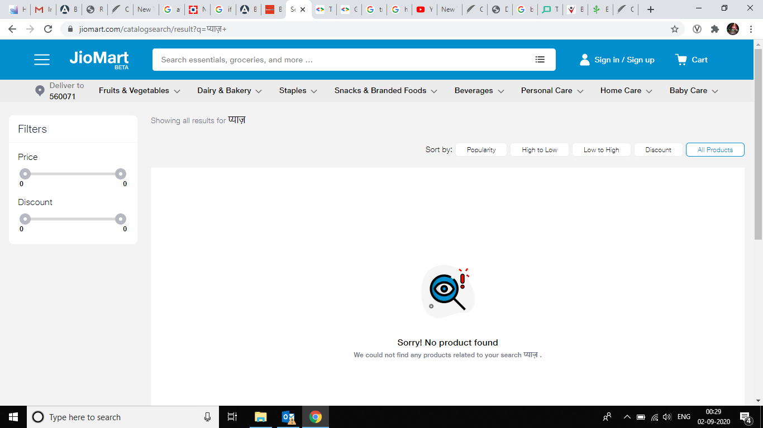
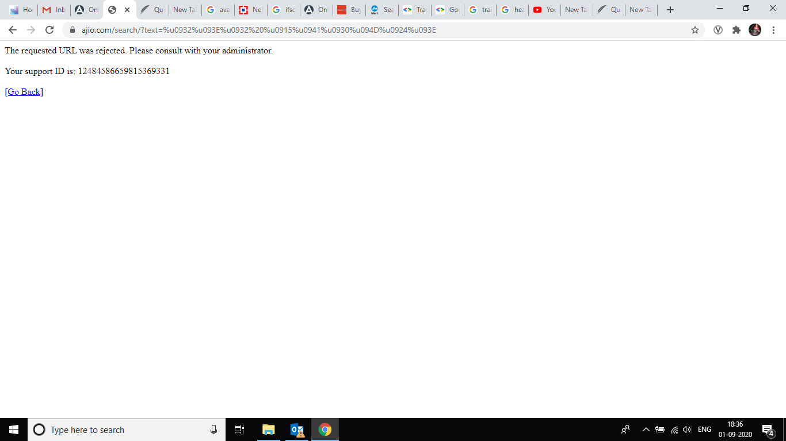
Product Catalogue Tagging: Why Tagging?
Query on Jiomart: प्याज़
Query on AJIO : लाल कुरती

Slide 6
Product Catalogue Tagging: Why Tagging?
JioMART non-English query statistics
Query | Count
बेसन | 60
राइस | 60
साफ | 62
अमूल | 63
सौ | 71
पातंजल | 71
पाटन | 86
Query | Count
घी | 93
शुगर | 96
री | 750
सोए | 47
पतंग | 51
पर्ल | 88
राव | 213
Query | Count
जग | 120
पोहा | 163
काजू | 58
चॉकलेट | 45
माघ | 150
आम | 78
సు | 41
Query | Count | Conversion | Click Count
potato | 4334 | 406 | 923
Comparison of Aloo and Potato
aloo | 5048 | 168 | 497

Slide 7
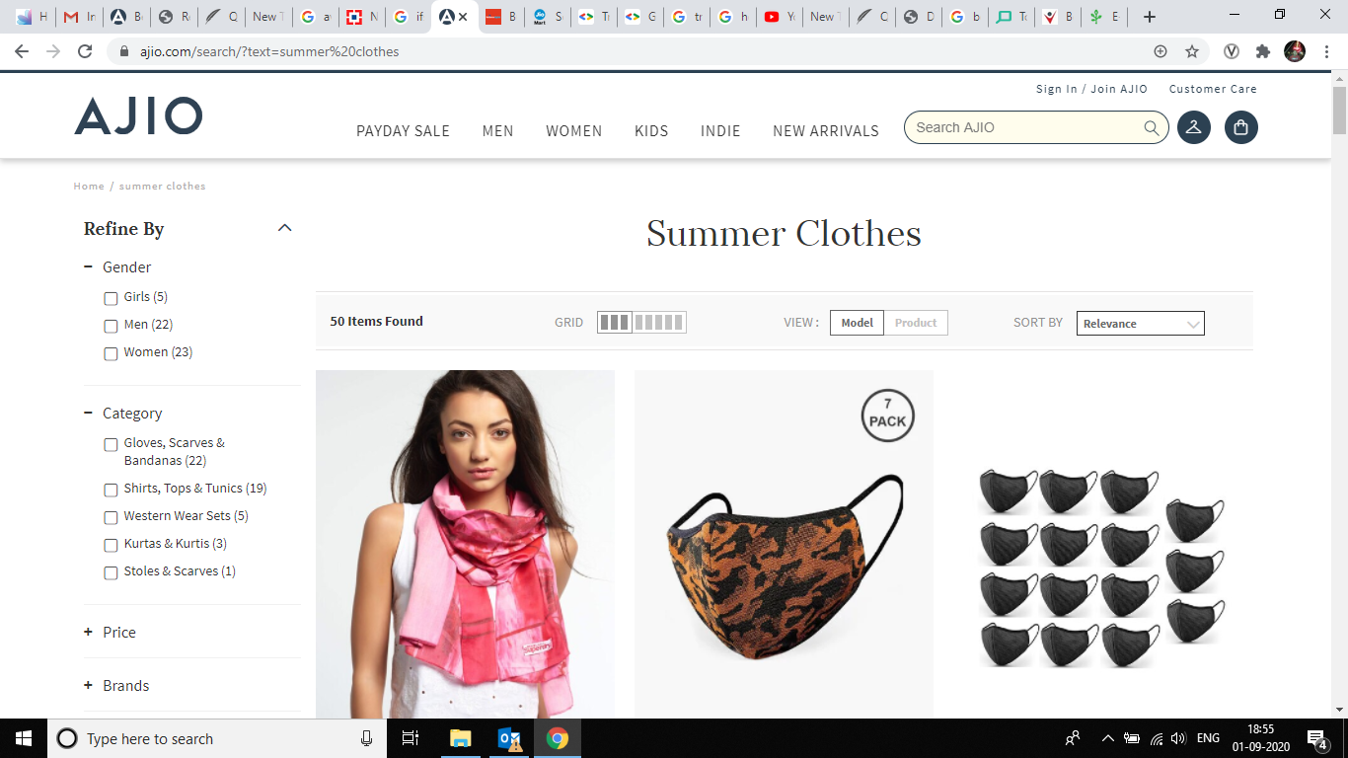
Product Catalogue Tagging: Why Tagging?
Irrelevant results for queries on AJIO
query: Summer Clothes

Slide 8
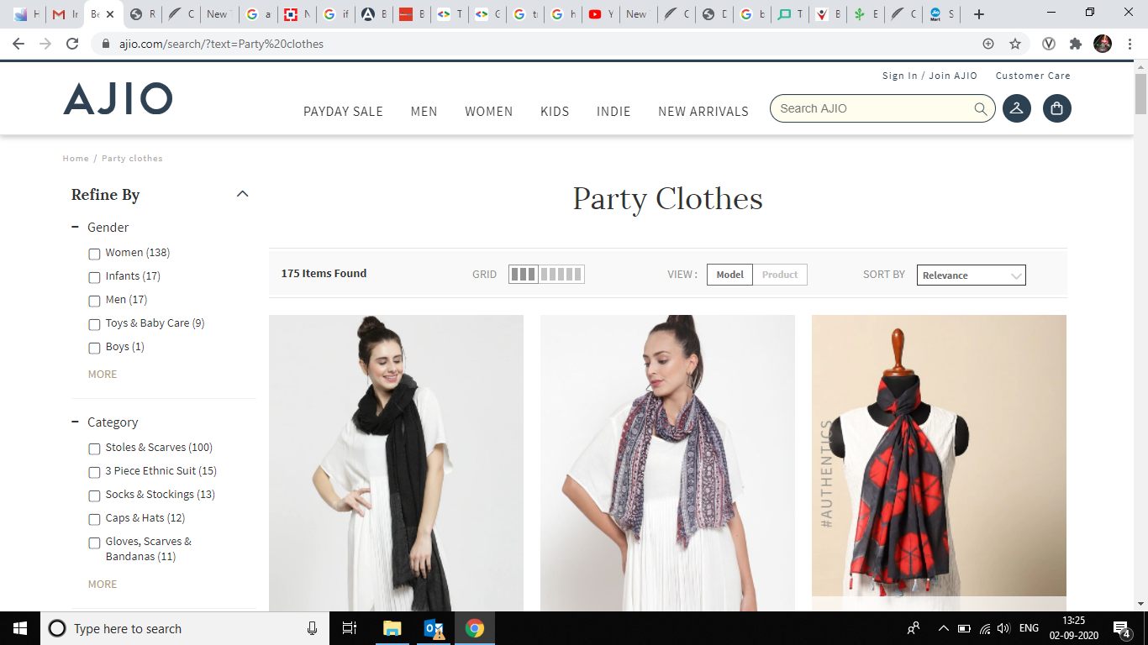
Product Catalogue Tagging: Why Tagging?
Irrelevant results for queries on AJIO
query: Party Clothes

Slide 9
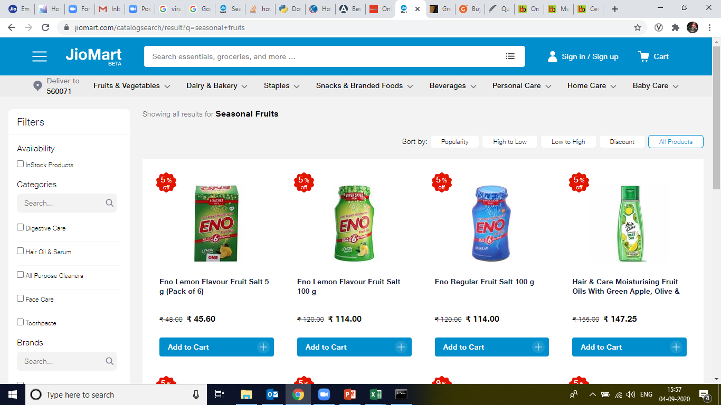
Product Catalogue Tagging: Why Tagging?
Irrelevant results for queries on Jiomart
query: Seasional Fruits

Slide 10
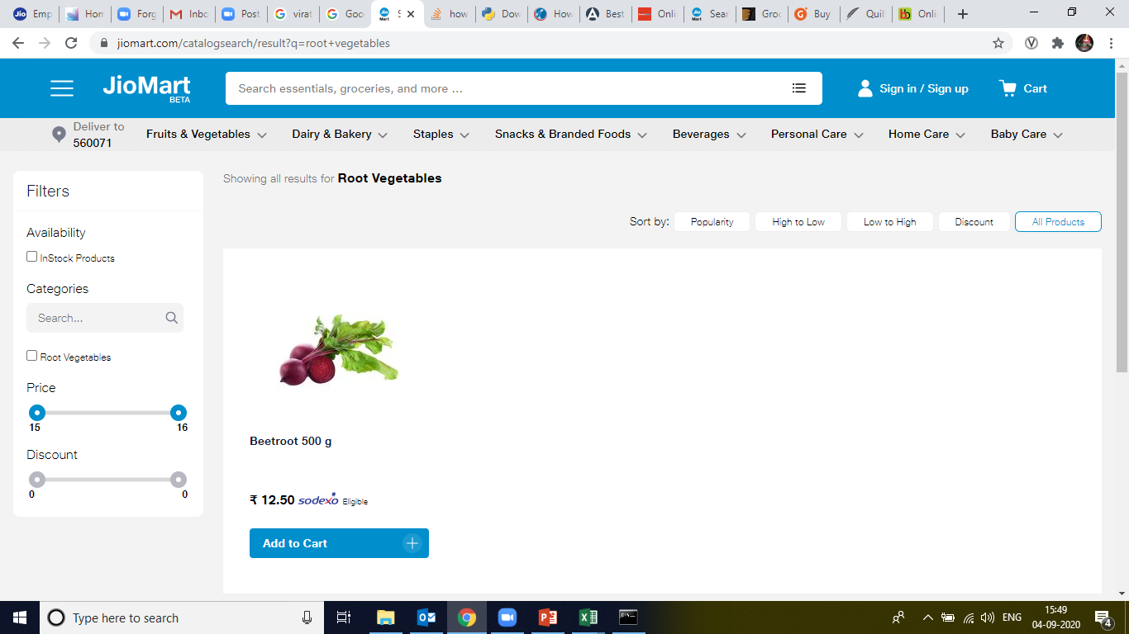
Product Catalogue Tagging: Why Tagging?
Irrelevant results for queries on Jiomart
query: Root Vegetables

Slide 11
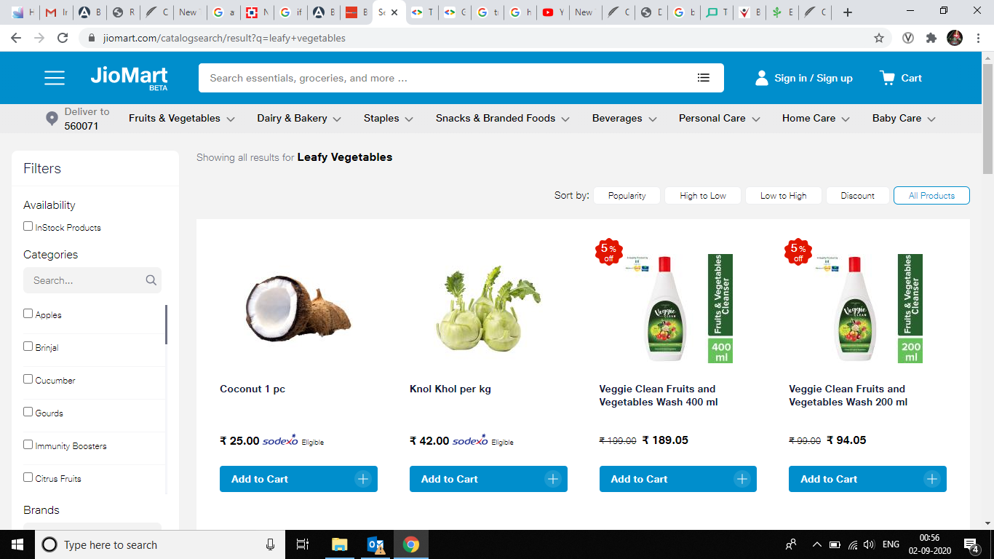
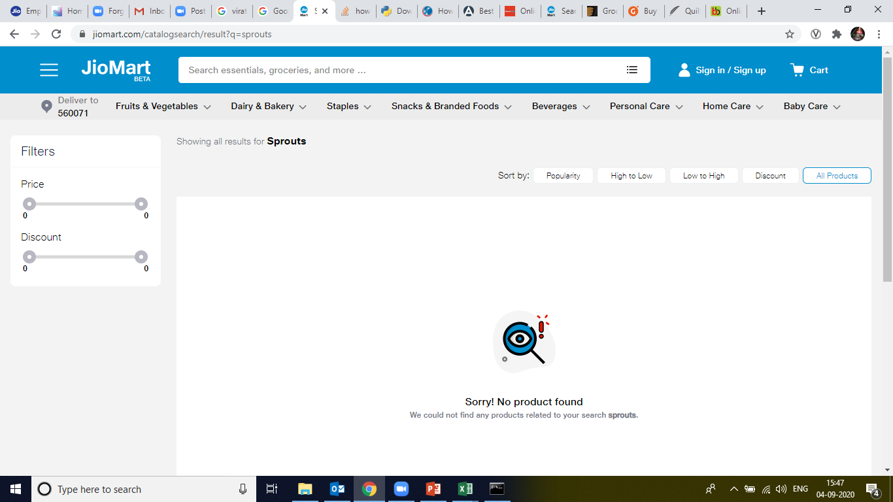
Product Catalogue Tagging : Why Tagging?
Irrelevant /No results for queries on Jiomart
query: Leafy Vegetables
query: Sprouts

Slide 12
Product Catalogue Tagging: Why Tagging?
Couple of interesting statistics of Jiomart search queries data
Query | Count | Click Count | Conversion
Sprouts | 148 | 1 | 0
Leafy Vegetables | 601 | 36 | 3
Query count proves the possible existence of thematic queries.
CTR and conversion rate for these thematic queries proves irrelevancy of result.

Slide 13
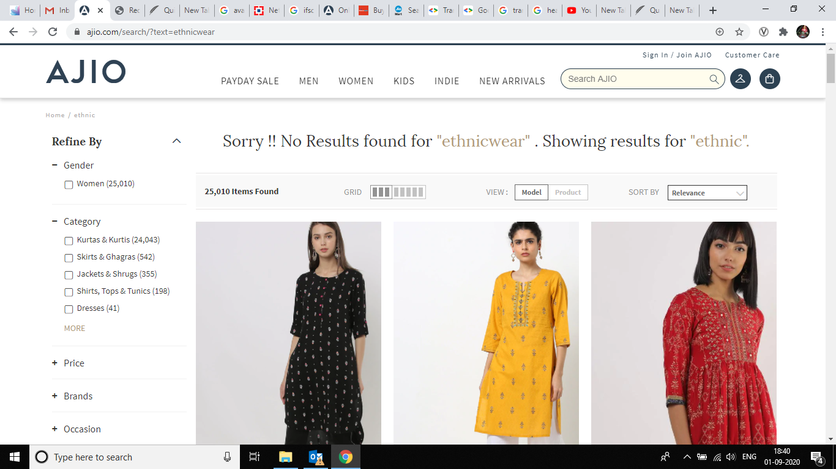
Product Catalogue Tagging: Why Tagging?

Slide 14
Product Catalogue Tagging: Why Tagging?
Chips, Lays, Waffer, Kaya Varathathu,Snacks,Kappa Varathathu,Chakka Varathathu, Nendran Chips, Upperi,Banana Chips,Tapioca Chips, Jackfruit Chips, Karela Chips,Pringle, Nachos,,
Chips, Lays, Waffer, Kaya Varathathu,Snacks,Kappa Varathathu,Chakka Varathathu, Nendran Chips, Upperi,Banana Chips,Tapioca Chips, Jackfruit Chips, Karela Chips,Pringles, Nachos, Savories, Salty Snacks, Aloo Wafer, Alu Wafer, Seedai, Nendran Chips, Upperi, Tapioca Chips, Jackfruit Chips, Karela Chips, , Soya Chips, Chips, Soya Snacks,
Chips, Lays, Waffer, Kaya Varathathu,Snacks,Kappa Varathathu,Chakka Varathathu, Nendran Chips, Upperi,Banana Chips,Tapioca Chips, Jackfruit Chips, Karela Chips,Pringles, Nachos, Savories, Salty Snacks, Aloo Wafer, Alu Wafer, Seedai, Nendran Chips, Upperi, Tapioca Chips, Jackfruit Chips, Karela Chips, , Chips, Diet Chips, Snacks,
Chips, Lays, Waffer, Kaya Varathathu,Snacks,Kappa Varathathu,Chakka Varathathu, Nendran Chips, Upperi,Banana Chips,Tapioca Chips, Jackfruit Chips, Karela Chips,Pringles, Nachos, Savories, Salty Snacks, Aloo Wafer, Alu Wafer, Seedai, Nendran Chips, Upperi, Tapioca Chips, Jackfruit Chips, Karela Chips, , Kela Chips, Chips, Kela Wafers,
Search Keywords were missing for 11,231 products
“Pending” count for L1, L2 and L3 was more than 1000 till August End and most of the products were belonging to major categories
Most of the search Keywords field is still empty which can be easily filled automatically.
Although most of the tags are generally present but this is being done manually.
Till the time product is manually tagged, it’s not live as it’s not searchable(can not appear in search results).
Vacant fields for search keywords in assortment

Slide 15
Product Catalogue Tagging: Why Tagging?
Below is a simple statistics showing comparison of numbers between Products whose category was marked “Pending”(Black row) and actual mentioned categories.
Product. Query Count Conversion Click count
coconut powder | 4050 | 19 | 70
sattu | 4039 | 109 | 406
mag | 4030 | 103 | 497
Even though , missing search keywords and ”Pending” count has decreased, this will keep happening every time new products will be added.

Slide 16
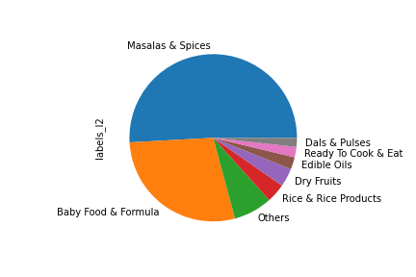
Product Catalogue Tagging: Case Study
Trained a very simple model to predict actual categories in catalog which has been marked “Pending”
Predicted data is almost 95% accurate.
Most of the products were belonging to major categories.
Search results have been affected as we have seen on the last slide
Distribution of predicted categories

Slide 17
Product Catalogue Tagging: How to tag?
We need product tagging to alleviate the existing pain in the product catalog for each of our product domain.
How to tag?

Slide 18
Product Catalogue Tagging: Types
Broadly, all the tags through which relevant results can be delivered can be divided in these 4 categories.
Tags
Explicit Tags
Implicit Tags
Indic-Tags
Enrichment Tags

Slide 19
Product Catalogue Tagging: Explicit Tags
Explicit Tags
Textual keywords from product description
Image Features
Hard tags like brand, color, material etc.
L1, L2, L3 categories

Slide 20
Product Catalogue Tagging: Indic Tags
Indic-Tags are needed to make them searchable even in case of Indian search queries.
Below is an example of possible Indic-tags for ”Potato”
Potato : [Aloo, Batata, Uralaikilangu, Urlagadda, Kook , Kizhangu]
Potato: [आलू, અલૂ, बटाटा, ಆಲೂಗಡ್ಡೆ, ಉರಾಲೈಕಿಲಂಗು]

Slide 21
Product Catalogue Tagging: Enrichment Tags
Enrichment tags can help in increase of sale from customer point of view psychologically.
”Depleting Fast” tag can help to make user do the transaction as soon as possible.
These tags also provide some extra details about the product like “current trends”/ ”latest fashion” or “out of stock”/ “broken style”.

Slide 22
Product Catalogue Tagging : Offline Architecture
Current Inventory Stock Data
Last Month Sale Data
User Clickstream data
Implicit Tags using Topic Modelling and Clustering
Implicit Tag Generator Model
Tags Enrichment Module
Image Tags using object and other feature detection
Product Catalogue DB with all details
Id
Text tags using Automatic Keyword Extraction
Products with all possible relevant tags
Translated and transliterated tags generator
Preprocessing
L1,L2 and L3 category prediction model

Slide 23

Product Catalogue Tagging : Example
1234
Product Catalogue DB with all details
Shirt, Black, Partywear, Lee, Chinese Collar, full sleeve
Id
Image Tags using object and other feature detection
Shirt, Lee, Black, Plain Black Shirt
Text tags using Automatic Keyword Extraction
Desc: Lee plain black shirt
Image
Preprocessing
Products with all possible relevant tags
Lee PlainBlack Shirt
Translated and transliterated tags generator
Kurta, Kala Kurta, काला कुरता , कुरता
L1,L2 and L3 category prediction model
Topwear, Casual Shirt , Plain black shirt

Slide 24
Product Catalogue Tagging
There is a detailed document ready to explain the entire document tagging process. Lets go through that.

Slide 25
Thank You

