Slide 1
Advancing Hinglish Language Modeling: Text generation for Auto Completion
Presented by - Mukund Dhar, Jitesh Parapoil and Chetan Choudhary​

Slide 2
Introduction​
In today's digital age, effortless communication is key, and Hinglish – the blend of Hindi and English languages – has become a widespread means of expression, especially in urban India.​
Our project aims to develop an innovative auto-completion system that can intelligently suggest relevant words or phrases in Hinglish, making text entry more efficient and intuitive for millions of users.​
While existing text auto-completion systems have utilized sequence models for languages like English, our focus is on tackling the unique challenges of Hinglish, a language that seamlessly combines two distinct linguistic structures.​

Slide 3
Goals​
Leverage available Hinglish Datasets:​
Agarwal, A., Gupta, J., Goel, R., Upadhyay, S., Joshi, P., & Aravamudhan, R. (2022). CST5: Data Augmentation for Code-Switched Semantic Parsing. arXiv preprint arXiv:2211.07514. Link: https://doi.org/10.48550/arXiv.2211.07514​
Vivek Srivastava and Mayank Singh. 2021. HinGE: A Dataset for Generation and Evaluation of Code-Mixed Hinglish Text. In Proceedings of the 2nd Workshop on Evaluation and Comparison of NLP Systems, pages 200–208, Punta Cana, Dominican Republic. Association for Computational Linguistics. Link: https://aclanthology.org/2021.eval4nlp-1.20.pdf​
Adapt the models for Hinglish: By training and fine-tuning advanced sequence models such as mT5, LSTMs on these datasets, our system will learn the patterns and context-specific word relationships in Hinglish, enabling accurate and relevant auto-completion suggestions.​
Explore Novel Techniques: We will investigate innovative techniques to handle the complexities of Hinglish, ensuring our system is able to handle the distinct linguistic structures.​

Slide 4
Current Approaches and their Shortcomings​
LSTM-based Next Word Prediction (Kulkarni et al., 2022):​
An LSTM (Long Short-Term Memory) network predicts the next word based on the previous sequence of words.​​
Transformer-based Language Model (Lewis et al., 2019):​
BART (Bidirectional and Auto-Regressive Transformers) pre-trained on large English corpora for sequence-to-sequence tasks, including text generation.​
​
RNN-based Next Words Prediction (Ambulgekar et al., 2021):​
Utilizes RNNs (Recurrent Neural Networks) to predict the next few words based on the input sequence.​
Shortcomings:
Trained on English data, lack the ability to capture the nuances of Hinglish, such as code-switching and language mixing, potentially leading to inaccurate or irrelevant suggestions.​
They do not cater to the intricate semantics and code-switching and may not generalize well to the unique characteristics of Hinglish.

Slide 5
Our Approach - Handling Hinglish Complexity​
Unique Challenges: ​
Code-switching: Hinglish often involves seamless switching between Hindi and English within a single sentence or conversation.​
Orthographic Variations: Variability in spelling and writing conventions poses challenges for tokenization and normalization.​
Innovative Approaches: ​
Data Preprocessing:​
Normalize orthographic variations through tokenization, stemming, and lemmatization.​
Handle code-switching by incorporating language identification techniques and context-aware tokenization.​
Cleanse noisy data and remove irrelevant content to improve model performance.​
Model Adaptation:​
Train a baseline model (LSTM) and beat it by fine-tuning an advanced language model (mT5) on Hinglish-specific corpora to adapt to the linguistic nuances of the language.​
Employ transfer learning techniques to leverage pre-trained models and improve performance on Hinglish tasks.​

Slide 6
Why will our Approach succeed?​
By specifically addressing the challenges posed by the Hinglish dataset, our approach fills a critical gap in the existing literature on auto-completion.
Rather than applying generic models designed for English to Hinglish data, we tailor our methods to the unique linguistic characteristics of Hinglish, increasing the likelihood of success in real-world applications.​
Trained on diverse socio-cultural contexts and idiomatic expressions prevalent in Hinglish-speaking communities, the model will exhibit heightened sensitivity to socio-cultural nuances and context-specific variations​
By resolving semantic ambiguity with greater accuracy, the model delivers more precise and contextually coherent responses, mitigating misunderstandings and enhancing communication clarity.​

Slide 7
Differences from Existing Methods​
​
Hinglish data complexity arises from its linguistic hybridity, orthographic variations, semantic ambiguity, and socio-cultural nuances, setting it apart from language models such as those designed for English.​
Addressing the unique challenges of Hinglish data requires specialized approaches in data preprocessing, model adaptation, and evaluation, distinct from strategies employed for monolingual languages.​
Unlike existing methods tailored for English, our approach centers specifically on addressing the challenges posed by Hinglish to deliver more accurate and contextually relevant auto-completion suggestions.​
Recognizing the diversity of writing styles and expressions within Hinglish, our approach prioritizes adaptability. Through extensive experimentation with different architectures and meticulous fine-tuning of parameters, our model adeptly adjusts to varying linguistic nuances, ensuring optimal performance across a spectrum of contexts.​

Slide 8

What are the Challenges?​
Gathering and Preprocessing a Large and Diverse Dataset:​
Employ a multi-faceted strategy leveraging techniques to find a diverse range of Hinglish text from authentic sources. Preprocess the dataset by handling orthographic variations, normalizing text, and filtering noise to ensure data quality and consistency. ​
Selecting Appropriate Model Architecture for Training and Fine-tuning ​
Conduct thorough experimentation with various models such as mT5, LSTMs, evaluating their suitability for Hinglish language tasks based on factors such as model size, multilingual capability, and task-specific performance metrics​
Exception Handling for Handling Out-of-Vocabulary Words and Rare Word Combinations​
Implement robust exception handling mechanisms such as subword tokenizationto handle OOV words and rare word combinations. Augment training data with synthetic or augmented samples to expose the model to diverse linguistic patterns and improve its ability to handle rare word occurrences during inference.​

Slide 9
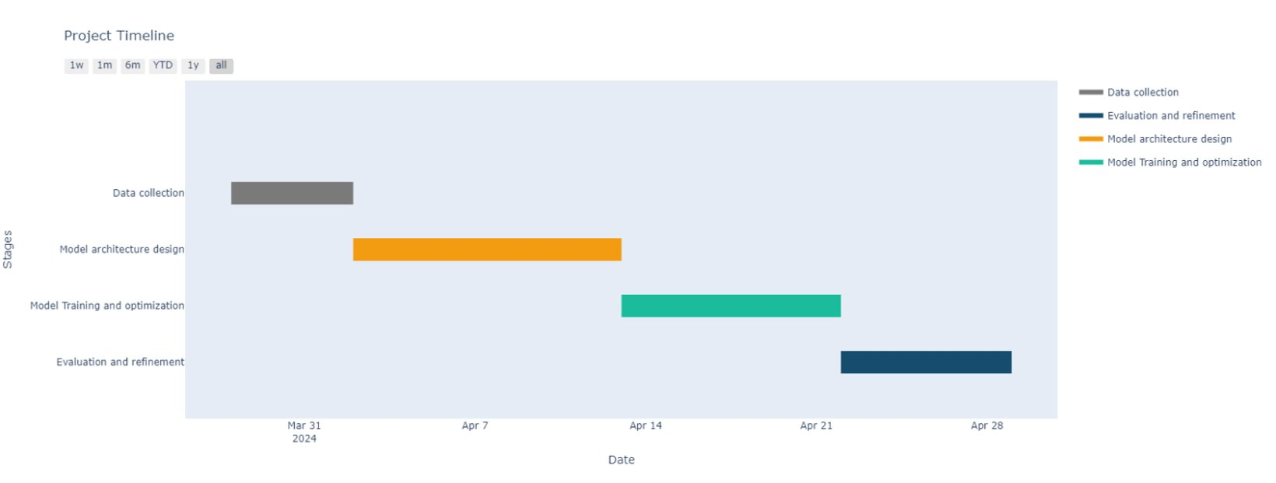
Timeline

Slide 10
Methodology for Evaluation - I​
1. Dataset Selection:​
Choice of Dataset: For evaluating the effectiveness of our approach in Hinglish language modeling, we will utilize a diverse and representative dataset comprising authentic Hinglish text sourced from various online papers or articles.​
2. Experimental Setup:​
Model Training and Fine-tuning: We will train and fine-tune language models such as mT5on the selected dataset using appropriate training methodologies and hyperparameters tailored to Hinglish language tasks.​​
Cross-validation: Employ cross-validation techniques to partition the dataset into training, validation, and test sets, ensuring robust evaluation of model generalization across diverse data splits.​
​

Slide 11
Methodology for Evaluation - II​
Metrics for Evaluation:​
Perplexity: Calculate perplexity as a measure of the model's ability to predict the next token in a sequence, reflecting its understanding of the language and context. Lower perplexity indicates better model performance.​
Accuracy: Evaluate the model's accuracy in generating grammatically correct and contextually coherent Hinglish text, assessing its ability to capture the intended meaning of input prompts.​
Semantic Coherence: Assess the semantic coherence of generated text through qualitative analysis and human evaluation, focusing on factors such as relevance, fluency, and coherence in conveying the intended message.​
Iterative Refinement: Iterate on the experimental setup, incorporating feedback from validation results and refining the approach to address identified limitations and enhance model performance.​

Slide 12

Conclusion​
Specialized Modeling: Our approach will demonstrate the effectiveness of specialized modeling techniques tailored to the unique linguistic characteristics and socio-cultural nuances of Hinglish.​
Comprehensive Evaluation: Through rigorous experimentation and evaluation, we will validate the efficacy, robustness, and competitiveness of our approach in Hinglish language modeling tasks.​
Future Directions: Our work sets the stage for future research and development efforts aimed at advancing Hinglish language processing capabilities, fostering cross-cultural communication, and empowering Hinglish-speaking communities.​

Slide 13
Questions ?​

Slide 14
Thank you.

