Slide 1
What are B+ Trees Used For?
When we store data in a table in a DBMS we want
  Fast lookup by primary key
    Just this – hashtable O(c)
  Ability to add/remove records on the fly
    Some kind of dynamic tree on disk
  Sequential access to records (physically sorted by primary key on disk)
    Tree structured keys (hierarchical index for searching)
    Records all at leaves in sorted order

Slide 2
What is a B+ Tree?
A variation of B trees in which
  internal nodes contain only search keys (no data)
  Leaf nodes contain pointers to data records
  Data records are in sorted order by the search key
  All leaves are at the same depth
Notes:
The properties of B-Trees (and the trees themselves) are a bit more complex than previous structures we’ve looked at.
Here’s a big, gnarly list; we’ll go one step at a time.
The maximum branching factor, as we said, is M (tunable for a given tree).
The root has between 2 and M children or at most L keys.
(L is another parameter)
These restrictions will be different for the root than for other nodes.

Slide 3
Definition of a B+Tree
A B+ tree is a balanced tree in which every path from the root of the tree to a leaf is of the same length, and each non-leaf node of the tree has between [M/2] and [M] children, where n is fixed for a particular tree.

Slide 4
Example
B+ Tree with M = 4
Often, leaf nodes linked together
10
40
3
15
20
30
50
1
2
10
11
12
20
25
26
40
42
3
5
6
9
15
17
30
32
33
36
50
60
70
Notes:
This is just an example B-tree. Notice that it has 24 entries with a depth of only 2.
A BST would be 4 deep.
Notice also that the leaves are at the same level in the tree. I’ll use integers as both key and data, but we all know that that could as well be different data at the bottom, right?

Slide 5
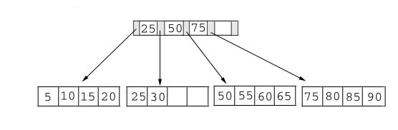
Searching
Just compare the key value with the data in the tree, then return the result.
For example: find the value 45, and 15 in below tree.

Slide 6
Insertion
inserting a value into a B+ tree may unbalance the tree, so rearrange the tree if needed.
Example #1: insert 28 into the below tree.
25 28 30
Fits inside the leaf

Slide 7
Searching
Result:
1. For the value of 45, not found.
2. For the value of 15, return the position where the pointer located.

Slide 8
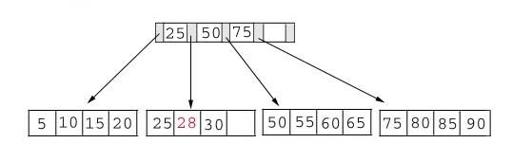
Insertion
Result:

Slide 9
Insertion
Example #2: insert 70 into below tree

Slide 10
Insertion
Process: split the leaf and propagate middle key up the tree
50 55 60 65 70
Does not fit inside the leaf
50 55
60 65 70

Slide 11
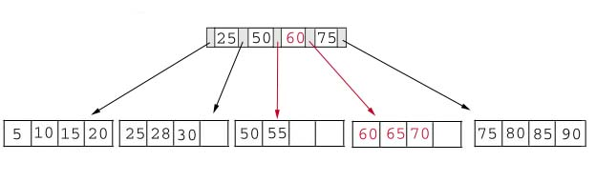
Insertion
Result: chose the middle key 60, and place it in the index page between 50 and 75.

Slide 12
Insertion
Exercise: add a key value 95 to the below tree.
75 80 85 90 95
Leaf node full, split the leaf.
75 80
85 90 95
25 50 60 75 85
Notes:
Add 95 to 75, 80, 85, 90; node full. Split into: 75, 80 and 85, 90 95. Propagate middle value (85) to parent.
Parent is full with 25, 50, 60, 75. Split into 25, 50 and 60, 75, 85. Propagate middle value (60) up the tree.

Slide 13
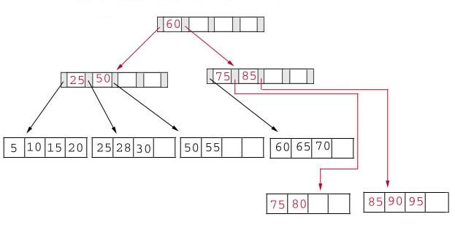
Insertion
Result: again put the middle key 60 to the index page and rearrange the tree.
Notes:
B+ Trees grow UP from the bottom

Slide 14
B+Trees and DBMS
  Used to index primary keys
  Can access records in O(log_{M/2}) traversals (height of the tree)
  Interior nodes contain Keys only
    Set node sizes so that the M-1 keys and M pointers fits inside a single block on disk
      E.g., block size 4096B, keys 10B, pointers 8 bytes
      (8+ (10+8)*M-1) = 4096
      M = 228; 2.7 billion nodes in 4 levels
    One block read per node visited

Slide 15
Advantages of B+ tree usage for databases
keeps keys in sorted order for sequential traversing
uses a hierarchical index to minimize the number of disk reads
uses partially full blocks to speed insertions and deletions
keeps the index balanced with a recursive algorithm
In addition, a B+ tree minimizes waste by making sure the interior nodes are at least half full. A B+ tree can handle an arbitrary number of insertions and deletions.

Slide 16
Conclusion
For a B+ Tree:
It is “easy” to maintain its balance
  Insert/Deletion complexity O(log_{M/2})
The searching time is shorter than most of other types of trees because branching factor is high

Slide 17
Reference
Li Wen & Sin-Min Lee, San Jose State University

