Slide 1

Linux File System Security
Linux File System Security restricts user to access the files and directories. User require permissions to access files or directories. “ls -l” or “ll” command can be used to check security of any file or directory. Above command will display contents from directory along with its security details.
File type.
Owner Permissions.
Group Permissions.
Other User Permission.
Link Count.
Owner of file/directory.
Group Owner of File or Directory.
File Size.
Creation Date and Time.
File/Directory Name.

Slide 2
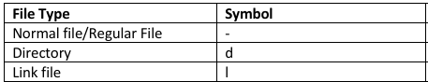
File Types in Linux: There are seven types of file available mentioned as below,
Regular File: The regular file is a most common file type found on the Linux system. It governs all different files such us text files, images, binary files, shared libraries, etc.
Directory: Directory is second most common file type found in Linux. Directory can be created with the mkdir command
Symbolic Link: With symbolic links an administrator can assign a file or directory multiple identities. Symbolic link can be thought of as a pointer to an original file.

Slide 3
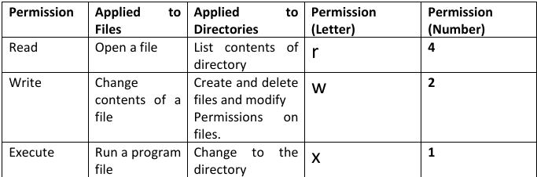
Managing Permissions: Field 2nd, 3rd and 4th represents permissions for owner, group owner and other users. Each of that field contain three basic permissions which allow user to read, write, and executes files. The effect of these permissions differ when applied to file or directory.
If applied to a file, the read permission gives user the right to open file for reading. Therefore, user can read it’s contain. “chmod” command is use to change these basic permissions.

Slide 4
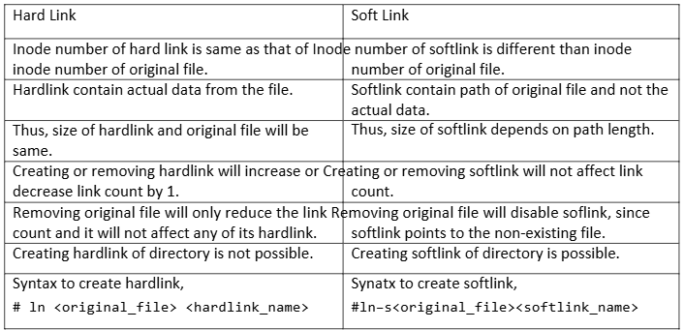
Link Count: Also called as reference count. It shows count of links of file/directory that has been created. Default link count of directory is 2 whereas default link count of file is 1.
Whenever new directory is created, link count of its just parent directory will increase by 1. There are two types of symbolic link, a. Hard Link b. Soft Link
What is an inode?
By definition, an inode is an index node. It serves as a unique identifier for a specific piece of metadata on a given filesystem.

Slide 5


User and group ownership: Basically, by default, user who creates the file/directory is the owner and his primary group acquires group ownerships of that file/directory.
User owner and group owner of file will be shown in 6th and 7th field as shown in the figure. “chown” command is use to change owner and group where as using “chgrp” we can change group ownership.
chmod (u,g,o) +-= (rwx) filename

Slide 6
Default Permission: When a user creates a file as a regular user, it’s given permission rw rw-r-- (664) by default. A directory is given the permission rwxrwxr-x (775).
For the root user, file and directory permission are rw-r--r-- (644) and rwxr-xr-x (755), respectively. These default values are determined by the value of umask.
Type umask to see what your umask value is. If you ignore the leading zero for the moment, the umask value masks what is considered to be fully opened permissions for a file 666 or a directory 777.
The umask value of 002 results in permission for a directory of 775 (rwxrwxr-x). That same umask results in a file permission of 644 (rw-rw-r--).
# root
full permission - umask = defalt permission
file 666 - 022 = 644
dir 777 - 022 = 755
# local/regular
full permission - umask = defalt permission
file 666 - 002 = 664
dir 777 - 002 = 775

