Slide 1
KernelOracle++: A Modernized Framework for Scheduler Prediction
Group Member: Zixu Shen

Slide 2
What Problem Does KernelOracle Try to Solve?
Kernel Scheduling Matters
  Linux scheduler decides which task runs next and how long it runs
  Scheduler behavior directly affects: System responsiveness, Latency, Throughput, CPU utilization
Prediction is Hard but Valuable
  If we can predict scheduler behavior:
    We can analyze bottlenecks
    Reduce unnecessary context switches
    Detect anomalies
    Potentially guide scheduling decisions
Notes:
“In this project, we focus on understanding and predicting the behavior of the Linux kernel scheduler.
The scheduler plays a central role in any operating system: it decides which task runs next, how long it stays on the CPU, and ultimately determines the responsiveness and overall performance of the system. Even very small changes in the scheduling pattern can affect throughput, latency, and user experience.”
“If we could reliably predict the scheduler’s future decisions, we would gain powerful capabilities.
For example, we could analyze scheduling bottlenecks, detect abnormal patterns, reduce unnecessary context switches, or even guide scheduling strategies in specialized environments. In other words, scheduler prediction is both intellectually interesting and practically useful.”
“This is the motivation behind the original KernelOracle project.
KernelOracle attempts to model Linux scheduling events as a time series and to use an LSTM-based neural network to forecast the next thousand steps of the scheduling sequence. The goal is to learn temporal patterns from real perf traces and generate long-horizon predictions of task execution behavior.”
“So this project begins with a simple but ambitious question:
Can we learn and predict how the Linux scheduler behaves over time?
This forms the foundation of our work and sets the stage for the improvements I will introduce next.”

Slide 3
What Limitations Exist in the Original KernelOracle?
Key Limitations of the Original System
  Overly general assumption: “all Linux systems are predictable”
  Standalone machines have noisy, irregular workloads
  Unstable long-horizon predictions (frequent oscillations)
  Inefficient architecture: step-wise LSTMCell loops
  LBFGS optimizer causes slow, unstable training
  No validation set, no early stopping mechanism
  No reproducibility tools (config, logging, checkpoints)
Notes:
“Before improving the system, it is important to recognize the limitations of the original KernelOracle design. The first and most fundamental issue is that the original project assumes all Linux systems exhibit predictable scheduling patterns. In reality, this assumption does not hold. Standalone Linux machines, or systems with only a few irregular users, tend to have highly noisy and inconsistent workloads. Under such conditions, predicting scheduler behavior is essentially impossible.”
“This unrealistic assumption leads to practical problems in the model. The original LSTMCell-based architecture produces unstable long-horizon forecasts. When the model enters free-running prediction mode, the output begins to oscillate dramatically, especially in the baseline result shown here. These oscillations are not meaningful patterns—they are simply artifacts of model instability.”
“From an engineering perspective, the system also suffers from several technical limitations. It uses step-wise LSTMCell loops implemented in Python, which are slow and inefficient. The LBFGS optimizer further slows down training and causes unstable gradient behavior. In addition, the pipeline lacks essential ML components such as a validation set, early stopping, reproducible configuration files, structured logging, and model checkpointing. Altogether, the original system is more of a proof-of-concept rather than a robust or deployable tool.”
“These limitations strongly motivate the redesign work that follows, including narrowing the application scope and rebuilding the architecture, training pipeline, and engineering tools to create a more stable and reliable system.”

Slide 4
Refining the Prediction Scope
Original system assumes all Linux hosts are predictable
But standalone / low-user machines = high noise, no stable patterns
Prediction only meaningful in structured workloads
New target environment:
  cloud servers
  long-running services
  applications with repeatable traffic
Standalone Machine
- Random bursts
- No user regularity
- Low predictability
Cloud/Server System
- Fixed workload profiles
- Repeated patterns
- High predictability
Notes:
“One of the key insights during this project is that the original KernelOracle
was trying to solve a problem that is often unsolvable in practice. It assumes
that any Linux system—no matter how it is used—will exhibit predictable
scheduler behavior. But this simply isn’t true. For many standalone systems or
machines used by only a few inconsistent users, workloads are irregular and
noisy, making the scheduling patterns essentially unpredictable.”
“This means that, even with a better model, the prediction task itself is not
well-posed unless we restrict the domain. To address this, I refined the scope
of the project and focused on environments where the scheduler actually follows
consistent temporal patterns. These include cloud servers, web applications,
microservice backends, and enterprise workloads, where user behavior is
relatively stable and often periodic or repetitive.”
“This refinement narrows the applicability of the system, but it dramatically
improves the realism and practical value of the prediction task. In these more
structured environments, temporal regularities exist, so an LSTM model can learn
meaningful patterns rather than modeling noise. In short: prediction becomes not
only possible, but useful.”
“This scope refinement serves as the conceptual foundation for the redesign of
KernelOracle. With a more realistic target environment, we can build a model and
training pipeline that produce credible and actionable predictions.”

Slide 5
Model Architecture Enhancement
Replace step-wise LSTMCell loop
Use batched nn.LSTM for full-sequence processing
Supports dropout and multi-layer structure
Faster, more stable temporal modeling
Enables better long-horizon prediction
self.lstm = nn.LSTM(
input_dim, hidden_dim,
num_layers=2, dropout=0.2,
batch_first=True
)
Notes:
“After refining the prediction scope, the first major component I improved was the model architecture itself. The original KernelOracle implementation used two manually iterated LSTMCell layers. This design processed the sequence one time step at a time in Python, which is slow, inefficient, and does not take advantage of PyTorch’s optimized sequence operations. As a result, the model suffered from unstable hidden-state dynamics and poor long-horizon behavior.”
“To address these issues, I replaced the entire LSTMCell loop with a batched \texttt{nn.LSTM} module. This allows the model to process the full input sequence in a single forward pass, leveraging efficient CUDA kernels and enabling true multi-layer sequence modeling. The new architecture also supports dropout, which provides better regularization and helps prevent overfitting.”
“In practice, this architectural change alone improves training speed by roughly two to three times, while producing much more stable temporal representations. More importantly, it lays the foundation for coherent long-horizon prediction, because the recurrent states evolve more smoothly when handled by a batched LSTM rather than step-wise Python loops.”
“Overall, this redesign transforms the model from a prototype-level implementation into a robust sequence predictor capable of learning meaningful scheduling patterns.”

Slide 6
Training Pipeline Optimization
Adam optimizer replaces LBFGS
Validation split + early stopping
Adaptive LR scheduling
More stable, faster convergence
Supports rigorous evaluation and tuning
Original Pipeline
- No validation set
- No early stopping
- LBFGS optimizer
- Fixed LR
- No monitoring
Enhanced Pipeline
- Train/Val/Test split
- Early stopping
- Adam + LR scheduler
- ReduceLROnPlateau
- TensorBoard curves
Notes:
“In addition to the architectural improvements, a major part of this work involves redesigning the training pipeline. The original system trained with LBFGS, used all data as training data, and had no validation steps or early stopping. This caused unstable convergence and made it impossible to track generalization performance.”
“On the redesigned side, as shown in the figure, I introduced a proper train–validation–test split and added a validation-driven early stopping mechanism. This ensures that the model stops training at the optimal point and prevents overfitting.”
“I also replaced LBFGS with the Adam optimizer, which provides adaptive learning rates and much more stable gradient dynamics. Combined with the ReduceLROnPlateau scheduler, the training process automatically slows down the learning rate when validation improvement stalls. This makes convergence smoother and more predictable.”
“Together, these changes transform the pipeline from a rigid, fixed 15-epoch loop into a modern, feedback-driven training process that converges faster and produces more generalizable models.”

Slide 7
Engineering and Reproducibility Enhancements
Centralized configuration (config.yaml)
Structured logging (timestamps & levels)
Automatic checkpointing (best model + config snapshot)
TensorBoard monitoring
End-to-end reproducibility of experiments
Config.yaml
Logging
Training
Checkpointing
TensorBoard
Notes:
“On this slide, I want to explain the engineering enhancements that make the improved KernelOracle system reproducible, maintainable, and much closer to a production-quality training pipeline. Let me start with the text on the slide.”
“The first improvement is the introduction of a centralized configuration file, config.yaml.
Instead of scattering hyperparameters and settings across multiple Python files, everything—from model size to optimizer settings to data splits—is stored in one place. This ensures that experiments are fully reproducible and easy to re-run or modify.”
“Second, I reworked the logging system. The original code relied on simple print statements, which provide no structured information. Now we have a complete logging framework with timestamps and log levels, so every training event is recorded and can be traced later.”
“The third enhancement is automatic checkpointing. The system now saves the best-performing model along with the optimizer state and a full configuration snapshot. This allows us to resume training at any time and guarantees that the best model is preserved.”
“Finally, TensorBoard integration provides real-time visualization of training and validation curves, learning rate schedules, and other metrics. This makes it much easier to diagnose model behavior during training.”
“The diagram on the slide summarizes how these components interact.
At the top, config.yaml feeds directly into the training process. This shows that configuration is now the single source of truth for the entire pipeline.”
“On the left, the Logging block indicates that training continuously emits structured logs as it runs. This component is independent but always active, providing a complete, chronological record of each run.”
“On the right, we have the Checkpointing module. The dashed outline shows that this is an enhancement layered onto the training process. Whenever the model reaches a new best validation score, this module automatically stores the model state, optimizer state, and configuration snapshot.”
“At the bottom is TensorBoard, which receives summary data directly from the training loop. This enables us to visually monitor the model’s progress in real time and immediately catch issues such as divergence or plateauing.”
“Together, these engineering improvements turn KernelOracle into a fully reproducible and analyzable system, rather than a one-off prototype. This is crucial for evaluating long-horizon prediction models and conducting meaningful system research.”

Slide 8
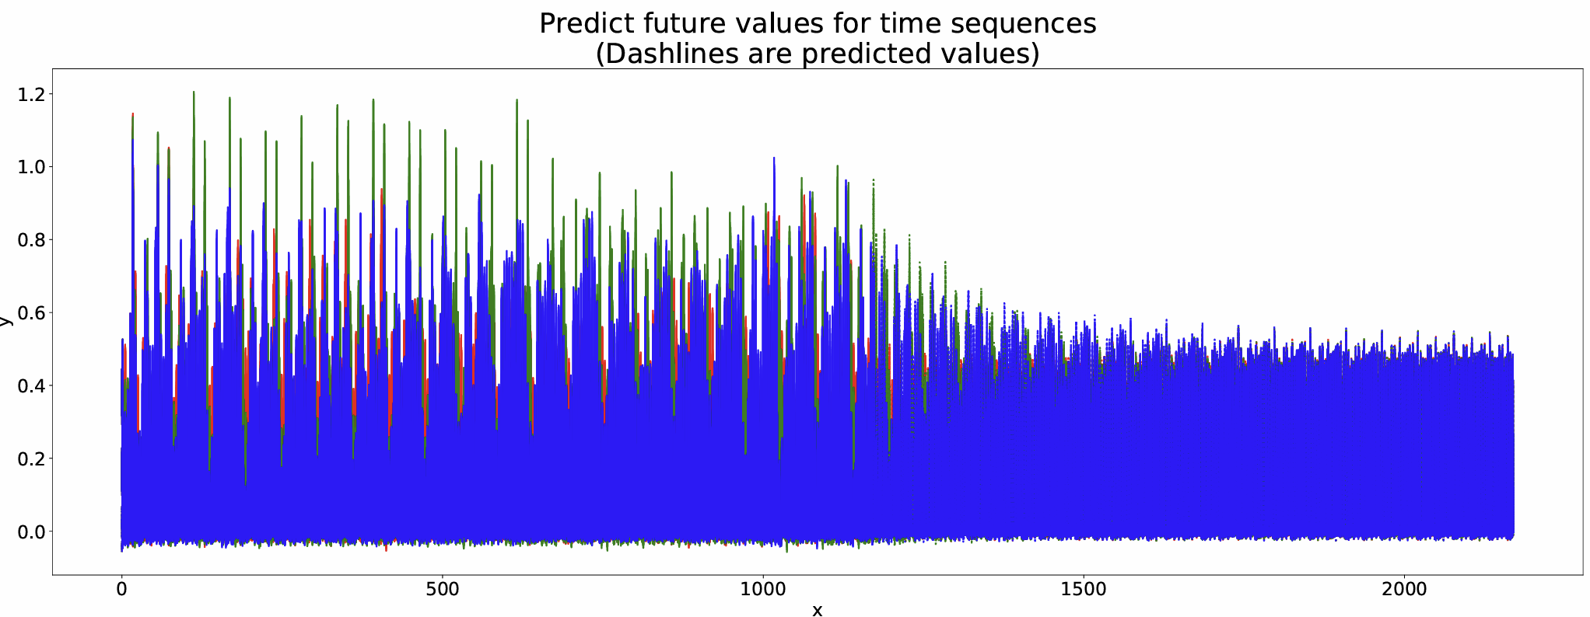
Baseline vs Enhanced Prediction
(a) Original Implementation
Notes:
X-axis: Time steps (observed sequence + 1000-step autoregressive forecast)
Y-axis: Normalized inter-event time (Δt) between scheduling events
Value after min–max normalization
Range roughly 0.0 ~ 1.2 reflects original preprocessing scale
“This plot shows the epoch-14 prediction from the original KernelOracle system.
The X-axis represents time steps, including both the observed part of the sequence and the future 1000-step autoregressive prediction. The Y-axis represents the normalized inter-event time, which is the time difference between consecutive scheduling events after min–max scaling.”
“We can clearly observe that in the future prediction region—shown by the dotted lines—the model becomes unstable. The predicted curve exhibits large oscillations, rapidly changing amplitude, and noise-like behavior. These do not correspond to meaningful scheduling dynamics; they are artifacts caused by the step-wise LSTMCell implementation, the lack of validation feedback, and the instability of the LBFGS optimizer.”
“This plot illustrates the core problem: the baseline model cannot maintain coherent long-horizon prediction and tends to diverge into noise.”

Slide 9
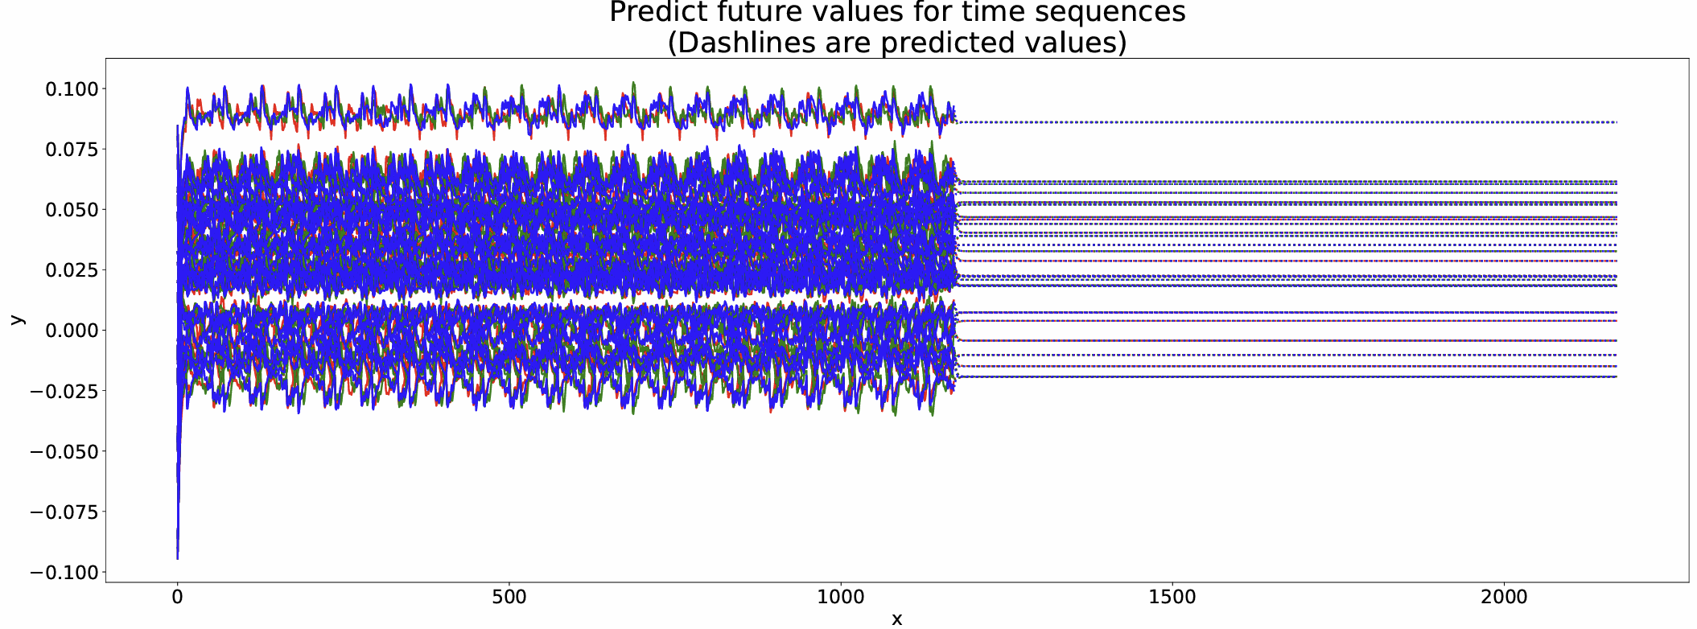
Baseline vs Enhanced Prediction
(b) Enhanced Implementation
Notes:
X-axis: Time steps (observed data + 1000-step future forecast)
Y-axis: Normalized inter-event time (Δt)
After standardization (mean≈0, std≈1)
Range ≈ –0.1 ~ 0.1 naturally smaller
“Now this is the prediction produced by the enhanced system.
The X-axis again represents the sequence index with a 1000-step autoregressive forecast, and the Y-axis represents the normalized inter-event time. In the improved pipeline, the normalization is based on standardization, so the numerical range is centered near zero and naturally appears more compact.”
“What is important is not the range but the behavior.
Unlike the baseline result, the enhanced model maintains a smooth, stable, and coherent prediction throughout the entire future region. There are no large oscillations, no divergence, and no noise bursts. The temporal pattern stays internally consistent.”
“This improvement directly reflects the redesigned architecture and training pipeline:
batched nn.LSTM stabilizes hidden-state propagation
Adam optimizer provides smoother gradient updates
learning rate scheduling avoids overshooting
validation + early stopping ensure proper convergence**
Together, these changes produce a model that can sustain reliable long-horizon autoregressive prediction—something the original design was unable to achieve.”

Slide 10
Performance Summary
Training efficiency improved (2–3× faster per epoch)
Forecast stability improved (no oscillation / no divergence)
Better convergence control (Adam, LR scheduling, early stopping)
Full reproducibility (config, logs, checkpoints, TensorBoard)
Metric | Original | Enhanced
Training stability | Low | High
Prediction coherence | Poor | Strong
Engineering support | Minimal | Full
Long-horizon behavior | Divergent | Stable
Notes:
“This slide summarizes the overall performance improvements achieved through the redesign of the KernelOracle system. The first major improvement is training efficiency. By replacing the step-wise LSTMCell loop with a batched LSTM and switching from LBFGS to the Adam optimizer, each epoch now trains two to three times faster while maintaining much more stable gradient behavior.”
“In terms of prediction quality, the enhanced model produces significantly more stable long-horizon forecasts. As we saw in the previous two slides, the original implementation diverged quickly into oscillations and noise, whereas the improved model maintains a smooth and coherent sequence over the entire 1000-step autoregressive window. This indicates that the model has learned a more reliable temporal representation.”
“Convergence control has also improved. Using validation-driven early stopping and adaptive learning rate scheduling, the training process now stops automatically at the optimal point. This prevents both overfitting and unnecessary training time, and ensures that the best-performing model is always captured.”
“Finally, from an engineering standpoint, the system is now fully reproducible. With centralized configuration, structured logging, automatic checkpointing, and TensorBoard integration, every experiment can be repeated, analyzed, and monitored in a controlled way. This level of reproducibility is essential for meaningful system research and for comparing different model designs fairly.”
“Taken together, these improvements demonstrate that the enhanced system is not only faster and more accurate but also substantially more reliable and practical for real-world use.”

Slide 11
Conclusion
Redesigned architecture improves stability and prediction quality
Optimized training pipeline enables controlled and reliable convergence
Engineering enhancements provide full reproducibility and transparency
Scope refinement makes prediction meaningful in real server environments
KernelOracle evolves from a prototype into a robust predictive framework
Notes:
“To conclude, this project significantly improves the original KernelOracle framework across multiple dimensions.At the architectural level, replacing the step-wise LSTMCell loop with a batched LSTM provides stronger temporal modeling and much greater stability, especially during long-horizon forecasting. This eliminates the oscillations and noise that we observed in the baseline system.”“In terms of training methodology, the introduction of the Adam optimizer, adaptive learning rate scheduling, proper train–validation–test splits, and early stopping ensures controlled, predictable convergence. These tools transform the training process from a fixed, rigid loop into a feedback-driven pipeline that reliably finds the best-performing model.”“On the engineering side, elements such as configuration files, structured logging, automatic checkpointing, and TensorBoard monitoring bring a high level of reproducibility and transparency. Every experiment is now traceable, repeatable, and easy to analyze—something the original implementation could not achieve.”“An important conceptual change is the refinement of the prediction scope. Instead of assuming that all Linux systems are predictable—which is often unrealistic—the enhanced framework focuses on cloud and server environments where workloads follow regular patterns. This makes the prediction task both feasible and practically valuable.”“Overall, the enhanced KernelOracle system evolves from a research prototype into a robust, stable, and reproducible predictive platform. It is better suited for real-world analysis of scheduler dynamics and provides a solid foundation for future extensions.”

