Slide 1
Mechanisms and Robotics
DE ES ZG561
Lecture - 3
Dr. Glynn John
Mechanical Engineering

Slide 2
Fundamentals of Robot Technology
Wrist Configuration
Design & Control issues
Manipulation & Control
Robot Specifications
Analysis & modelling of mechanisms
  Mechanisms
Robot Kinematics
  Forward kinematics
  Rotation
  Translation
  Post-multiplication Vs. Pre-multiplication
  Homogeneous Transformation

Slide 3
Wrist Configurations
    Arm configurations carry and position the wrist, the second major part of a Manipulator, Wrist is attached to the end point of the arm
    Wrist subassembly enables the manipulator to orient the end-effector to perform the desired task properly.
    The end effector, if gripper, must be oriented at an appropriate angle to pick and grasp a work piece.

Slide 4
Wrist Configurations
    For an arbitrary orientation of wrist in 3-D space, the wrist must possess at least 3-DOF.
    This 3-DOF gives three rotations about the three principal axes.
    Less than 3-DOF wrists are also used depending on the requirement.
    Wrist must be compact and at the same time must not affect the performance of the arm.

Slide 5
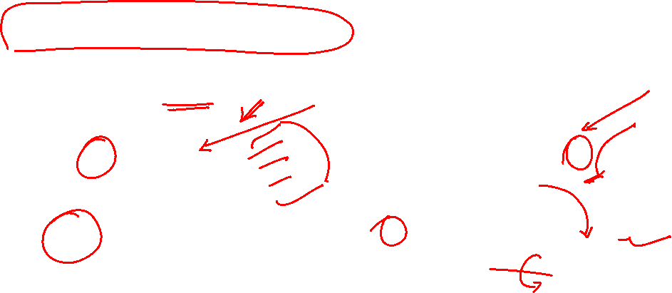
Wrist Configurations
Two Axis Wrist (RT)
Two Axis Wrist (TR)

Slide 6
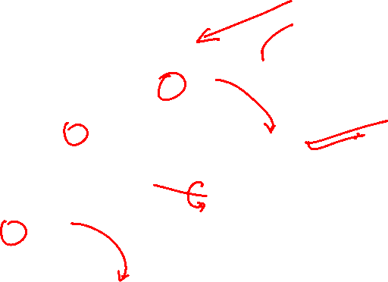
Wrist Configurations
Three Axis Wrist (TRT)

Slide 7
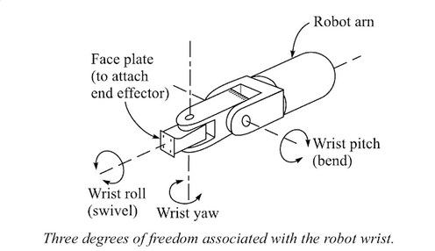
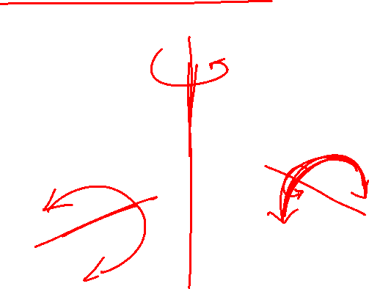
Wrist Configurations
Wrist with Roll, Pitch and Yaw motions is shown below.

Slide 8
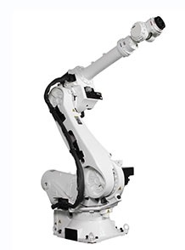
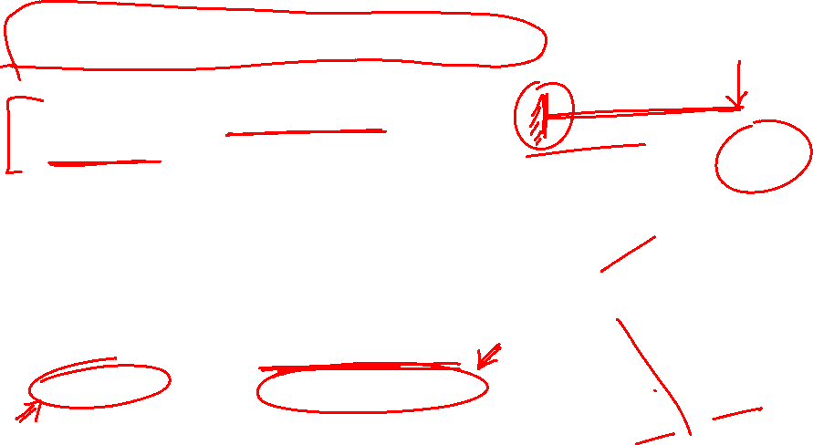
Design and Control Issues
Robots require higher mobility and dexterity than conventional machine tools.
The mechanical structure of a robot consists of rigid cantilever beams connected by hinged joints.
This is inherently poor in stiffness, accuracy and load carrying capacity.

Slide 9
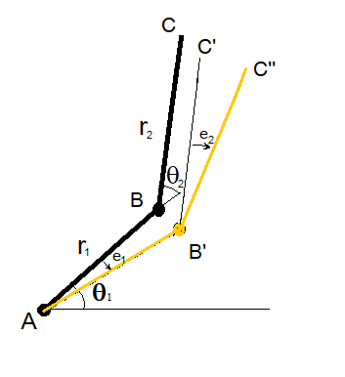
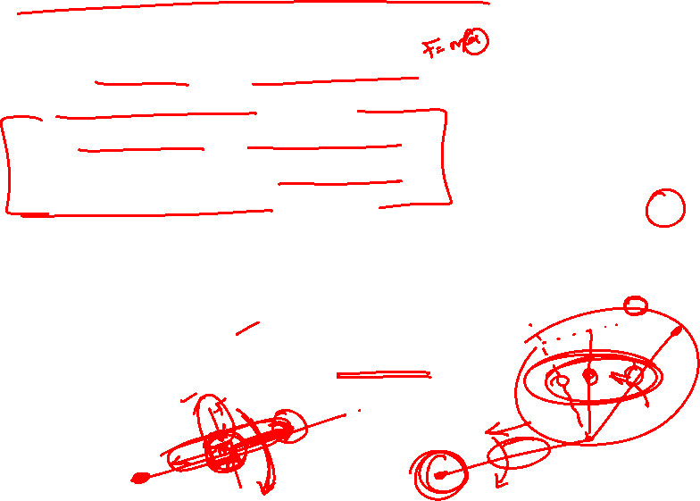
Design and Control Issues
The errors accumulate because the joints are in series.
The position and motion of each joint is affected by the position and motion of other joints.
The weight and inertial load of each link is carried by the previous link and the links undergo rotary and linear motion, making centrifugal and Coriolis accelerations significant.

Slide 10
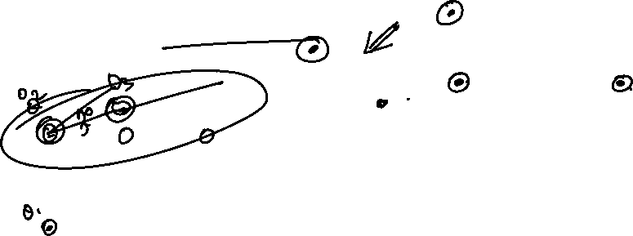
Manipulation and Control
In the analysis of spatial mechanisms (manipulators), the location of links, joints and end effector in 3-D space is continuously required.
These need to be calculated using mathematical methods.
To describe the position and orientation of a body in space a frame or a coordinate system is attached to the body
The position and orientation of this frame with respect to a reference frame, mathematically describes the location of the body.

Slide 11


Robot Specifications
Drive System
  Electrical
  Hydraulic
  Pneumatic
Speed of Motion
Load-Carrying Capacity (Pay – Load)
Control Systems
Precision of Movement
  Spatial Resolution
  Accuracy
  Repeatability
Work Volume

Slide 12
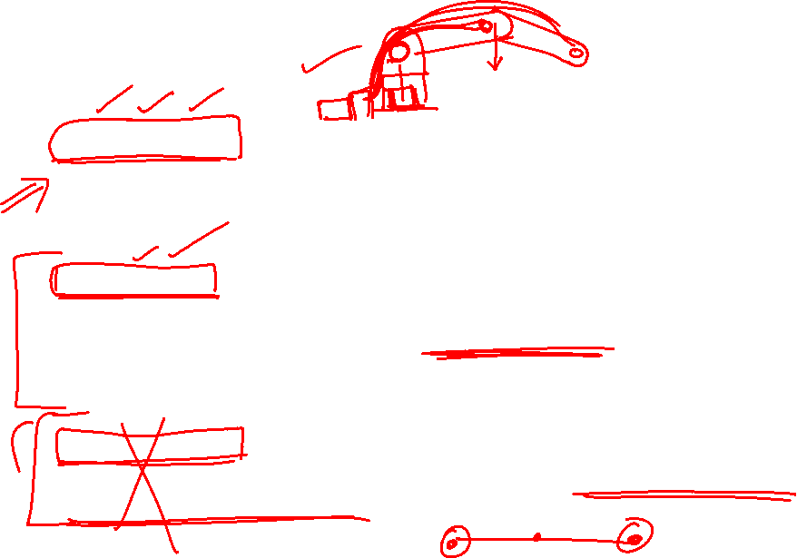
Drive System
Hydraulic drive: gives a robot great speed and strength. These systems can be designed to actuate linear or rotational joints. The main disadvantage of a hydraulic system is that it occupies floor space in addition to that required by the robot.
Electric drive: compared with a hydraulic system, an electric system provides a robot with less speed and strength. Accordingly, electric drive systems are adopted for smaller robots. However, robots supported by electric drive systems are more accurate, exhibit better repeatability, and are cleaner to use.
Pneumatic drive: are generally used for smaller robots. These robots, with fewer degrees of freedom, carry out simple pick-and-place material handling operations.

Slide 13
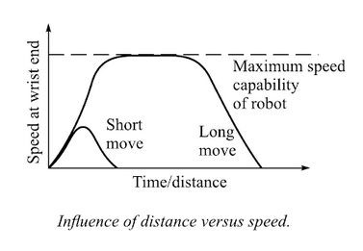
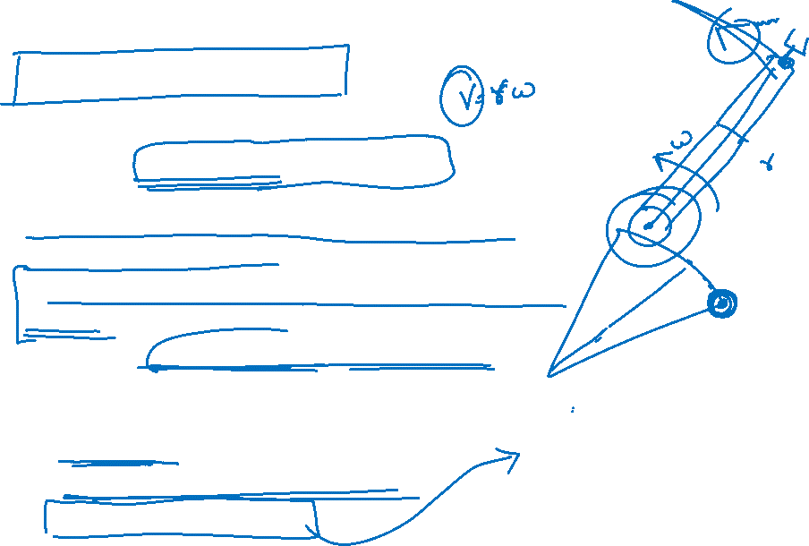
Speed of Motion
Maximum speed of 500 degrees/second can be achieved.
Highest speed can be achieved by large robots with arm extended fully.
Hydraulic robots tend to be faster than electric drive robots.
Robots with electric drives have better control.
Selection of the most desirable speed also depends on
  Accuracy of positioning of the object
  Weight of the object to be handled
  Distances to be moved.

Slide 14
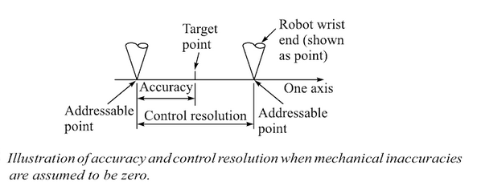
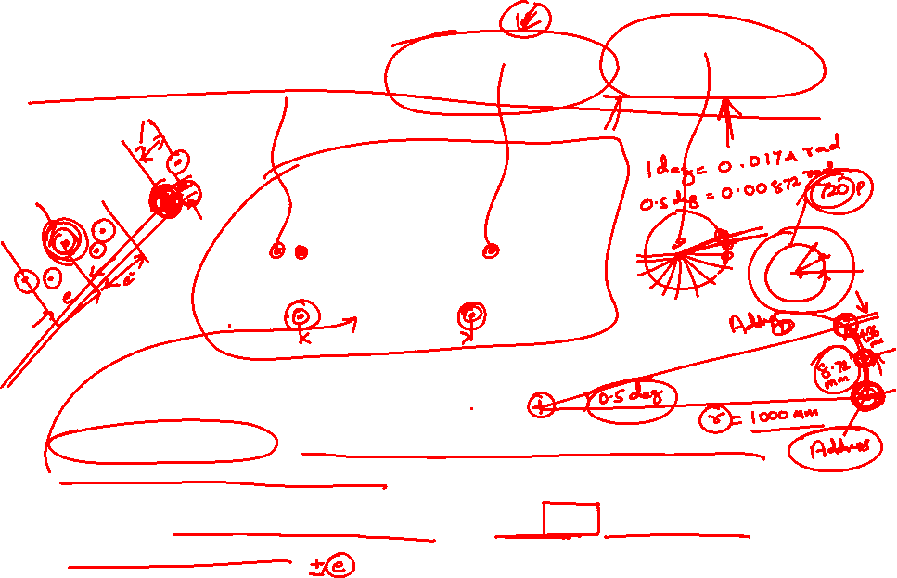
Spatial Resolution, Accuracy, Precision
Spatial Resolution is the smallest increment of movement into which the robot can divide its work volume.
Accuracy refers to a robot’s ability to position its wrist at a target point within its work volume.
Source: Industrial Robotics - Mikell P. Groover

Slide 15
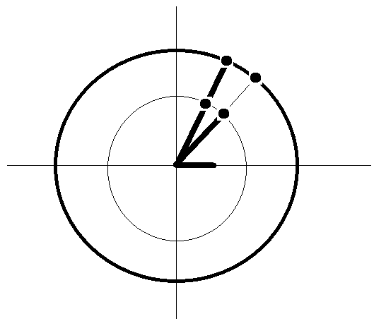
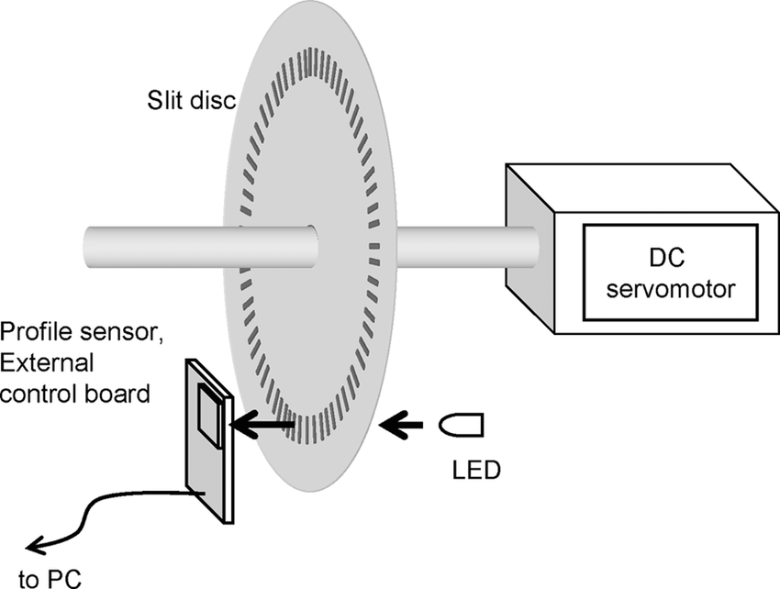
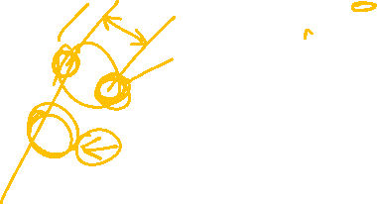
Spatial Resolution, Accuracy, Repeatability

Slide 16
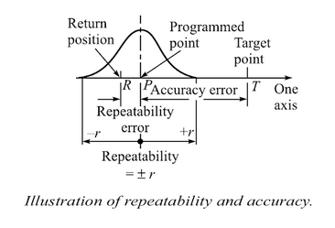
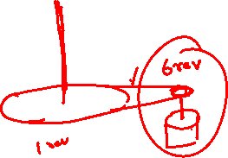
Spatial Resolution, Accuracy, Precision
Repeatability is the ability of the robot to position its wrist at a point in space that had previously been taught to the robot.

Slide 17
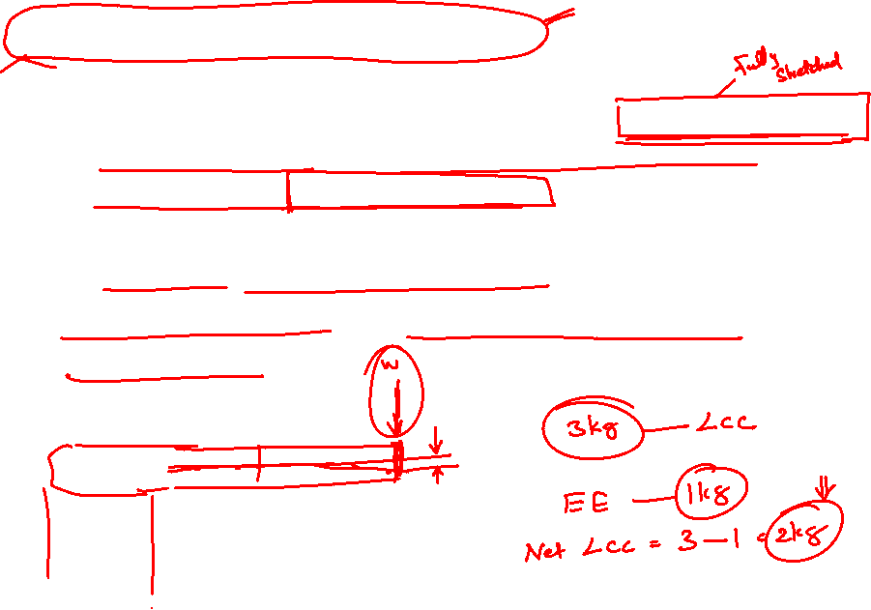
Load Carrying Capacity
The load the robot can carry at its weakest position without including the weight of the end effector, while maintaining its specified accuracy.
Effective/Net load carrying Capacity =
(Load carrying capacity – weight of the end effector) @ the weakest position

Slide 18
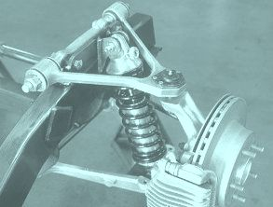
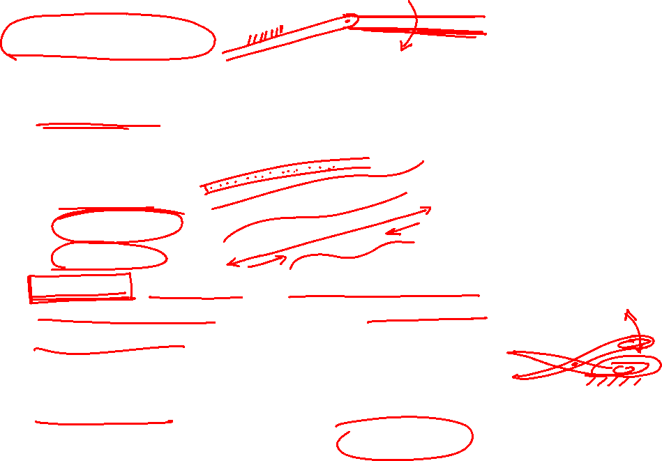
Mechanisms
Kinematic Link: Each part of a machine, which moves relative to some other part is known as a kinematic link or link or element.
Types of Links:
  Rigid Link
  Flexible Link
  Fluid Link
Structure: Assemblage of resistant bodies having no relative motion between them and meant for carrying loads.
Kinematic Pair: The two links or elements of a machine, when in contact with each other if the relative motion between them is completely constrained, the pair is known as kinematic pair.

Slide 19
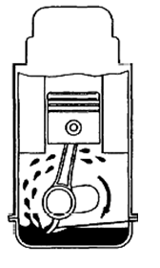
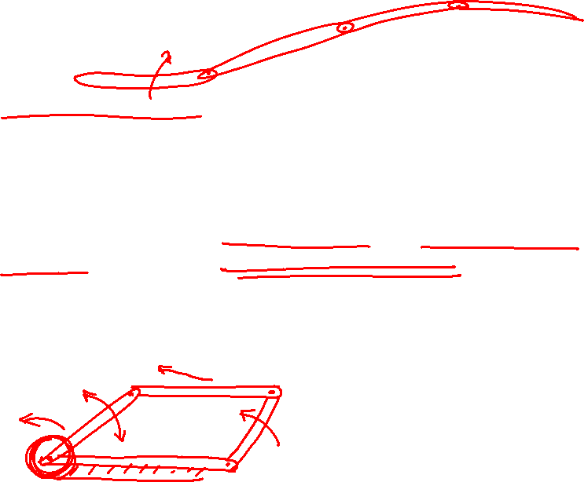
Mechanisms
Kinematic Chain: When the kinematic pairs are coupled in such a way that the last link is joined with the first link to transmit definite motion, it is called kinematic chain (Closed).
Mechanism: When one of the links in a kinematic chain is fixed, the chain is known as a mechanism.
Machine: When a mechanism is required to transmit power or do some particular work, it is called a machine.

Slide 20
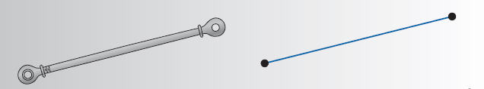
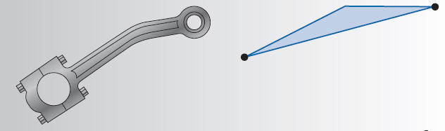
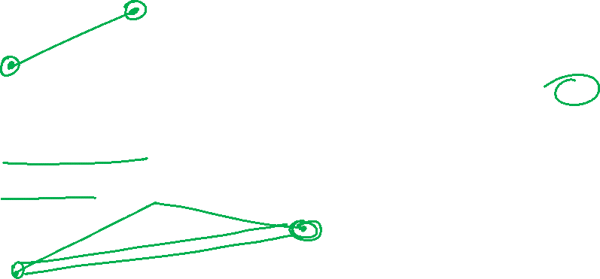

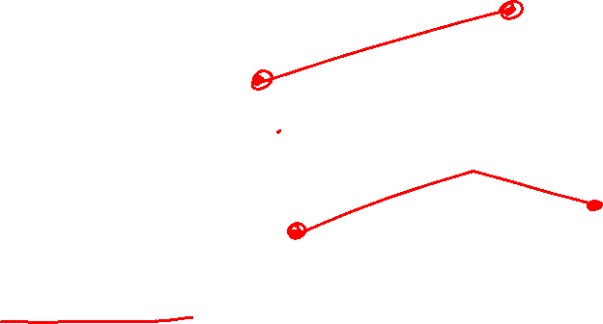
Links and Kinematic symbols
Simple Link
Simple Link
with Point of interest

Slide 21
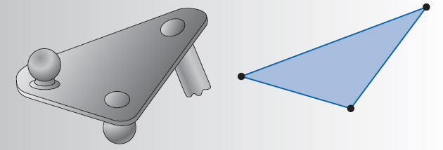
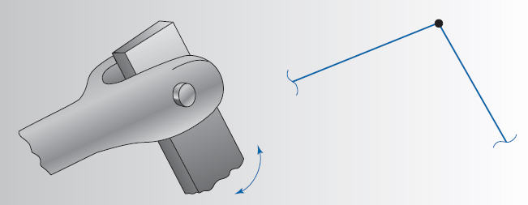
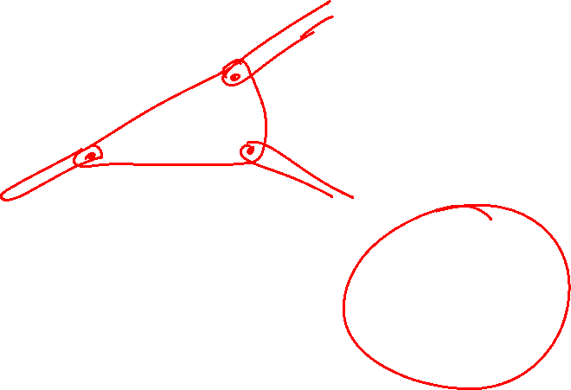
Links and Kinematic symbols
Complex Link
Pin Joint

Slide 22
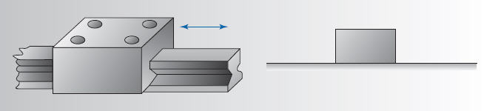
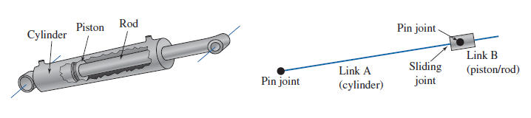

Links and Kinematic symbols
Slide Joint

Slide 23
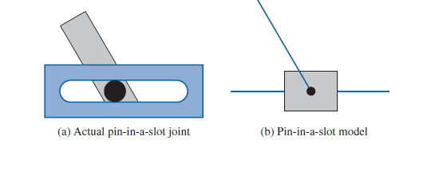
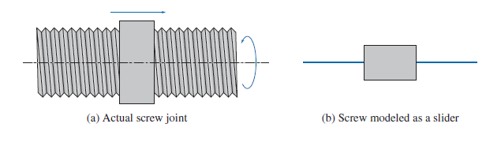
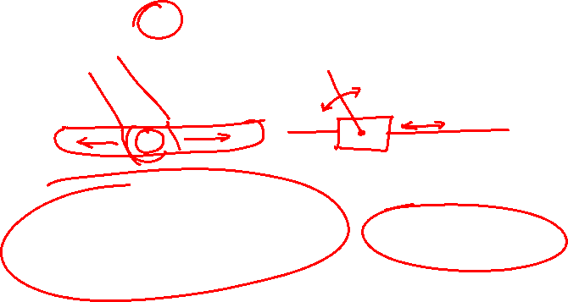
Links and Kinematic symbols

Slide 24
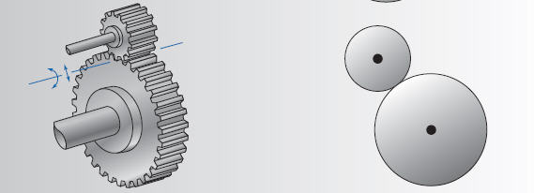
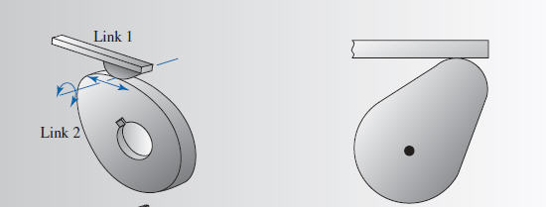
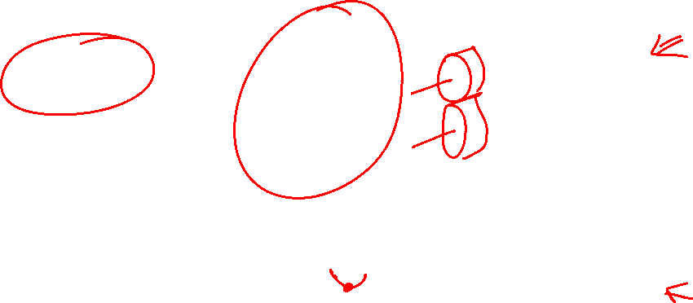
Links and Kinematic symbols
Gear pair
Cam and Follower

Slide 25
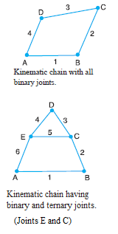
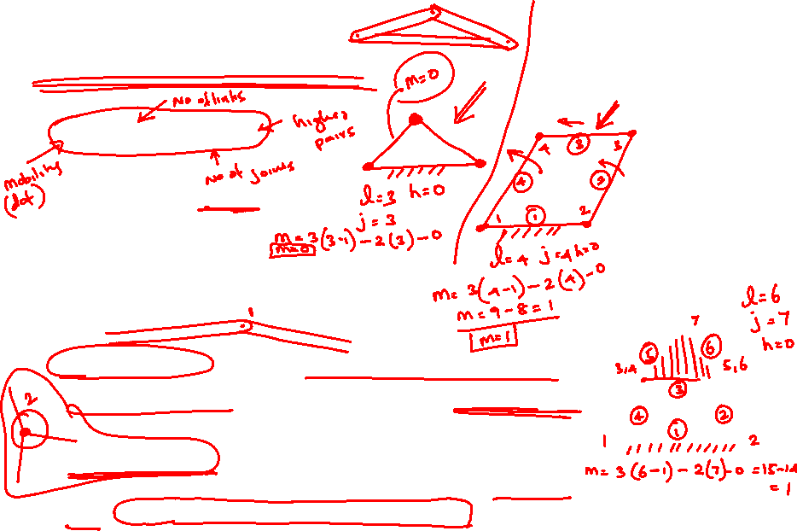
Kutzbach criterion
When h = 0, Kutzbach criterion becomes Grubler’s Equation
m = 3(l - 1) - 2j – h
j = number of binary joints
l = no. of links
h – no of higher pairs (Cams and Gears).
m – mobility, degree of freedom
Binary joint. When two links are joined at the same connection, the joint is known as binary joint.
Ternary joint. When three links are joined at the same connection, the joint is known as ternary joint. It is equivalent to two binary joints as one of the three links joined carry the pin for the other two links

Slide 26
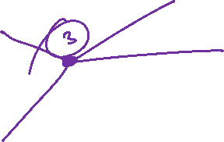

Slide 28
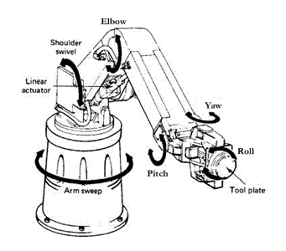
Robot Construction
A robot is mechanically constructed by connecting a set of bodies, called links, to each other using various types of joints.
Actuators, such as electric motors, deliver forces or torques to the joints that cause the robot’s links to move.

Slide 29
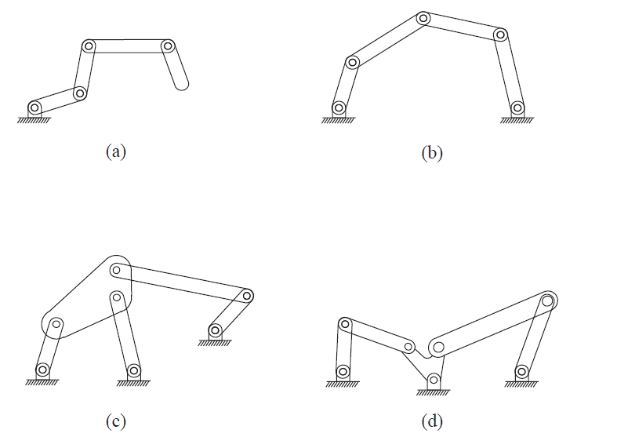
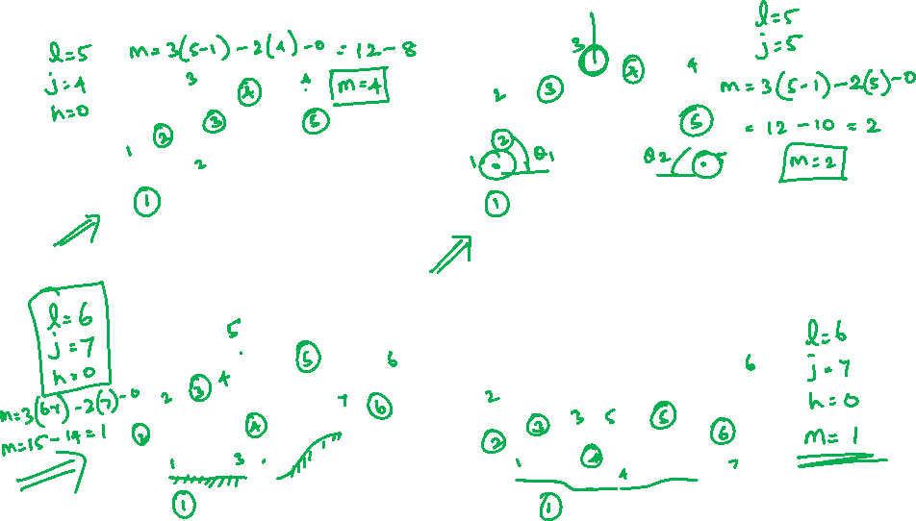
Find the degrees of freedom

Slide 30

Find the degrees of freedom
Dof = 4
Dof = 2
Dof = 1
Dof = 1

Slide 33
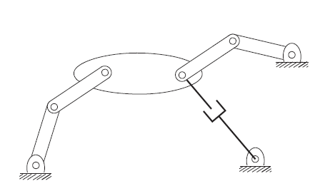
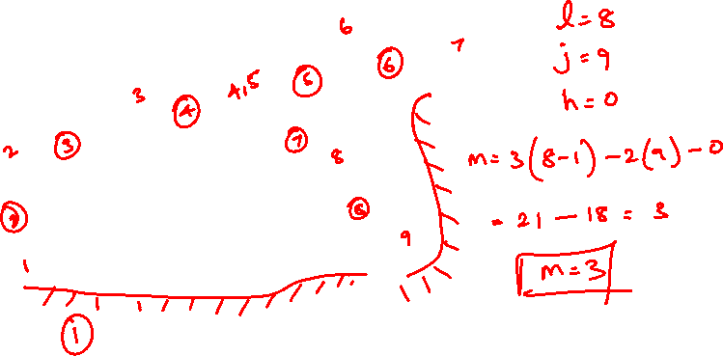
Find the degrees of freedom

Slide 34
Find the degrees of freedom
N = 8
J = 9
Dof = 3

Slide 35
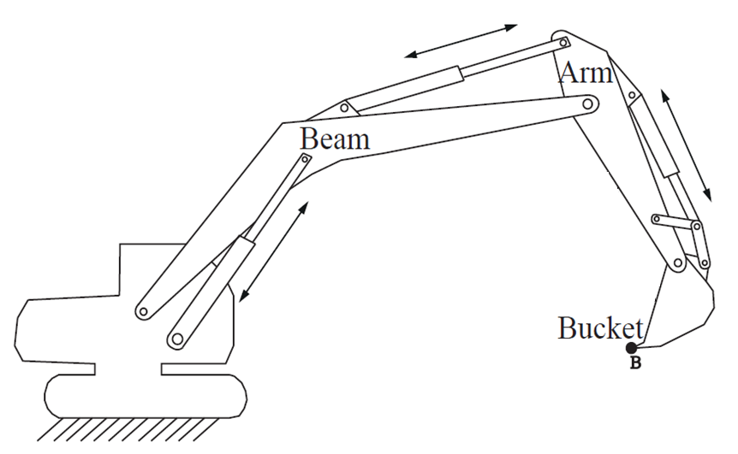
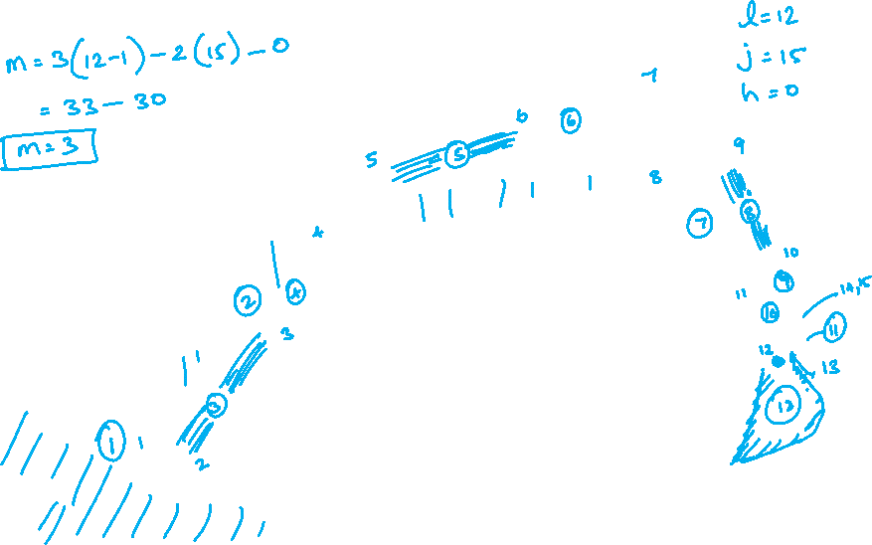
Find the degrees of freedom

Slide 36

l = 12
j = 15
Dof = 3

Slide 37
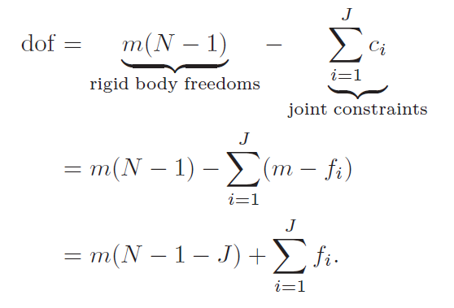

Gr¨ubler’s formula for degrees of freedom
Consider a mechanism consisting of N links, where ground is also regarded as a link. Let J be the number of joints, m be the number of degrees of freedom of a rigid body.
  (m = 3 for planar mechanisms and
  m = 6 for spatial mechanisms)
fi be the number of degrees of freedom provided by joint i, and ci be the number of constraints provided by joint i (it follows that fi + ci = m for all i).
Then Gr¨ubler’s formula for the degrees of freedom (dof) of the robot is

Slide 38


Joint types

Slide 39



Joint dof

Slide 40


Find the dof
The Stewart-Gough platform consists of two platforms—the lower one stationary and regarded as ground, the upper one mobile—connected by six universal-prismatic-spherical (UPS) serial chains.

Slide 41
Find the dof
The Stewart-Gough platform consists of two platforms—the lower one stationary and regarded as ground, the upper one mobile—connected by six universal-prismatic-spherical (UPS) serial chains.
N =14
J = 18
Dof = 6

Slide 42
THANK YOU
References:
Machines and Mechanisms, Applied Kinematic Analysis (Fourth Edition) – David H. Myszka
Industrial Robotics - Mikell P. Groover
Fundamentals of Robotics – Robert Schilling
INTRODUCTION TO ROBOTICS MECHANICS, PLANNING, AND CONTROL- F. C. Park and K. M. Lynch
Modern Robotics: Mechanics, Planning, and Control," Kevin M. Lynch and Frank C. Park, Cambridge University Press, 2017.
Theory of Machines, R.S. Khurmi.

