Slide 1
Mechanisms and Robotics
DE ES DM ZG561
Lecture - 4
Dr. Glynn John
Mechanical Engineering

Slide 2
Robot Kinematics
Forward kinematics
Rotation
Translation
Post-multiplication Vs. Pre-multiplication
Homogeneous Transformation
Introduction to Denavit – Hartenberg Parameters
θ – r manipulator

Slide 3
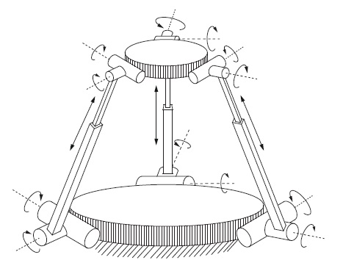
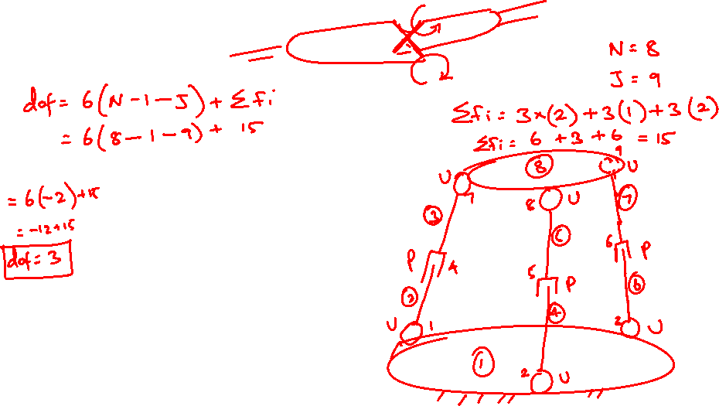
Find the dof

Slide 4
Find the dof
N= 8
J = 9
Fi = 15
Dof = 3

Slide 5
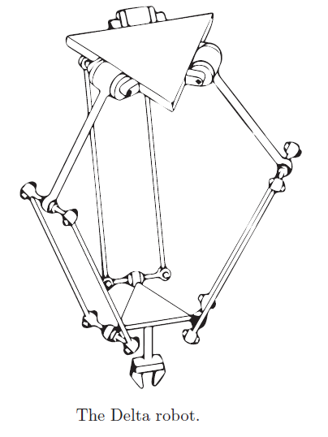

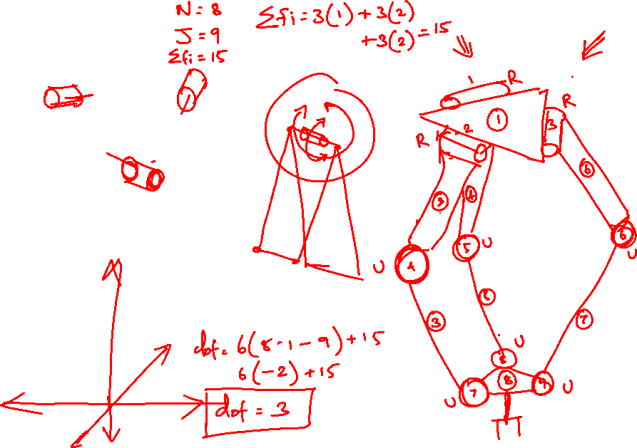
Find the dof

Slide 6
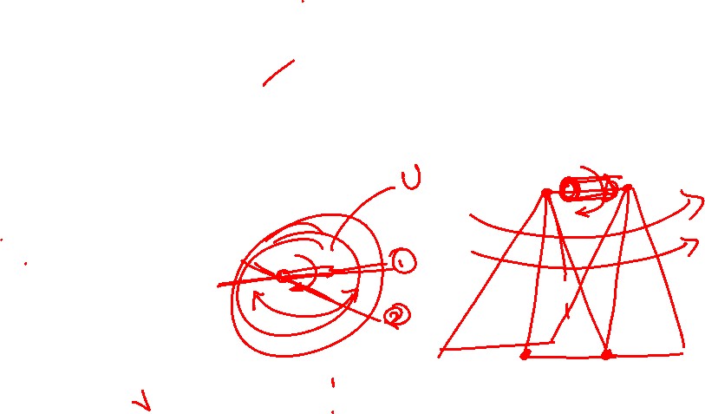
Find the dof
Each parallelogram linkage has one degree of freedom of motion, so that each leg of the Delta robot is kinematically equivalent to an RUU chain.
L= 8
J = 9
Fi = 15
Dof = 3

Slide 7
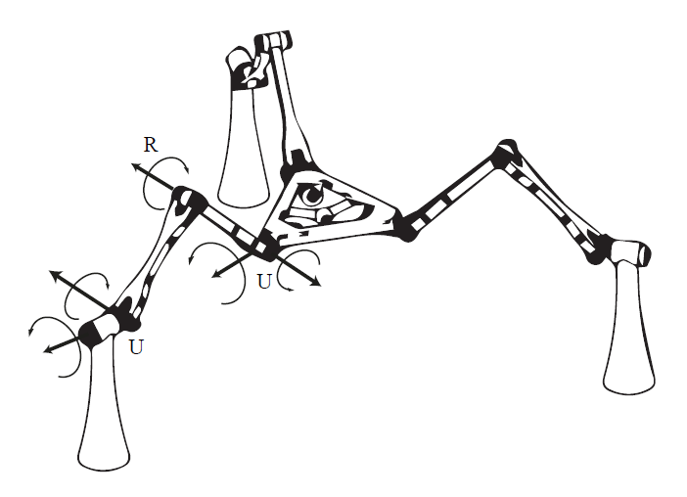

Home Work

Slide 8
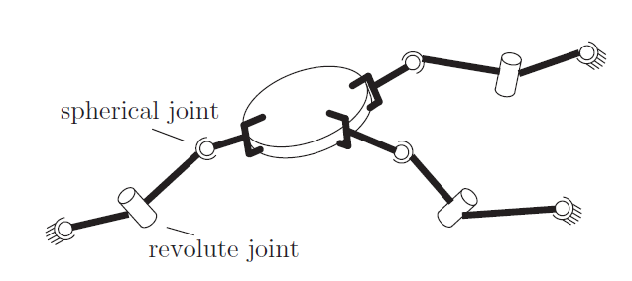
Home Work

Slide 10
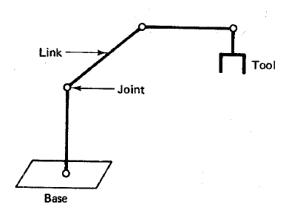
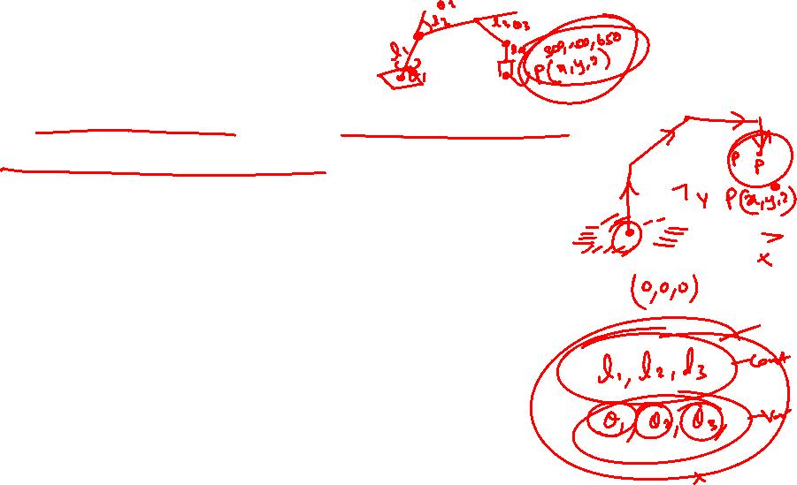
Direct Kinematics
A robotic manipulator can be modelled as a chain of rigid bodies called links.
The links are interconnected to one other by joints.
The objective is to control both the position and the orientation of the tool in three-dimensional space.
In order to program the tool, we must formulate the relationship between the joint variables and the position and the orientation of the tool.
This is called the Direct Kinematics problem.

Slide 11
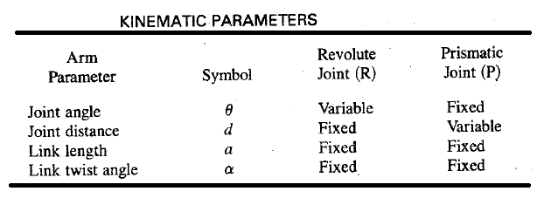
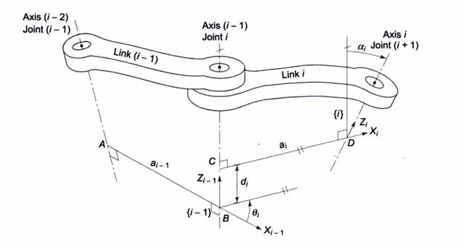
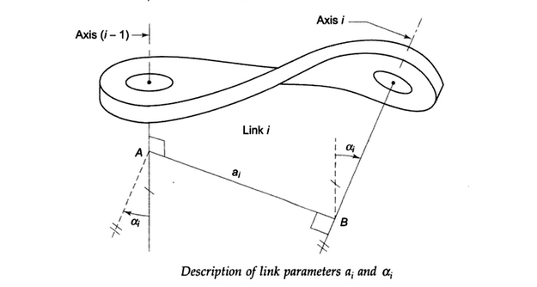
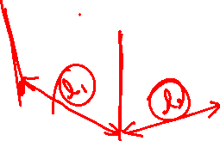
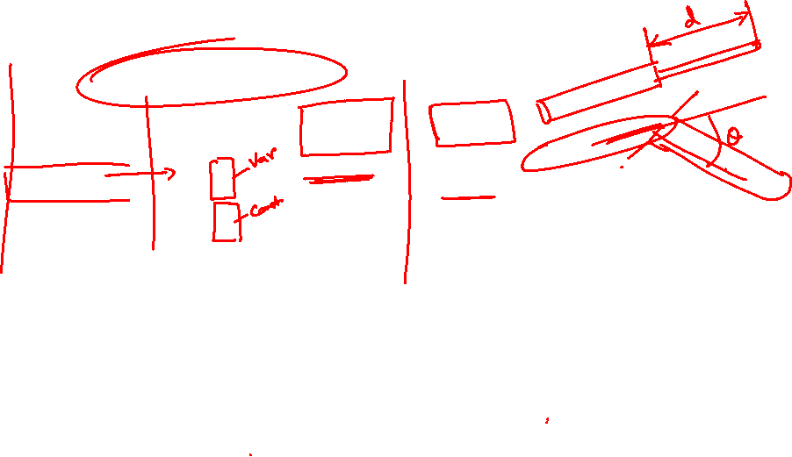
Kinematic Parameters
Joint Parameters
Link Parameters

Slide 12
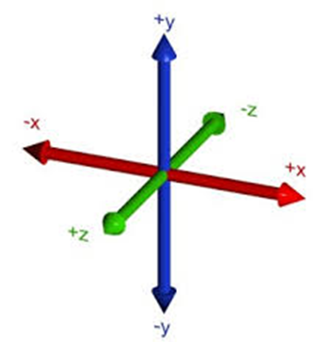
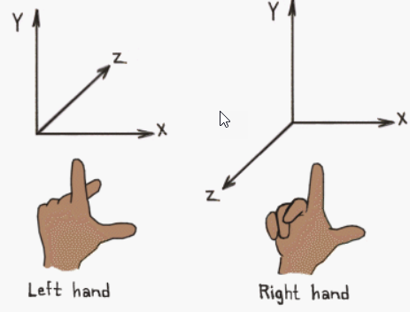
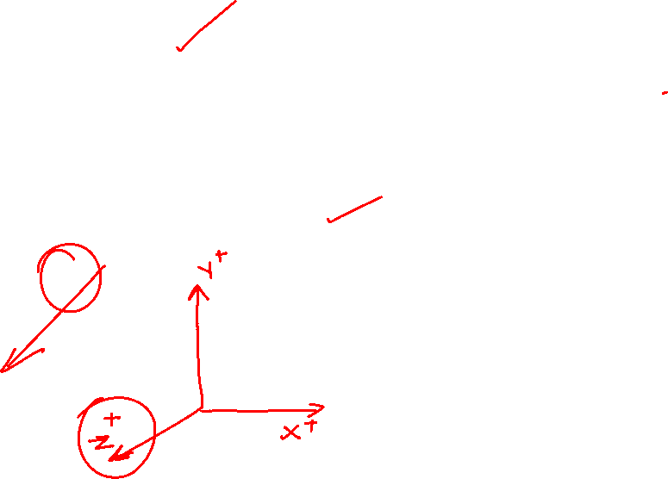
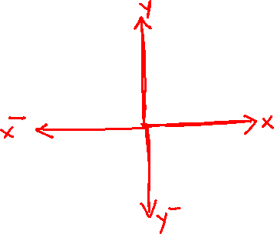
Coordinate Systems – Right Handed, Left Handed
Directions of Positive X Y Z axes

Slide 13
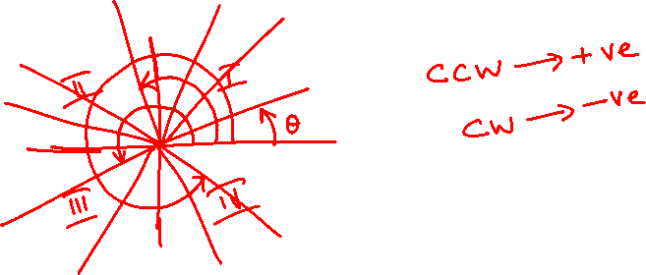

Slide 14
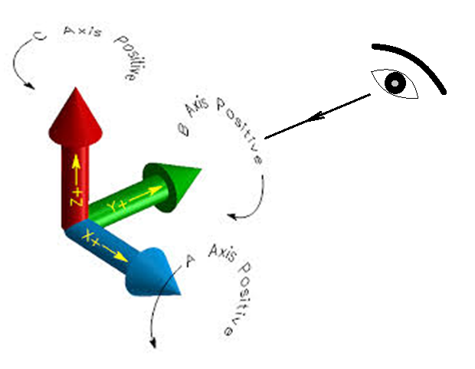
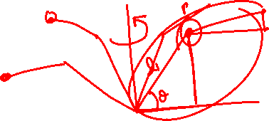
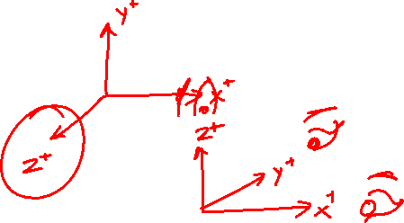
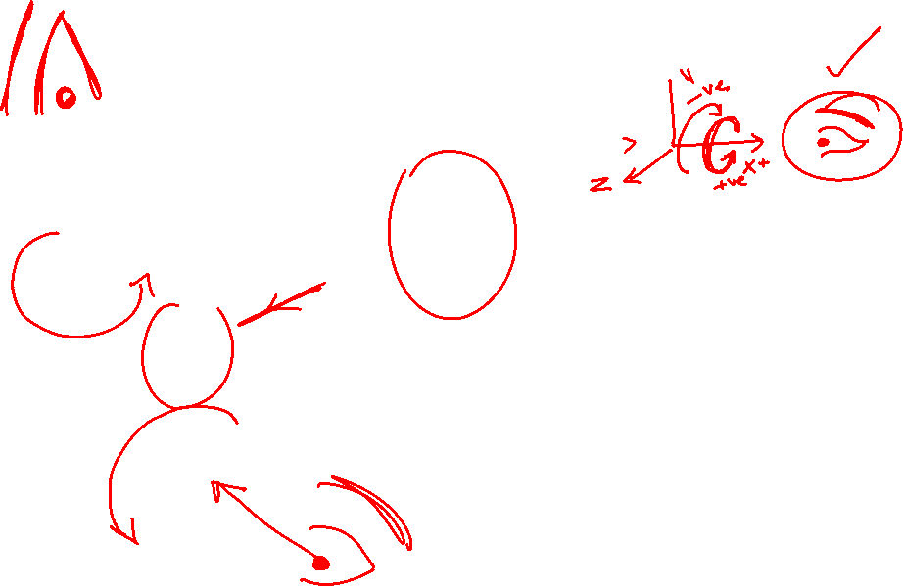
Coordinate Systems
Directions of Positive X Y Z rotations
Anticlockwise rotation is positive when seen from the opposite direction of the arrow head

Slide 15

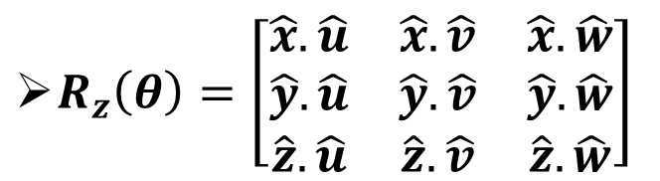

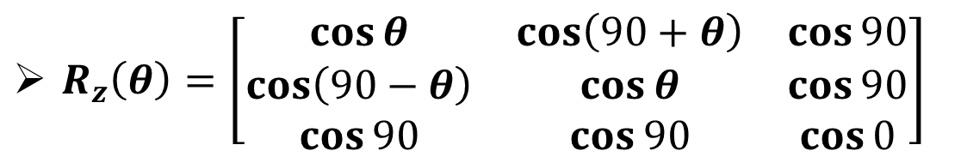
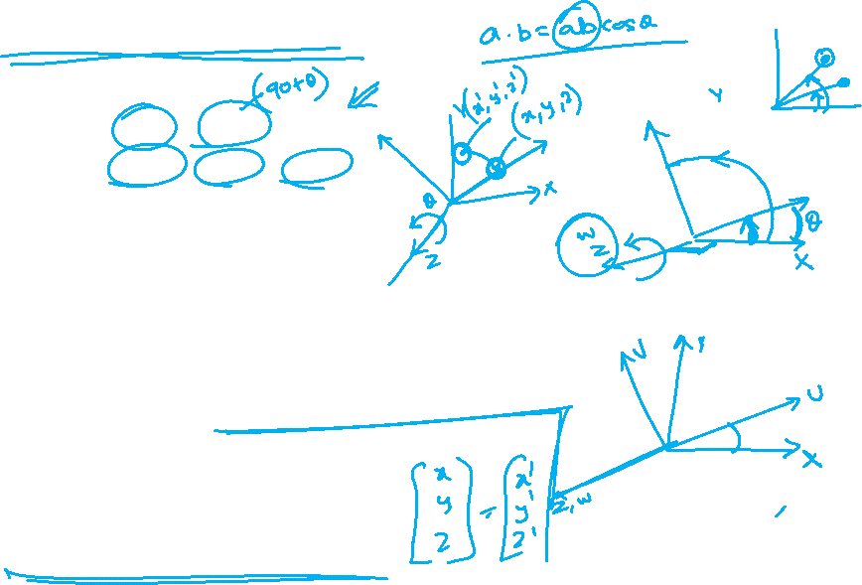


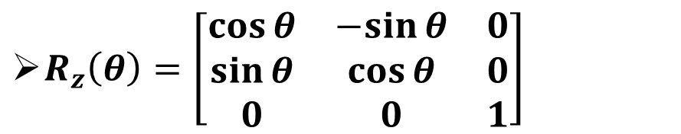


Rotation Matrices
$$\hat{v}$$
$R_{z}\left(θ\right)=\left[\begin{matrix}\hat{x}.\hat{u} & \hat{x}.\hat{v} & \hat{x}.\hat{w} \\ \hat{y}.\hat{u} & \hat{y}.\hat{v} & \hat{y}.\hat{w} \\ \hat{z}.\hat{u} & \hat{z}.\hat{v} & \hat{z}.\hat{w}\end{matrix}\right]$
$$θ$$
$$\hat{y}$$
$$θ$$
$$\hat{x}$$
$$\hat{u}$$
$R_{z}\left(θ\right)=\left[\begin{matrix}\cos{θ} & \cos\left(90+θ\right) & \cos{90} \\ \cos\left(90−θ\right) & \cos{θ} & \cos{90} \\ \cos{90} & \cos{90} & \cos{0}\end{matrix}\right]$
$R_{z}\left(θ\right)=\left[\begin{matrix}\cos{θ} & −sin{θ} & 0 \\ \sin{θ} & \cos{θ} & 0 \\ 0 & 0 & 1\end{matrix}\right]$

Slide 16

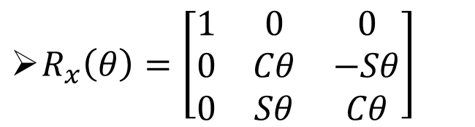
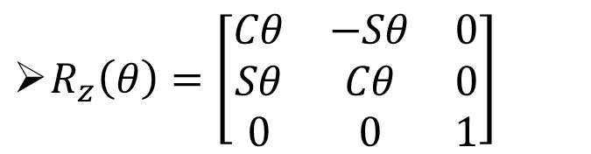


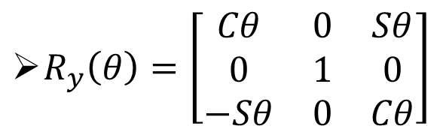
Rotation Matrices
Fundamental rotation matrices for rotation about x axis y axis and z axis are given as follows.
$R_{x}\left(θ\right)=\left[\begin{matrix}1 & 0 & 0 \\ 0 & Cθ & −Sθ \\ 0 & Sθ & Cθ\end{matrix}\right]$
$R_{y}\left(θ\right)=\left[\begin{matrix}Cθ & 0 & Sθ \\ 0 & 1 & 0 \\ −Sθ & 0 & Cθ\end{matrix}\right]$
$R_{z}\left(θ\right)=\left[\begin{matrix}Cθ & −Sθ & 0 \\ Sθ & Cθ & 0 \\ 0 & 0 & 1\end{matrix}\right]$

Slide 17
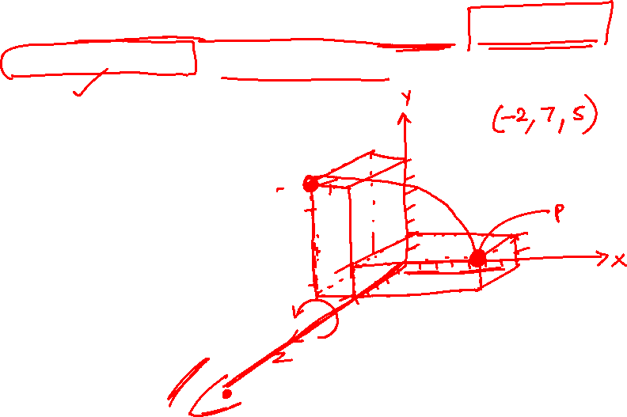
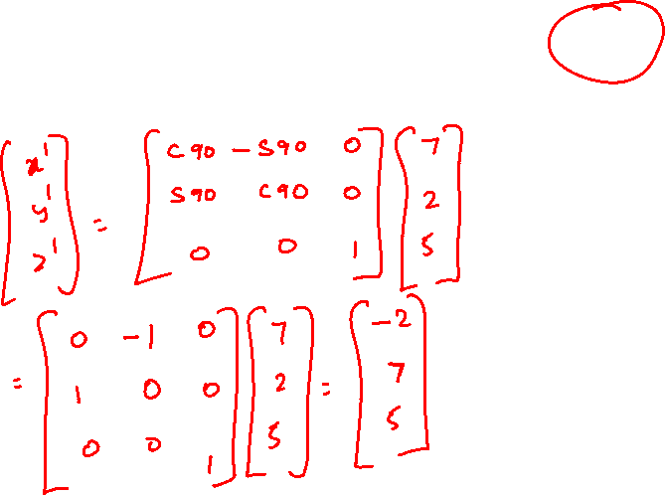
Problem 1
Find the result of rotating the point [7,2,5]T through 90° in the positive direction about the z-axis.

Slide 18
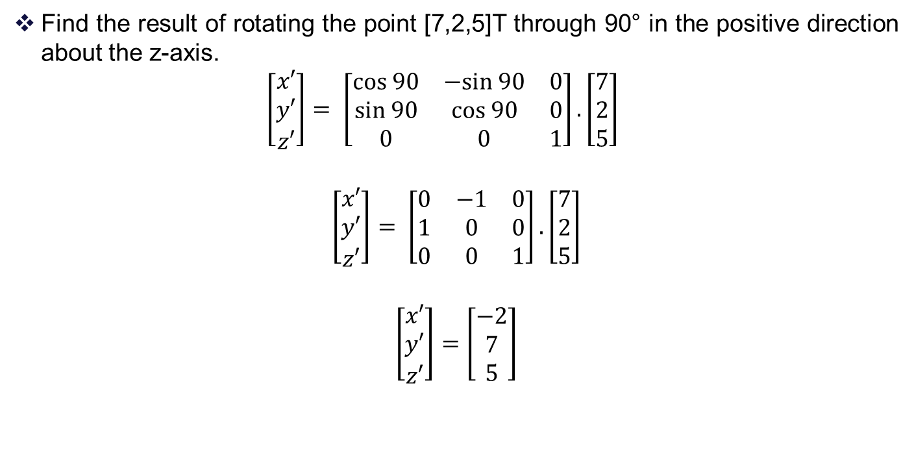
Problem 1 - Solution
Find the result of rotating the point [7,2,5]T through 90° in the positive direction about the z-axis.
$$\left[\begin{matrix}x′ \\ y′ \\ z′\end{matrix}\right]= \left[\begin{matrix}cos 90 & −sin 90 & 0 \\ sin 90 & cos 90 & 0 \\ 0 & 0 & 1\end{matrix}\right].\left[\begin{matrix}7 \\ 2 \\ 5\end{matrix}\right]$$
$$\left[\begin{matrix}x′ \\ y′ \\ z′\end{matrix}\right]= \left[\begin{matrix}0 & −1 & 0 \\ 1 & 0 & 0 \\ 0 & 0 & 1\end{matrix}\right].\left[\begin{matrix}7 \\ 2 \\ 5\end{matrix}\right]$$
$$\left[\begin{matrix}x′ \\ y′ \\ z′\end{matrix}\right]=\left[\begin{matrix}−2 \\ 7 \\ 5\end{matrix}\right]$$

Slide 19
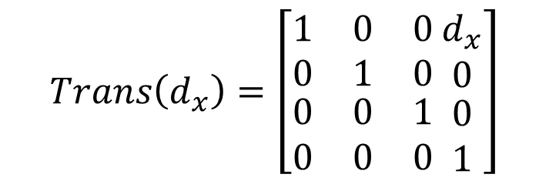
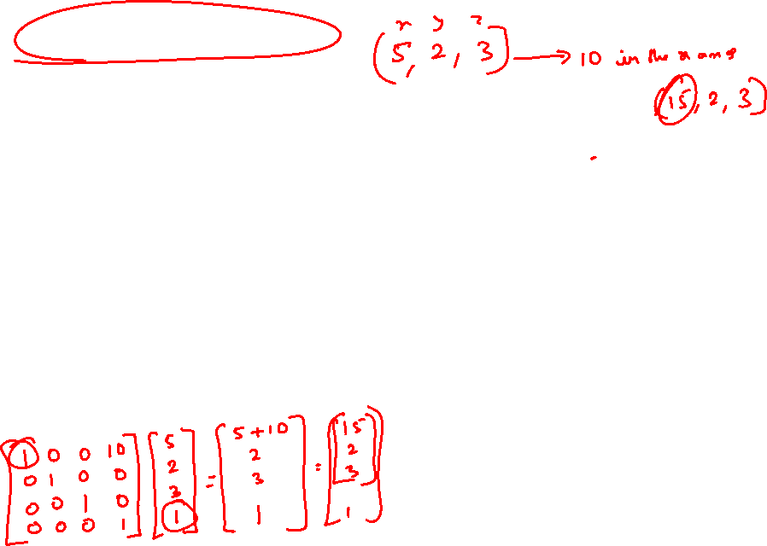
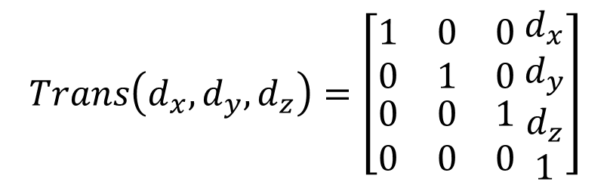
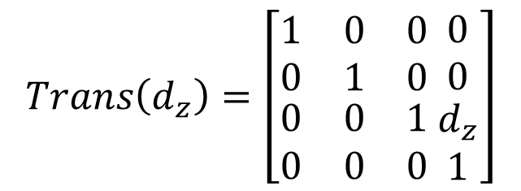
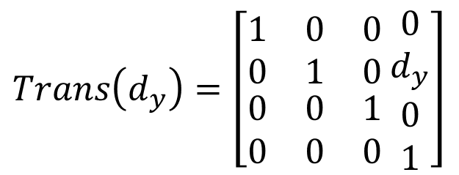
Translation of a Point
$$Trans\left(d_{x},d_{y},d_{z}\right)=\left[\begin{matrix}1 & 0 & 0 \\ 0 & 1 & 0 \\ \begin{matrix}0 \\ 0\end{matrix} & \begin{matrix}0 \\ 0\end{matrix} & \begin{matrix}1 \\ 0\end{matrix}\end{matrix} \begin{matrix}d_{x} \\ d_{y} \\ \begin{matrix}d_{z} \\ 1\end{matrix}\end{matrix}\right]$$
$$Trans\left(d_{x}\right)=\left[\begin{matrix}1 & 0 & 0 \\ 0 & 1 & 0 \\ \begin{matrix}0 \\ 0\end{matrix} & \begin{matrix}0 \\ 0\end{matrix} & \begin{matrix}1 \\ 0\end{matrix}\end{matrix} \begin{matrix}d_{x} \\ 0 \\ \begin{matrix}0 \\ 1\end{matrix}\end{matrix}\right]$$
$$Trans\left(d_{z}\right)=\left[\begin{matrix}1 & 0 & 0 \\ 0 & 1 & 0 \\ \begin{matrix}0 \\ 0\end{matrix} & \begin{matrix}0 \\ 0\end{matrix} & \begin{matrix}1 \\ 0\end{matrix}\end{matrix} \begin{matrix}0 \\ 0 \\ \begin{matrix}d_{z} \\ 1\end{matrix}\end{matrix}\right]$$
$$Trans\left(d_{y}\right)=\left[\begin{matrix}1 & 0 & 0 \\ 0 & 1 & 0 \\ \begin{matrix}0 \\ 0\end{matrix} & \begin{matrix}0 \\ 0\end{matrix} & \begin{matrix}1 \\ 0\end{matrix}\end{matrix} \begin{matrix}0 \\ d_{y} \\ \begin{matrix}0 \\ 1\end{matrix}\end{matrix}\right]$$

Slide 20
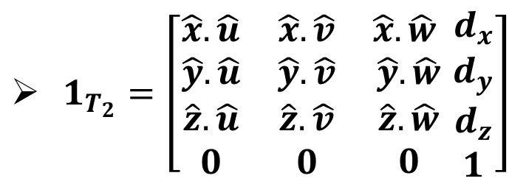
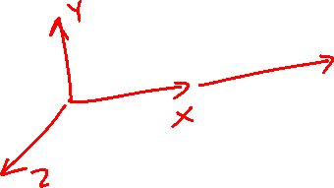
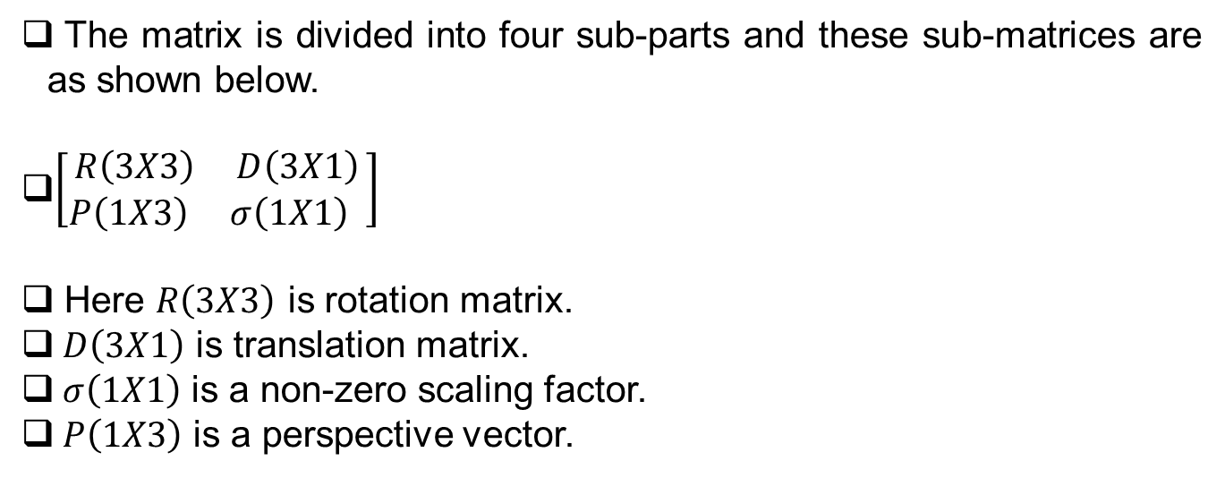
Homogeneous Transformation Matrices
$1_{T_{2}}=\left[\begin{matrix}\hat{x}.\hat{u} & \hat{x}.\hat{v} & \hat{x}.\hat{w} \\ \hat{y}.\hat{u} & \hat{y}.\hat{v} & \hat{y}.\hat{w} \\ \begin{matrix}\hat{z}.\hat{u} \\ 0\end{matrix} & \begin{matrix}\hat{z}.\hat{v} \\ 0\end{matrix} & \begin{matrix}\hat{z}.\hat{w} \\ 0\end{matrix}\end{matrix} \begin{matrix}d_{x} \\ d_{y} \\ \begin{matrix}d_{z} \\ 1\end{matrix}\end{matrix}\right]$
The matrix is divided into four sub-parts and these sub-matrices are as shown below.
$\left[\begin{aligned}R\left(3X3\right) D\left(3X1\right) \\ P\left(1X3\right) σ\left(1X1\right) \end{aligned}\right]$
Here $R\left(3X3\right)$ is rotation matrix.
$D\left(3X1\right)$ is translation matrix.
$σ\left(1X1\right)$ is a non-zero scaling factor.
$P\left(1X3\right)$ is a perspective vector.

Slide 21
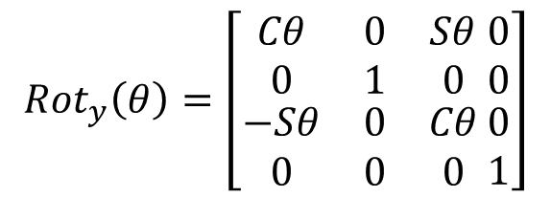

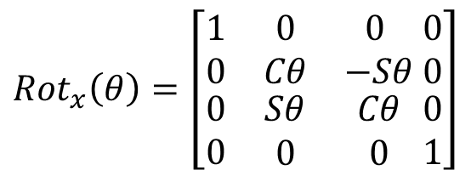

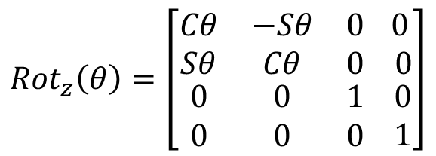

Homogeneous Transformation Matrices
When we want to describe a generalized transformation by a single matrix that combines the effects of translation and rotation, we define a vector by adding 1.
$${Rot}_{x}\left(θ\right)=\left[\begin{matrix}1 & 0 & 0 \\ 0 & Cθ & −Sθ \\ \begin{matrix}0 \\ 0\end{matrix} & \begin{matrix}Sθ \\ 0\end{matrix} & \begin{matrix}Cθ \\ 0\end{matrix}\end{matrix} \begin{matrix}0 \\ 0 \\ \begin{matrix}0 \\ 1\end{matrix}\end{matrix}\right]$$
$$V=\left[ \begin{matrix}x \\ y \\ \begin{matrix}z \\ 1\end{matrix}\end{matrix}\right]$$
$${Rot}_{z}\left(θ\right)=\left[\begin{matrix}Cθ & −Sθ & 0 \\ Sθ & Cθ & 0 \\ \begin{matrix}0 \\ 0\end{matrix} & \begin{matrix}0 \\ 0\end{matrix} & \begin{matrix}1 \\ 0\end{matrix}\end{matrix} \begin{matrix} 0 \\ 0 \\ \begin{matrix}0 \\ 1\end{matrix}\end{matrix}\right]$$
$${Rot}_{y}\left(θ\right)=\left[\begin{matrix}Cθ & 0 & Sθ \\ 0 & 1 & 0 \\ \begin{matrix}−Sθ \\ 0\end{matrix} & \begin{matrix}0 \\ 0\end{matrix} & \begin{matrix}Cθ \\ 0\end{matrix}\end{matrix} \begin{matrix}0 \\ 0 \\ \begin{matrix}0 \\ 1\end{matrix}\end{matrix}\right]$$

Slide 22
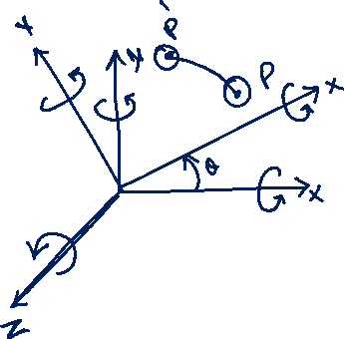

Slide 23
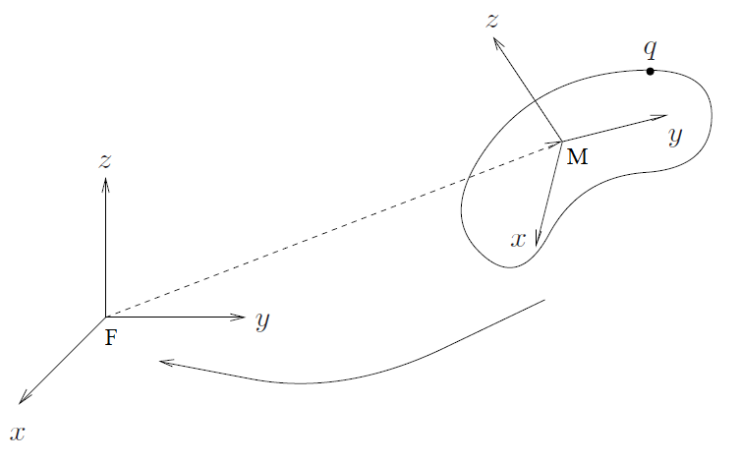
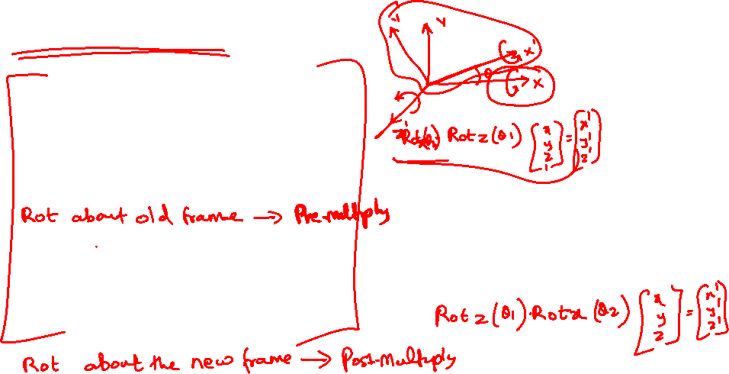
Post-Multiplication Vs. Pre-Multiplication
Composite Rotations
If the mobile coordinate frame M is to be rotated by an amount ϕ about the K^{th} unit vector of the fixed coordinate frame F, then pre-multiply R by Rk(ϕ)
If the mobile coordinate frame M is to be rotated by an amount ϕ about its own K^{th} unit vector, then post-multiply R by Rk(ϕ)

Slide 24
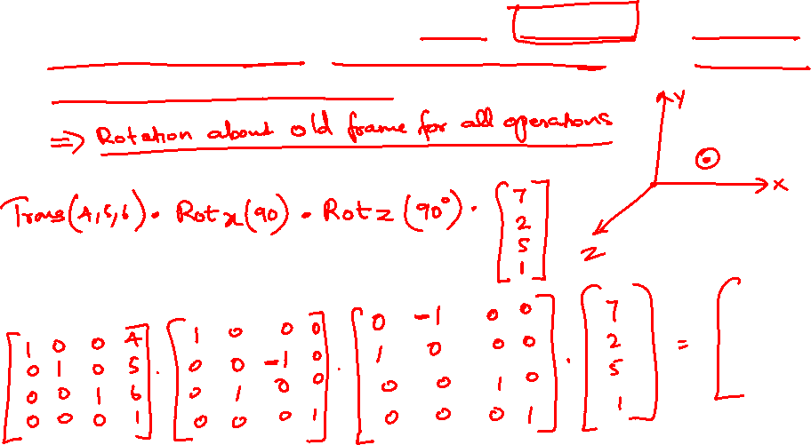
Problem 2
Find the result of rotating the point [7,2,5]T through 90° in the positive direction about the z-axis followed by a rotation of 90° about the x-axis, followed by a translation of (4,5,6).

Slide 25
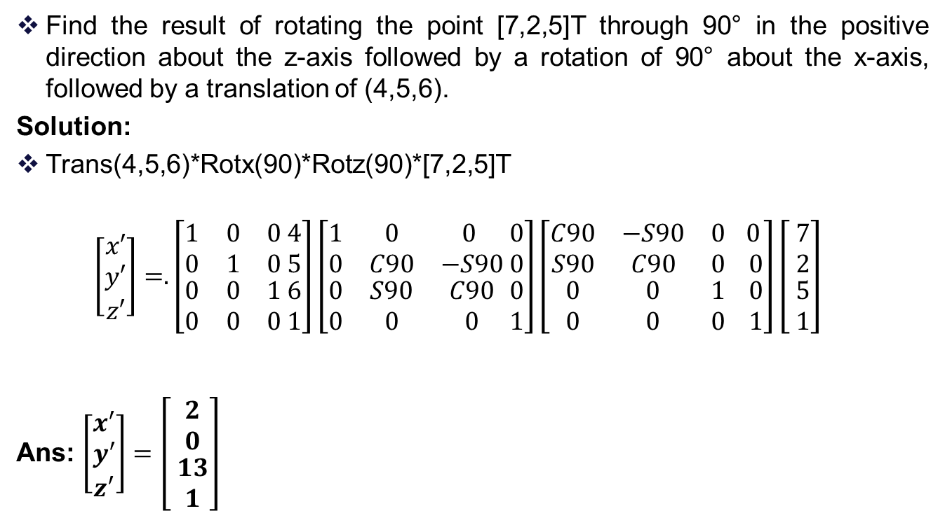

Problem 2 - Solution
Find the result of rotating the point [7,2,5]T through 90° in the positive direction about the z-axis followed by a rotation of 90° about the x-axis, followed by a translation of (4,5,6).
Solution:
Trans(4,5,6)*Rotx(90)*Rotz(90)*[7,2,5]T
$$\left[\begin{matrix}x′ \\ y′ \\ z′\end{matrix}\right]=.\left[\begin{matrix}1 & 0 & 0 \\ 0 & 1 & 0 \\ \begin{matrix}0 \\ 0\end{matrix} & \begin{matrix}0 \\ 0\end{matrix} & \begin{matrix}1 \\ 0\end{matrix}\end{matrix} \begin{matrix}4 \\ 5 \\ \begin{matrix}6 \\ 1\end{matrix}\end{matrix}\right]\left[\begin{matrix}1 & 0 & 0 \\ 0 & C90 & −S90 \\ \begin{matrix}0 \\ 0\end{matrix} & \begin{matrix}S90 \\ 0\end{matrix} & \begin{matrix}C90 \\ 0\end{matrix}\end{matrix} \begin{matrix}0 \\ 0 \\ \begin{matrix}0 \\ 1\end{matrix}\end{matrix}\right]\left[\begin{matrix}C90 & −S90 & 0 \\ S90 & C90 & 0 \\ \begin{matrix}0 \\ 0\end{matrix} & \begin{matrix}0 \\ 0\end{matrix} & \begin{matrix}1 \\ 0\end{matrix}\end{matrix} \begin{matrix} 0 \\ 0 \\ \begin{matrix}0 \\ 1\end{matrix}\end{matrix}\right]\left[ \begin{matrix}7 \\ 2 \\ \begin{matrix}5 \\ 1\end{matrix}\end{matrix}\right]$$
Ans: $\left[\begin{matrix}x′ \\ y′ \\ z′\end{matrix}\right]=\left[ \begin{matrix}2 \\ 0 \\ \begin{matrix}13 \\ 1\end{matrix}\end{matrix}\right]$

Slide 26
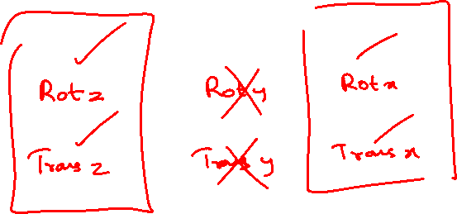

Slide 27


Denavit - Hartenberg Representation
Denavit and Hartenberg (1955) proposed a systematic notation scheme for assigning right handed orthonormal coordinate frames, one to each link in an open kinematic chain of links.
Once these coordinated frames are assigned, transformations between adjacent coordinate frames can be represented by a single standard 4X4 homogeneous coordinate transformation matrix.

Slide 28



Slide 29

Denavit-Hartenberg (D-H) framework
The Denavit-Hartenberg (D-H) framework is a method for assigning frames of reference to a serial robot arm constructed of sequential rotary (and/or translational) joints connected with rigid links.
If the robot arm is imagined at any fixed time, the axes about which the joints turn are viewed as lines in space.
In the most general case, these lines will be skew, and in degenerate cases, they can be parallel or intersect.
In the D-H framework, a frame of reference is assigned to each link of the robot at the joint where it meets the previous link.
The z-axis of the ith D-H frame points along the ith joint axis.
Since a robot arm is usually attached to a base, there is no ambiguity in terms of which of the two (+-) directions along the joint axis should be chosen, i.e., the “up” direction for the first joint is chosen.
Since the (i + 1)st joint axis in space will generally be skew relative to axis i , a unique x-axis is assigned to frame i, by defining it to be the unit vector pointing in the direction of the shortest line segment from axis i to axis i + 1.
This segment intersects both axes orthogonally. In addition to completely defining the relative orientation of the ith frame relative to the (i − 1)st, it also provides the relative position of the origin of this frame.

Slide 30

Denavit-Hartenberg (D-H) framework

Slide 31



2 dof manipulator – Forward Kinematics

Slide 32
2 dof manipulator – Forward Kinematics

Slide 36



THANK YOU
References:
Industrial Robotics - Mikell P. Groover
Industrial Robotics Computer Interfacing and Control – Wesley E. Snyder
Fundamentals of Robotics – Robert Schilling
Introduction to Robotics: Analysis, Control, Applications, 2ed - Saeed B. Niku
Modern Robotics – Park and Lynch

