Slide 1
Mechanisms and Robotics
DE / ES ZG561
Lecture - 6
Dr. Glynn John
Mechanical Engineering

Slide 2

Inverse kinematics
Inverse Kinematics of a 2dof Planar Arm
Inverse Kinematics of a 3 dof Polar Arm
Inverse Kinematics of a 3 dof Cylindrical Arm
Inverse Kinematics of a 3 dof Articulated Arm

Slide 3
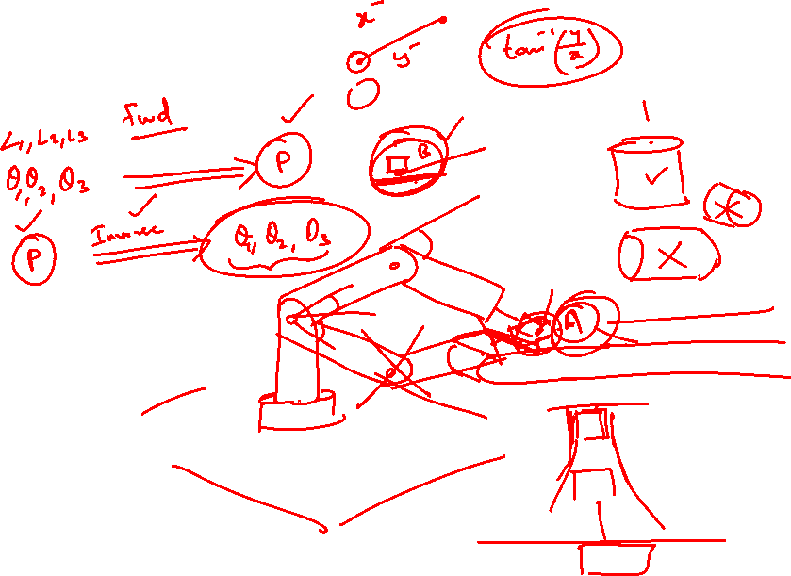

Slide 4
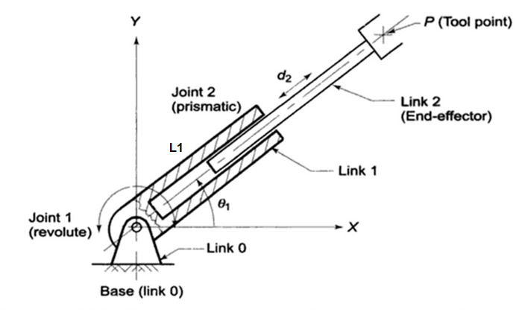
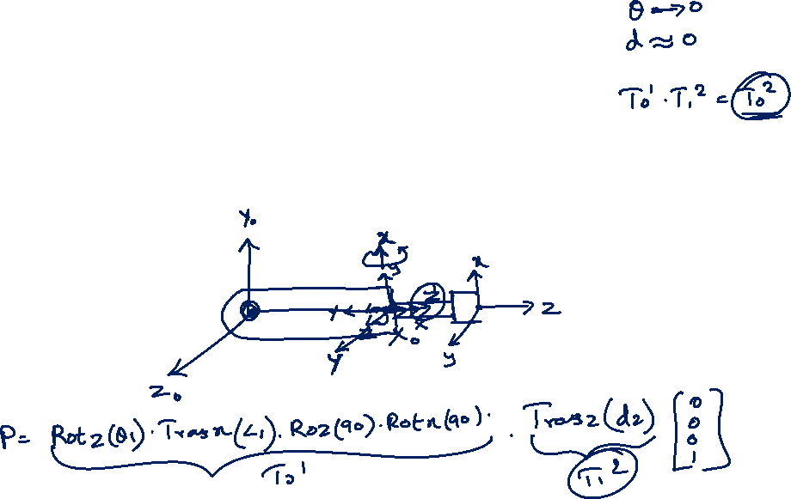
2 dof manipulator – Inverse Kinematics
P (700,700,0)
L1 = 500 mm

Slide 5
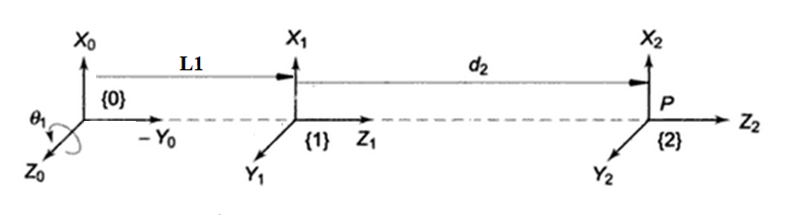
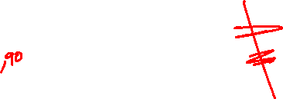
2 dof manipulator – Link Coordinate Diagram
Link i | θ | d | α | a | Home
1 | θ1 |  | 90 | L1 | 90
2 |  | d2
Solution:
[x’,y’,z’] = Rotz (θ1)*Transx(L1)*Rotz(90)* Rotx(90)* Transz(d1)* [0,0,0]’

Slide 6

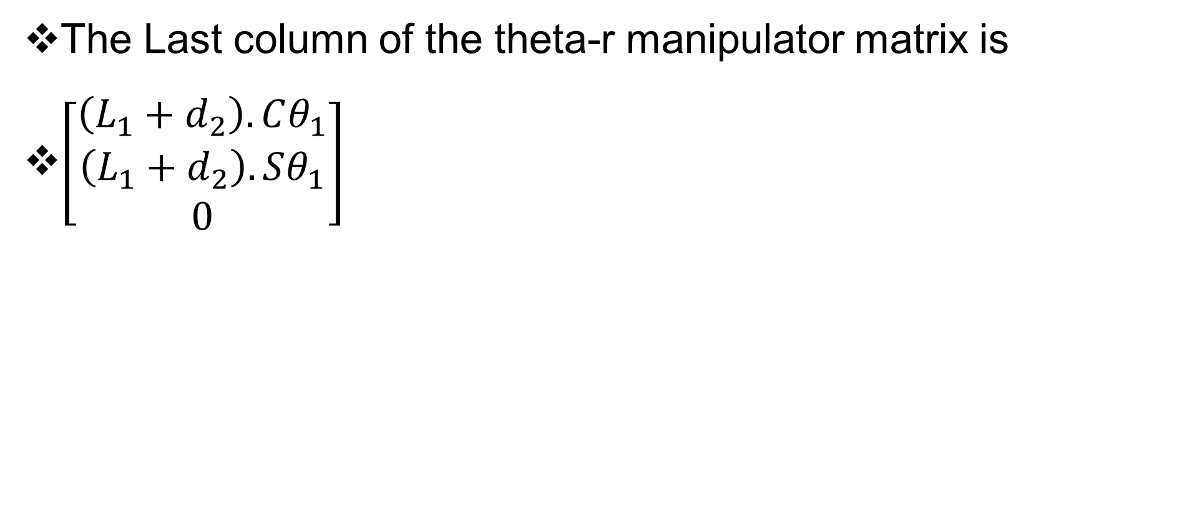
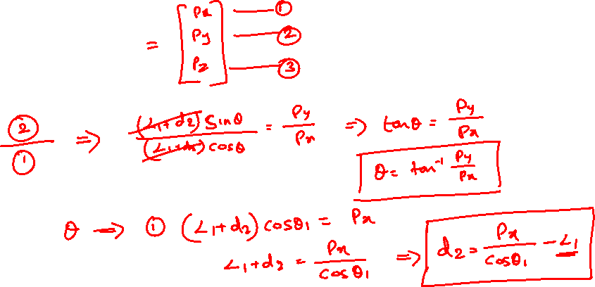
2 dof manipulator – Inverse Kinematics
The Last column of the theta-r manipulator matrix is
$\left[\begin{matrix}\left(L_{1}+d_{2}\right).Cθ_{1} \\ \left(L_{1}+d_{2}\right).Sθ_{1} \\ 0\end{matrix}\right]$

Slide 7
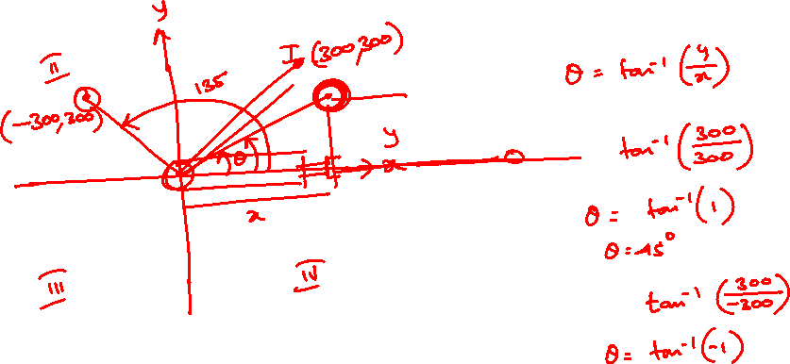
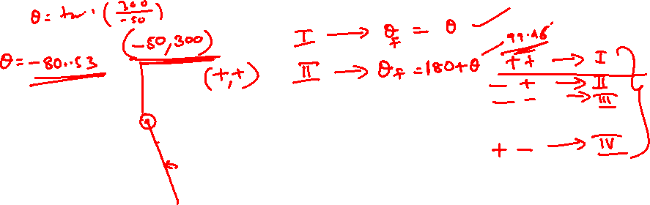
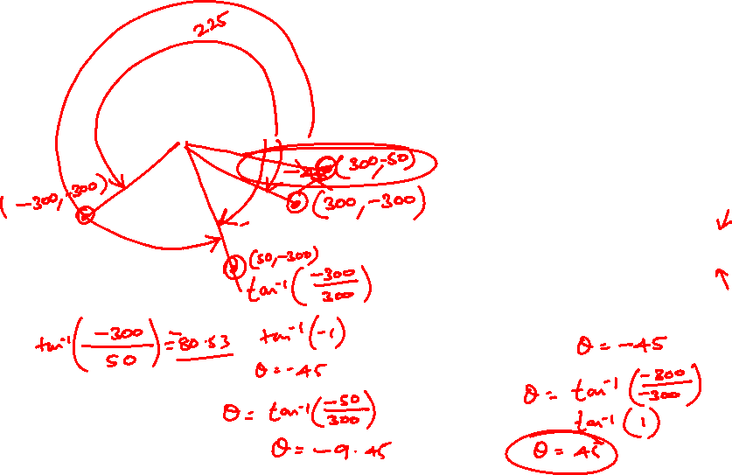
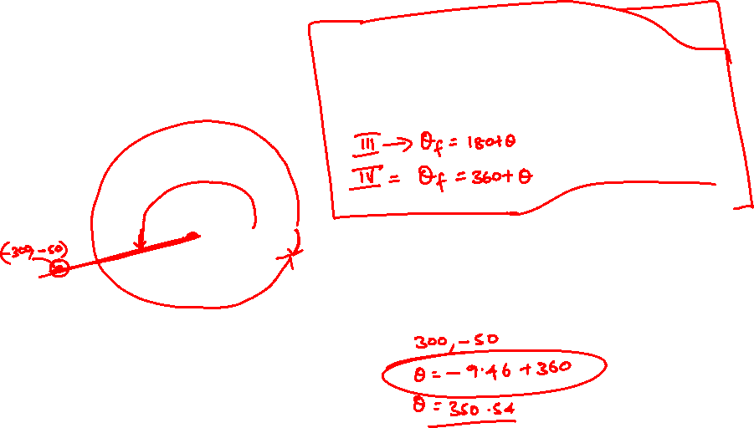

Slide 8
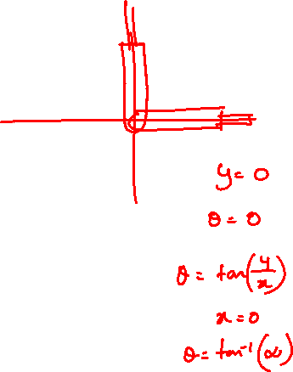
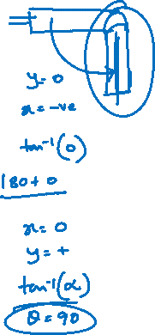

Slide 10
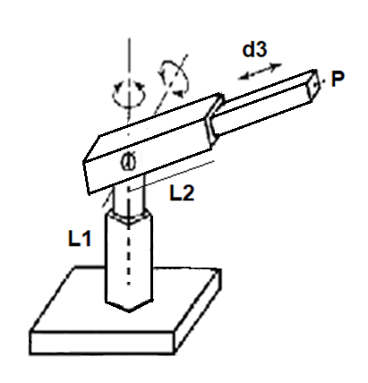
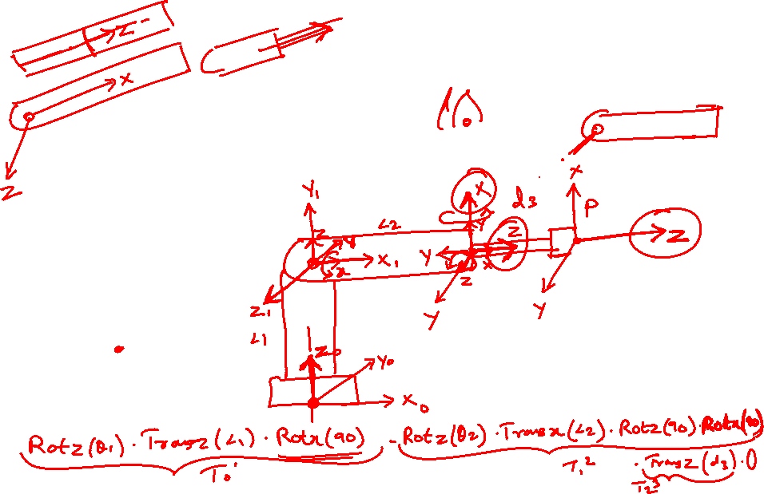
Inverse Kinematics of a 3 dof Polar Arm
Find the joint angles and extension d3 for the tool point P(650,150,350)
L1 = 250 mm
L2= 500 mm

Slide 11
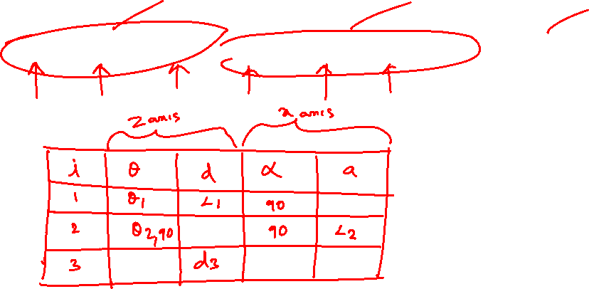
Inverse Kinematics of a 3 dof Polar Arm
P = [Rotz(θ1).Transz(L1).Rotx(90)]*[Rotz(θ2).Transx(L2)*Rotz(90).Rotx(90)]*[Transz(d3)]*Origin

Slide 12
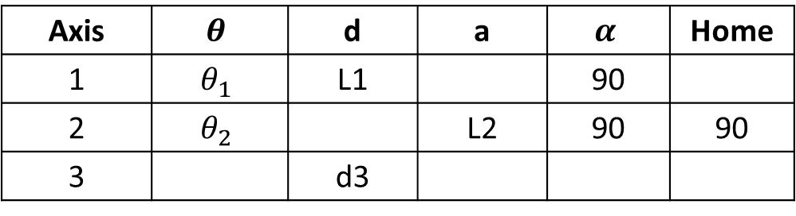

Inverse Kinematics of a 3 dof Polar Arm
D-H Parameters
Axis | $$θ$$ | d | a | $$α$$ | Home
1 | $$θ_{1}$$ | L1 |  | 90
2 | $$θ_{2}$$ |  | L2 | 90 | 90
3 |  | d3

Slide 13
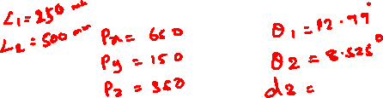
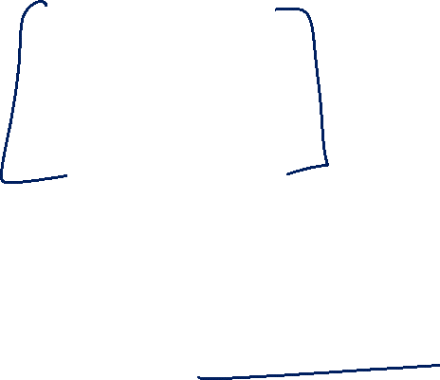
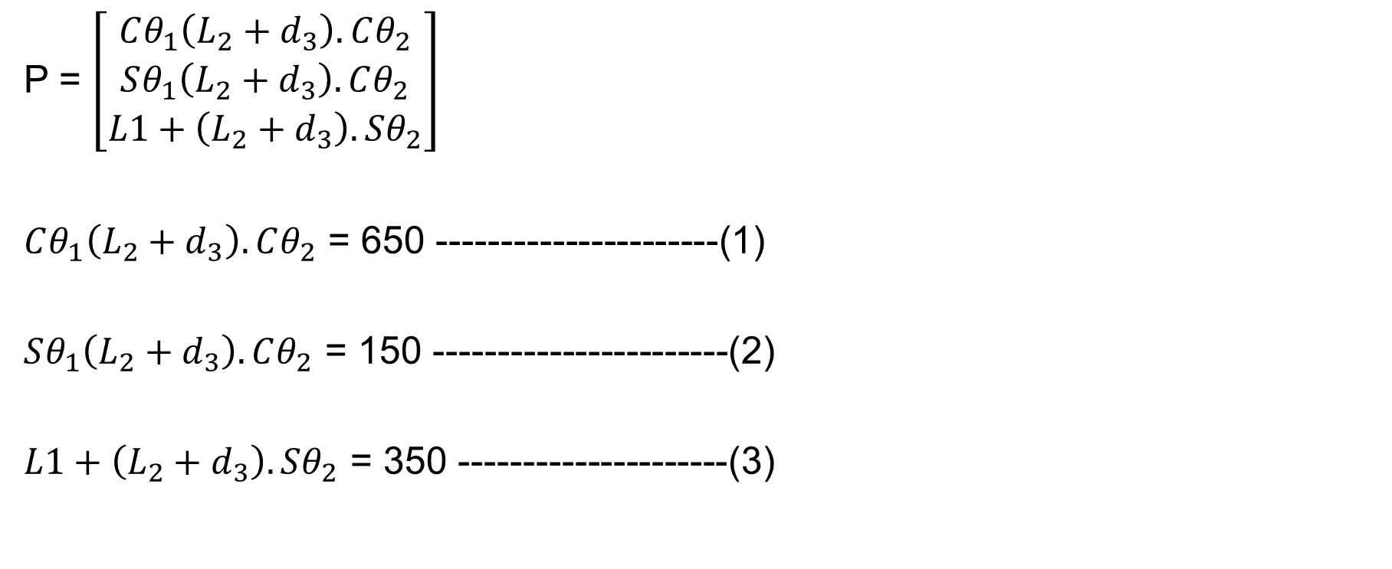
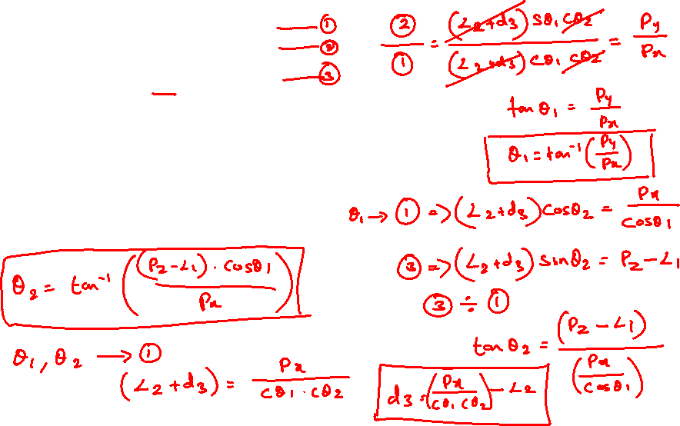

Equations
P = $\left[\begin{matrix}Cθ_{1}\left(L_{2}+d_{3}\right).Cθ_{2} \\ Sθ_{1}\left(L_{2}+d_{3}\right).Cθ_{2} \\ L1+\left(L_{2}+d_{3}\right).Sθ_{2}\end{matrix}\right]$
$Cθ_{1}\left(L_{2}+d_{3}\right).Cθ_{2}$ = 650 ----------------------(1)
$Sθ_{1}\left(L_{2}+d_{3}\right).Cθ_{2}$ = 150 -----------------------(2)
$L1+\left(L_{2}+d_{3}\right).Sθ_{2}$ = 350 ---------------------(3)

Slide 14
Answers
θ1 = 12.9946 °
θ2 = 8.5255 °
d3 = 174.5368 mm

Slide 15
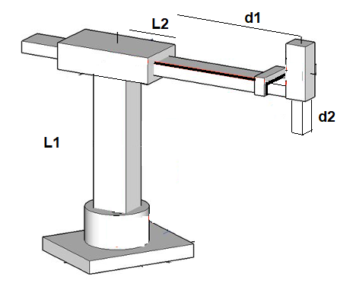
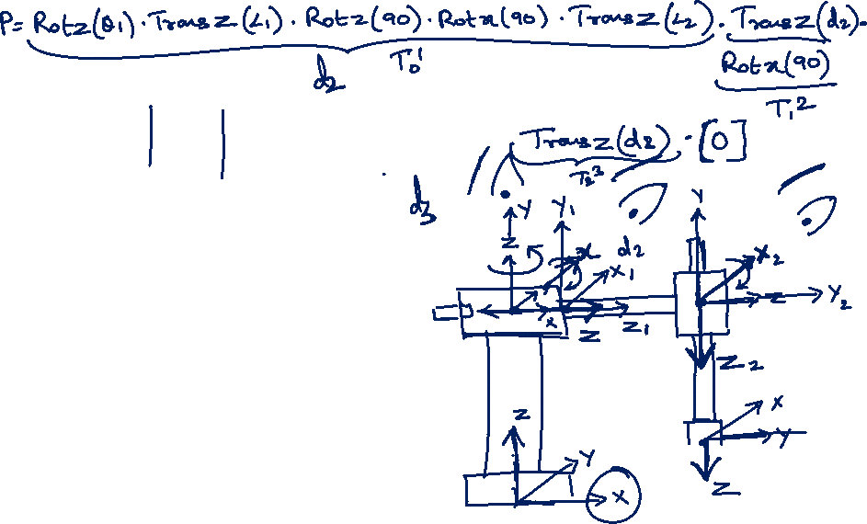
Inverse Kinematics of a 3 dof Cylindrical Arm
L1 = 700 mm
L2 = 600 mm
P (750,750,300)

Slide 17

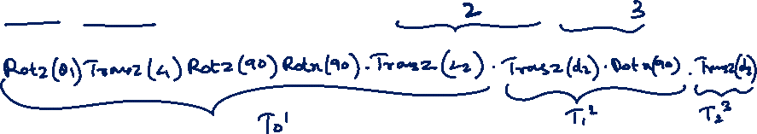
Inverse Kinematics of a 3 dof Cylindrical Arm
P = [Rotz($θ_{1}$).Transz(L1).Transx(L2).Rotz(90).Rotx(90)].[Transz(d1).Rotx(90)].[Transz(d2)]*origin.

Slide 18
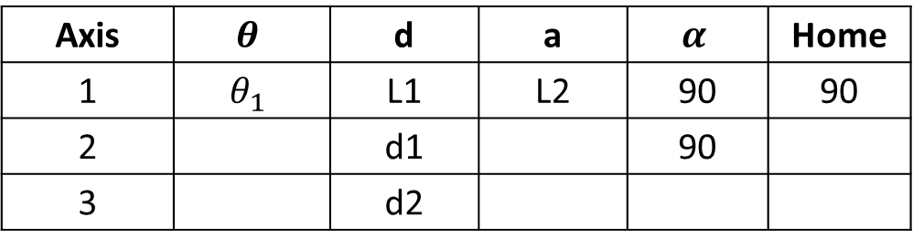

Inverse Kinematics of a 3 dof Cylindrical Arm
Axis | $$θ$$ | d | a | $$α$$ | Home
1 | $$θ_{1}$$ | L1 | L2 | 90 | 90
2 |  | d1 |  | 90
3 |  | d2

Slide 19
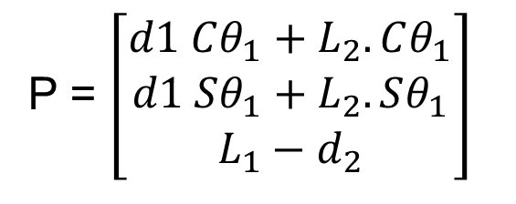
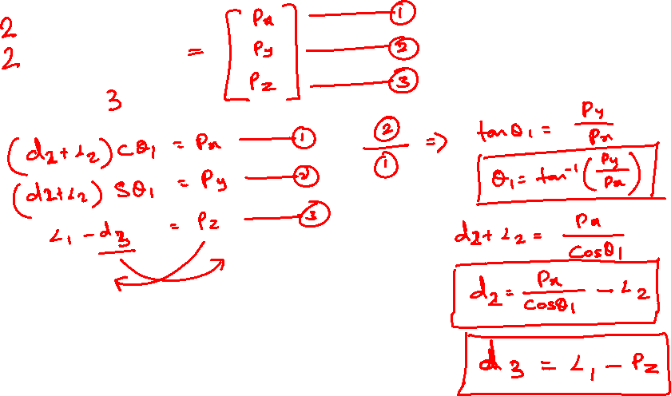
P = $\left[\begin{matrix}d1 Cθ_{1}+L_{2}.Cθ_{1} \\ d1 Sθ_{1}+L_{2}.Sθ_{1} \\ L_{1}−d_{2}\end{matrix}\right]$

Slide 20

$θ_{1}$ = 45 deg
d1= 460.66 mm
d2 = 400 mm

Slide 21
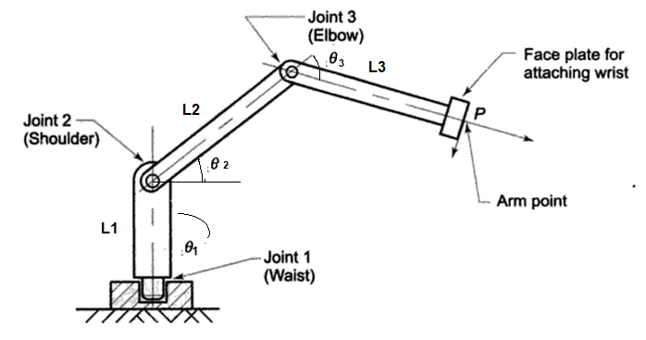
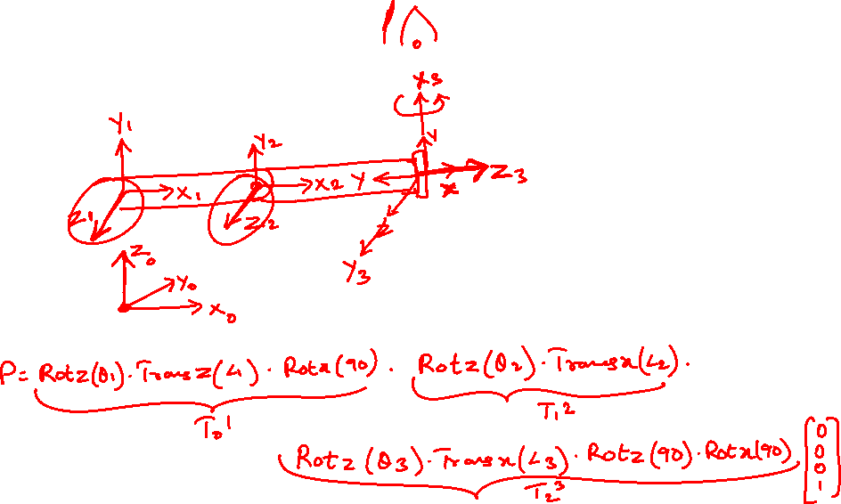
3 dof Articulated
P (650, 200, 250)
L1 = 150 mm
L2 = 400 mm
L3 = 300 mm

Slide 23
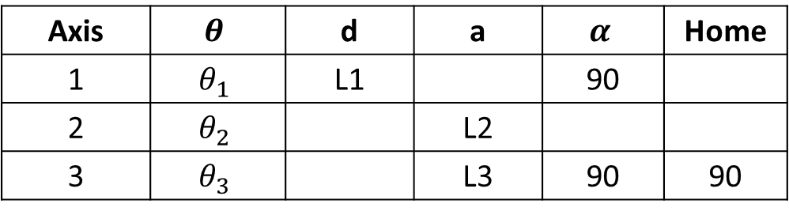
Articulated
Axis | $$θ$$ | d | a | $$α$$ | Home
1 | $$θ_{1}$$ | L1 |  | 90
2 | $$θ_{2}$$ |  | L2
3 | $$θ_{3}$$ |  | L3 | 90 | 90

Slide 24
Articulated
P = [rotz(theta1)*transz(L1)*rotx(90)]*[rotz(theta2)*transx(L2)]*[rotz(theta3)*transx(L3)*rotz(90)rotx(90)]*origin
T 0 → 1 = [rotz(theta1)*transz(L1)*rotx(90)]
T 1 → 2 = [rotz(theta2)*transx(L2)]
T 2 → 3 = [rotz(theta3)*transx(L3)*rotz(90)rotx(90)]
P = [T 0 → 1] * [T 1 → 2] * [T 2 → 3] *origin

Slide 25
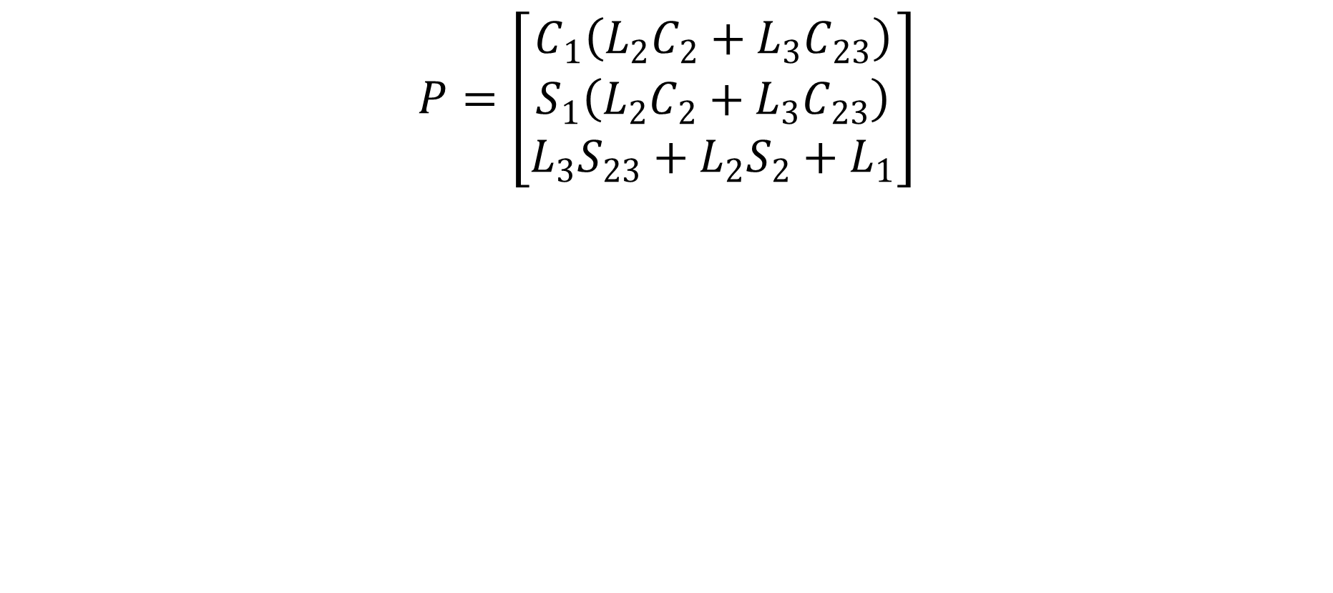
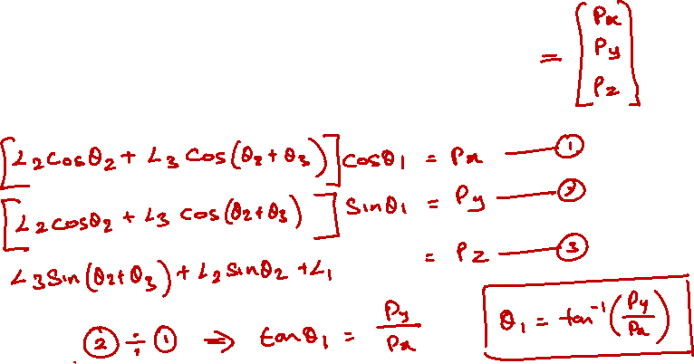
Solution - Articulated
$$P=\left[\begin{matrix}C_{1}\left(L_{2}C_{2}+L_{3}C_{23}\right) \\ S_{1}\left(L_{2}C_{2}+L_{3}C_{23}\right) \\ L_{3}S_{23}+L_{2}S_{2}+L_{1}\end{matrix}\right]$$

Slide 26
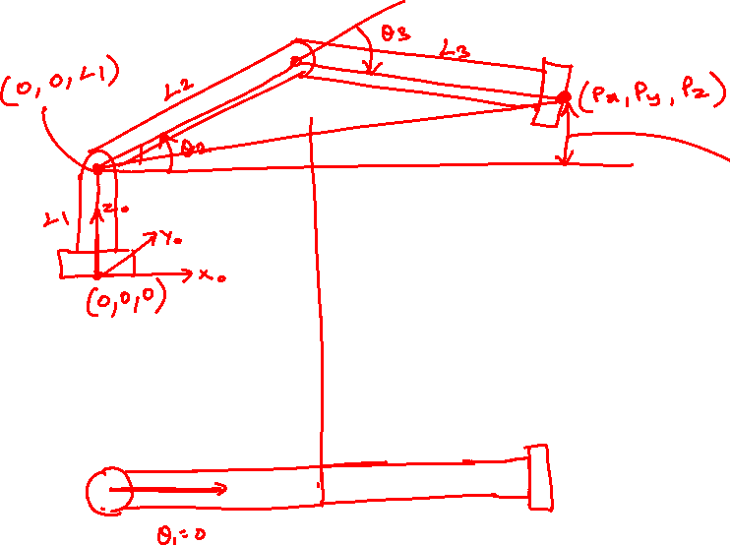
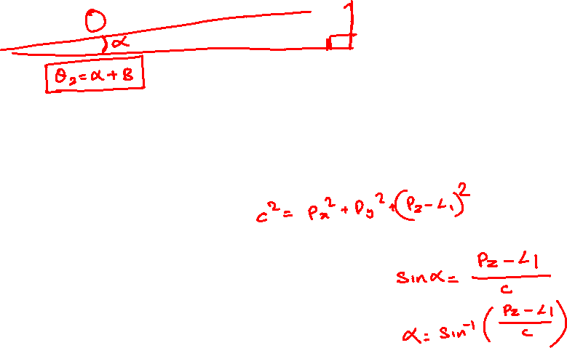
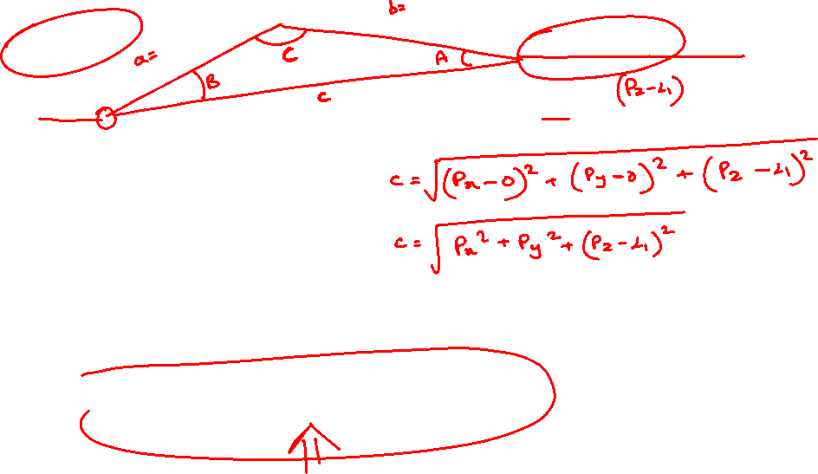

Slide 27
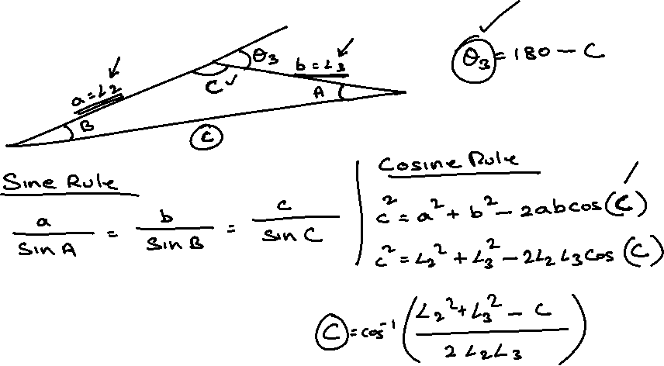
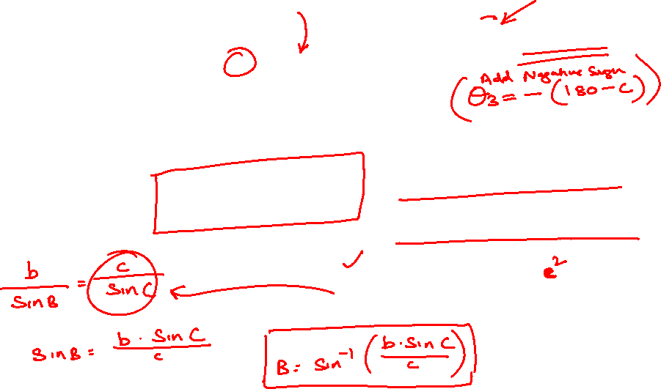

Slide 28

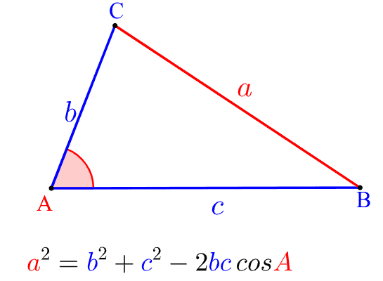


Law of cosines

Slide 29
THANK YOU
References:
Industrial Robotics Computer Interfacing and Control – Wesley E. Snyder
Fundamentals of Robotics – Robert Schilling

