Slide 1
Mechanisms and Robotics
DE ES DM ZG561
Lecture - 7
Dr. Glynn John
Mechanical Engineering

Slide 2
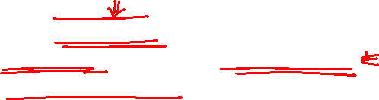
Inverse Kinematics
Inverse Kinematics
  Inverse Kinematics of a 4 dof SCARA Arm
  Inverse Kinematics of a 2 dof RR Planar Arm using Matrix inverse
  Inverse Kinematics of a 3 dof Articulated Arm using Matrix inverse

Slide 3
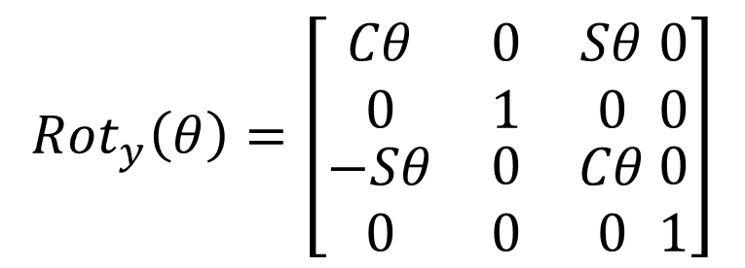
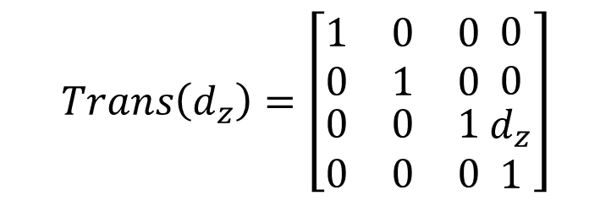
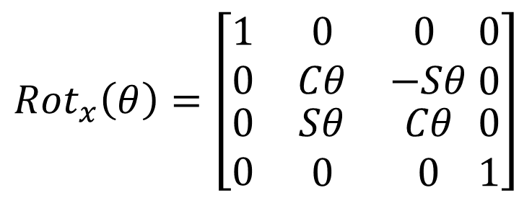
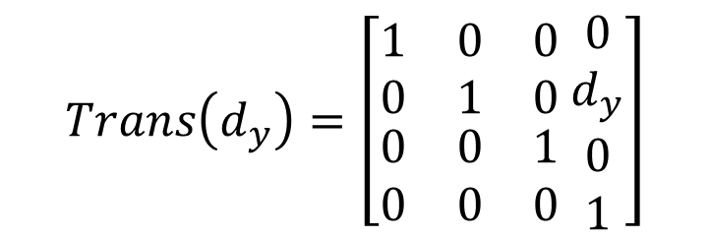
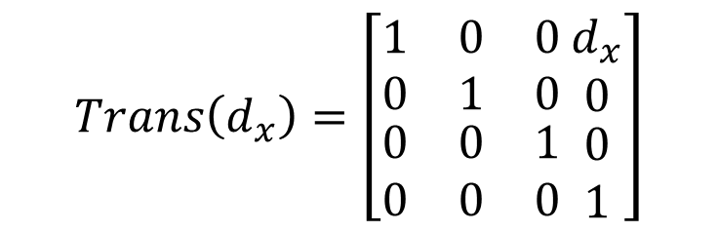
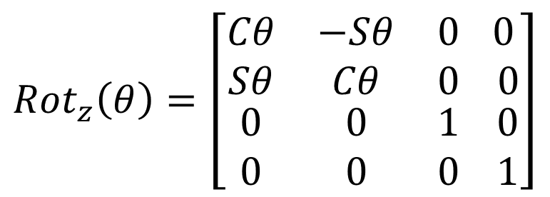
Homogeneous Transformation Matrices
$${Rot}_{x}\left(θ\right)=\left[\begin{matrix}1 & 0 & 0 \\ 0 & Cθ & −Sθ \\ \begin{matrix}0 \\ 0\end{matrix} & \begin{matrix}Sθ \\ 0\end{matrix} & \begin{matrix}Cθ \\ 0\end{matrix}\end{matrix} \begin{matrix}0 \\ 0 \\ \begin{matrix}0 \\ 1\end{matrix}\end{matrix}\right]$$
$$Trans\left(d_{x}\right)=\left[\begin{matrix}1 & 0 & 0 \\ 0 & 1 & 0 \\ \begin{matrix}0 \\ 0\end{matrix} & \begin{matrix}0 \\ 0\end{matrix} & \begin{matrix}1 \\ 0\end{matrix}\end{matrix} \begin{matrix}d_{x} \\ 0 \\ \begin{matrix}0 \\ 1\end{matrix}\end{matrix}\right]$$
$${Rot}_{y}\left(θ\right)=\left[\begin{matrix}Cθ & 0 & Sθ \\ 0 & 1 & 0 \\ \begin{matrix}−Sθ \\ 0\end{matrix} & \begin{matrix}0 \\ 0\end{matrix} & \begin{matrix}Cθ \\ 0\end{matrix}\end{matrix} \begin{matrix}0 \\ 0 \\ \begin{matrix}0 \\ 1\end{matrix}\end{matrix}\right]$$
$$Trans\left(d_{y}\right)=\left[\begin{matrix}1 & 0 & 0 \\ 0 & 1 & 0 \\ \begin{matrix}0 \\ 0\end{matrix} & \begin{matrix}0 \\ 0\end{matrix} & \begin{matrix}1 \\ 0\end{matrix}\end{matrix} \begin{matrix}0 \\ d_{y} \\ \begin{matrix}0 \\ 1\end{matrix}\end{matrix}\right]$$
$${Rot}_{z}\left(θ\right)=\left[\begin{matrix}Cθ & −Sθ & 0 \\ Sθ & Cθ & 0 \\ \begin{matrix}0 \\ 0\end{matrix} & \begin{matrix}0 \\ 0\end{matrix} & \begin{matrix}1 \\ 0\end{matrix}\end{matrix} \begin{matrix} 0 \\ 0 \\ \begin{matrix}0 \\ 1\end{matrix}\end{matrix}\right]$$
$$Trans\left(d_{z}\right)=\left[\begin{matrix}1 & 0 & 0 \\ 0 & 1 & 0 \\ \begin{matrix}0 \\ 0\end{matrix} & \begin{matrix}0 \\ 0\end{matrix} & \begin{matrix}1 \\ 0\end{matrix}\end{matrix} \begin{matrix}0 \\ 0 \\ \begin{matrix}d_{z} \\ 1\end{matrix}\end{matrix}\right]$$

Slide 4
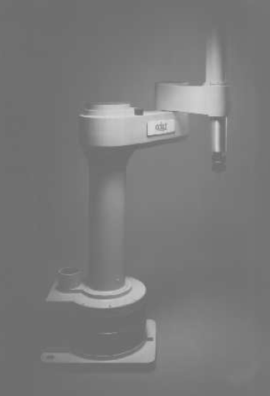
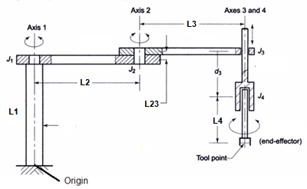

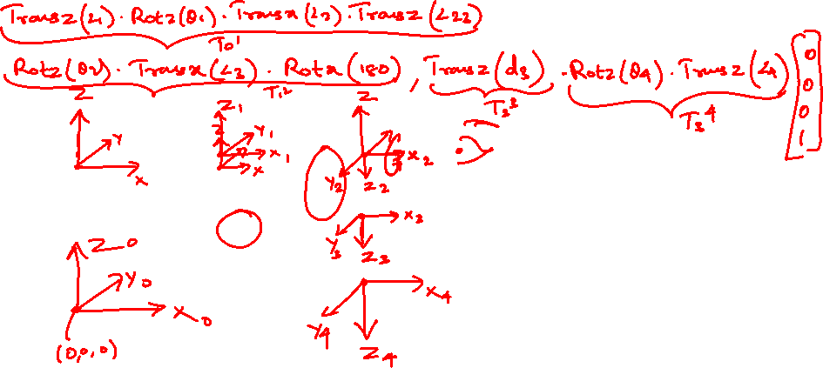
4 dof SCARA
Find the joint angles and the extension of the 4 dof SCARA Robot for the target point (650,250,200)
L1= 500mm L2 = 450, L23 = 50, L3 = 350, L4 = 200.

Slide 5
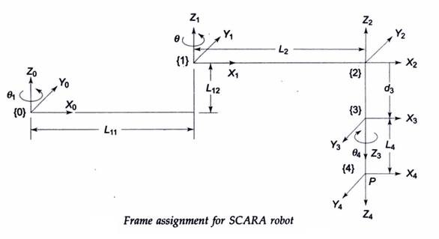
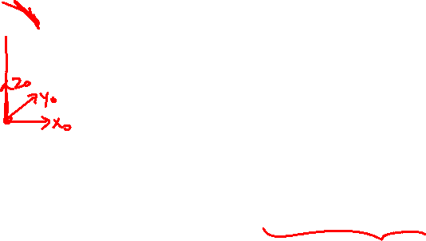
4 dof SCARA
P = Transz(L1)*rotz(theta1)*transx(L2)*transz(L23)*rotz(theta2)*transx(L3)*rotx(180)*transz(d3)*rotz(theta4)*transz(L4)*origin

Slide 6

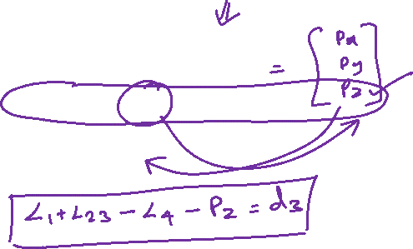
4 dof SCARA
P = $\left[\begin{matrix}L_{2}.cosθ_{1}+ L_{3}.cos{(θ}_{1}+θ_{2}) \\ L_{2}. sinθ_{1}+ L_{3}. sin{(θ}_{1}+θ_{2}) \\ L_{1} + L_{23}− d_{3}− L_{4}\end{matrix}\right]$

Slide 7
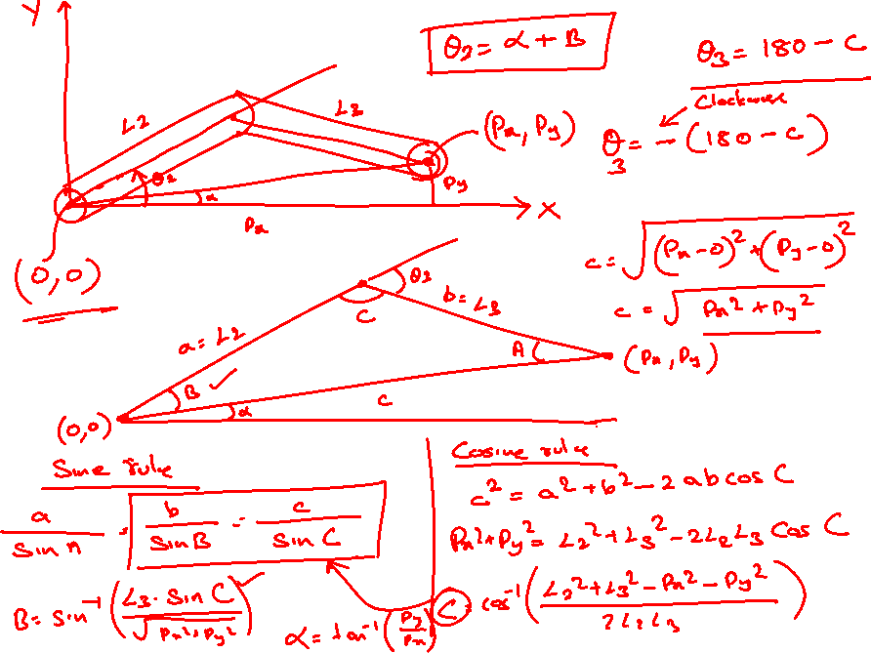


Slide 10
4 dof SCARA
d3 = 150 mm
Theta1 = 46.69 deg (21.0375+25.6525)
Theta2 = -59.4735 deg

Slide 12

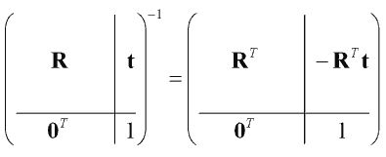


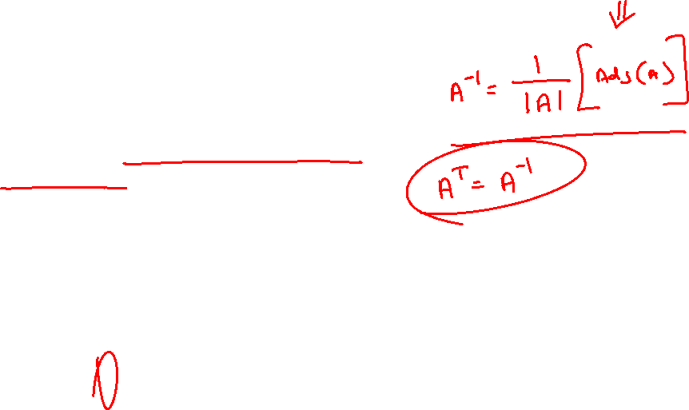
Inverse of a Homogeneous Transformation Matrix
Orthogonal Matrix
A square matrix with real numbers or elements is said to be an orthogonal matrix if its transpose is equal to its inverse matrix.
Inverse of a Homogeneous Transformation Matrix

Slide 13
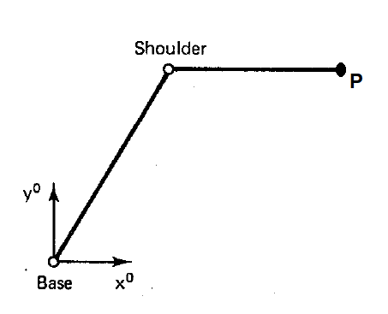

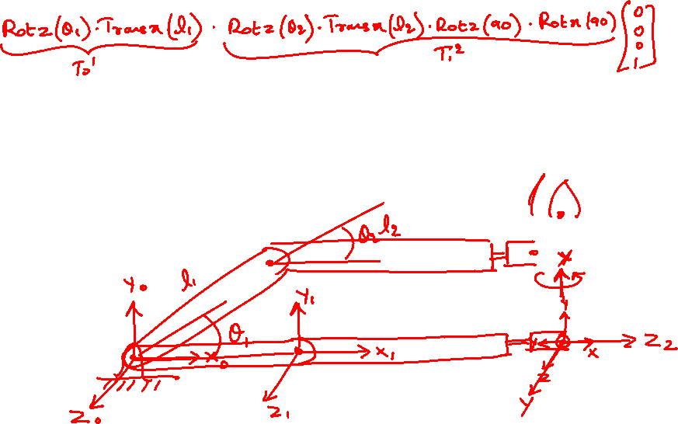


2 dof Planar Arm – Inverse Kinematics using matrix inverse
$${P=T}_{0}^{1}. T_{1}^{2}.O$$
$${T_{0}^{2}=T}_{0}^{1}. T_{1}^{2}$$

Slide 14
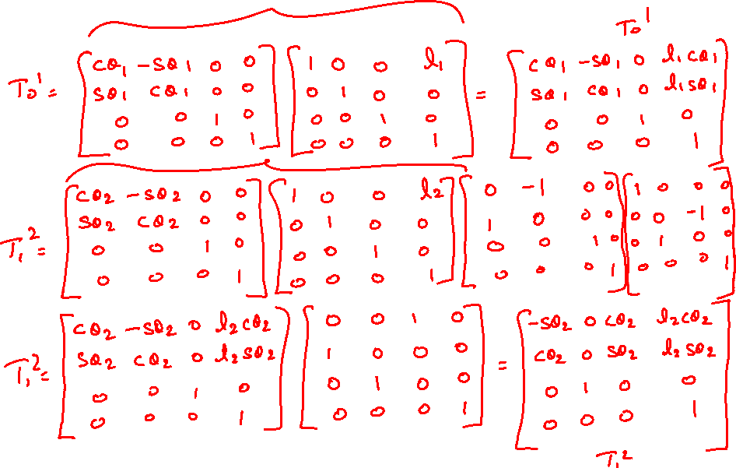

Slide 15
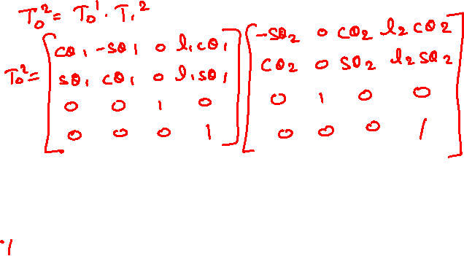
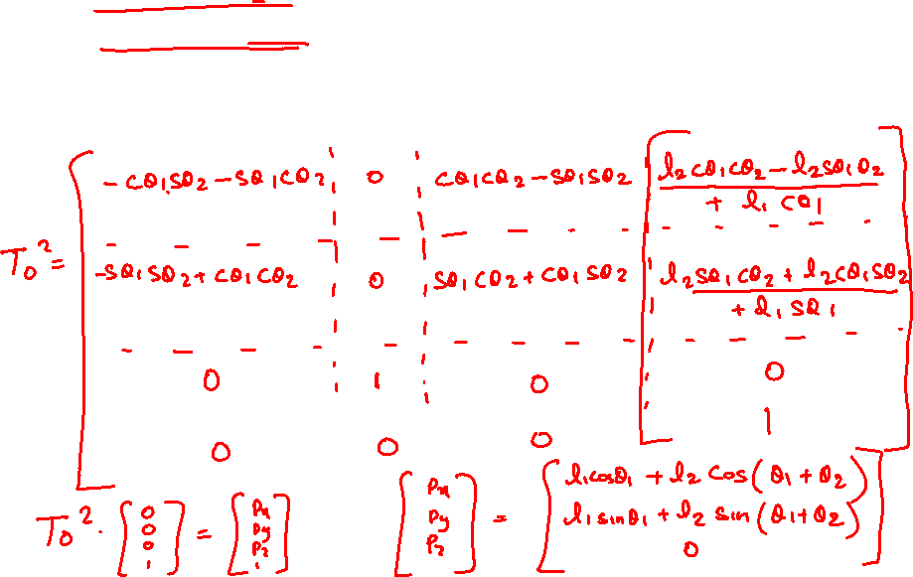

Slide 16
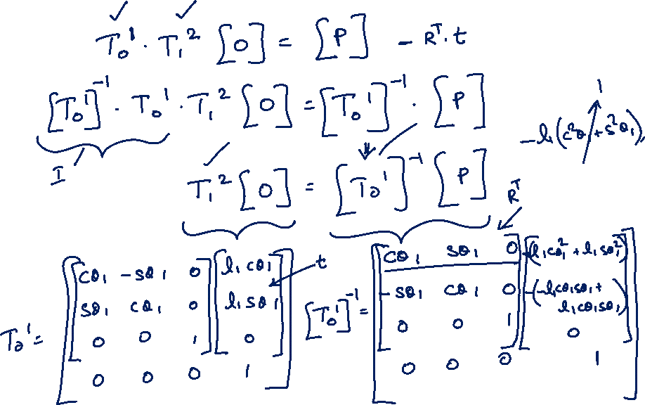

Slide 17
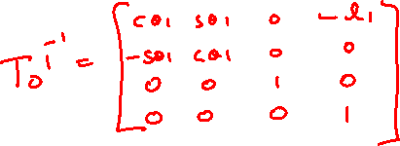
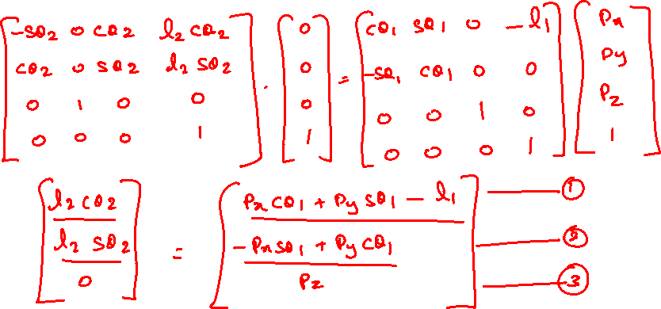

Slide 18
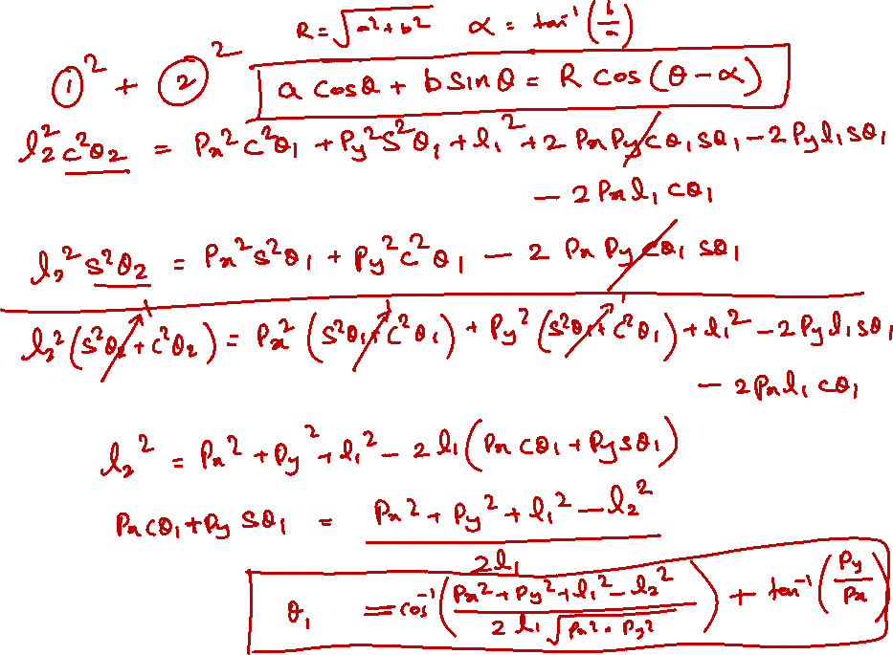

Slide 19
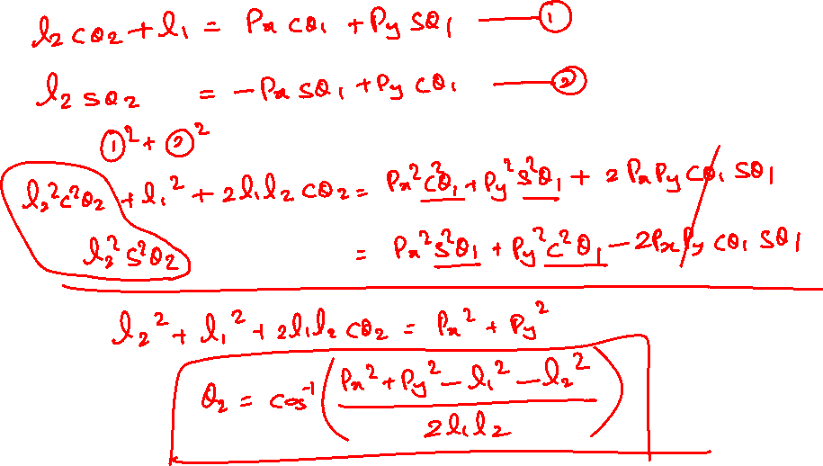

Slide 21


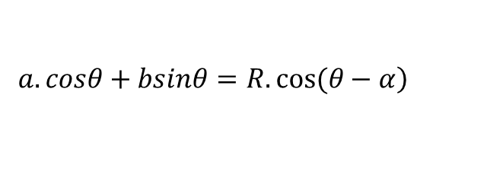
$$\left.a.cosθ+bsinθ=R.cos⁡(θ−α\right)$$
$$R=\sqrt{a^{2}+b^{2}}$$
$$α=\tan^{−1}\left(\frac{b}{a}\right)$$

Slide 23


Slide 28

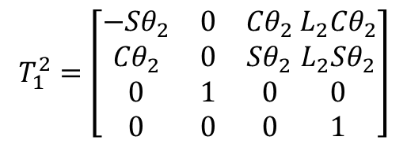
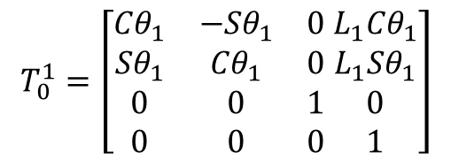

2 dof Planar Arm
$${P=T}_{0}^{1}. T_{1}^{2}.O$$
$${T_{0}^{1}}^{−1}.P= T_{1}^{2}.O$$
$$T_{0}^{1}=\left[\begin{matrix}{Cθ}_{1} & {−Sθ}_{1} & 0 \\ {Sθ}_{1} & {Cθ}_{1} & 0 \\ \begin{matrix}0 \\ 0\end{matrix} & \begin{matrix}0 \\ 0\end{matrix} & \begin{matrix}1 \\ 0\end{matrix}\end{matrix} \begin{matrix}{L_{1}Cθ}_{1} \\ {L_{1}Sθ}_{1} \\ \begin{matrix}0 \\ 1\end{matrix}\end{matrix}\right]$$
$$T_{1}^{2}=\left[\begin{matrix}{−Sθ}_{2} & 0 & {Cθ}_{2} \\ {Cθ}_{2} & 0 & {Sθ}_{2} \\ \begin{matrix}0 \\ 0\end{matrix} & \begin{matrix}1 \\ 0\end{matrix} & \begin{matrix}0 \\ 0\end{matrix}\end{matrix} \begin{matrix}{L_{2}Cθ}_{2} \\ {L_{2}Sθ}_{2} \\ \begin{matrix}0 \\ 1\end{matrix}\end{matrix}\right]$$

Slide 29
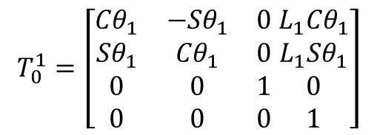
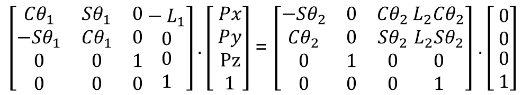

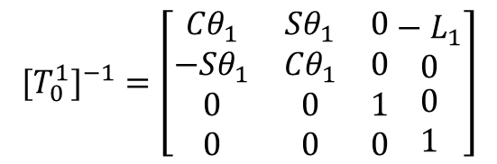


2 dof Planar Arm
$${P=T}_{0}^{1}. T_{1}^{2}.O$$
$$T_{0}^{1}=\left[\begin{matrix}{Cθ}_{1} & {−Sθ}_{1} & 0 \\ {Sθ}_{1} & {Cθ}_{1} & 0 \\ \begin{matrix}0 \\ 0\end{matrix} & \begin{matrix}0 \\ 0\end{matrix} & \begin{matrix}1 \\ 0\end{matrix}\end{matrix} \begin{matrix}{L_{1}Cθ}_{1} \\ {L_{1}Sθ}_{1} \\ \begin{matrix}0 \\ 1\end{matrix}\end{matrix}\right]$$
$${T_{0}^{1}}^{−1}.P= T_{1}^{2}.O$$
$${{[T}_{0}^{1}]}^{−1}=\left[\begin{matrix}{Cθ}_{1} & {Sθ}_{1} & 0 \\ {−Sθ}_{1} & {Cθ}_{1} & 0 \\ \begin{matrix}0 \\ 0\end{matrix} & \begin{matrix}0 \\ 0\end{matrix} & \begin{matrix}1 \\ 0\end{matrix}\end{matrix} \begin{matrix}− L_{1} \\ 0 \\ \begin{matrix}0 \\ 1\end{matrix}\end{matrix}\right]$$
$\left[\begin{matrix}{Cθ}_{1} & {Sθ}_{1} & 0 \\ {−Sθ}_{1} & {Cθ}_{1} & 0 \\ \begin{matrix}0 \\ 0\end{matrix} & \begin{matrix}0 \\ 0\end{matrix} & \begin{matrix}1 \\ 0\end{matrix}\end{matrix} \begin{matrix}− L_{1} \\ 0 \\ \begin{matrix}0 \\ 1\end{matrix}\end{matrix}\right].\left[ \begin{matrix}Px \\ Py \\ \begin{matrix}Pz \\ 1\end{matrix}\end{matrix}\right]$ = $\left[\begin{matrix}{−Sθ}_{2} & 0 & {Cθ}_{2} \\ {Cθ}_{2} & 0 & {Sθ}_{2} \\ \begin{matrix}0 \\ 0\end{matrix} & \begin{matrix}1 \\ 0\end{matrix} & \begin{matrix}0 \\ 0\end{matrix}\end{matrix} \begin{matrix}{L_{2}Cθ}_{2} \\ {L_{2}Sθ}_{2} \\ \begin{matrix}0 \\ 1\end{matrix}\end{matrix}\right]$ $.\left[ \begin{matrix}0 \\ 0 \\ \begin{matrix}0 \\ 1\end{matrix}\end{matrix}\right]$

Slide 30

$$T_{0}^{1}=\left[\begin{matrix}{Cθ}_{1} & {−Sθ}_{1} & 0 \\ {Sθ}_{1} & {Cθ}_{1} & 0 \\ \begin{matrix}0 \\ 0\end{matrix} & \begin{matrix}0 \\ 0\end{matrix} & \begin{matrix}1 \\ 0\end{matrix}\end{matrix} \begin{matrix}{L_{1}Cθ}_{1} \\ {L_{1}Sθ}_{1} \\ \begin{matrix}0 \\ 1\end{matrix}\end{matrix}\right]$$

Slide 31




2 dof Planar Arm
${L_{1}Cosθ}_{1}$+ ${L_{2}Cos(θ_{1}+θ}_{2})$ = $Px$
Coupled Equations
${L_{1}Sinθ}_{1}$+ ${L_{2}Sin(θ_{1}+θ}_{2})$ = $Py$
${PxCθ}_{1}$+ $Py{Sθ}_{1}−L_{1}$ = ${L_{2}Cθ}_{2}$
Decoupled Equations
${−PxSθ}_{1}$+ ${PyCθ}_{1}$= ${L_{2}Sθ}_{2}$

Slide 33
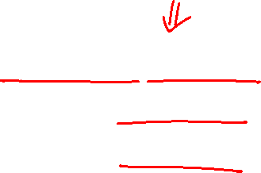

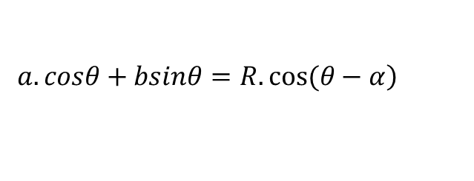


2 dof Planar Arm
${PxCθ}_{1}$+ $Py{Sθ}_{1}−L_{1}$ = ${L_{2}Cθ}_{2}$ ----------------------(1)
${−PxSθ}_{1}$+ ${PyCθ}_{1}$= ${L_{2}Sθ}_{2}$ ----------------------(2)
$$\left.a.cosθ+bsinθ=R.cos⁡(θ−α\right)$$
$$R=\sqrt{a^{2}+b^{2}}$$
$$α=\tan^{−1}\left(\frac{b}{a}\right)$$

Slide 34
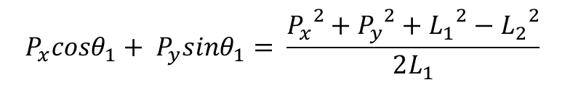

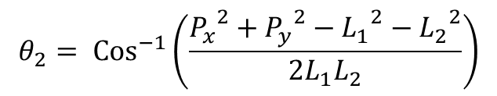

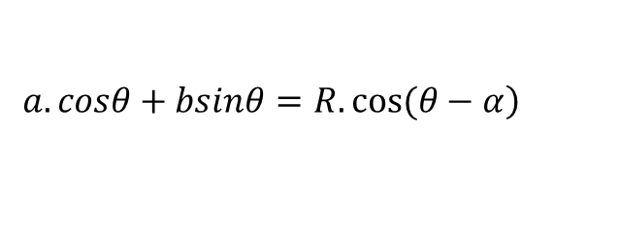

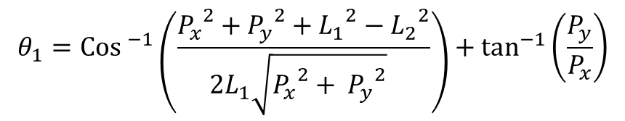

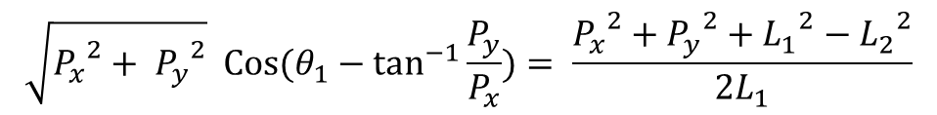
2 dof Planar Arm
$$\left.a.cosθ+bsinθ=R.cos⁡(θ−α\right)$$
${PxCθ}_{1}$+ $Py{Sθ}_{1}−L_{1}$ = ${L_{2}Cθ}_{2}$ ----------------------(1)
$$R=\sqrt{a^{2}+b^{2}}$$
${−PxSθ}_{1}$+ ${PyCθ}_{1}$= ${L_{2}Sθ}_{2}$ ----------------------(2)
$$α=\tan^{−1}\left(\frac{b}{a}\right)$$
solving
$$P_{x}cosθ_{1}+ P_{y}sinθ_{1}= \frac{{P_{x}}^{2}+{P_{y}}^{2}+{L_{1}}^{2}−{L_{2}}^{2}}{2L_{1}}$$
$$\sqrt{{P_{x}}^{2}+ {P_{y}}^{2}} Cos(θ_{1}−\tan^{−1}\frac{P_{y}}{P_{x}})= \frac{{P_{x}}^{2}+{P_{y}}^{2}+{L_{1}}^{2}−{L_{2}}^{2}}{2L_{1}}$$
$$θ_{1}={Cos }^{−1}\left(\frac{{P_{x}}^{2}+{P_{y}}^{2}+{L_{1}}^{2}−{L_{2}}^{2}}{2L_{1}\sqrt{{P_{x}}^{2}+ {P_{y}}^{2}} }\right)+\tan^{−1}\left(\frac{P_{y}}{P_{x}}\right)$$
$$θ_{2}= {Cos}^{−1}\left(\frac{{P_{x}}^{2}+{P_{y}}^{2}−{L_{1}}^{2}−{L_{2}}^{2}}{2L_{1}L_{2}}\right)$$

Slide 35
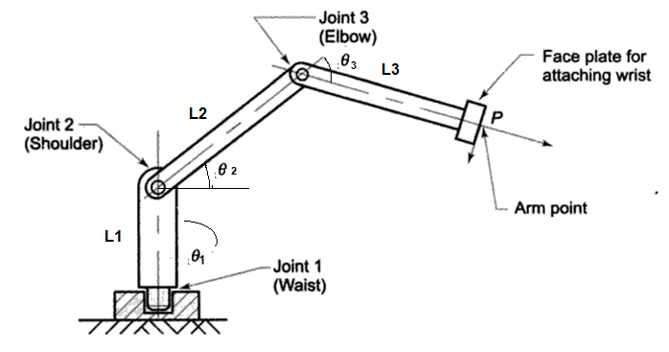
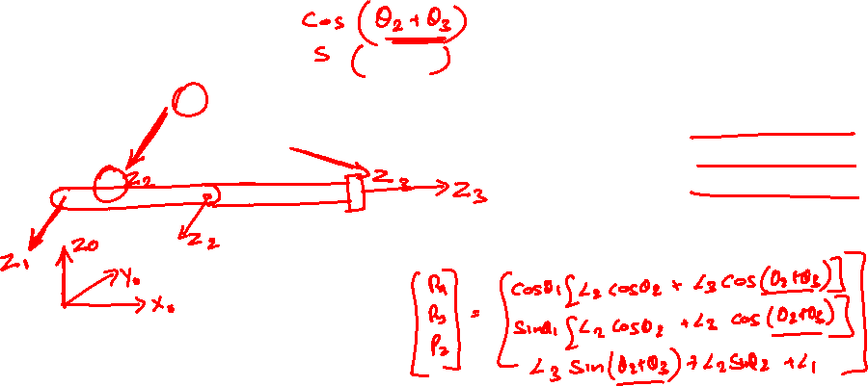

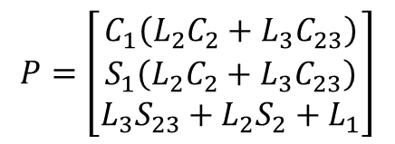
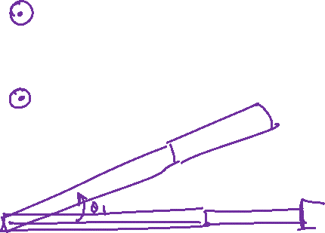
Inverse Kinematics of a 3 dof arm using matrix inverse
Find the angles for the given tool point
$$P=\left[\begin{matrix}C_{1}\left(L_{2}C_{2}+L_{3}C_{23}\right) \\ S_{1}\left(L_{2}C_{2}+L_{3}C_{23}\right) \\ L_{3}S_{23}+L_{2}S_{2}+L_{1}\end{matrix}\right]$$
P (650, 200, 250)
L1 = 150 mm
L2 = 400 mm
L3 = 300 mm

Slide 36
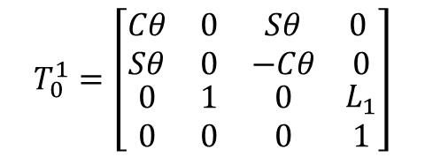


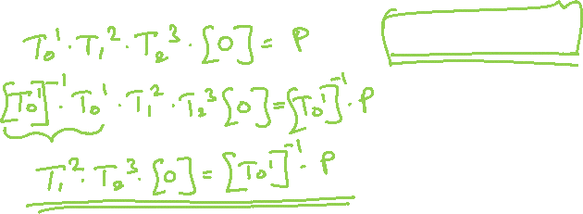







Inverse Kinematics of a 3 dof arm using matrix inverse
Solution from Forward Kinematics
$${P=T}_{0}^{1}. T_{1}^{2}.T_{2}^{3}.O$$
$${T_{0}^{1}}^{−1}P= T_{1}^{2}.T_{2}^{3}.O$$
$\left[\begin{matrix}C_{1}\left(L_{2}C_{2}+L_{3}C_{23}\right) \\ S_{1}\left(L_{2}C_{2}+L_{3}C_{23}\right) \\ L_{3}S_{23}+L_{2}S_{2}+L_{1}\end{matrix}\right]$ $=\left[\begin{matrix}P_{x} \\ P_{y} \\ P_{z}\end{matrix}\right]$
$${{{{ T}_{1}^{2}}^{−1} T}_{0}^{1}}^{−1}P=T_{2}^{3}.O$$
$$T_{0}^{1}=\left[\begin{matrix}Cθ & 0 & Sθ \\ Sθ & 0 & −Cθ \\ \begin{matrix}0 \\ 0\end{matrix} & \begin{matrix}1 \\ 0\end{matrix} & \begin{matrix}0 \\ 0\end{matrix}\end{matrix} \begin{matrix} 0 \\ 0 \\ \begin{matrix}L_{1} \\ 1\end{matrix}\end{matrix}\right]$$
$$T_{0}^{1}=\left[\begin{matrix}0.9557 & 0 & 0.2940 \\ 0.2940 & 0 & −0.9557 \\ \begin{matrix}0 \\ 0\end{matrix} & \begin{matrix}1 \\ 0\end{matrix} & \begin{matrix}0 \\ 0\end{matrix}\end{matrix} \begin{matrix} 0 \\ 0 \\ \begin{matrix}150 \\ 1\end{matrix}\end{matrix}\right]$$
$$θ_{1}=\tan^{−1}\left(\frac{P_{y}}{P_{x}}\right)$$
$$θ_{1}=17.1027°$$
$${T_{0}^{1}}^{−1}=\left[\begin{matrix}0.9559 & 0.2941 & 0 \\ 0 & 0 & 1 \\ \begin{matrix}0.2941 \\ 0\end{matrix} & \begin{matrix}−0.9559 \\ 0\end{matrix} & \begin{matrix}0 \\ 0\end{matrix}\end{matrix} \begin{matrix} 0 \\ −150 \\ \begin{matrix}0 \\ 1\end{matrix}\end{matrix}\right]$$

Slide 37










Inverse Kinematics of a 3 dof arm using matrix inverse
Solution from Forward Kinematics
$${P=T}_{0}^{1}. T_{1}^{2}.T_{2}^{3}.O$$
$${T_{0}^{1}}^{−1}P= T_{1}^{2}.T_{2}^{3}.O$$
$\left[\begin{matrix}C_{1}\left(L_{2}C_{2}+L_{3}C_{23}\right) \\ S_{1}\left(L_{2}C_{2}+L_{3}C_{23}\right) \\ L_{3}S_{23}+L_{2}S_{2}+L_{1}\end{matrix}\right]$ $=\left[\begin{matrix}P_{x} \\ P_{y} \\ P_{z}\end{matrix}\right]$
$${{{{ T}_{1}^{2}}^{−1} T}_{0}^{1}}^{−1}P=T_{2}^{3}.O$$
$${T_{0}^{1}}^{−1}\left[\begin{matrix}P_{x} \\ P_{y} \\ P_{z}\end{matrix}\right]=\left[\begin{matrix}0.9559 & 0.2941 & 0 \\ 0 & 0 & 1 \\ \begin{matrix}0.2941 \\ 0\end{matrix} & \begin{matrix}−0.9559 \\ 0\end{matrix} & \begin{matrix}0 \\ 0\end{matrix}\end{matrix} \begin{matrix} 0 \\ −150 \\ \begin{matrix}0 \\ 1\end{matrix}\end{matrix}\right]\left[\begin{matrix}650 \\ 200 \\ \begin{aligned}250 \\ 1\end{aligned}\end{matrix}\right]$$
$$θ_{1}=\tan^{−1}\left(\frac{P_{y}}{P_{x}}\right)$$
$$θ_{1}=17.1027°$$
$$\left[\begin{matrix}680.1421 \\ 100 \\ \begin{aligned}−0.0400 \\ 1\end{aligned}\end{matrix}\right]= T_{1}^{2}.T_{2}^{3}.\left[\begin{matrix}0 \\ 0 \\ \begin{aligned}0 \\ 1\end{aligned}\end{matrix}\right]$$

Slide 38



$$T_{1}^{2}=\left[\begin{matrix}{Cθ}_{2} & {−Sθ}_{2} & 0 \\ {Sθ}_{2} & {Cθ}_{2} & 0 \\ \begin{matrix}0 \\ 0\end{matrix} & \begin{matrix}0 \\ 0\end{matrix} & \begin{matrix}1 \\ 0\end{matrix}\end{matrix} \begin{matrix}{L_{2}Cθ}_{2} \\ {L_{2}Sθ}_{2} \\ \begin{matrix}0 \\ 1\end{matrix}\end{matrix}\right]$$
$${{[T}_{1}^{2}]}^{−1}=\left[\begin{matrix}{Cθ}_{2} & {Sθ}_{2} & 0 \\ {−Sθ}_{2} & {Cθ}_{2} & 0 \\ \begin{matrix}0 \\ 0\end{matrix} & \begin{matrix}0 \\ 0\end{matrix} & \begin{matrix}1 \\ 0\end{matrix}\end{matrix} \begin{matrix}− L_{2} \\ 0 \\ \begin{matrix}0 \\ 1\end{matrix}\end{matrix}\right]$$

Slide 39

$T_{1}^{2}=\left[\begin{matrix}{−Sθ}_{2} & 0 & {Cθ}_{2} \\ {Cθ}_{2} & 0 & {Sθ}_{2} \\ \begin{matrix}0 \\ 0\end{matrix} & \begin{matrix}1 \\ 0\end{matrix} & \begin{matrix}0 \\ 0\end{matrix}\end{matrix} \begin{matrix}{L_{2}Cθ}_{2} \\ {L_{2}Sθ}_{2} \\ \begin{matrix}0 \\ 1\end{matrix}\end{matrix}\right]$

Slide 40



Slide 45


5 dof manipulator
P = (400,350,250)
L1 = 200mm,
L2 = 400mm,
L3 = 300mm,
L5 = 150mm,

Slide 46
5 dof manipulator
Solution:
P = rotz(theta1)*transz(L1)*rotx(90)]*[rotz(theta2)*transx(L2)]*[rotz(theta3)*transx(L3)]*[rotz(theta4)*rotz(90)*rotx(90)]*[rotz(theta5)*transz(L4)]*origin

Slide 47
5 dof manipulator
P = [rotz(theta1)*transz(L1)*rotx(90)]*[rotz(theta2)*transx(L2)]*[rotz(theta3)*transx(L3)]*[rotz(theta4)*rotz(90)*rotx(90)]*[rotz(theta5)*transz(L4)]*origin
Axis | θ | d | a | α | Home
1 | θ1 | L1 |  | 90
2 | θ2 |  | L2
3 | θ3 |  | L3
4 | θ4 |  |  | 90 | 90
5 | θ5 | L4

Slide 48

P = $\left[\begin{matrix}C_{1}\left[L_{2}C_{2}+ L_{3} C_{23}+ L_{4}(C_{4}C_{23}−S_{4}S_{23})\right] \\ S_{1}\left[L_{2}C_{2}+ L_{3} C_{23}+ L_{4}(C_{4}C_{23}−S_{4}S_{23})\right] \\ {L_{3} S_{23}+L_{2}S_{2}+L}_{1} + L_{4}{(C_{4}S}_{23}+S_{4}C_{23})\end{matrix}\right]$
P = $\left[\begin{matrix}C_{1}\left[L_{2}C_{2}+ L_{3} C_{23}+ L_{4}(C_{234})\right] \\ S_{1}\left[L_{2}C_{2}+ L_{3} C_{23}+L_{4}(C_{234})\right] \\ {L_{3} S_{23}+L_{2}S_{2}+L}_{1} + L_{4}{(S}_{234})\end{matrix}\right]$

Slide 49
THANK YOU
References:
Industrial Robotics Computer Interfacing and Control – Wesley E. Snyder
Fundamentals of Robotics – Robert Schilling

