Slide 1

WINNING CAMP
Name – Mukund Kumar Choudhary
UID – 21MCA2147
Section – MCA-11

Slide 2





Web Crawlers bot on WhatsApp Using Python

Slide 3
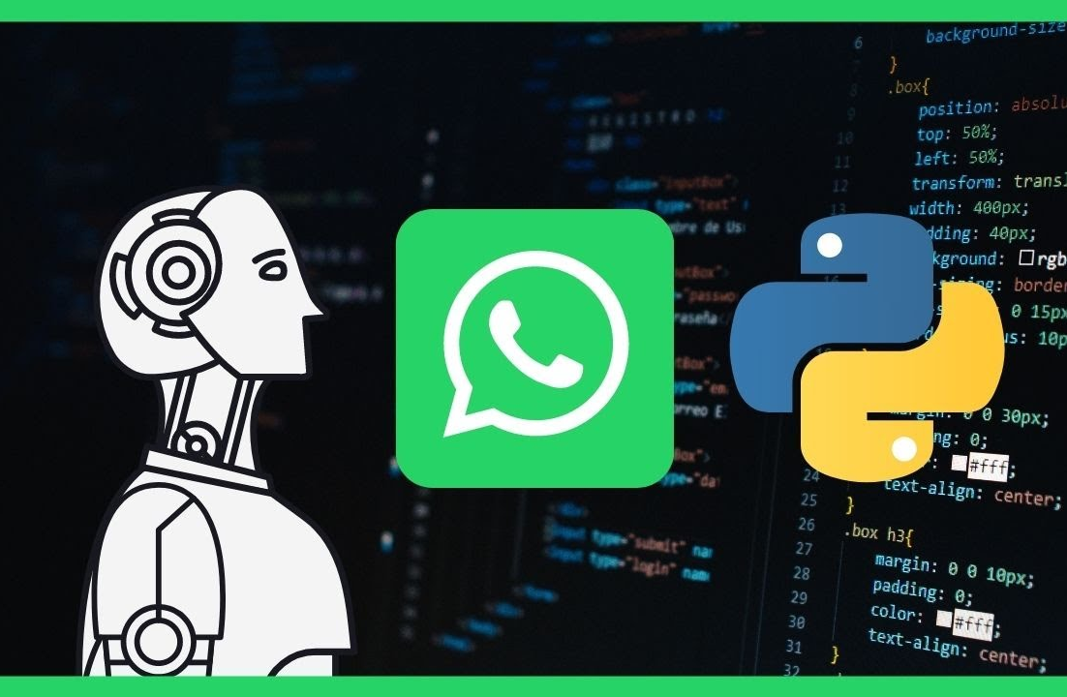
What Are Web Crawlers Bot
A web crawler, or spider, is a type of bot that is typically operated by search engines like Google and Bing. Their purpose is to index the content of websites all across the Internet so that those websites can appear in search engine results.

Slide 4

Why we use Bots
Bots are normally used to automate certain tasks, meaning they can run without specific instructions from humans.
We can automate the repetitive process by using bots.
It saves time and also requires less bandwidth.

Slide 5
Technologies Used
WhatsApp - WhatsApp is a messaging app that uses the internet to send messages, images, audio or video. The service is very similar to text messaging services.
Python – It is a high level dynamic widely used language. I used this language because of large support of the different libraries that can be use later on the project.
Flask - Flask is a small and lightweight Python web framework that provides useful tools and features that make creating web applications in Python easier.
Twilio- The Twilio Sandbox for WhatsApp is a tool created by Twilio for you to prototype and test sending and receiving WhatsApp messages.

Slide 6
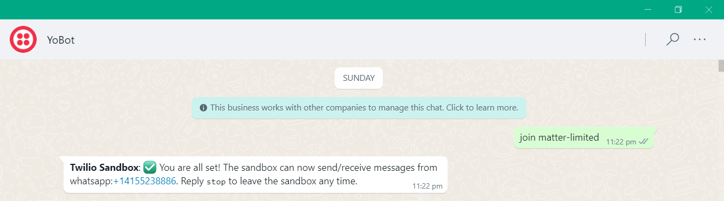
Steps to Start Web Scrawlers Bot On WhatsApp
Start a new conversation with the Bot using Twilio Sandbox Number.
Send uniqe code that you have received from twilio to Sandbox Number.
After getting confirmation , you can start using bot as a web scrawlers/search engine on WhatsApp.

Slide 7
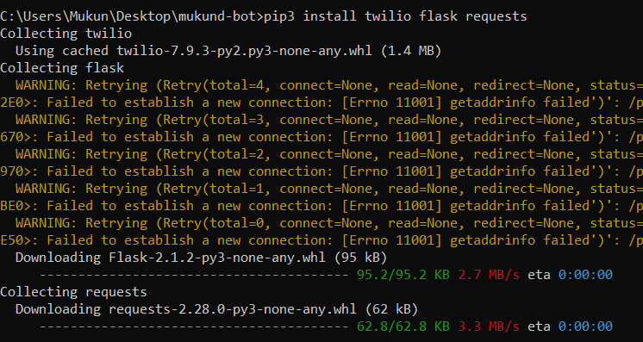
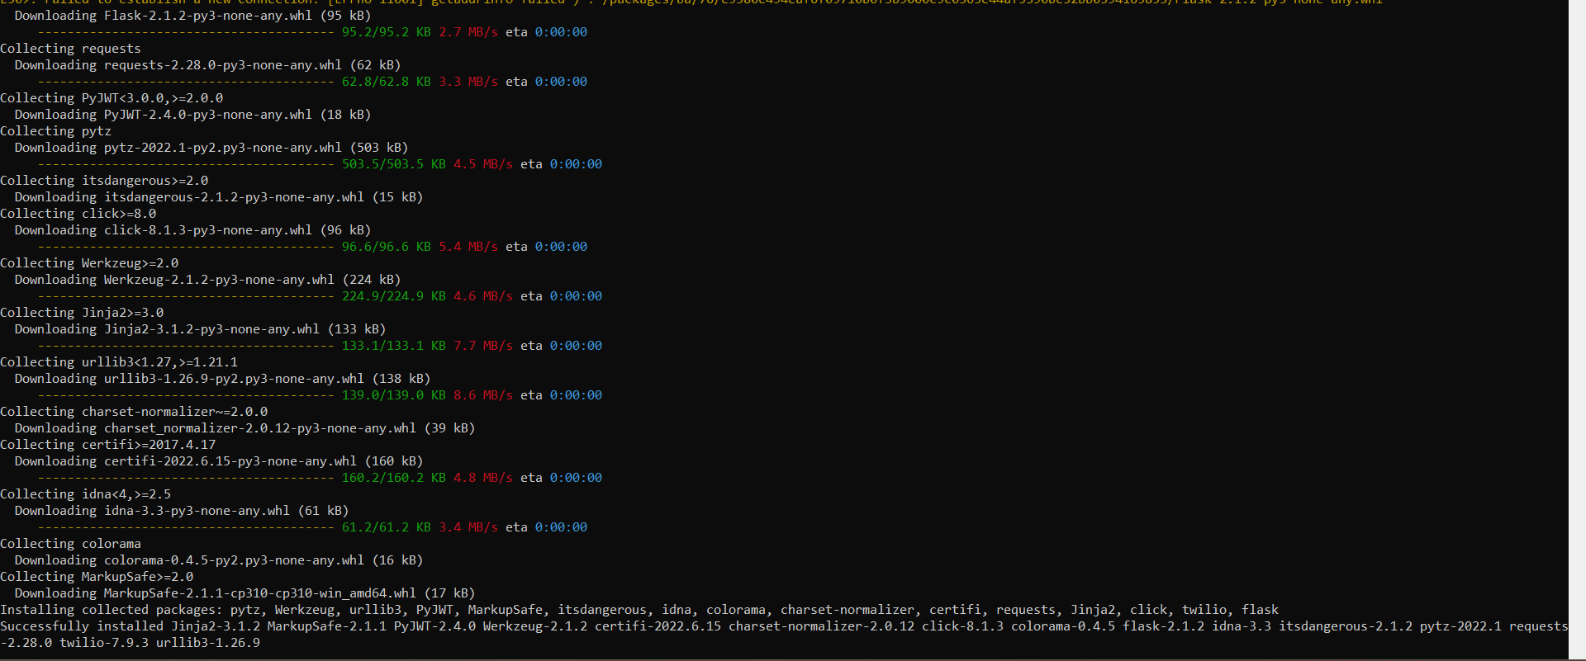
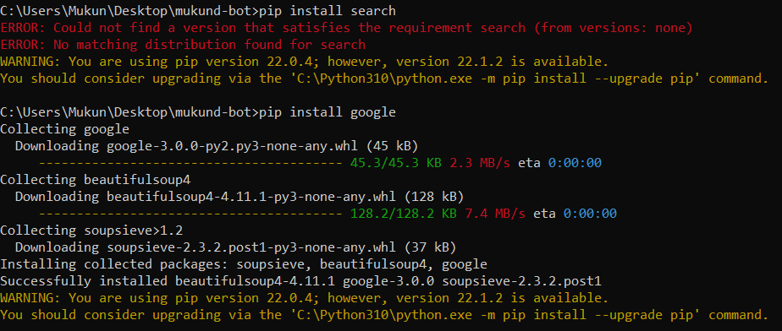
Integration of Python, Flask, Ngrok and Twilio
Installation of Module
1. Pip3 install twilio flask request: Twilio is a web application programming interface (API) that software developers can use to add communications such as phone calling, messaging, video and two-factor authentication into their Python applications.
2. pip3 install google: Googlesearch is a Python library for searching Google, easily. Googlesearch uses requests and BeautifulSoup4 to scrape Google.

Slide 8
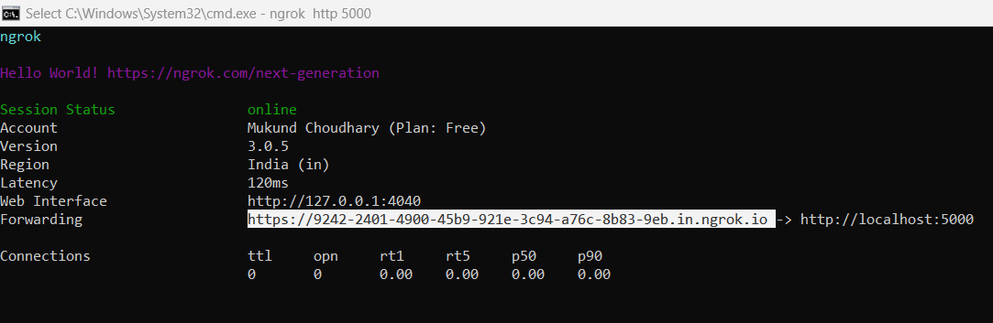
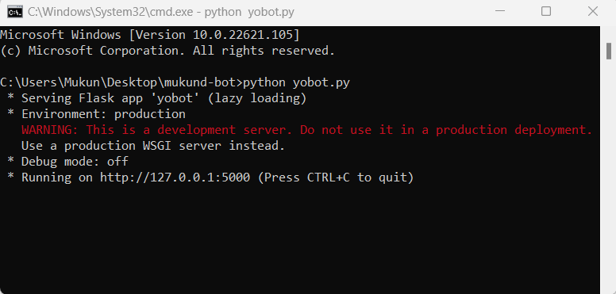
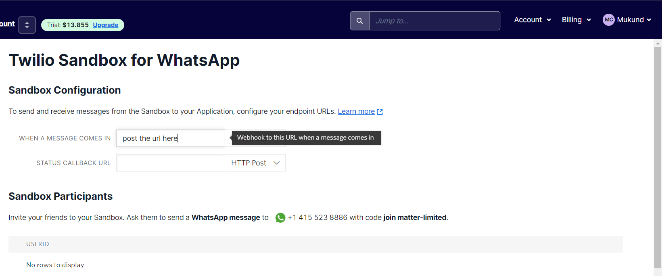
Integration of Python, Flask, Ngrok and Twilio
3. After installation of all requiered
library , run the python code .
4. Now the code will run on local server
at Ip 127.0.0.1/5000
5. Now run the ngrok on the same port,
now ngrok will give you a forwarding url .
6. Now configure that url with Twilio Sandbox API.

Slide 9
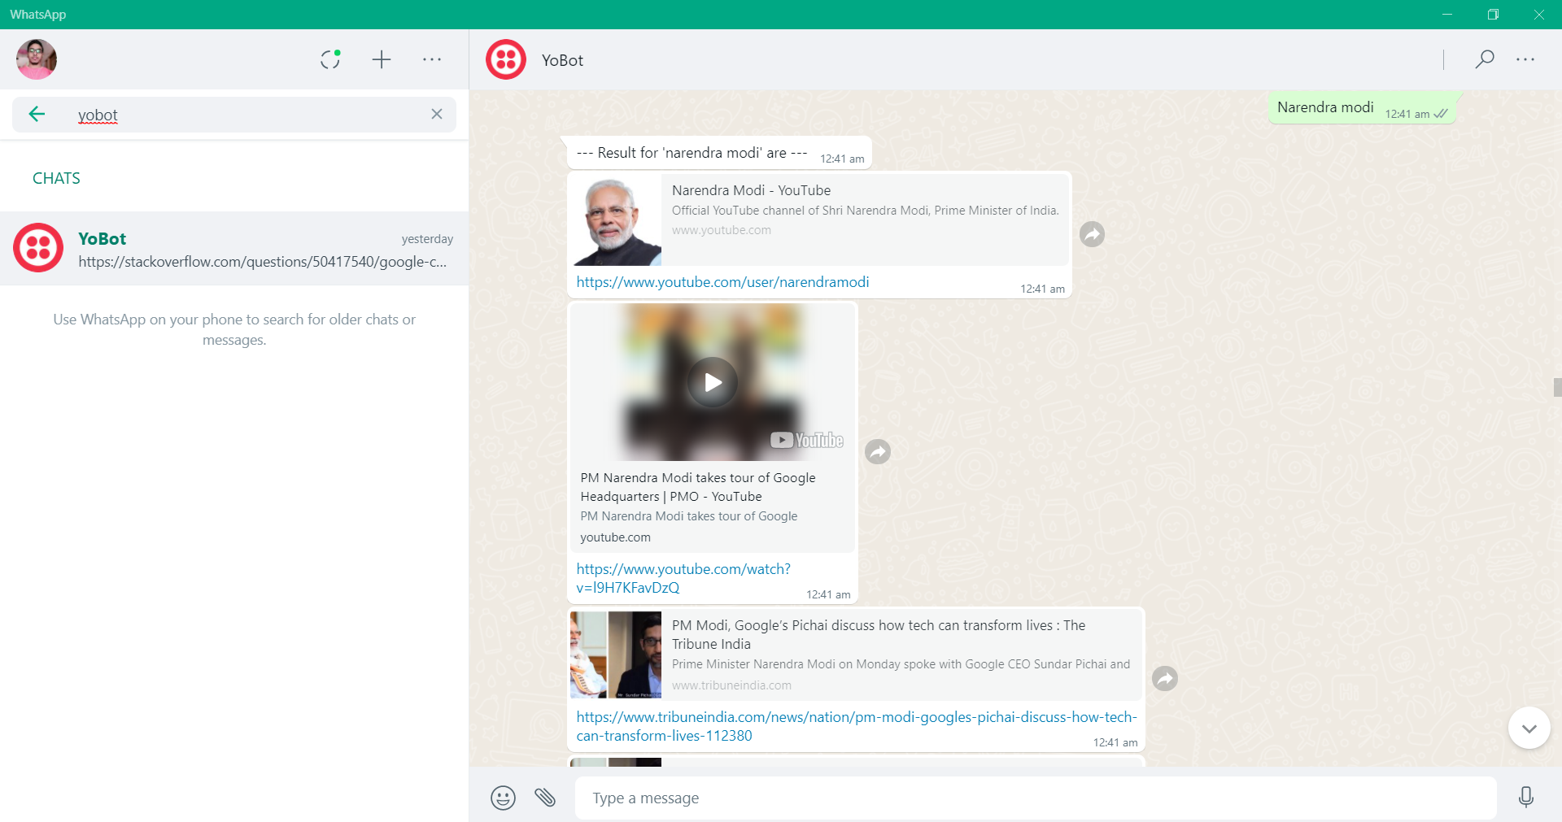
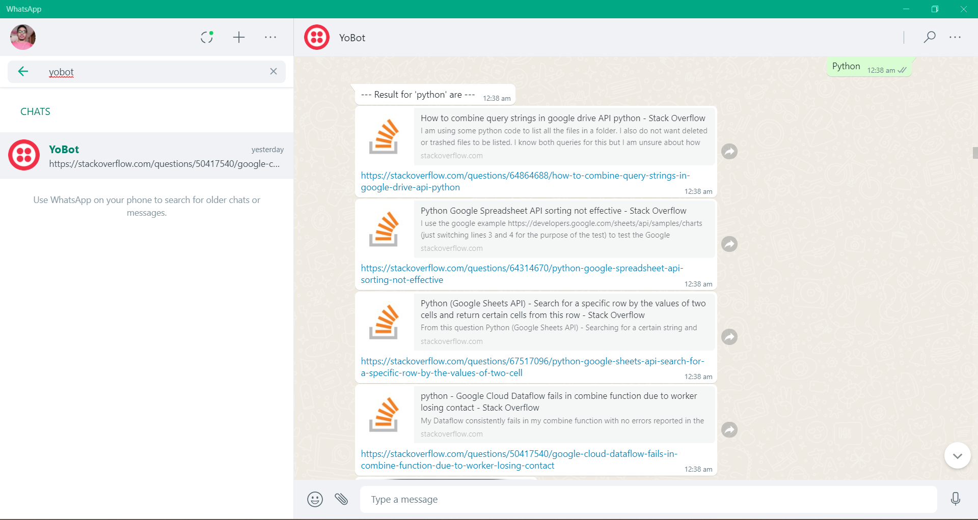
Response by Bot after user request
These are responses we get from the bot when we searched for anything.
The bot will reply the 5 best search result for particular request from google.

Slide 10

Future Scope
In future , we can filter out the search engine result like if user asked for song, movie or etc the bot will reply to that particular subject.
We can also add chatbot module and give user option to use as a ChatBot or a Search/Web Scrawlers. It can be achieved using machine learning and AI which helps the bot for the more user friendly.
We can also host this bot on a server , so the bot can be accessible 24x7 hour.

Slide 11
Thank You

