Slide 1
Forensic Management System
A Project By :
Mukund Gaikwad. Vishakha Penmahale.
Akshay Bhambure. Shital Kharade.
Rasik Nille. Komal Bhapkar
Rushikesh Pawar. Nikita Kukreja.
.

Slide 2
Content :
Introduction.
Overall Description.
Interface Requirement.
System Features.
Flow Diagram.
Conclusion.

Slide 3
Introduction :
Modern science and technology has revolutionized the field of crime solving and has made the process much faster and more reliable. The word Forensic refers to all the science and technology used in the solving of crime. The aim of this system is to manage the large volumes of data that are produced in the process of solving crimes by the application of scientific methods and modern technology.

Slide 4
What is Forensic Management System ?
When creating a new case file the system will be able to store specific information in categories. Such as crime scene photographs, details about any firearms used, all fingerprint and DNA evidence, etc. Fingerprint data and DNA data can be sent to the concerned laboratory from this system and the results can be viewed on the same. All detective notes will also have to be entered on this system.
In the event that a detective has to cooperate with other departments, this system can be used to easily collaborate on case files, temporary user profiles can be created if the other department does not implement this system.

Slide 5
Overall Description :
Time saver.
Easy Access.
Improve Performance.
More Accurate.
Increased Transparency.
Reduce Paper Trail.
Consume Man Power.

Slide 6
Interface Requirement :
Software Requirements :
Windows 7 and above
Apache Tomcat Web Server
Oracle
Technology Used :
Java
J2EE

Slide 7
Hardware Requirements :
Hard Disk – 2 GB
RAM – 1 GB
Processor – Dual Core or Above
Mouse
Keyboard
Monitor
Printer

Slide 8
System Features :
An important feature of this system will be its search feature.
This system will automatically log all user activity, regardless of officer rank, in a secure read only file.
The proposed system will be able to reduce the paper trail required in the process.
Digital files will make the sharing and appending of case files extremely easy.
Since access to the system is required to view a case file it becomes very simple to track and regulate access to the case files.
Documents from different laboratories regarding analyses can be securely and instantly sent via the internet.
This system will augment the crime solving and record keeping abilities of a modern police force.

Slide 9
Flow Diagram :
ERD :

Slide 10
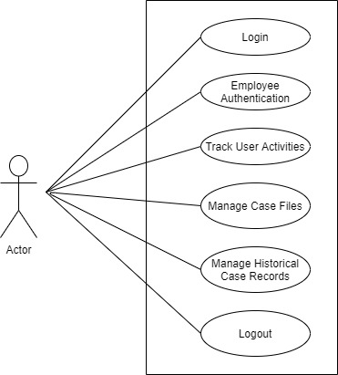
Use Case Diagram :
Admin :

Slide 11
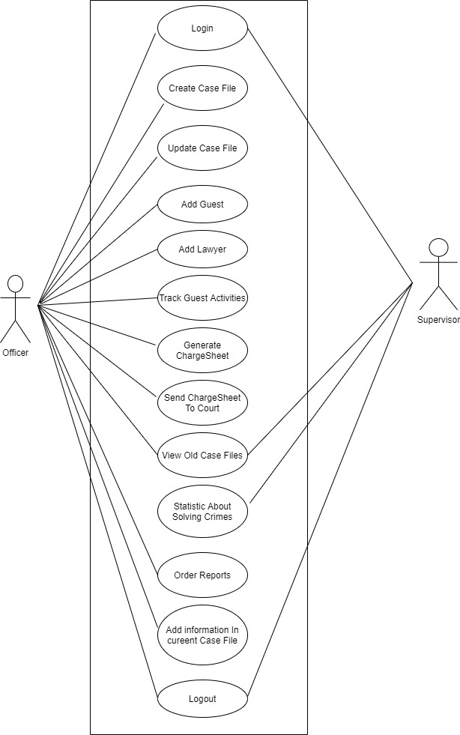
Officer :

Slide 12
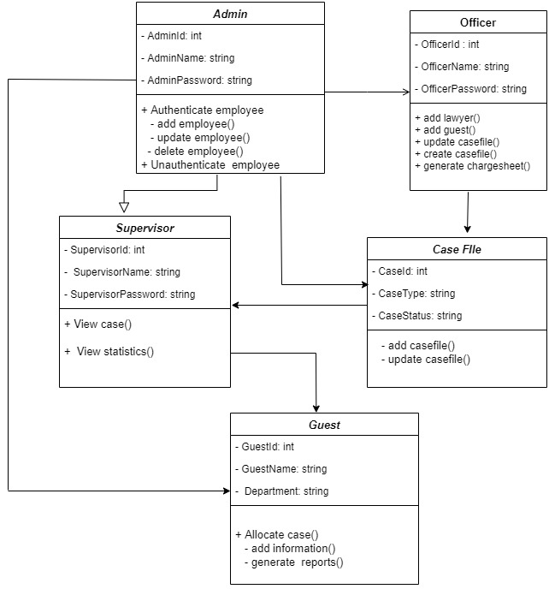
Class Diagram :

Slide 13
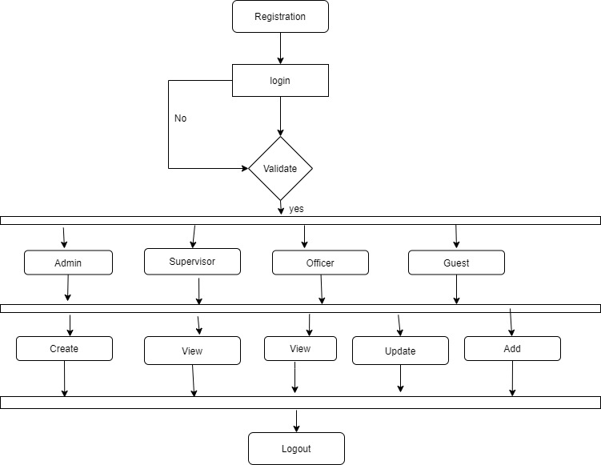
Activity Diagram :

Slide 14
Screen Shots :

Slide 15
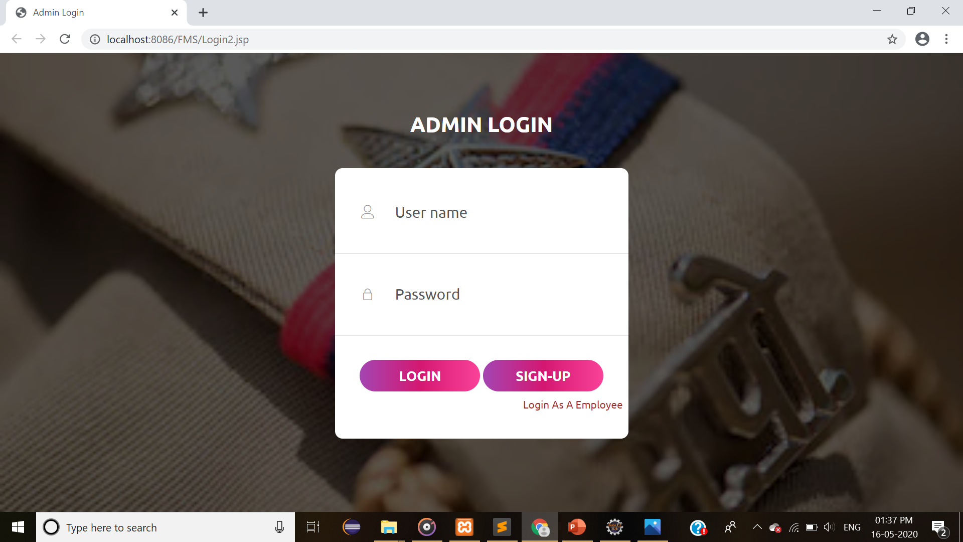
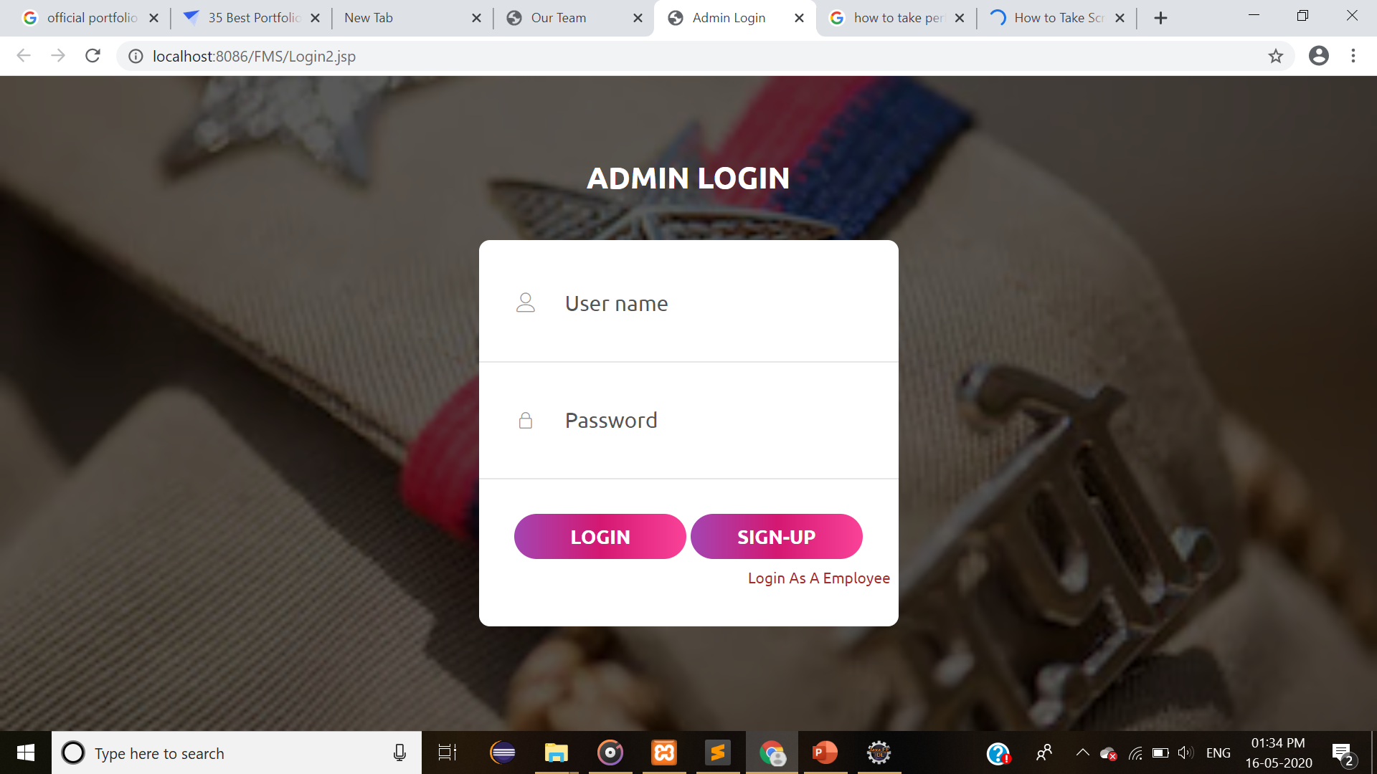
Conclusion :

Slide 16
THANK YOU !!!

