Slide 1

SmartStore
POS & Inventory Management System
Retail billing and inventory management for faster checkout and accurate stock tracking
Presented by: Mukund Kumar, Ayan Shaikh, Aaron Famy

Slide 2



Overview
A lightweight billing + inventory system for small stores, grocery shops and supermarkets (GST included).
Fast Digital Checkout
Real-time Stock
Auto GST & Invoice
Replace paper billing — search / barcode based.
Catch low-stock and out-of-stock issues on time.
Calculation errors zero, invoice print ready.

Slide 3




Problem Statement
Retail operations need one reliable system for products, stock, billing, and visibility.
Fragmented records
Stock uncertainty
Product and inventory data can be spread across manual files or disconnected tools, making updates inconsistent.
Without timely stock updates, teams risk stockouts, overstock, and slow replenishment decisions.
Slow checkout
Limited visibility
Manual billing and quantity calculations increase effort at the point of sale and create room for errors.
Managers need clear dashboards and reports to understand sales activity, inventory movement, and operational health.

Slide 4






Advantages
Centralized control
Faster checkout
Accurate stock
Manage products, quantities, billing, and inventory from one connected system.
Streamlined product selection and billing calculation reduce friction at the counter.
Completed transactions update stock records consistently, improving reliability.
Secure transactions
Actionable insight
Ready to grow
ACID-aligned transaction handling helps preserve consistency and integrity.
Dashboards and reports give managers a clearer view of sales and inventory trends.
A modular foundation can expand as store processes and product volumes increase.

Slide 5




Key Modules
Analytics Dashboard
POS Billing
Revenue KPI, total bills, 7-day chart, low-stock alerts
Search, dynamic cart, CASH / CARD / UPI
Product Management
GST & Invoicing
CRUD, categories, units, soft-delete
0/5/12/18% GST, printable invoice

Slide 6





Platform & Data Foundations
Backend
Request handling and business logic
Database
MySQL 8.0 (InnoDB, utf8mb4)
Connectivity
Database connection layer
Frontend
HTML5 + responsive CSS3 (glass / card UI)
Automation
Launch workflow — one-click run

Slide 7
Working Flow / Flowchart
From POS action to inventory accuracy and management visibility.
Insufficient stock
show low-stock message
NO
START
Open POS
Select / search product
Enter quantity
Stock available?
YES
Calculate
subtotal + GST + total
END
Update dashboard
and reports
Reduce stock
quantity
Generate invoice
save transaction
Select payment
Cash / Card / UPI
Notes:
Walk through the decision point: insufficient stock loops back to product selection; available stock continues through payment, invoicing, inventory update, and reporting.

Slide 8

Database Schema
products
bills
bill_items
id (PK)
name, category
barcode, price, gst
quantity, unit, active
id (PK)
customer, phone
payment_mode
bill_date
id (PK)
bill_id (FK)
product_id (FK)
quantity, price
gst_percent, gst_amount, total
Bill delete → bill_items cascade (FK). Historical data safe.

Slide 9
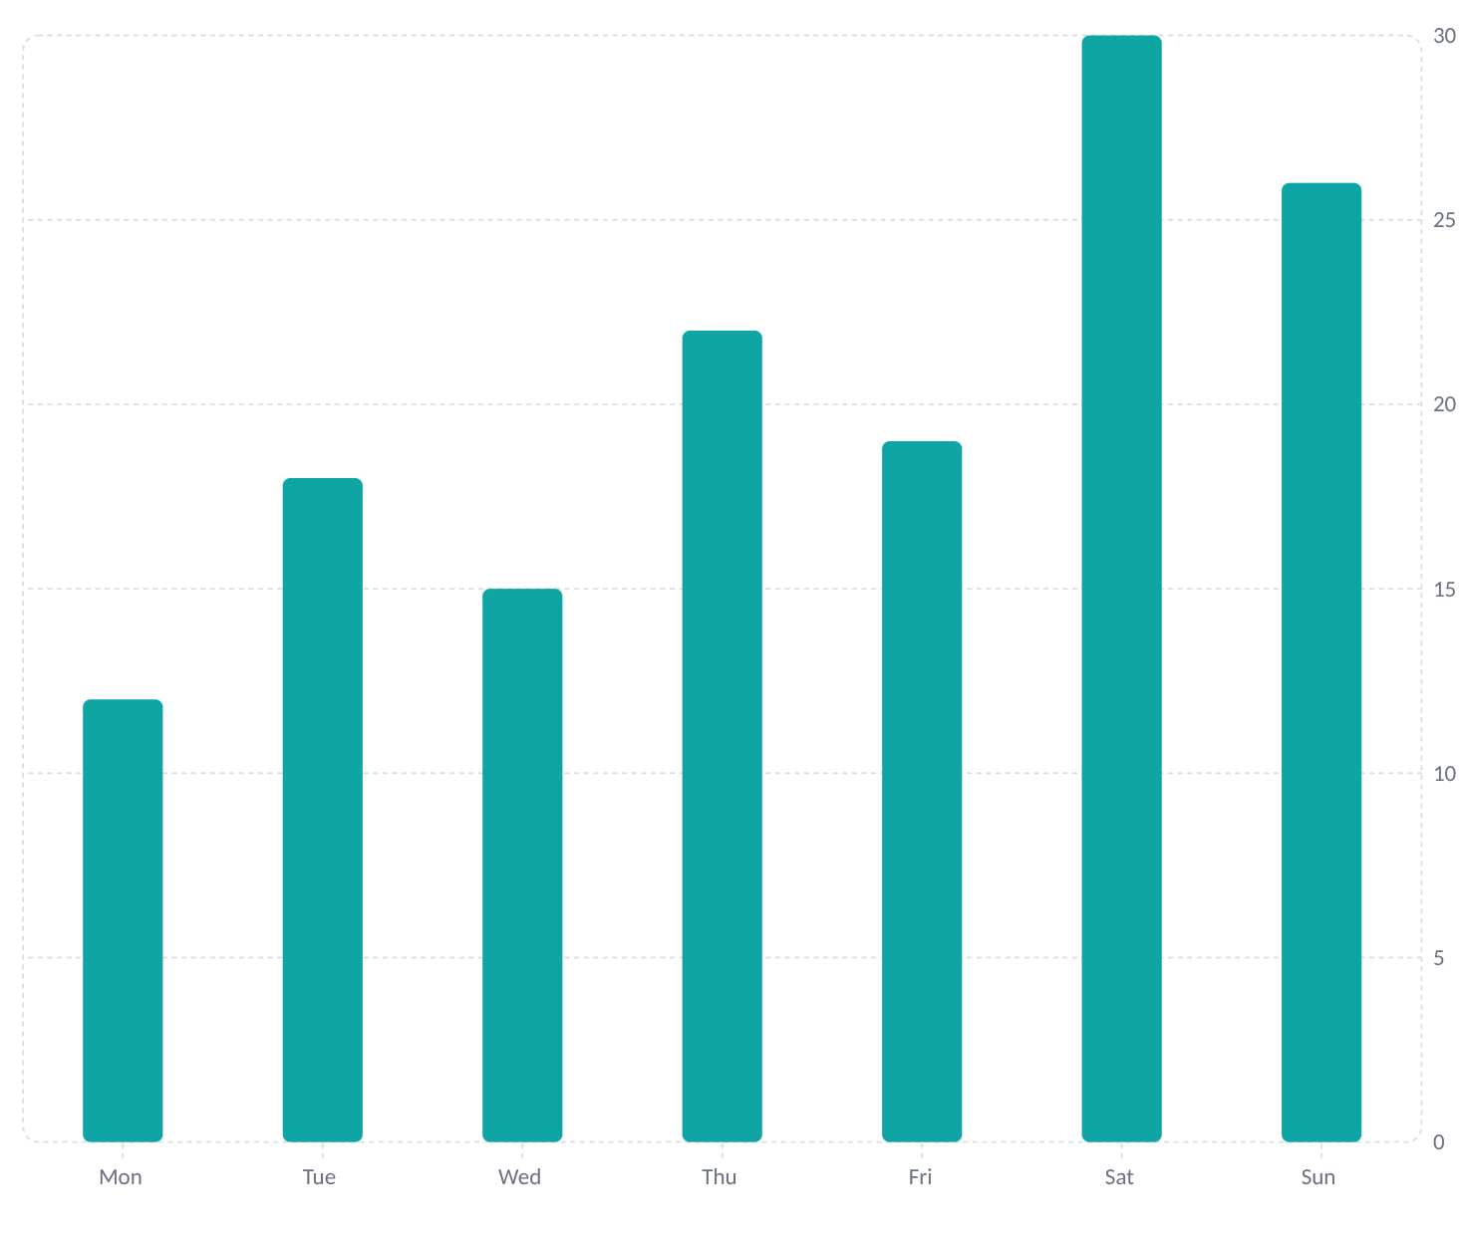



UI Highlights
Smart Stock Badges
7-Day Revenue (sample)
In Stock
Low (≤ 5)
Out of Stock
Instant search by Name, Category, Barcode
Print-ready invoice (@media print)
Responsive checkout and stock views

Slide 10






Future Scope
Barcode & mobile workflows
Purchasing and suppliers
Accelerate product lookup, receiving, and checkout with barcode scanning and mobile-friendly tools.
Add purchase orders, supplier records, and restocking workflows to the inventory loop.
Multi-store and cloud sync
Customer & channel integrations
Connect locations and keep product, inventory, and transaction data synchronized.
Support loyalty, e-commerce, and other connected retail experiences as the system grows.
Analytics & forecasting
Scalable platform services
Extend dashboards with trend analysis, demand forecasting, and replenishment support.
Continue modularizing the platform for stronger automation, security, and maintainability.

Slide 11





References
Retail POS products that informed the SmartStore context and feature direction.
Shopify POS
Connected commerce and point-of-sale reference.
Square for Retail
Retail checkout and inventory management reference.
Clover Retail POS
Store operations and payment workflow reference.
Toast Retail POS
Retail transaction and operational tooling reference.
Loyverse POS
Small-business POS, inventory, and reporting reference.

Slide 12
Thank You
Questions & Discussion
SmartStore — POS & Inventory Management System
Presented by: Mukund Kumar, Ayan Shaikh, Aaron Famy

