Slide 1

Discussion Forum webapp– Student
<Stackunderflow/>
(FUTURE FINDERS ORGANISATION)

Slide 2
MERN Stack for Discussion forum like StackOverflow
Stack Overflow is a popular online community where developers can ask and answer technical questions related to programming. The Stack Overflow web application is built using the MERN stack, which consists of MongoDB, Express.js, React, and Node.js. Here is a brief summary of how each component of the MERN stack is used in the Stack Overflow web application:
MongoDB: MongoDB is used as the database management system for the Stack Overflow web application. It stores all the user data, questions, answers, comments, and other content on the platform.
Express.js: Express.js is used as the web application framework for the Stack Overflow backend. It provides an easy-to-use interface for handling HTTP requests and responses, as well as integrating with MongoDB.
React: React is used as the frontend framework for the Stack Overflow web application. It provides a user-friendly interface for developers to interact with the platform, and allows for seamless integration with the backend.
Node.js: Node.js is used as the backend runtime environment for the Stack Overflow web application. It allows developers to write server-side JavaScript code that can interact with the database and handle HTTP requests and responses.
Overall, the MERN stack provides a powerful and flexible framework for building web applications, and is well-suited to the needs of a large-scale platform like Stack Overflow.

Slide 3
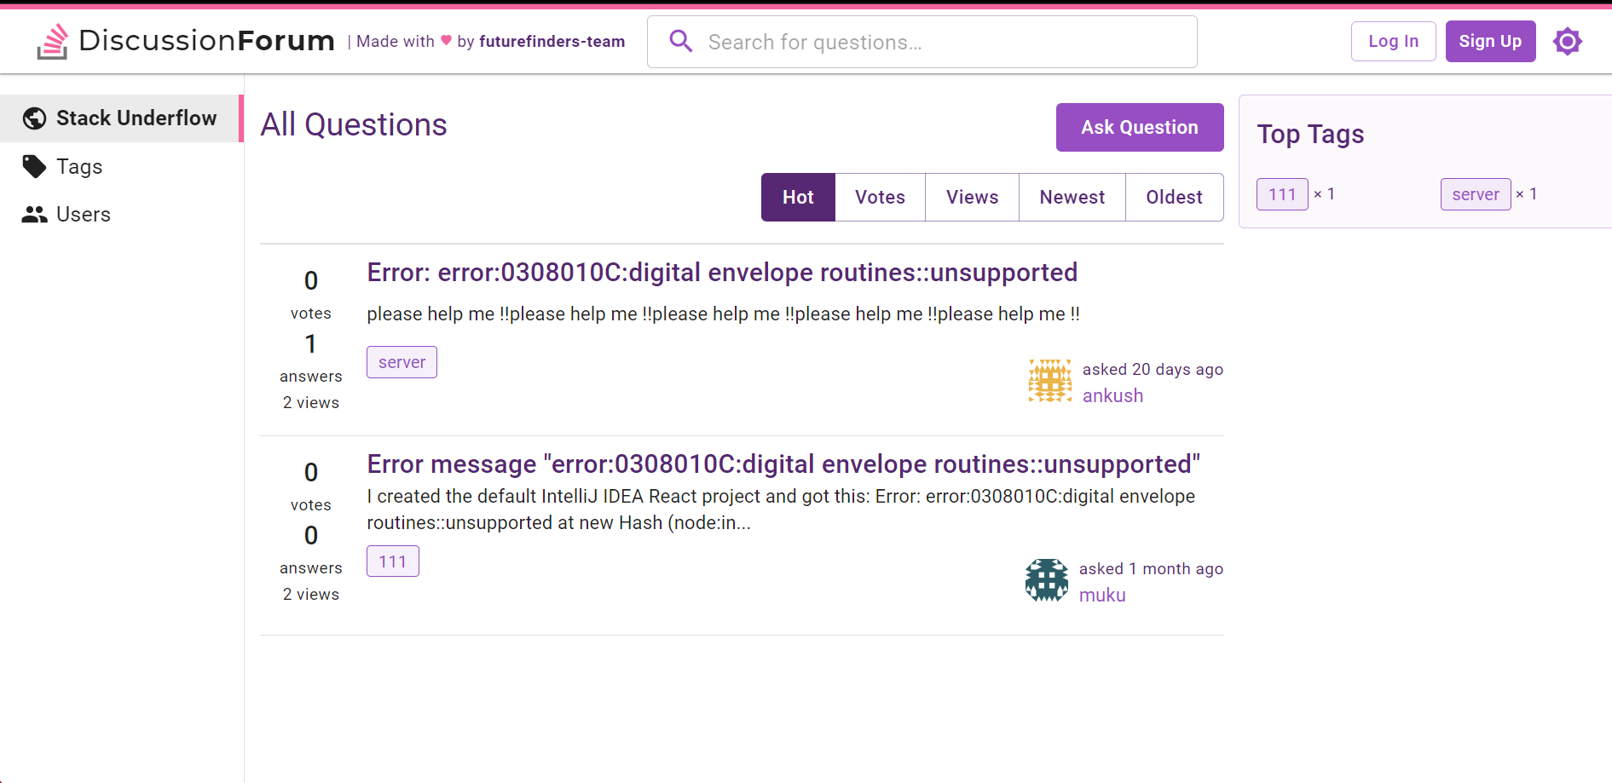
Home page:

Slide 4
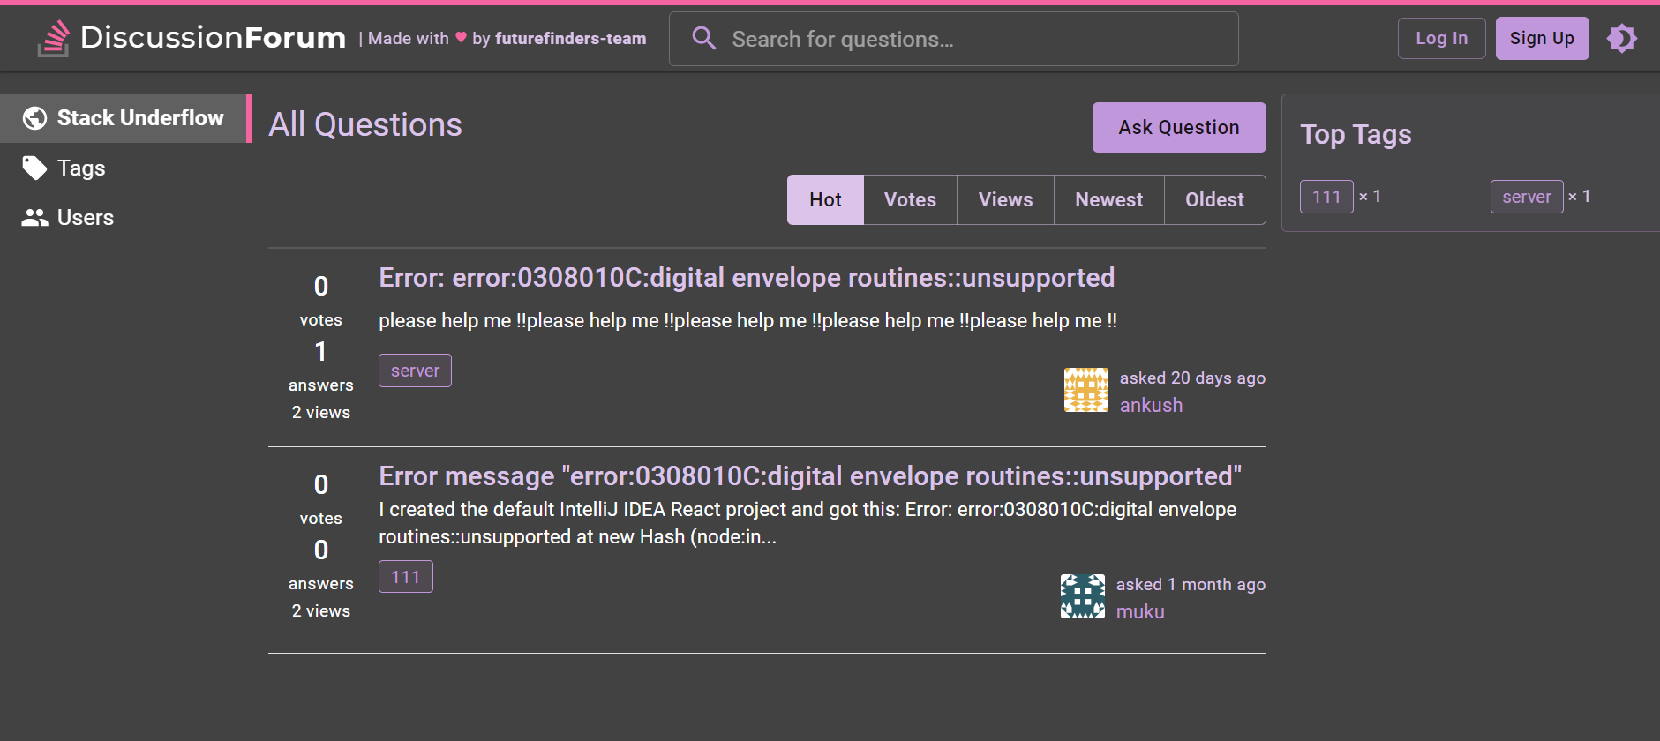
Home page(DARK MODE):

Slide 5
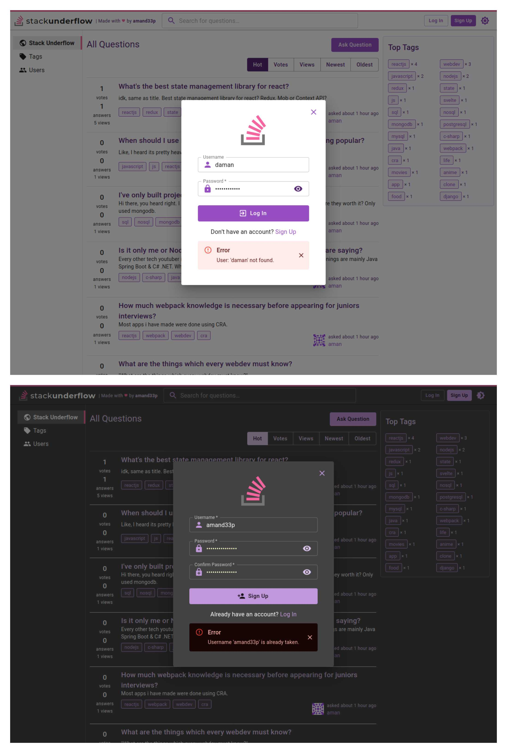
User Login:

Slide 6
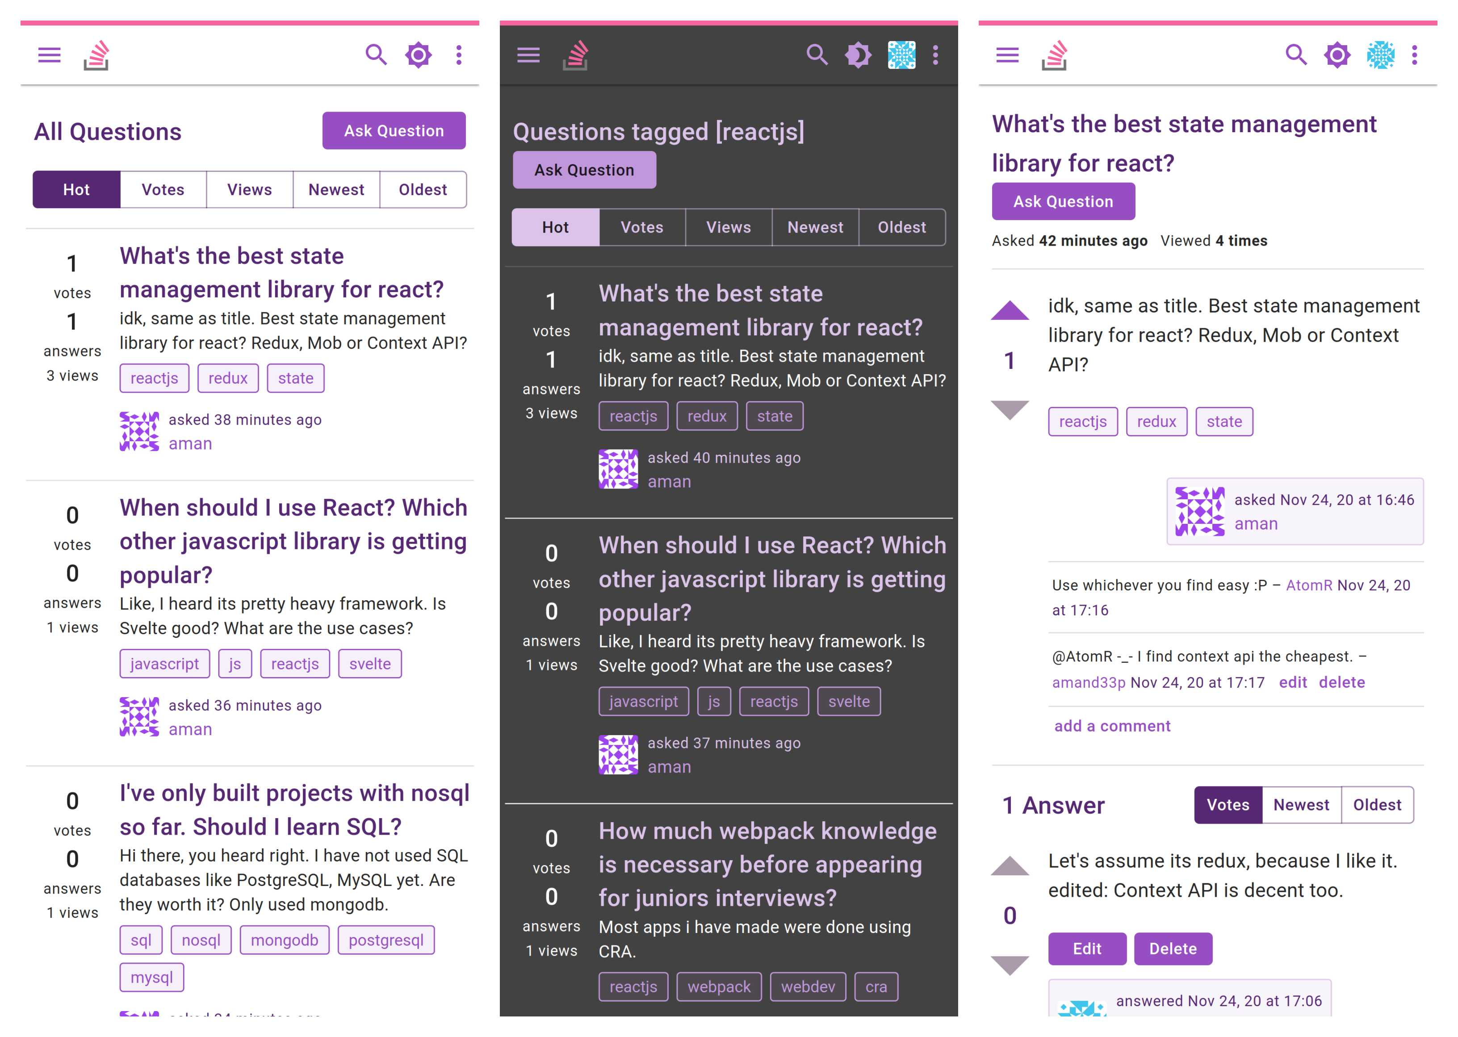
Questions component

Slide 7
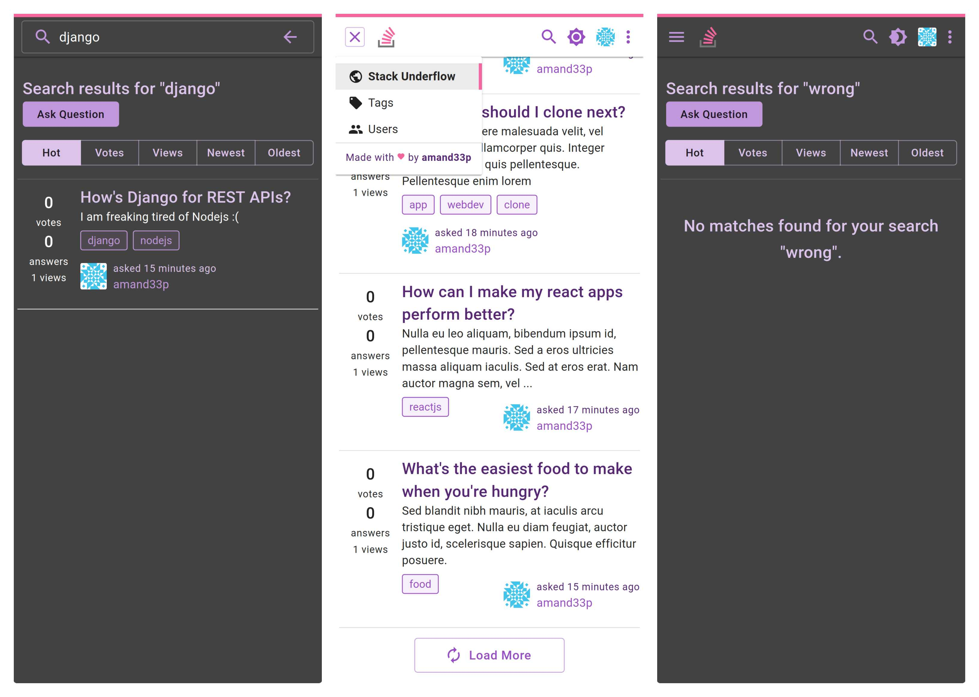
Search:

Slide 8
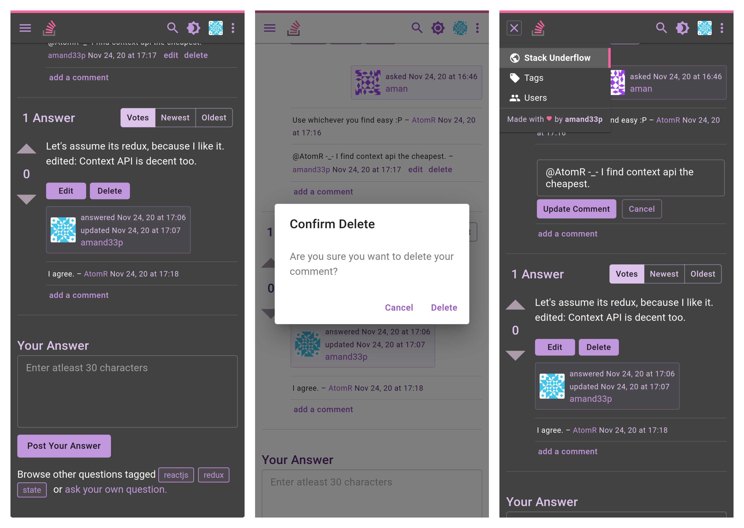
Delete component

Slide 9
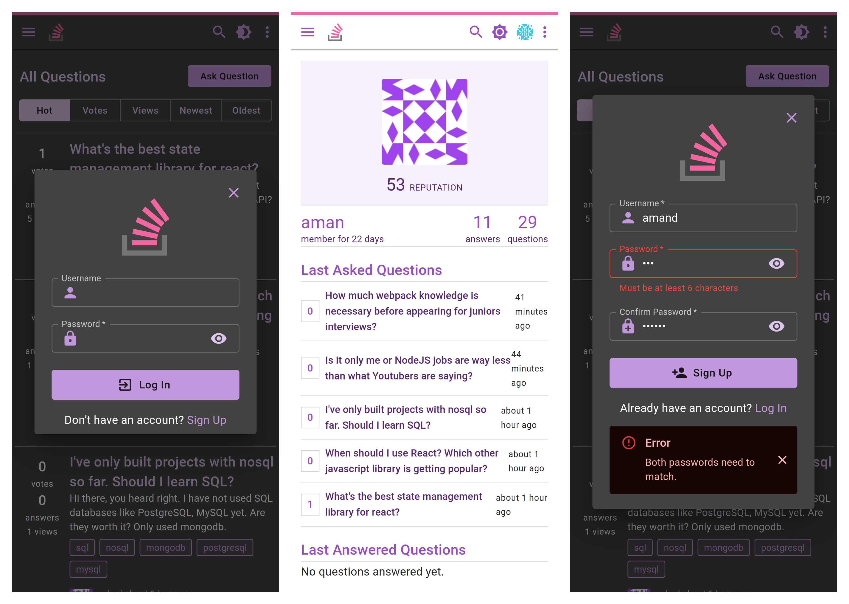
Login Page, user profile, sign up page

