Slide 1
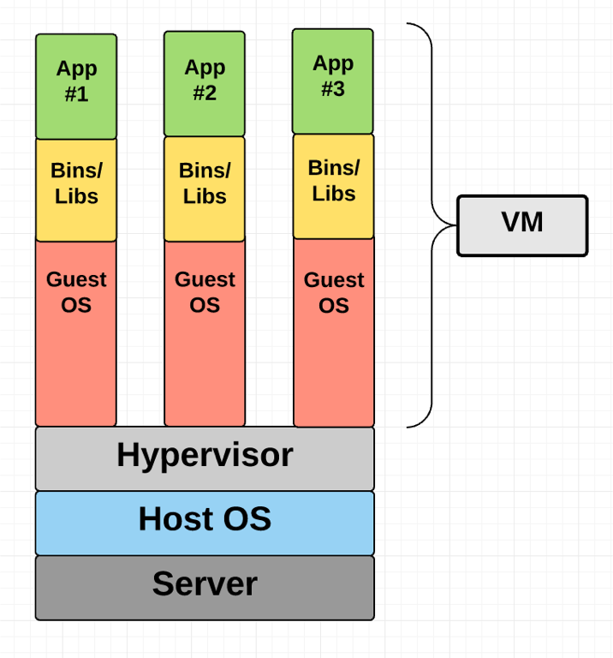

Slide 2
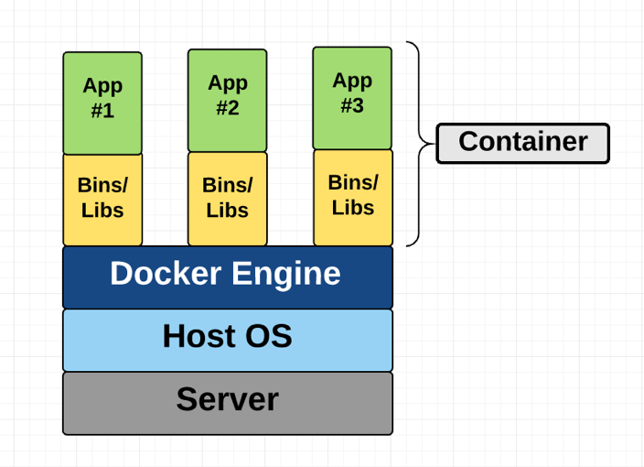
Container
The one big difference between containers and VMs is that containers *share* the host system’s kernel with other containers.

Slide 3
Where does Docker come in?
Docker is an open-source project based on Linux containers. It uses Linux Kernel features like namespaces and control groups to create containers on top of an operating system.
Ease of use
Speed
Docker Hub
Modularity and Scalability : Docker makes it easy to break out your application’s functionality into individual containers

Slide 4
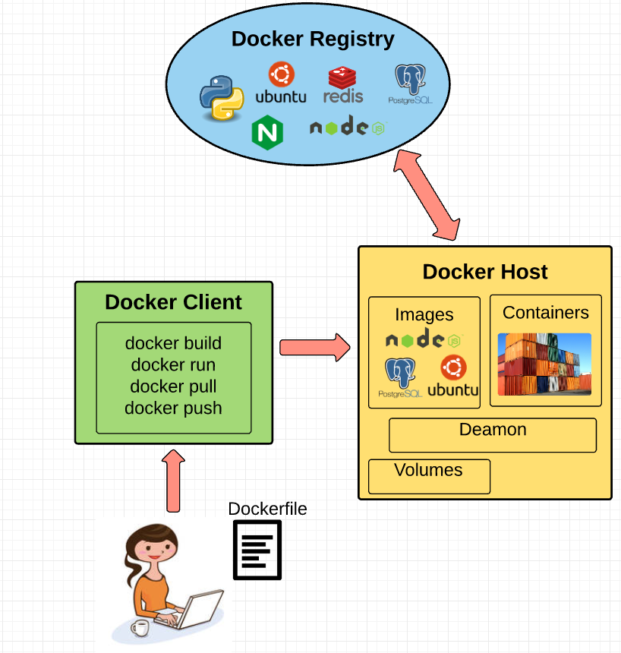
Fundamental Docker Concepts

Slide 5
Docker Engine
Docker engine is the layer on which Docker runs. It’s a lightweight runtime and tooling that manages containers, images, builds, and more. It runs natively on Linux systems and is made up of:

Slide 6
Docker Engine
Docker engine is the layer on which Docker runs. It’s a lightweight runtime and tooling that manages containers, images, builds, and more. It runs natively on Linux systems and is made up of:
1. A Docker Daemon that runs in the host computer. 2. A Docker Client that then communicates with the Docker Daemon to execute commands. 3. A REST API for interacting with the Docker Daemon remotely.

Slide 7
Docker Client
The Docker Client is what you, as the end-user of Docker, communicate with. Think of it as the UI for Docker. For example, when you do…
Docker Daemon
The Docker daemon is what actually executes commands sent to the Docker Client — like building, running, and distributing your containers
Dockerfile
A Dockerfile is where you write the instructions to build a Docker image

Slide 8
Docker Image
Images are read-only templates that you build from a set of instructions written in your Dockerfile. Images define both what you want your packaged application and its dependencies to look like *and* what processes to run when it’s launched.
Union File Systems
Docker uses Union File Systems to build up an image. You can think of a Union File System as a stackable file system, meaning files and directories of separate file systems (known as branches) can be transparently overlaid to form a single file system.

