Slide 1
The 7th International Conference on Medical Imaging and Computer-Aided Diagnosis
Paper ID: 740
Title: BISON: Boundary-Injected Segmentation Of Nuclei via Exact Softmax Attention
Author’s Information: Mukut Chatterjee¹, Diptarko Bhattacharjee¹, Debatra Banerjee¹, Dmitrii Kaplun^{2,3,*}, Asya Lyanova³, Ram Sarkar¹
1 Jadavpur University, Kolkata, India | 2 China University of Mining and Technology, China
3 Intelligent Devices Institute, St. Petersburg Electrotechnical University “LETI”, Russia
* Corresponding author: dikaplun@etu.ru
Presented By: Mukut Chatterjee
Notes:
Good afternoon, everyone. I'm going to talk about BISON, which is our approach to separating densely packed nuclei in H&E histopathology images by feeding boundary information into the network at several points, rather than hoping the decoder recovers it. I have about fifteen minutes: first the problem and where existing methods stop, then the three pieces of the model, then the numbers on TNBC, MoNuSeg and CPM-15. (about 30 seconds)

Slide 2
Why nuclei instance segmentation is hard
Why it matters. Nuclei segmentation in H&E images underpins cancer grading, sub-typing and survival prognosis.
1
The merge problem
Why it is hard. In TNBC, nuclei differ in size, shape and texture, crowd together, and often contrast poorly with stroma.
2
Touching nuclei
Merged into one region
Separated into two
Where models fall short. U-Net [1] merges touching nuclei. HoVer-Net [2] adds HV maps and watershed, yet downsampling still erodes edge detail.
3
Whether two nuclei are counted as one or two comes down to boundary detail.
Notes:
Nuclei segmentation in H&E images is the first step for things like cancer grading, sub-typing and prognosis, so errors here travel downstream. It is particularly hard in triple-negative breast cancer: nuclei differ a lot in size, shape and chromatin texture, they sit very close or overlap, and the contrast against stroma is often poor because of how the tissue was prepared and stained.
A plain U-Net gives good pixel-level accuracy but tends to merge touching nuclei into one region. HoVer-Net handles this by predicting horizontal and vertical distance maps and running watershed, which is the idea we build on. But the downsampling inside any encoder-decoder still removes the high-frequency detail that sharp boundaries need. The small schematic on the right is just the merge problem in one picture. (about 1 minute)

Slide 3
Related work and the remaining gap
SAAMU-Net [3]
InceptionV4 backbone with selective attention aggregation and memory-augmented attention in the skips.
DyGLNet [4]
Global and local feature fusion with dynamic upsampling and phase alignment for boundary consistency.
VEGAN [5]
Pix2Pix GAN whose generator is an edge-aware Attention U-Net with CLIP-based skips and CBAM.
WDRE-NET [6]
Weak supervision: wavelet differential convolution and region expansion of point annotations.
EViT-UNet [7]
Lightweight convolution plus self-attention layers in place of full ViT blocks.
DeltaSegment [8]
Multifidelity change detection between color-quantized and full-resolution inputs.
AFINITI [9]
Separate heads for instance probability, shape radial and classification.
The gap
Deep semantic abstraction versus fine boundary preservation.
Notes:
Recent work attacks the problem from several directions. SAAMU-Net stabilises skip connections with selective attention and a memory module. DyGLNet uses dynamic upsampling with phase alignment for boundary consistency. VEGAN is a GAN that takes an edge map into an attention U-Net generator. WDRE-Net is aimed at weak supervision from point labels. EViT-UNet is about efficiency, DeltaSegment learns from change between quantised and full-resolution inputs, and AFINITI uses separate heads for instance probability, shape and class.
All of these are useful, but the trade-off between deep semantic abstraction and fine boundary preservation is still there. That is the gap BISON is built for. (about 45 seconds)

Slide 4
Contributions
Spatial Boundary-Aware (SBA) attention
Scharr pre-bottleneck refinement gate
End-to-end multi-task objective
1
2
3
Fuses visual feature similarity with a fixed, multi-scale boundary similarity, so long-range context follows structural edges.
Nucleus boundaries are where intensity changes fastest. The gate amplifies that detail just before the bottleneck compresses it away.
A Boundary Consistency Loss from fixed differential operators, plus a Mean Squared Gradient Error (MSGE) on offset fields for smooth instance separation.
Notes:
We make three contributions. First, the Spatial Boundary-Aware attention module: it adds a fixed geometric boundary similarity to the usual visual similarity, so that attention follows edges. Second, the Scharr gate before the bottleneck, which boosts exactly the high-frequency edge content that the heavy spatial compression would otherwise wash out. Third, the training objective: a Boundary Consistency Loss based on fixed differential operators, and a mean squared gradient error on the offset fields so instance separation stays geometrically smooth.
The strip at the bottom is the outcome, Dice, IoU and AJI on the three datasets. I'll come back to these later. (about 45 seconds)

Slide 5
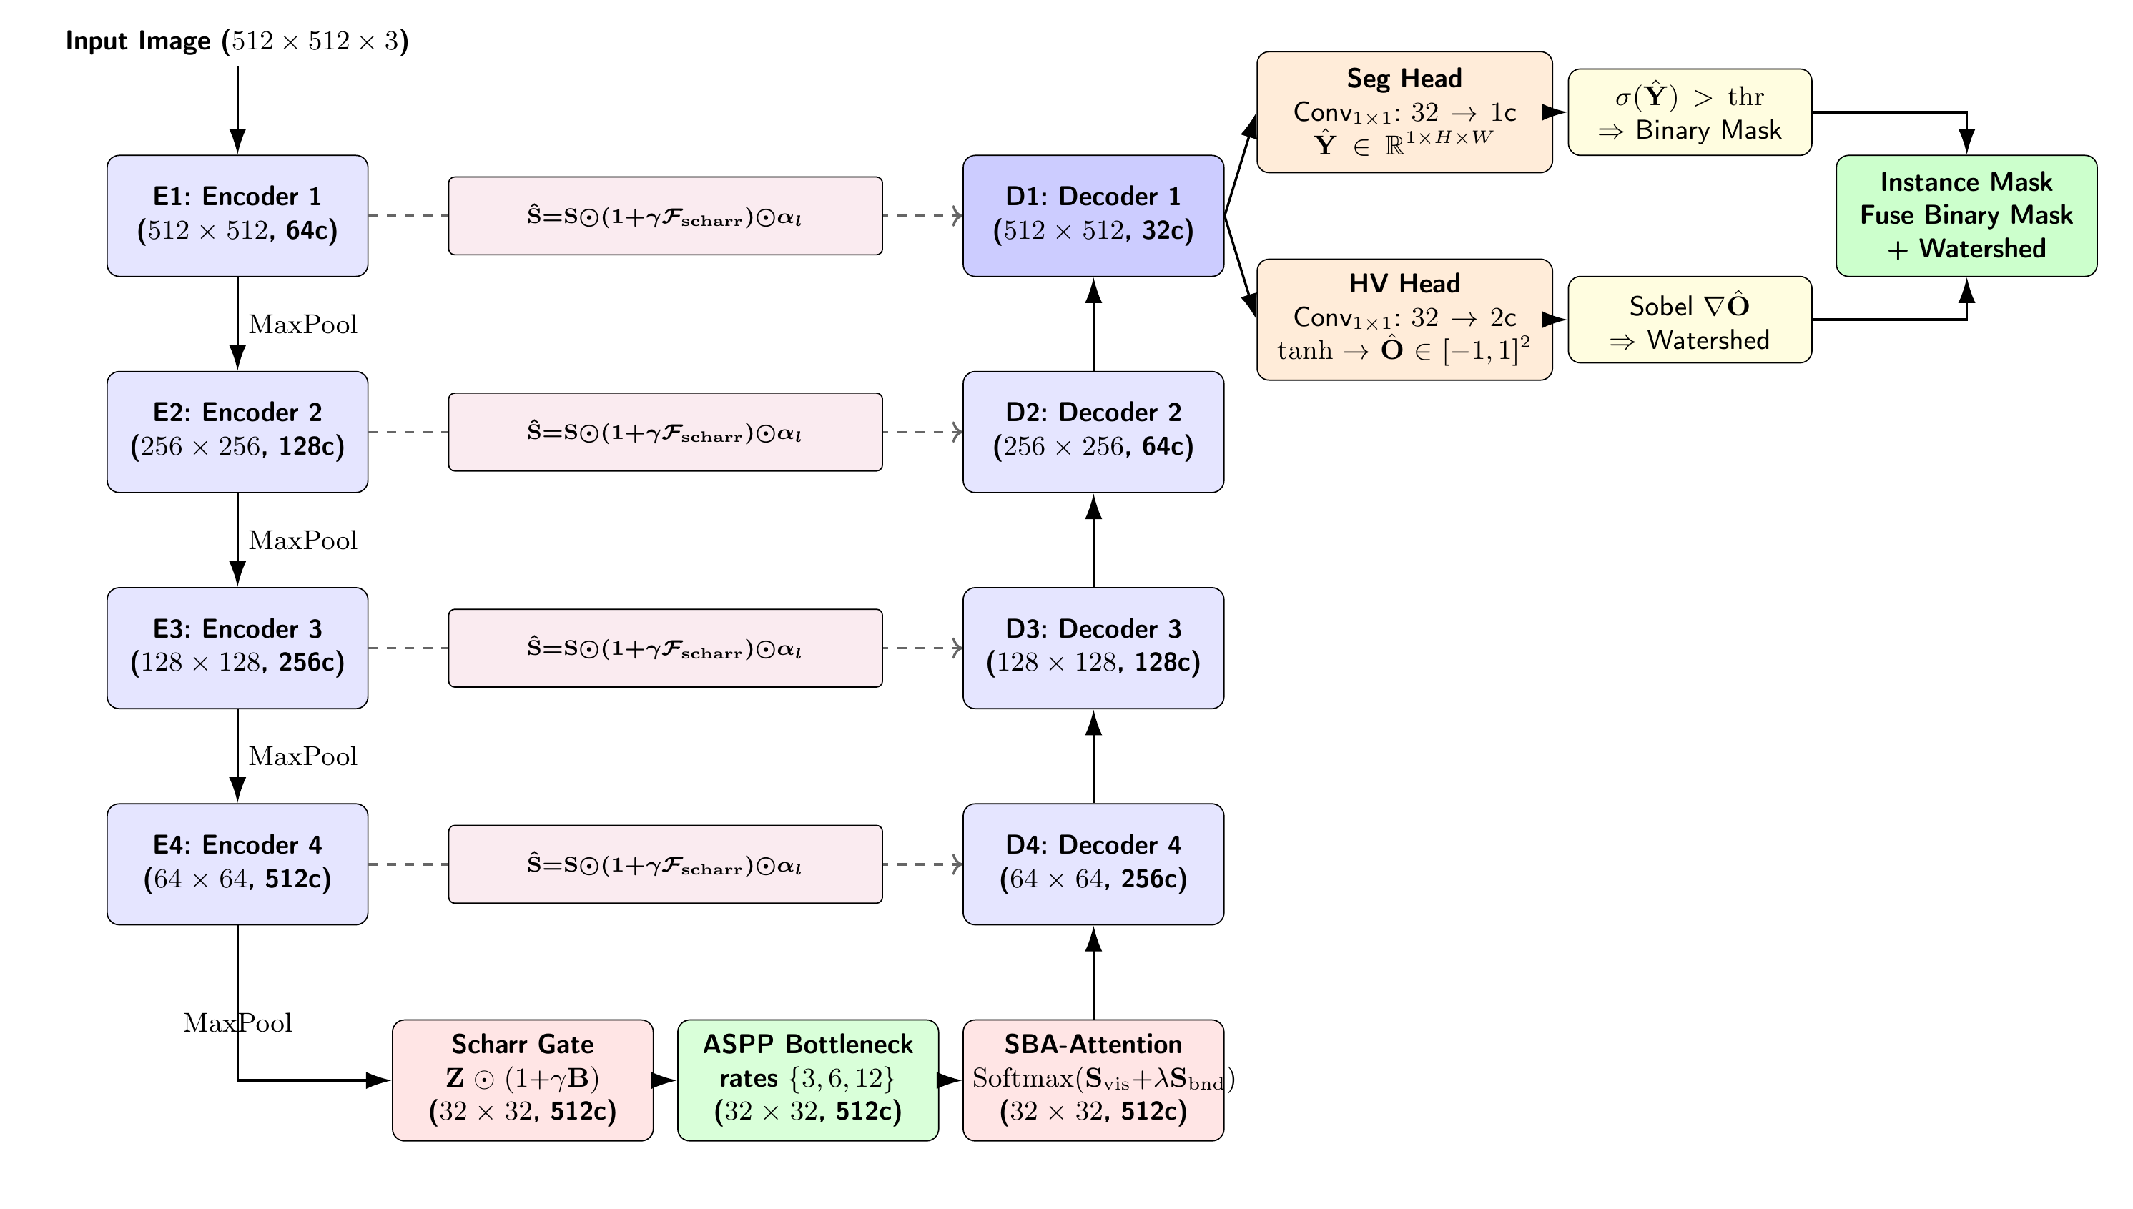
BISON architecture
1
Encoder
ResNet [11] stages E1 to E4, 64 to 512 channels; pre-pool maps kept as skips.
2
Bottleneck
Scharr gate, ASPP, SBA attention at 32 × 32.
3
Decoder
D4 to D1 with two-stage gated skips.
4
Heads
Seg head gives the binary mask; HV head offsets drive watershed.
Notes:
This is the whole model. On the left is a ResNet encoder with four stages, 64 up to 512 channels, with max-pooling between stages. The pre-pooling map of each stage is kept as a skip. At the bottom is the bottleneck, which is where most of our additions sit: the Scharr gate, then ASPP, then SBA attention, all at 32 by 32.
On the right the decoder mirrors the encoder. Skips are not plain concatenations, they pass through the boundary gate and then an attention gate, which is the pink box in the middle. At the top, the final decoder output feeds a segmentation head and an HV offset head. The segmentation head gives the binary mask, the offsets drive watershed, and the two are fused into the instance mask. I'll go through the pieces in that order. (about 1 minute)

Slide 6

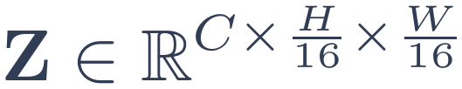
Scharr pre-bottleneck refinement
Pooled map Z
512 ch, 32 × 32
1×1 conv to grayscale
Fixed Scharr filters [12], two dilation scales
Boundary-likeness map B
Residual gate on Z
Residual gating
ASPP on the gated map
ASPP [13], atrous rates {3, 6, 12}
A global-pooling branch
Dropout 0.1
Each location is treated independently, which motivates SBA attention
γ is a learnable scalar, initialised to 0.1. Where γB ≈ 0 the features pass through unchanged; near edges they are amplified.
Notes:
Pooling weakens boundary detail, so right before the bottleneck we try to protect it. The pooled feature map Z goes through a 1 by 1 convolution to a single grayscale-like channel. Fixed Scharr filters at two dilation scales turn that into a boundary-likeness map B. Then we gate the features residually: Z times one plus gamma B. Gamma is a learnable scalar initialised at 0.1, so where gamma B is close to zero the features pass through untouched, and near edges they are amplified.
The gated map goes through ASPP with rates 3, 6 and 12, a global-pooling branch and dropout 0.1. ASPP gives multi-scale context but treats every location independently, which is exactly what the next module addresses. (about 1 minute)

Slide 7
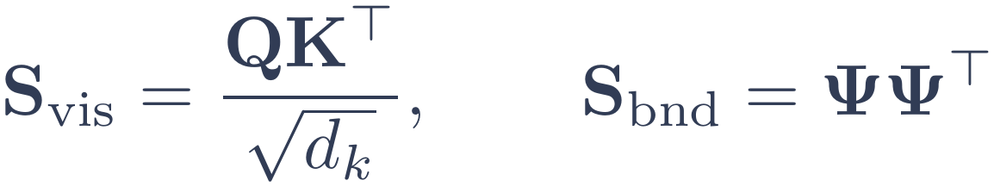

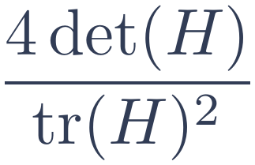
Spatial Boundary-Aware (SBA) attention
Visual similarity alone cannot separate pixels of similar texture on opposite sides of a boundary.
Fixed Scharr boundary descriptor Ψ
d_{ψ} = 6 channels per token; no learnable parameters beyond one sharpness scalar β
1
Boundary likeness
sharpened gradient magnitude
2
Cross-scale orientation agreement
3
Oriented edge, two channels
4
Hessian polarity
h = 4 heads, d_k = C/h, N = H/16 · W/16 ≈ 1024 tokens. λ is a per-head scalar, squared to stay positive; λ → 0 recovers standard multi-head self-attention.
5
Blobness
Notes:
Visual similarity alone cannot tell apart two pixels with similar texture that sit on opposite sides of a nucleus boundary. So inside the attention softmax we add a second similarity term. Queries, keys and values come from the ASPP output through 1 by 1 convolutions, four heads, and at this resolution we have about a thousand tokens, so the full N by N matrix is affordable. That is why we call it exact softmax attention.
In parallel, a fixed, non-learnable Scharr boundary descriptor gives each token a six-channel fingerprint, listed on the right. The boundary similarity is just the inner product of those fingerprints, and it is added to the visual similarity with a per-head scalar lambda, squared to keep it positive. As lambda goes to zero we recover ordinary multi-head self-attention. A depthwise 3 by 3 convolution on V adds a local term, and the whole thing is residual. (about 1 minute 30 seconds)

Slide 8
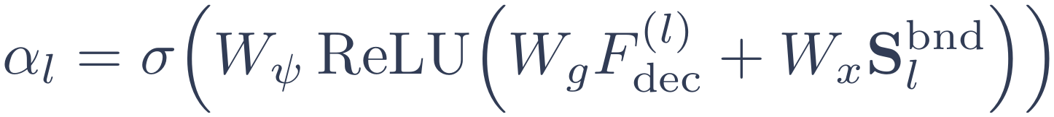
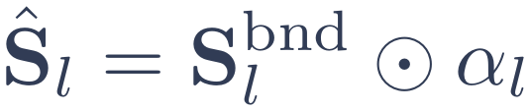
Gated skip connections and prediction heads
Each skip is filtered twice
Seg head
1×1 conv to one logit Ŷ, sigmoid-thresholded at inference.
A fixed Scharr detector boosts high-frequency content, then an Attention Gate [14] suppresses background using the upsampled decoder state. The result is concatenated, blended by a 1×1 conv and refined by residual blocks.
Auxiliary heads
On decoder stages 2 and 3, same segmentation loss, to stabilise gradient flow.
HV offset head
1×1 conv to 2 channels, tanh: Ô ∈ [−1, 1] offsets toward each instance centroid.
Notes:
On the decoder side, we do not simply concatenate the encoder feature. Each skip is filtered in two stages. First a fixed Scharr detector boosts high-frequency content in the encoder feature. Then an attention gate, which follows the Attention U-Net design, suppresses background using the upsampled decoder state. The result is concatenated with the upsampled decoder feature, blended with a 1 by 1 convolution and refined by residual blocks.
The last decoder output D1 has 32 channels and feeds three things: the segmentation head, which is a 1 by 1 convolution to one logit, thresholded at inference; two auxiliary segmentation heads on decoder stages 2 and 3 for deep supervision; and the HV head, a 1 by 1 convolution to two channels with tanh, predicting offsets toward each instance centroid. (about 1 minute)

Slide 9
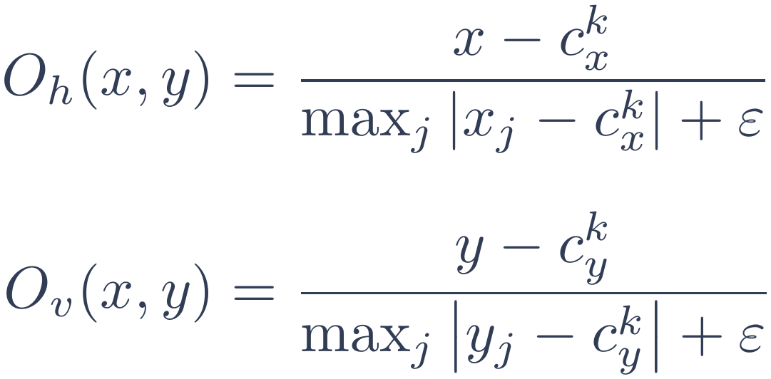
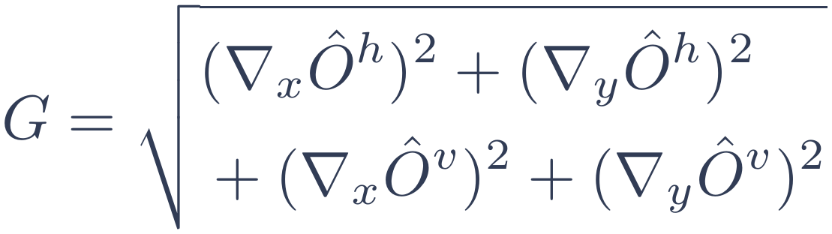

From offsets to instances: marker-controlled watershed
1
Threshold
2
Energy surface
3
Seeds
4
Watershed [15]
τ* from a 19-value grid over [0.05, 0.95], maximising validation Dice.
Sobel gradients of the HV offset maps give G.
Normalised G < 0.4 inside M, eroded with a radius-2 disk.
Flood G from the seeds within M; drop fragments under 10 pixels.
HV offset target
Energy surface
Foreground mask
τ* is the validation-Dice-optimal threshold.
Low inside a nucleus; spikes where the offset field reverses at a boundary.
Per foreground pixel of instance k; ε = 10⁻⁸.
Notes:
At inference, the segmentation probability map is binarised at a threshold chosen by a 19-value grid search between 0.05 and 0.95, picking whatever maximises validation Dice on cached predictions. That gives the foreground mask M.
Inside M we need to split touching nuclei. The ground-truth offsets for each pixel are its distance to the instance centroid, normalised per instance. At prediction time we take Sobel gradients of the two offset maps and combine them into an energy surface G. It is low inside a nucleus and spikes where the offset field flips sign at a boundary. Pixels with low normalised gradient, below 0.4, inside M are eroded with a radius-2 disk to form the seeds. Watershed then floods G from those seeds within M, and we throw away fragments below ten pixels. (about 1 minute)

Slide 10

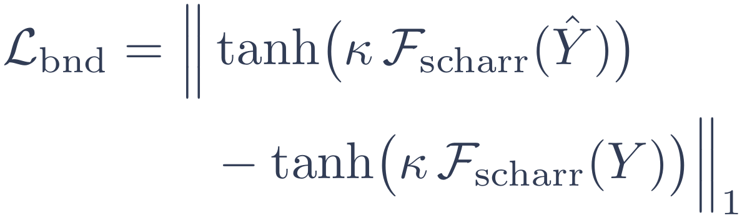
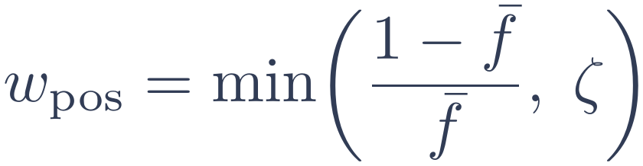
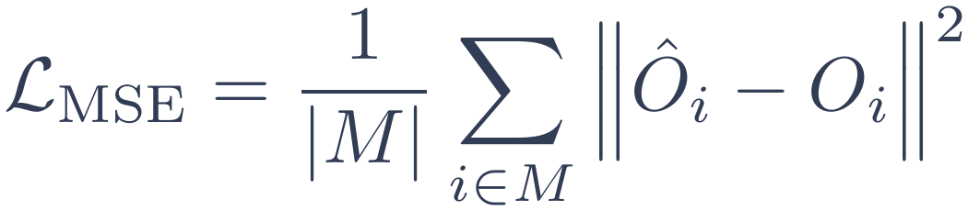
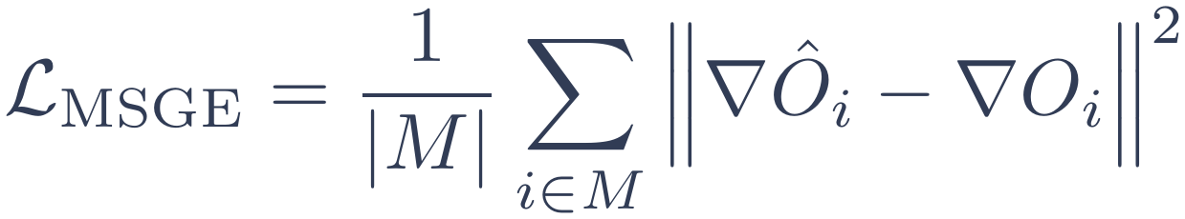
Multi-task training objective
Total loss
Segmentation
Instance geometry
Boundary consistency
Each term is a Focal Tversky loss [10] plus class-weighted BCE; the weight comes from the mean foreground fraction, capped by ζ.
Compares Scharr edge responses of predicted and ground-truth masks, supervising sharpness independent of area overlap.
As in HoVer-Net [2]: offset MSE plus MSGE on their gradients, over foreground M.
Notes:
The total loss has three parts. The segmentation term applies to the main prediction at D1 plus the two auxiliary heads at D2 and D3. Each of these is a focal Tversky loss combined with a class-weighted binary cross-entropy. The positive weight is computed automatically from the mean foreground fraction, and capped by zeta so extremely sparse masks do not destabilise training.
The instance geometry loss follows HoVer-Net: mean squared error on the offsets, plus the mean squared gradient error, which compares spatial gradients of predicted and true offsets over foreground pixels. That second term is what discourages the gradient inconsistencies that hurt watershed.
Finally, the boundary consistency loss compares Scharr edge responses of the predicted and ground-truth masks, so boundary sharpness is supervised directly, independent of overall area overlap. (about 1 minute 15 seconds)

Slide 11
Datasets, metrics and training setup
Datasets
512 × 512
500
AdamW
1.0
TNBC [16]
MoNuSeg [17]
CPM-15 [18]
input size, ImageNet statistics
epochs, batch size 4
with OneCycleLR schedule
gradient clipping norm
FP16
0.999
h = 4
0.1
mixed-precision training
EMA decay, used for val and test
SBA attention heads
initial γ, ASPP dropout
Metrics
Dice and IoU for semantic segmentation; AJI for instance-level separation.
Augmentation flips, rotations, affine jitter, colour jitter, Gaussian blur and noise, random erasing.
Notes:
We evaluate on three public histopathology datasets: TNBC, MoNuSeg and CPM-15. Dice and IoU measure semantic segmentation, and the aggregated Jaccard index, AJI, measures how well individual instances are separated, so AJI is the number to watch for the touching-nuclei problem.
Images are resized to 512 by 512 and normalised with ImageNet statistics. We train for 500 epochs with batch size 4, AdamW and a one-cycle schedule, gradient clipping at norm 1, mixed precision, and an exponential moving average of the weights with decay 0.999, which is what we use for validation and testing. Augmentation is the standard set: flips, rotations, affine and colour jitter, blur, noise and random erasing. (about 45 seconds)

Slide 12
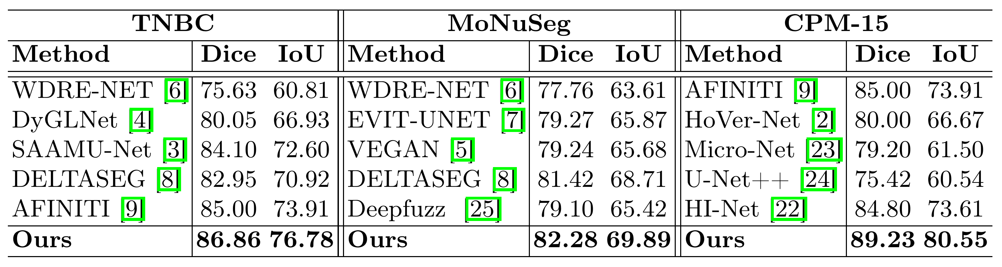
Comparison with recent methods
Dice / IoU (%). Other baselines: HI-Net [22], Micro-Net [23], U-Net++ [24], Deepfuzz [25].
+1.86 Dice TNBC vs AFINITI [9]
+0.86 Dice MoNuSeg vs DeltaSeg [8]
+4.23 Dice CPM-15 vs AFINITI [9]
Notes:
This is the comparison table from the paper, Dice and IoU on each dataset. BISON is best on all three. On TNBC we reach 86.86 Dice and 76.78 IoU, 1.86 Dice points above the strongest baseline, AFINITI. On MoNuSeg we reach 82.28 and 69.89, 0.86 above DeltaSegment. On CPM-15 it is 89.23 and 80.55, 4.23 above AFINITI.
The largest gain is on CPM-15, which suggests the approach copes well with more heterogeneous tissue morphology. (about 1 minute)

Slide 13
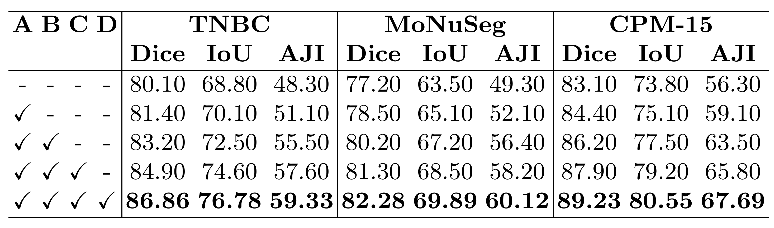
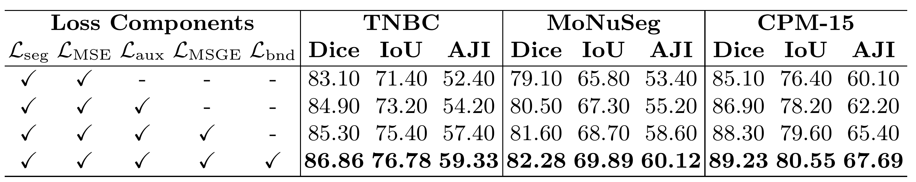
Ablation studies
Table 1. Architectural components (A: pre-bottleneck gate, B: SBA attention, C: attention gates, D: boundary loss)
+4.3 to +4.4 AJI
from SBA attention on every dataset, the largest single step in Table 1.
+3.2 to +3.4 AJI
from adding MSGE to the loss, which helps watershed separation.
Table 2. Composite loss terms
ResNet-18 had better results
over MobileNet-v2 [19], EfficientNet-B0 [20], SqueezeNet [21], ResNet-34 and ResNet-50.
Notes:
Here we start from a ResNet-UNet with the HV head and add components one at a time. Table 1 is architecture: A is the pre-bottleneck gate, B is SBA attention, C the attention gates, D the boundary loss. Each row improves every metric on every dataset. SBA attention gives the biggest step, about 4.3 to 4.4 AJI points on all three datasets, which supports the idea that boundary priors matter most for separating touching nuclei.
Table 2 isolates the loss terms, starting from segmentation loss plus MSE. Deep supervision helps across the board, and adding MSGE gives a large AJI jump, between 3.2 and 3.4 points, which fits the idea that penalising offset-gradient errors helps watershed. The boundary loss gives the last boost.
We also compared encoders under an identical setup: MobileNet-v2, EfficientNet-B0, SqueezeNet, ResNet-34 and ResNet-50, against our pre-activation ResNet-18. Lightweight backbones lose the high-frequency gradients the boundary losses need, ResNet-50 shows diminishing returns, and ResNet-18 was best. (about 1 minute 30 seconds)

Slide 14
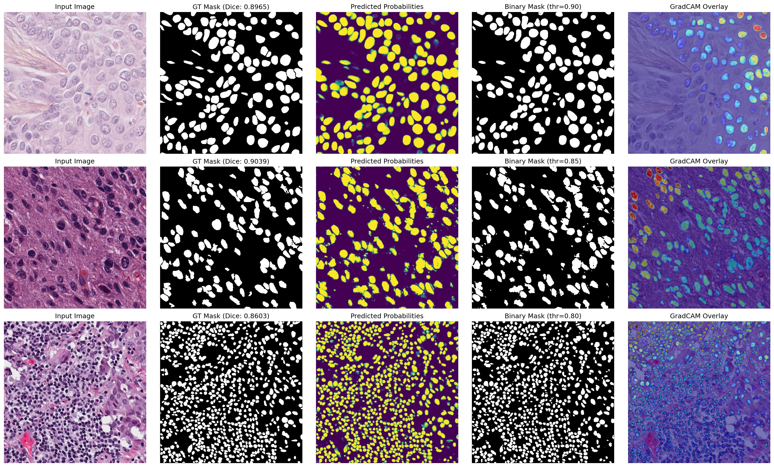
Qualitative results
Columns
Input image, ground truth, predicted probabilities, binary mask, Grad-CAM overlay.
Rows, top to bottom
TNBC
Dice 0.8965
thr 0.90
CPM-15
Dice 0.9039
thr 0.85
MoNuSeg
Dice 0.8603
thr 0.80
Notes:
This figure shows one example from each dataset, top to bottom TNBC, CPM-15 and MoNuSeg. Columns are the input image, the ground-truth mask, the predicted probabilities, the binary mask after thresholding, and a Grad-CAM overlay. The panel titles print the per-image Dice, 0.8965, 0.9039 and 0.8603, and the thresholds used, 0.90, 0.85 and 0.80. You can see the predicted masks follow the ground-truth layout in both the sparse TNBC field and the very dense MoNuSeg field. (about 45 seconds)

Slide 15
Conclusion, limitations and next steps
What we showed
Limitations
Next steps
Boundary priors injected at the Scharr gate, SBA attention and gated skips.
Best Dice, IoU and AJI on TNBC, MoNuSeg and CPM-15.
AJI up by as much as 9.6 points, with fewer merges in dense clusters.
HV supervision falls back on connected components without native instance labels.
Exact softmax SBA runs only at the low-resolution bottleneck.
Fixed boundary filters may not suit every modality or stain.
Scalable boundary-aware attention for higher-resolution decoder stages.
Learnable boundary filters adapted to each dataset.
More tumour types, plus lightweight variants for clinical use.
Thank you. Questions are welcome.
Code and ablations: github.com/mukut02/MICAD_unet
Notes:
To wrap up. BISON injects boundary priors at three points: the Scharr gate before the bottleneck, SBA attention at the bottleneck, and gated skips in the decoder, with an HV head and watershed for instances. It gives the best Dice, IoU and AJI on TNBC, MoNuSeg and CPM-15, and the paper reports AJI gains of up to 9.6 points over a connected-component baseline with fewer merges in dense clusters.
There are limits. The HV supervision falls back on connected components when native instance annotations are missing, which can reduce centroid precision. The exact softmax attention only runs at the low-resolution bottleneck. And the boundary filters are fixed, so they may not suit every modality or stain.
Next we want scalable approximations of boundary-aware attention for higher-resolution decoder stages, learnable boundary filters, and wider tumour types with lightweight variants for clinical use.
The code, hyperparameters and ablation results are on GitHub. This work was supported by the Russian Science Foundation, project 26-19-00620. Thank you, I'm happy to take questions. (about 1 minute)

Slide 16
Acknowledgment:
This work was supported by the Russian Science Foundation (Project № 26-19-00620)

Slide 17
References (1/4)
[1] Ronneberger, O., Fischer, P., Brox, T.: U-Net: Convolutional Networks for Biomedical Image Segmentation. In: MICCAI, pp. 234–241. Springer (2015)
[2] Graham, S., Vu, Q.D., Raza, S.E.A., Azam, A., Tsang, Y.W., Kwak, J.T., Rajpoot, N.: HoVer-Net: Simultaneous segmentation and classification of nuclei in multi-tissue histology images. Medical Image Analysis 58, 101563 (2019)
[3] Roy, T., et al.: SAAMU-Net: A Selective Attention Aggregation and Memory-Augmented U-Net Model for Microscopic Medical Image Segmentation. In: 2025 XXVIII Int. Conf. on Soft Computing and Measurements (SCM). IEEE (2025)
[4] Zhao, Y., et al.: DyGLNet: Hybrid global-local feature fusion with dynamic upsampling for medical image segmentation. Pattern Recognition, 112792 (2025)
[5] Maity, G., Pramanik, S., Mandal, D., Kaplun, D., Gulvanskii, V., Sarkar, R.: VEGAN: A Vision-language and Edge-enhanced GAN-based Microscopic Medical Image Segmentation Model. IEEE (2025)
[6] Geng, M., Huang, Q., Chen, Y., Zhang, X.: WDRE-NET: Wavelet-Differential Convolution and Region-Expansion to Enhance Weakly Supervised Adjacent Nuclei Segmentation. IEEE (2025)
[7] Li, X., Zhu, W., Dong, X., Dumitrascu, O.M., Wang, Y.: EViT-UNET: U-Net Like Efficient Vision Transformer for Medical Image Segmentation on Mobile and Edge Devices. IEEE (2025)
Notes:
Reference list from the paper. Not presented; available for questions.

Slide 18
References (2/4)
[8] Niu, Y., Reed, H., Yang, Q.: DeltaSegment: Multifidelity Medical Image Segmentation via Change Detection. In: 2026 IEEE 23rd ISBI, pp. 1–5. IEEE (2026). doi:10.1109/ISBI61048.2026.11515780
[9] Nasir, E.S., et al.: AFINITI: attention-aware feature integration for nuclei instance segmentation and type identification. Neural Computing and Applications 36(29), 18343–18361 (2024)
[10] Abraham, N., Khan, N.M.: A Novel Focal Tversky loss function with improved Attention U-Net for lesion segmentation. In: ISBI, pp. 683–687. IEEE (2019)
[11] He, K., Zhang, X., Ren, S., Sun, J.: Deep Residual Learning for Image Recognition. In: CVPR, pp. 770–778. IEEE (2016)
[12] Scharr, H.: Optimale Operatoren in der digitalen Bildverarbeitung. Doctoral dissertation, University of Heidelberg (2000)
[13] Chen, L.-C., Papandreou, G., Schroff, F., Adam, H.: Rethinking Atrous Convolution for Semantic Image Segmentation. arXiv:1706.05587 (2017)
Notes:
Reference list from the paper. Not presented; available for questions.

Slide 19
References (3/4)
[14] Oktay, O., et al.: Attention U-Net: Learning Where to Look for the Pancreas. In: MIDL (2018)
[15] Beucher, S., Meyer, F.: The morphological approach to segmentation: the watershed transformation. In: Mathematical Morphology in Image Processing, pp. 433–481. Marcel Dekker (1993)
[16] Naylor, P., Lae, M., Reyal, F., Walter, T.: Segmentation of nuclei in histopathology images by deep regression of the distance map. IEEE TMI 38(2), 448–459 (2018)
[17] Kumar, N., Verma, R., Anand, D., et al.: A multi-organ nucleus segmentation challenge. IEEE TMI 39(5), 1380–1391 (2019)
[18] Kumar, N., Verma, R., Sharma, S., Bhargava, S., Vahadane, A., Sethi, A.: A Dataset and a Technique for Generalized Nuclear Segmentation for Computational Pathology. IEEE TMI 36(7), 1550–1560 (2017)
[19] Sandler, M., Howard, A., Zhu, M., Zhmoginov, A., Chen, L.-C.: MobileNetV2: Inverted residuals and linear bottlenecks. In: CVPR, pp. 4510–4520. IEEE (2018)
Notes:
Reference list from the paper. Not presented; available for questions.

Slide 20
References (4/4)
[20] Tan, M., Le, Q.V.: EfficientNet: Rethinking model scaling for convolutional neural networks. In: ICML, pp. 6105–6114. PMLR (2019)
[21] Iandola, F.N., et al.: SqueezeNet: AlexNet-level accuracy with 50x fewer parameters and <0.5MB model size. arXiv:1602.07360 (2016)
[22] Chen, L., Lu, X., Zhang, J., Chu, X., Chen, C.: HINet: Half instance normalization network for image restoration (2022)
[23] Raza, S.E.A., et al.: Micro-Net: A unified model for segmentation of various objects in microscopy images. Medical Image Analysis 52, 160–173 (2019)
[24] Zhou, Z., Siddiquee, M.M.R., Tajbakhsh, N., Liang, J.: U-Net++: A nested U-Net architecture for medical image segmentation. In: DLMIA and ML-CDS, pp. 3–11. Springer (2018)
[25] Das, N., Saha, S., Nasipuri, M., Basu, S., Chakraborti, T.: Deep-fuzz: A synergistic integration of deep learning and fuzzy water flows for fine-grained nuclei segmentation in digital pathology. PLOS ONE 18(6), e0286862 (2023)
Notes:
Reference list from the paper. Not presented; available for questions.

