Slide 1
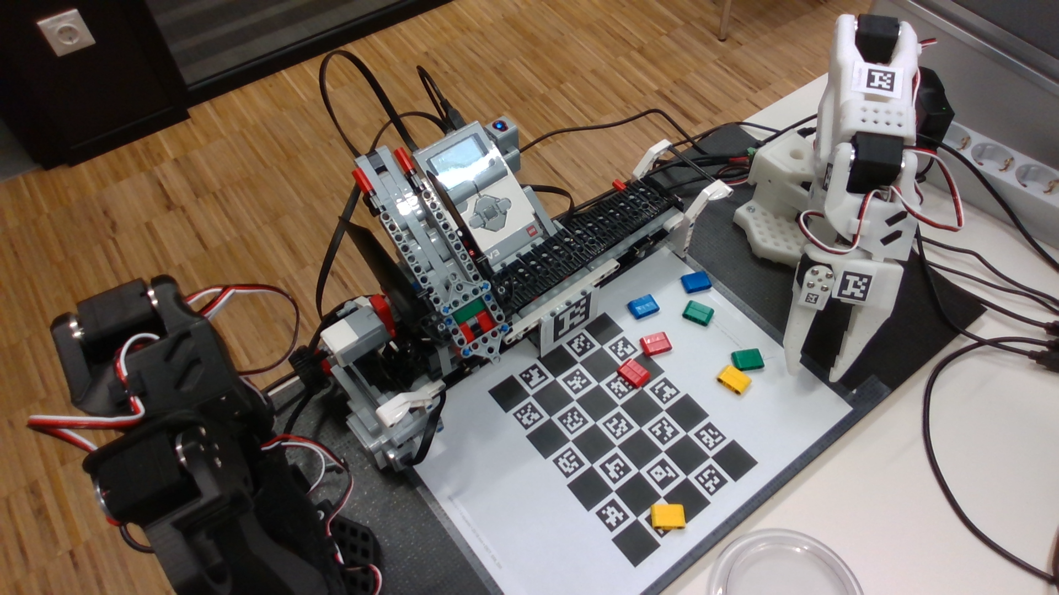
Our fixed-fixture factory
Dispense one object
Carry it to a stopped pickup fixture
Pick, place, release and return
Actual station photograph · one fixed pickup and one fixed destination
1/8 · 2 min
Notes:
2 minutes
Point to actual equipment. Ask which step needs an observation. Explain fixed pickup/drop is core; colors are later.

Slide 2
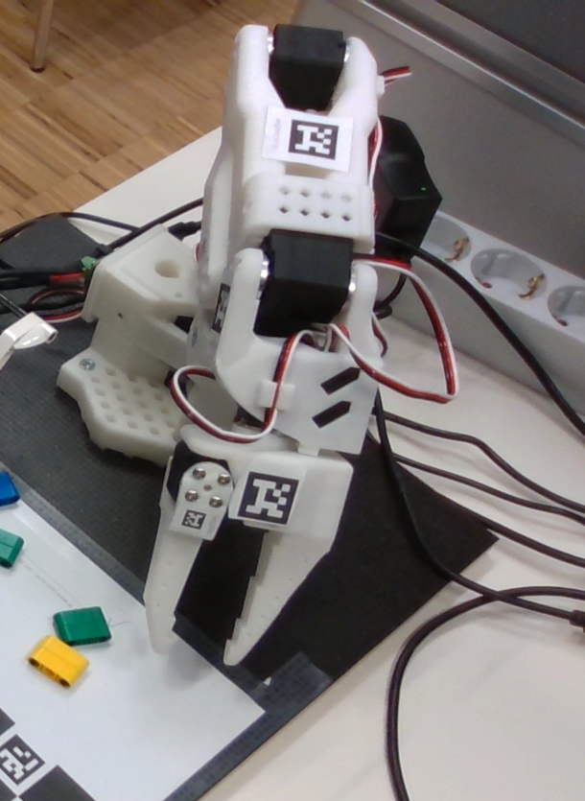
Measure decide act check
Sensor measures
Program decides
Actuator moves
Inspection checks the result
2/8 · 3 min
Notes:
3 minutes
Define sensor and actuator with the actual station. Learners point to examples. A command acknowledgement is not object arrival.

Slide 3
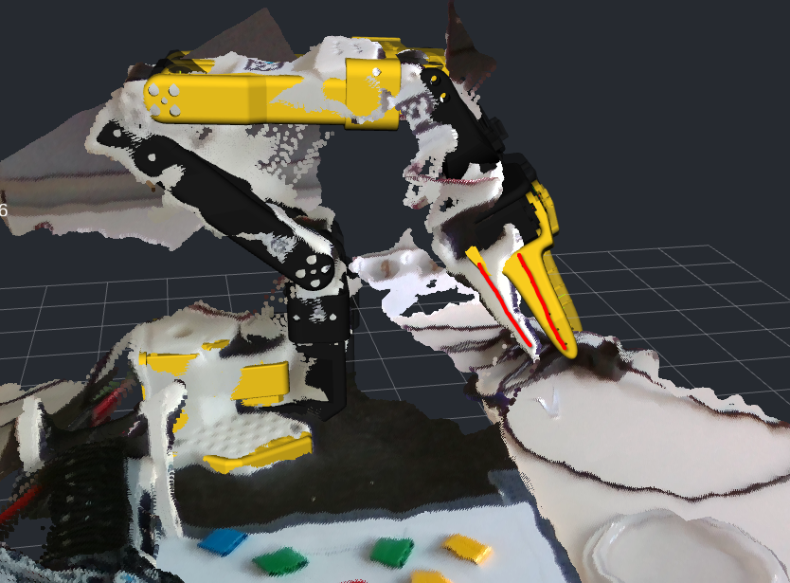
Robot and screen twin
Leader: handle
Follower: physical arm
Twin: screen model
3/8 · 3 min
Notes:
3 minutes
Compare leader/follower/twin. A matching screen is not an independent sensor or payload proof.

Slide 4
Put the steps in order
1 Dispense
2 Conveyor to fixture and stop
3 Approach and grasp
4 Lift and place
5 Release and return
4/8 · 3 min
Notes:
3 minutes
Ask what happens if the belt is moving at pickup. Fixed-fixture sequence first. Separate calibrated jaw actions and validated strokes.

Slide 5

An observation can be wrong
Actual object: red
Reported label: blue (altered example)
Missing report: pause and inspect
5/8 · 2 min
Notes:
2 minutes
Label the altered report clearly. Discuss lighting, occlusion and missing data. Unknown does not certify free space.

Slide 6
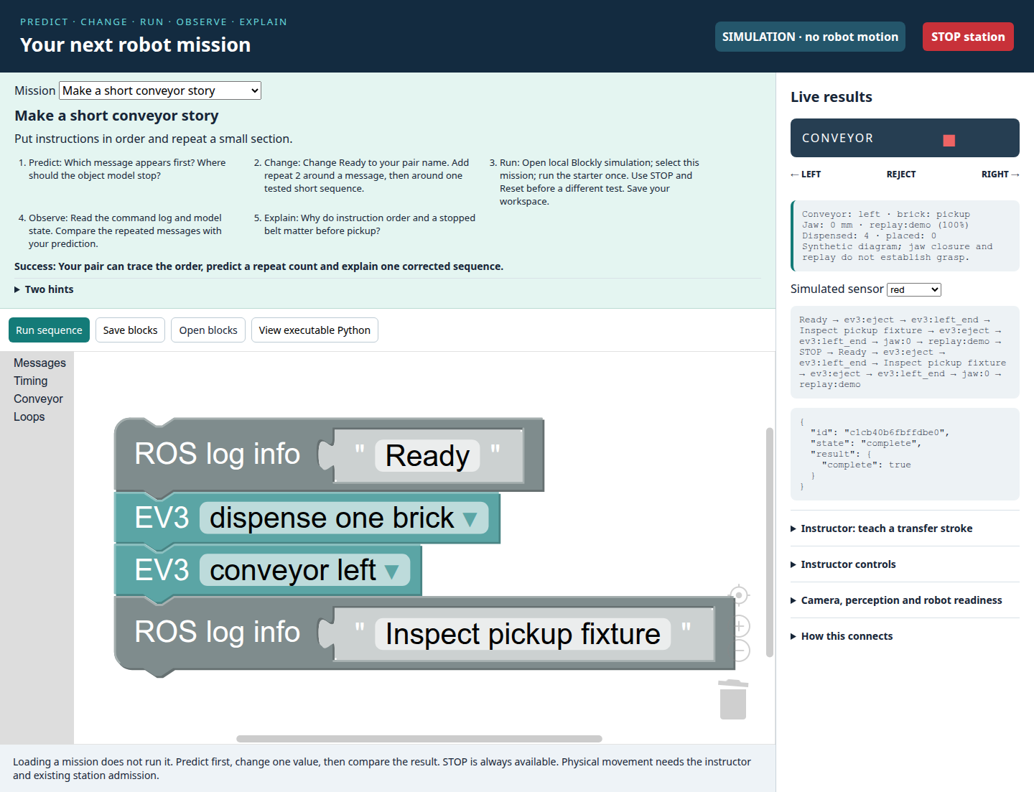
Blocks run in order
Read from the top
Repeat the blocks inside
Predict before Run
6/8 · 2 min
Notes:
2 minutes
This is a local station screenshot, not an external Maze. Show short log/repeat sequence and STOP. No internet needed.

Slide 7
Your first Python change
TEAM = "Pair A"
REPEATS = 3
print("Hello", TEAM)
print("Count", REPEATS)
Predict the output, then change one value.
7/8 · 3 min
Notes:
3 minutes
Read four lines aloud. Quotes store text; REPEATS stores a number. Ask what changes if TEAM changes. More code follows in practical missions.

Slide 8
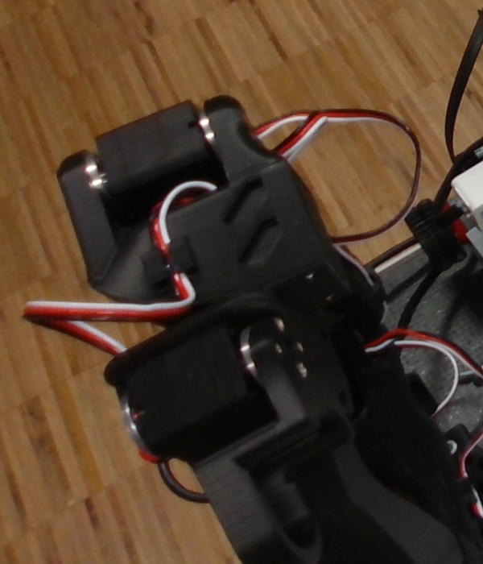
Teach inspect return replay
Teach a short stroke
Inspect and validate
Return to the validated start
Replay separately
8/8 · 2 min
Notes:
2 minutes
Swap pair driver/observer. Point to STOP. Physical execution requires the instructor and prepared verified recordings. Begin the first local mission.

Slide 9
Make a short conveyor story
Mission 1 · 25 minutes total · Predict and run
Worked example
Ready → dispense → belt to pickup → inspect. Simulation is a model.
Predict
Which instruction runs first? Where should the model stop?
Change
Change Ready to your pair name. Repeat one tested message twice.
Run
Run the local Blockly starter once. Reset between experiments.
Notes:
25 minute activity. These two cards share that one activity duration.
worked_example: Ready → dispense → belt to pickup endpoint → inspect. In simulation each command changes a model; no physical object is verified.
predict: Which message appears first? Where should the object model stop?
change: Change Ready to your pair name. Add repeat 2 around a message, then around one tested short sequence.
run: Open local Blockly simulation; select this mission; run the starter once. Use STOP and Reset before a different test. Save your workspace.
observe: Read the command log and model state. Compare the repeated messages with your prediction.
explain: Why do instruction order and a stopped belt matter before pickup?
success: Your pair can trace the order, predict a repeat count and explain one corrected sequence.
offline_route: Draw each instruction on paper and move a paper object only when its instruction runs.
extension: Try an intentionally wrong order in simulation and explain the result.
Read from the top connection down.
Repeat repeats every block inside it; start with a message.
Instructor: Expected order is message, eject, endpoint, inspect. Repeat does not imply two verified physical placements.

Slide 10
Make a short conveyor story
Mission 1 · 25 minutes total · Check and explain
Observe
Compare command order, model position and repeated messages.
Explain
Why must the conveyor stop before the arm approaches?
Success
Trace the order, predict repeat count and explain one correction.
Hints
Read connected blocks from top to bottom.
Repeat runs every block inside it.
Optional: Try a wrong order in simulation and explain what changed.
Notes:
25 minute activity. These two cards share that one activity duration.
worked_example: Ready → dispense → belt to pickup endpoint → inspect. In simulation each command changes a model; no physical object is verified.
predict: Which message appears first? Where should the object model stop?
change: Change Ready to your pair name. Add repeat 2 around a message, then around one tested short sequence.
run: Open local Blockly simulation; select this mission; run the starter once. Use STOP and Reset before a different test. Save your workspace.
observe: Read the command log and model state. Compare the repeated messages with your prediction.
explain: Why do instruction order and a stopped belt matter before pickup?
success: Your pair can trace the order, predict a repeat count and explain one corrected sequence.
offline_route: Draw each instruction on paper and move a paper object only when its instruction runs.
extension: Try an intentionally wrong order in simulation and explain the result.
Read from the top connection down.
Repeat repeats every block inside it; start with a message.
Instructor: Expected order is message, eject, endpoint, inspect. Repeat does not imply two verified physical placements.

Slide 11
Separate the object from its report
Mission 2 · 20 minutes total · Predict and run
Worked example
Actual blue + missing report: pause. Actual red + blue report: inspect.
Predict
Which report is missing? Which disagrees with the actual object?
Change
Change one report to None; then change a known report to a wrong color.
Run
Run or trace the three rows. Use the supplied labelled photograph.
Notes:
20 minute activity. These two cards share that one activity duration.
worked_example: An actual blue brick can have a missing report. An actual red brick can be reported blue. Both need inspection.
predict: Which of the three reports is missing? Which disagrees with the labelled object?
change: Change one report to None; then change one known report to a wrong known color.
run: Run the short Python example or trace its three rows on paper. Compare the real labelled photo with a deliberately changed report.
observe: Record actual object, reported label and your decision separately. None means missing, never zero or proof of empty space.
explain: Why can a fresh color label still be wrong? What evidence would justify continuing?
success: You identify one missing and one wrong report and choose pause/inspect for uncertainty.
offline_route: Use the supplied real photo and handwritten report cards; no camera or website is needed.
extension: Test unfamiliar green without adding a rule.
Compare actual and reported columns one row at a time.
A known word is still only a report.
Instructor: Missing is row two; wrong known label row three. Correct words alone do not validate a classifier.

Slide 12
Separate the object from its report
Mission 2 · 20 minutes total · Check and explain
Observe
Record actual object and reported label in separate columns.
Explain
Why can a fresh, familiar label still be wrong?
Success
Identify one missing and one wrong report; choose pause and inspect.
Hints
Compare actual and reported one row at a time.
A known word is still only a report.
Optional: Test green without adding a rule.
Notes:
20 minute activity. These two cards share that one activity duration.
worked_example: An actual blue brick can have a missing report. An actual red brick can be reported blue. Both need inspection.
predict: Which of the three reports is missing? Which disagrees with the labelled object?
change: Change one report to None; then change one known report to a wrong known color.
run: Run the short Python example or trace its three rows on paper. Compare the real labelled photo with a deliberately changed report.
observe: Record actual object, reported label and your decision separately. None means missing, never zero or proof of empty space.
explain: Why can a fresh color label still be wrong? What evidence would justify continuing?
success: You identify one missing and one wrong report and choose pause/inspect for uncertainty.
offline_route: Use the supplied real photo and handwritten report cards; no camera or website is needed.
extension: Test unfamiliar green without adding a rule.
Compare actual and reported columns one row at a time.
A known word is still only a report.
Instructor: Missing is row two; wrong known label row three. Correct words alone do not validate a classifier.

Slide 13
Change a name and a number
Mission 3 · 30 minutes total · Predict and run
Worked example
TEAM stores text; REPEATS stores a number. Indentation defines the loop.
Predict
What greeting and how many object lines will appear?
Change
Change TEAM. Run. Then predict and change REPEATS to 2.
Run
Save a pair notebook copy; run from the top with Shift+Enter.
Notes:
30 minute activity. These two cards share that one activity duration.
worked_example: TEAM stores text in quotes. REPEATS stores a number. print shows text. The indented line runs once for each number.
predict: What greeting and how many object lines will appear?
change: Change TEAM, predict, run. Then change REPEATS to 2, predict, run. Keep indentation.
run: Open the Student notebook, save a pair copy and run cells from the top with Shift+Enter. Run the shared Program example in simulation.
observe: Count output lines and compare the shared Python program JSON with the Blockly exported JSON.
explain: Which edit changed text? Which changed how often a line ran? What stayed in the same order?
success: Both partners make one edit and explain it; shared commands are validated before execution.
offline_route: Run exercises/01_python.py using the prepared Python or trace it on paper. No package downloads.
extension: Change a wait or message in both Python and Blockly and compare command traces.
Quotes surround text; do not quote the number.
Four spaces keep print inside the loop.
Instructor: Original prints three object lines. Changing REPEATS resets the next run; Program simulation is not hardware proof.

Slide 14
Change a name and a number
Mission 3 · 30 minutes total · Check and explain
Observe
Count lines. Compare Program JSON with the Blockly export.
Explain
Which edit changed text? Which changed the number of repetitions?
Success
Both partners make and explain one edit; share the same validated commands.
Hints
Quotes surround text, not the repeat number.
Keep four spaces before the repeated print.
Optional: Change a message in Python and Blockly; compare both traces.
Notes:
30 minute activity. These two cards share that one activity duration.
worked_example: TEAM stores text in quotes. REPEATS stores a number. print shows text. The indented line runs once for each number.
predict: What greeting and how many object lines will appear?
change: Change TEAM, predict, run. Then change REPEATS to 2, predict, run. Keep indentation.
run: Open the Student notebook, save a pair copy and run cells from the top with Shift+Enter. Run the shared Program example in simulation.
observe: Count output lines and compare the shared Python program JSON with the Blockly exported JSON.
explain: Which edit changed text? Which changed how often a line ran? What stayed in the same order?
success: Both partners make one edit and explain it; shared commands are validated before execution.
offline_route: Run exercises/01_python.py using the prepared Python or trace it on paper. No package downloads.
extension: Change a wait or message in both Python and Blockly and compare command traces.
Quotes surround text; do not quote the number.
Four spaces keep print inside the loop.
Instructor: Original prints three object lines. Changing REPEATS resets the next run; Program simulation is not hardware proof.

Slide 15
Watch teach inspect return replay
Mission 4 · 15 minutes total · Predict and run
Worked example
Leader 10°, follower 30°, leader now 15°: relative request 35°.
Predict
Can replay begin from any pose? What if the jaw state changed?
Change
Change one invented angle after predicting. Instructor owns physical modes.
Run
Watch: teach, stop recording, inspect, return to validated start, replay.
Notes:
15 minute activity. These two cards share that one activity duration.
worked_example: Leader 10°, follower 30°, leader now 15° gives relative request 35°. A request and a measured result are different.
predict: Will a replay start safely from any pose? What if the jaw state changed?
change: Ask the instructor to change one invented angle; predict before rerunning. Learners do not change physical modes.
run: Watch instructor: teach a short empty stroke, stop recording, inspect metadata and path, return safely to its validated start, then replay separately.
observe: Name start pose, endpoint, jaw state, identity/calibration and validity evidence. An invented demo recording is never a student-taught physical skill.
explain: Why must teaching and playback be separate runs? Why does a changed robot or calibration require reteaching?
success: You can say teach → inspect/validate → return to start → replay, and point to STOP.
offline_route: Use the invented joint example and paper start/end diagrams. Label evidence DEMO.
extension: Predict a relative versus absolute joint request.
A recording stores movement; it does not plan a safe approach from every pose.
A screen model can match commands while a physical object slips.
Instructor: Relative is 35 and absolute 15. Demonstrate only with prepared supervised hardware; if validation fails use paper and report physical gate incomplete.

Slide 16
Watch teach inspect return replay
Mission 4 · 15 minutes total · Check and explain
Observe
Identify start, endpoint, jaw state and validation evidence.
Explain
Why separate teaching from replay? Why reteach after calibration changes?
Success
Explain teach → inspect → return → replay, and locate STOP.
Hints
A saved stroke does not plan from every start pose.
A matching screen does not prove a physical grasp.
Optional: Compare relative 35° with absolute 15°. Invented arithmetic sends no motion.
Notes:
15 minute activity. These two cards share that one activity duration.
worked_example: Leader 10°, follower 30°, leader now 15° gives relative request 35°. A request and a measured result are different.
predict: Will a replay start safely from any pose? What if the jaw state changed?
change: Ask the instructor to change one invented angle; predict before rerunning. Learners do not change physical modes.
run: Watch instructor: teach a short empty stroke, stop recording, inspect metadata and path, return safely to its validated start, then replay separately.
observe: Name start pose, endpoint, jaw state, identity/calibration and validity evidence. An invented demo recording is never a student-taught physical skill.
explain: Why must teaching and playback be separate runs? Why does a changed robot or calibration require reteaching?
success: You can say teach → inspect/validate → return to start → replay, and point to STOP.
offline_route: Use the invented joint example and paper start/end diagrams. Label evidence DEMO.
extension: Predict a relative versus absolute joint request.
A recording stores movement; it does not plan a safe approach from every pose.
A screen model can match commands while a physical object slips.
Instructor: Relative is 35 and absolute 15. Demonstrate only with prepared supervised hardware; if validation fails use paper and report physical gate incomplete.

Slide 17
Explore three stations
Mission 5 · 45 minutes total · Predict and run
Worked example
Three pairs: arm/twin; conveyor/observations; offline preparation.
Predict
Predict one direction, report or instruction order at this station.
Change
Change one angle, report or message. Swap driver and observer.
Run
15 minutes: 2 predict, 7 change/run, 4 observe/explain, 2 transition.
Notes:
45 minute activity. These two cards share that one activity duration.
worked_example: Three pairs rotate through arm/twin observation, conveyor/observation sequencing, and offline Blockly/Python preparation.
predict: At your current station, predict one direction, report or sequence before the instructor or simulator acts.
change: Change only one paper angle, report or message; switch driver and observer halfway.
run: Each slot is 15 minutes: 2 predict, 7 change/run, 4 observe/explain, 2 save and transition. Use the rotation table.
observe: Arm: compare measured joint and twin when available. Conveyor: inspect stopped fixture/report. Offline: compare ordered traces. Label each evidence source.
explain: Which part measures, decides or acts? What can your evidence establish?
success: Every pair completes all three positions with one recorded prediction and evidence statement per position.
offline_route: All three positions have photo, paper and simulation versions; record DEMO/OFFLINE if no measured stream.
extension: Compare a fresh report with a stale one without guessing missing values.
The twin is a model updated from a stream.
Use the same short sequence at the offline table.
Instructor: No three physical robots implied. Instructor controls the arm path; preserve transition time.

Slide 18
Explore three stations
Mission 5 · 45 minutes total · Check and explain
Observe
Record one observation and label it PAPER, SIMULATION or PHYSICAL.
Explain
Which part measures, decides or acts? What can your evidence establish?
Success
Every pair visits all three positions and records prediction plus evidence.
Hints
The twin is a model updated from a stream.
Use the same short sequence at the offline desk.
Optional: Compare fresh with stale without guessing a missing angle.
Notes:
45 minute activity. These two cards share that one activity duration.
worked_example: Three pairs rotate through arm/twin observation, conveyor/observation sequencing, and offline Blockly/Python preparation.
predict: At your current station, predict one direction, report or sequence before the instructor or simulator acts.
change: Change only one paper angle, report or message; switch driver and observer halfway.
run: Each slot is 15 minutes: 2 predict, 7 change/run, 4 observe/explain, 2 save and transition. Use the rotation table.
observe: Arm: compare measured joint and twin when available. Conveyor: inspect stopped fixture/report. Offline: compare ordered traces. Label each evidence source.
explain: Which part measures, decides or acts? What can your evidence establish?
success: Every pair completes all three positions with one recorded prediction and evidence statement per position.
offline_route: All three positions have photo, paper and simulation versions; record DEMO/OFFLINE if no measured stream.
extension: Compare a fresh report with a stale one without guessing missing values.
The twin is a model updated from a stream.
Use the same short sequence at the offline table.
Instructor: No three physical robots implied. Instructor controls the arm path; preserve transition time.

Slide 19
Dispense carry pick and place
Mission 6 · 45 minutes total · Predict and run
Worked example
Dispense → conveyor/stop → fixed_pick_place. Missing qualification blocks hardware.
Predict
Where must the object and arm be before each step? What should stop the run?
Change
Reorder paper cards. Use the named skill fixed_pick_place in simulation.
Run
Rotate: supervised integration, offline rehearsal, failure/evidence desk.
Notes:
45 minute activity. These two cards share that one activity duration.
worked_example: EV3 dispense → conveyor to pickup fixture and stop → named taught skill fixed_pick_place. That skill binds validated approach/open, calibrated grasp, lift/transfer, release and return phases. Missing or uncommissioned qualification blocks physical execution; simulation labels every transfer synthetic.
predict: Where must the object and arm be before each next step? What should stop the run?
change: First reorder paper cards. In simulation use pick_place_recording named fixed_pick_place and change one message or delay. Physical execution requires instructor-validated phase recordings, measured jaw calibration and the qualification manifest; missing evidence is a blocking result.
run: Rotate: supervised integration, offline trace/rehearsal, failure/evidence desk. Each 15-minute slot includes 2 minutes transition. Run dispense, conveyor/stop and the named fixed_pick_place skill only through the existing shared endpoint. Instructor alone enables a qualified physical run; otherwise complete explicit synthetic simulation.
observe: Record dispense, stopped fixture arrival, grasp, lift, placement/release and return separately. A completed command does not prove object transfer.
explain: Which observation supports each claimed step? Which step remains unverified?
success: Your pair explains the full fixed-fixture sequence and records honest per-step evidence. Physical completion requires observed object transfer; offline completion is labelled rehearsal.
offline_route: Use the same fixed pickup/drop paper layout and named-skill simulation. Its grasp/lift/release outcomes are synthetic assumptions with physical_evidence false. Missing recordings or qualification means physical execution remains incomplete.
extension: After the core succeeds, discuss color-dependent destinations as separately validated taught skills.
Stop the conveyor before the arm approaches.
Start/end poses and jaw state of adjacent taught strokes must agree.
Instructor: Do not substitute demo recordings. Current historical operational notes remain evidence until a new physical rehearsal supersedes them. Never infer payload success from a log.

Slide 20
Dispense carry pick and place
Mission 6 · 45 minutes total · Check and explain
Observe
Inspect dispense, arrival, grasp, lift, release and return separately.
Explain
Which measurement supports each step? What remains unverified?
Success
Explain the full sequence and label synthetic rehearsal versus observed transfer.
Hints
Stop belt; match the validated start and jaw state.
Missing qualification blocks hardware; ask instructor.
Optional: After fixed-fixture success, discuss separately validated color destinations.
Notes:
45 minute activity. These two cards share that one activity duration.
worked_example: EV3 dispense → conveyor to pickup fixture and stop → named taught skill fixed_pick_place. That skill binds validated approach/open, calibrated grasp, lift/transfer, release and return phases. Missing or uncommissioned qualification blocks physical execution; simulation labels every transfer synthetic.
predict: Where must the object and arm be before each next step? What should stop the run?
change: First reorder paper cards. In simulation use pick_place_recording named fixed_pick_place and change one message or delay. Physical execution requires instructor-validated phase recordings, measured jaw calibration and the qualification manifest; missing evidence is a blocking result.
run: Rotate: supervised integration, offline trace/rehearsal, failure/evidence desk. Each 15-minute slot includes 2 minutes transition. Run dispense, conveyor/stop and the named fixed_pick_place skill only through the existing shared endpoint. Instructor alone enables a qualified physical run; otherwise complete explicit synthetic simulation.
observe: Record dispense, stopped fixture arrival, grasp, lift, placement/release and return separately. A completed command does not prove object transfer.
explain: Which observation supports each claimed step? Which step remains unverified?
success: Your pair explains the full fixed-fixture sequence and records honest per-step evidence. Physical completion requires observed object transfer; offline completion is labelled rehearsal.
offline_route: Use the same fixed pickup/drop paper layout and named-skill simulation. Its grasp/lift/release outcomes are synthetic assumptions with physical_evidence false. Missing recordings or qualification means physical execution remains incomplete.
extension: After the core succeeds, discuss color-dependent destinations as separately validated taught skills.
Stop the conveyor before the arm approaches.
Start/end poses and jaw state of adjacent taught strokes must agree.
Instructor: Do not substitute demo recordings. Current historical operational notes remain evidence until a new physical rehearsal supersedes them. Never infer payload success from a log.

Slide 21
Find one failure and test a repair
Mission 7 · 20 minutes total · Predict and run
Worked example
present, missing, present: pause after one inspected simulated object.
Predict
What should happen at the missing middle report?
Change
Choose one failure and one repair. Reset before the repeat check.
Run
Reproduce on paper or in simulation. Repair and rerun the same input.
Notes:
20 minute activity. These two cards share that one activity duration.
worked_example: A missing fixture observation pauses the sequence after one inspected object. Fix the observation path before retrying.
predict: What happens when the middle report is None?
change: Test one failure: missing report, wrong order, missing recording or STOP. Change one cause only and reset.
run: Reproduce in simulation or paper; record expected versus actual. Repair and rerun the same input.
observe: Capture the failure message, stopped state and repaired trace. No physical fault injection by learners.
explain: Did your test detect the problem? What could still fail on hardware?
success: You show a failing prediction, one repair and a repeated check with its limits.
offline_route: All failures can be traced with paper command/report cards.
extension: Use the optional color-routing example with three reds and one blue to expose swapped rules.
Choose one input so cause and effect stay clear.
A successful run alone cannot identify a wrong known report.
Instructor: Missing report stops after one; avoid relaxing admission or faking a report to pass.

Slide 22
Find one failure and test a repair
Mission 7 · 20 minutes total · Check and explain
Observe
Record failure message, stopped state and the repaired trace.
Explain
Did the test detect the problem? What could still fail on hardware?
Success
Show a failed prediction, one repair and a repeated check with limits.
Hints
Change one cause so you can explain its effect.
One passing run can still hide a wrong known report.
Optional: Try three reds and one blue to expose swapped extension rules.
Notes:
20 minute activity. These two cards share that one activity duration.
worked_example: A missing fixture observation pauses the sequence after one inspected object. Fix the observation path before retrying.
predict: What happens when the middle report is None?
change: Test one failure: missing report, wrong order, missing recording or STOP. Change one cause only and reset.
run: Reproduce in simulation or paper; record expected versus actual. Repair and rerun the same input.
observe: Capture the failure message, stopped state and repaired trace. No physical fault injection by learners.
explain: Did your test detect the problem? What could still fail on hardware?
success: You show a failing prediction, one repair and a repeated check with its limits.
offline_route: All failures can be traced with paper command/report cards.
extension: Use the optional color-routing example with three reds and one blue to expose swapped rules.
Choose one input so cause and effect stay clear.
A successful run alone cannot identify a wrong known report.
Instructor: Missing report stops after one; avoid relaxing admission or faking a report to pass.

Slide 23
Show one prediction and result
Mission 8 · 10 minutes total · Predict and run
Worked example
Show prediction, one change, observed result and one limit.
Predict
Which saved output best supports your claim?
Change
Choose one change and one observation for the demonstration.
Run
1 minute prepare; 3 × 2-minute pair demos; 3 minutes reflection.
Notes:
10 minute activity. These two cards share that one activity duration.
worked_example: Pair A shows prediction, one change, observed result and one limit; then pairs B and C follow.
predict: Which single output best supports your claim?
change: Shorten your demonstration to one change and one observation.
run: Use 1 minute preparation, 3 demonstrations of 2 minutes, 3 minutes shared reflection. Both partners speak.
observe: Show saved trace, worksheet or observed supervised step; label simulation, paper or physical.
explain: Name one next test that would increase confidence.
success: All three pairs demonstrate and state a specific limitation.
offline_route: Present the worksheet and paper trace.
extension: Explain how a wrong known color differs from a missing report.
Read your prediction before the result.
A trace supports instruction order, not physical arrival.
Instructor: Keep all three demonstrations within ten minutes. Do not require successful hardware to explain evidence.

Slide 24
Show one prediction and result
Mission 8 · 10 minutes total · Check and explain
Observe
Show the trace or worksheet; label paper, simulation or physical evidence.
Explain
What next test would increase confidence?
Success
All three pairs demonstrate; both partners speak and name a limitation.
Hints
Read your prediction before showing the result.
A trace shows order; arrival needs physical evidence.
Optional: Explain wrong known color versus missing observation.
Notes:
10 minute activity. These two cards share that one activity duration.
worked_example: Pair A shows prediction, one change, observed result and one limit; then pairs B and C follow.
predict: Which single output best supports your claim?
change: Shorten your demonstration to one change and one observation.
run: Use 1 minute preparation, 3 demonstrations of 2 minutes, 3 minutes shared reflection. Both partners speak.
observe: Show saved trace, worksheet or observed supervised step; label simulation, paper or physical.
explain: Name one next test that would increase confidence.
success: All three pairs demonstrate and state a specific limitation.
offline_route: Present the worksheet and paper trace.
extension: Explain how a wrong known color differs from a missing report.
Read your prediction before the result.
A trace supports instruction order, not physical arrival.
Instructor: Keep all three demonstrations within ten minutes. Do not require successful hardware to explain evidence.

