Slide 1
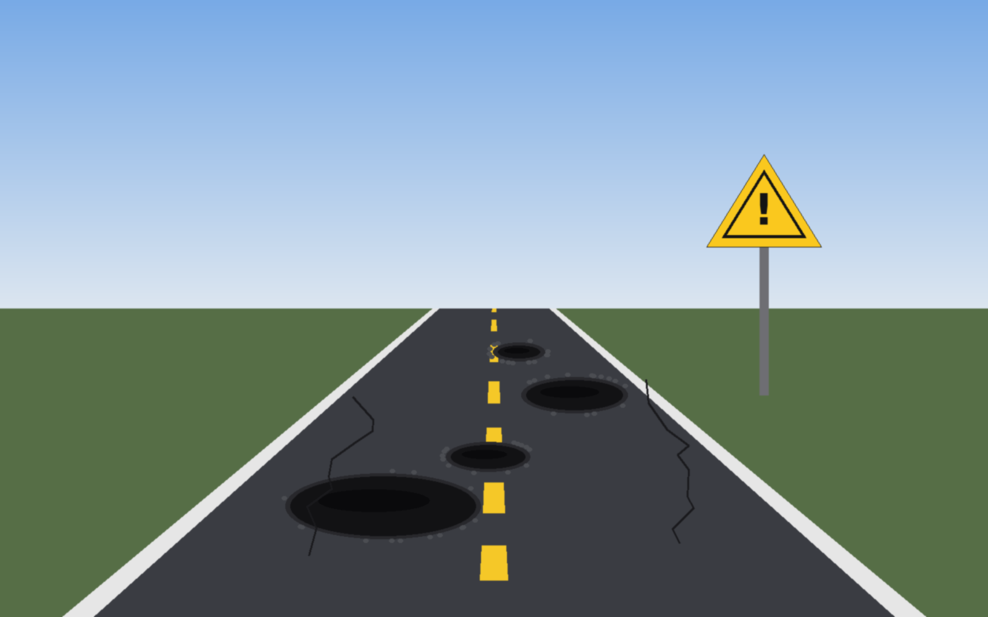
MERN STACK PROJECT
Road Damage Reporting System
Report potholes and damaged roads with location, type, photo and description, and track repairs end to end.
MongoDB • Express.js • React • Node.js
Notes:
Introduce the project: a full-stack MERN app that lets citizens report road damage and lets admins manage repairs.

Slide 2
Problem Statement & Objectives
The Problem
Objectives
Potholes and damaged roads cause accidents and vehicle damage
Citizens have no simple way to report them
Authorities lack organised, location-tagged data to prioritise repairs
Demonstrate MERN stack development
Implement CRUD operations with MongoDB
Build REST APIs using Node.js and Express
Develop the frontend with React.js
Add authentication and role-based access
Display project information and results clearly
2

Slide 3
Key Features & User Roles
Citizen (User)
Admin
Register and log in
Report damage with location, type, image and description
View and edit own reports
Track status of reports
View all reports on a dashboard
Update status: Pending, In Progress, Resolved
Delete invalid or duplicate reports
Filter by type, area and status
C Create
R Read
U Update
D Delete
Add a new report
View and list reports
Edit details, change status
Remove a report
3

Slide 4
System Architecture & Tech Stack
React.js
Node + Express
MongoDB
UI: forms, report list, admin dashboard, Axios calls
REST APIs, JWT auth, role middleware, Multer uploads
Users and Reports collections via Mongoose
HTTP
JSON
Mongoose
ODM
Auth: JWT tokens, bcrypt password hashing, roles (user / admin)
Images: Multer upload, file path stored in MongoDB
Location: Address text plus latitude / longitude (browser geolocation)
Tools: VS Code, Postman, MongoDB Compass, Git
4

Slide 5
Database Design & REST APIs
Report schema (MongoDB)
API endpoints
Field | Type
damageType | String (pothole, crack...)
location | { address, lat, lng }
image | String (file path)
description | String
status | Pending / In Progress / Resolved
reportedBy | ObjectId (User)
createdAt | Date
Method | Route | Access
POST | /api/auth/register, /login | Public
POST | /api/reports | User
GET | /api/reports | User / Admin
GET | /api/reports/:id | User / Admin
PUT | /api/reports/:id | Owner / Admin
DELETE | /api/reports/:id | Admin
5

Slide 6
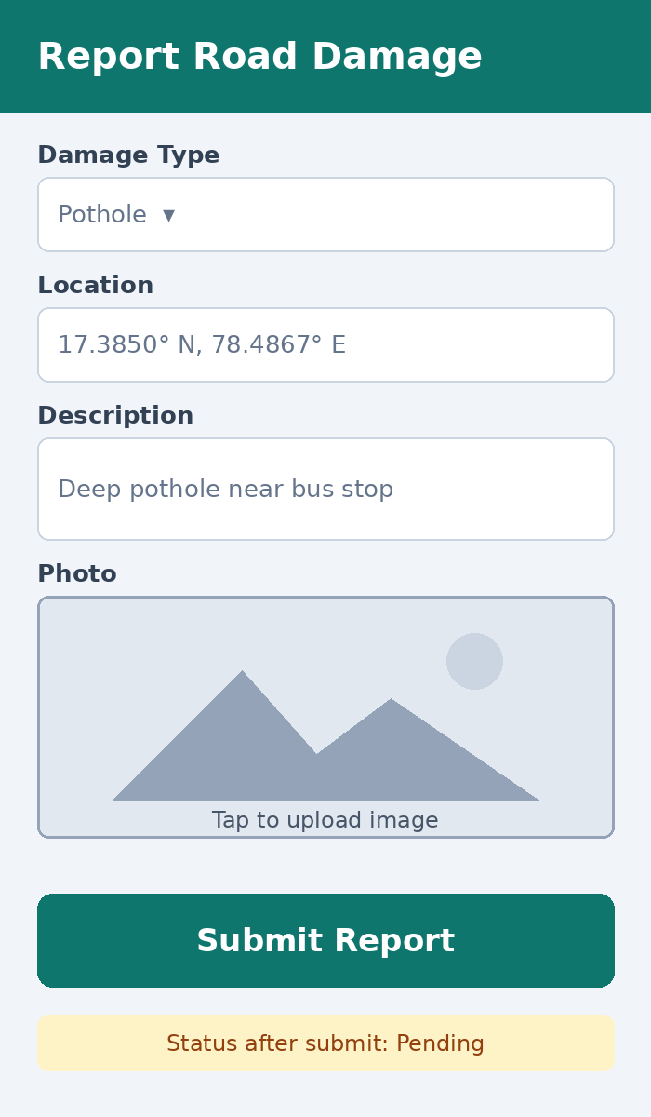
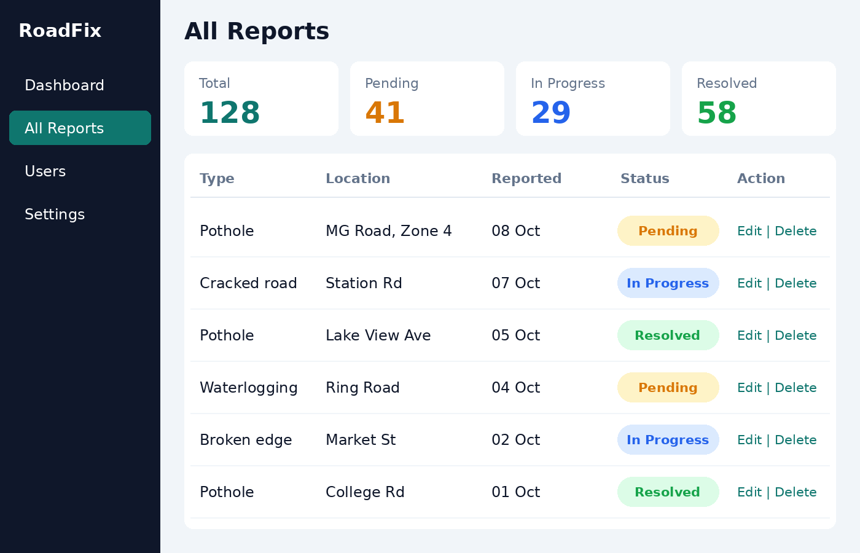
User Interface Screens
Admin: manage reports
Citizen: report form
6

Slide 7
Results, Future Scope & Conclusion
Results
Future Scope
Working end-to-end MERN app
Full CRUD on road damage reports
Secure login with role-based access
Clear dashboard with status tracking
Interactive map view of reports
Email / SMS status notifications
Upvotes and duplicate detection
Mobile app with offline reporting
The system turns citizen reports into organised, trackable data so safer roads get fixed faster.
7

