Slide 1
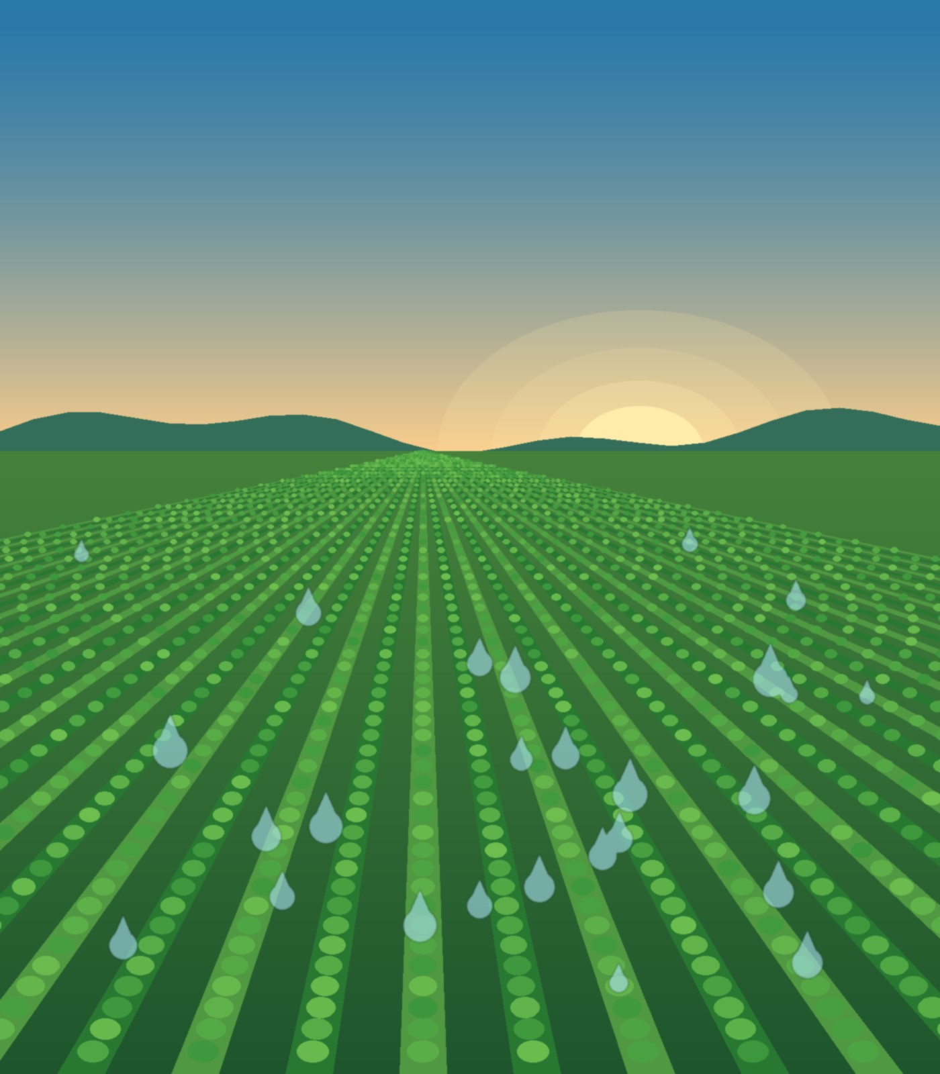

SmartIrrigate
HACKATHON PROJECT
Agriculture Irrigation Planner
Optimizing limited water for maximum expected crop yield
TEAM :17
M AJAY
S BHARGAV
SHAIK OMER
P SRINIVAS
Notes:
Photo idea: sunrise over drip-irrigated crop rows (search: 'drip irrigation field sunrise'). Replace the illustration on the right.

Slide 2
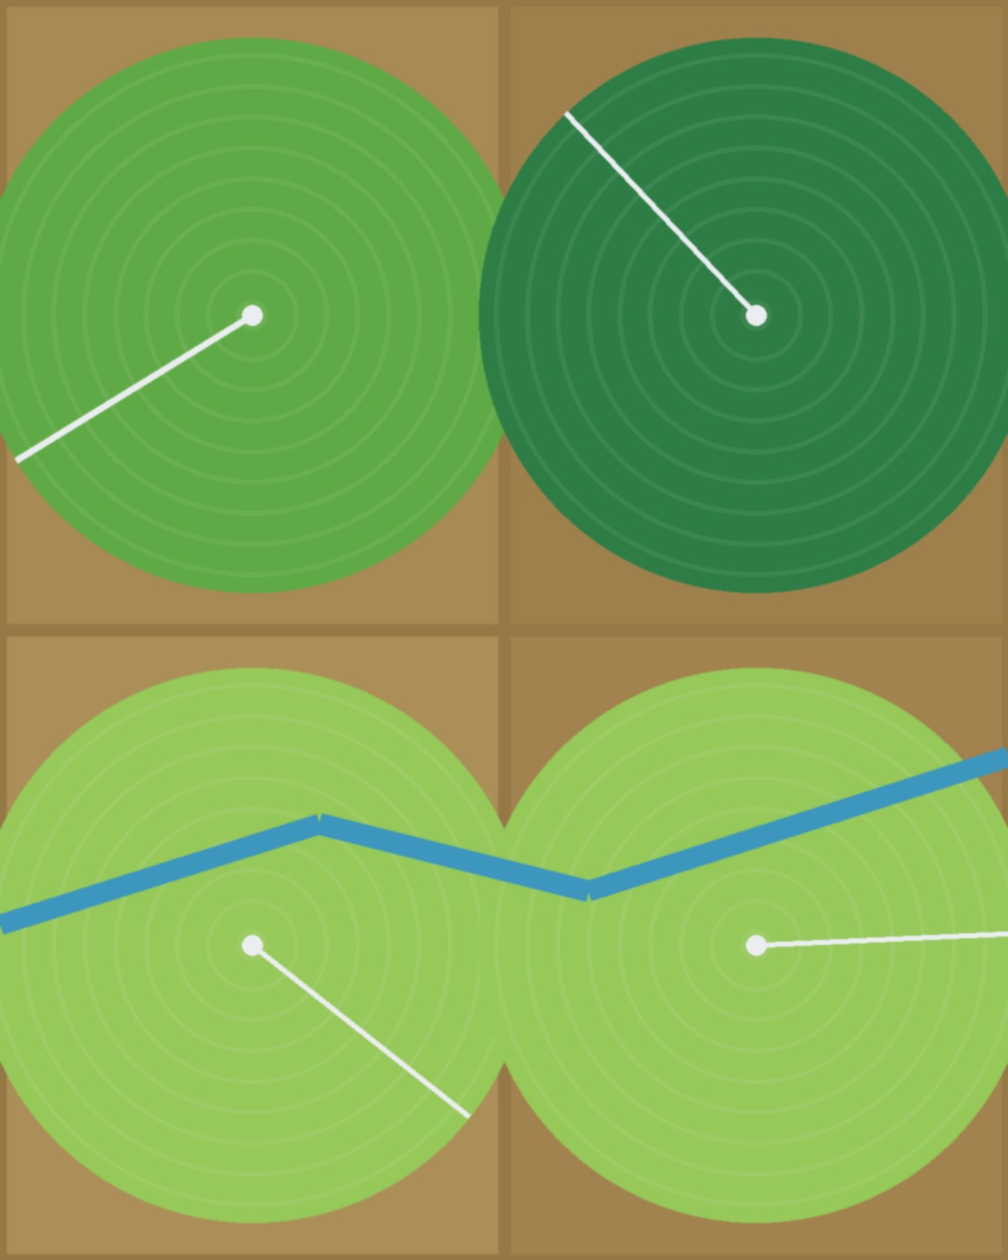



Problem Statement
Limited water
Farmers often have limited water but multiple crops.
Different needs
Each crop has different minimum and maximum water needs.
Efficient sharing
The challenge is to distribute available water efficiently.
Goal: maximize expected yield while respecting irrigation limits.
Notes:
Photo idea: aerial view of center-pivot irrigated fields (search: 'aerial center pivot irrigation').

Slide 3
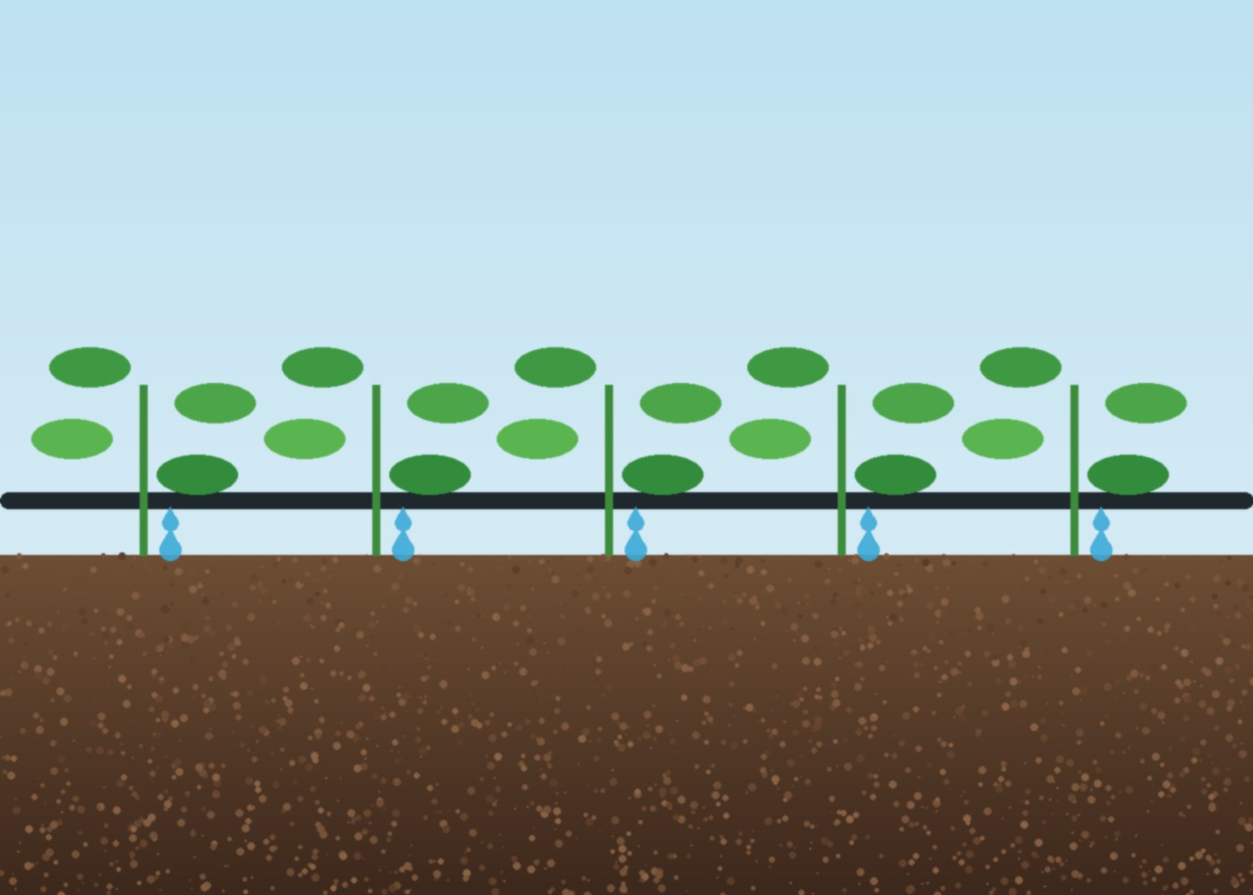




Our Solution
SmartIrrigate is a simple web application for irrigation planning.
User enters crop details and available water.
The system calculates a recommended water allocation.
It uses Greedy and Dynamic Programming algorithms.
Results are shown with tables, charts, and a simple explanation.
Notes:
Photo idea: close-up of drip tubing watering seedlings (search: 'drip irrigation seedlings close up').

Slide 4
How the System Works
1
Add crops
2
Enter water
3
Run optimization
Minimum water, maximum water, yield rate, and priority.
Enter the total available water.
Run the optimization.
4
Greedy
5
Dynamic Programming
6
Recommended plan
Gives a fast allocation based on efficiency.
Searches for the best feasible allocation.
The application displays the recommended plan.
Notes:
Photo idea: screenshot of the dashboard for each step in place of numbers, or farmer using a tablet in a field.

Slide 5

Algorithms Used
FAST
OPTIMAL
Greedy Algorithm
Dynamic Programming
Makes the best available choice at each step.
Fast and simple for quick allocation.
Considers different feasible allocations.
Stores previous results and finds the maximum expected yield.
Notes:
Photo idea: simple diagram image of a decision tree / DP table next to each card.

Slide 6




Technology & Features
Frontend
Backend
Database
Charts
HTML, CSS, JavaScript
Python + Flask
SQLite
Chart.js
Key features
Add/delete crops
Live optimization
Allocation chart
Greedy vs DP comparison
Smart result explanation
Notes:
Photo idea: screenshot of the allocation chart / dashboard.

Slide 7





Demo, Results & Future Scope
LIVE DEMO FLOW
Dashboard
Add crops
Enter available water
Optimize
View recommendation
EXPECTED OUTPUT
FUTURE SCOPE
Water allocation for each crop
Weather data
Soil moisture
Expected yield
Greedy vs DP comparison
Rainfall prediction
Real-time farm sensors
Notes:
Photo idea: farm soil-moisture sensor in a field (search: 'soil moisture sensor farm'); screenshot of results screen for live demo.

